Slide 1

Parent Carer Forum…
Children's and Young People’s Mental Health.
Thursday 22nd October 2026 13.00-14.30
Notes:
Good Morning & Welcome

Slide 2



Housekeeping...
Notes:
Before we start, a little housekeeping. We'll be recording this session for anyone who can't attend today recordings go on our YouTube channel. To keep the recording clear and avoid background noise, please keep your microphones and cameras off. You can use the chat to ask questions, and our volunteers and professionals on the call will keep an eye on it and answer as things come through.

Slide 3





Children and Young People’s Mental Health Services
(CYPMHS – formerly CAMHS)
Ian Roberts – Head of Clinical Services Cheshire CYPMHS
Jill Wasley – MHST Clinical Co-Ordinator
Jonathan Girvan – Operational Team Manager 0-18 Cheshire West
Jenni Butler Meadows – Team Co-ordinator LD CAMHS West
Clare Cooper – Advanced Nurse Practitioner, Urgent Support/Crisis Team
Claire Evans – Participation & Engagement Lead
Catherine Rudd – Cheshire Participation & Engagement Worker

Slide 4
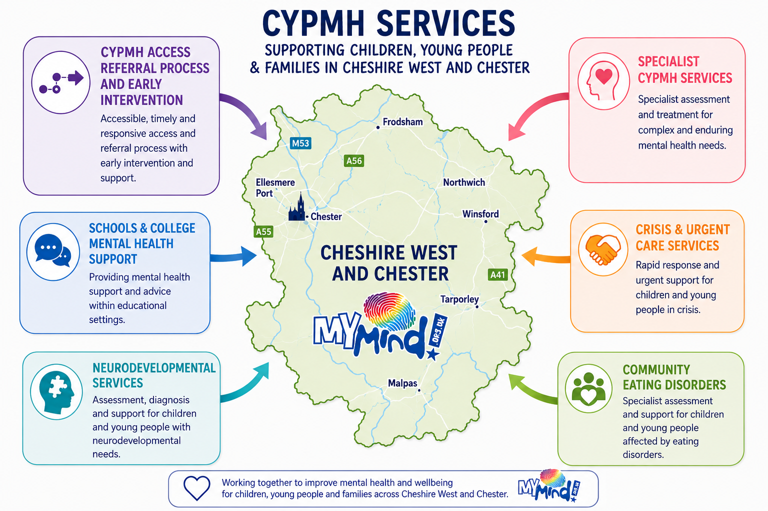

Slide 5

Mental Health Support Team (MHST)

Slide 6
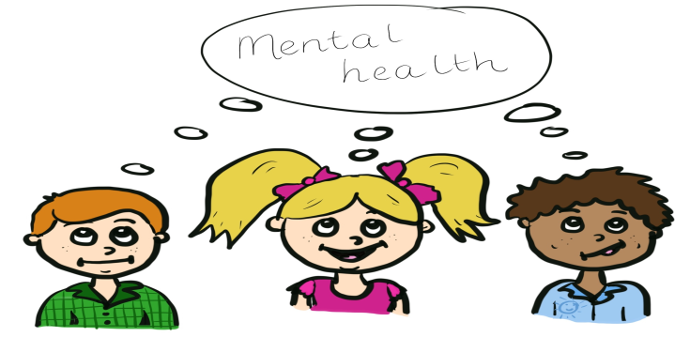
What are MHSTs?
Mental Health Support Teams (MHST) are part of a joint national initiative between the Department of Education and NHS England to improve access to psychological therapies for children and young people presenting with emerging low mood and mild to moderate anxiety.

Slide 7
Core Functions
To provide evidence-based interventions for children and young people presenting with mild to moderate mental health issues using low intensity CBT
Provide support to school as part of the whole school approach which aims to raise awareness of mental health and provide early intervention and prevention strategies
Give timely advice and signposting to school staff, and liaise with external agencies to help children and young people to get the right support

Slide 8
What do we offer?
We offer low intensity evidence based brief 1:1 CBT interventions for mild to moderate low mood, worry, panic, sleep hygiene, simple phobias, and other forms of anxiety
Evidence based parent CBT interventions for challenging behaviour and anxiety
Whole school approach activities such as assemblies, classroom workshops and staff support and training in schools
Consultation

Slide 9



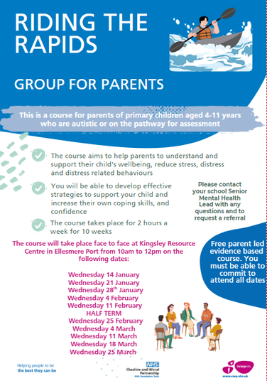
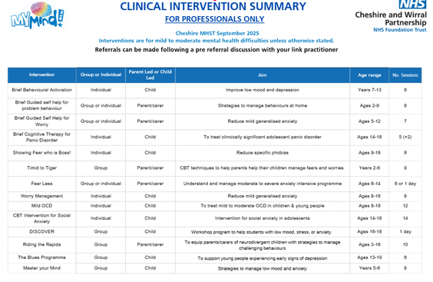

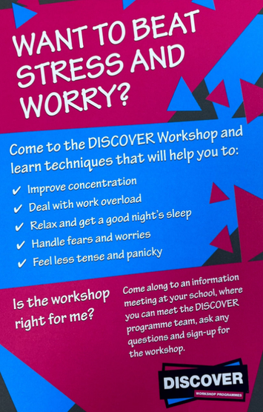
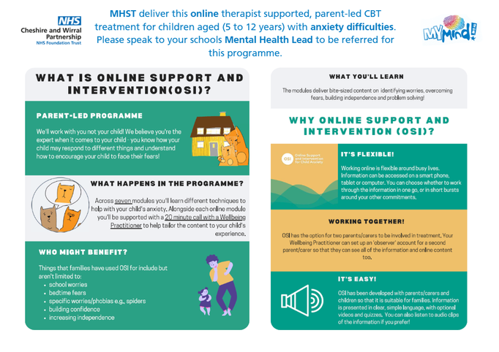


MHST Offer

Slide 10
Why parent led work?
Research has shown that parent led treatment is more effective in the 5-12 year age range and progress can be made in fewer sessions
Children will look towards their parents to answer questions for them and as such parents are best placed to help children make sense of their world, help them implement change and problem solve difficulties as they arise
Notes:
Other advantages include:
It reduces the burden on children of attending therapy appointments (missing school and other activities)
Parents are often more motivated than the child to make changes - children may be focussed on the short term pain whereas parents are likely to be more focussed on the long term gain!
Parents can sometimes put strategies in place across the whole family – helping other children and sometimes adults too.
If problems arise in the future parents are more likely to remember what has been helpful previously and put these strategies in place again as needed
Parents are often the ones having to manage their child’s difficulties on a day to day basis. This can be stressful and parents want help to know what to do

Slide 11

From Timid to Tiger
For parents of anxious children.
4 – 11 years old.
9 sessions (weekly).
Key aspects:
Child centred play
Cognitive behaviour therapy (CBT) – the link between our thoughts, feelings and behaviour
Praise and rewards
Effective limit setting
Management of anxiety
Notes:
For parents of anxious children, aged between 4 and 11 years.
9-week course – 1 session per week. Will be same time and day each week.
Delivered online or face to face.
Combination of behavioural techniques to manage behaviour such as child centred play, praise and rewards, and effective limit setting
Coupled with cognitive behaviour therapy which looks at the link between our thoughts, feelings and behaviour when our children or ourselves get anxious.
Involves a step plan to manage your child’s anxiety and strategies to manage anxiety.

Slide 12

Fear-Less
For parents of anxious children.
6 – 14 years old.
6 sessions (weekly) or 2 half-day workshops.
Key aspects:
Addresses anxious thoughts, feelings (both physical and emotional) and behaviours.
Step plan to tackle child anxieties and strategies to manage them.
Supports a child’s emotional resilience.
Notes:
For parents of anxious children, aged between 6 and 14 years.
6-week course - 1 session per week. Will be same time and day each week.
Can be delivered in 2x half day workshops.
Can be delivered face to face or online.
Uses the cognitive behavioural model of anxiety to address anxious thoughts, feelings (both physical and emotional) and behaviours.
Involves a step plan to tackle your child’s anxieties and strategies to manage them.
Supports a child’s emotional resilience.

Slide 13

Riding the Rapids
For parents of children who have a diagnosis of autism, are on
the pathway for assessment of autism and/or have a learning disability.
11 sessions (weekly).
Primary and Secondary School course depending on the age of your child.
Key aspects:
Addresses behavioural issues and what might be driving them.
Includes strategies to manage behaviour.
Increase in parental confidence in addressing behaviours that challenge.
Includes a 6 week follow up.
MUST BE DELIVERED FACE-TO-FACE (No online option at present)

Slide 14
0-18 Children & Young People’s Mental Health Service (CYPMHS)
Supporting children, young people, and families with moderate to severe mental health needs
Notes:
Explain that CYPMHS is a specialist service supporting mental health needs from early childhood through adolescence. Emphasize the focus on moderate to severe difficulties and the commitment to supporting families as well as young people.

Slide 15

What is CYPMHS?
Community-based specialist mental health service
Provides assessments and evidence-based psychological treatments
Supports ages 0–18
Focuses on difficulties significantly impacting daily functioning
Notes:
Describe how CYPMHS operates within the community and highlight the importance of evidence-based approaches. Clarify what “significant impact on daily functioning” means in practical terms.

Slide 16

Our approach
Person- and family-centred
Partnership with families/carers
Needs, goals, and strengths focused
Multi-agency collaboration
Notes:
Emphasize the collaborative nature of the service and how families are involved at every stage. Mention that multi-agency work ensures holistic support.

Slide 17

Who is the service for?
Children and young people with moderate to severe mental health difficulties
Those needing structured, evidence-based support
Those requiring help beyond universal or early-help services
Notes:
Clarify the threshold for CYPMHS involvement and explain the difference between early-help services and specialist support.

Slide 18

How to access the service
We accept self referrals via the MyMind website.
Request for Help form used for all referrals
GPs, Paediatricians, Social care, Schools etc can also complete the form on your behalf
Each request for help is reviewed to determine next steps. If we have any questions to help our decision making, we would contact you
If we believe we could help, we will offer a ‘choice appointment’
Notes:
Walk through the referral process and reassure families that the service will reach out if more information is needed.

Slide 19

The Choice appointment
Practitioner meets with young person and family
Explore concerns, strengths, and goals
Agree a plan based on assessed needs
May lead to CYPMHS work or signposting to more appropriate service
Notes:
Explain what families can expect during the Choice appointment and how decisions are made collaboratively.

Slide 20
While waiting
Families jointly agree how often contact will occur whilst waiting
Daily duty practitioner available
Routine check-in calls for support and guidance
Waiting times updated monthly on MyMind website
CWP Crisis line is available 24 hours a day by calling NHS 111 and selecting option 2.
There may be times when more urgent support is needed, and our team work alongside the urgent support team to deliver this.
Notes:
Reassure families that support continues even while waiting. Highlight the crisis line and urgent support options.

Slide 21

Our hope
We are a busy but dedicated service
Helping young people be the best they can be
Building skills, knowledge, and confidence for future self-management
Notes:
Emphasize the long-term goal of empowering young people and families.

Slide 22

Summary
Specialist assessment and treatment
Family-centred support
Clear pathways and communication
Commitment to helping young people thrive
Notes:
Provide a brief recap and reinforce the service’s mission.

Slide 23
Learning Disability Child and
Adolescent Mental Health Service
(LD CAMHS)

Slide 24

Aim of the service
To provide:
Specialised
Person-centred
Needs-led
Evidence based
Flexible service to support families who have a young person aged 0-18 with a moderate to severe learning disability who may be experiencing mental health difficulties, displaying behaviour people may view as challenging and or sleep problems.

Slide 25
The Diagnostic and Statistical Manual of Mental Disorders 5th Edition in their definition of ‘Intellectual Disability’ or a Learning Disability refers to limited functioning in three areas:
Social skills (e.g. communicating with others)
Conceptual skills (e.g. reading and writing ability)
Practical ability (e.g. clothing/bathing oneself)
If you are unsure if your young person would meet the team's criteria, please contact the team to discuss
Criteria

Slide 26


Referrals
Open Referral System anyone can refer to the team.
You can send via email/phone or post

Slide 27

Who’s in the team?
The team consists of :
Learning Disability Nurses
Consultant Psychiatrist
Consultant Clinical Psychologist
Assistant Practitioners
Team Administrators

Slide 28
Early Intervention
The team provide an early years offer where we aim to identify young people 0-5 years of age who are at high risk of developing challenging behaviours and intervene early with these young people and their families.
We have strong links with Starting Well and work with our partners to offer preventative support while the child is still very young.

Slide 29

Support into schools
We have a link nurse in each special school
Consultations for parents/carers and professionals
Courses offered at local special schools about sleep and behaviour
Evidence based parent groups including Signposts for Building Better Behaviour, and Riding the Rapids

Slide 30

Services offered
Advice, support & training to other professionals
Universal preventative parenting strategies
Sleep assessments
Individualised behavioural sleep interventions.
Behavioural assessment utilising a functional assessment model

Slide 31

Services offered
continued
Individualised behavioural advice and interventions utilising a Positive Behaviour Support model (PBS)
Health Facilitation as part of a behavioural plan including pain assessments & patient passports
Desensitisation for phobias for children e.g. support with having a blood test if needed as part of a behavioural plan

Slide 32

Supporting your child’s mental wellbeing:
For young people with no verbal communication or who have limited ability to communicate their feelings the following things are essential for good mental well being:
Ensure your child eats as well as you can
Ensure they drink plenty of fluids

Slide 33

Supporting your child’s mental wellbeing:
Do you know if they are in pain? Always try pain relief when needed (assuming no allergies etc)
Be aware of their bowel habits and ensure no issues – one soft formed poo a day or every other day is considered normal for most young people. If not seek out advice from your GP or Starting Well.

Slide 34

Supporting your child’s mental wellbeing:
Provide a consistent routine at home.
Access to activities they enjoy as much as possible in a predictable way.
Try to provide a good sleep routine.
Decide on house rules/boundaries in your home as a family and stick to them – again it can be helpful to do this visually (more do rules than don’t rules).

Slide 35
Supporting your child’s mental wellbeing:
Visual routines and social stories can be helpful for most young people
Model the behaviour you want to see
Practice how you want your child to respond to things when they are calm (adapt to their ability level).
Teach your child how to be as independent as possible – this will increase their self-esteem – start where they are at

Slide 36


Contact the team:
Please contact the team in Ellesmere Port by calling: 0151 488 8041 or email cwp.ldcamhs.west@nhs.net
Contact the team based in Crewe (for young people living in Northwich or Winsford area) on 01270 848030 or email cwp.ldcamhs.centralandeast@nhs.net

Slide 37
Urgent Support/Crisis Team (UST)

Slide 38
Supporting your child in crisis:
Who We Are
The Urgent Support Team (UST) provides urgent mental health assessment, support and intervention for children and young people experiencing a mental health crisis.
The team works across Cheshire and Wirral and supports young people up to the age of 16, and in some circumstances young people aged 16-18 years.

Slide 39
Supporting your child in crisis:
What We Do
Mental health crisis assessments
Support for young people presenting in A&E or on paediatric wards
Advice and support to acute hospital colleagues
Safety planning and risk management
Signposting and referral to appropriate ongoing services
Crisis Resolution interventions (up to 2 weeks)
Intensive Home Treatment (up to 12 weeks) where required

Slide 40
Supporting your child in crisis:
When We Provide Cover
Urgent mental health support is accessible 24 hours a day, 7 days a week through the NHS 111 Mental Health Option.
UST assessments are provided following referral from acute hospitals or via the crisis pathway.
How to Contact Us
NHS 111 - Select the Mental Health Option (available 24/7)Parents, carers, professionals and young people can access urgent mental health support through NHS 111.

Slide 41
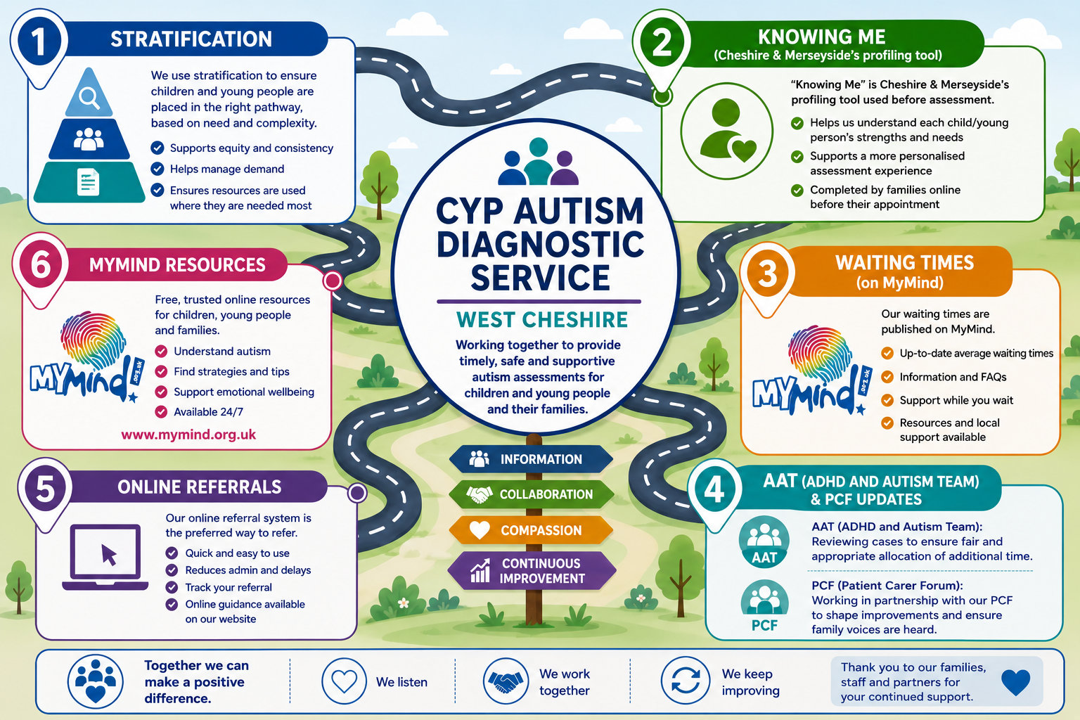

Slide 42

Top 10 things to do to help your CYP mental health
Small, supportive actions can make a real difference
1
2
3
4
5
6
7
8
9
1
If a child or young person may be in immediate danger, seek urgent help.
NHS-aligned parent/carer guidance
Notes:
[Sources]
- NHS Every Mind Matters, “Children’s mental health”: https://www.nhs.uk/every-mind-matters/supporting-others/childrens-mental-health/
- NHS, “Advice for parents”: https://www.nhs.uk/mental-health/children-and-young-adults/advice-for-parents/
- YoungMinds parent support: https://www.youngminds.org.uk/parent/
- Visual on this slide was generated with Microsoft Copilot.

Slide 43
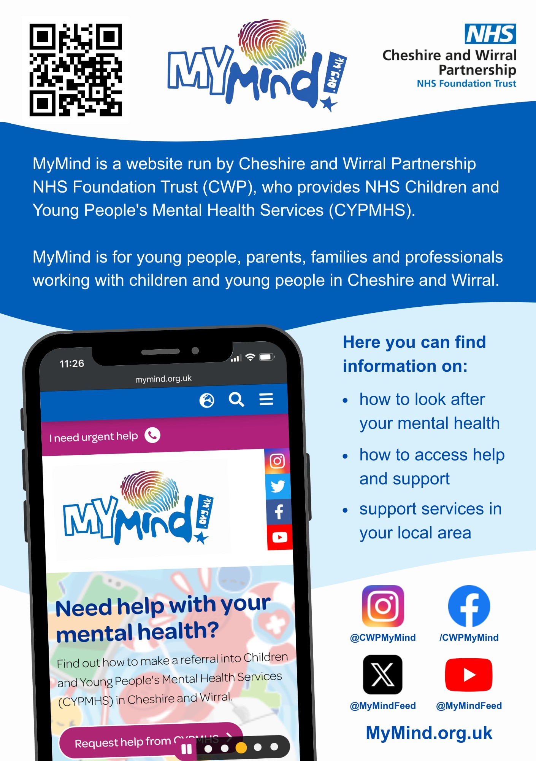
MyMind
Mental health information and support for children and young people
What is MyMind?
A website run by Cheshire and Wirral Partnership NHS Foundation Trust (CWP), which provides NHS Children and Young People’s Mental Health Services (CYPMHS).
Who is it for?
Young people, parents, families and professionals working with children and young people in Cheshire and Wirral.
Here you can find information on:
1
Look after your mental health
Practical information about mental wellbeing.
2
Access help and support
Guidance on finding help and support.
3
Local support services
Information about services in your local area.
@CWPMyMind • /CWPMyMind • @MyMindFeed
Notes:
[Sources]
- User-provided image.png: source for all MyMind wording, organisation reference, website address and social media handles.
- Visual on this slide was generated with Microsoft Copilot.

Slide 44


Slide 45
Participation & Engagement Team
Ensuring lived experience brings meaningful influence within our service development

Slide 46
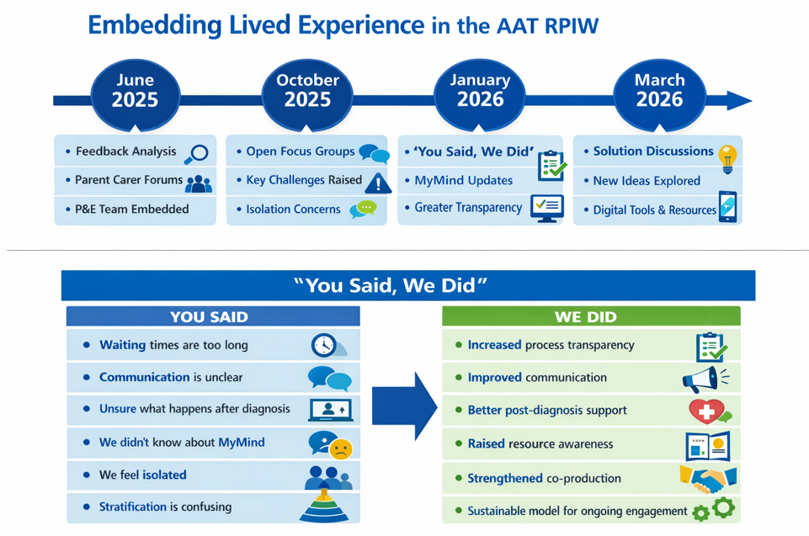

Slide 47
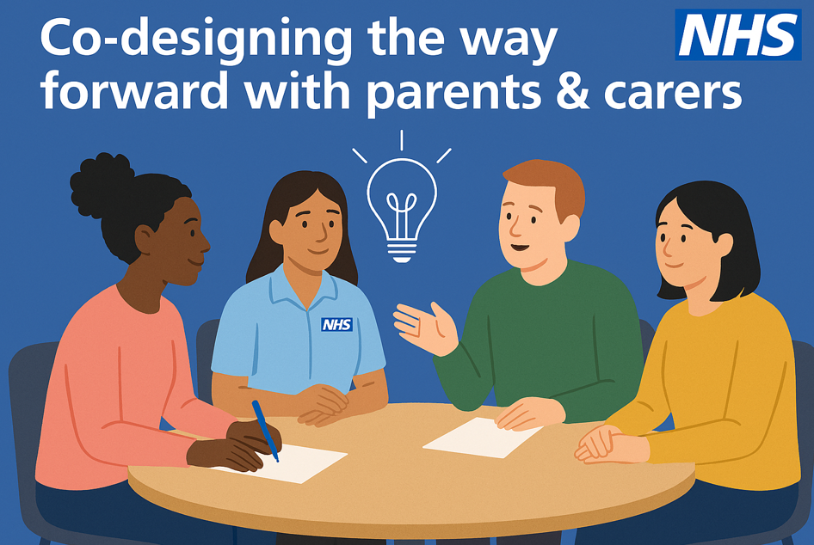
Solutions & Lasting Impact (March/June 2026 → Future (next Sept)
Solution‑focused discussions on stratification and service impact
Parent/carer ideas included:
  Simplified written information
  Text messaging for updates
  Exploring digital/AI tools
  Co‑producing pathway resources
Outcomes:
  Stronger relationships with families
  Improved communication & transparency
  Sustainable model for ongoing engagement
  Culture of continuous learning and collaboration

Slide 48
Q&A

Slide 49

Events….

Slide 50
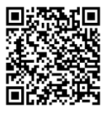
Feedback….
Thank you for joining us today. We would love to hear your feedback, so please use the links below to let us know how we did.
https://forms.cloud.microsoft/e/gue6mnqSRw?origin=lprLink

Slide 51
How to find us & stay updated
Monthly Newsletters
Sign up here!
Email: info@pcfcheshirewest.org
Website: www.pcfcheshirewest.org
Phone number: 07900840867
PCF YouTube Channel
https://facebook.com/pcfcwac

Slide 52

Thank you.

