Slide 1

Benefits and Support Virtual Webinar
10am-11:30am 11th March 2026
Parent Carer Forum

Slide 2

Agenda
Welcome & Housekeeping
Citizens Advice Cheshire West
Parent Carer Andrea Catton
Cheshire and Warrington Carers Trust
SPACE
Koala
Petty Pool in the Community
Early Help
PCF Events & Support
Q&A

Slide 3


Slide 4


Slide 5
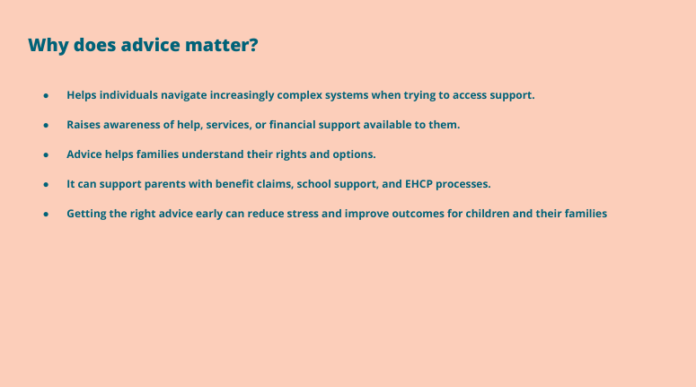

Slide 6


Slide 7
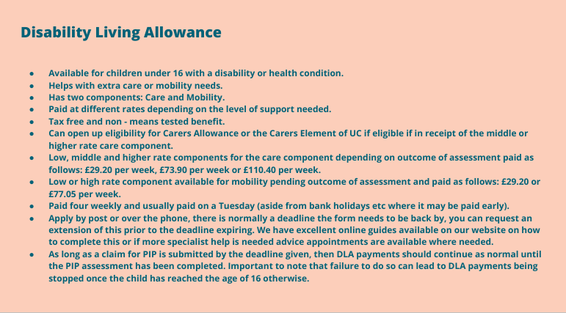

Slide 8
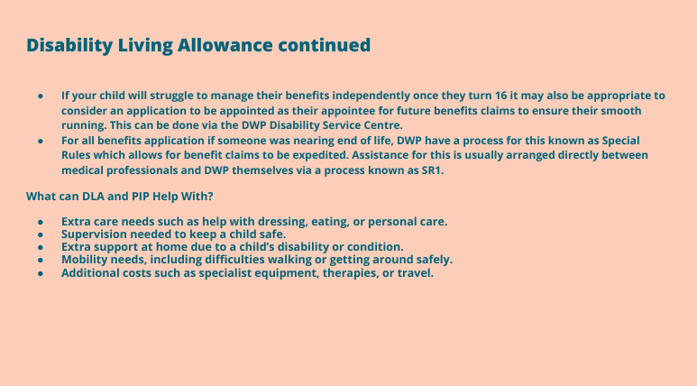

Slide 9
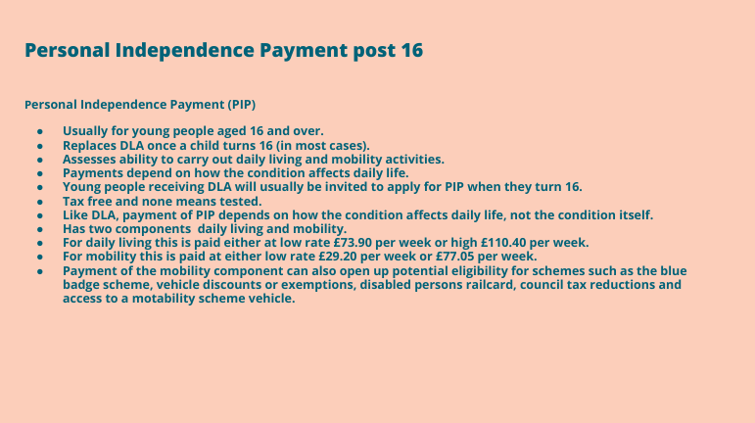

Slide 10


Slide 11


Slide 12


Slide 13


Slide 14


Slide 15


Slide 16


Slide 17
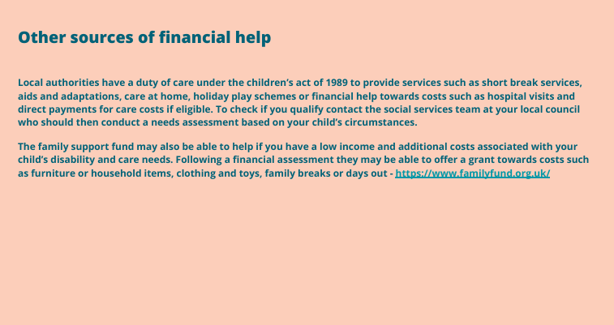

Slide 18


Slide 19


SEND Coffee Mornings Rake and Pikel Huntington Chester Road CH3 6BS

Slide 20
What is a Send Coffee Morning?
Coffee Send Mornings are informal, welcoming sessions held at The Rake for parents and carers to come together in a relaxed and friendly environment. These mornings offer an opportunity to meet new people who may be in similar situations, share experiences, and talk openly about any issues or challenges. Attendees can both give and receive advice, as well as access helpful information and support. The atmosphere is warm, informal, and supportive, making it a lovely space to connect, chat, and enjoy a coffee together.

Slide 21
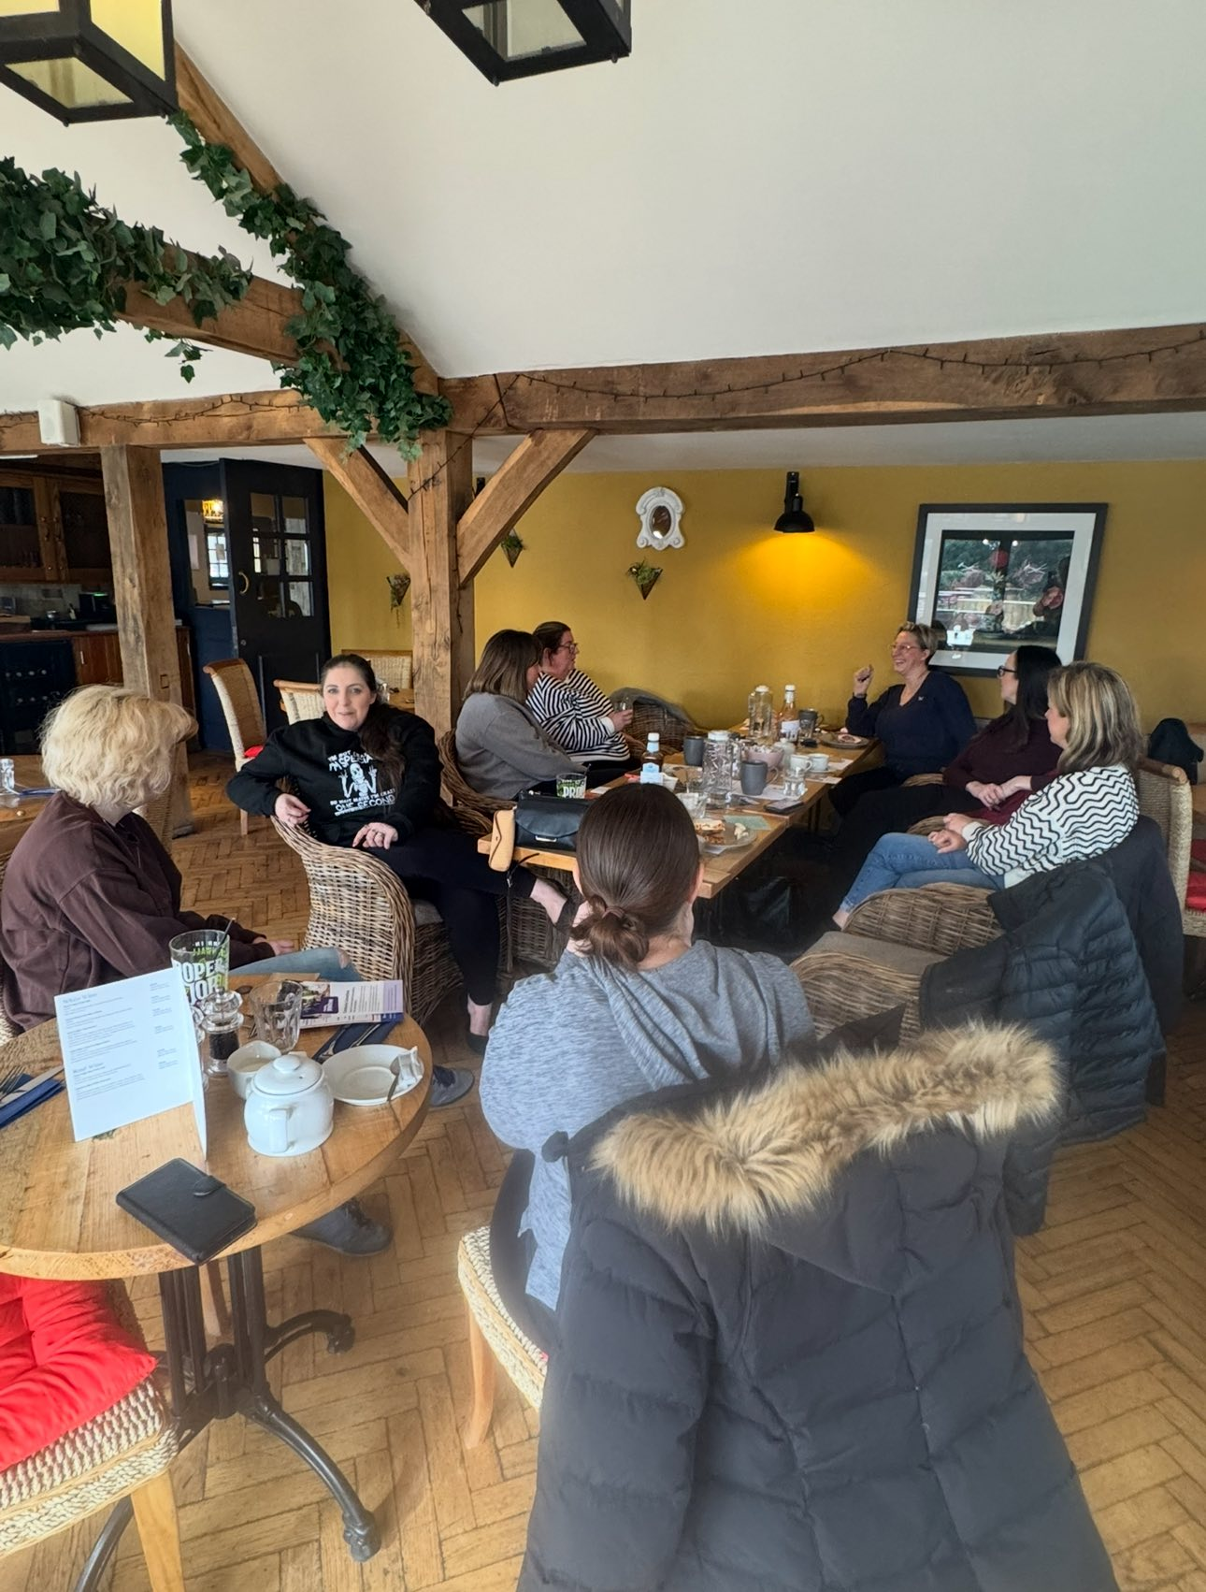

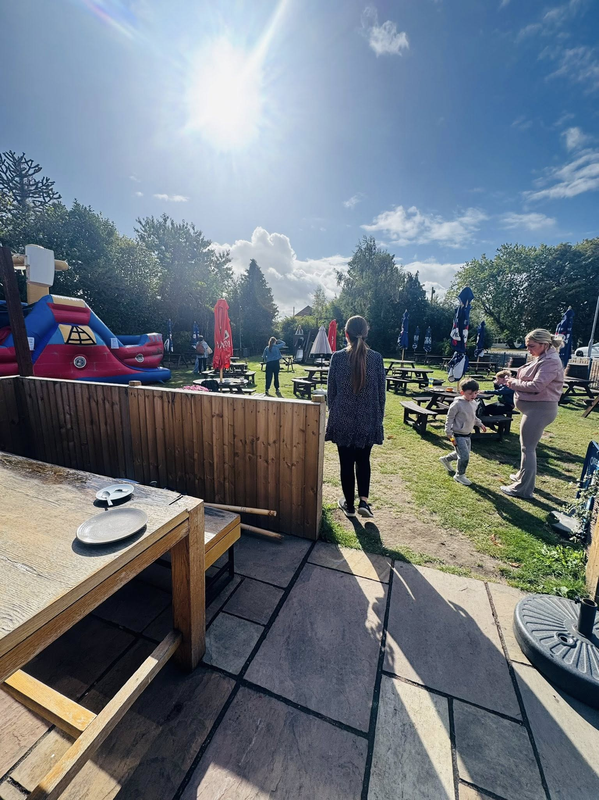
Purpose of the Event
- Build a sense of community
- Encourage open conversation
- Provide support and signposting where needed

Slide 22
What Happens?
- Tea, coffee, and light refreshments
- Informal discussions
- Chance to meet others and ask questions

Slide 23
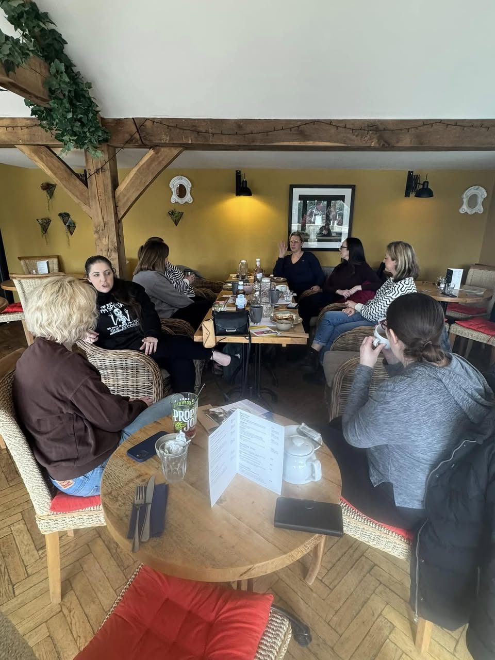
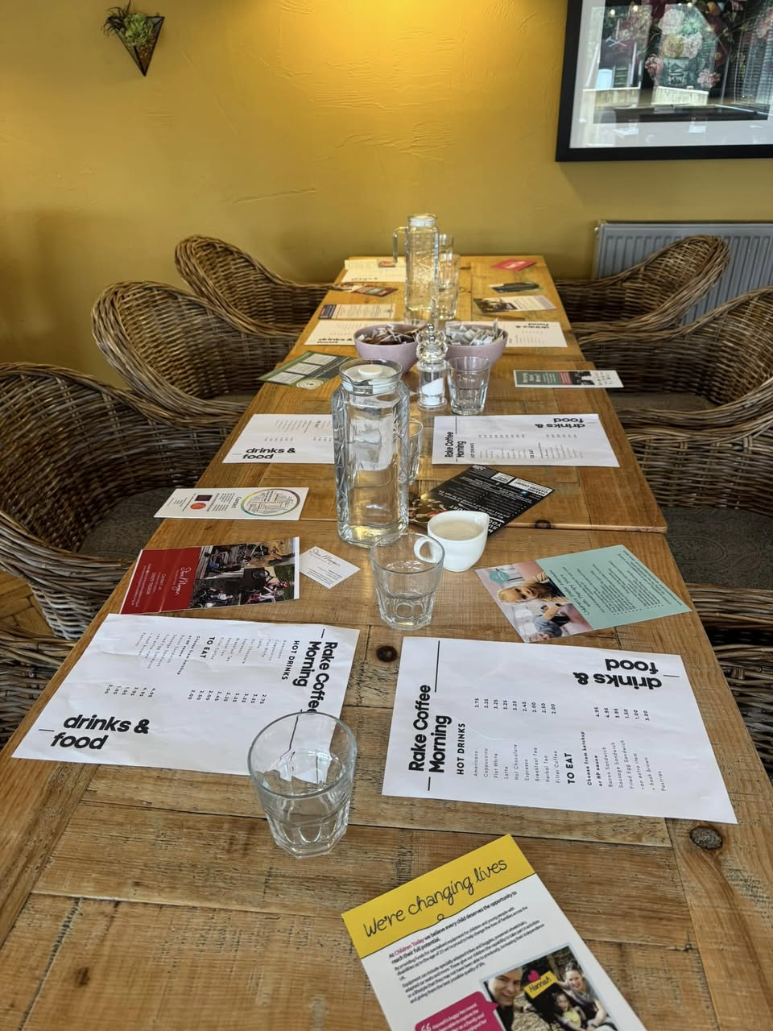

Why Get Involved?
- Meet new people
- Feel supported and informed
- Enjoy a welcoming and relaxed environment

Slide 24

Date for next coffee morning
Rake and Pikel, Chester Road Huntington Chester CH3 6BS
9am-11am
We hope you can make it

Slide 25

Cheshire and Warrington Carers Trust
Contact line: 0300102 0008

Slide 26
Who are we?
We have been supporting unpaid carers of all ages from 1994
We offer 1:1 bespoke information, advice, and support
We offer peer support groups throughout Cheshire West and Chester- including regular parent carer support groups in Northwich, Chester, Ellesmere Port, Frodsham, Malpas and Tattenhall
Carers contact line- Monday-Friday 9-5pm and Saturdays 9-12.30pm
We offer benefits advice and support in completing forms for SPECIFIC groups of parent carers- Rural Cheshire West (funded through The Westminster Foundation) and Ellesmere Port, The Lache and Blacon (funded through the Marjory Body Trust)
We provide SEND support and can attend some school meetings (For the parent carers listed above)
Signposting to other charities and relevant organisations

Slide 27

Examples of parent carer activities from summer 2025
Last summer, we ran 4 exciting summer holiday activities for parent carers living in rural Cheshire West and Chester (Including those who have children in schools in rural Cheshire West)

Slide 28

Current peer support groups

Slide 29

Current peer support groups

Slide 30

Current peer support groups

Slide 31

Current peer support groups

Slide 32

Current peer support groups

Slide 33

Current peer support groups: Ground Up Café - Theatre Porto, Ellesmere Port: Fridays- 23rd January 20th March 17th April and 22nd May @ 10-12 noon- Free breakfast for all new attendees!
Contact Clare Gallagher on 07871 797342 or email clareg@cheshireandwarringtoncarers.org

Slide 34
Contact details:
Clare Gallagher- Children and Families Lead.
Mobile: 07871 797342
Email: clareg@cheshireandwarringtoncarers.org
Carers contact line: 0300 102 0008
Offices in Chester, Northwich, and Crewe
Any questions?

Slide 35

SPACE Charity
Family Play Sessions
Parent Carer Support
Sibling Group
Training for Parents and Carers
Lending Library
Counselling
Activity Club (after school)
Birthday Parties

Slide 36


Koala
Sleep Service Supporting families

Slide 37


Petty Pool In the Community

Slide 38

Early Help

Slide 39


Short Breaks
Endorphins we create engaging and inclusive group sessions where SEND children and young people can play, learn and build confidence!
With themed activities, games and sports for all abilities, our safe and supportive sessions are a great way to have fun, make friends and flourish.
Ellesmere Port, Winsford, Chester, Dorin Park school after school club
Advocacy
Direct Payments
Personal Health Budget (PHB)
Community Connections Funding for activity and carer break
The Buzz Group

Slide 40


PCF Coffee Events

Slide 41


PCF Virtual Events

Slide 42

PCF YouTube Channel

Slide 43





Other Coffees events and parent Support
Offer activities, coffee sessions and parent empowerment course
Offer activities that are accessible and enjoyable for a chance to meet other parent carers
Listening Ear: 1-1 telephone appointments for parent carers looking for emotional support.
The Information Advice and Support Service helps parents and carers.
SEND Law, Meeting preparations, Mediations and tribunals, transport ect
One Stop Shop for everything SEND. activities, support, health, education, social care

Slide 44


Feedback
https://forms.office.com/e/dELL9V1yVc?origin=lprLink

Slide 45
How to find us & stay updated
Monthly Newsletters
Sign up here!
Email: info@pcfcheshirewest.org
Website: www.pcfcheshirewest.org
Phone number: 07900840867
PCF YouTube Channel
https://facebook.com/pcfcwac

Slide 46
Thank you

