Slide 1

AGM and Transport
Thursday 9th July 2026

Slide 2



Housekeeping

Slide 3
Welcome – Julie Duff
Transport Update – Vikki Williams & Lynee McGonigle
AGM Report 2026 – Julie Duff
Nominations, Appointments and Resignations – All
Summer Holiday Activity Provision – Lucy/Emma Walker
A.O.B

Slide 4
Parent Carer Forum AGM
9 July 2026
Annual Update on SEND Home to School Travel Assistance​

Slide 5
Purpose of the Annual Update
Overview of SEND Travel Assistance​
Explanation of the review, planning, and preparation of SEND Home to School Travel Assistance for the upcoming academic year.​
Provide clarification
The update clarifies processes around application processes, dates for notification of travel arrangements, useful contact points for queries and an opportunity to address any common concerns.​

Slide 6
Transport Planning for September Intake
Comprehensive Annual Review Process​
Annual re plan is undertaken each year ensures school travel arrangements are efficient and meet pupils’ evolving needs effectively.​
Scope and Scale​
The Council plans travel for over 1500 SEND pupils across multiple educational settings both in and out of borough.​ We manage approximately 450 SEND transport contracts and administer over 250 personal travel budgets.
Logistical Challenges​
Varied start times, specialist support, and sometimes long travel distances require tailored transport solutions.​
Collaboration ​
Close coordination with colleagues across various services including SEN, Young Peoples Services, Education, Social Care, Education Access etc.. In addition, meetings with over 10 special schools and independent schools take place over late spring to discuss proposed pupil groupings
Benefits of Early Planning​
Starting early reduces delays, improves communication with families, and enables a smooth start to the academic year.

Slide 7
Tendering Process
Phased Tendering Process​
A phased tendering approach balances competition, quality, and continuity whilst complying with procurement regs.​
Balanced Tender Decisions​
Tendering decisions consider cost, operator performance, safeguarding, and reliability to ensure quality service.​
Changes to Travel Arrangements
Cannot guarantee the same travel arrangements each year. New children start and others leave causing the demand for routes to school to change. Where this is the case, we may need to adjust the travel arrangements – such as, using a different driver or company, varying the pick-up and drop-off times and passenger assistant. Aim to provide as much notice as possible of any of these changes.
Operator Mobilisation​
New contracts include a mobilisation process to prepare operators fully before service commencement – meet and greets are written into operator's contract T&Cs – If you haven’t heard from your driver by 21 August, please contact the Transport Commissioning Team SENtransport@cheshirewestandchester.gov.uk

Slide 8
Modes of SEND travel assistance
Pass on public transport (only where identified as being suitable)
Multiple occupancy contracted vehicle
Personal Travel Budget
Independent Travel Training
Single Occupancy Vehicle – this will only be provided where needs identify this as a specific requirement or due to geographical reasons i.e. child is only one attend the setting or no other contract nearby to be used

Slide 9
When to apply and when not to apply
Automatic Eligibility Assessment​ (no need to apply)
Eligibility for SEND travel assistance usually continues automatically if the child's school and needs remain unchanged.​ The SEN team assess eligibility when an EHCP is agreed. If there are no changes then you shouldn’t need to apply for travel assistance. If you have not heard about your child's travel arrangements for September by 3 August 2026 please contact SENtransport@cheshirewestandchester.gov.uk
Post 16 Students​ (application required)
Please submit an application as soon as possible if your child is due to change their educational setting in September. This will then be assessed by the SEN Team. All applications go to the sendschooltravelassistance@cheshirewestandchester.gov.uk
Please note there may be a delay if the establishment on the form does not match what is named in the EHCP. The Post 16 team will need to consult with the setting who needs to agree they are suitable.
Travel assistance will only be provided to the named setting in the EHCP. It is not offered to work experience placements, even if these are part of the course.

Slide 10
Who to contact

Slide 11

Annual Report - Highlights
Growth
The Big One – PCF survey
Your Voices Share – External Scrutiny
  Local Government Association/Ofsted CQC/SEND Reforms
Championing Co-Production
  Commitment
  Knowing Me
Financials
Re-structure
Plans for 2026/27

Slide 12

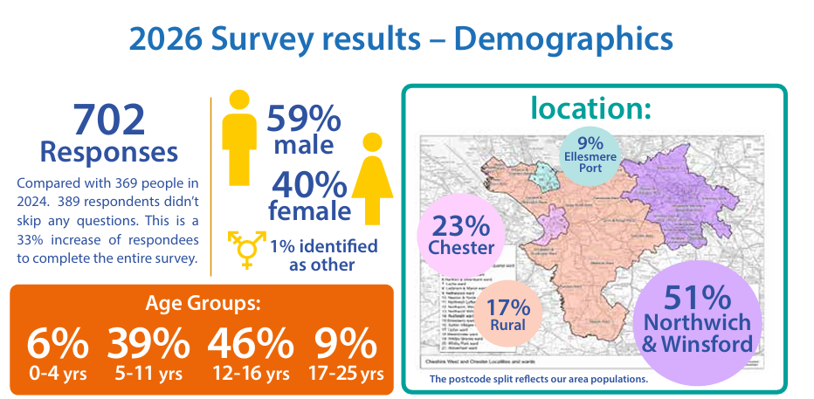


Slide 13




Slide 14



Your Voices Share – External Scrutiny
Local Government Association
"The parent carer annual survey is impressive and is being used to inform people about practice and service decisions.“
Ofsted and Care Quality Commission

Slide 15



Championing Co-Production

Slide 16


Slide 17

Time to Vote
Chair
  Lucy Kennerley
Secretary
  Jayne Roberts

Slide 18
Plans for 2026/27
Virtual Forums:
Who We Are and What We Do
Children and Young People’s Mental Health
Technology and Digital Resources
ADHD — Training Session
In person events
Social Care, Family Support and Short Breaks
Education, Health and Wellbeing
Preparation for Adulthood
Support for Me as a Carer
Carer Wellbeing Training Programme
Volunteer Training

Slide 19


Slide 20
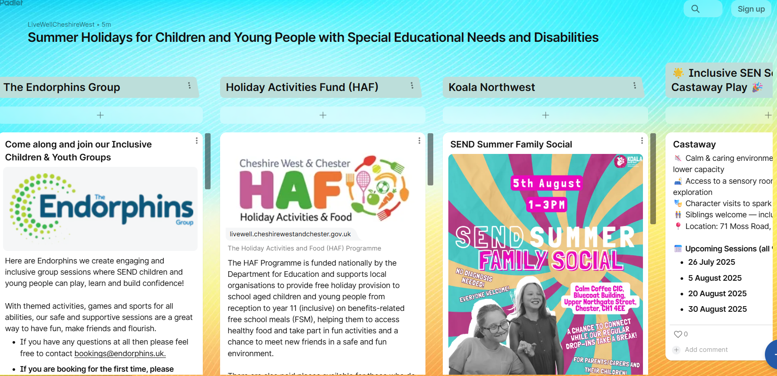
Summer Holiday
  https://padlet.com/LiveWellCheshireWest/summer-holidays-for-children-and-young-people-with-special-e-q2rhq7j53s3w3ax9

Slide 21

Contact Us
Join Us Here!

