Slide 1
Welcome
Hays County Capital Improvement Plan (CIP)
Monday, July 7 – Friday, August 8, 2025
Virtual Open House
Submit comments through the survey or by email to bsaucedo@broaddususa.com

Slide 2
Project Overview & Purpose
Hays County is developing a Capital Improvement Plan (CIP) that will position Hays County to deliver County-wide services in buildings that most effectively support its citizens.
WHAT IS A CIP?
An outline of current and upcoming facility upgrade County projects and associated costs that have been prioritized based on their potential to benefit the community.
PURPOSE
To ensure that the county effectively manages its resources, addresses the needs of the community, and plans for future growth and development.
HAYS COUNTY CAPITAL IMPROVEMENT PLAN (CIP)

Slide 3
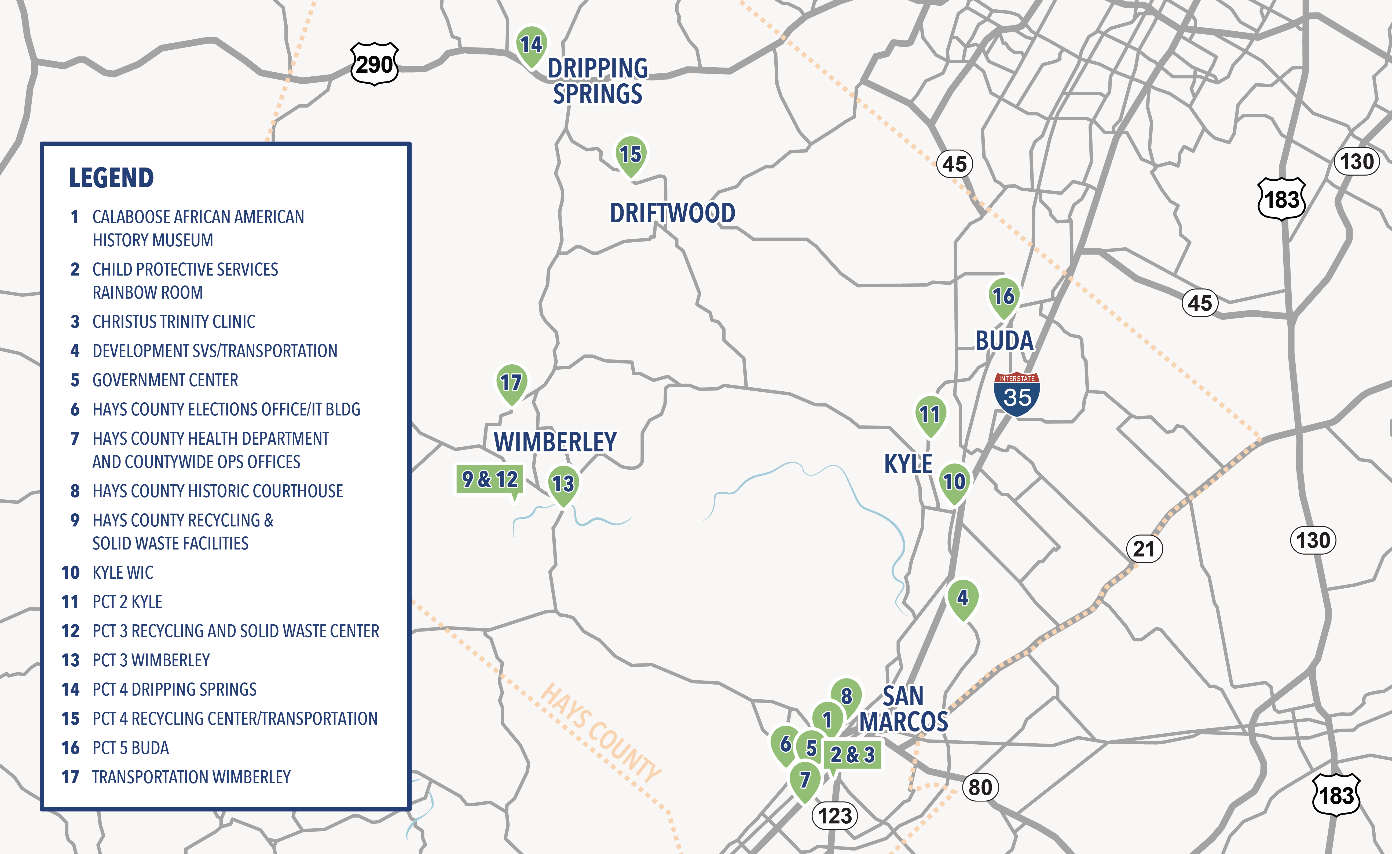
Existing County Facilities
Hays County facilities will be reviewed and evaluated to prioritize potential improvements. Please see all existing facilities available to the public below:
HAYS COUNTY CAPITAL IMPROVEMENT PLAN (CIP)

Slide 4
Project Development Process
WE ARE HERE
HAYS COUNTY CAPITAL IMPROVEMENT PLAN (CIP)

Slide 5
Tell Us How You Use County Facilities & Services
The key to this plan is to identify:
How county-wide services are being used
Convenience of service locations
Improvements to facilities that will enhance the public’s experience
Public input is a key factor to the development of the Hays County CIP. Your feedback will help our team identify and prioritize County facilities and services.
Onion Creek, First Independent Baptist Church, 2013 Halloween Flood
Source: KVUE
HAYS COUNTY CAPITAL IMPROVEMENT PLAN (CIP)

Slide 6
Comments and Questions
Submit your comments by
Friday, August 8, 2025
Take the survey at:
surveymonkey.com/r/HAYSCIP
or submit by email at bsaucedo@broaddususa.com
HAYS COUNTY CAPITAL IMPROVEMENT PLAN (CIP)

