Slide 1



CUSTOMER SUCCESS WITH THE SHARPE TEAM

Slide 2


Hi!
I am Ashley McKenzie Sharpe
  Our team is in the top 1% of mortgage originators in the country
  Helping people finance their dream homes in the area since 2005
  Known for figuring out how to structure loans
  Local presence in the Triad
  Well-established and trusted team

Slide 3
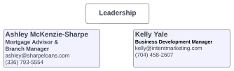









colleen@sharpeloans.com

Slide 4

Best Customer Communication
Our team prides itself on the communication we provide throughout the entire buying process. We teach your customers everything about how to be a successful homebuyer!
  Protecting their credit
  Complete explanation of lending
  Understanding appraisals in this market
  Preparing their children for a move
  What to bring to closing
  What to expect during walk-throughs
  How to move into a new home

Slide 5
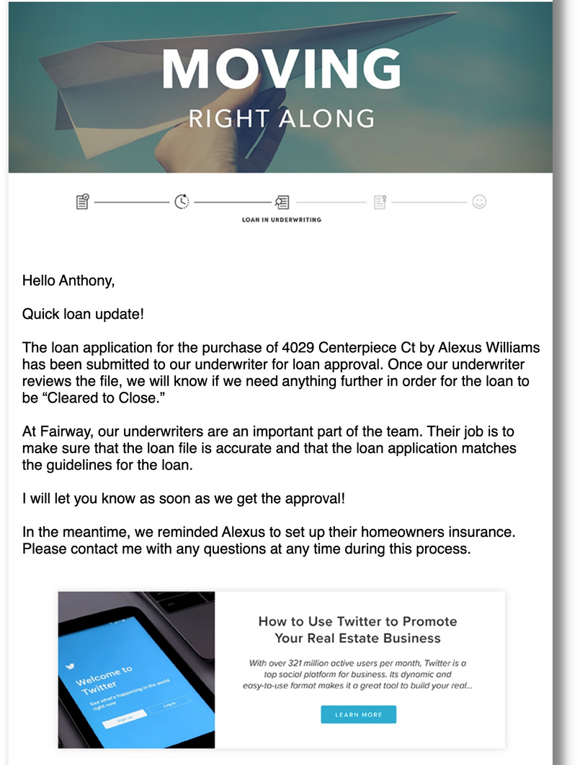
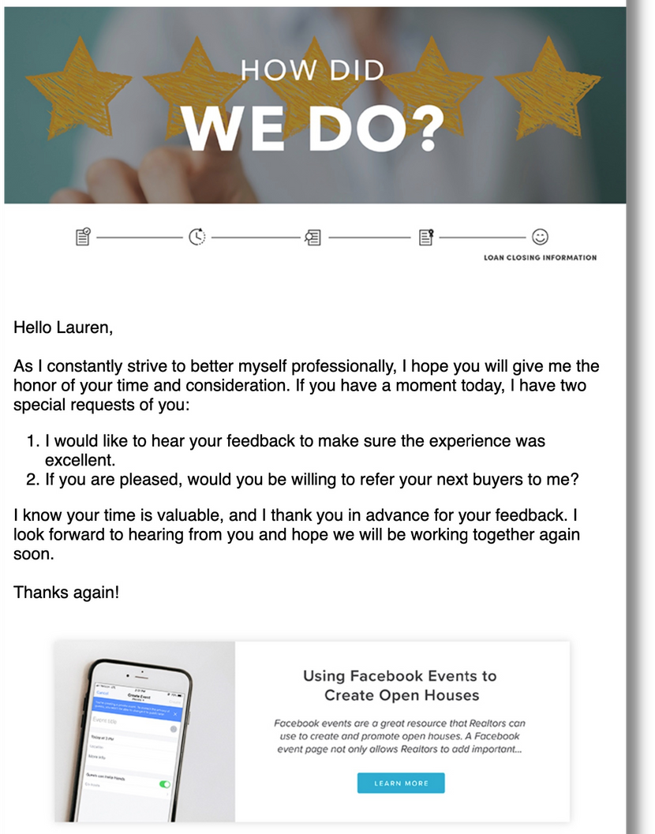
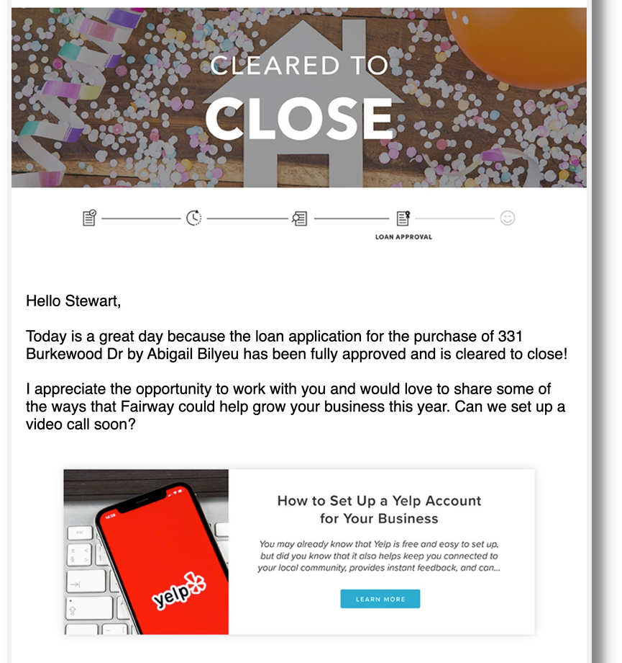
Updating YOU During the Loan Process

Slide 6

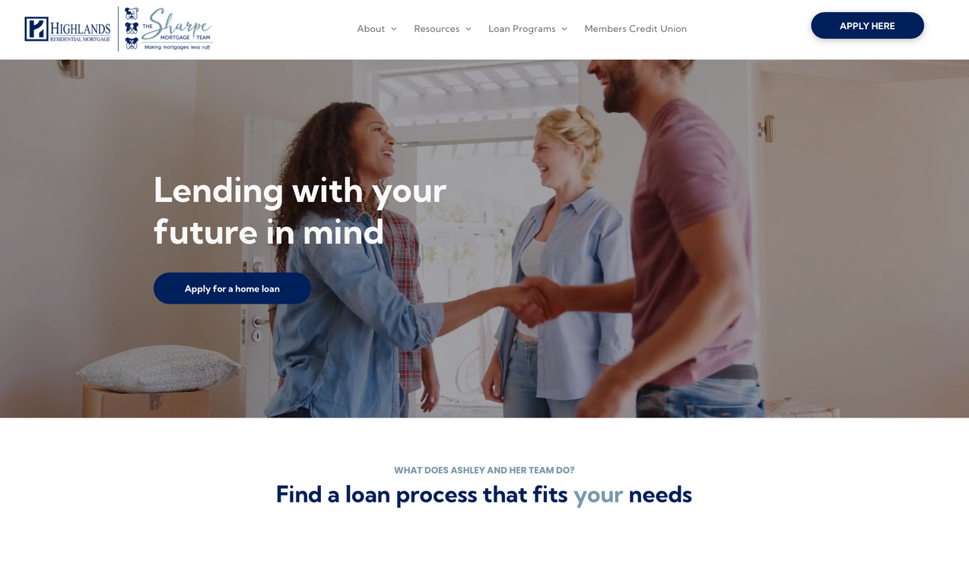
sharpemortgageteam.com

Slide 7
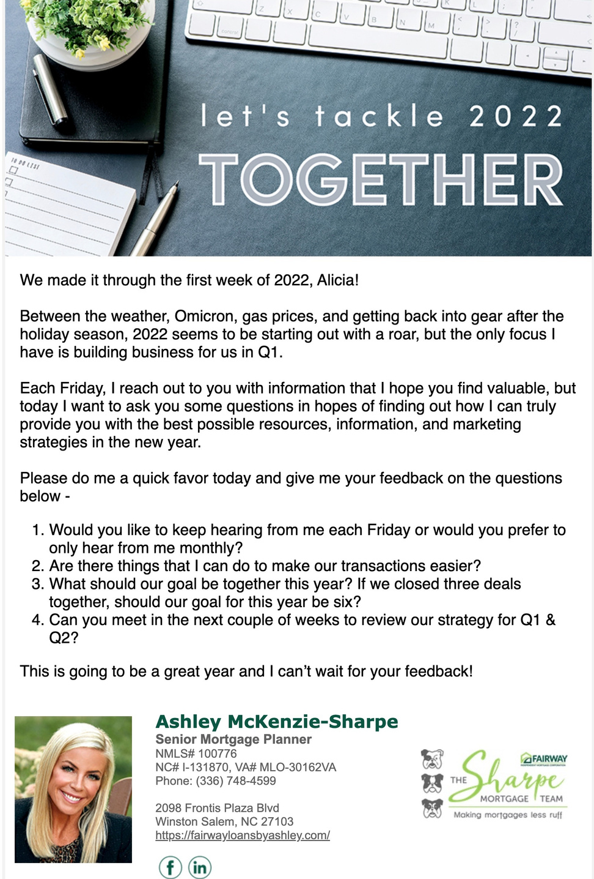

Always here to support YOU
Weekly Realtor Email
1
Helping you build your marketing and business with weekly tips and news
Training & Events
2
We want to help you succeed, so we will be happy to come to your office to give this presentation or others to your agents.
Curating Future Deals
3
Know a buyer who is 3-6 months away from moving? Let our team prepare them with all the will need to become a successful buyer.

Slide 8

Questions?
Our team is poised to help your customers understand the importance of working with the right lender, the buying power that they have, and representing your brand in the best way possible.
Some highlights from today...
1
Local Lender
5
Backed by Fairway
"If everyone is moving forward together, then success takes care of itself." – Henry Ford
2
Excellent Reputation
6
Robust Social Media
3
Good Rates
7
Highlights on Website
4
Fantastic Communication
8
Many Loan Programs for Your Buyers

