Slide 1


Product Highlights

Slide 2


Mortgages Aren’t One-Size-Fits-All!
At Highlands Residential Mortgage, our difference is simple: we put people first. Every transaction is more than a mortgage—it’s a milestone in someone’s life. That’s why we’ve built a culture centered on service, trust, and long-lasting partnerships.

Slide 3

Conventional Loans
Great for borrowers with solid credit and stable income who want flexible terms and competitive pricing with down payment options as low as 3% down.
Temporary Buydowns: 3/2/1, 2/1, 1/0 (where eligible)
10–30 year fixed; SOFR ARMs (3/6, 5/6, 7/6, 10/6)
Purchase & refinance
Down payments as low as 3% (guidelines apply)
MI options vary (monthly/single/split)

Slide 4

VA Loans
  VA financing helps eligible service members and veterans buy with exceptional benefits often with little to no money down and no monthly mortgage insurance.
  15–30 year fixed-rate options
  3/1 and 5/1 CMT ARMs
  Purchase, IRRRL, and cash-out refinance options
  100% financing for eligible borrowers (guidelines apply)
  No monthly mortgage insurance
  Can finance the VA Funding Fee (if applicable)
  VA Jumbo Loan Amounts Allowed

Slide 5

FHA Loans
  FHA is designed to make homeownership more accessible with flexible qualifying and a low-down payment option.
  15-30 Year Fixed Rate
  As little as 3.5% down
  Up to 6% seller-paid closing costs (per FHA limits)
  Gift funds permitted
  FHA 203(k) renovation option and 203(h) disaster program (where eligible)

Slide 6
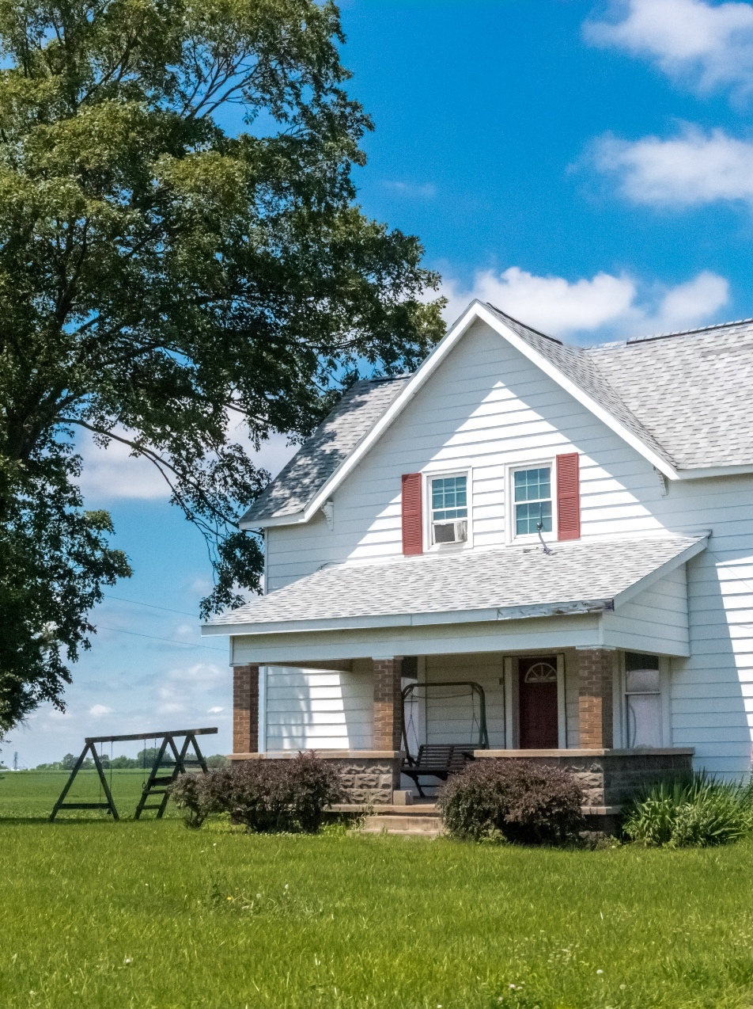
USDA Loans
USDA loans help eligible buyers purchase in qualified rural/suburban areas with 0% down and affordable terms.
Zero down payment for eligible borrowers/properties
30-year term option common for affordability
6% seller concessions may be permitted (program limits apply)
Gift funds allowed for closing costs
Eligibility includes income and location guidelines
Refinance options available (where eligible)

Slide 7
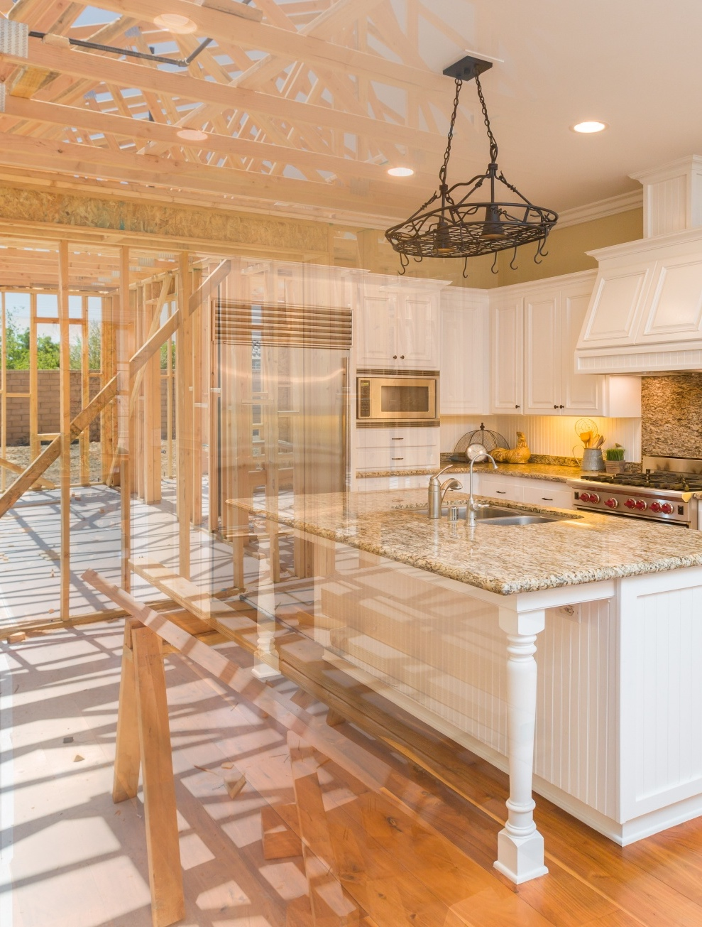
Renovation/Construction
Whether the buyer is renovating, purchasing a fixer, or building a custom home, we help structure financing early so draws, change orders, and timelines don’t derail the close.
Renovation options: FHA 203(k) (Limited/Standard) and FNMA HomeStyle® (where eligible)
Typical renovations: kitchens/baths, roof/windows, HVAC/plumbing/electrical systems, additions (guidelines apply)
Custom build support: align early on builder docs, draw schedule, inspections, and change orders
Keep contract-to-close predictable with upfront expectations on timeline + documentation
Scenario desk support to confirm the best lane before the buyer gets deep into selections

Slide 8

Doctor Program
Built for medical professionals who may have strong earning potential but unique early-career challenges—like student loan debt or new employment contracts.
Eligible designations include:
MD/DO/DDS/DMD/PharmD/VMD/DPM/CRNA + residents/fellows/interns (guidelines apply)
Up to 100% LTV
Minimum FICO 680
Maximum loan amount up to $2,000,000 (program parameters)
MI not required

Slide 9

Non-Conforming/Jumbo Loans
For borrowers who need higher loan amounts or more flexible underwriting than standard agency guidelines—while still maintaining strong structure and documentation.
Fixed & ARM options (interest-only on select programs)
Higher loan amounts for luxury and high-cost markets (program dependent)
Minimum FICO / LTV / DTI vary by product
Asset-based qualification options may be available

Slide 10

Non-QM & Specialty Lending
Designed for buyers who don’t fit traditional underwriting—self-employed, complex income, and investor scenarios.
Bank statement income options (e.g., 12–24 months)
DSCR investor programs
(including short-term rental scenarios in some cases)
Asset utilization / asset depletion qualifying
ITIN borrowers and foreign national options
Condo/condotel and non-warrantable options

Slide 11

Down Payment Assistance
Down payment support can unlock homeownership sooner, especially for first-time and moderate-income buyers, when paired with the right program and eligibility.
State/local DPA options may be available (eligibility varies)
HomeReady Credit: $2,500 (where eligible)
Chenoa FHA and Essex FHA DPA options (program dependent)
Eligibility requires early screening (income, location, program rules)

Slide 12
Additional Product Options
Extra tools to help more buyers qualify—especially when the property or borrower doesn’t fit standard guidelines.
Payment / pricing tools: Temporary Buydowns (Conventional), Investor Paid MI (where available), Rate Drop Pledge option
Broker / specialty property types: Mixed Use, Co-Ops, Graduated Payment, Unique Homes, Vacant Land, 2nd Liens (availability varies)
Investor & expanded qualifying: DSCR (including 5–8 units where available), Written VOE Income Only, No-Ratio options (where available)
Affordable / niche programs: HUD REO $100 Down, FHA Good Neighbor Next Door, HUD 184 (where eligible)
Other buyer/property scenarios: ITIN, Hobby Farms, Singlewide & Multi-Wide Manufactured Housing, Family Opportunity

Slide 13


Ashley McKenzie-Sharpe
Branch Manager– NMLS #100776
C: (336) 575-9448
Ashley@SharpeLoans.com
www.Sharpeloans.com
2098 Frontis Plaza Blvd
Winston Salem, NC 27103
NMLS # 134871 | EQUAL HOUSING LENDER | 950 W. BETHANY DRIVE, SUITE 800 - ALLEN, TX 75013

Slide 14

Thank you!

