Slide 1


BUYING YOUR FIRST HOME:
A STEP-BY-STEP GUIDE FOR
FIRST-TIME HOMEBUYERS

Slide 2

AGENDA
Buying vs Renting
Homebuyer’s Road Map
Who are the Players?
Why Use A Realtor
Prequalification vs Preapproval
Finding the Right Loan for You
Dos and Don’ts
Documentation Checklist
Closing Day

Slide 3
MOVING CAN BE STRESSFUL,
BUT GETTING A MORTGAGE DOESN’T HAVE TO BE!
Helping families achieve their dreams of homeownership is my passion! I personalize my service to help you meet your financial goals and provide you with the resources and education so you can make confident, informed financial decisions. Whether you are a first-time homebuyer, repeat buyer or looking to expand your real estate portfolio with investment properties, I will guide you from application to close.
Buying a home is the single most important investment you will ever make. Although it can be intimidating, I am dedicated to making the process a positive and rewarding experience for you. I am honored by the opportunity to earn your business, and I look forward to serving you.

Slide 4

BUYING VS RENTING
BUYING
Stability: When you buy a home, you control how long you live there and if you have a fixed-rate loan, have predictable payments
Pride of Ownership: You can make your home your own by decorating it to suit your style! You can also gain a sense of belonging in your community.
Investment in the Future: As you make payments and your property value appreciates, you begin to build equity and set a foundation for long-term financial growth!
Tax Benefits*: Often, homeowners can be eligible to deduct mortgage insurance and/ or property tax costs from their income tax.
RENTING
Rent rates are determined by the landlord and can change yearly! Also, your landlord can choose to sell at any time, potentially affecting your ability to continue to stay in the home.
Typically, you have limited creative freedom in a rental. This means painting, remodels, and even outdoor space updates can be off-limits.
Any rental payments you make go to your landlord. You cannot build any equity in a renting situation.
There are no tax benefits for renters.
*Consult with a tax professional for more details.

Slide 5
BUYING VS RENTING
THINK OF HOW MUCH YOU SPENT ON RENT THAT COULD HAVE BEEN BUILDING YOUR HOME EQUITY!
Rent | 1 Year | 5 Years | 10 Years
$1,000 | $12,000 | $60,000 | $120,000
$1,250 | $15,000 | $75,000 | $150,000
$1,500 | $18,000 | $90,000 | $180,000
$1,750 | $21,000 | $105,000 | $210,000
$2,000 | $24,000 | $120,000 | $240,000
$2,500 | $30,000 | $150,000 | $300,000

Slide 6
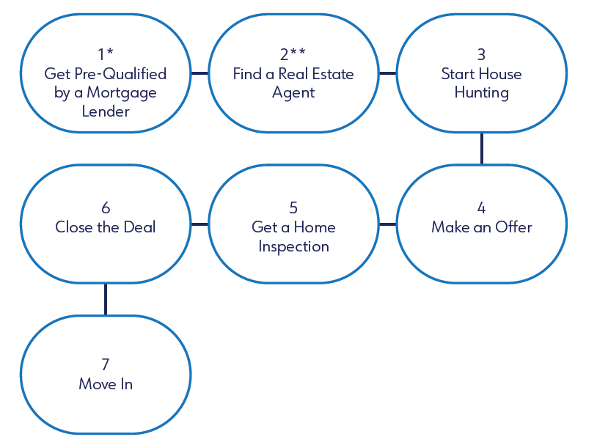
HOMEBUYER’S ROAD MAP
Your step-by-step guide to finding your dream home, from
pre-qualification to moving day!
STEP 1 DETAILS
Meet with your mortgage professional to: determine the type of loan you will be using, determine your desired purchase price, loan costs and monthly payment, understand the financial benefits of home ownership and understand what to expect throughout the home buying process.
STEP 2 DETAILS
Identify a Realtor to help you: find suitable homes in your area and schedule visits into those homes for your consideration, negotiate the terms of your offer(s), help you navigate through your legal aspects and contractual requirements and protect you from potential hazards throughout your home buying process.

Slide 7
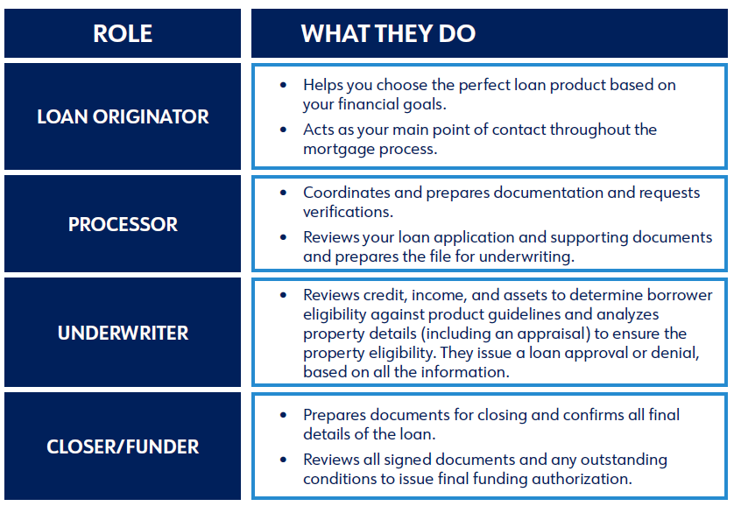
WHO ARE THE PLAYERS
AND WHAT DO THEY DO?

Slide 8

WHY USE A REALTOR WHEN BUYING A HOME
Since buying or selling a home is likely the largest financial transaction a person might make in their lifetime, having an expert real estate agent represent you is critical!
Benefits to working with a Real Estate Agent include:
Expert advice to avoid common homebuying mistakes!
They have access to the MLS (Multiple Listing Service), understand the local markets, and can help you narrow down your search to find the right fit.
Purchase negotiations!
They help you navigate the contracts and addendums!
Notes:
Licensed real estate agents have seen it all, and their experience with property transactions will be extremely useful when you start looking at homes for purchase.
Real Estate Agents are experts at researching homes that meet your personal and budget requirements.
Real Estate Agents are armed with resources to help you make the best offer on a home you want to purchase, including any repairs or inspections that may need to be negotiated and/or included.
Real Estate Agents are well-versed in property contract writing and negotiating. They understand the in’s and out’s of any sales agreement you will potentially sign and can help you avoid any pitfalls (and make sure you’re getting what you pay for)!

Slide 9
PRE-QUALIFICATION VS PRE-APPROVAL
PRE-QUALIFICATION
PRE-APPROVAL
Provides a “ballpark” estimate of your buying power
Is based on summary information of your income and assets
Provides proof to real estate agents and sellers you’re pre-approved fora specific loan
Is based on verification of your income, credit and assets

Slide 10
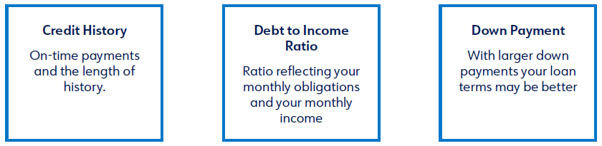
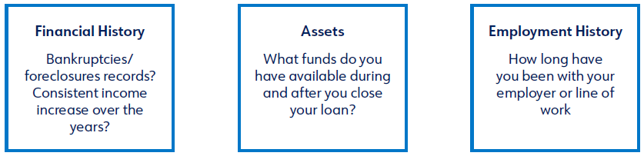
PRE-QUALIFICATION VS PRE-APPROVAL
BELOW ARE KEY FACTORS THAT YOUR LENDER WILL CONSIDER WHEN QUALIFYING A BORROWER FOR A MORTGAGE LOAN.

Slide 11
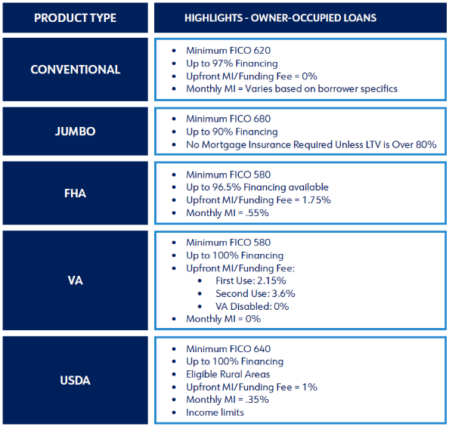
FINDING THE RIGHT LOAN FOR YOU
Highlands Residential Mortgage offers the perfect mix of products, pricing, and superior customer service to make your home financing experience the best it can possibly be!
Whether you’re looking for your first home, dream home or investment property, or if you’re interested in refinancing an existing loan, your Loan Originator will work with you to help identify the ideal program for your lifestyle!
*Loans are subject to credit and property approval; certain restrictions and conditions apply.
Mortgage Insurance (MI) is dependent on LTV and program requirements.
Programs and guidelines are subject to change without notice. Rates change daily.

Slide 12

DOs AND DON’Ts
DO
Ask questions
Keep your original paycheck stubs and bank statements
Provide documentation for the sale of your current home (if applicable)
Let me know if you will receive a gift of funds or need a power of attorney
Let us know if your employment changes
Notify me if your marital status changes
DON’T
Change jobs
Buy a car or make any major purchases
Deposit any funny money (cash-at-home cannot be used)
Get a credit card cash advance
Close or open any new lines of credit
Change your closing date

Slide 13

DOCUMENTATION CHECKLIST
Knowing what documentation you will need for your mortgage transaction can help smooth the process and reduce your stress!
We’ve outlined common documentation required for mortgage loans. Note that not all will be required, depending on your scenario. Please check with your Loan Originator if you have any questions.

Slide 14
DOCUMENTATION CHECKLIST
SCHEUDULE OF REAL ESTATE
(Please provide information for all properties currently owned.)
Recent Mortgage Statement for Current Residence
Copy of Your Homeowners’ Insurance
Recent Property Tax Bill
Property Lease (if rented with 2 year landlord history
HOA Information (Monthly Payments)
IF APPLICABLE
DD214 (If Using VA Loan)
Bankruptcy Discharge Papers (All Pages)
Gift Letter / Gift Documentation
Divorce Decree or Legal Separation Agreement, Including Child Support Agreement Documentation
INCOME DOCUMENTAITON (W2 Employee)
Most Recent 2 years of Tax Returns
2 Years of W2s
2 Paystubs (Most Recent)
ASSET DOCUMENTATION
Most Recent Bank Statements
  All Pages of All Accounts
  (Borrower and Co-Borrower)
Most Recent Investment Acccount Statements
  All Pages of All Accounts
  (Borrower and Co-Borrower)

Slide 15
CLOSING DAY
PRE-CLOSING CHECKLIST
Contact your closing agent to confirm closing location and review any special instructions or items that are needed at the closing table
Review your closing documents prior to closing day to ensure there are no errors and make notes of any questions or concerns you have regarding the information listed
Double-check all the information (spelling, numbers, names, etc.) small mistakes can lead into bigger problems down the road.
Review seller responsibilities with a walkthrough checklist to make sure any repairs or changes have been made prior to closing
Review closing costs required on closing day

Slide 16
CLOSING DAY
WHAT TO BRING TO CLOSING
Photo ID
Cashier’s Check
Closing Disclosures
Proof of Insurance
POST CLOSING REMINDERS
Make sure all accounts with your address have been updated
Confirm all utilities have been set up and are prepared to transfer on closing day
Prepare a cleaning plan before furniture is moved in
BOTTOM LINE:
The more prepared you are for closing day, the more you get to enjoy closing on your new home!

Slide 17



A HIGHER STANDARD OF LENDING
When you work with our team, from your initial application all the way through closing, you can have confidence that you will be informed and supported every step of the way.
Providing “A Higher Standard of Lending” means honesty, integrity, and award-winning customer service that you can count on throughout the mortgage process. Are you ready to get started?
Ashley McKenzie-Sharpe
Branch Manager– NMLS #100776
C: (336) 575-9448
Ashley@SharpeLoans.com
www.Sharpeloans.com
2098 Frontis Plaza Blvd
Winston Salem, NC 27103
Highlands Residential Mortgage NMLS 134871 | An Equal Housing Lender
This is not a commitment to lend. This offer is subject to verification of borrower qualifications, property evaluations, and credit approval. Not all borrowers will meet the requirements necessary to qualify. Loans are subject to credit and property approval; certain restrictions and conditions apply. Programs and guidelines are subject to change without notice. Rates change daily

