Slide 1

Spirit Empowered
Discovering Genuine Spiritual Power and its Impact

Slide 2

His divine power has given us everything we need for a godly life through our knowledge of him who called us by his own glory and goodness
2 Peter 1:3

Slide 3
Brothers, count it all joy when you fall into various trials, knowing that the testing of your faith produces patience. But let patience have its perfect work, that you may be perfect and complete, lacking nothing.
James 1:2-4

Slide 4

Chapter 1
G
o
d
s
r
o
l
e
i
n
o
u
r
w
o
r
l
d

Slide 5
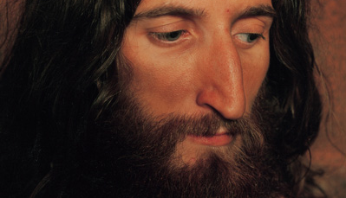
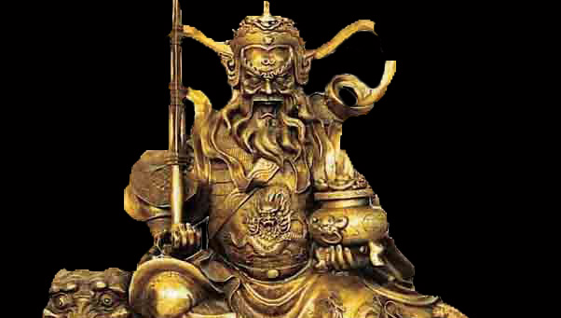
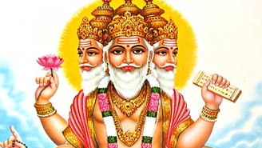
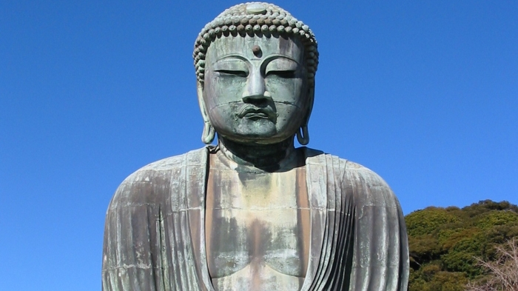
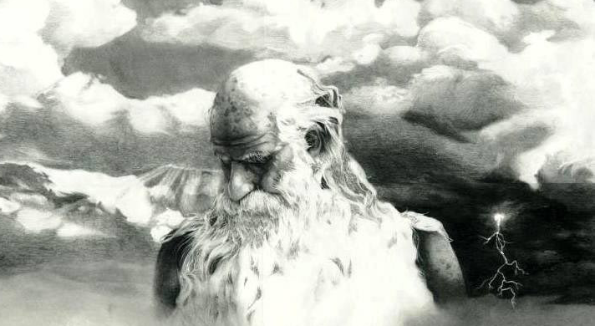
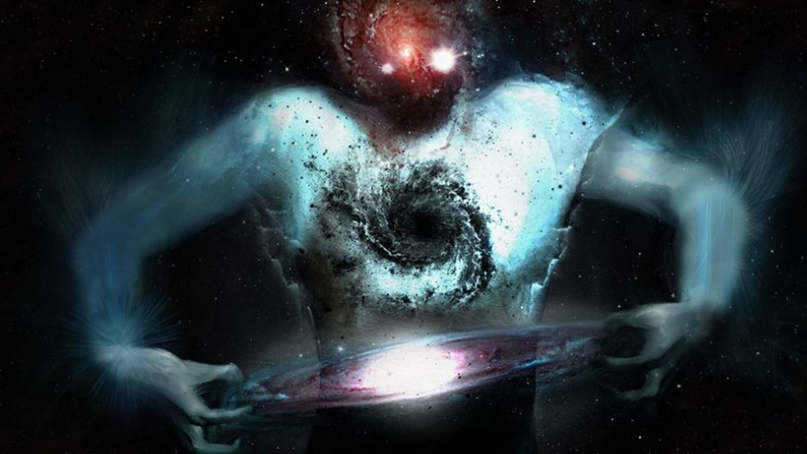
What do people today think about God?

Slide 6
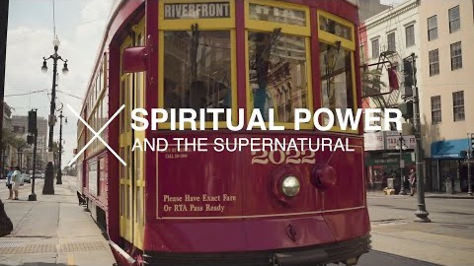

Slide 7
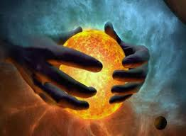
The God of creation

Slide 8

The laws of nature

Slide 9

What makes
something
supernatural
?

Slide 10

How was God involved with people in the Bible?

Slide 11
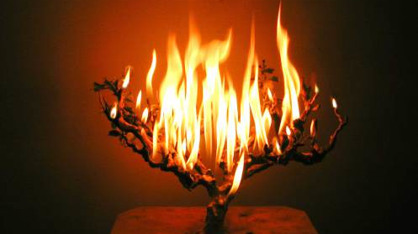
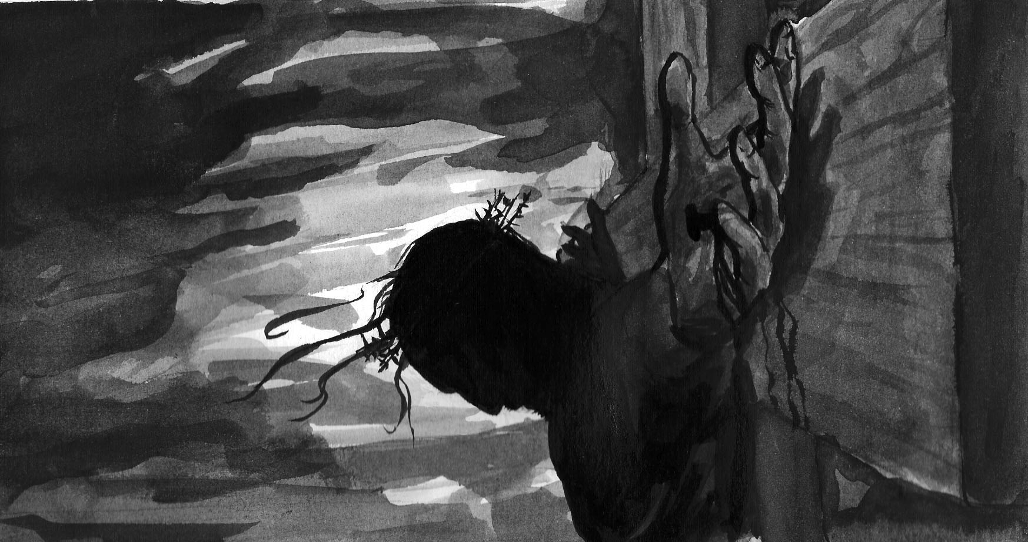
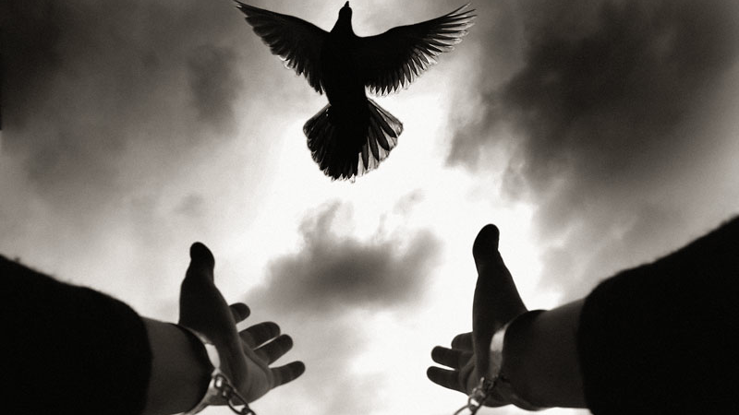
How dose God use His supernatural powers?
1. The greatest supernatural event of all time
2. We need spiritual power to continue being a Christian

Slide 12


Slide 13

What are God’s plans for the future?

Slide 14
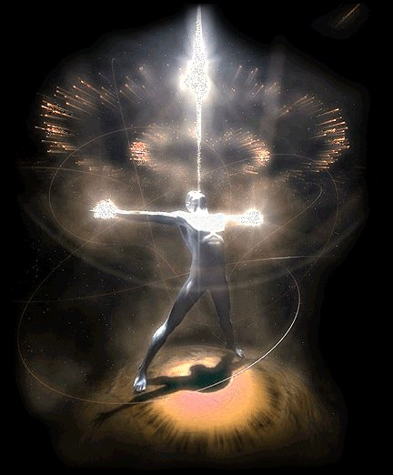
Chapter 2
The characteristics of true spiritual power

Slide 15

The reality of being spiritually
weak

Slide 16
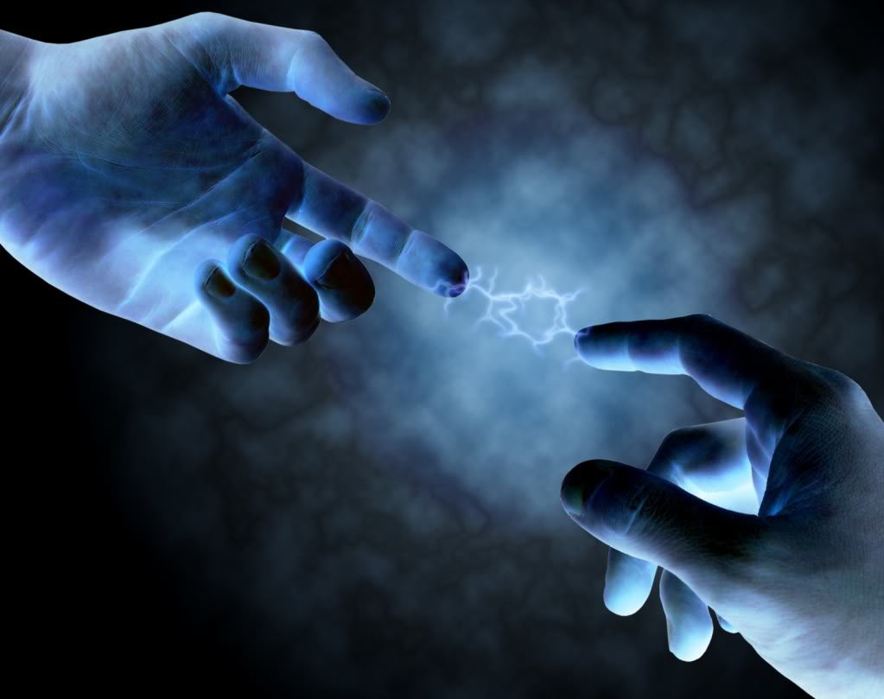
What is true spiritual power?

Slide 17

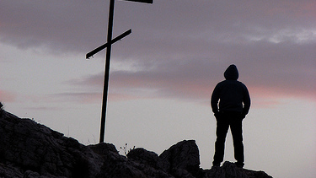
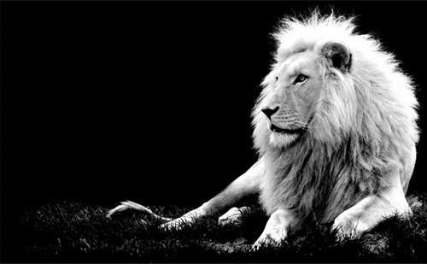
What does it mean to be spiritually strong?
1. You have made a deep commitment to live for Jesus
2. Make your decisions after looking at what the Bible tells you to do
3. Prayer is an important part of your life
4. Listen to God through your spirit

Slide 18


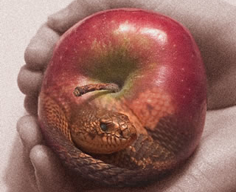
What does it mean to be spiritually strong?
5. You love God more than other people or things
6. You have learned how to overcome temptations to sin
7. Your life shows the fruit of the Holy Spirit

Slide 19

Don’t try to imitate God’s power

Slide 20

Four keys to the life of spiritual power
1. Belief
2. Trust
3. Hope
4. Faith

Slide 21

The relationship between these 4 keys to spiritual power

Slide 22

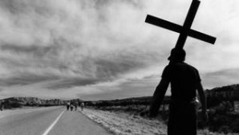
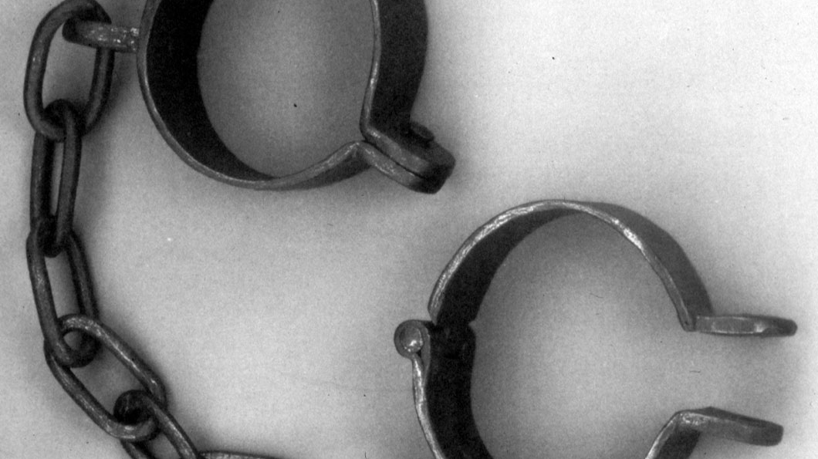

Where we can use spiritual power in our lives
1. Becoming a Christian
2. To keep on being a Christian
3. To do God’s will
4. To have power over sin

Slide 23
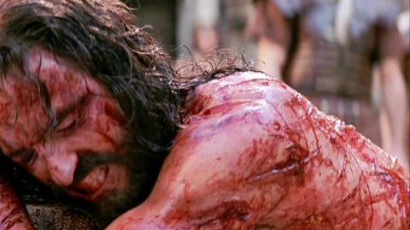

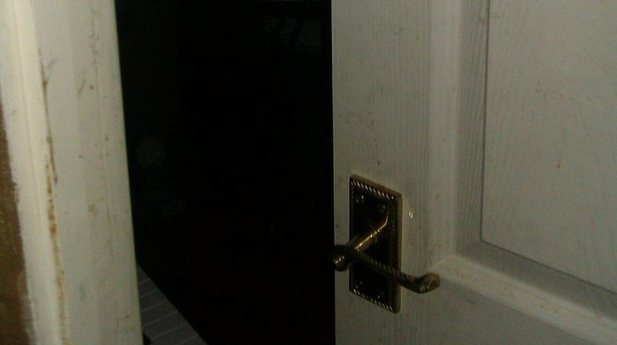
Where we can use spiritual power in our lives
5. To go through trials & problems
6. Healing
7. To overcome temptation

Slide 24
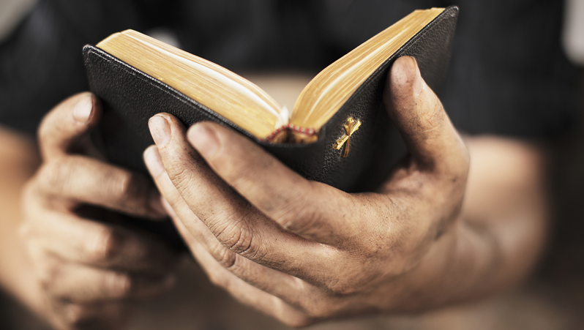

Where we can use spiritual power in our lives
8. To obey God’s laws
9. For present needs. You cannot store up faith for future needs

Slide 25
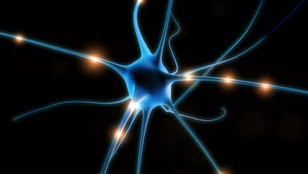
Chapter 3
How to get spiritual power

Slide 26
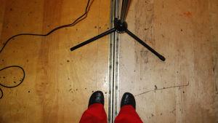
Don’t seek to be a spiritual superstar specializing in miracles

Slide 27
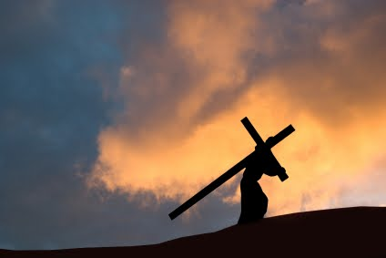
It takes time and work to develop spiritual power

Slide 28
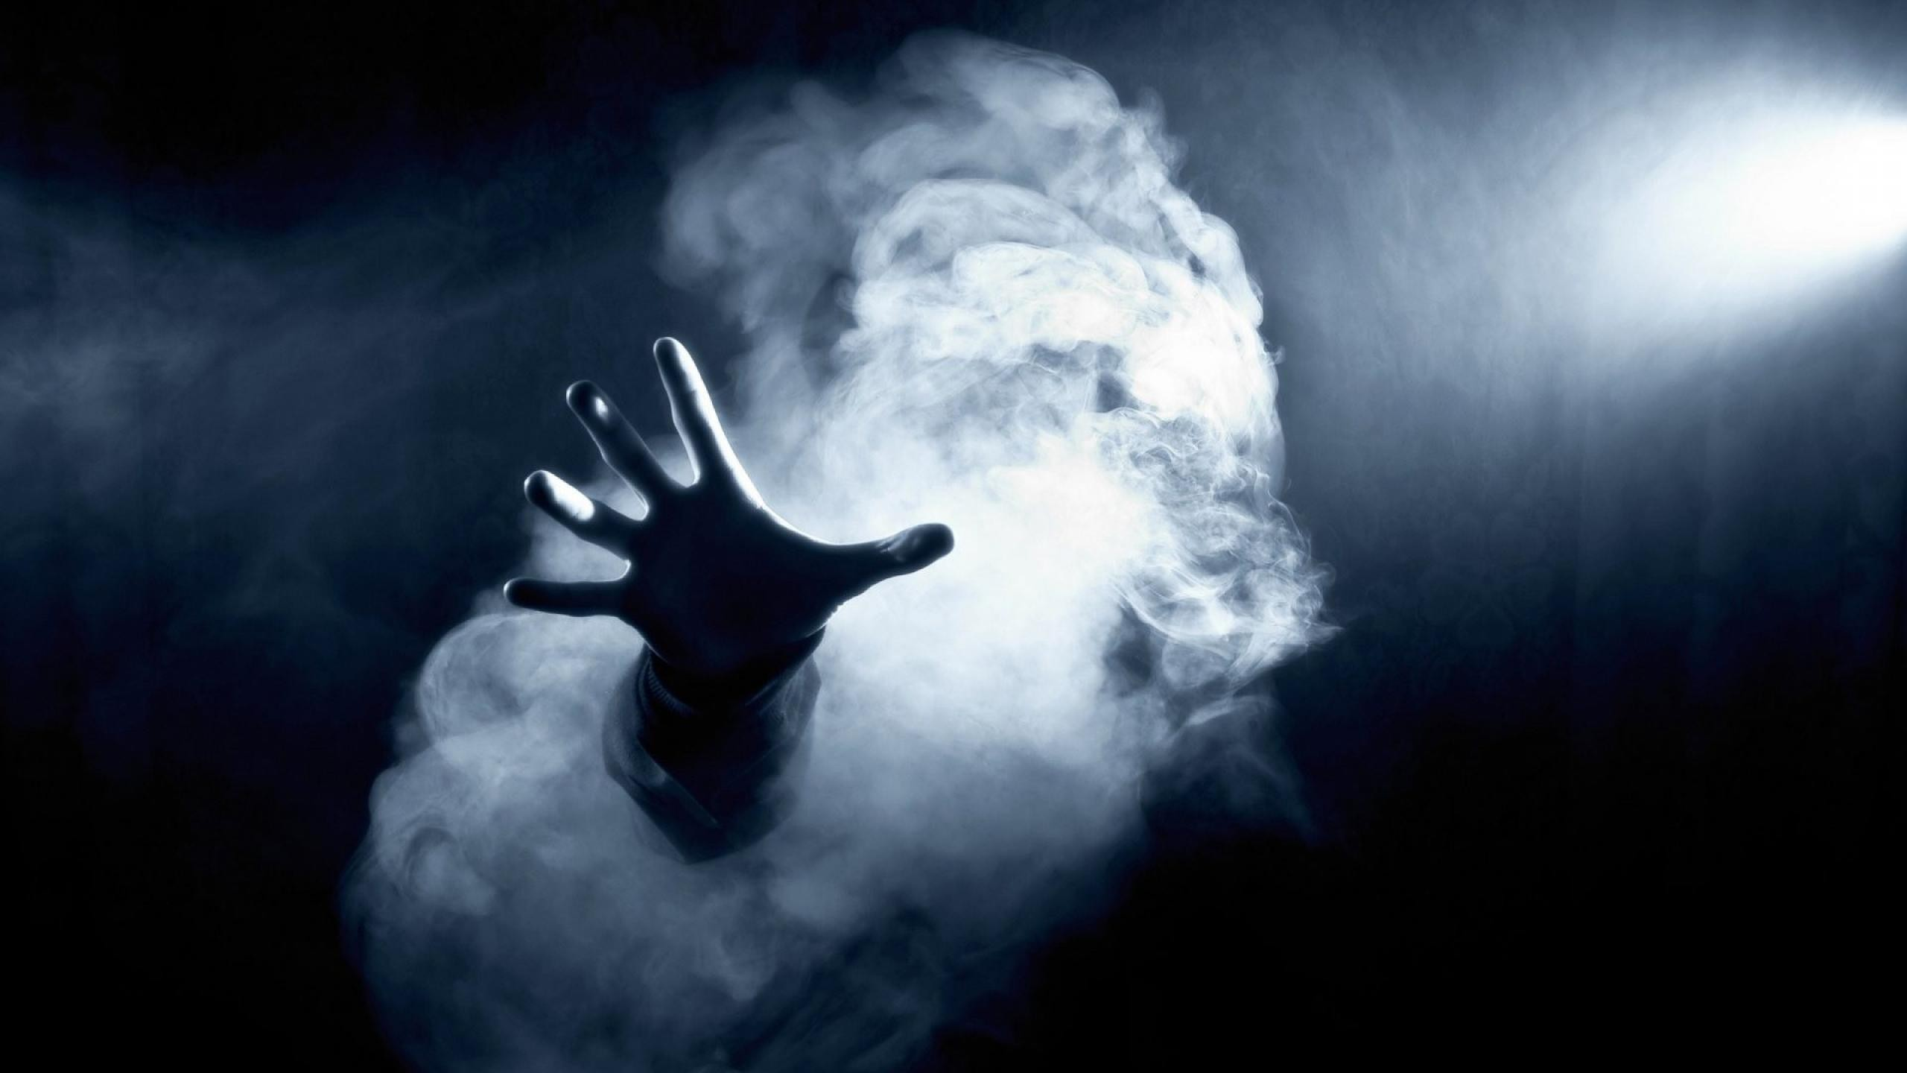

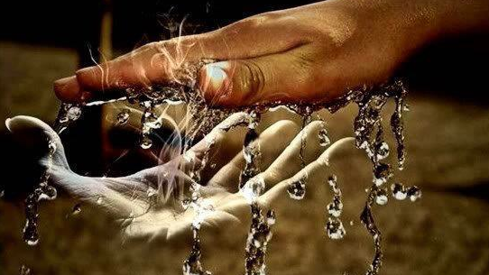
Basic steps to developing spiritual power
1. Become a Christian
2. Draw closer to God
3. Obedience
4. Prepare yourself to receive God’s spiritual power

Slide 29



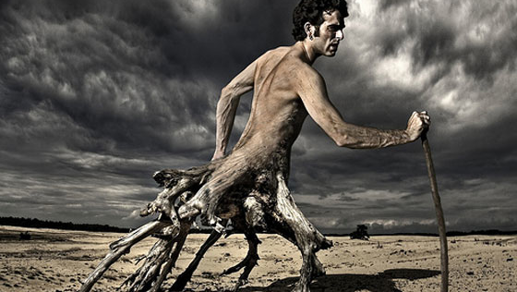
Basic steps to developing spiritual power
5. Prayer
6. Learn from your tests and problems
7. Fasting
8. Praise & Worship

Slide 30


Slide 31

So where do I start?

Slide 32

Chapter 4
True spiritual power vs.
Counterfeits

Slide 33
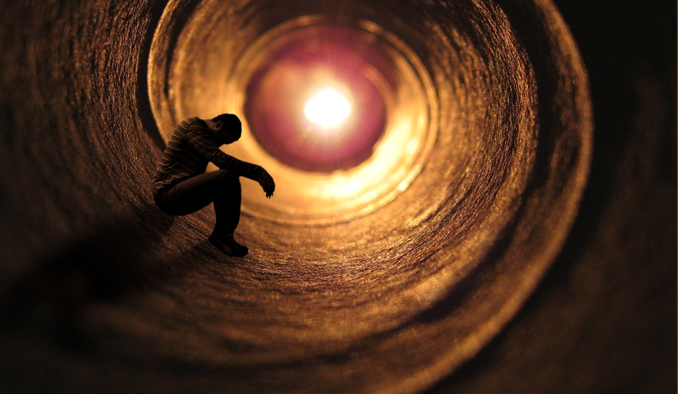
God’s power vs.
Satan’s power vs.
Human power

Slide 34
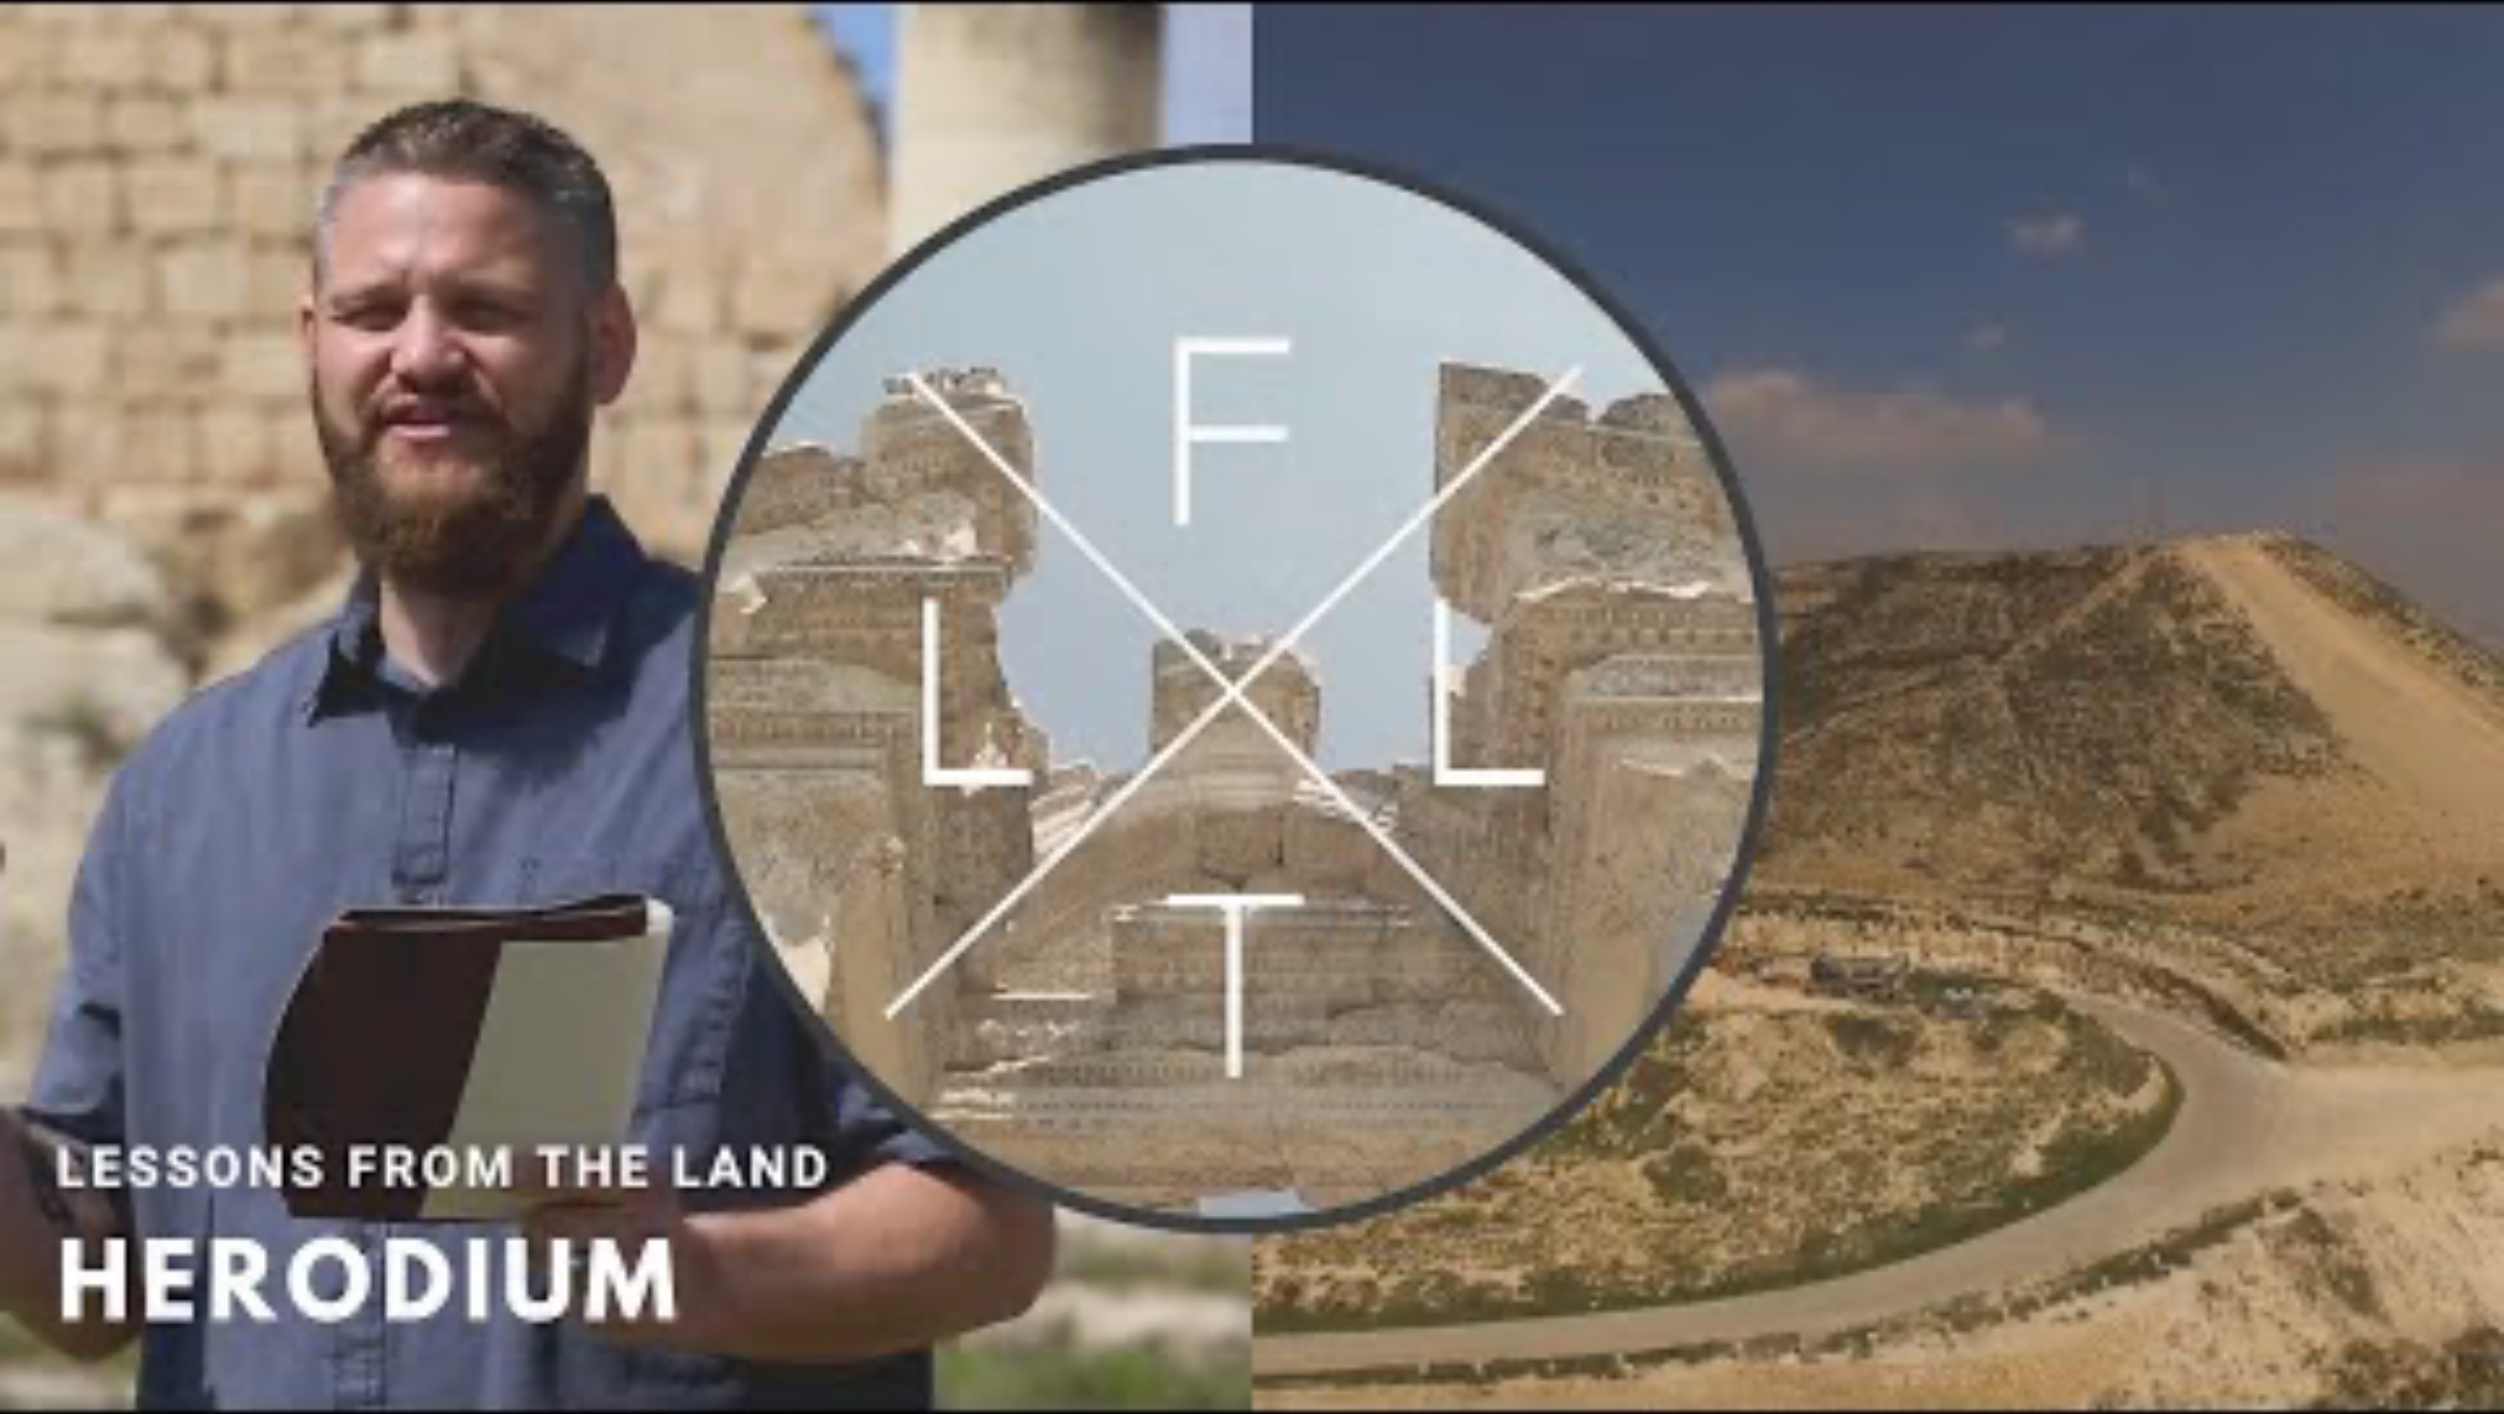

Slide 35
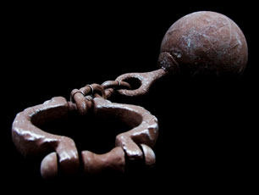


1. You must choose the master of your life
2. Is God’s power real?
3. The power within you

Slide 36

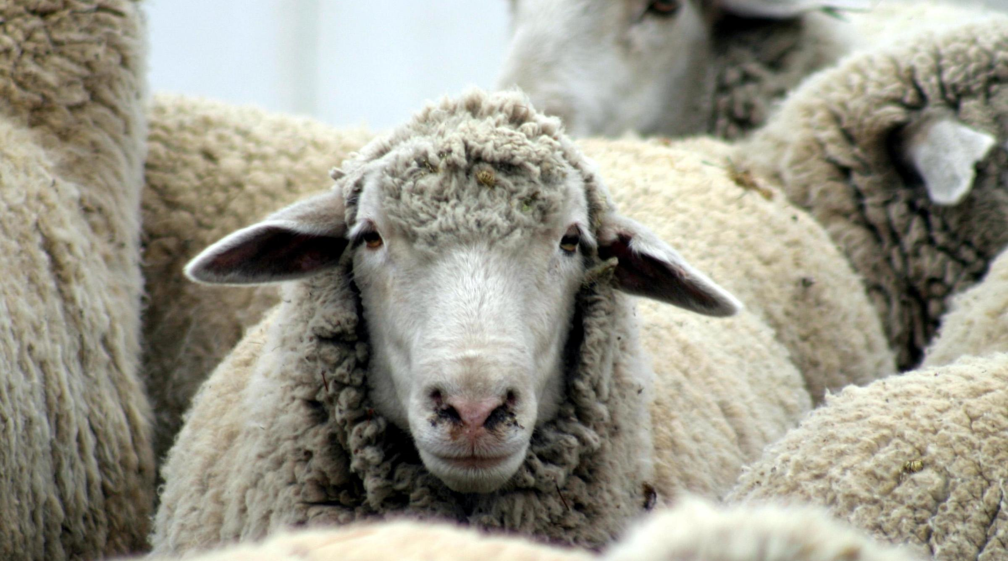

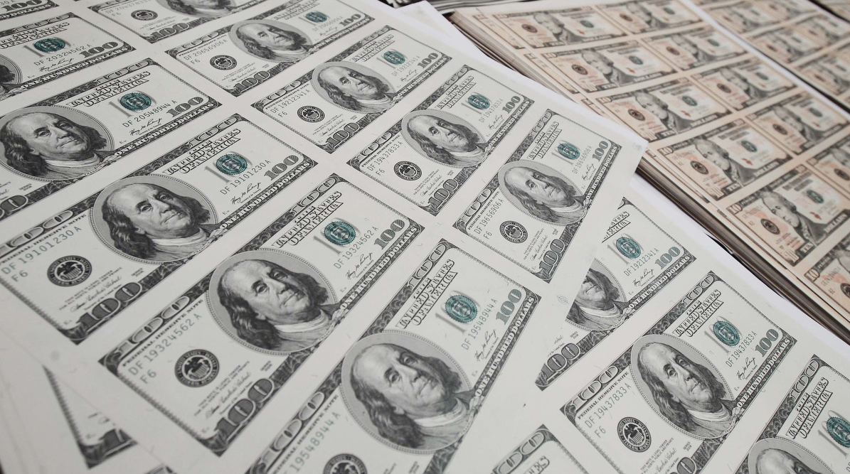
Satan wants to confuse you with counterfeit experiences
1. Satan has a counterfeit substitute for every good thing God has for your life
2. Faith vs. Presumption

Slide 37

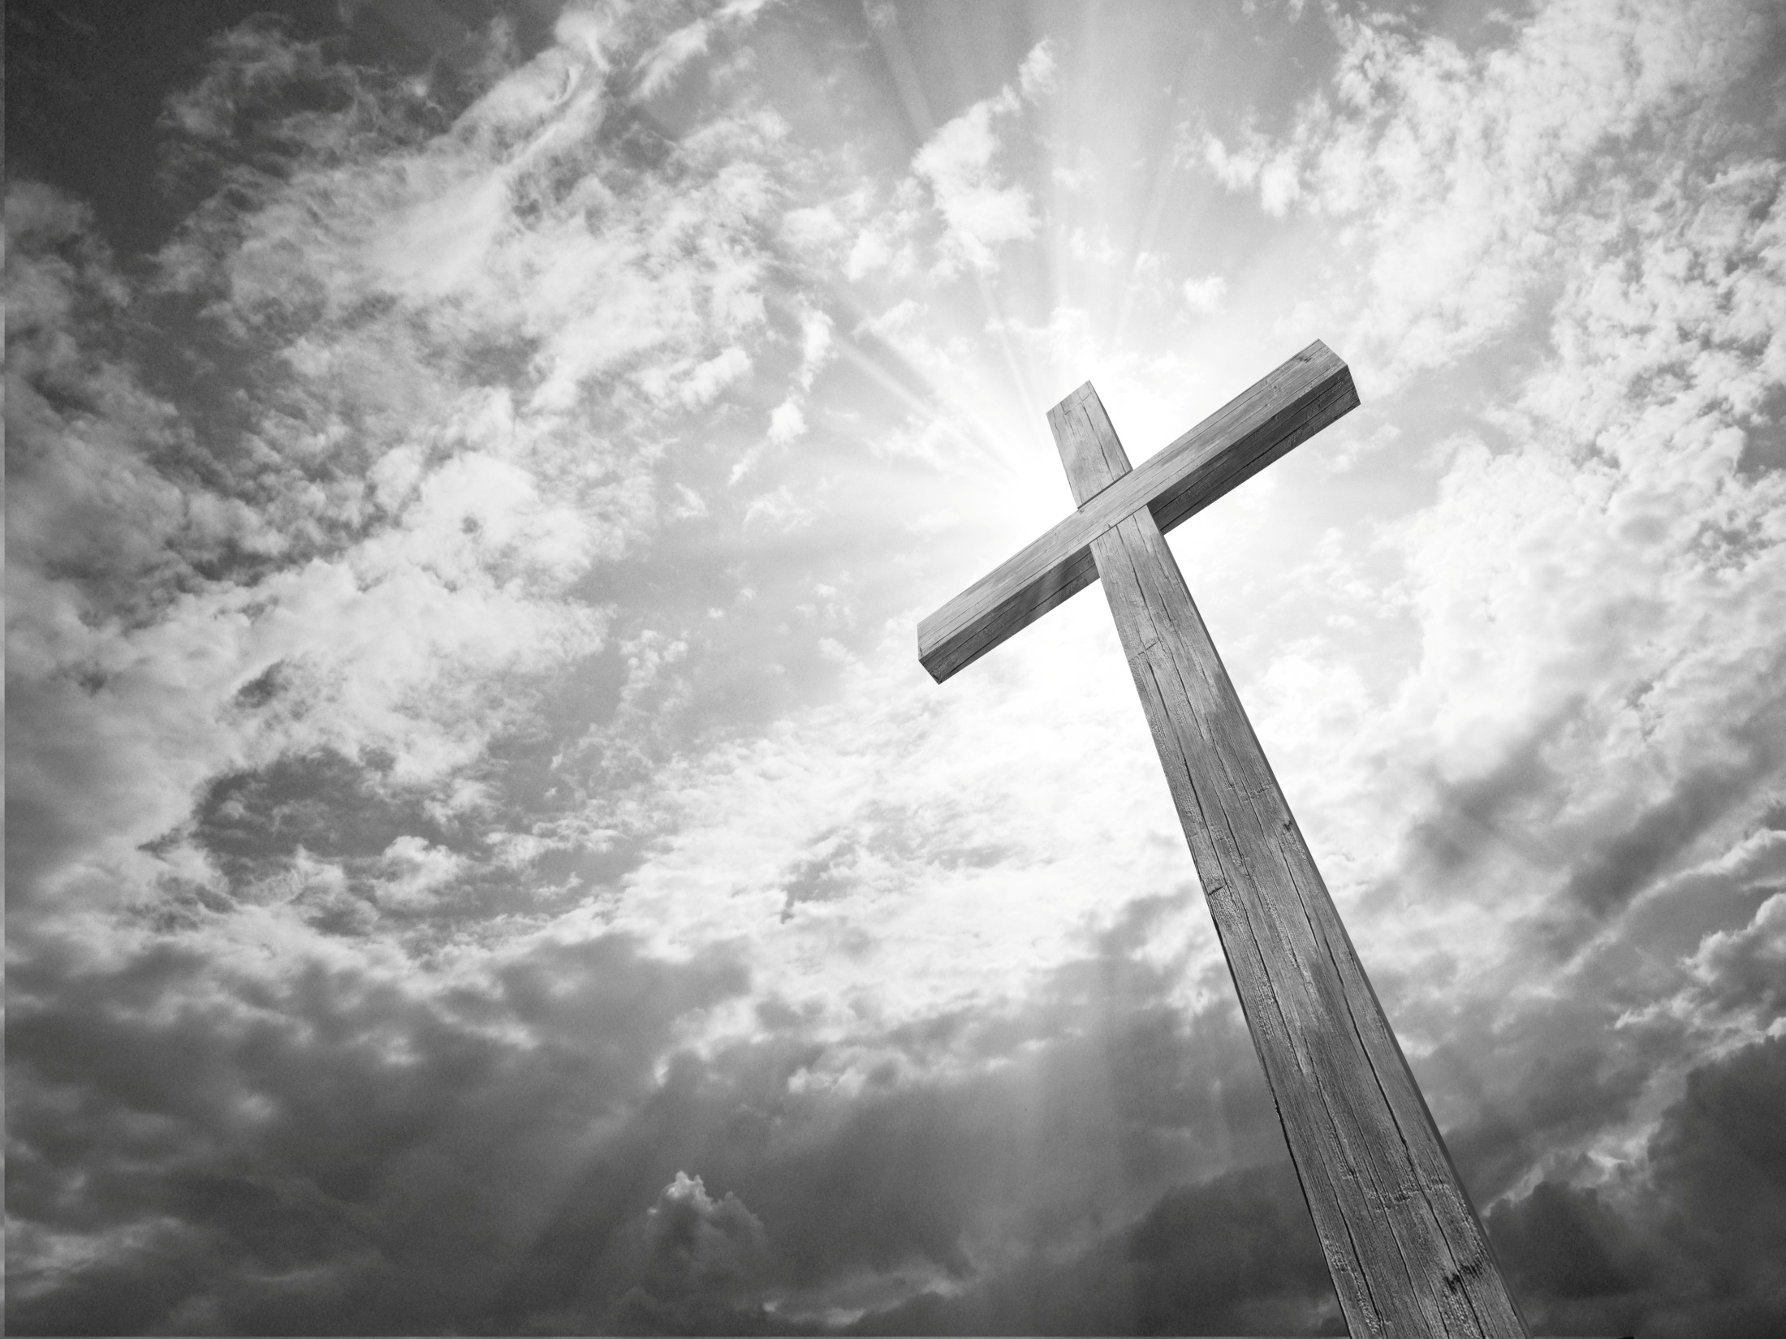
Errors in faith teaching today
1. Is there a difference between faith and belief?

Slide 38
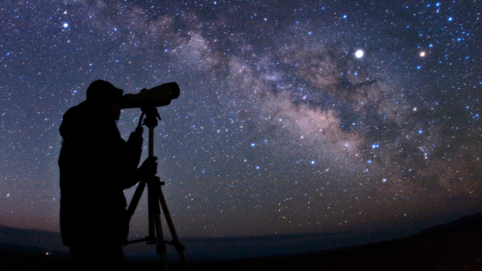
Belief- agreeing with the facts
Trust- having confidence in another person or thing
Hope- expecting something to happen in the future
Faith- a power from God that always leads to action

Slide 39

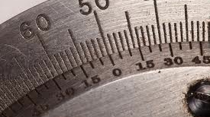
Errors in faith teaching today
1. Is there a difference between faith and belief?
2. Faith words are locked into knowledge of God’s Word
3. What is faith action?

Slide 40

Errors in faith teaching today
4. Doubt and negative confessions
5. Is using medicine wrong?
6. Is God bound to the words in the Bible?

