Slide 1


Strategic Planning for
Business Growth
From Vision to Action
March 11, 2026
© 2026 UBI Business Consulting LLC
Notes:
Welcome everyone.
What does the term strategic planning bring to mind?
Who here has participated in a strategic planning process?
Strategic Planning is a process.

Slide 2

Workshop Outcomes
OUTCOMES
The Importance of Strategic Planning
Identify Growth Stage
Clarity
  Vision
  Mission
  Values
Goals and Objectives
Understanding the Process
  Prerequisites
  Execution
Notes:
Why strategic planning matters and how it will help you out in growing your business.
Why identify the growth stage? Because not all things are good to implement from the get go.
Clarity is essential for decision making, and critical for any planning effort.
Strategic planning is a tool, a process to keep everyone focused on achieving results.
We’ll review some prerequisites that help guide the process and go thru steps that help execute strategic planning.

Slide 3

Why Strategic Planning Matters
WHY
Ending Business Drift
Notes:
Relate the Alice in Wonderland story
Which path should I take?
Where do want to go?
I don’t know.
Strategic planning answers the “where do you want to go question which will help guide you to selecting the best path to go down.

Slide 4

Why Strategic Planning Matters
WHY
WHY
Ending Business Drift
Creating Clarity
Notes:
Strategic planning allows everyone in the organization to see the same future.
Without a strategic planning how can you tell everyone is even looking in the same direction, let alone seeing what you see on the horizon.
(Consarc story)

Slide 5
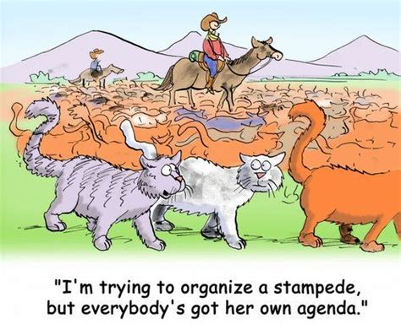
Why Strategic Planning Matters
WHY
WHY
Ending Business Drift
Creating Clarity
Enabling Alignment
Notes:
When everyone sees the same future and is privy to the strategies, plans, goals and objectives, alignment of efforts is easy to achieve.

Slide 6
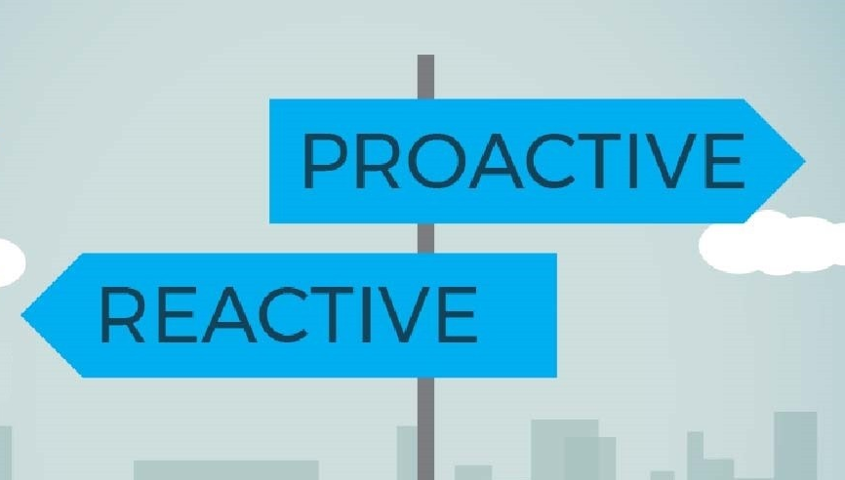
Why Strategic Planning Matters
WHY
WHY
Ending Business Drift
Creating Clarity
Enabling Alignment
Planning vs. Reacting
Notes:
Having strategies in place to meet goals and objectives is the transition from react and respond mode to proactive planning mode.
React and respond mode, while essential in the beginning is not a scalable mode of operation.

Slide 7


Why Strategic Planning Matters
WHY
WHY
Ending Business Drift
Creating Clarity
Enabling Alignment
Planning vs. Reacting
Turning Effort Into Progress
Notes:
Strategic planning is the tool that your organization uses to bring to fruition Aristotle’s observation that “the whole is more than the sum of the parts”. It ends the feeling of being busy all day and no sense of accomplishment.

Slide 8
Workbook Time
Take a few minutes to complete Section 1 of the Workbook.
After we will delve into where you are at in the typical company growth stages.

Slide 9

Company Growth Stages
Growth Stage
Startup / Survival
Notes:
This is typically the me, myself and I stage.
A lot of time is spent in generating awareness and interest. Know-Like-Trust
Even tho you may have a Vision and Mission in your mind, you still operate more in react and respond mode
Why? Because cash flow is the objective.

Slide 10

Company Growth Stages
Growth Stage
Startup / Survival
Stability
Notes:
After you have survived all the firefighting, the unknowns, the gotchas.
You have developed a routine that you operate in and begin to feel like you have the bases covered.
You’re probably still small enough that personal interaction with your employees is enough to gain alignment, ensure clarity, set directions, and see some progress.
Owner dependency is still very high, with the owner making nearly every decision.
This is the stage that you start dreaming about, contemplating and planning for growing the business.
This is the stage that Vision, Mission, and Values become extremely important to avoiding Business Drift
It is also the stage that many owner/founders stagnate. They avoid proactive planning for the much more familiar react and respond.

Slide 11
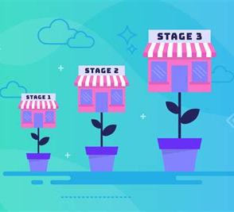
Company Growth Stages
Growth Stage
Startup / Survival
Stability
Growth
Notes:
This is a time when delegation to department heads/supervisors is critical to freeing up time for the owner/founder to work on the business instead of in the business.
At the beginning of this stage the owner/founder is calling the shots relative to direction and doing all the business planning solo.
Communicating goals and plans to key individuals is probably happening.
Growth can still be hit or miss, depending on how effective you are in your planning efforts, and how much you are actually delegating.
This is the stage where some form of strategic planning is implemented.

Slide 12
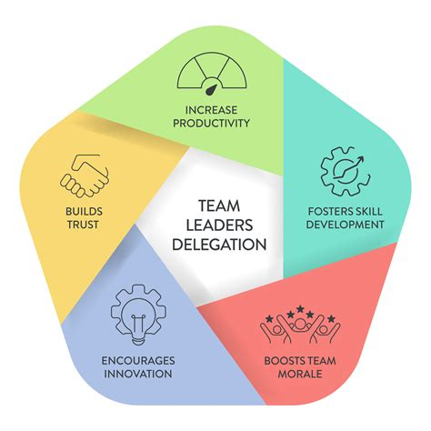
Company Growth Stages
Growth Stage
Startup / Survival
Stability
Growth
Maturity / Optimization
Notes:
This is where departments, divisions etc. typically have autonomy and authority.
A robust budgeting process is probably in place.
Strategic planning is in place, and essential to ensure that autonomy and authority are not only aligned with the Vison Mission Values, but also that budgets, tasks and schedules all support the Goals and Objectives of the organization.

Slide 13
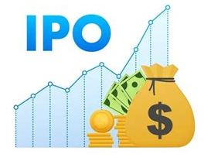

Company Growth Stages
Growth Stage
Startup / Survival
Stability
Growth
Maturity / Optimization
Transition / Exit
Notes:
Sale of the company to a competitor or complementary company (talk about Applied Energy Systems)
It could be a generational transition of ownership/leadership (talk about Skyline Products)
It could be that the company is happy where its at and how its operating and just stays in that lane
This stage is where it can all fall apart, or move to even bigger and better things, such as getting venture funding for exponential growth or going public.

Slide 14
Workbook Time
Take a few minutes to complete Section 2 of the Workbook.
After we will delve into the importance of Vision, Mission, Values, Goals and Objectives and how they play into strategic planning.
Notes:
Show of hands…
Startup/survival
Stability
Growth
Maturity/Optimization
Transition

Slide 15
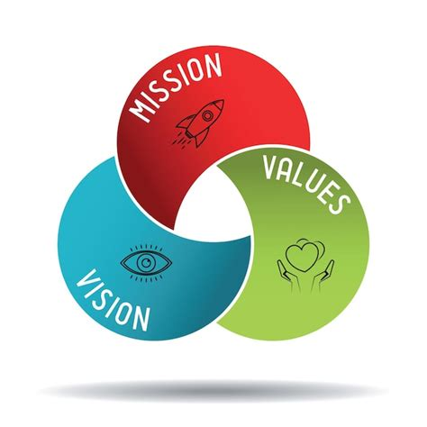
Vision, Mission, Values, Goals, Objectives
VMVGO
Vision
Mission
Values
Goal 1 Goal 2 Goal 3
Objectives Objectives Objectives
The Strategic Planning Process
Notes:
No matter where you are on the growth curve, you can only benefit from having good Vision Mission Values in place.
The pyramid represents how goals and objectives are supportive of your Vision, Mission and Values.
If you can’t align goals and objectives to something in your Vision, Mission and Values, they will eventually lead to misalignment and drift. (United Airlines)

Slide 16
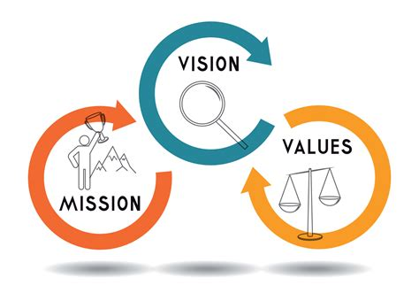

Vision, Mission, Values, Goals, Objectives
VMVGO
Vision – Mission - Values
  Provides Direction
  Typically Long Range
  Meaning Based
…
Dec
Jan
Feb
Mar
Apr
May
…
…
2032
2033
2034
2035
2036
2037
…
Teamwork
Trust
Innovation
Notes:
They work hand in hand to guide not only the direction the company will take, they will also influence nearly every decision made regardless of where in the hierarchy that decision is being addressed.
How it works? Asking how that decision will support Vision, Mission and Values supports alignment in your organization.
Your Vision, Mission and Values should hold true regardless of the stage your company is in or is transitioning through.
Doesn’t mean your company’s Vision Mission and Values can’t or won’t change but that should not be something that happens often. (Lift Jack anecdote)
They should mean something to you, should reflect who you are as a person, your expectations of the future and what you expect from your employees.
Your Vision, Mission and Values
- reviewed by all in your company on a regular basis to enhance alignment and minimize drift. (Raytheon)
- used to vet new hires to enhance alignment and minimize drift. (Plant)
- when published become one of the first ways customers or clients get to know-like-trust you and your brand. (Surface Science anecdote)

Slide 17
Vision, Mission, Values, Goals, Objectives
VMVGO
AI Assistance
I started a window cleaning business. I believe that clean windows are important to maintaining a positive outlook on the day, and more people with clean windows means more positivity in the world. I value honesty, integrity and thoroughness. Can you write me a Vision statement, Mission statement and Values statement that reflects me and my company.
ChatGPT

Slide 18

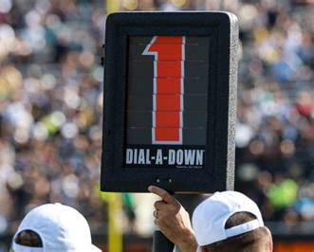
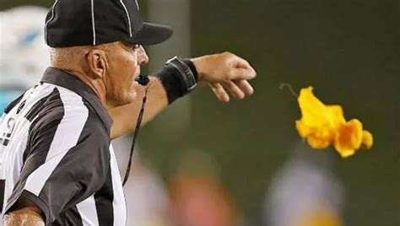

Vision, Mission, Values, Goals, Objectives
VMVGO
Goals - Objectives
  Map Progress
  Provide Accountability
  Measures Success
Notes:
Growing your business can be viewed as a project utilizing typical project management tools.
Anyone familiar with PMI, the Project Management Institute?
Goals and objectives need to be identified and put on a timeline.
Tracking progress in meeting those goals and objectives helps with alignment and clarity, as well as completion on time and on budget.
Again with project management in mind, assigning responsibility to meet objectives and periodically reporting on progress facilitates accountability. (AES anecdote)
Goals and objectives without accountability is really just wishful thinking.
Remember that in general, people pay attention and work on things that are publicly tracked. (days since last injury)
Having goals defined, and objectives determined, all with targeted dates for completion, allows you to measure and track your success in reaching your goals.
Like the pictures, in football, the vision is winning the Superbowl, the mission is excellence in all facets of the game, the goal is to win the game you’re playing, the objective is to score more points than your opponent, the strategy is threefold, more takeaways, fewer penalties, and a game plan exploits the opponent’s known or perceived weaknesses.

Slide 19
Workbook Time
Take a few minutes to complete Section 3 of the Workbook.
After we will dig into Strategic Planning

Slide 20


Strategic Planning
Strategic Planning
It’s a Process
  Individual
  Group
  Shorter Term
  Longer Term
Broad Focus
  Sales Increase
  Operations Efficiency
Notes:
Strategic Planning is a process to identify the goals and objectives to grow your business, develop strategize and execute plans that results in meeting those goals and objectives.
Depending on your growth stage it can be an individual or group effort.
Strategic Planning can be applied to the business as a whole, a department or a specific function.
It is traditionally focused on longer term goals but can be applied to shorter term goals as well.
The “strategic” part of strategic planning is that all facets of your organization are involved in setting the goals, objectives and strategies that support the long-term desires outlined in your Vision/Mission.

Slide 21
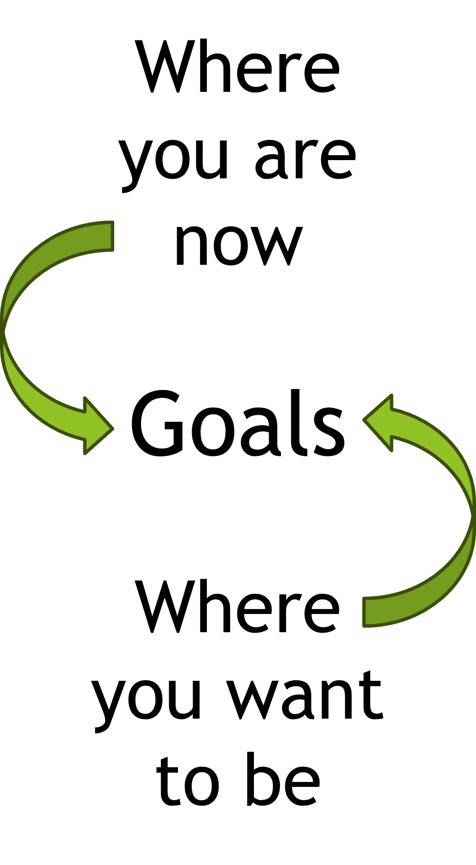
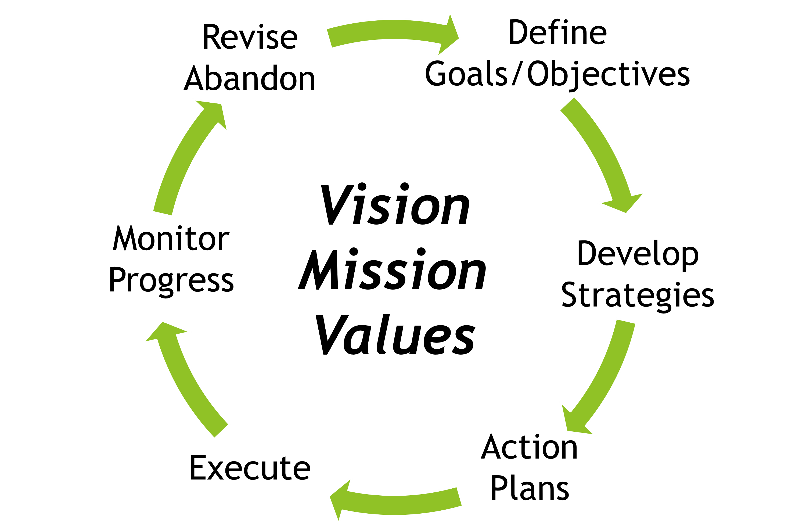
The Process
Strategic Planning
An iterative process
A “team” effort
Based on analysis of both internal and external data
Applied to any goal
Effective facilitator is a must
Notes:
You have linear processes in your organization
-Sales process takes it from a contact to a PO.
-Operations takes it from a PO to shipping.
-Accounting takes it from an invoice to money in the bank.
These are all pass-through processes. Strategic planning is a continuous process that facilitates the planning and execution required to meet your objectives and ultimately your goals.
You develop goals by assessing where you are now and defining where you want to be. The deeper you assess where you are, compared to where you want to be will bring clarity to goal setting.
The process starts with the top 1-3 goals you determined from analyzing where you are and where you want to be. Gap analysis.
Develop and prioritize strategies to achieve your goal. There are 10 viable ways to accomplish anything, some cost less, some are quicker, some are short term and some are long term.
Strategies are team efforts. Discussing the various strategies with all perspectives participating will lead to the best 2 or 3 becoming evident to all.
Actions are individual or departmental efforts. (Engineering anecdote, define by committee design alone)
Develop action plans that support your top strategy
Execute the action plans
Metrics and reporting is necessary to gauge level of success. Monitor performance and review results as a group.
After the agreed upon time decide if you want to tweak the strategy/plan, abandon that strategy and pick the next one, or call it completed and pick the next goal.

Slide 22
Implementing Strategic Planning
Strategic Planning
Prerequisites
  Clear Vision, Mission, Values shared with all in the company
  Decide on the Team
    Just Owner/Founder
    Owner/Founder and Ops/Office Manager
    Ideally all departments are represented
Notes:
We’ve reviewed the importance and purpose of having clear Vision, Mission and Values statements. It is in words what is important to you and extends to your company. Its is the basis of Clarity and Alignment
There is no reason why the sales manager, ops manager accounting manager and HR manager cannot also be in the strategic planning ‘department’ with the GM or Owner/Founder as strategic planning manager.

Slide 23
Implementing Strategic Planning
Strategic Planning
Phase 1 Team Meeting(s)
  Discuss and agree on where you are now and where you want to be.
  Record/save everything
Notes:
You can’t plan a trip if you don’t know where you’re starting from and where you want to go. Same with your business.
Analysis of where you are includes all the usual things every owner/founder tracks like revenue & profitability, It should also include where you are good and where you aren’t. These can be everything from internal processes to market segment performance, to reputation in the market. Could include manpower loading, efficiencies, scrap rate, warranty returns, bad reviews.
Done as a group, defining where you want to be both internally and externally provides clarity and enhances alignment.
Knowing where you’re doing good and where you aren’t prevents killing the healthy chicken to make soup for the sick chicken.

Slide 24
Implementing Strategic Planning
Strategic Planning
Phase 2 Team Meeting(s)
  Generate a list of Goals
  Define Objective(s) to reach each goal
  Prioritize for implementation
  Record/save everything
Notes:
Discuss the reasons why you aren’t now where you want to be.
Start brainstorming some goals that will address the now and future discrepancies.
Define the shorter term or supporting objectives that will support reaching the goal.
Alignment with Vision Mission and Values helps weed out the off the wall stuff.
Prioritizing will identify your top goal to tackle first and which to work on next when you reach that goal.
Resource limitations will tell you that you can’t do it all at once, minimizing what you work on helps with alignment. This shouldn’t limit you in the number of goals you want to achieve, it simply puts the goals in priority order starting with most beneficial or what needs to be done first to support longer term goals
When everyone has input, all viewpoints are heard and considered, which helps with buy in.

Slide 25
Implementing Strategic Planning
Strategic Planning
Phase 3 Team Meeting(s)
  Brainstorm various strategies for each goal
  Get them all down on a white board
  Discuss and agree on a ranked short list
  Assign a lead for each goal/strategy
  Save everything
Notes:
Nothing is out of bounds. Free flow of consciousness. Reason is, one idea might spark someone else to offer a better one.
Develop a list of strategies This is where you can use the ‘how does this fit into our vision mission values?’ to quell emotional responses.
Prioritizing will identify your top 3 and what to work on next if the decision is to abandon.
Save all the work. You have a lot of time (money) invested in strategic planning meetings and if you eventually abandon a strategy for whatever reason you want to quickly pick up where you left off and decide if the remaining strategies are still viable without starting the process from brainstorming.

Slide 26
Implementing Strategic Planning
Strategic Planning
AI Assistance
I started a window cleaning business. I am struggling with gaining awareness and building my contact list and client list. Can you suggest a few strategies I might use to overcome these issues. I have a small marketing budget but do have plenty of time to dedicate to these issues.
ChatGPT

Slide 27
Implementing Strategic Planning
Strategic Planning
Phase 4 Goal/Strategy Leads
  Responsible for the action plan
  Oversees execution
  Collects/compiles data
  Presents status to the team during regular meetings
  Typically, it’s the department manager
Notes:
The goal/strategy lead is typically the cognizant department head. If its company-wide it would be the GM or owner/founder

Slide 28
Implementing Strategic Planning
Strategic Planning
Phase 5 Quarterly Meetings
  Quarterly is frequent enough
  Review reports from Goals/Strategies leads
  Continue/revise/abandon
  When a goal is reached, move to the next goal and repeat the process
Notes:
Strategic planning is a long game. Quarterly meetings give time to collect meaningful data and over time show trends that help with the continue/abandon decision.
As you work with any strategic planning process the more you do the quicker it goes. So the time sink that it was to implement diminishes.

Slide 29
Workbook Time
Take a few minutes to complete Section 4 of the Workbook.
Story time….

Slide 30
In Closing…
Strategic Planning
“While the worriers are worrying, the planners are planning and the accountants are figuring out why we can’t afford it, I’m busy getting started.“
-Walt Disney
Visionary/Manager
You don’t drive a horse
Not ready yet? Be aware of when you are being strategic and when you are being reactive
Notes:
Are you as owner/founder a visionary or manager? Every company that wants to grow needs both.
It can, and often is the same individual in the survival and stability stages.
A strategic planning process can be very helpful when you are filling both roles.
Strategic planning can shorten the time it takes for the horse and rider to become one.
The takeaways….
You are never too small to benefit from good Vision, Mission and Values statements.
If you aren’t ready to implement a strategic planning process, be cognizant of the difference between strategic & proactive, vs reacting and responding.

Slide 31

Strategic Planning
Notes:
Any questions?

