Slide 1
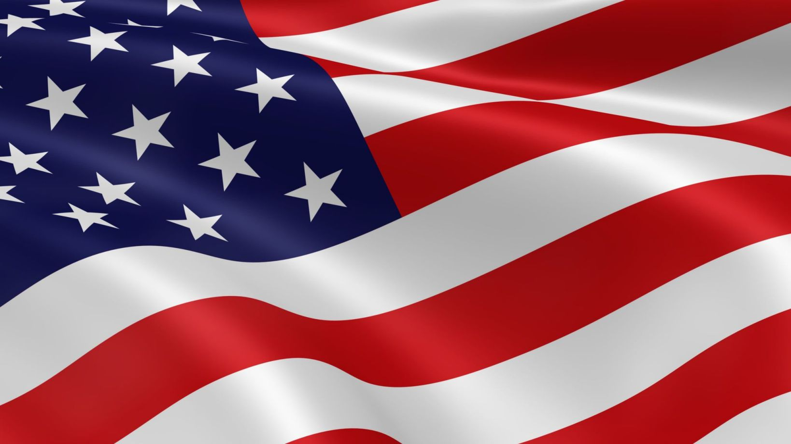
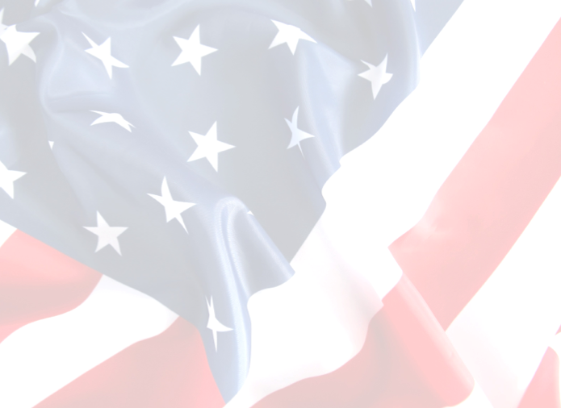





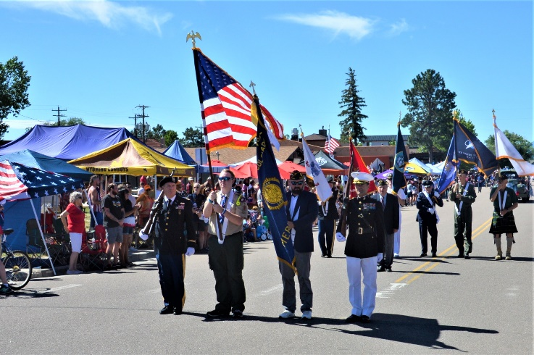


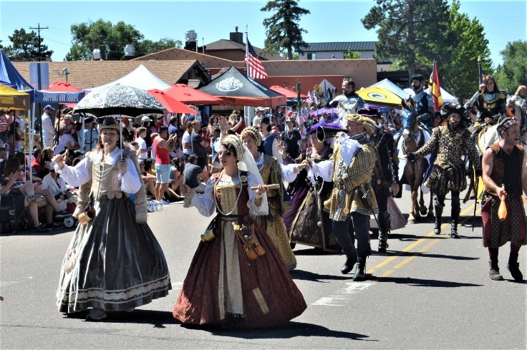
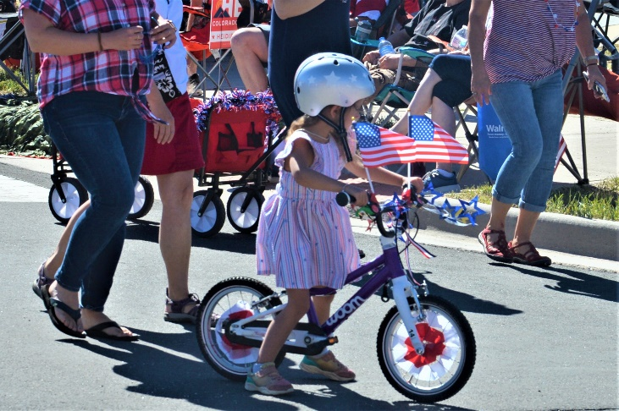
Schedule of Events
Sponsors
An Independence Day Celebration
250 Years of Freedom; 150 Years of Colorado Statehood
Saturday, July 4, 2026
7:00 am – Palmer Lake Fun Run
at Palmer Lake – July4FunRun.com
7:00 –10:00 am – Pancake Breakfast
St. Peter Catholic Church – Monument
Tickets at the door
8:00 am – 3:00 pm
Tri-Lakes Chamber Street Fair
2nd St. and Washington St. - Monument
Air Academy Credit Union**
All American Gutter Protection
Apex Waste Solutions
bellwether homes
El Paso County Sheriff
Force Broadband**
High Valley Roofing**
Home Depot
Line-X**
Mountain View Electric Association**
Mutt Masters K9 Academy**
Palmer Ridge HS Football Team
Pikes Peak Business Lending**
The Gazette/Tri-Lakes Tribune
Tri-Lakes Printing
Woodmen Valley Chapel – Monument
** Platinum/Gold Sponsors for the Tri-Lakes Chamber of Commerce
9:45 am – 10:00 am
Monument Hill Kiwanis Children’s Parade
10:00 am – 12:00 pm
Monument Hill Kiwanis 4th of July Parade
11:00 am – 5:00 pm
Family Friendly Beer Garden
Tri-Lakes Chamber of Commerce
Limbach Park, Monument
11:30 am – 5:00 pm
Live Music, Limbach Park
Bus Information
ALL PARKING AT
Lewis-Palmer High School
Buses FROM Parking - 7:30am - 9:45am
LAST BUS: 9:45am
Buses TO Parking - 12:30pm - 3:00pm
LAST BUS Back: 3:00pm
4:00 pm – Festival on the Fourth
At Palmer Lake
9:15 pm
Town of Palmer Lake Fireworks
Display
(weather and fire restrictions permitting)
Saturday, July 4, 2026 in Historic Downtown Monument, Colorado

Slide 2

North
PUBLIC PARKING
Lewis-Palmer
High School
1300 Higby Rd
Buses Depart
7:30am - 9:45am
Buses Return
12:30pm - 3:00pm
CO 105
Frontage Rd
Jackson Creek Parkway
I-25
CO 105
Exit 161
Van back to Woodman Valley Chapel at Bethesda Senior Center
Santa Fe Regional Trail
Parade START
Beacon Lite
ADA Parking
259 Beacon Lite
Old Denver
T
Lineup
Area
Lavelett Park
T
A
T
T
Monument
Police
Band & Horse
Assembly Area
Santa Fe
T
Adams
T
T
H
Big Red
T
T
CO 105
Santa Fe Regional Trail
T
MCPC
T
T
Jefferson
L
Palmer Lake Fun Run Finish
T
T
Franklyn
Chamber of
Commerce
T
St Peter
T
T
T
T
Washington
LEGEND
No Parking on Parade
Route – July 4th
3rd St
2nd St
1st St
Lincoln
Parade
Route
Spectator Bus
Drop off & Pickup
To Palmer
Lake
T
T
T
T
T
Street Fair
Search & Rescue
First Aid &
Lost Child
Parade Announcer
Front
T
T
Toilets
L
H
T
Limbach
Park
T
Handicap
Toilets
T
T
T
T
T
H
Music & Beer Garden
Railroad Tracks
Mitchell Rd

Slide 3
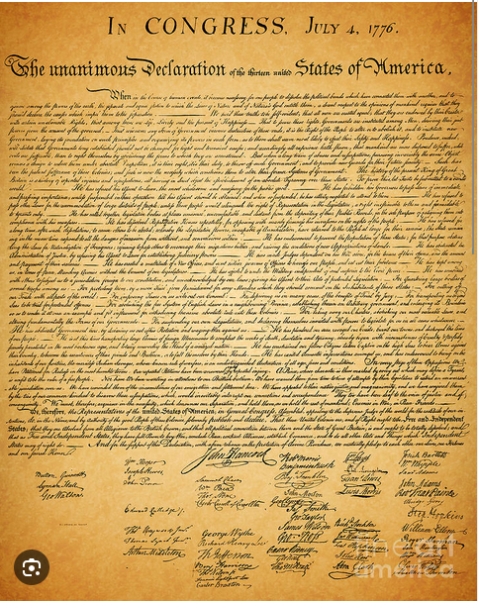




Our Parade
Gold Sponsors
250 Years of Freedom
150 Years of Statehood
38th U.S. state - August 1, 1876

