Slide 1

District Governor Orientation

Slide 2

Session Objectives
Demonstrate an understanding of district governor responsibilities
Access and take advantage of available resources
Develop strategies to aid in anticipated challenges and tasks

Slide 3
Responsibilities
Global Action Team Chairperson
LCIF & LCI service initiatives
Meeting management
Club support
Fiscal responsibility
Safeguard name and emblem

Slide 4

District Governor Online Resources

Slide 5
Benefits of Using Online Resources
Saves time
Saves money
Increases collaboration
Increases communication
Enhances organization

Slide 6
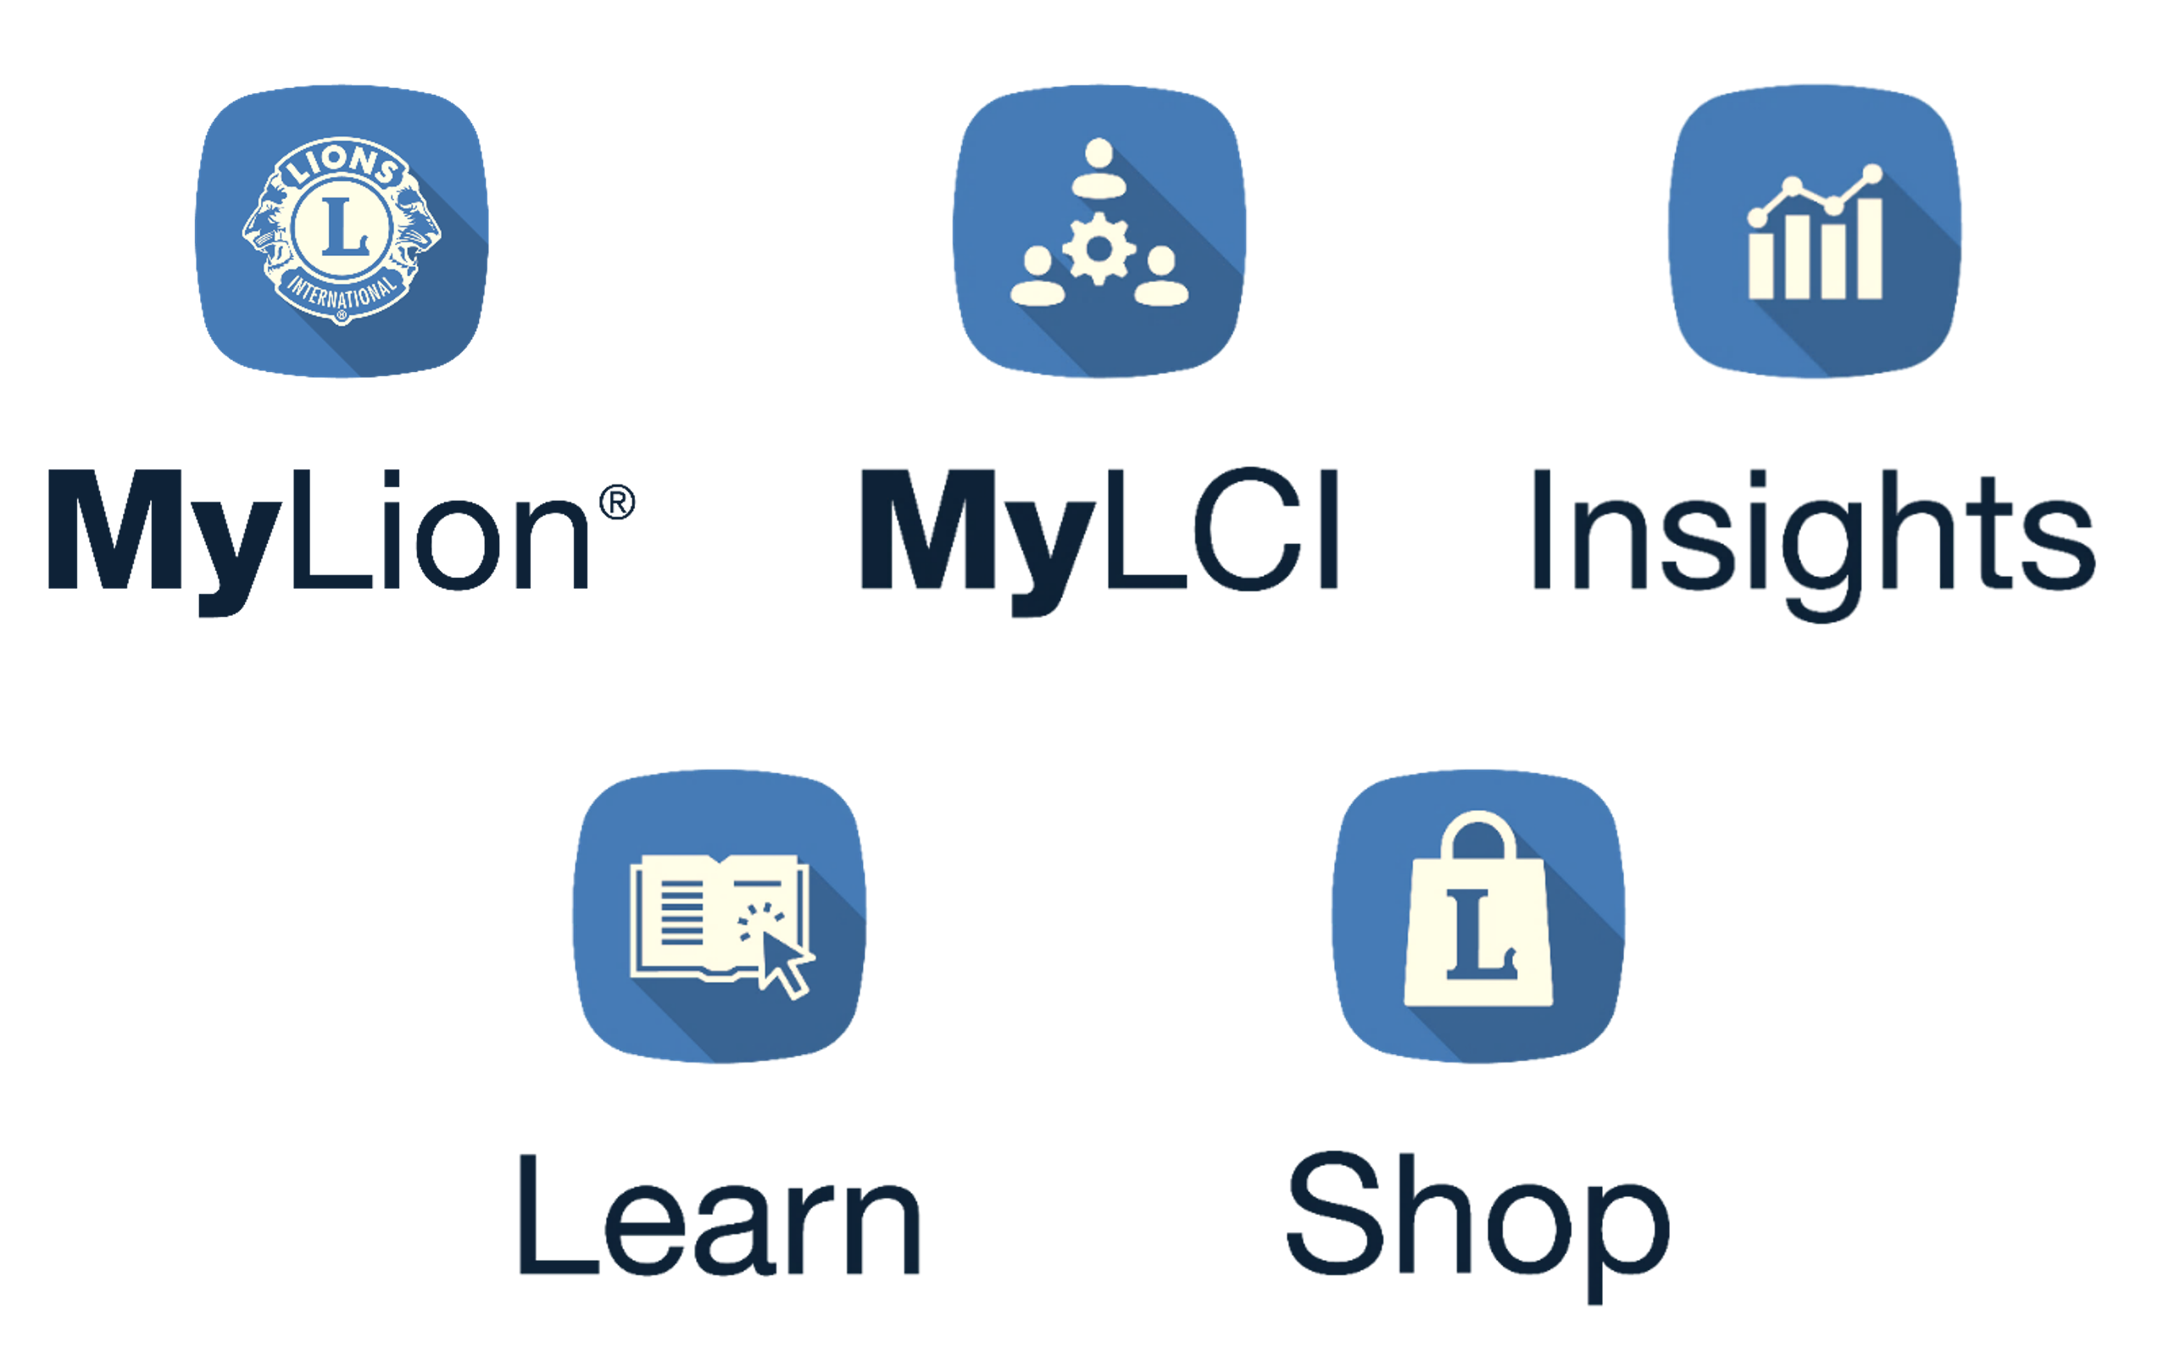
Member Portal

Slide 7


Report service
Plan projects
Connect with other Lions
Create personal profile

Slide 8

Track actionable tasks
Access club and district metrics
Run membership reports
Track district convention information

Slide 9

Explore membership trends
Explore club trends
View service activity impact
Monitor district goals progress
View Learn statistics

Slide 10

Take free online courses
Identify Lions Clubs International hosted institute offerings
View local training sessions

Slide 11

Order club essentials
Order awards, apparel and pins
Get great Lions gifts

Slide 12

Other Resources
District e-Book
Your fellow officers
Lions International website
Lions International staff

Slide 13
Planning a District Convention
Selecting committee members
Preparing teams
Choosing programs
Holding elections
Planning the event
Promoting the event

Slide 14
Activity: Planning a District Convention
Refer to pages 16-17
Consider what tasks are involved in each aspect of planning a convention
Consider who to delegate tasks to and any potential planning ideas
Be prepared to share

Slide 15

Public Relations
I wonder what really happened.
I heard there was more to the story.
I wish they would talk about what happened.

Slide 16
Handling Public Relations
Be prepared to communicate quickly
Show compassion and understanding
Do not lie or try to “spin” the truth
Share as much as possible
Be open for questions or concerns

Slide 17
Activity: Handling Public Relations
Review your assigned public relations event
Discuss how to address each question on page 19
Be prepared to share

Slide 18

New Club Guidance
District e-Book
Learning Opportunities or Events
Club Quality Resources
New Club Development
The Service Journey

Slide 19
Activity: New Club Guidance
Refer to pages 20-21
Review the District e-Book
Discuss advice what new club advice you can provide
Be prepared to share

Slide 20
Meeting Management Phases
Phase 1: Preparation
Developing meeting objectives, agendas and timelines
Phase 2: Facilitation
Providing information to and engaging attendees
Phase 3: Follow Up
Taking steps to ensure issues and action items are addressed

Slide 21
Activity: Meeting Management
Refer to pages 22-23
Review your assigned scenario
Consider actions you will take, advice you would give and/or recommended resources
Be prepared to share

Slide 22
Session Objectives
Demonstrate an understanding of district governor responsibilities
Access and take advantage of available resources
Develop strategies to aid in anticipated challenges and tasks

