Slide 1
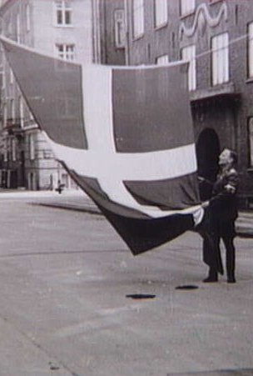
80 years of Light:
Danish Liberation Day
5.4.2025

Slide 2
The Darkness
After the German surprise attack on Denmark on April 9, 1940, the Danish people bore many difficult burdens under German occupation. Many ordinary things–food, clothing, candles, and more, became scarce.

Slide 3
The world of this peaceful land fell into a five-year period of darkness. The streets were deserted at night as no street lights were permitted. All Danish homes and buildings were required to have blackout curtains covering all windows at night, so as not to make targets for bombing. News from the outside world was limited as BBC radio broadcasts were suppressed.

Slide 4
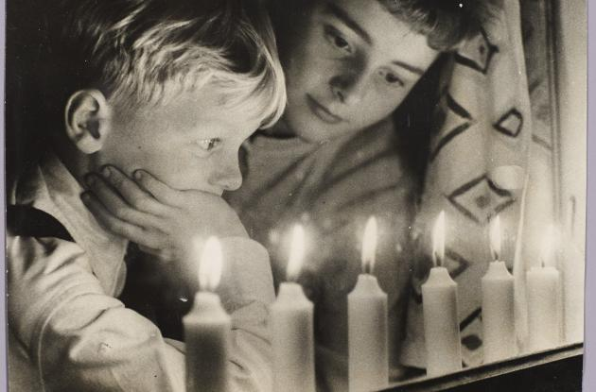
The Light
On May 4, 1945, at 8:35 p.m., in the middle of a British radio newscast, word came that German forces in The Netherlands, Northwestern Germany and Denmark had surrendered to British Field Marshal Bernard Montgomery. The Germans had fled Denmark!

Slide 5
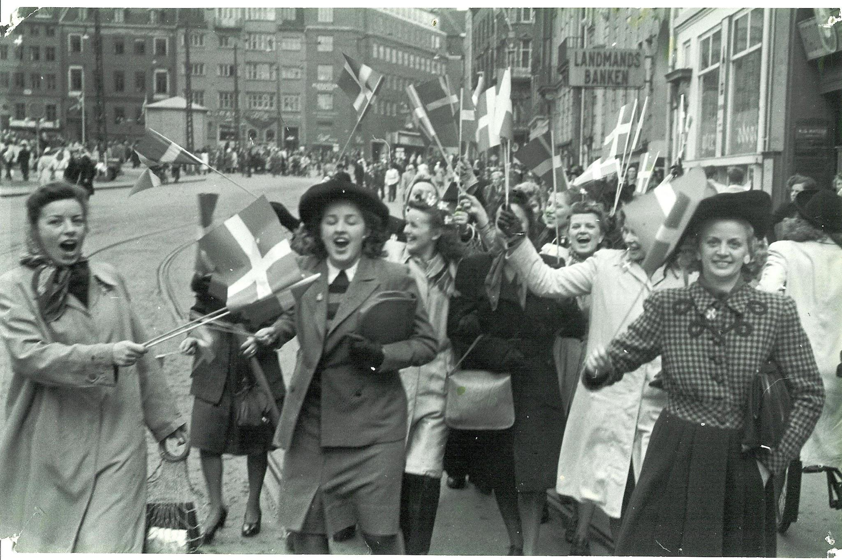
Word quickly spread as celebrating Danes flooded the streets. Some pulled down their blackout blinds and burned them in the streets, letting the light shine out of their homes once again.

Slide 6
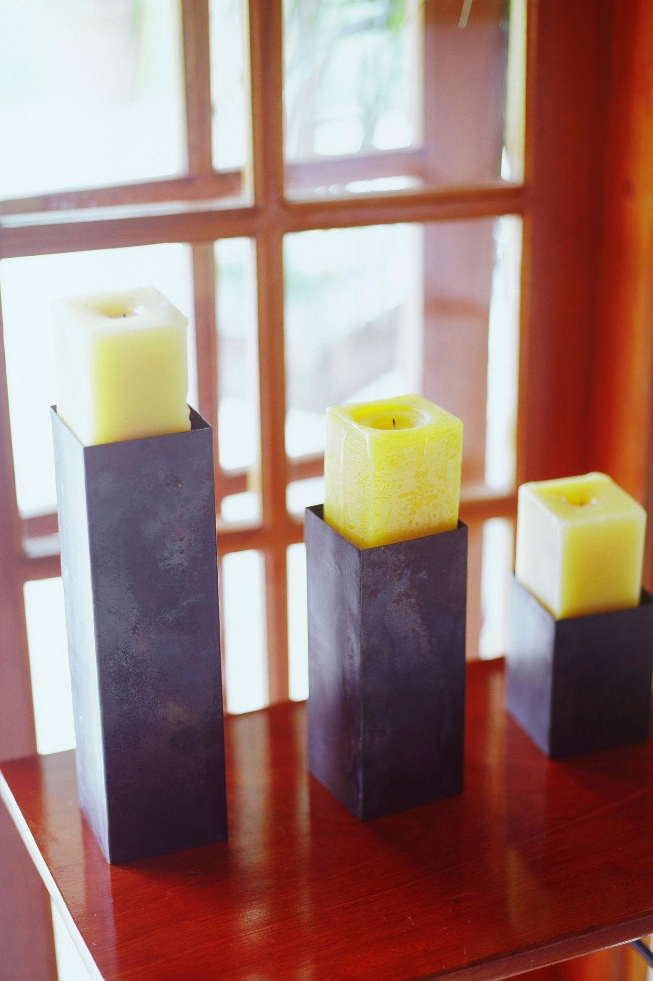
Candles in the Windows
After a time, candles and other goods became available again. To commemorate Denmark regaining independence, people began putting lit candles in their windows in the evening of May 4th.

Slide 7
80th Anniversary
For 80 years, the tradition of placing lighted candles in windows to commemorate the return of light on the anniversary of Liberation Day continues. Nearly 50% of all Danish households still observe this tradition.

Slide 8
Although Liberation Day is not a public holiday in Denmark, many museums and other historical organizations will hold commemorative activities including speeches, laying of wreaths, replaying of the radio announcement of German surrender, and exhibits of the times.
https://www.facebook.com/watch/?v=1940523689737825

Slide 9
“At this moment it is announced that Montgomery has stated that the German troops in Holland, Northwest Germany and Denmark have surrendered.”

Slide 10
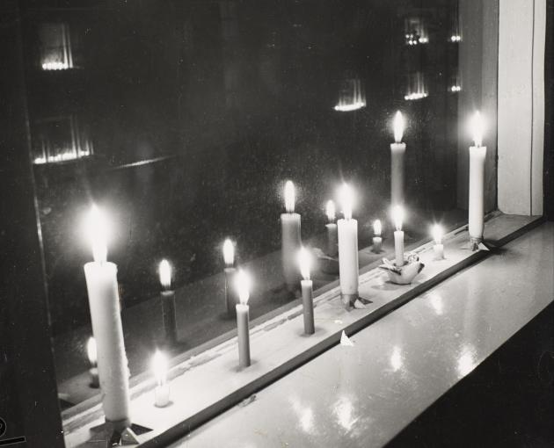
The average Dane burns roughly 13 lbs of candle wax each year, causing Denmark to be the leading consumer of candles in Europe.
With the population being about 5.8 million people, this means that the Danes consume 1.3 million candles every year!

Slide 11
Some Celebrations Today
King Frederik and Queen Mary and many members of the government attended a commemorative church service in Copenhagen.
Special church services were held in many places across the country.

Slide 12
Museums have special exhibitions set up to celebrate the 80th anniversary
Public places in many towns have speeches by government and other dignitaries
Jazz concerts are being held in Gilleleje

Slide 13
An interactive audio walk in being sponsored by Museum North Zealand in an area that was very active in the resistance
Tivoli Gardens has displayed special lanterns at the Bubble Fountain
Tivoli Youth Guard's band and color guard will lead a torchlight procession following a historic announcement broadcast

Slide 14
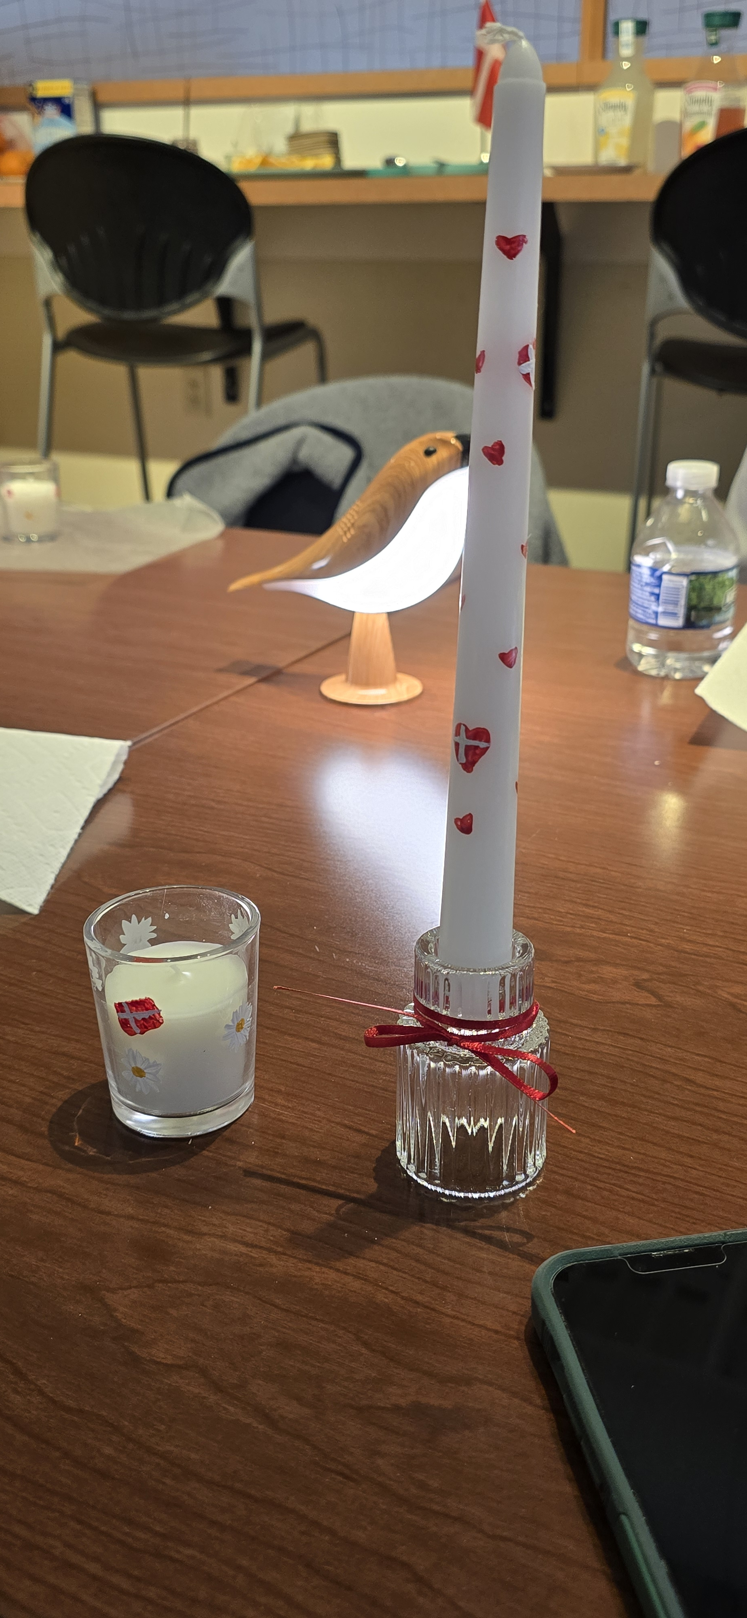
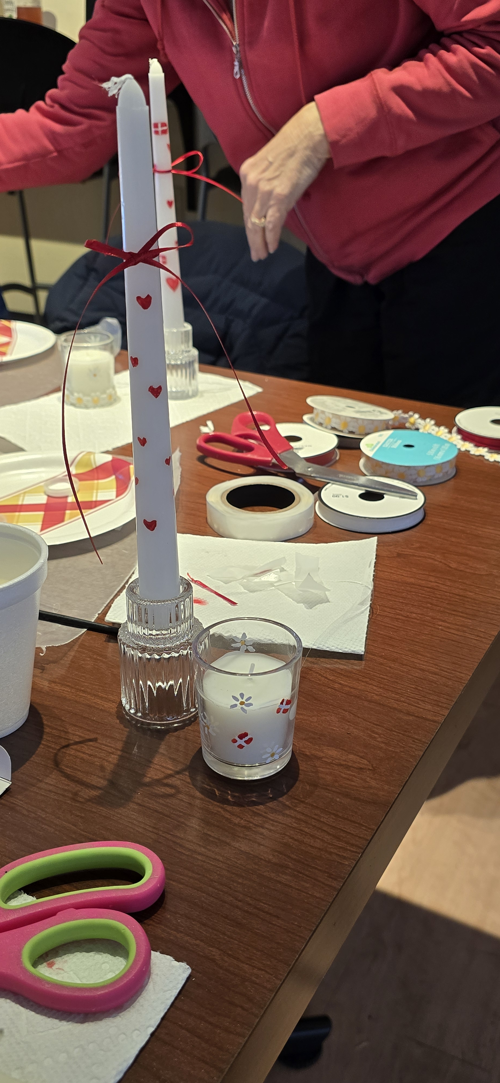
Activity: Candle Painting
Supply List:
- White taper candles
- Candle Holder
- Fine tip paint brush
- Non-toxic, water based acrylic paint color(s) of your choice
- Paper towel

Slide 15
Sources
https://visitdenmark.com
https://detgroennemuseum.dk/en/taste-the-occupation-period-and-celebrate-the-liberation/
https://en.wikipedia.org/wiki/Denmark_in_World_War_I
https://www.kb.dk/en/inspiration/liberation
https://www.kb.dk/en/inspiration/liberation/candlelight-windows
www.tivoli.dk
https://www.newmyroyals.com

