Slide 1

Anne O. Rice
SPEAKER PACKET
AnneORice@gmail.com www.AnneORice.com

Slide 2

Anne O. Rice
RDH, BS, FAAOSH, CDP
Oral medicine providers are an under-utilized effective healthcare field. The impact is not only patient’s oral wellness and overall systemic health but their future of cognitive health.
A clinical dental hygienist for more than 35 years, Anne Rice is a speaker, writer, and consultant specializing in oral–systemic health and dementia prevention. Oral Systemic Seminars was created in 2017, and her work now centers on advancing oral–systemic science, preventive care, and cognitive health.
A preceptor for the Bale/Doneen Method, Certified Dementia Practitioner, and Longevity Specialist with the Alzheimer’s Research and Prevention Foundation, she has also contributed to curriculum development in dementia prevention. Anne was named a Fellow of the American Academy for Oral Systemic Health and serves on its advisory board, along with several others. She recently joined faculty at The Institute for Functional Dentistry.
She has authored an oral–systemic health column for RDH Magazine for three years and, in 2024, received Sunstar’s Award of Distinction in the research category for her 2021 Frontiers manuscript, Alzheimer’s Disease and Oral-Systemic Health: Bidirectional Care Integration Improving Outcomes. Her work includes participation in an international consortium of brain researchers, clinicians, and institutions focused on Alzheimer’s prevention, and consulting collaborations with the Weill Cornell Alzheimer’s Prevention Clinic, Florida Atlantic University’s Center for Brain Health, the Atria Health and Research Institute, and the Institute for Neurodegenerative Diseases. .
AnneORice@gmail.com www.AnneORice.com

Slide 3

Anne O. Rice
RDH, BS, FAAOSH, CDP
SUGGESTED AUDIENCE
Dentist, Hygienist & Team
Suggested Format:
Partial Day, Lecture
Uniting Dentistry and Medicine to Reduce Alzheimer’s Risk
Alzheimer’s disease is one of the most pressing public health challenges of our time, demanding integrated approaches to prevention, care, and support. Although no single cause has been identified, a growing body of evidence shows that risk is modifiable through lifestyle, behavioral, and medical interventions.
Oral health has emerged as an independent and often overlooked contributor to Alzheimer’s risk. Conditions like periodontal disease, untreated caries, gingivitis, tooth loss, and chronic oral infections are consistently associated with increased risk and cognitive decline. Because oral disease is closely linked to other major Alzheimer’s risk factors—including cardiovascular disease, diabetes, and systemic inflammation—dental professionals are uniquely positioned to identify early warning signs and intervene.
KEY OBJECTIVES
Understand how heart health, hearing loss, genetics, insulin resistance, diet, exercise, and sleep, shape cognitive decline risk
Determine how existing dental care practices can be adapted to educate patients on the risk factors of and preventative measures against Alzheimer’s Disease
Identify “red flag” risk factors in medical histories and learn how dental professionals can intervene for meaningful impact
Realize relationships between tooth loss, implant restoration and failure, as related to cognitive decline
Explore the role of bacteria, yeast, and viruses in Alzheimer’s development
AnneORice@gmail.com www.AnneORice.com

Slide 4
Anne O. Rice
RDH, BS, FAAOSH, CDP
The Battle of the Microbiome: The Synergistic Relationship Between Oral Health and Nutrition
The phrase “You are what you eat,” often attributed to nutritionist Victor Lindlahr, reflects a fundamental truth: nutrition directly shapes overall health, including the oral cavity. Adequate intake of macronutrients and micronutrients is essential for immune function, tissue integrity, and microbial balance.
Periodontal disease is increasingly recognized as a manifestation of oral dysbiosis, marked by reduced microbial diversity, overgrowth of pathogenic species, and loss of protective commensals. As biofilms become more complex and antimicrobial resistance increases, conventional treatment approaches often fall short.
This presentation explores the relationship between nutrition and periodontal health, offering evidence-based strategies clinicians can immediately apply. Attendees will learn how dietary choices and targeted interventions can both support beneficial microbes and suppress
pathogenic ones, with focused discussion on vitamins,
xylitol, pH modulation, antimicrobials, essential oils,
xerostomia, and nitric oxide signaling.
KEY OBJECTIVES
Iidentify key vitamins and nutrients that support a healthy oral microbiome and periodontal tissues
Evaluate the benefits and unintended consequences of antimicrobial use on microbial balance
Explain how gingival inflammation alters the oral environment to favor pathogenic biofilms
Differentiate oral hygiene ingredients that may support healing versus those that hinder management of periodontal cases
SUGGESTED AUDIENCE
Dentist, Hygienist & Team
Suggested Format:
Partial Day, Lecture
AnneORice@gmail.com www.AnneORice.com

Slide 5

Anne O. Rice
RDH, BS, FAAOSH, CDP
Biofilm to Bloodstream: Oral Inflammation and Systemic Disease
One of the most important shifts in modern healthcare is the recognition that the oral cavity is not isolated—it is a biologically active gateway that directly influences systemic physiology. The oral microbiome plays a critical role in immune regulation, and when dysbiosis develops, its effects extend far beyond the gingiva.
Oral dysbiosis drives chronic inflammation, endothelial dysfunction, metabolic disruption, and neuroinflammatory signaling, and is increasingly associated with conditions such as hypertension, diabetes, obesity, cardiovascular disease, and cognitive decline. Factors including antimicrobial overuse, ultra-processed diets, reduced microbial diversity, genetic susceptibility, and recurrent bacteremia reshape the oral microbiome in ways that amplify pathogenic virulence and systemic risk.
This course examines the mechanisms linking oral dysbiosis to systemic disease, the virulence strategies of key periodontal pathogens, and the role of salivary diagnostics as an early-warning tool for whole-body health.
1 |
Identify the primary drivers of oral dysbiosis and the virulence mechanisms of clinically significant periodontal pathogens
2 |
Explain how shifts in the oral microbiota influence systemic diseases, including cardiometabolic and inflammatory conditions
3 |
Differentiate the biological pathways connecting oral infection, immune dysregulation, vascular dysfunction, and systemic disease
4 |
SUGGESTED AUDIENCE
Dentist, Hygienist & Team
Suggested Format:
Partial Day, Lecture
Understand the what and the why of salivary diagnostics, and how saliva reflects real-time inflammatory and immune burden
AnneORice@gmail.com www.AnneORice.com

Slide 6


Anne O. Rice
RDH, BS, FAAOSH, CDP
Beneath the Surface: Pseudomonas aeruginosa, Biofilm Warfare,
and Dental Implant Failure
Pseudomonas aeruginosa is a resilient, biofilm-forming opportunistic pathogen increasingly linked to dental implant failure. Its adaptability, antimicrobial resistance, and ability to thrive in dysbiotic environments make it a formidable contributor to both acute and chronic infections.
We’ll examine the role of P. aeruginosa in oral implantology—from its virulence mechanisms and biofilm behavior to its interactions with other pathogens and its contribution to peri-implant inflammation and bone loss. Integrating microbiology with clinical practice, we review current evidence on implant surface colonization, immune evasion, and pathways to implant failure, with emphasis on evidence-based prevention strategies, emerging antimicrobial approaches, and future directions to support long-term implant success.
1 |
Describe the biological and pathogenic characteristics of Pseudomonas aeruginosa.
2 |
Illustrate the processes of biofilm development, antimicrobial resistance, and immune evasion utilized by P. aeruginosa.
3 |
Evaluate clinical and laboratory evidence linking P. aeruginosa to peri-implant mucositis and peri-implantitis.
4 |
Apply current strategies for the prevention, diagnosis, and management of
P. aeruginosa-associated implant
complications.
AnneORice@gmail.com www.AnneORice.com

Slide 7
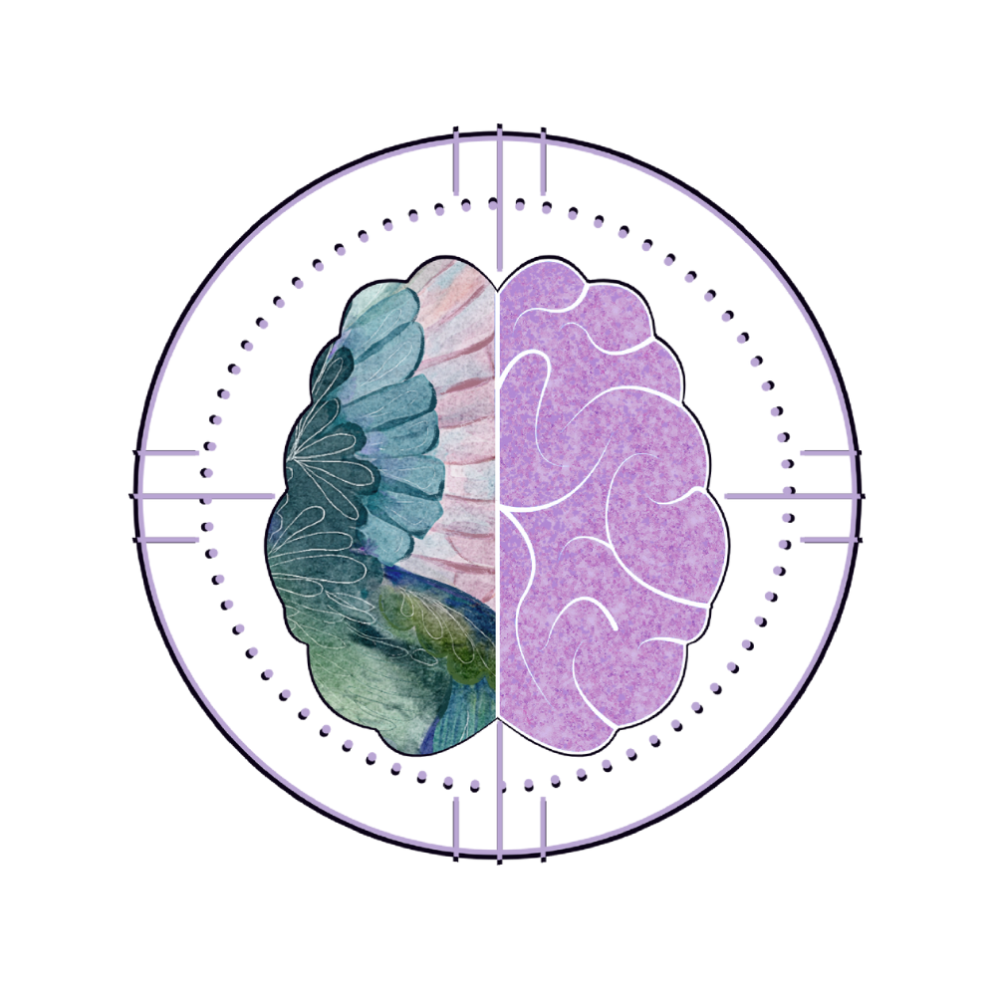
Anne O. Rice
RDH, BS, FAAOSH, CDP
Shhh… Solving the sleep loss epidemic
Although it might not be “sexy” news, getting a good night’s sleep is one of the best things we can do to improve our physical and emotional well-being. We spend 1/3 of our life sleeping and is proven to be of the utmost importance. The 2 most feared diseases throughout developed nations are cancer and Alzheimer’s Disease both of which are related to inadequate sleep.
Sleep revs up the immune system, fine tunes the balance of insulin and circulating glucose, regulates appetite and helps to maintain the microbiome of your gut. It is directly linked to cardiovascular health and lowers blood pressure. Beautiful sleep staves off anxiety and depression and there is not one major organ or process that isn’t enhanced by optimal sleep. With over 17,000 well-scrutinized scientific reports proving the benefits of the miracle called a full night’s sleep it is one of the biggest health challenges in the 21st century.
Join me to discuss the history and mystery of sleep, how sleep will reset our brains and body health and how we in the dental community can help not only in the sleep apnea arena but in overall sleep hygiene.
KEY OBJECTIVES
SUGGESTED AUDIENCE
Dentist, Hygienist & Team
Suggested Format:
Partial Day, Lecture,
Keynote
Explore how sleep is the bedrock for all body systems.
Discover what could be the worst science experiment we are doing to our children.
Understand critical sleep activities related to memory storage and clearance of brain toxins.
Gain a deeper understanding of sleep disordered breathing & the role of nitic oxide.
AnneORice@gmail.com www.AnneORice.com

Slide 8
Anne O. Rice
RDH, BS, FAAOSH, CDP
SUGGESTED AUDIENCE
Dentist, Hygienist & Team
Suggested Format:
Partial Day, Lecture
Keynote
Mouth to Medicine: The Biology of Oral Health and Neurodegeneration
Dementia isn’t inevitable—and oral health belongs on the roadmap to prevention, with dental providers on the front lines. Alzheimer’s disease develops over decades of vascular, metabolic, and inflammatory stress, and growing evidence shows that poor oral health—including periodontitis, caries, tooth loss, gingival inflammation, and mucosal disease—is independently associated with higher Alzheimer’s risk.
We’ll reframe the dental operatory as an early-warning system for brain health, linking oral dysbiosis, barrier dysfunction, and oxidative stress to cerebrovascular injury and neuroinflammation. We then integrate major risk modifiers—hypertension and atrial fibrillation, insulin resistance, hearing loss, genetics (e.g., APOE), diet, exercise, breathing patterns (nasal vs. mouth breathing; sleep-disordered breathing/OSA), and sleep quality. Attendees leave with a practical playbook to identify red flags in medical histories, manage oral inflammation, support saliva and pH, screen airway, encourage nasal breathing, coach lifestyle behaviors, and coordinate timely referrals—extending patients’ brain span through everyday dental care.
KEY OBJECTIVES
Clarify how oral microbes—bacteria, Candida, and common neurotropic viruses—and periodontal inflammation contribute to Alzheimer’s pathobiology (barrier dysfunction, neuroinflammation, proteopathy).
Integrate cardio-metabolic and lifestyle determinants—hypertension/AFib, insulin resistance, hearing loss, genetics (e.g., APOE), diet, exercise, and sleep—into cognitive risk assessment and counseling.
Identify medical-history red flags and chairside markers, and outline dental interventions (biofilm control, salivary/pH support, BP/AFib referral, inflammation/oxidative-stress reduction) that may lower dementia risk.
AnneORice@gmail.com www.AnneORice.com

Slide 9
Anne O. Rice
RDH, BS, FAAOSH, CDP
Women in Dentistry, Strong Mind Initiative
Upon Completing the course attendees will be able to:
Women make up the majority of dentistry’s nearly one-million-member workforce, yet disparities in income, leadership, and influence persist. More concerning, however, is a deeper inequity—the longstanding gap in knowledge, research, and clinical focus on women’s health.
The Strong Mind Initiative will study the history of “bikini medicine,” then explore aspects needed to comprehend how the female brain operates and any trials, hazards, risks, and opportunities for optimization it poses. This session will also look at critical diagnostic tools to maximize healthy brains and identify areas to prevent disease in women. It will look at the steps needed for women’s brains to thrive, minimize their risks, and translate this information into workspaces. Women in Dentistry: Strong Mind Initiative will help attendees personally, as practitioners, and the millions of women they serve to start taking care of their brains and bodies for lifetime rewards.
1 |
Examine when and why the female brain becomes more vulnerable with aging, drawing on current research, clinical trials, known risk factors, and emerging opportunities for optimization and protection.
2 |
Be able to carefully assess risk factors by applying diagnostic tools to increase brain health and identify areas to prevent disease in women, determining useful tests, and focusing on the screening process.
3 |
Understand the current hypothesis of bacteria, yeast, and the herpes virus that results in a cascade of events that leads to Alzheimer’s disease in both women and men.
4 |
Apply knowledge in daily life to protect brains, bodies, and protect precious vitality while minimizing risks with evidence-based practices designed for women.
AnneORice@gmail.com www.AnneORice.com

Slide 10


Anne O. Rice
RDH, BS, FAAOSH, CDP
Silent Signals: Recognizing Systemic Risk Through Health Histories
Every patient’s medical history has a story — and sometimes the most important clues are hiding in plain sight. Dental professionals review medical histories daily, yet subtle, critical “red flags” that point to systemic risks impacting oral health — and vice versa — can easily be overlooked.
This fast-paced, eye-opening course takes a deep dive into cardiovascular, metabolic, neurological, airway, immune, gastrointestinal, hematologic, and oncologic conditions, showing precisely how they connect to oral disease, microbial dysbiosis, and inflammatory pathways. Through compelling case connections and the latest research, attendees will learn how to interpret hidden warning signs, bridge the gap between oral and systemic health, and translate findings into actionable patient care.
You’ll leave equipped with practical screening tools, evidence-based talking points that spark meaningful patient conversations, and interprofessional collaboration strategies that position dentistry as a vital link in whole-body health.
KEY OBJECTIVES
Identify key medical history items that signal elevated oral systemic health risk
Explain the pathophysiologic connections between systemic disease and oral disease
Recognize medication - and treatment - related factors that alter oral risk
Integrate medical history findings into treatment planning, prevention, and patient education
Apply red flag recognition in case-based scenarios to improve clinical decision making
SUGGESTED AUDIENCE
Dentist, Hygienist & Team
Suggested Format:
Partial Day, Lecture
AnneORice@gmail.com www.AnneORice.com

Slide 11
Anne O. Rice
RDH, BS, FAAOSH, CDP
Vitals and The Verdict: Investigating the Case of Hypertension
Uncontrolled hypertension is the leading global risk factor for preventable death, driving cardiovascular disease, stroke, kidney failure, and cognitive decline. It rarely occurs in isolation and markedly amplifies risk when combined with diabetes, obesity, dyslipidemia, obstructive sleep apnea, and neurodegenerative disease.
In dentistry, hypertension directly affects patient safety, treatment planning, healing, and outcomes. This presentation reviews best practices for blood pressure assessment and interpretation and examines the bidirectional relationship between hypertension and oral health, including vascular effects on periodontal disease and wound healing.
Special focus is given to airway disorders and their role in blood pressure dysregulation. Dental professionals are uniquely positioned to
recognize early warning signs, assess risk, and facilitate timely referral as part of preventive, whole-person care.
KEY OBJECTIVES
Explain the physiology of blood pressure regulation and its clinical relevance in dentistry
Identify the systemic and oral–systemic risks associated with uncontrolled hypertension
Apply evidence-based guidelines for accurate blood pressure measurement in the dental setting
Recognize the relationship between airway disorders (e.g., obstructive sleep apnea) and elevated blood pressure
Integrate blood pressure screening into dental risk assessment and interprofessional referral pathways
SUGGESTED AUDIENCE
Dentist, Hygienist & Team
Suggested Format:
Partial Day, Lecture
AnneORice@gmail.com www.AnneORice.com

Slide 12
CHOICES 2027
Uniting Dentistry and Medicine to Reduce Alzheimer’s Risk
Biofilm to Bloodstream: Oral Inflammation and Systemic Disease
Vitals and the Verdict: Investigating the Case of Hypertension
Silent Signals: Recognizing Systemic Risk Through Health Histories
Shh..Solving the Sleep Loss Epidemic
Beneath the Surface: Pseudomonas aeruginosa, Biofilm Warfare, and Dental Implant Failure
Shielding Your Teeth: A Comprehensive Guide to Dental Erosion
Women in Dentistry: The Strong Mind Initiative
The Power of Pathogens: Systemic Effects 2.0
Mouth to Medicine: The Biology of Oral Health and Neurodegeneration
The Battle of the Microbiome: The Synergistic Relationship Between Oral Health and Nutrition
Parkinson's Disease: A Deep Dive into the Oral Health Connections
Your Mind Your Body: How Sleep Impacts Alzheimer’s Disease
AnneORice@gmail.com www.AnneORice.com

Slide 13

Anne O. Rice
A FEW COMMENTS
RDH, BS, FAAOSH, CDP
"...an engaging speaker with an immense amount of knowledge concerning the connection of oral health to overall health. She captivates her audience resulting in great interaction"
Lori Hare, DDS, FAGD
"She sheds new light on current research and provides way to apply this in everyday practice"
Courtney Johnson, DDS
”Very grateful to have you on our team!”
Kellyann Niotis, MD, Alzheimer’s and Prevention Clinic at Weill Cornell Medicine and New York-Presbyterian
"Anne shows great passion and is a wonderful educator and resource. The content and information in her seminars provide the most up to date information to treat dental patients and promote their overall well being."
Angela West, RDH
“Anne Rice is a gifted speaker who speaks not only the clinicians in attendance, but she thoughtfully crafts her presentations to address and celebrate the team members that carry and support the message back to the patients that they serve.”
Deb Roberge Creator and Founder of Our Perio Team
"We need an army of people like Anne Rice to help this nation become a whole lot healthier."
Dr. Chris Kammer, DDS Co-Founder & Past President, American Academy to Oral System Health
"No nonsense, to the point yet charismatic and engaging."
Joseph J. Massad, DDS, Massad Learning Center
AnneORice@gmail.com www.AnneORice.com

Slide 14

Anne O. Rice
Thank You
www.AnneORice.com

