Slide 1


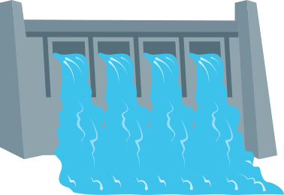
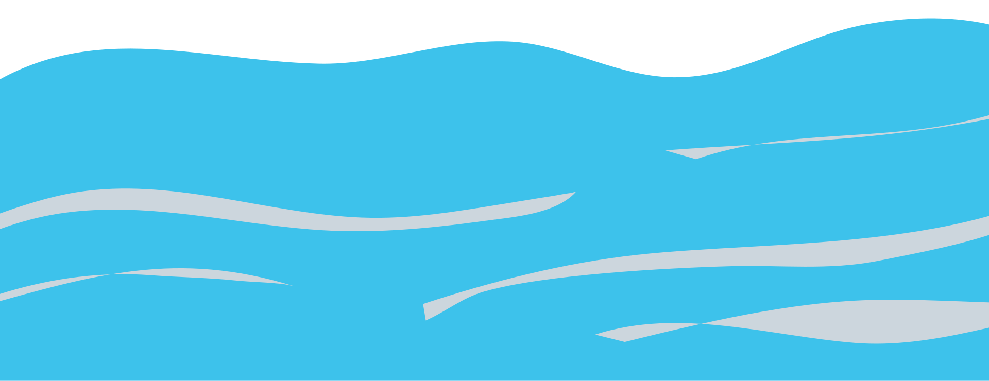
LOCKS & DAMS
Let’s learn!

Slide 2



DID YOU KNOW?
About 48% of the corn grown in Illinois is moved out of the state - some to other states in the U.S. and some to other countries.
Illinois is the second-largest corn-growing state in the United States. Where does all of the corn go?

Slide 3

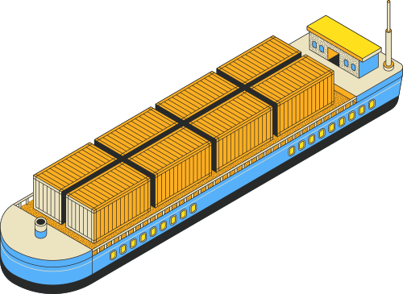
HOW DOES ALL OF THAT CORN GET MOVED?
Much of the corn grown here is moved by very large boats called barges on the Mississippi and Illinois Rivers.

Slide 4

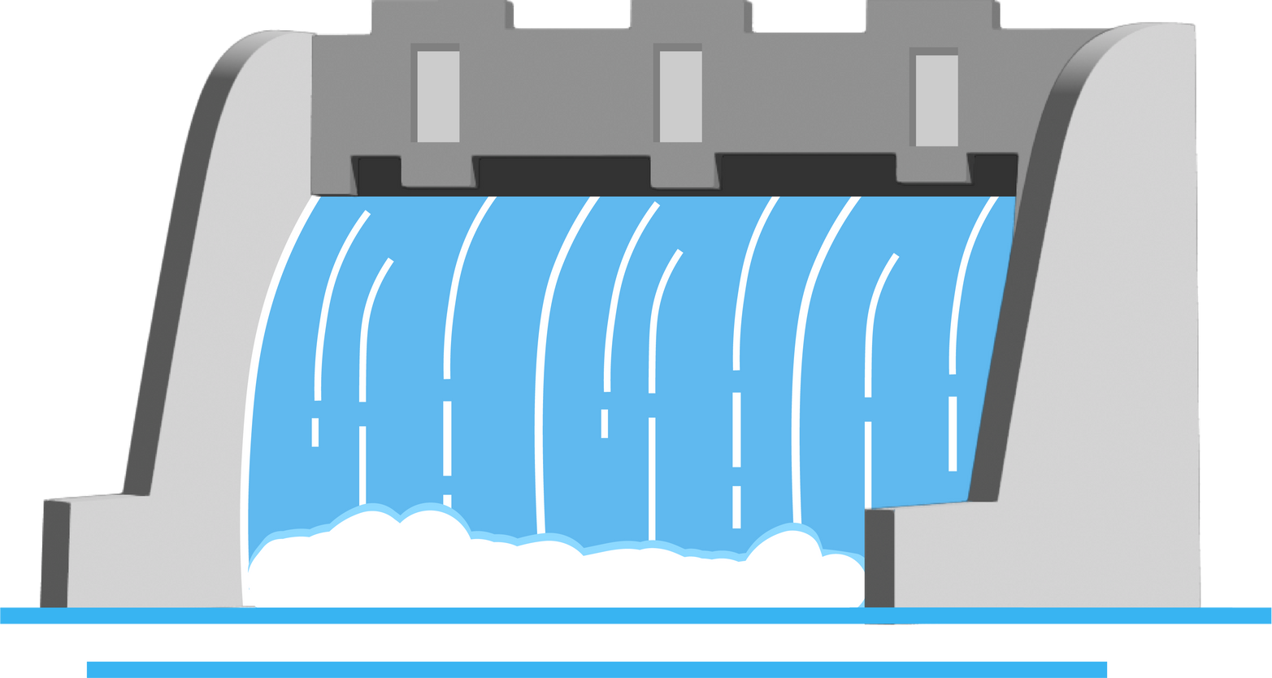
LOCK & DAMS
Locks and dams are important structures built along rivers to help boats travel smoothly even when water levels change.

Slide 5


DAMS
A dam is a barrier that blocks or slows down the flow of water, creating a pool or reservoir behind it.
This helps control flooding, produce electricity, and keep the water level steady for boats to pass. But because dams change the height of the water, boats can’t simply float past them.

Slide 6
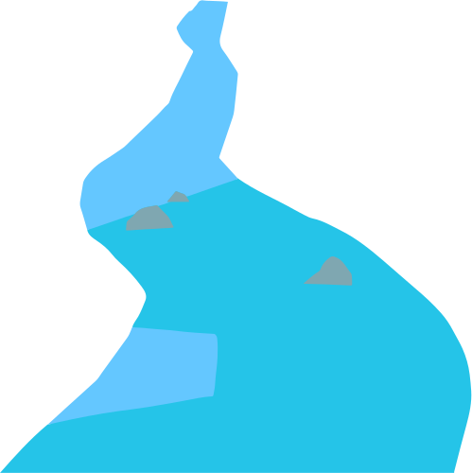
LOCK
Locks help boats move up or down the river. A lock is like an elevator for boats. It is a chamber with gates on both ends. When a boat gets to a lock, it goes inside and the gates close.
Then the lock fills with water to lift the boat up, or lets water out to lower the boat down. When the water inside the lock is the same as the next section of the river, the other gates open and the boat moves on.

Slide 7
Locks and dams work together to make river travel safe and efficient, allowing boats to pass through areas where the water level changes.

