Slide 1
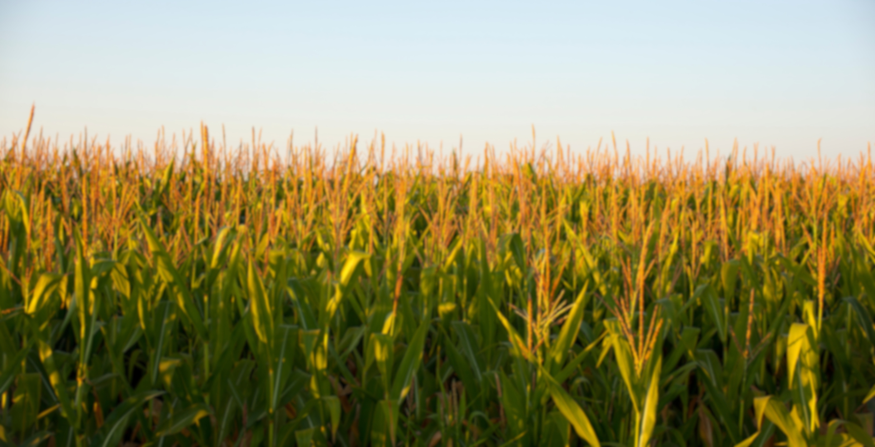

THE
GOLDEN CROP

Slide 2
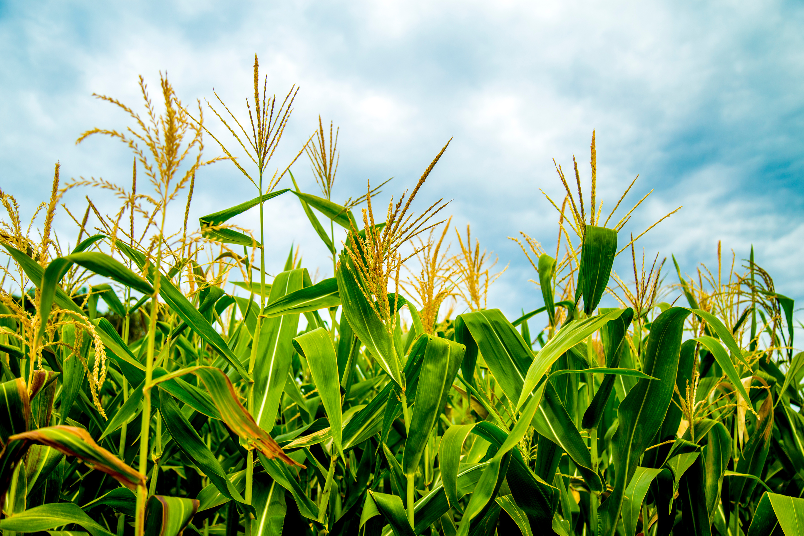


NOW, CORN IS A POWERHOUSE OF THE U.S. ECONOMY.
The golden crop:
CORN
Corn was first domesticated about 9,000 years ago in southern Mexico from a wild grass called teosinte.
Through generations of selective breeding by Indigenous peoples and modern day scientists, it has become the productive crop we know today.

Slide 3

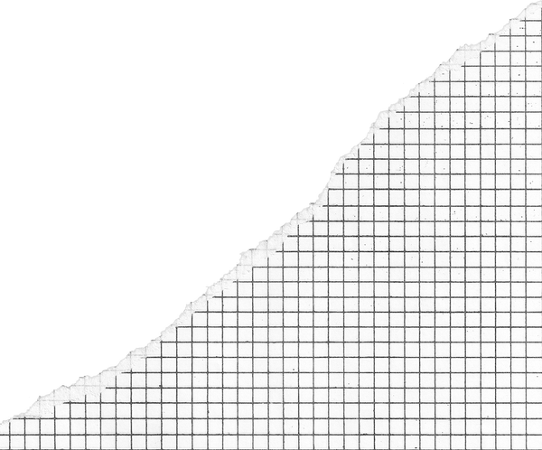

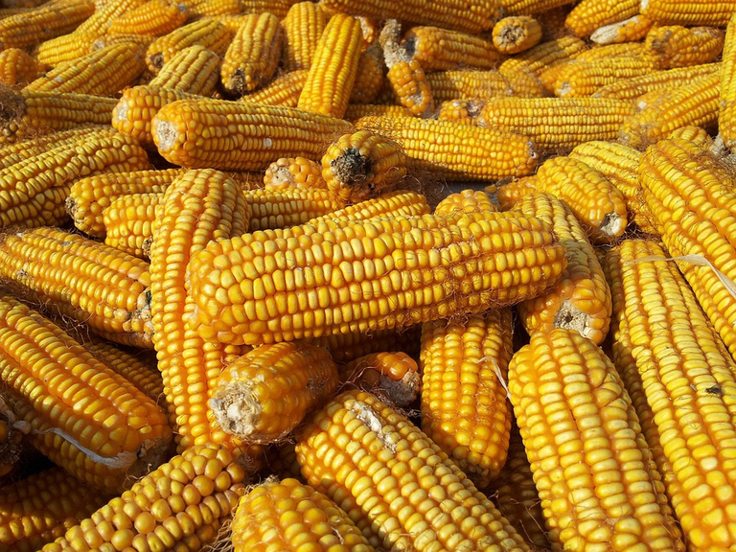
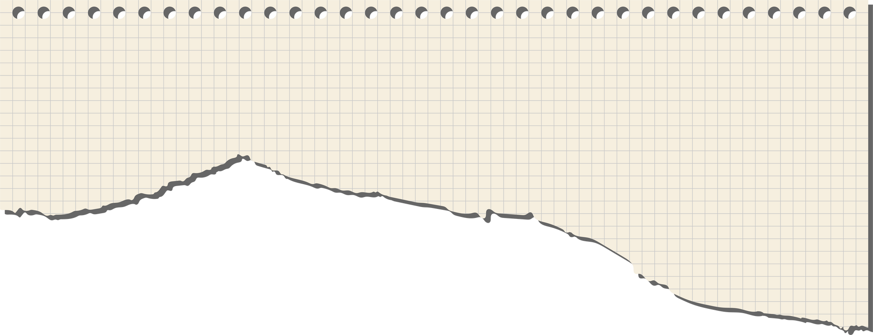

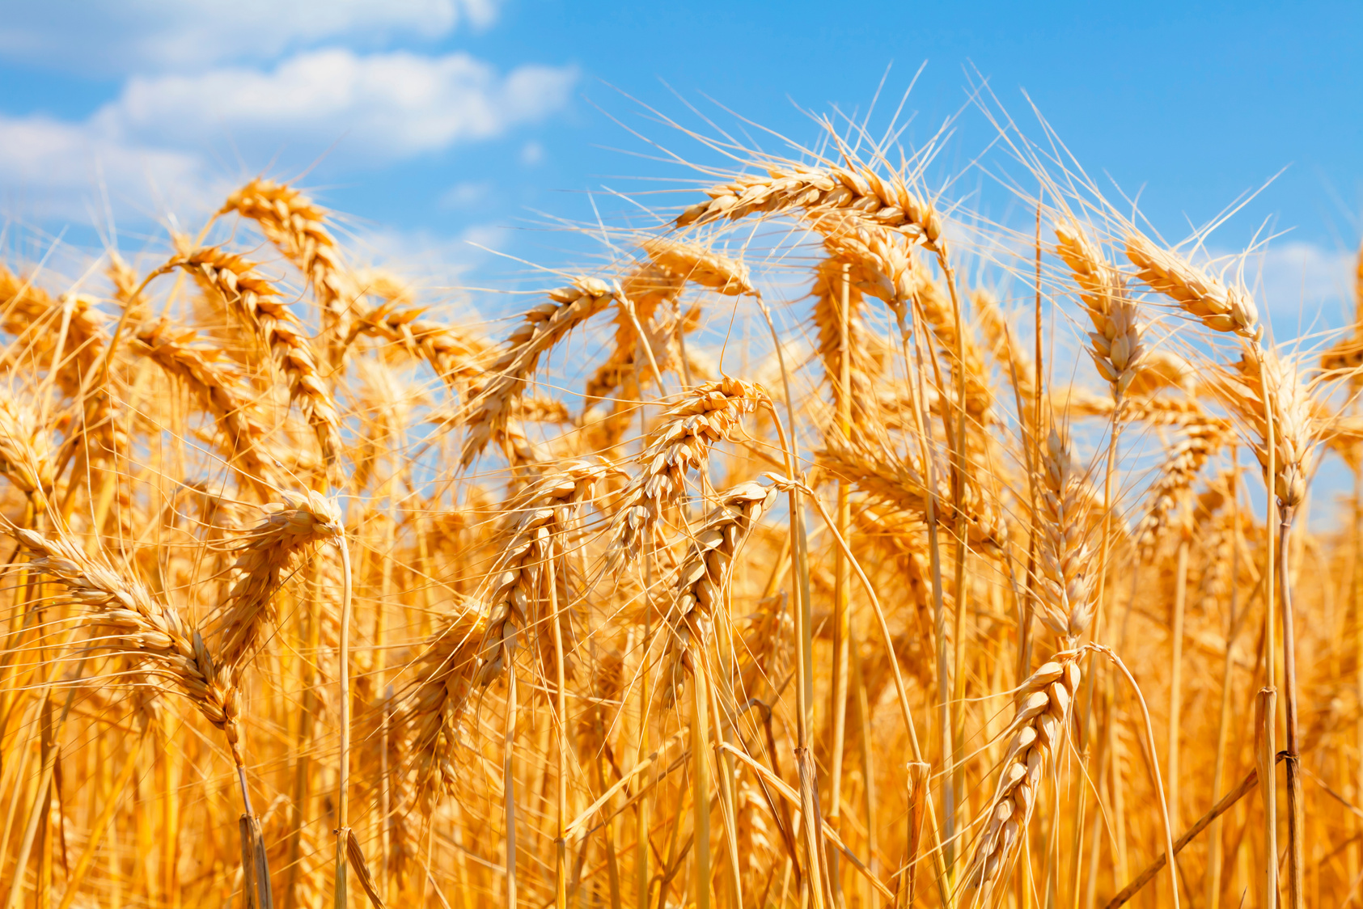


Corn: a commodity
A commodity is a basic good that is interchangeable with other goods of the same type
Commodities are usually traded in bulk and are essential to the economy.
Examples include:
  Corn
  Wheat
  Oil
  Coffee
Corn is the most produced agricultural commodity in the United States.

Slide 4





CORN’S IMPACT ON AMERICA
In 2023, corn farming contributed $151 billion to the U.S. economy, including $62 billion to GDP
Corn production supports over 600,000 jobs nationwide and generates $35 billion in wages
The U.S. is the world’s largest producer and exporter of corn, accounting for over 30% of global exports
The U.S. produced 15.3 billion bushels of corn in 2023, making it the largest crop by volume in the country

Slide 5

Understanding Corn:
Supply, Demand & Market Price
1
2
How much corn buyers, like food companies, ethanol producers, and livestock farmers, want to purchase.
How much corn farmers are willing and able to grow and sell.
Supply
Demand

Slide 6
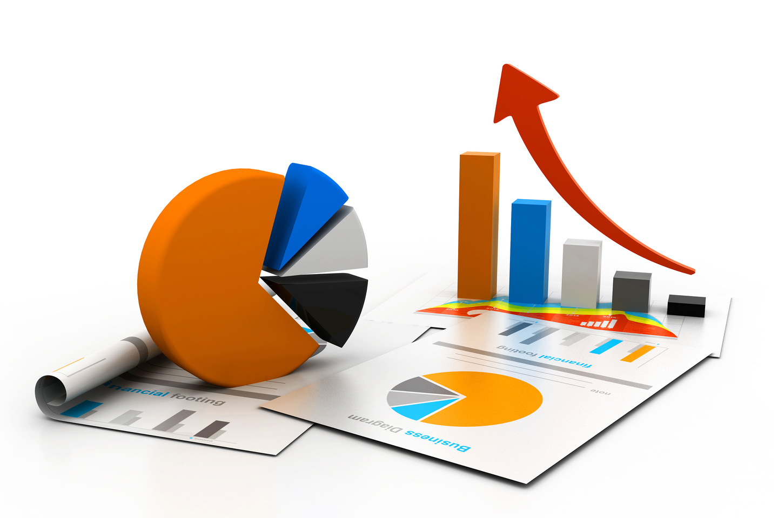
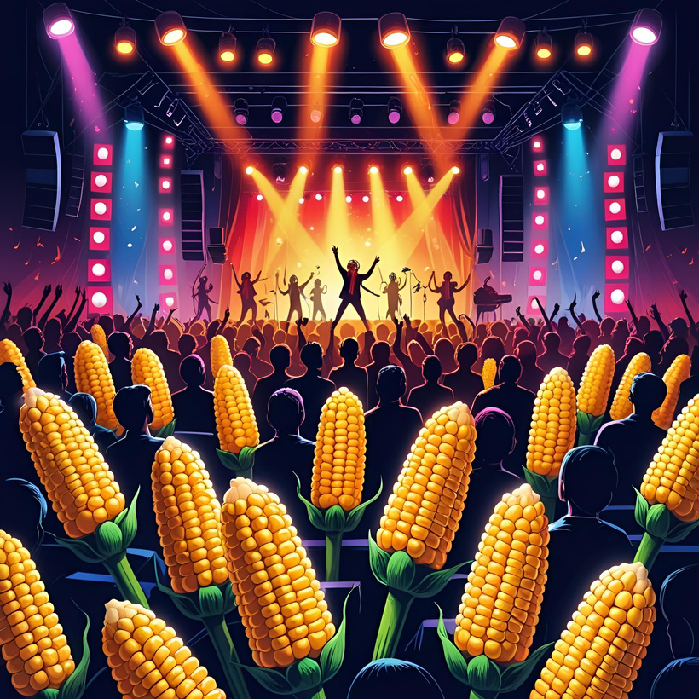
MARKET PRICE
The market price of corn is determined by the balance between supply & demand.
Think of it like a concert. If there are few tickets but lots of fans, prices go up. If there are too many tickets and not enough fans, prices drop. Corn works the same way; price depends on supply and demand.

Slide 7


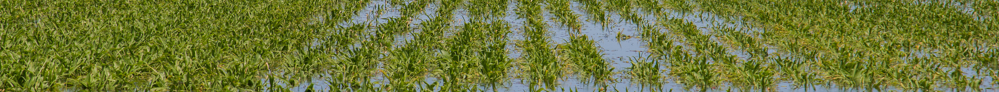
?
?
What drives market price
WEATHER. SUPPLY LEVELS. GLOBAL DEMAND. INPUT COSTS. FUTURES MARKETS.
There are so many things that can disrupt the balance of supply and demand, changing market price.

Slide 8


Farming is unpredictableand oftentimes scary
While there may not be answers for all that farmers have to worry about...
What if the weather is bad and affects my crops?
What if disease or pests affects my yield?
What if the market for selling my corn isn’t good when I harvest?
There is a way to take back a little bit of control around when a farmer decides to sell their corn and ways to hold off until prices are optimal.
Let’s explore farmer’s options...

Slide 9

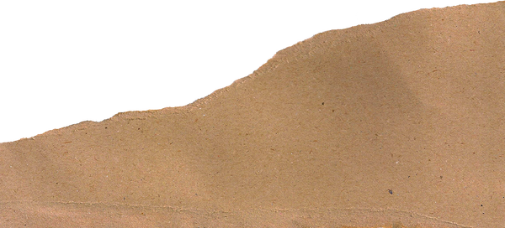
1
2
3
The farmer holds onto their harvested corn and stores it, hoping to sell later when prices are higher.
The farmer agrees to sell corn later at a set price by using a futures contract. This helps protect against price changes.
The farmer sells their corn immediately at the current market price
Sell now
Store
Hedge

Slide 10
Cash vs futures market
When determining when to sell corn, farmers will decide which market to sell their corn on. The two main markets that farmers look towards are...
cash market & futures market

Slide 11
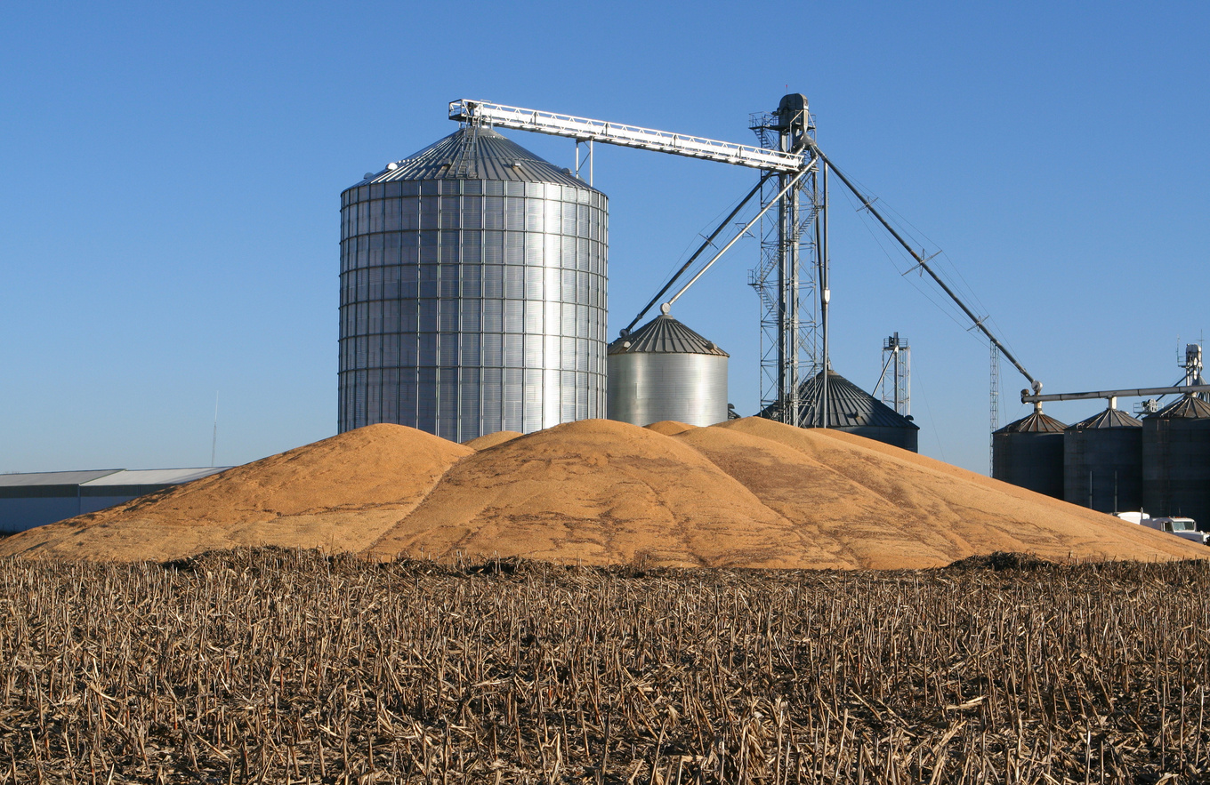
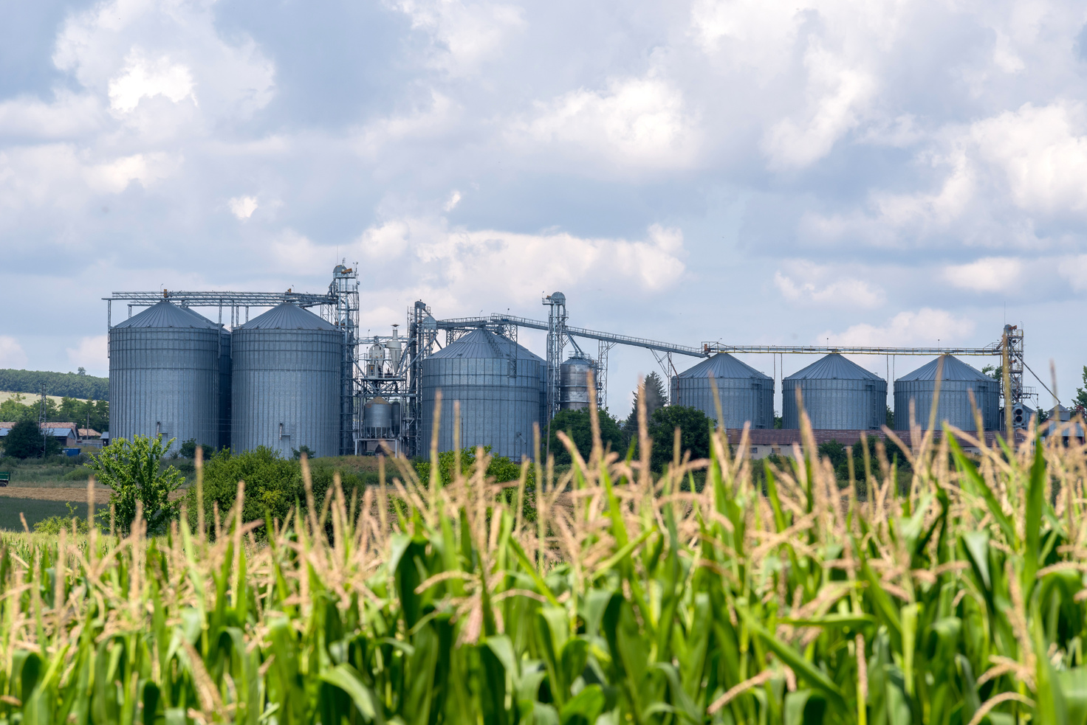
THE CASH MARKET
The cash market is the most common type of market utilized by farmers and involves selling and storing corn. It is where the physical grain is handled and traded directly between farmers and entities like grain elevators, processors, or terminals.
Cash markets deal with the physical trading of commodities in the present. The cash market price is determined by local supply and demand, transportation costs, and storage costs.

Slide 12

THE FUTURES MARKET
Farmers use the futures market to hedge the prices of corn as a tool for risk management.
The futures market involves contracts to buy or sell a specific quantity of a commodity at a predetermined price and future date. These contracts are traded on commodity exchanges like the Chicago Board of Trade.

Slide 13
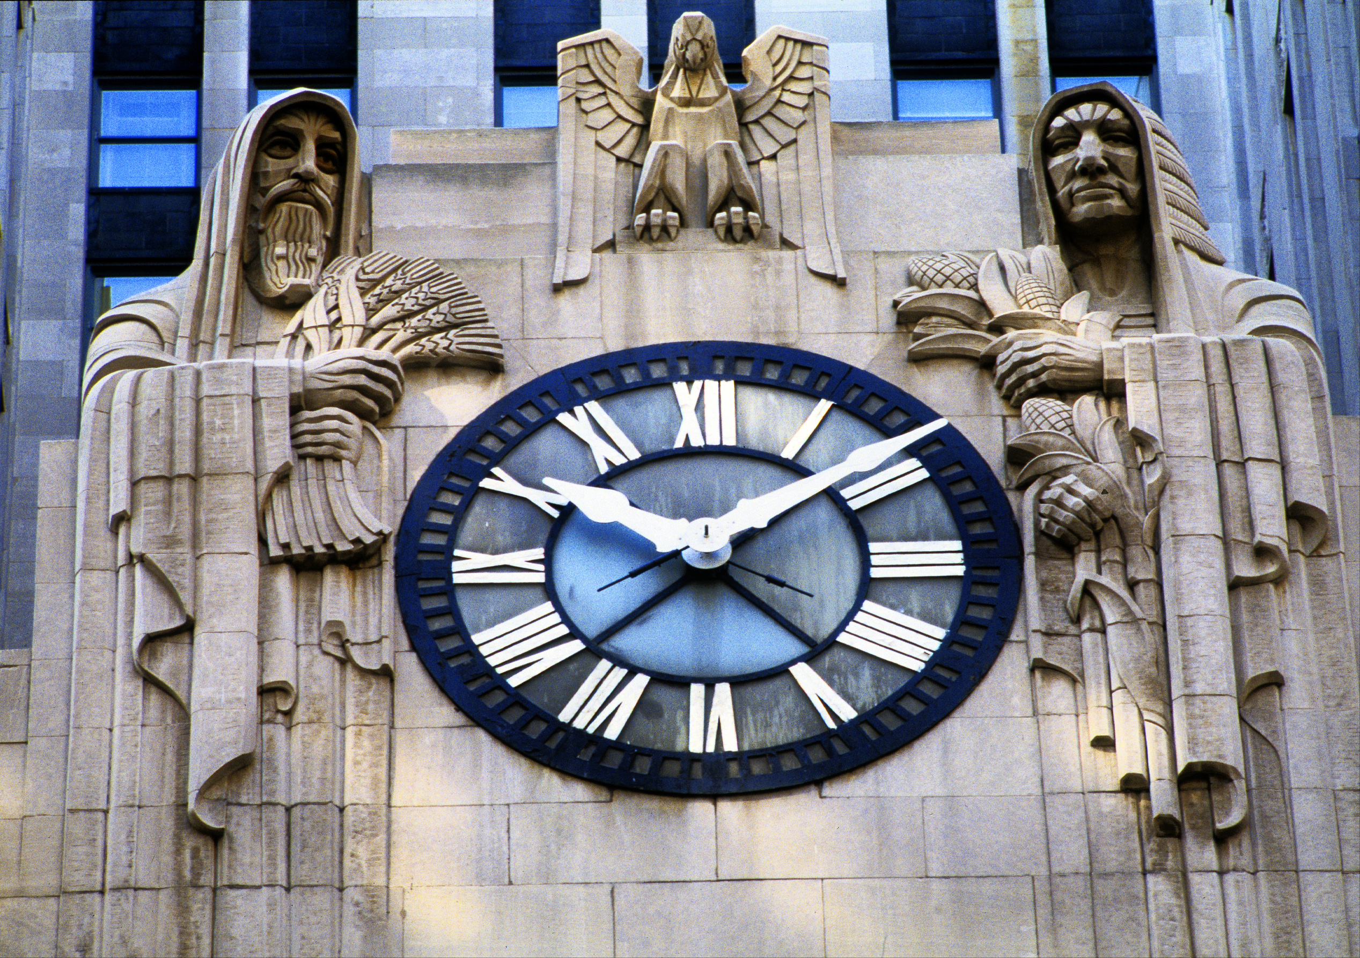
THE CHICAGO BOARD OF TRADE
The Chicago Board of Trade (CBOT) is one of the oldest and most influential commodity futures and exchanges in the world.
Founded in 1848, it plays a central role in the corn industry by providing a transparent, regulated marketplace where buyers and sellers can trade corn and other agricultural commodities.

Slide 14
The Golden Opportunity
Corn is a vital part of the American economy and farmers battle the fluctuating prices and challenges of the corn industry on a daily basis.
As consumers, it is important to recognize where your food comes from, the impact of the corn industry, and to appreciate farmers across the globe for the work they do to feed the world.

