Slide 1
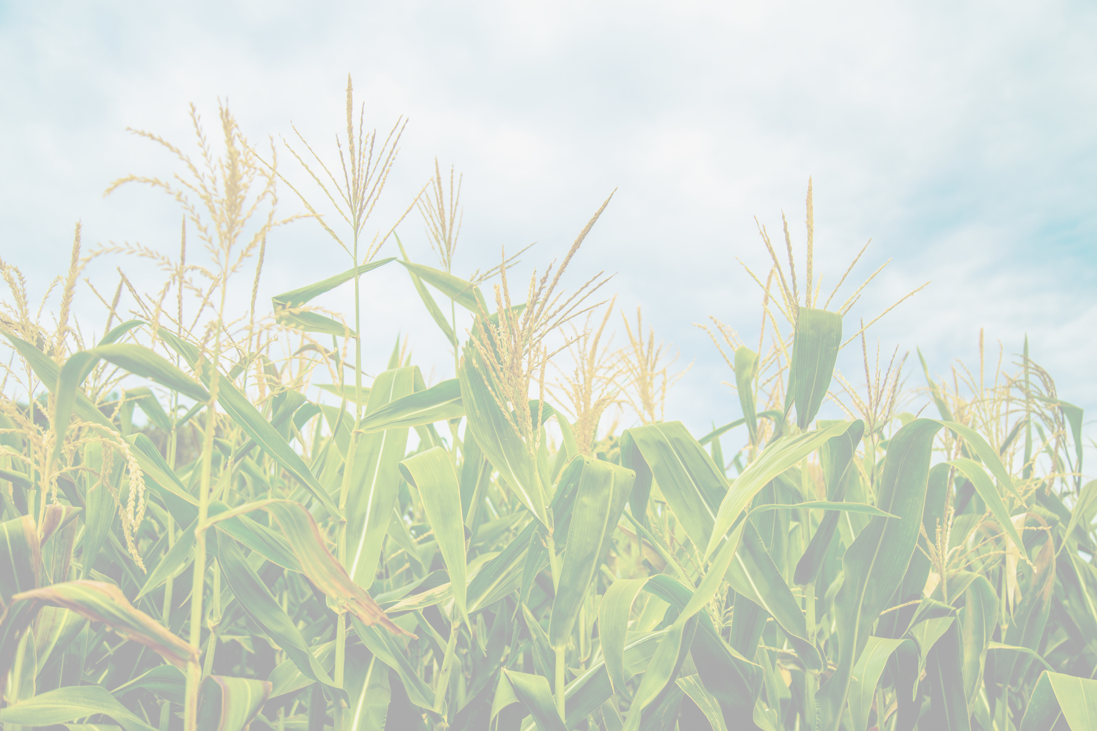


Corn
a multipurpose crop

Slide 2

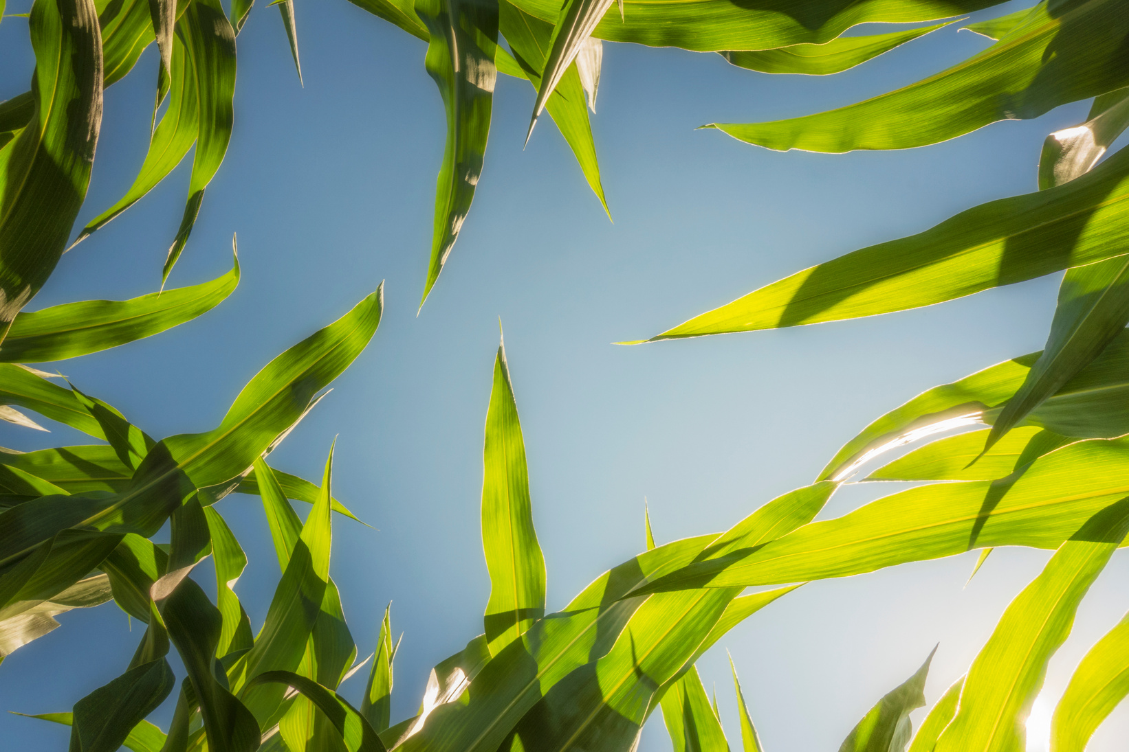
In 2024, the United States produced approximately 14.9 billion bushels of corn.

Slide 3




How much is that?
What’s a bushel?
If you filled a large laundry basket with corn kernels, that would be about one bushel.
A bushel is a unit of volume used in farming. For corn, one bushel equals about 56 pounds of corn.

Slide 4
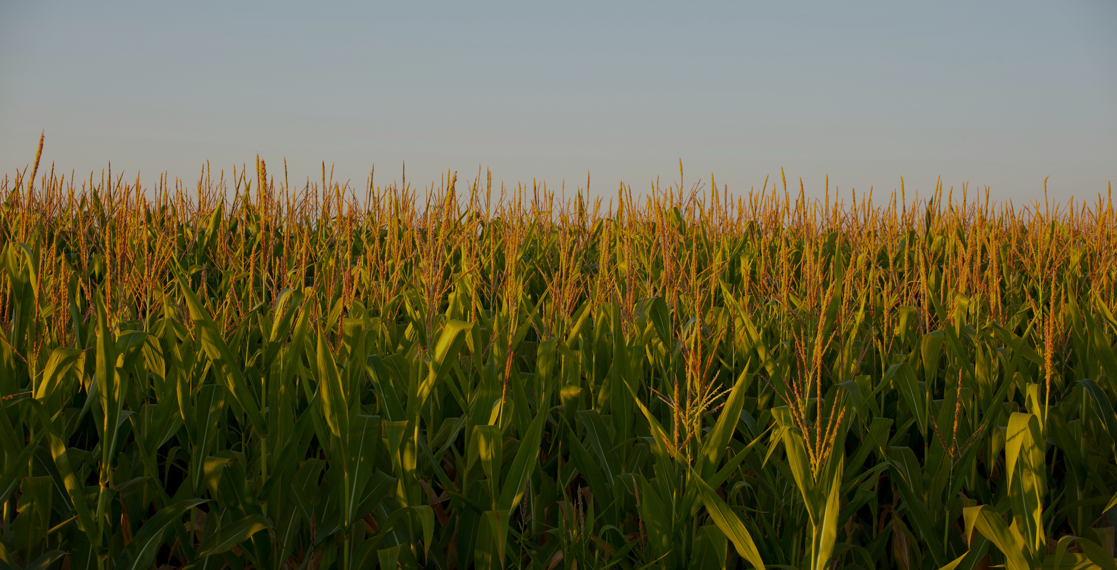
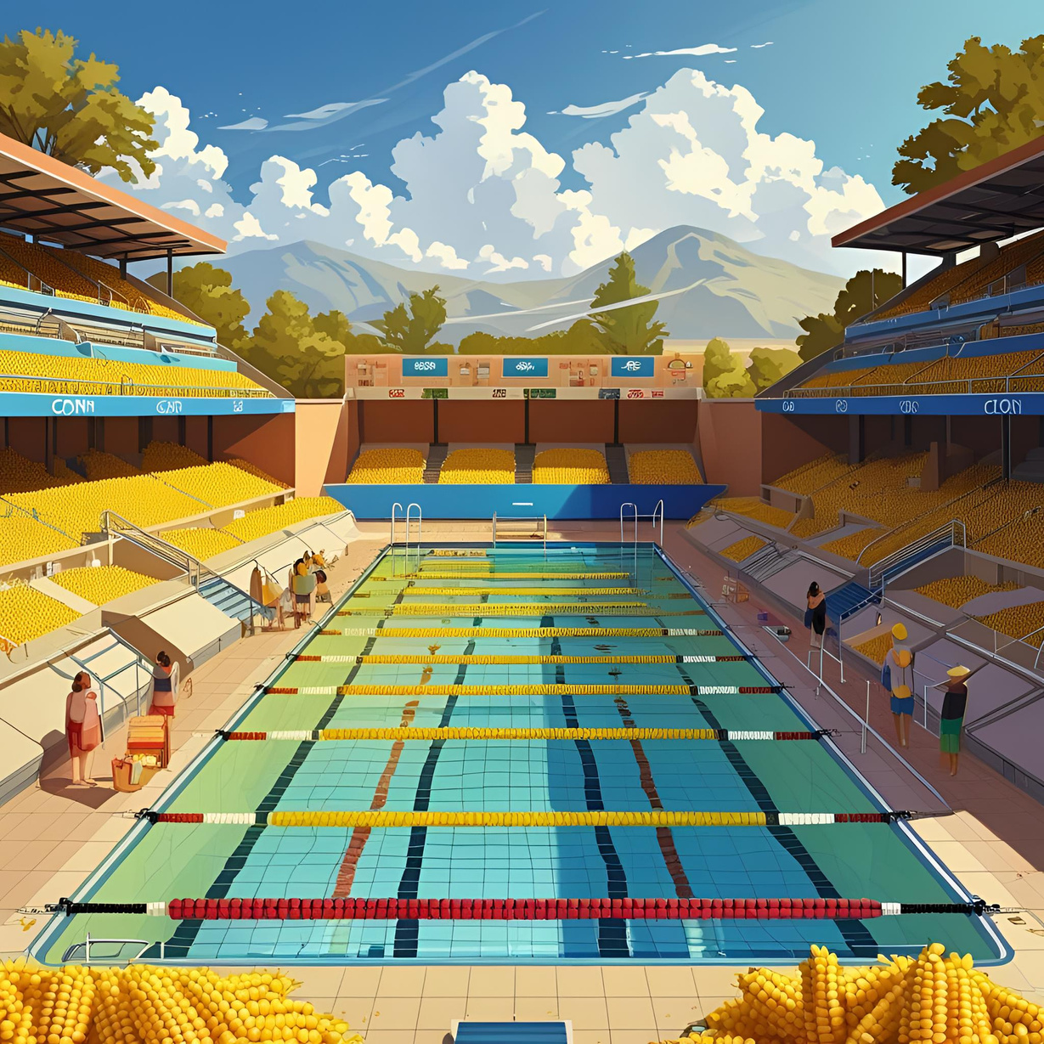
14.9 billion bushels of corn can fill over 209,560 Olympic-sized pools

Slide 5
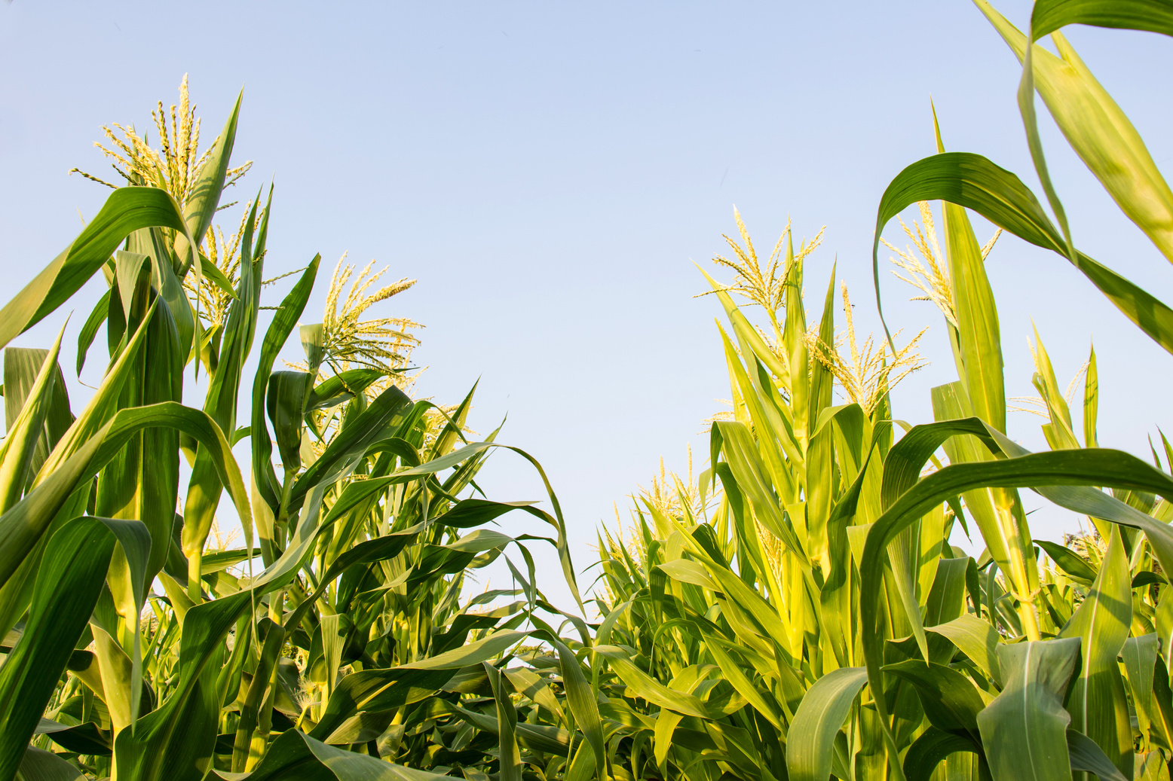

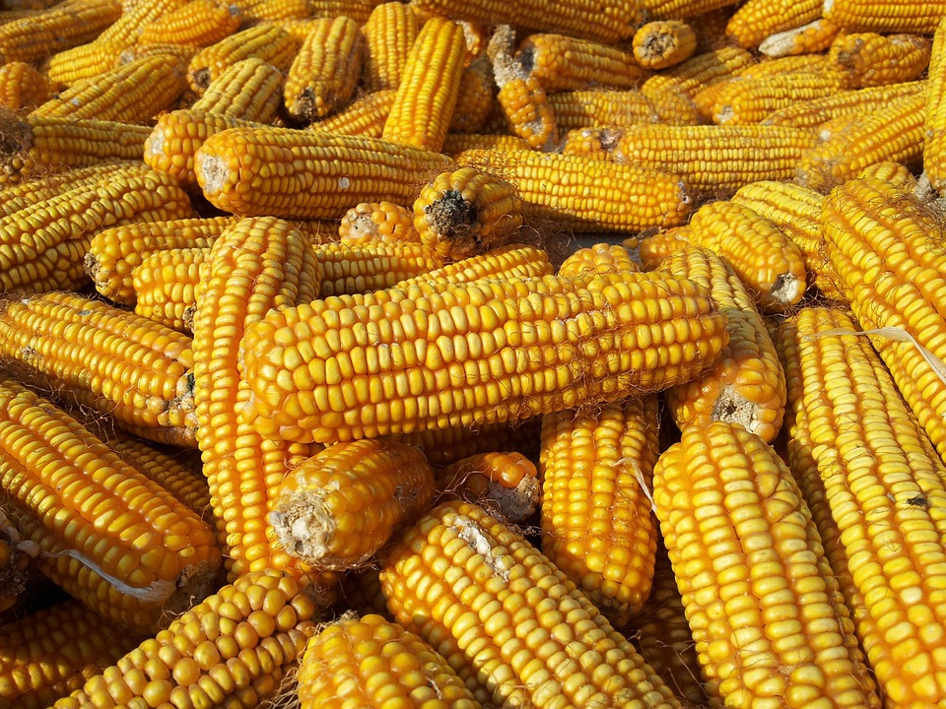
Of corn produced in the U.S., Illinois produced about 2.31 billion bushels.
Illinois is the second-largest corn producing state

Slide 6
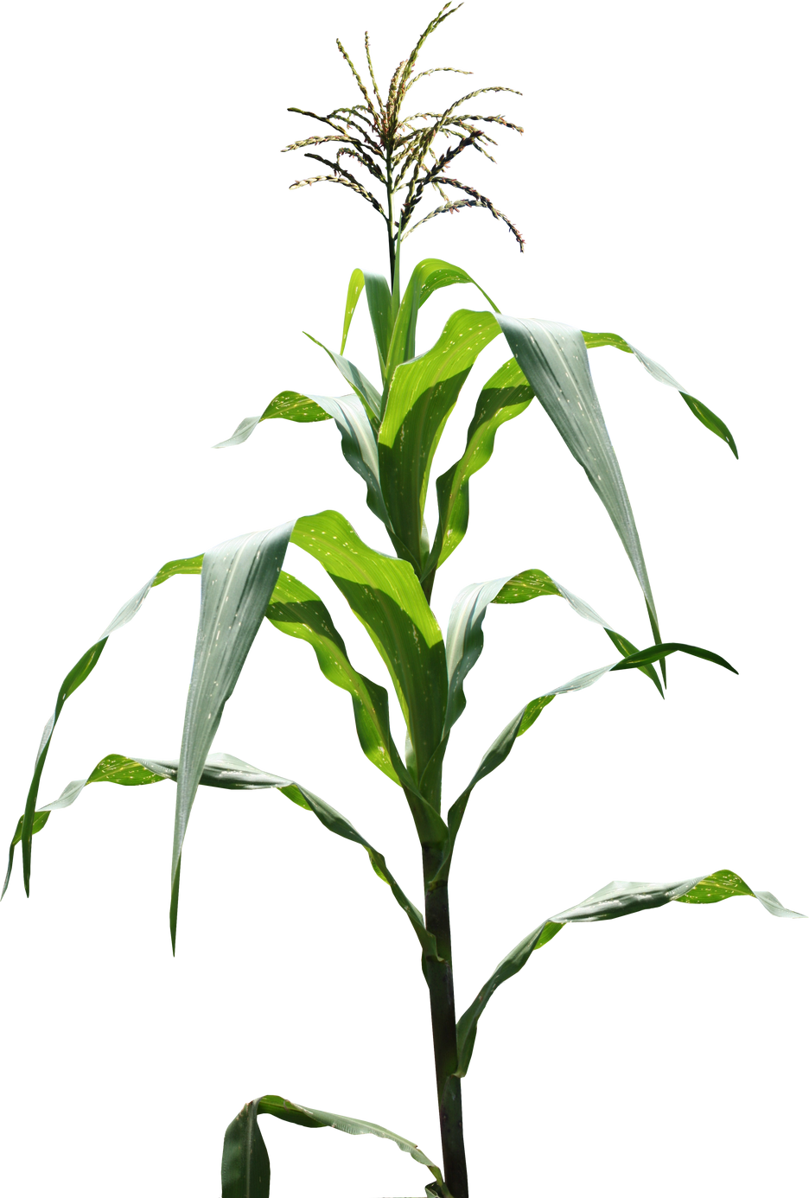
What happens with all that corn?
Food
Fiber
Fuel

Slide 7
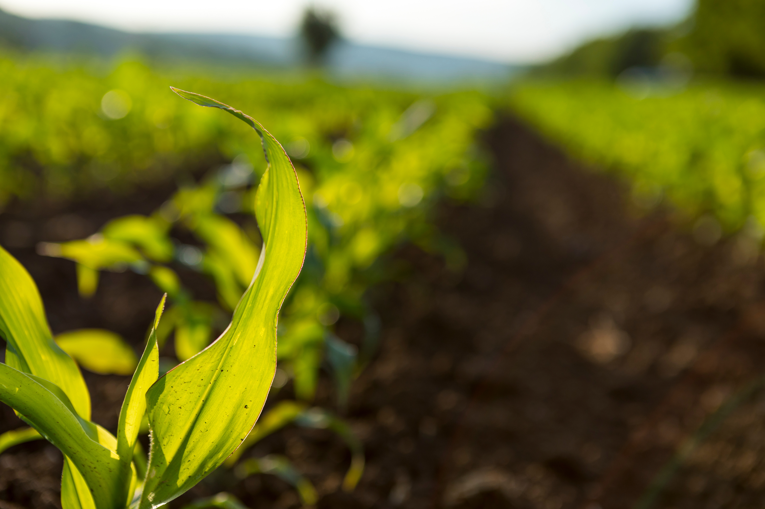




Food
Human
con-sumption
Animal feed

Slide 8

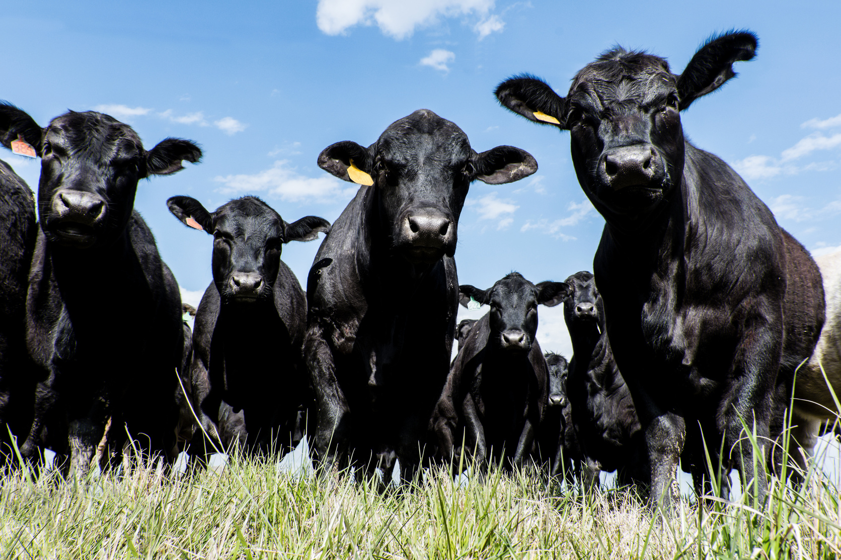
About 6% of corn grown in Illinois is used for animal feed in state
Animals that eat corn feed:
Cows, pigs, chickens, turkeys, sheep, and goats
Forms of corn feed
  Cracked corn: Dried and broken kernels.
  Ground corn: Finely milled for easier digestion.
  Pelleted feed: Corn mixed with other nutrients and compressed.
  Distillers grains: Byproduct of ethanol, high in protein.
  Corn silage: Whole corn plants (stalks, leaves, and ears) chopped and fermented.

Slide 9
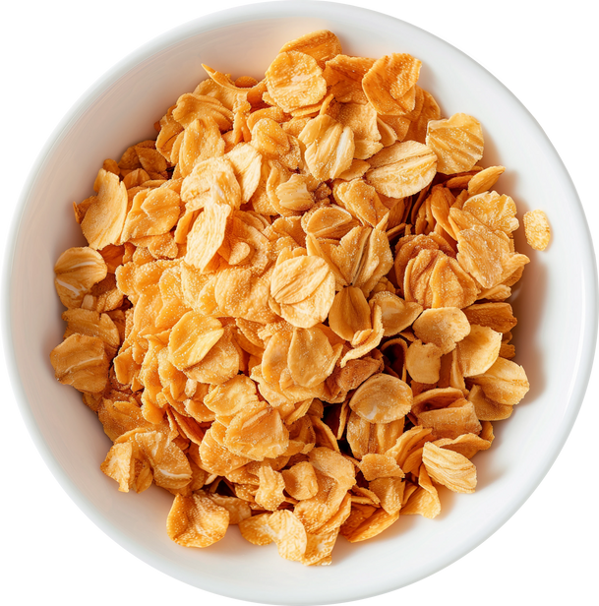
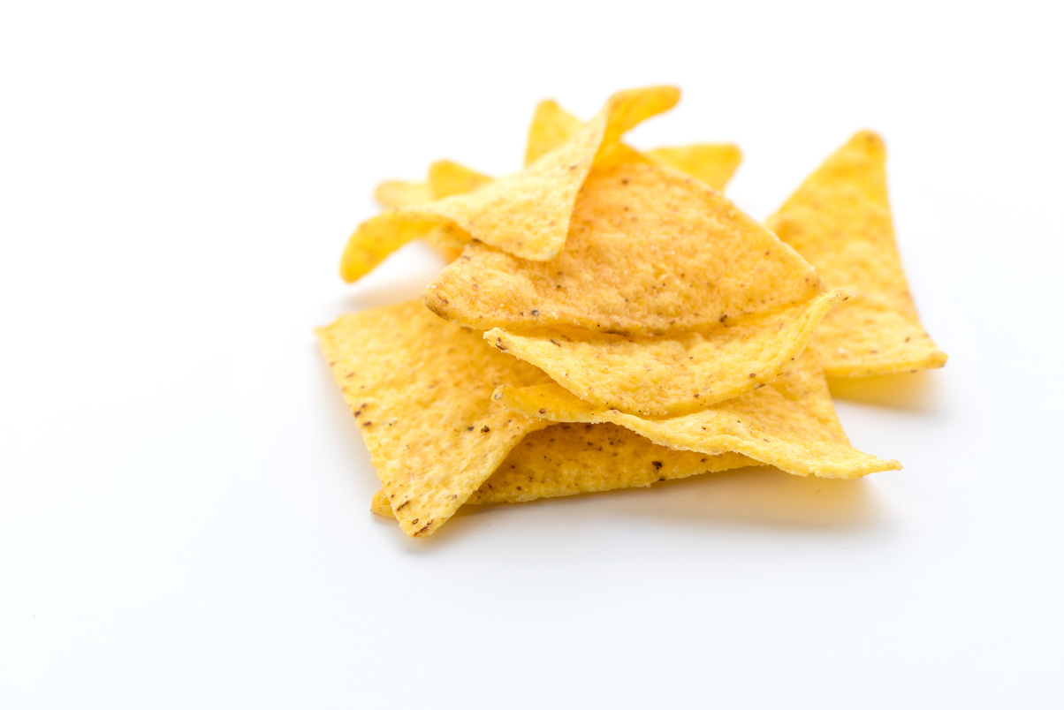
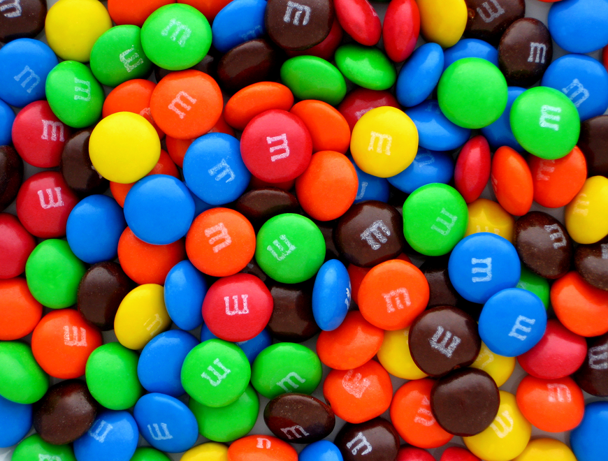
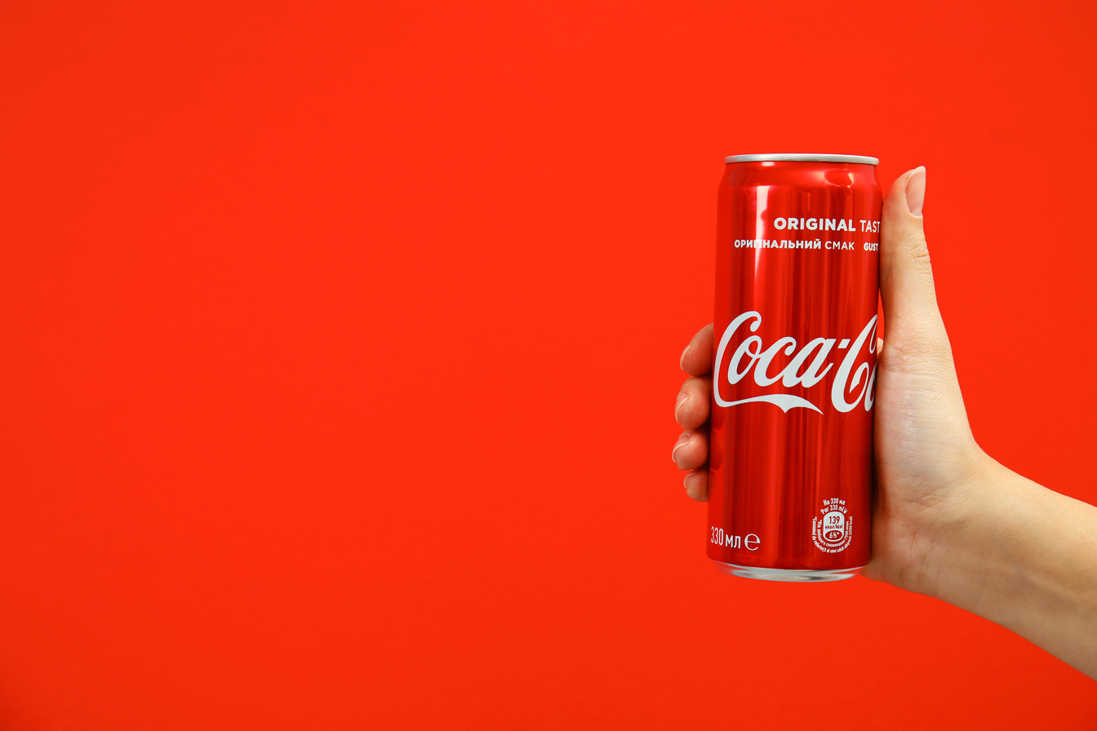
Human consumption
Cereal
Snacks
Corn flakes
Tortilla chips
Corn is in SO many things we eat! Approximately 4,000 items in a typical grocery store list corn or a corn-derived ingredient on the label
Candy
Soda/Pop
M&M’s
Coca-Cola

Slide 10
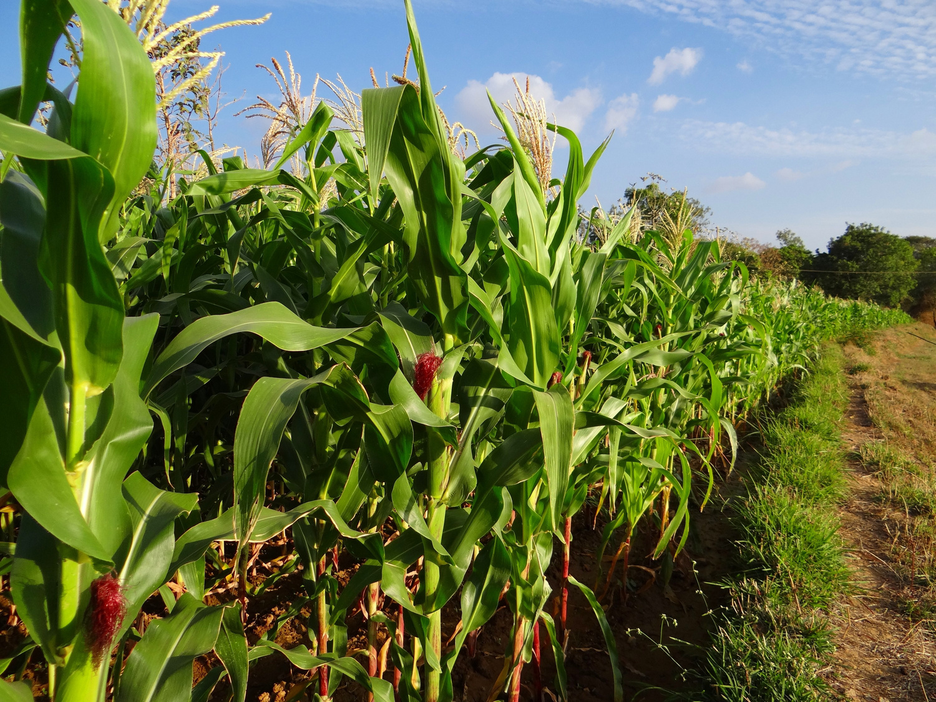
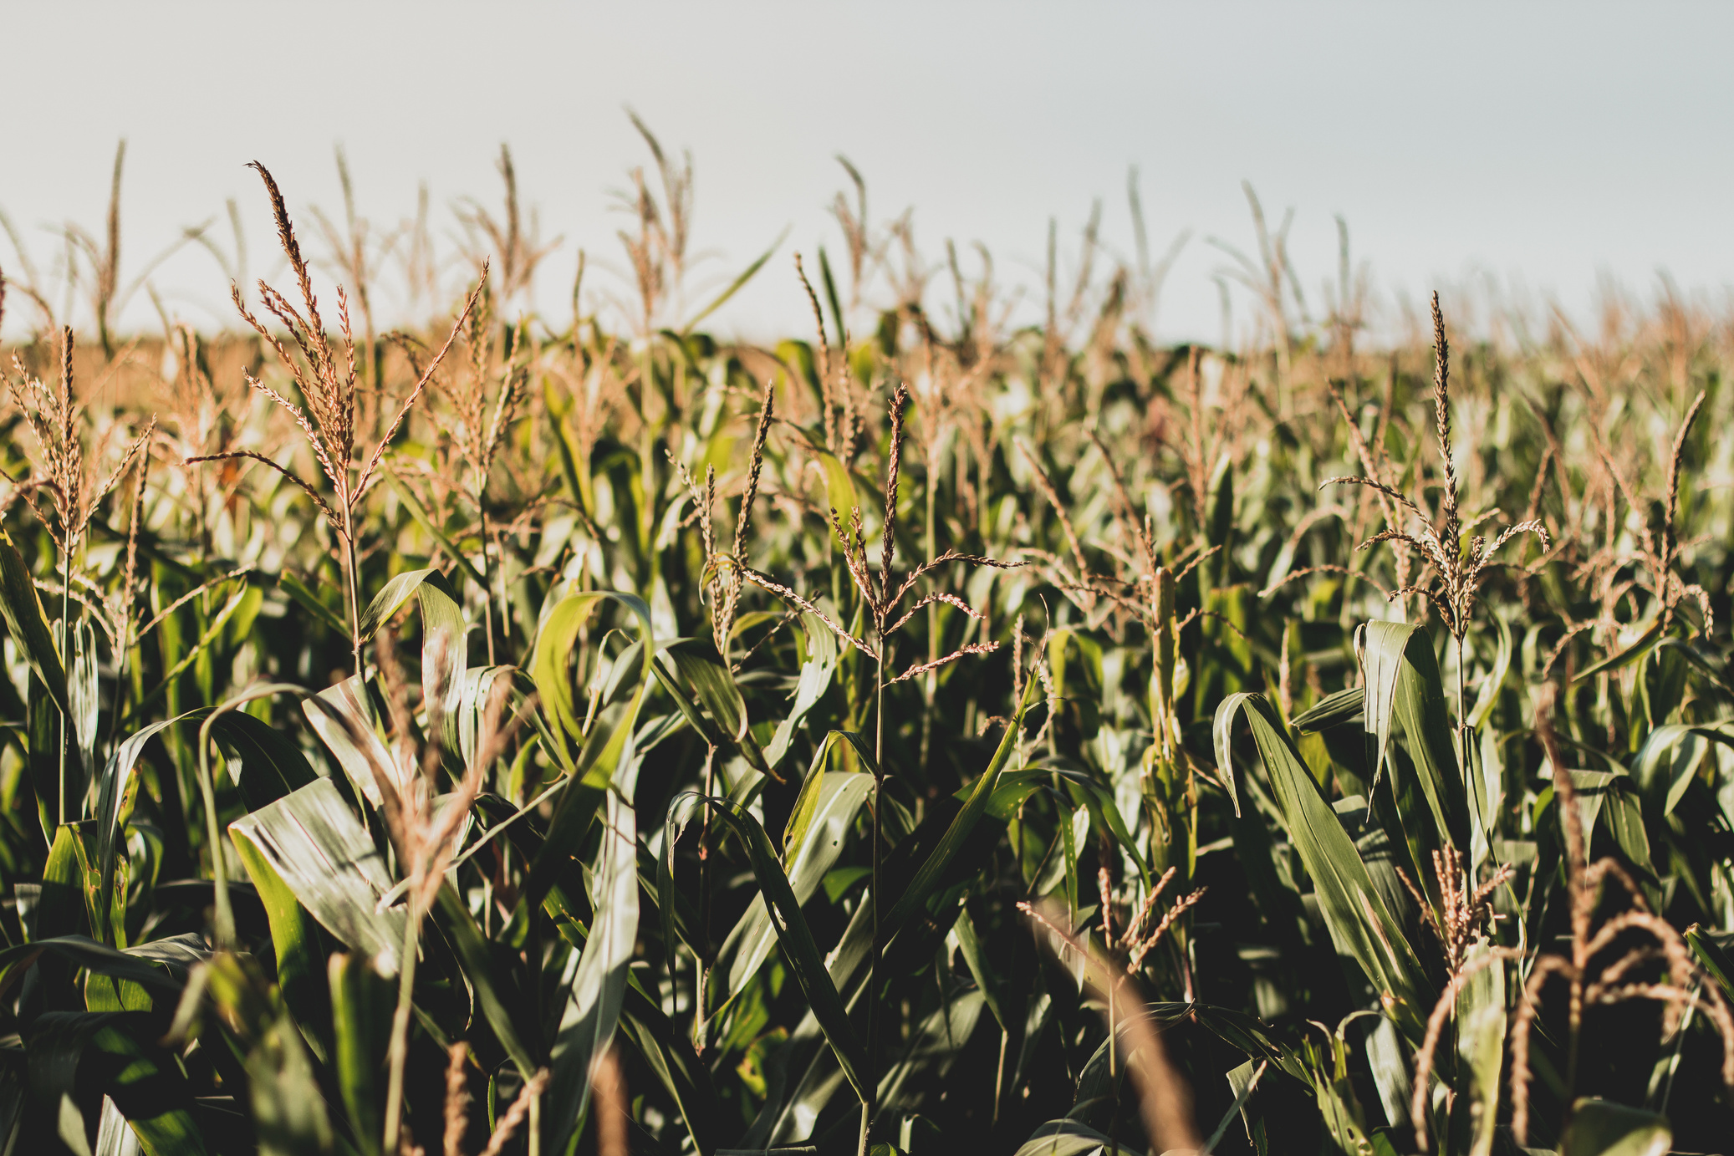
Fiber:
Corn is used to make biobased materials like fabrics, plastics, and packaging. These are often biodegradable and eco-friendly.

Slide 11

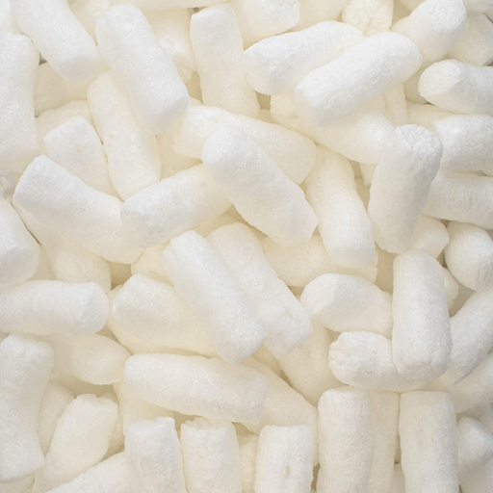

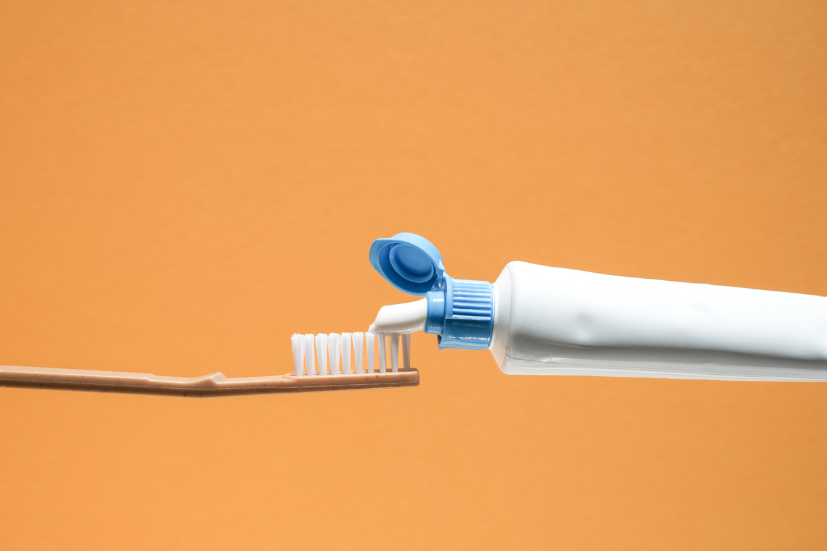

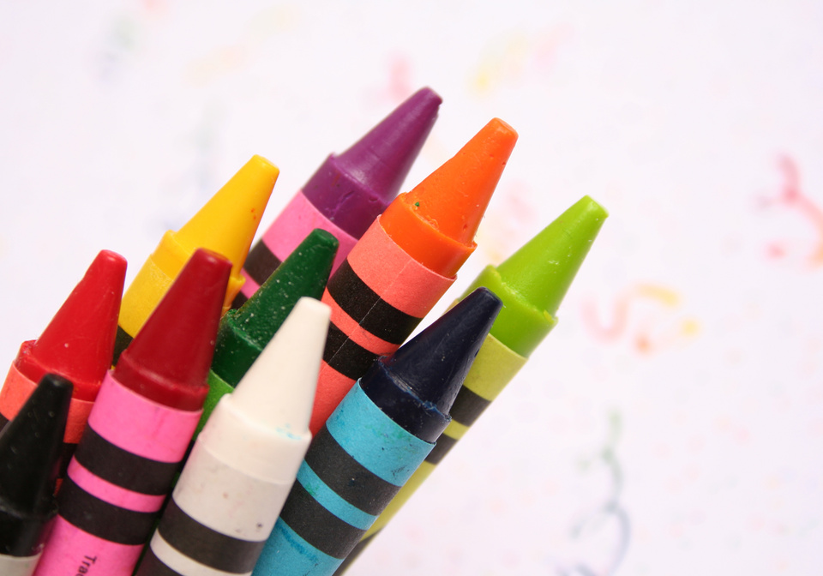

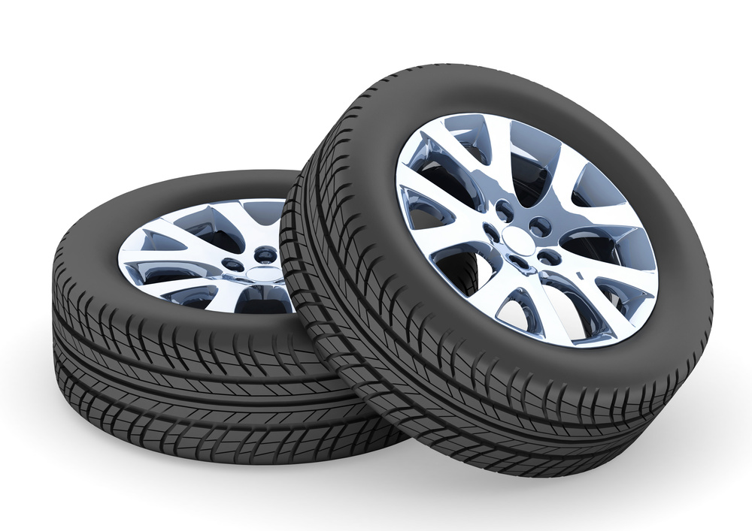
Bioplastics
Packaging
Personal care
Hygiene
Plastic cup
Packing peanuts
Lipstick
Toothpaste
At-home items
School supplies
Industrial
Automotive
Laundry detergent
Crayons
Fireworks
Tires

Slide 12
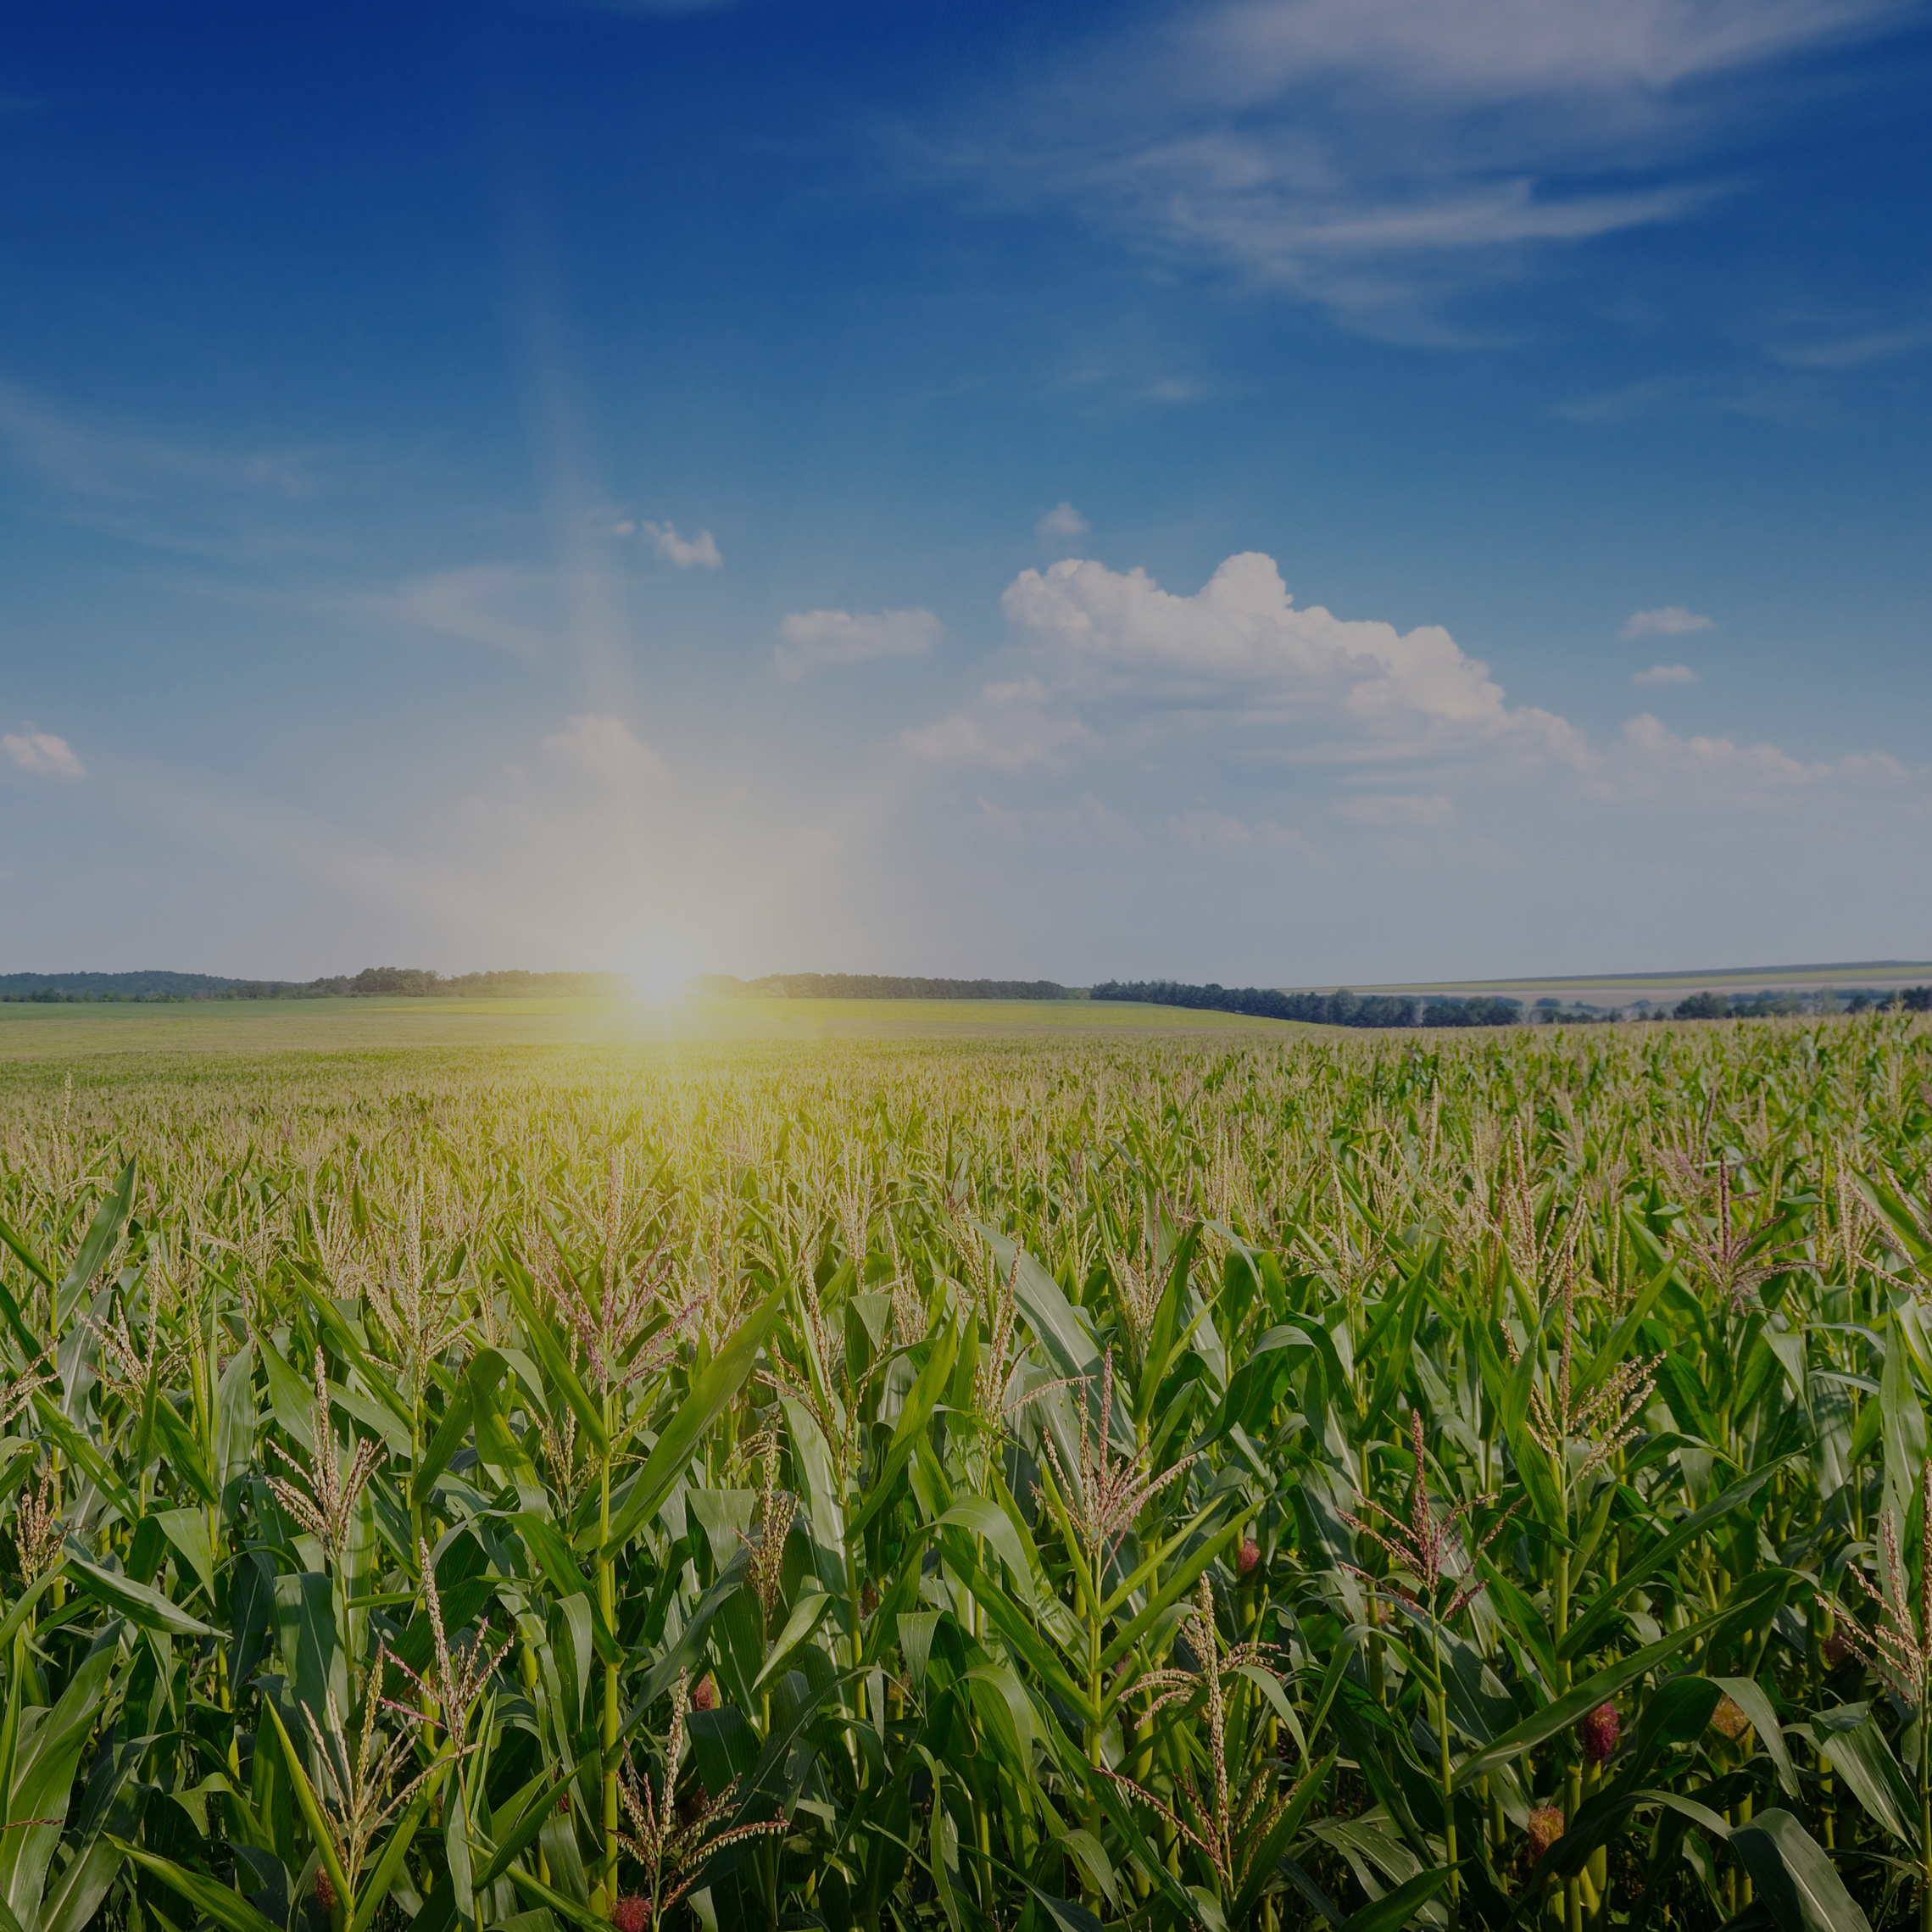
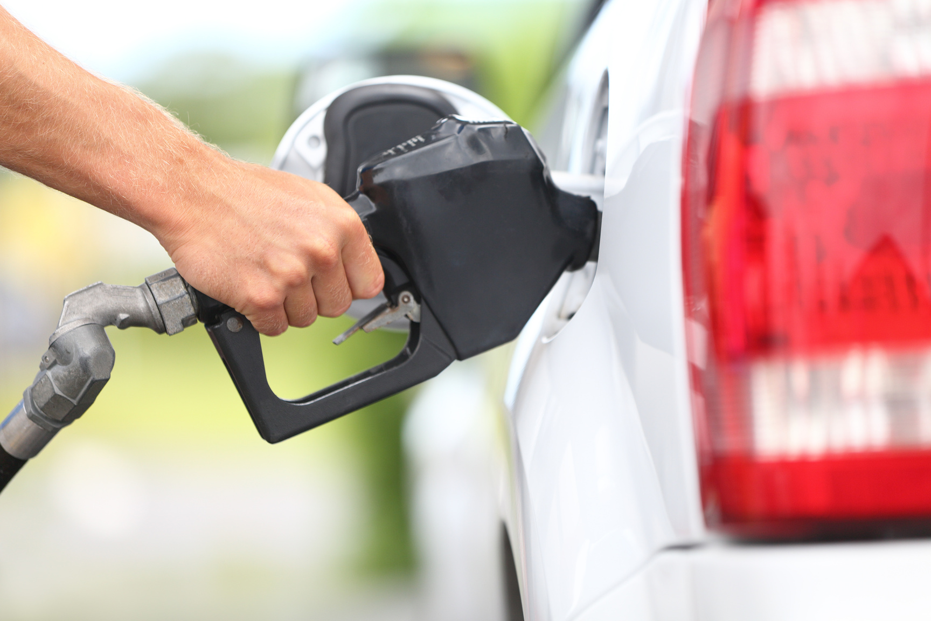
FUEL

Slide 13

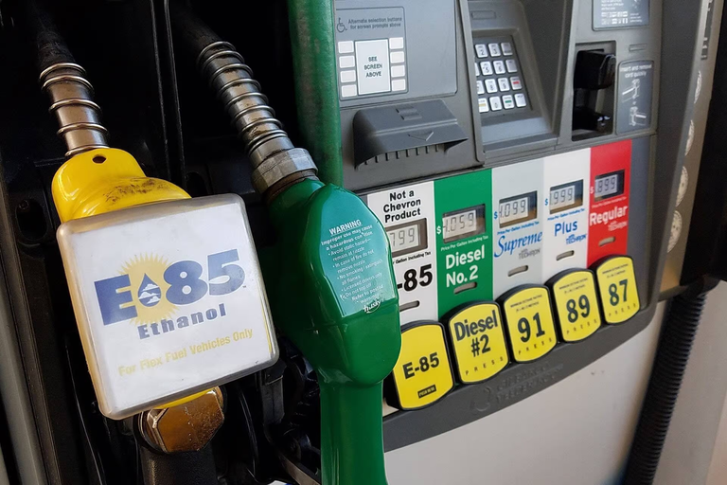
Ethanol
A renewable fuel made from corn starch, blended with gasoline
Ethanol burns cleaner than gasoline... which is better for the environment!

Slide 14
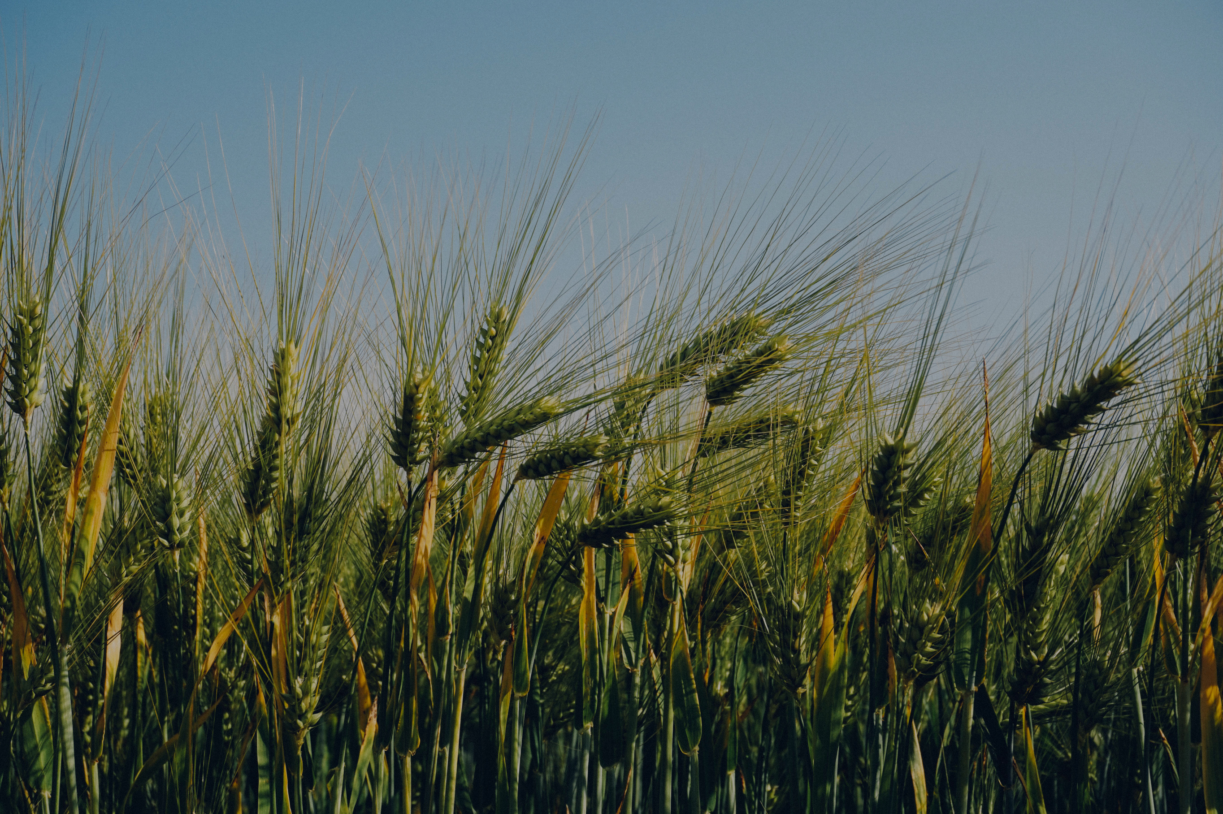
Corn is in food,
fiber, fuel, and EVERYWHERE!
Learn more at ilcorn.org

