Slide 1
BRIEF CONVERSATIONS:
Talking with Youth Who Vape to Encourage and Support Change
This presentation and toolkit resources were developed in collaboration with Ontario Public Health Units and the Lung Health Foundation.
Notes:
Welcome to “BRIEF CONVERSATIONS: Talking to Youth Who Vape to Encourage and Support Change” – a training for individuals who work or interact with youth regularly through various roles in the community.
During this presentation, we will discuss how you can influence youth vaping behaviour change through your day to day interactions, by incorporating a few simple techniques -- and it only takes a few minutes!

Slide 2
What do you know about vaping?
Activity
Notes:
*Eliminate from recorded presentation*
You don’t need to be an expert on vaping to influence change. However, understanding some of the main issues can help to build confidence as you interact with youth.
Goal of Activity: Elicit from participants what they currently know about vaping
popcorn style” from audience, list and group items into themes. (physical health, mental health, addiction, types of devices, flavours etc)

Slide 3

LEARNING OBJECTIVES
This presentation will enhance your:
Understanding of why it’s important to apply interventions to reduce youth vaping
Knowledge of how to have brief conversations with youth who vape to encourage and support behaviour change
Knowledge of where to direct youth who vape for more information or additional support
Notes:
This presentation will introduce several key concepts for developing skills to help support behaviour change in youth who vape.
It will enhance your:
understanding of why it’s important to apply interventions to reduce youth vaping
knowledge of how to have short conversations with youth who vape to encourage and support behaviour change
knowledge of where to direct youth who vape for more information or additional support
To participate, you do not need to be an expert on vaping or counselling, but you are an ally who has a trusted relationship with youth. Because of this role, you are in an optimal position to influence their decisions about health. You can have conversations with youth about their vaping and offer support aimed at preventing continued use.
The skills and approaches shared in this presentation are based on evidence informed practices used in tobacco cessation.

Slide 4
Why do Youth Vape?
Industry Influences
Social Influences
Flavours
Technology
Influencers
Advertising
Peers
Social Media
Parents/Family
Exposure
Mental Health
Addiction
Stress
Anxiety
Depression
Nicotine is highly addictive
Products can contain high levels of nicotine
Youth brain is addicted quickly
Notes:
It’s important to understand the strong draw that vaping has for youth - why they vape and have trouble stopping or may not even consider stopping.
Some of these reasons include, industry & social influence as well as mental health and nicotine addiction.
Most of the biggest, most popular vape companies are owned or partly owned by Big Tobacco…Not only are they well funded, but they have a long history of deceiving the public and attracting new users – especially youth.
They use youth appealing strategies such as :
Adding fruit and candy flavouring,
Designing sleek looking devices that are easy to use and conceal,
Hiring young and attractive social influencers…not adult smokers. These influencers advertise vape products as cool, fun social and harmless
The industry wants people to believe they have the public’s best interest at heart by promoting a ‘smoke-free future’ but their actions show they are targeting youth with ‘cool’ flavoured high nicotine products in an effort to attract new lifelong customers.
We all know that to teens, peers and belonging are everything. If friends are vaping, it will be especially difficult for youth to stop vaping or remain vape-free. Even though the data tells us that most youth still do not vape, this might not be their perception if vaping is prevalent at school (in bathrooms or on school property), among peer groups or all over their favourite social media platforms.
Recent data tells us that a primary reason for youth to begin vaping is because they believe it can help them cope with stress and feelings of anxiety. The reality is - VAPING DOES NOT RELIEVE STRESS. People addicted to nicotine have strong urges to vape that make them feel bad. These uncomfortable feelings go away for a short period when they use nicotine…but they will come back. Nicotine relieves cravings, not stress.
The most popular products with youth contain nicotine – addiction to nicotine can occur quickly in youth as their brains are still developing. As well as the many negative health impacts of nicotine, it is well established that addiction to nicotine products is especially complicated because it is so much more than just the body’s addiction to nicotine – it involves social and behavioural components as well.

Slide 5


Why Should We Be Concerned About Youth Vaping?
Vaping has physical and mental health risks.
Vaping nicotine is highly addictive and increases the likelihood of smoking cigarettes and other addictions.
Vaping impacts mood, learning, school, activities, and relationships.
Notes:
Youth vaping is increasing and there are frequent reports of students vaping on school property both at the high school & elementary school level.
There are numerous health concerns related to vaping that can impact physical and mental health. Of particular concern among youth is the impact nicotine has on the developing brain.
Using nicotine during adolescence can harm parts of the brain that control attention, learning, and susceptibility to addiction. Research has shown that nicotine use can lower impulse control, worsen anxiety symptoms and amplify feelings of depression.
Youth can become addicted to nicotine quickly and research shows youth who vape are more susceptible to smoking and addiction to other substances.
Nicotine addiction may impact school attendance, performance and behavior.
Of course the ultimate goal is to prevent youth from starting – however Ontario data shows that almost 1 in 5 students in high school have vaped in the last 30 days (Compass, 2022), so we need to also focus on helping these kids so that they don’t end up having a lengthy/lifetime of addiction.

Slide 6

YOU can make a difference
Vaping is harmful to the health and well-being of youth.
You can help youth achieve their full potential
Youth want to talk AND listen to trusted adults
Youth respect guidance offered by the trusted adults in their lives.
Notes:
In your role, you are in an optimal position to influence youth vaping decisions because of your frequent interactions and ability to connect with youth who vape.
You care about youth and want them to achieve their full potential. It is likely that you already have and use many of the communication skills that we will describe throughout this presentation.
With a little guidance, you can make a difference and assist youth to take the next step toward a vape-free life.

Slide 7

Behaviour Change Theory: Stages of Change
A person’s readiness or willingness to make the behavior change depends on where they are in the stages of change model.
Not Ready
Ask questions to learn more
Reset
Help get back on track
Thinking About It
Amplify reasons for change
Keep Going
Practice coping skills
Getting Ready
Assist planning for change
Starting To Change
Motivate and support
Notes:
When supporting youth through behaviour change, like quitting vaping, knowing some basics about the different stages of change can help you prepare. If you can identify which stage a youth is in, you can tailor your support to better suit their needs.
The Stages of Change are:
Not Ready – Youth in this stage are not interested in changing. It is likely that many youth you engage with will be in this stage, where they don’t feel vaping is an issue and do not want to quit. As such, they may minimize the problem, be resistant to pressure, and act defensively.
Your goal here is to learn their thoughts about vaping. Listen to their reasons for vaping and accept them. It’s very important to avoid lecturing or arguing and risk having them shut down. If they are willing to talk to you, listen. You will have opportunities to help them make connections between vaping and problems or potential risks.
Thinking about it – Here, youth are starting to think about change. Help them solidify their reasons for change by identifying the benefits of changing and the risks of continuing.
Getting ready – In this stage, they are getting ready to change. It’s time to help them figure out what strategies and supports they will use when they are ready.
Starting to change – They’re doing it! They’re making the change. It might not go completely smoothly so continue to motive and assist with problem solving, as needed.
Keep going – This stage focuses on staying changed. Here, it’s important to continue to check in, motivate and support.
Reset – In this stage the youth has returned to their old behaviour. Provide support by helping them get back on track quickly.
It’s important to note that youth may not progress through the stages in order. They can go back and forth or even skip stages before change is solidified.

Slide 8

What Can You Do?
Brief Conversations
The goal is to assess their thoughts about quitting or changing and guide them toward taking the next step.
TIP: use a sensitive and non-judgmental approach to motivate and support change
Notes:
Alright, you’re motivated to take action, but what can you do?
You can have short strategic conversations with youth who vape to encourage and support behaviour change. In less than 3 minutes, you can assess their thoughts about change and guide them toward taking the next step.
The guidance we will provide during this presentation applies best practices learned from tobacco cessation that are adapted to vaping and apply youth-friendly communication skills for maximum engagement.
Using a sensitive and non-judgmental approach you can motivate and support youth by directing them to resources and supports to help them quit.
Anyone can do it – you don’t have to be an expert in vaping!

Slide 9
Before You Start…
TIME AND PLACE
Youth won’t want to talk about their vaping in front of others, so choose a time and place where they will feel safe to open up.
TIPS
Remain calm and non-judgmental
Avoid arguing or confrontation
Listen and give personalized feedback
Make a plan to check-in
*
Conversation should feel like a dance, NOT a wrestling match.
Notes:
Before you try to start a conversation, there are few things to consider…
First, think about choosing an appropriate time and place to talk. Youth won’t want to talk about their vaping in front of others, so choose a time and place where they will feel safe to open up.
Next we’ll provide a few tips for a more effective conversation.
It’s important to remain calm and non-judgmental. Take a minute to reflect on your own biases and park them.
Avoid lecturing or arguing. Even if they act defensively, you can roll with resistance and keep them talking to learn their point of view.
Listen carefully so you can provide personalized feedback. Find out what’s important to them and help them connect how vaping may interfere.
Lastly, make a plan to keep checking-in. The more times you talk about it, the more times they will have to reflect and consider changing or stay on track.

Slide 10
2 STEPS to Guide
Brief Conversations
ASK
Ask questions to learn about their vaping and interest in change
ACT
Provide resources to increase awareness or provide cessation support
Notes:
Now that you’re ready, what should you say? To make the most out of these short conversations, we recommend following these 2 easy steps: ASK and then ACT
When you have an opportunity to connect with a youth who vapes, first ASK questions to learn about their vaping and if they are interested in quitting or changing. After you know how they feel about changing, you can ACT to provide resources to increase awareness or provide cessation support.
Let’s look a little closer at these 2 steps.

Slide 11
More About the 2 Steps…
Series of open-ended questions
Be curious, listen and seek to understand
Personalize feedback
Avoid confrontation, arguing or being judgmental
ASK
Learn their thoughts and what they know about vaping and how they feel about quitting or changing.
*
Notes:
The ASK step requires you to ask open-ended questions to learn their thoughts and what they know about vaping and how they feel about quitting or changing.
You will want to introduce the topic gently and focus on building rapport and understanding for their vaping point of view.
It’s important to listen and personalize feedback to help youth make connections between how vaping may interfere with the things that are important to them.
Before moving to the next step, you’ll need to find out what they think about the possibility of changing or even quitting.

Slide 12


More About the 2 Steps…
Refer to appropriate resources depending on responses
Make a plan to follow-up
Interested in Change?
NOT Interested in Change?
Encourage, excite, empower
Build trust, offer encouragement,
raise awareness
Let them know where to access
additional support
Let them know where to get more
information
ACT
Notes:
When you know how they feel about changing, you can ACT. How you ACT will be based on their interest in change:
If the youth is NOT interested in change you can link them to more information to help raise awareness of the risks of vaping and the benefits of changing. Your conversation will focus on building trust, offering encouragement and helping them make connections between vaping and problems or potential risks.
If the youth IS interested in change, you can link them to cessation supports. Even if they’re not ready to change right away, there are steps they can take to get ready for change and supports to help them make a plan that’s right for them. You can help to elicit their strengths, coping skills and supports for this journey.
In either situation, you should be ready to share tools and supports such as the apps and websites that we’re going to take a look at next.

Slide 13



Vaping Resources
Additional Support
More Information
ACT
Public Health Unit
Notes:
For youth who are interested in changing or quitting, there are a couple of free apps that can help get them started.
Quash is a judgement-free app to help youth quit smoking or vaping their way. The app will help youth create a plan and set goals based on their readiness. It will monitor their progress and provide feedback such as badges, streaks and money saved.
Stop Vaping Challenge is an app that provides a space for youth to reflect on their vaping behaviours through an “abstinence challenge” they can do on their own or with friends. They are encouraged to try to stop vaping for as long as they can, with the help of a timer within the app tracking seconds, minutes, and hours. This can be a highly revealing experience. The Stop Vaping Challenge website also offers a chatbot that can provide support.
If a youth who vapes expresses interest in nicotine replacement therapy to help them quit, they should contact their health care provider to discuss.
For youth who are not ready to stop vaping, you can share the Not An Experiment website. This website provides information for youth about the impacts of vaping on their physical and mental health. It also has information about how the industry targets youth and how what they can do to resist pressure to vape. There’s even an online escape room game to play.
You can also contact your Local Public Health Unit for more information and resources. They may be able to link to other community programs, if available.

Slide 14



Vaping Resources
Sample Referral Resource
Notes:
There are resources available to help you provide this information to youth such as wallet cards or tear-off pads.
You can find them linked in the toolkit resources <update description when toolkit is available>.

Slide 15

Motivational Interviewing is:
Taking a
Motivational
Interviewing
Approach
Active, reflective listening
Avoids confrontation, arguing or being judgmental
People are the best experts of their own lives. It works well when you arrange your conversations “alongside” participants with:
COMPASSION
PARTNERSHIP
EVOCATION and
ACCEPTANCE
Motivational Interviewing IS NOT:
A way of tricking people into doing what you want them to do
Notes:
Now you know the basics, but if you have a little more time to talk and want to bring your communication skills to the next level, you can learn more about motivational interviewing or MI for short.
MI is about arranging conversations so that people talk themselves into change, based on their own values and interests. It is about guiding and not directing. Given MI's non-confrontational, autonomy-building approach, youth respond to it very well.
To effectively apply MI, you must first embrace the spirit. This is the way that we bring ourselves, our style and our approach to interactions with youth. 4 key elements needed are:
Compassion
Partnership
Evocation
Acceptance
Show compassion by staying focused on the youth’s wellbeing.
Both you and the youth work in partnership and equally contribute knowledge and experience.
Stay curious with evocation while you elicit and listen to the youth’s perspective and ideas
Believe in the youth with acceptance by recognizing their worth, autonomy, ability and need to choose their own path
Now that you’re familiar with the spirit of MI, let’s look at another key strategy.

Slide 16
Motivational Interviewing Skills
O
Increase your collaborative skills by utilizing OARS in your discussions with youth.
A
R
S
Open Ended Questions “What do you think about vaping?”
Affirmations “That’s a great idea!”
Reflections “You feel like…”
Summaries “Let me see if I understand fully…”
*
Using these conversation strategies is an opportunity to build relationships with youth. Even if they do not stop vaping immediately, they have a positive experience that may shape success with quitting in the future.
Notes:
You can increase your collaborative skills is by utilizing OARS.
OARS is an acronym that stands for:
Open-ended questions
Affirmations
Reflections, and
Summaries
Open ended questions can help us learn about how youth think and feel, and they avoid the pitfalls of getting single word answers. An example is, “What do you think about vaping?
Seek to understand their motivations for vaping, and explore any ambivalence they may be feeling. Change is more likely to occur when it is motivated by their own values and interests.
Affirmations are statements that recognize youth’s strengths and acknowledge behaviors that lead in the direction of positive change, no matter how large or small. They help to build confidence in one’s ability to change. To be effective, affirmations must be honest and genuine.
An example is, “That’s a great idea!”
Reflective listening is about carefully listening, trying to understand what the youth is saying, and making a guess as to what they mean. It is used to show empathy, interest and understanding. In practice, this could be repeating or rephrasing some important points that have been shared, or paraphrasing an extended dialogue to help highlight a main point/theme/emotion.
An example is, “You feel like vaping is not a problem for you right now.”
Summaries are a form of reflection that include key points of a conversation and exclude irrelevant points. A good time to use summaries are when youth share large amounts of information, and you want to highlight the important points. This is especially true if they are speaking about change.
An example is, “You've told me a lot about why you like smoking/vaping. You think it's a good way to relax, and it’s fun to do with friends. You also said it's starting to cost a lot of money and you're actually a bit worried you're getting addicted.”
Using these conversation strategies is an opportunity to build relationships with youth. Even if youth do not stop vaping immediately, they have a positive experience that may shape success with quitting in the future.

Slide 17
Bringing it all together
ASK
open ended questions
ACT
according to responses
Start the conversation…
“I noticed you were with a group of students vaping between classes. Can you tell me more about this?”
Increase understanding and build rapport…
“When do you vape?”
“How do you think vaping is affecting your life?”
“What do you know about the risks of vaping?”
“I recently learned some stuff about vaping, can I share it with you?”
Find out what they think about quitting…
“Have you ever thought about quitting?”
If interested in changing…
“There is a free app that can help you make a quit plan and track your progress. Maybe you could give it a try and I’ll check-in again in a few days. Would that be alright with you?”
If not interested in changing…
“I know a great website where you can learn some facts about vaping. Would it be okay if I checked in with you next week, after you’ve had a chance to take a look?”
Notes:
Let’s bring everything together:
When you have the chance to chat with a youth who vapes, try the ASK and then ACT approach.
Think about situations you may encounter where you could start a conversation with youth. Plan for what you might say to approach the topic, find out what they think and feel about their vaping, and what they think about quitting or changing.
Since this may be new for you, it might feel a little awkward at first especially if you try to ‘wing it’. It can be helpful to think ahead and take a minute to consider what you could say to help you feel more prepared.
For example, a teacher might observe a youth vaping on break and when the time is right, gently say, “I noticed you vaping with friends between classes. Can you tell me more about this?”
It may take a few more questions to get a good understanding about how vaping fits into their life and if they have identified any ways it may interfere. Then, find out how they feel about changing or quitting.
Next, you will ACT based on if they are interested in changing their behaviour or not.
If interested in changing, share cessation resources; if not interested, you can gently recommend a resource to provide more information.
To close, mention that you would like to check-in again soon and provide them some space and time to reflect.
Anyone can use the brief conversations strategy, but like any new skill, it may take some time and practice before you become comfortable with it. There is a worksheet available in the toolkit to help you think ahead and prepare for situations that you encounter with youth who vape.

Slide 18
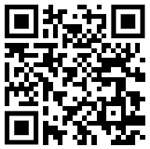
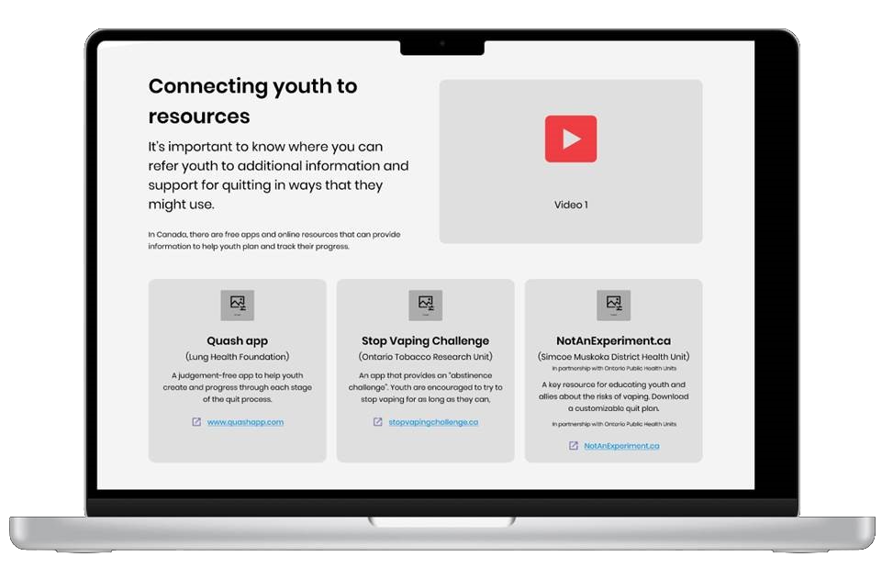
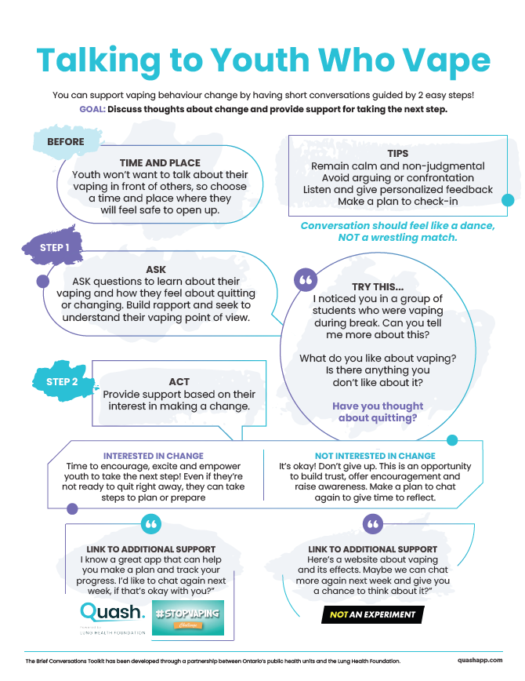

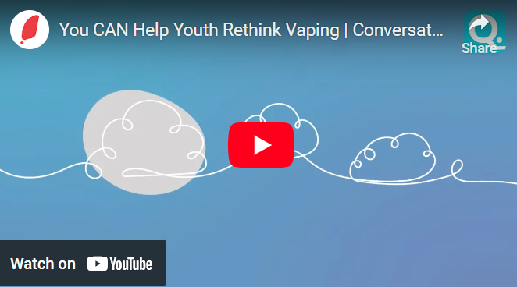


‘Brief Conversations’ Toolkit
How to videos
Referral Cards
Posters
And More!
Website Resources
Notes:
There is a toolkit available where you can find more information and resources on how to have brief conversations with youth who vape to encourage and support behaviour change.
In the toolkit there are videos, factsheets, posters, worksheets and more.
<insert web address – describe how to access the toolkit online>

Slide 19
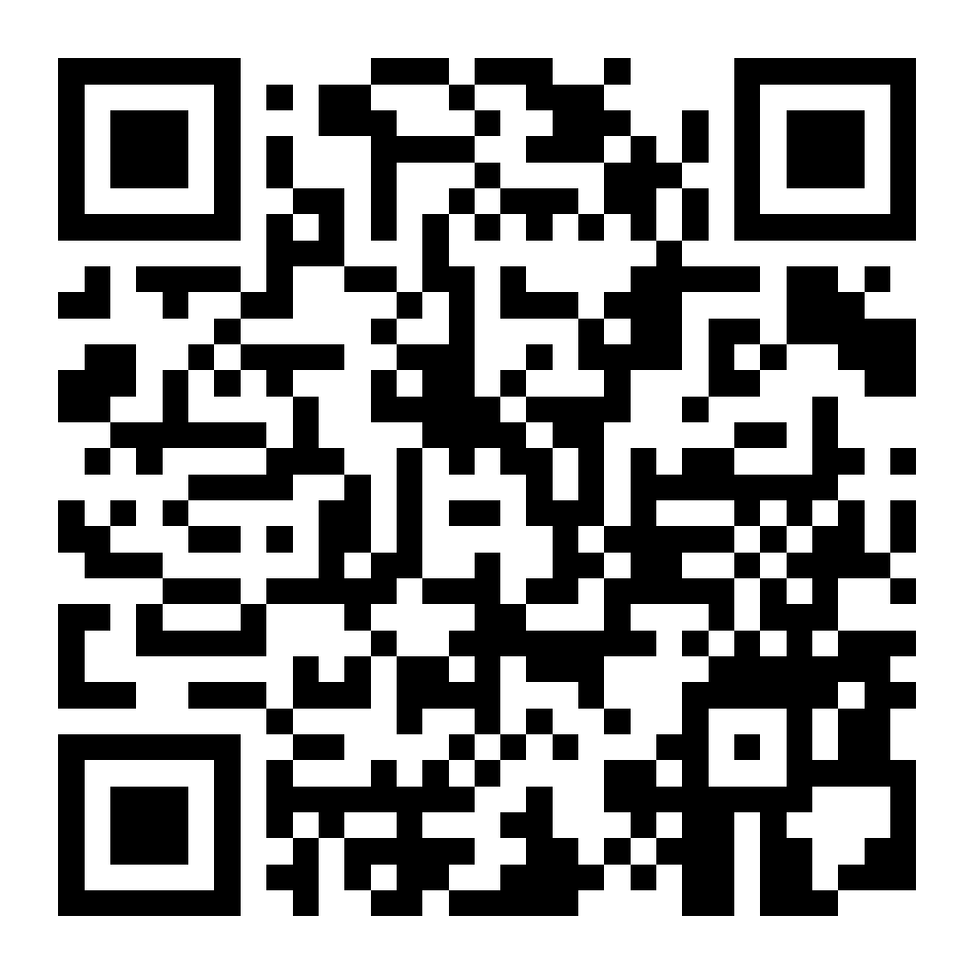
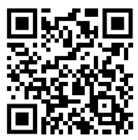
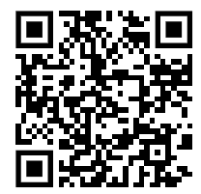

Thank you!
Please share your thoughts about this presentation by completing our
short survey
This presentation and toolkit resources were developed in collaboration with Ontario Public Health Units and the Lung Health Foundation.
For more information and training regarding youth vaping (or smoking) cessation programming, please visit:
The ‘Allies’ page on the QuashApp website.
Or contact your local Public Health Unit for more information or cessation programs that may be available in your community.
Notes:
The Toolkit and resources were developed in collaboration with Ontario Public Health Units and the Lung Health Foundation.
Thank you for tuning in and preparing yourself to take action to provide support to youth who vape and help reduce youth vaping rates.
If you are interested in learning more about how to provide more intensive youth vaping (or smoking) cessation support, please visit the ‘Allies’ page on the QuashApp website.
You can also contact your local Public Health Unit for more information or cessation programs that may be available in your community.
Please share your thoughts about this presentation by completing a short evaluation survey by scanning the QR code on the screen.
Link if needed:https://ca.mar.medallia.com/?e=90000858&d=l&h=37DD515C4093AC4

