Slide 1
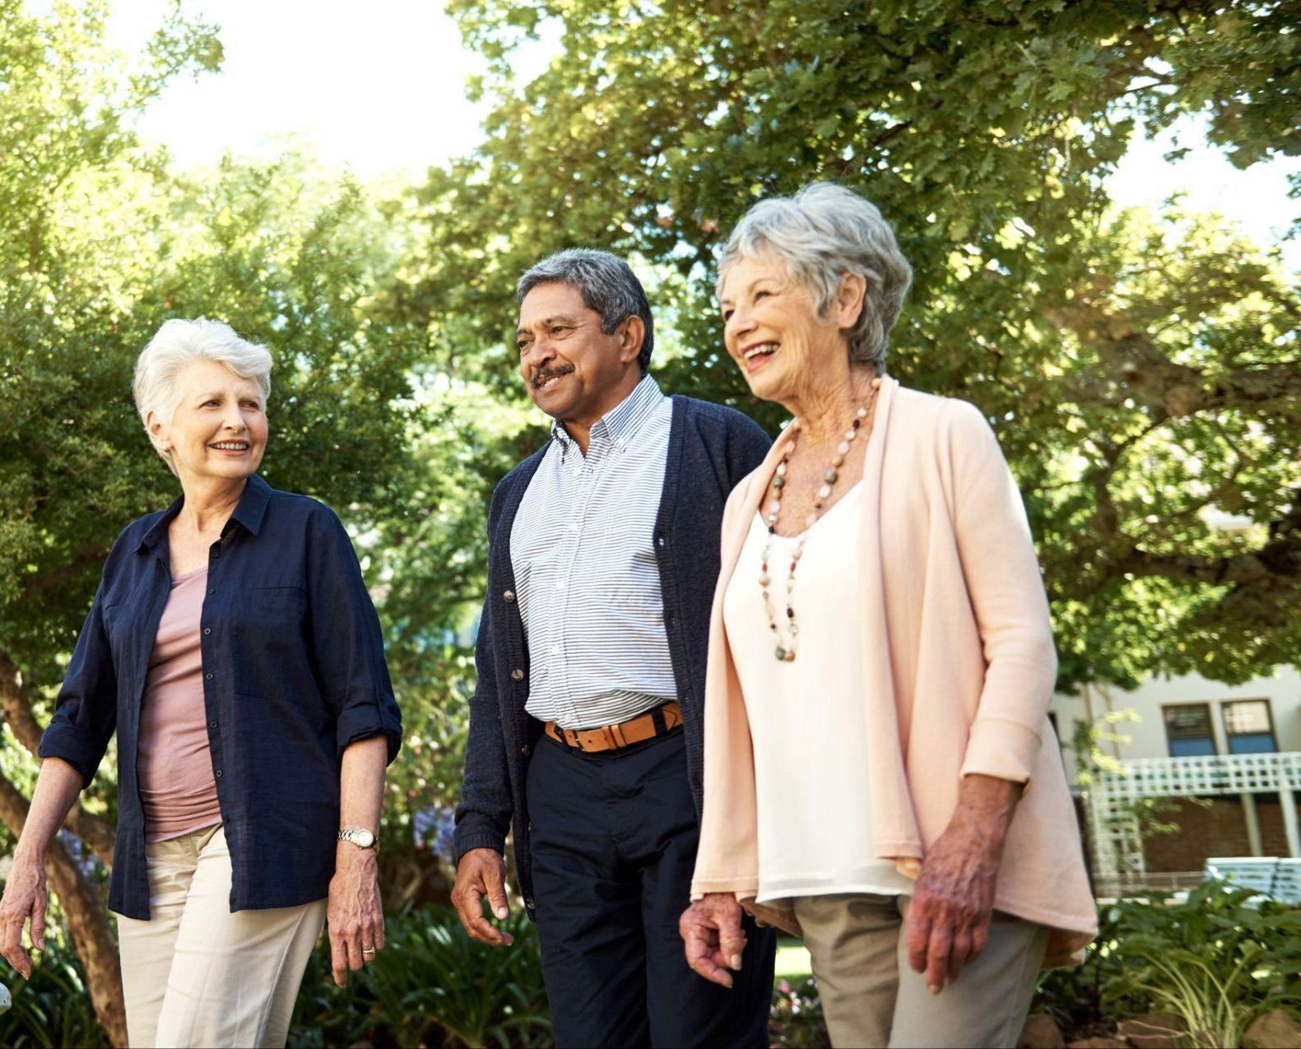

Mission
The Westminster CARES Foundation advances effective solutions that benefit seniors and people living with disabilities across Texas.

Slide 2
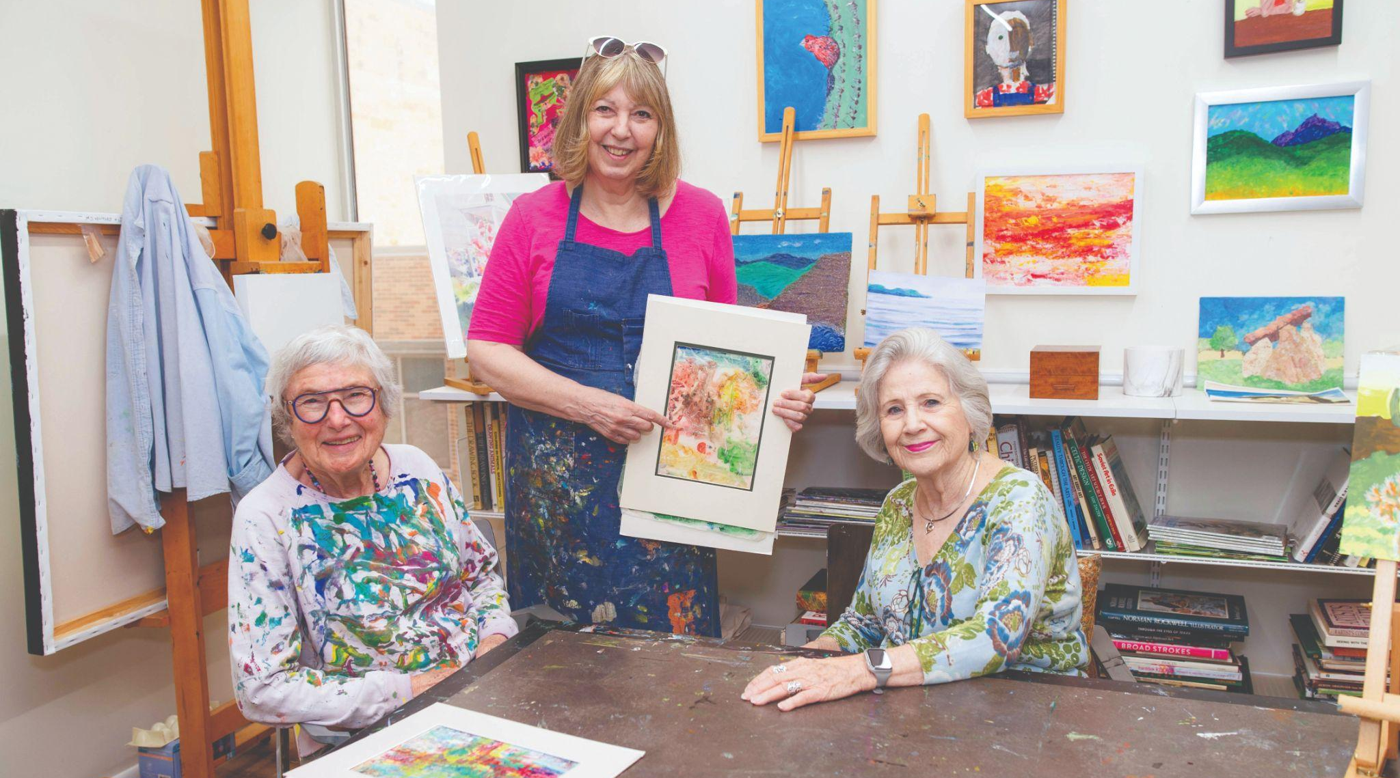
Vision
All Texas seniors and people with disabilities have access to a nurturing, purposeful, connected, and abundant life, and are treated with dignity and respect at all times.

Slide 3
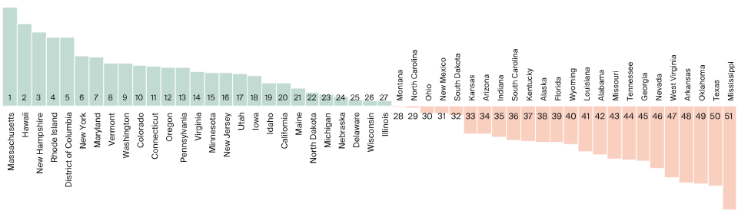
Texas continues to face opportunities in healthcare quality and outcomes
Healthcare Quality by State
US Healthcare by State 2025, Commonwealth Fund

Slide 4

Texas Culture Change Coalition (TXCCC)
Statewide initiative focused on transforming long-term care in Texas
Promotes person-centered care, dignity, and quality of life
Brings together providers, advocates, and organizations
Supports education, collaboration, and culture change efforts
Texas Culture Change Coalition
TXCCC aims to move towards a person-centered approach that promotes a higher quality of life.
The Texas Culture Change Coalition is a non-profit initiative that is dedicated to transforming the culture of long-term care provided to Texans, who are aging or have disabilities, by affirming the dignity and value of each individual and the caregivers who provide support for them.

Slide 5

How Westminster Supports Culture Change
While organizations like the Texas Culture Change Coalition are leading this movement across the state, the Westminster CARES Foundation is how we are putting those principles into action.
Westminster is an active participant in the culture change movement
We align with the principles of person-centered care
We support initiatives like the Texas Culture Change Coalition
The CARES Foundation was created to further this work

Slide 6

Purpose
The Westminster CARES Foundation provides grants, education, consulting, equipment, and other resources that foster social connections, promote independence, and create supportive communities serving seniors and the disabled.
The Foundation prioritizes projects that promote Texas Culture Change initiatives, quality improvement programs, and the Westminster Person Centered Care model.
CARES stands for Centered Around Resident Empowered Services, the model of care that allows residents to prioritize choices, dignity, and overall well-being.
Respect
Respect is the foundation of caring; it builds bridges between generations.

Slide 7

Residents choose how they spend their day
Staff build meaningful relationships-not just complete tasks
Families are actively involved in care planning
Environments feel comfortable, familiar, and home-like
What This Looks Like in Practice
Care plans reflect each resident’s individual goals and preferences

Slide 8
Voices Drive Improvement
We will continuously learn and improve based on resident feedback
Person Centered Care Promises
Relationships Before Tasks
We will provide meaningful relationships over task driven interactions
Guiding how we deliver care, build relationships, and support each resident.
Safety with Dignity and Freedom
We will provide safe environments that still allow reasonable risk and personal freedom
Families are Partners
We will collaborate with families as valued care partners
Purpose Matters at Every Age
We will support independence, dignity, and purposeful living

Slide 9
Every Person is Known
We will honor each resident’s life story, preferences, and goals every day
Person Centered Care Promises
Choice Shapes Daily Lives
We will provide residents with choice and control over their daily lives
Guiding how we deliver care, build relationships, and support each resident.
Listening Comes First
We will listen first and act with respect and empathy
Care is a Shared Decision
We will partner with residents in decisions about their care and services
People over Procedures
We will adapt our care to the person, not force the person to adapt to the system

Slide 10

Why the CARES Foundation was created
Aligned with the principles of culture change and person-centered care.
Growing need for services for seniors and individuals with disabilities
Gaps in access to care, social connection, and resources
Opportunity to invest in innovative, person-centered solutions
Commitment to extending impact beyond Westminster

Slide 11
Grants
Grants to support high-impact organizations
How CARES Makes an Impact
Education & Training
Every donation goes directly to carefully vetted, high-impact organizations dedicated to serving senior and disabled populations across every region of Texas. Thanks to your generosity, the CARES Foundation will provide essential support and dignity to some of the most underserved and at-risk members of our community.
Education and training to advance culture change
Resources
Resources that foster independence and connection

Slide 12
Who CARES Supports
Organizations that serve the following needs:
Senior adults and the disabled who have limited financial resources or struggle to meet basic needs
Senior adults facing food insecurity
Homebound or socially isolated seniors who lack regular companionship or support
Aging senior veterans who have served our country and now need our care
Adults living with disabilities who are navigating daily challenges with limited assistance
Senior adults in need of access to healthcare or safe, stable housing
Initially, the Foundation will invite organizations to submit grant applications.
This process will allow the Board to ensure effective use of the Foundation's resources.

Slide 13

Community Partnerships
Initial partners include organizations such as:
Texas Culture Change Coalition
AGE of Central Texas
Meals on Wheels Central Texas
Family Eldercare
Alzheimer’s Texas
Mobile Loaves & Fishes
The Arc of the Capital Area

Slide 14
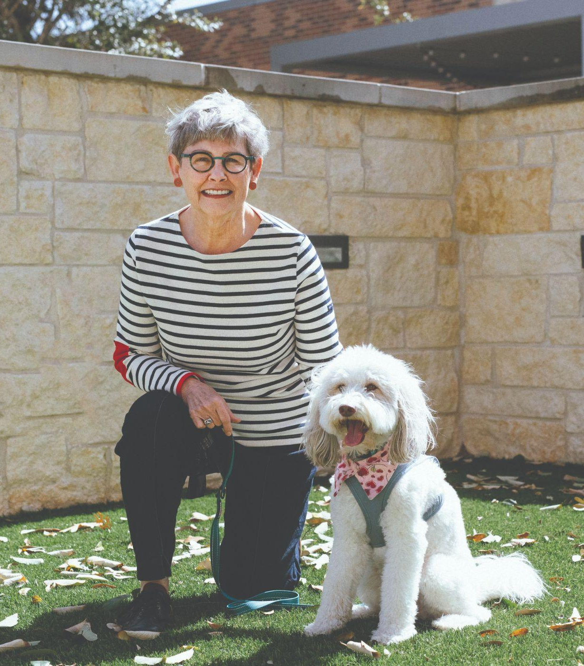

The Impact We Aim to Create
The CARES Foundation is focused on creating meaningful, measurable impact for seniors and individuals with disabilities across Texas.
Increased access to care and essential services
Reduced isolation among seniors
Greater independence and dignity
Stronger, more connected communities
Support for caregivers and service providers
Strengthening lives and communities across Texas

Slide 15
Challenges & Opportunities
Challenges
Opportunities
Growing aging population
Limited access to resources
Workforce pressures in senior care
Investment through CARES Foundation
Culture change through TXCCC
Expanding partnerships across Texas

Slide 16
Future Plans & Goals
Grow Donor & Community Support
Expand awareness and community involvement to support future grant funding.
Expand Partnerships across Texas
Strengthen relationships with organizations serving seniors and individuals with disabilities.
Advance Person-Centered Care Initiatives
Support programs that promote dignity, independence, and quality of life.

Slide 17


Contact Us
Charles Borst
Co-Founder & CEO
Phone: 512-454-2140
Address: 4100 Jackson Ave. Austin, TX 78731
wcares@wmanor.com
www.wcares.net
www.wcares.net

