Slide 1
Parenting Matters
What is Healthy Parenting?

Slide 2
Take a moment to recall both a positive and
a negative interaction with your parents/caregiver as an adolescent? What makes one positive and one negative?

Slide 3
Romans 12 vs 1,2 “Therefore, I urge you, brothers and sisters, in view of God’s mercy, to offer your bodies as a living sacrifice, holy and pleasing to God—this is your true and proper worship Do not conform to the pattern of this world, but be transformed by the renewing of your mind. Then you will be able to test and approve what God’s will is—his good, pleasing and perfect will. “NIV

Slide 4
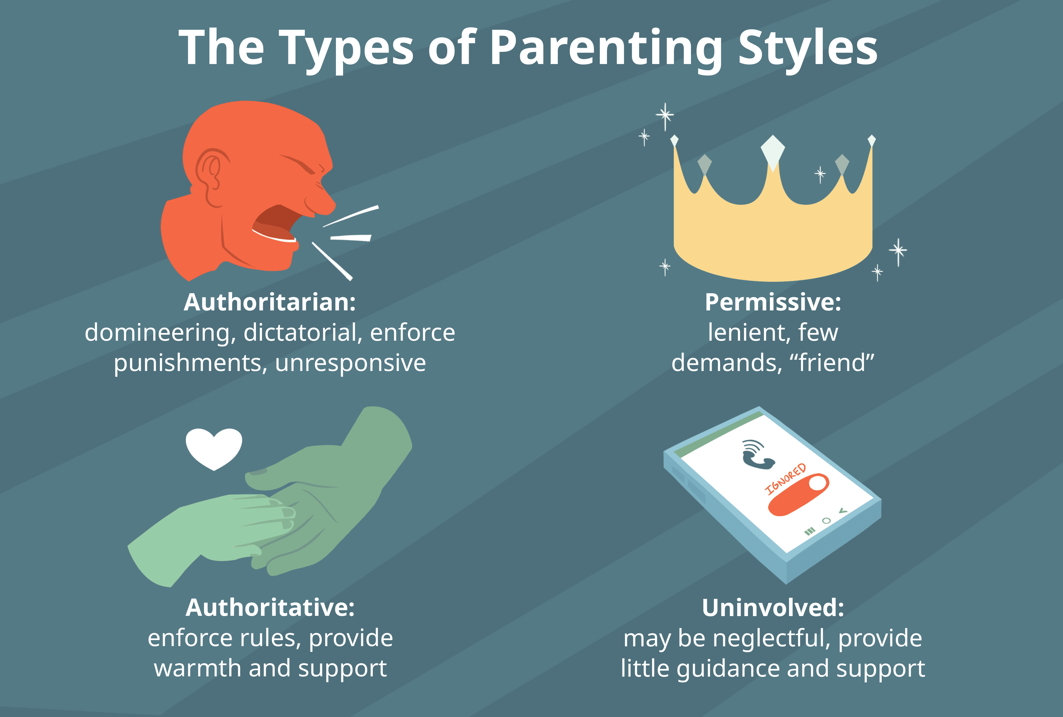

Slide 5
Ephesians 6 vs 4 “ Fathers, do not exasperate your children; instead, bring them up in the training and
instruction of the Lord.” NIV
Col 3 vs 21
“Fathers, do not embitter your children, or they will become discouraged.” NIV

Slide 6
What is Authoritative Parenting?
Acceptance /Involvement Warm Responsive Attentive Patient Sensitive | Level of Control Reasonable expectations for maturity Consistent Explains rules, expectations | Autonomy Allows decision-making where appropriate Encourages expression of thought, feelings, desires Disagreements handled with constructive co- operation

Slide 7
1 Corinthians 13 vs 4-8 “ Love is patient, love is kind. It does not envy, it does not boast, it is not proud. It does not dishonor others, it is not self-seeking, it is not easily angered, it keeps no record of wrongs. Love does not delight in evil but rejoices with the truth. It always protects, always trusts, always hopes, always perseveres. Love never fails.” NIV
James 1 vs 19,20 “ My dear brothers and sisters, take note of this: Everyone should be quick to listen, slow to speak and slow to become angry, because human anger does not produce the righteousness that God desires.” NIV
Proverbs 22 vs 6 “ Start children off on the way they should go, and even when they are old they will not turn from it.” NIV

Slide 8
Ephesians 4 vs 29-32 “ Do not let any unwholesome talk come out of your mouths, but only what is helpful for building others up according to their needs, that it may benefit those who listen. And do not grieve the Holy Spirit of God, with whom you were sealed for the day of redemption. Get rid of all bitterness, rage and anger, brawling and slander, along with every form of malice. Be kind and compassionate to one another, forgiving each other, just as in Christ God forgave you.” NIV
Phil 2 vs 3,4 “ Do nothing out of selfish ambition or vain conceit. Rather, in humility value others above yourselves, not looking to your own interests but each of you to the interests of the others.” NIV
Colossians 3 vs 12-14 “ Therefore, as God’s chosen people, holy and dearly loved, clothe yourselves with compassion, kindness, humility, gentleness and patience. Bear with each other and forgive one another if any of you has a grievance against someone. Forgive as the Lord forgave you. And over all these virtues put on love, which binds them all together in perfect unity.” NIV

Slide 9
Healthy parenting spells:
Love, trust, protection, patience, kindness, gentleness, compassion, using your words carefully and your ears more! This is Healthy Connection and Communication.

Slide 10
TIME time time
time TIME TIME TIME time TIME time TIME TIME time TIME time

Slide 11
Carl Jung, a famous psychologist said the following:
“Hurry is not of the devil; hurry is the devil.”

Slide 12
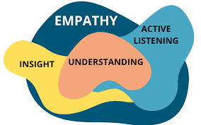
Empathy
“Empathy is a fundamental human trait that involves understanding and sharing the feelings, perspectives, and experiences of others. It goes beyond sympathy or compassion and requires actively putting yourself in someone else’s shoes to grasp their emotions and motivations”

Slide 14
Changes in brain structure and function: Thinking Risk and Reward Emotions Increased sensitivity to stress Sleep Patterns Social Changes

Slide 16
What you do matters
You cannot be too loving
Be involved in your child’s life
Adapt your parenting to fit your child
Establish rules and set limits
Help to foster your child’s independence
Be consistent
Avoid harsh discipline
Explain your rules and decisions
Treat your child with respect
Laurence Steinberg, “Adolescence”, McGraw Hill, LLC. NY,13th Ed. 2023.105.

Slide 17
1 Peter 4 vs 8
“Above all, love each other deeply, because love covers over a multitude of sins” NIV

Slide 18
“The key for both generations is to be open to what is unfolding,
to honour the person an adolescent is becoming through all the many unpredictable stages and experiences this time entails”
Dr. Daniel Siegel

Slide 19
Success “To laugh often and love much;
To win the respect of intelligent persons and the affection of children;
To earn the approbation of honest critics and endure betrayal of false friends;
To appreciate beauty;
To find the best in others;
To give of one’s self;
To leave the world a bit better, whether by a healthy child, a garden patch or a redeemed social condition;
To have played and laughed with enthusiasm and sung with exultation;
To know even one life has breathed easier because you have lived;
This is to have succeeded.”
Bessie Anderson Stanley

Slide 20
Recommended Reading:
Good Enough Parenting: John and Karen Louis
Brainstorm: Dr. Daniel Siegel
Boundaries for Teens: Dr. John Townsend
The Blessing: John Trent, Gary Smalley & Kari Trent Stageberg
The Power of the Other: Dr. Henry Cloud

