Slide 1

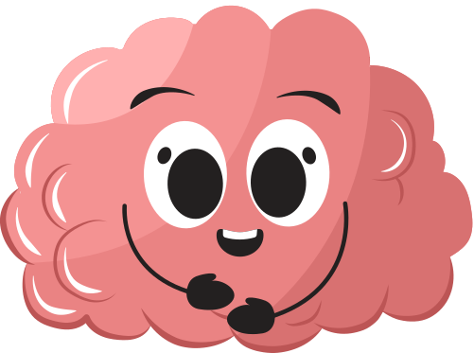




Your Guide to “NeuroQuest: National Brain Awareness Week at MoN ”
March 16-20 2026

Slide 2
NATHIONAL BRAIN AWARENESS WEEK AT MARY OF NAZARETH SCHOOL
5
M
1
Introduction
5
1st Grade
MS Assembly
2
Pre-K to 5th Assembly
6
2nd Grade
6
Middle School
3
PreK
7
3rd Grade
7
Specials
Kindergarten
4
8
4th / 5th Grade
8
Conclusion

Slide 3
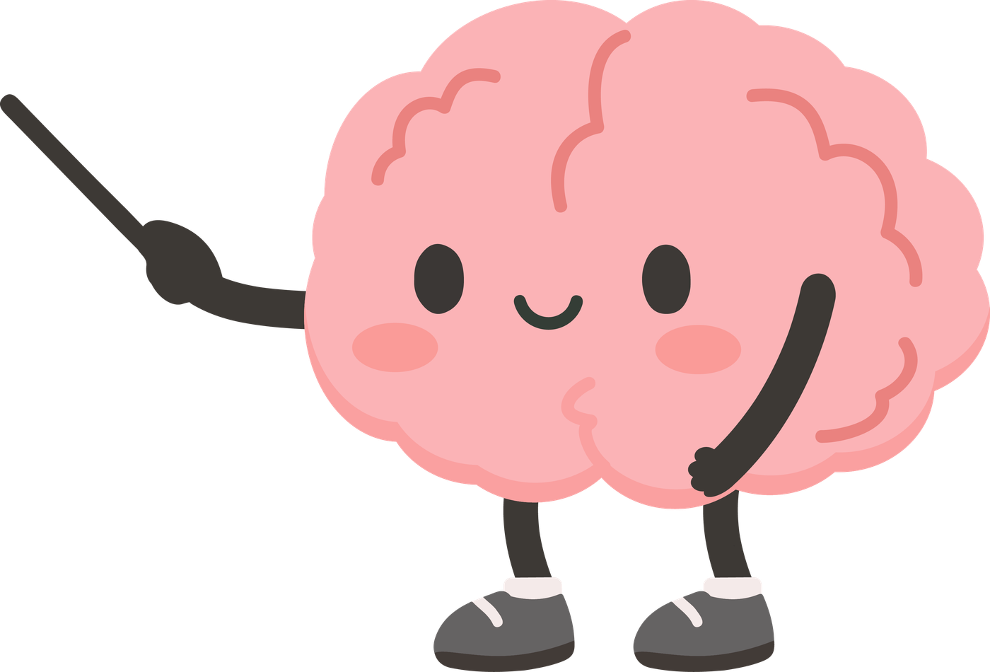

INTRODUCTION
Inspired by brainy insights from The Dana Foundation and The Franklin Institute, Brain Awareness Week is a worldwide initivitive celebrating brain science and understanding how our we use our brains to do everything.
At Mary of Nazareth, students will embark on a mind-bending adventure, uncovering the brain's daily magic tricks and picking up some savvy brain-boosting habits along the way!

Slide 4

WHY ARE STUDENTS AT MON LEARNING ABOUT THE BRAIN?
When children learn about how their brains work, related to thinking, feeling, and movement, it significantly boosts their self-awareness.
By understanding how their brains operate, they become better at identifying their emotions, recognizing when they need a break, and making healthier choices regarding their behavior and well-being.
Gaining insight into how the brain regulates emotions, focus, and actions greatly improves students' physical and emotional self-care. Studies indicate that a better understanding of brain function enhances confidence and happiness, fostering resilience. This knowledge empowers students to approach challenges with curiosity and determination instead of judgement and frustration.

Slide 5
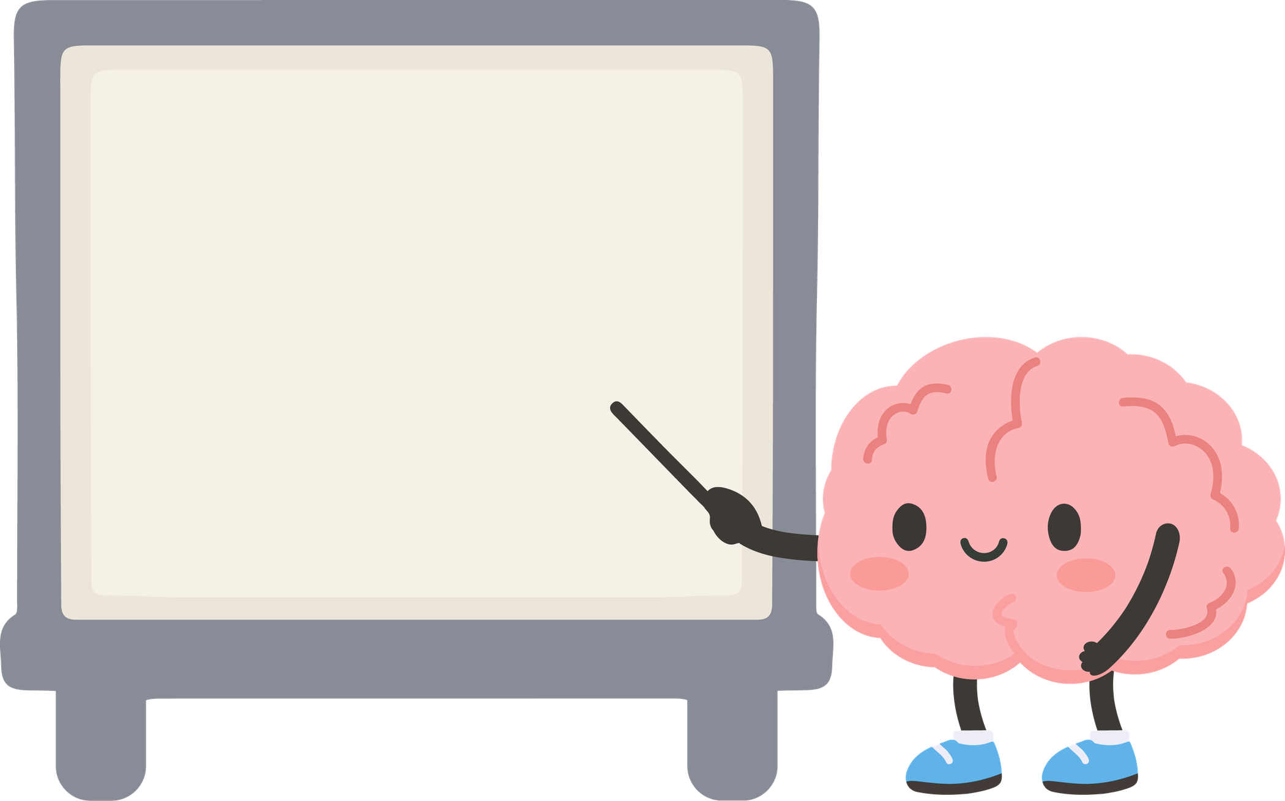

ASSEMBLY PREK-5TH GRADES
Students will learn about six different parts of the brain and how they interact to help our bodies move and balance, think through difficult tasks, remember things and develop and sustain friendships
Medical Prosessionals from our school community will present information all about the brain and will demonstrate how different parts of the brain work together.

Slide 6
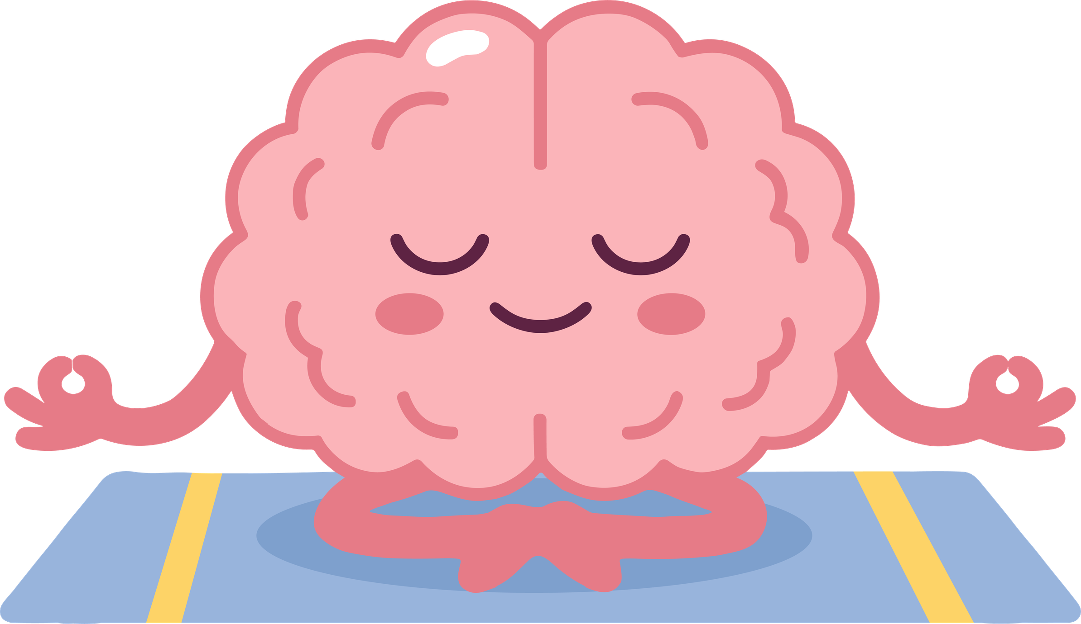
PRE-K
In Pre-K, students will learn:
that their brain helps them calm down when they feel upset
"When our brain feels calm, our body feels calm too."

Slide 7
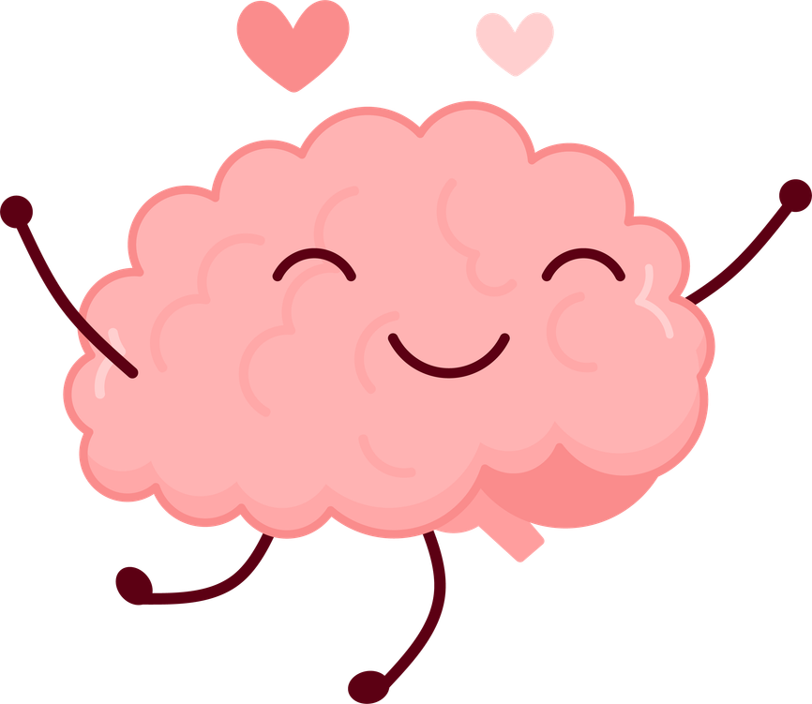
KINDERGARTEN
In Kindergarten, students will:
identify the 5 lobes/parts of the brain
learn the basic functions of each
understand where each part is located in the brain
have fun shaping and building the brain with clay
I love my brain!
And All its amazing parts

Slide 8
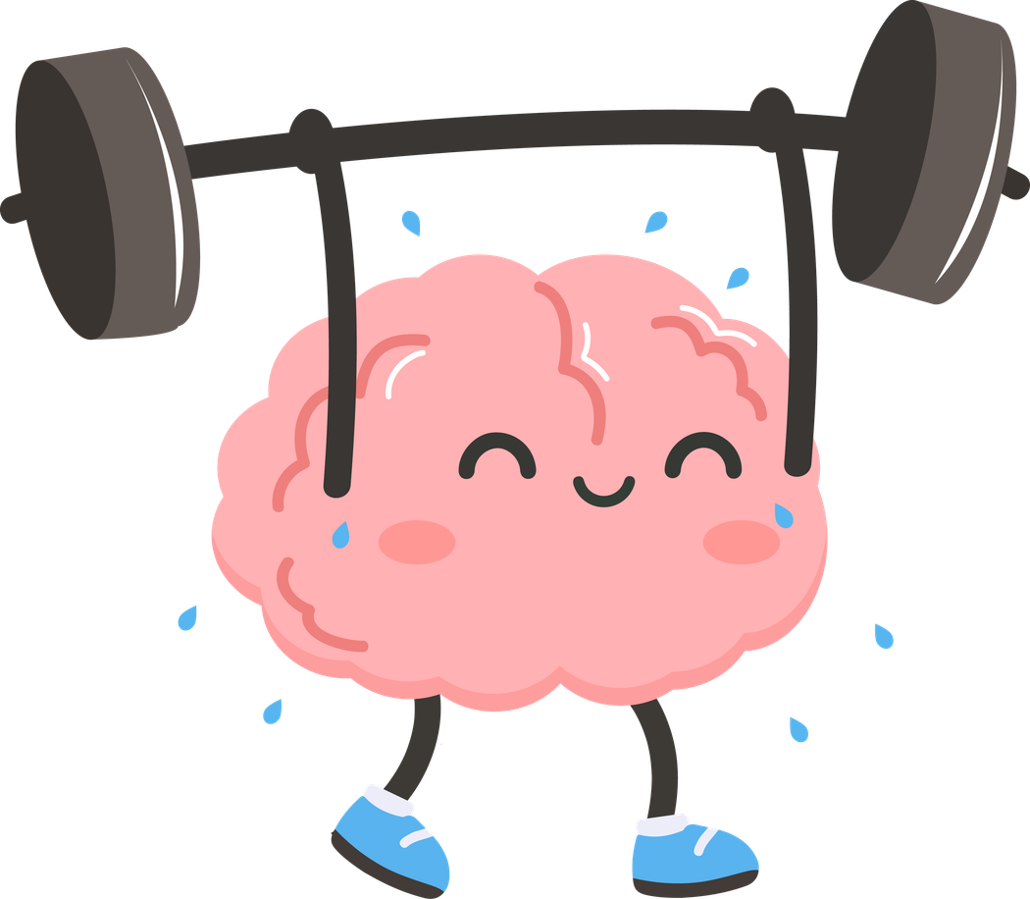
FIRST GRADE
"DOING HARD THINGS MAKES YOUR BRAIN STRONGER“
In first grade, students will learn:
their brains are powerful
their brains were designed by God
how to identify different parts of the brain and what they do

Slide 9

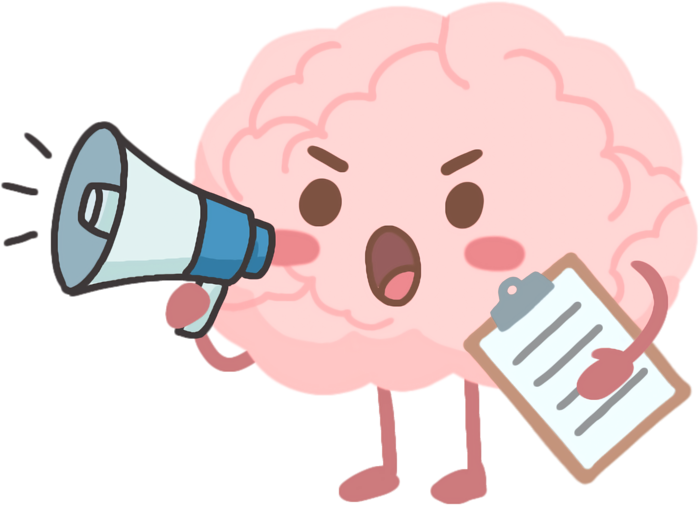
“Boss” Brain
SECOND GRADE
I’m the boss
In second grade, students will learn:
how their brain is the boss of their body
the power of daily habits
their “boss” brain helps them know how to focus, balance, and remember important information and develop good habits for learning

Slide 10
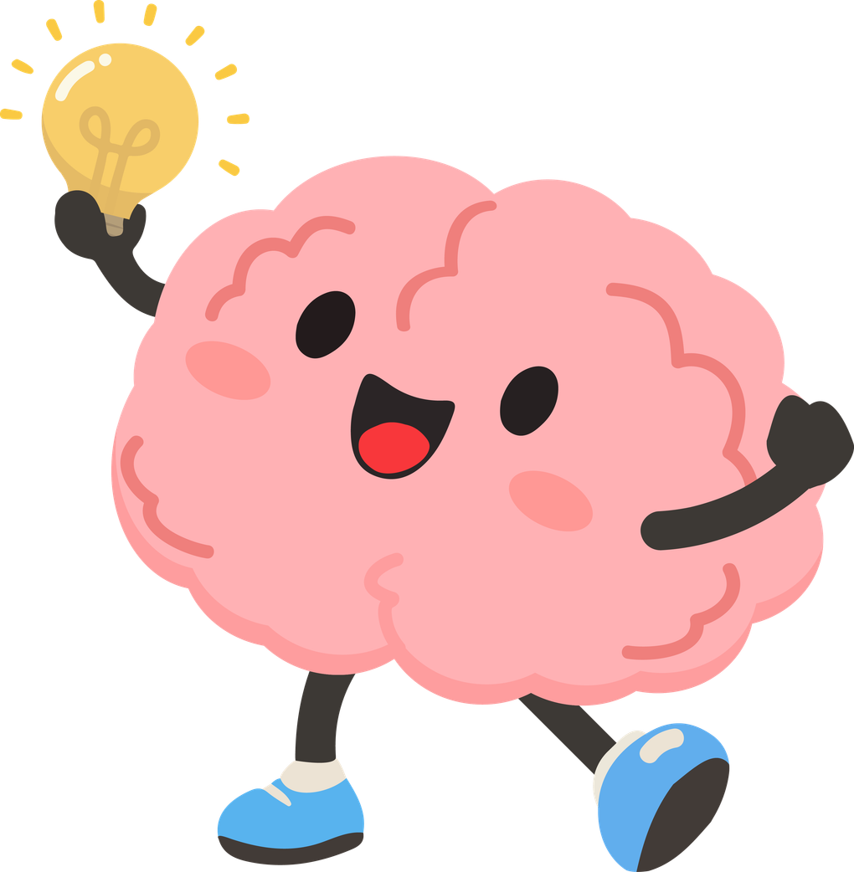
THIRD GRADE
EXPLORING ALL
THE AMAZING PARTS OF THE BRAIN
In third grade, students will:
explore the nervous system and reflexes
learn why taking care of our brains is important
get an overview of brain regions and their functions
understand memory, protective reflexes, and how the brain works
discover ways to keep the brain healthy and strong

Slide 11
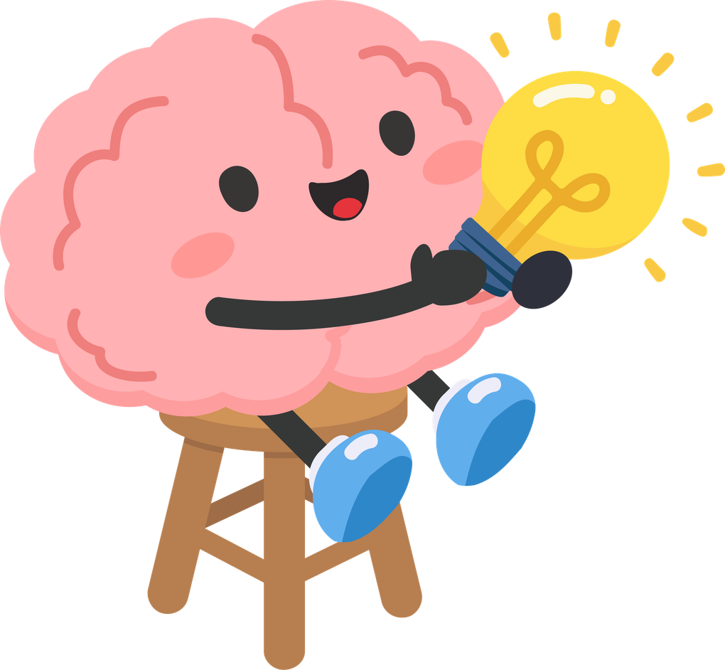
4TH/5TH GRADE
In 4th and 5th Grade, students will learn:
about the science behind Anxiety
how our brains fill in the gaps when we don’t have all the information about a situation
how to connect what they learned about the brain to their personal experiences
about the structure and regions of the brain and the parts responsible for focus, memory, and well-being.
Knowledge is power

Slide 12
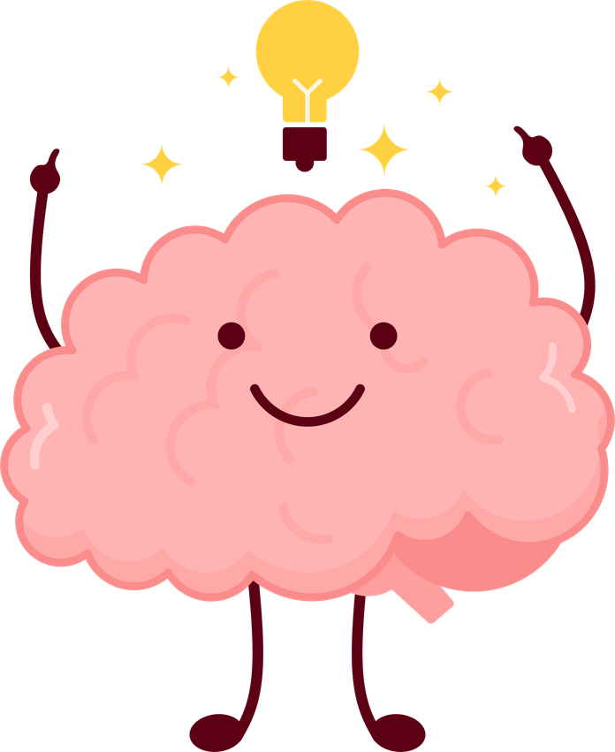

MIDDLE SCHOOL ASSEMBLY
MEET A NEUROSERGEON
We are thrilled to welcome Dr. Josh Olexa, a neurosurgeon and friend of Nurse Erin Demereria, who will engage middle school students in discussions about:
The various regions of the brain and their specific functions
Brain development during childhood and adolescence
The importance of developing self-awareness
Medical Advancements in AV technology being used during brain surgery
*Hands on opportunities will be avaliable.

Slide 13
MIDDLE SCHOOL
Middle School students will learn :
that prayer and meditation can change how our brain works and help us feel, think, and handle stress better
about the Stroop Effect and how our brain can get confused when words and colors don’t match
Doing math helps our brain stay active and grow
Learn brain and mind words using Greek and Latin roots
Explore how people have understood the brain over time and what happens when it doesn’t work right

Slide 14
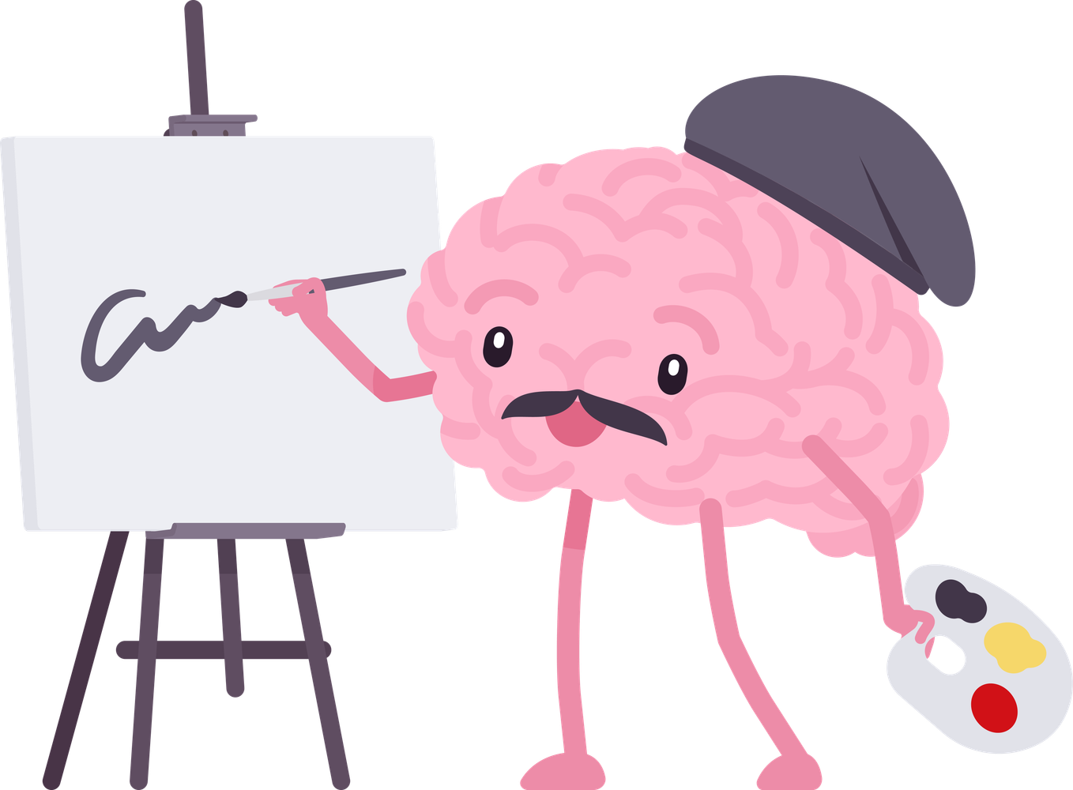
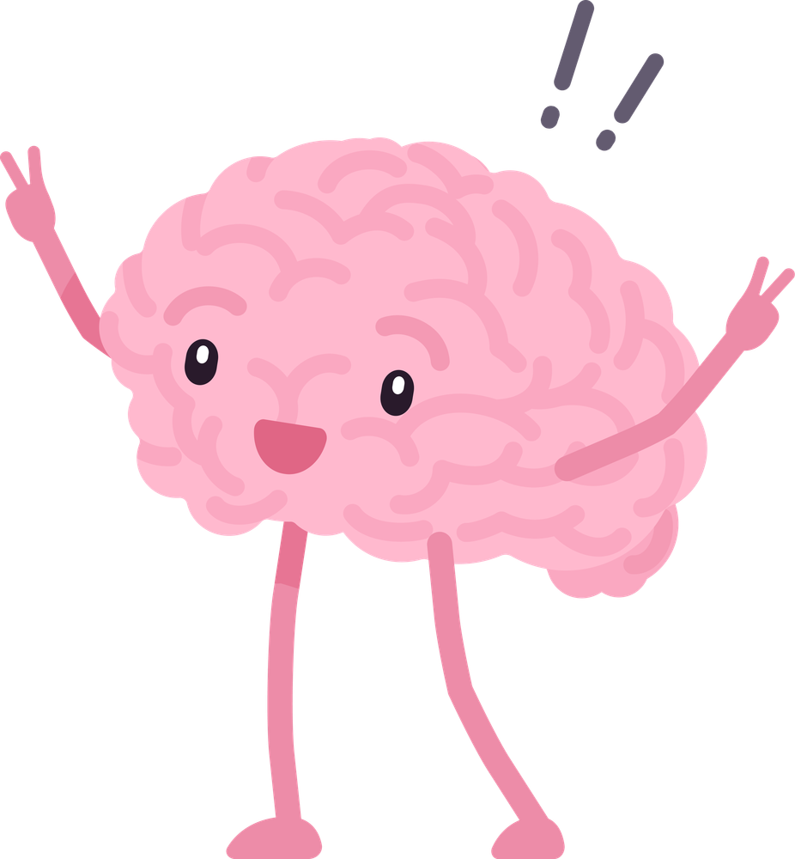
SPECIALS
In STREAM, students will learn how the brain interprets the five senses. They will also Explore focus, memory, habits, emotions, stress, decision-making, well-being, and nutrition
In Computers, students will compare the brain to computers and see how our brains use partial information in ways computers can’t. Students will explore how it processes directions and solves problems.
In Art, students will discover left vs. right brain functions with logic and creativity.
In PE, students will engage in fun, hands-on games to see the brain in action

Slide 15
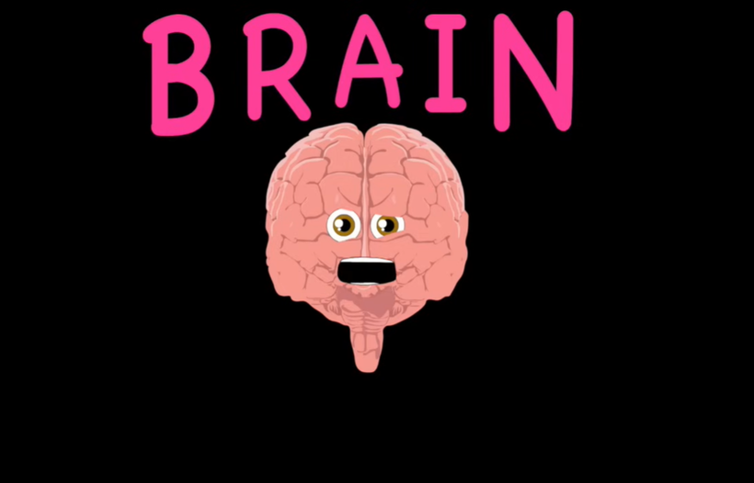

CONCLUSION
GET READY FOR A WEEK OF CURIOSITY, DISCOVERY, AND FUN AS WE BEGIN OUR NEUROQUEST—A JOURNEY TO BETTER UNDERSTAND OUR BRAINS AND HOW TO TAKE CARE OF THEM!

