Slide 1
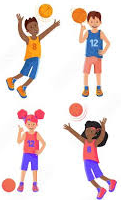

Occupational Therapy Motor Ball Skills Group
“Let’s Bounce”
Expression of Interest January 2026 School Holidays!
Dates:
January TBC
What is the Ball Skills Program?
Designed for ages 5-16 years (please contact us if your child is out of
this age group and wishes to attend). The ball skills program is a series of
seven 1 hour sessions. This fun, supportive, team based ball skills program incorporates skills and activities based on sports such as Basketball.
This program aims to support your child with developing their ball skills, hand-eye co-ordination, peer communication, winning and losing, shared play skills, team sport readiness, and overall confidence. The program
is facilitated by Occupational Therapists.
On completion, you will receive a written report of your child’s progress.
Next Steps:
Contact our administration staff if you wish to enrol your child on
98071114 or email info@kidsconnecttherapy.com.au
If your child does not attend Kids Connect Therapy you are required to book in for a consultation to assess suitability.

