Slide 1



Port Jefferson Hills
The North Fork Gateway at Ridge

Slide 2

OUR STORY
With over 30 years of experience, we specialize in high-end and exclusive residential homes as well as commercial. Producing high quality homes for a high quality life is the key to every home we build. We understand the excitement and adventure associated with a new home transition, but there are many things that can leave a homebuyer overwhelmed at any stage of the process.
Our developments are meant to make that process easier; from application to financing to move-in day. By working with an experienced team of local contracting, financial, and real estate experts, you can count on our experts to deliver you the home of your dreams in the highly-desired North Fork region of Long Island, NY.
OUR MISSION
To deliver a relaxed and refined buying and selling experience. We stand out from the rest with our standards of integrity, expertise and sophistication.

Slide 3

PAST
PROJECTS

Slide 4



THE NORTH FORK GATEWAY AT RIDGE
A hidden suburban gem, Ridge, NY is conveniently located a few miles from the Long Island Expressway minutes away from Long Island’s award-winning wineries, farms, and beaches.
Nearby parks & hiking trails
Close to Tanger Outlets & other shopping
Gateway to the famous North Fork Wine Trail

Slide 5




"LIVE THE LIFE YOU DREAMED OF BEING CLOSE TO IT ALL."
Long Island's prestigious North Shore can be your daily getaway!
Limitless beaches, wineries, golf courses, and so much more.

Slide 6




THE PROCESS
Choose Your Lot
Design Your
New Home
Lock Rate &
Close Once
Move Into Your
Dream Home

Slide 7
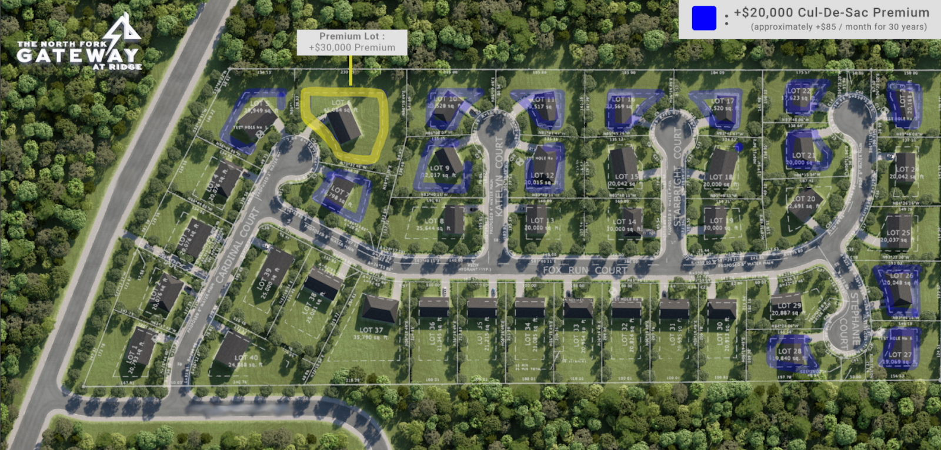

Slide 8




Slide 9
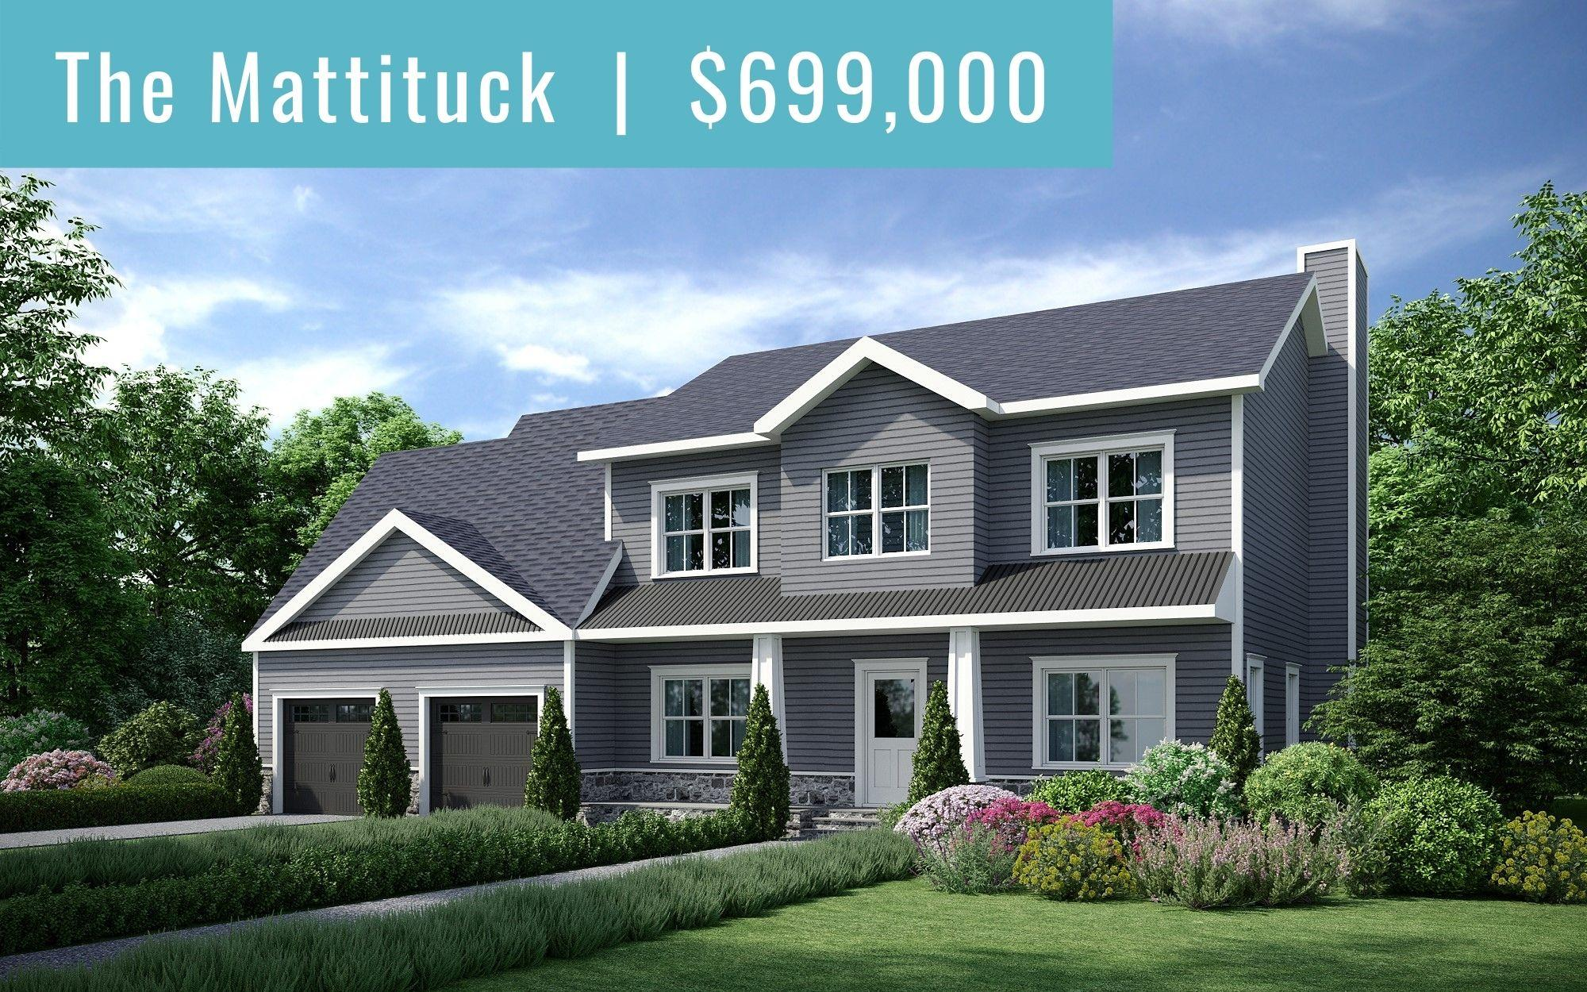
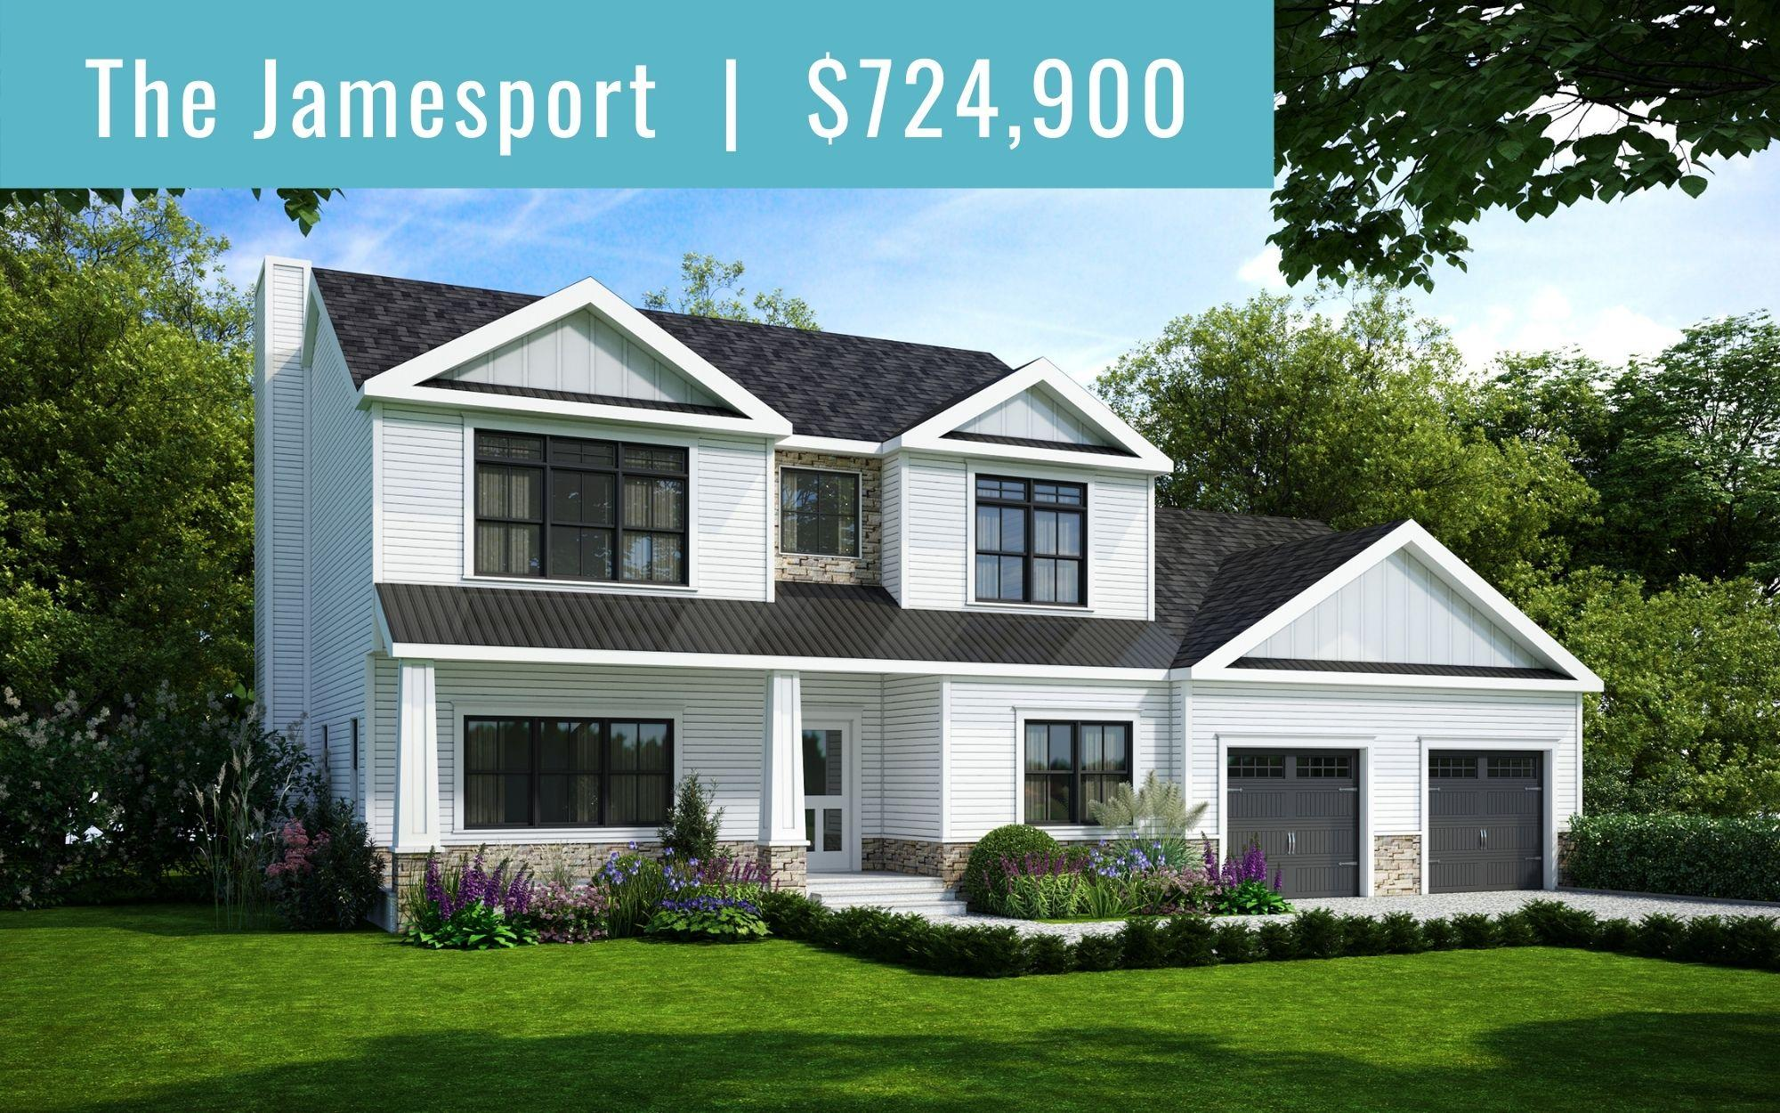
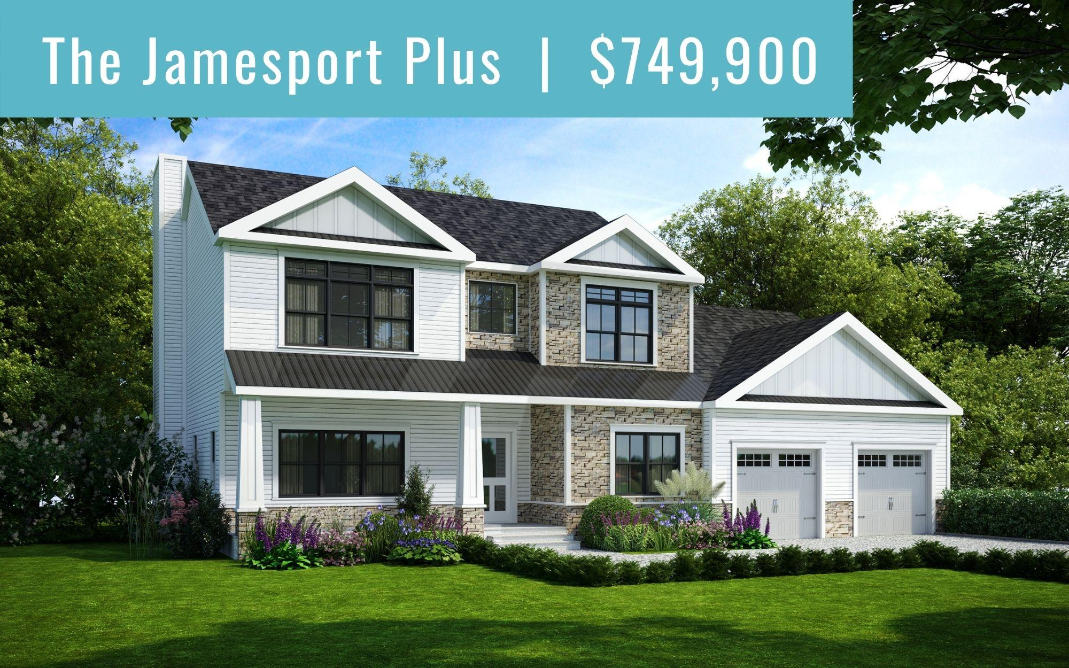
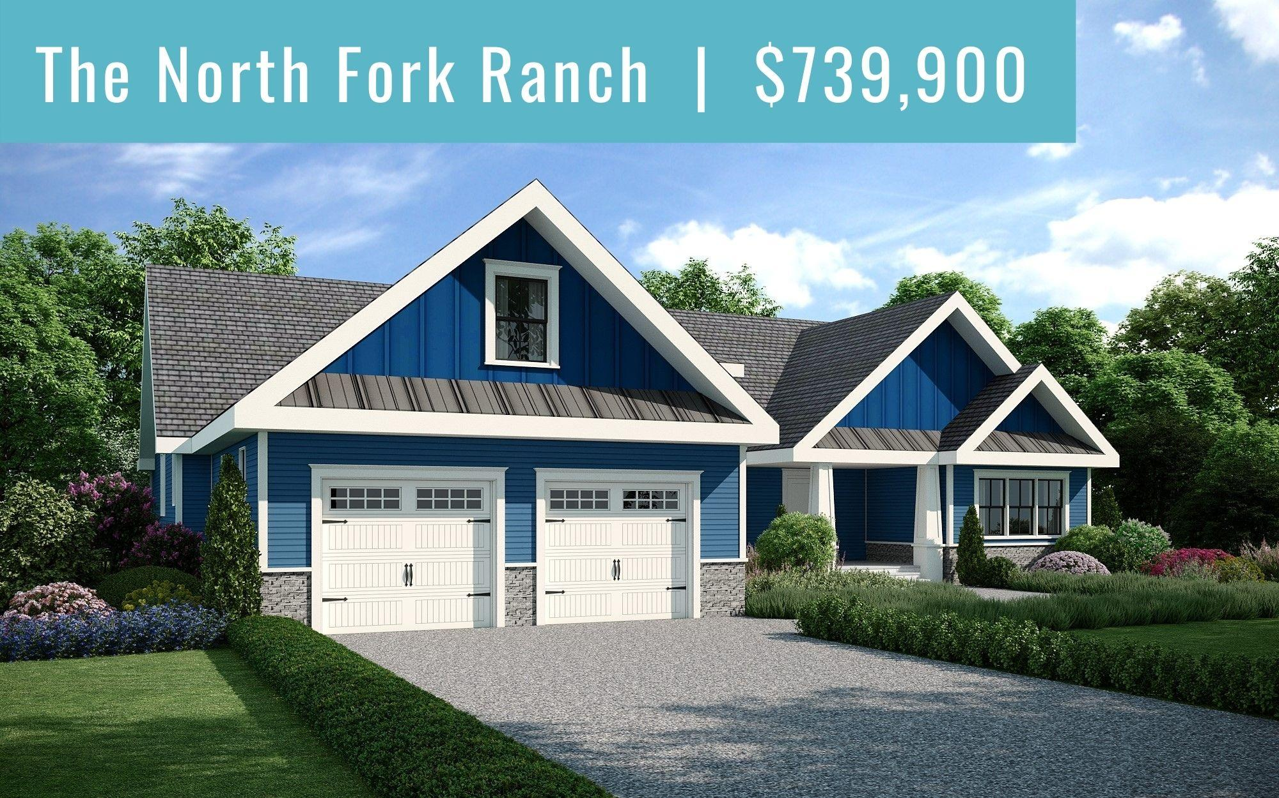

Slide 10
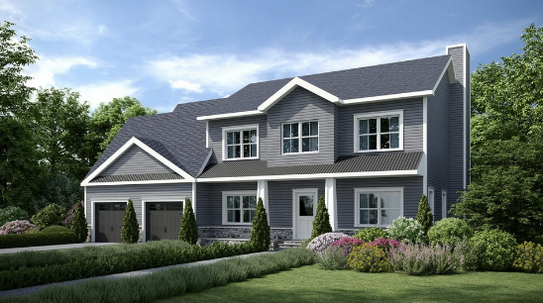
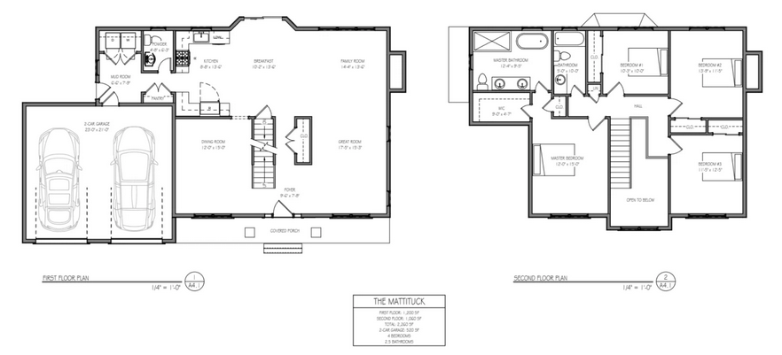
The Mattituck
FIRST FLOOR: 1,200 SQ FT
SECOND FLOOR: 1,060 SQ FT
TOTAL: 2,260 SQ FT
2-CAR GARAGE: 520 SQ FT
4 BEDROOMS
2.5 BATHROOMS

Slide 11
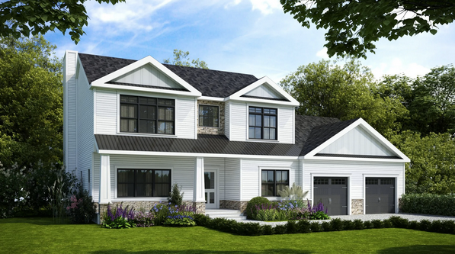
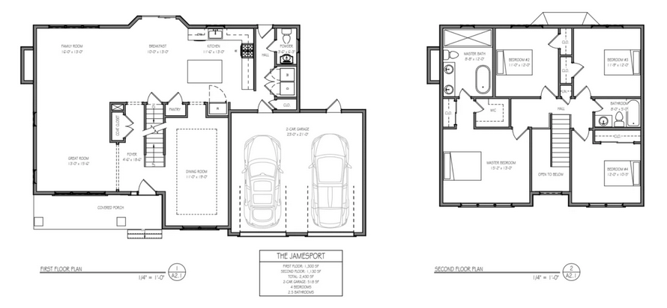
The Jamesport
FIRST FLOOR: 1,300 SQ FT
SECOND FLOOR: 1,130 SQ FT
TOTAL: 2,430 SQ FT
2-CAR GARAGE: 518 SQ FT
4 BEDROOMS
2.5 BATHROOMS

Slide 12
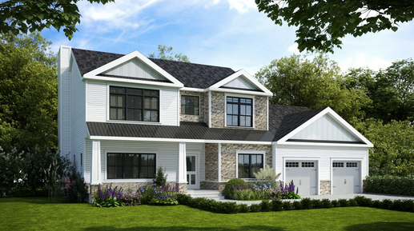
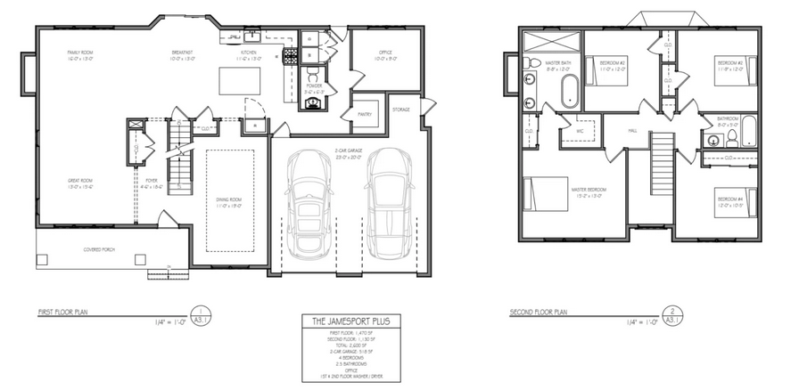
The Jamesport Plus
FIRST FLOOR: 1,470 SQ FT
SECOND FLOOR: 1,130 SQ FT
TOTAL: 2,600 SQ FT
2-CAR GARAGE: 518 SQ FT
4 BEDROOMS
2.5 BATHROOMS
OFFICE
1ST & 2ND FLOOR WASHER / DRYER

Slide 13
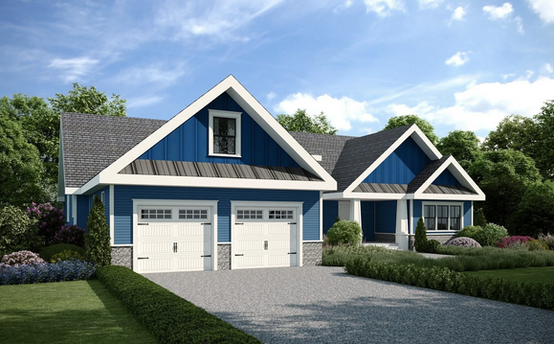
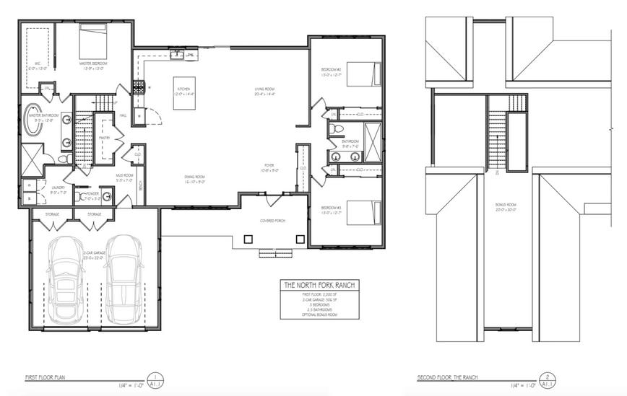
The North Fork Ranch
FIRST FLOOR: 2,200 SQ FT
2-CAR GARAGE: 506 SQ FT
3 BEDROOMS
2.5 BATHROOMS
OPTIONAL BONUS ROOM

Slide 14

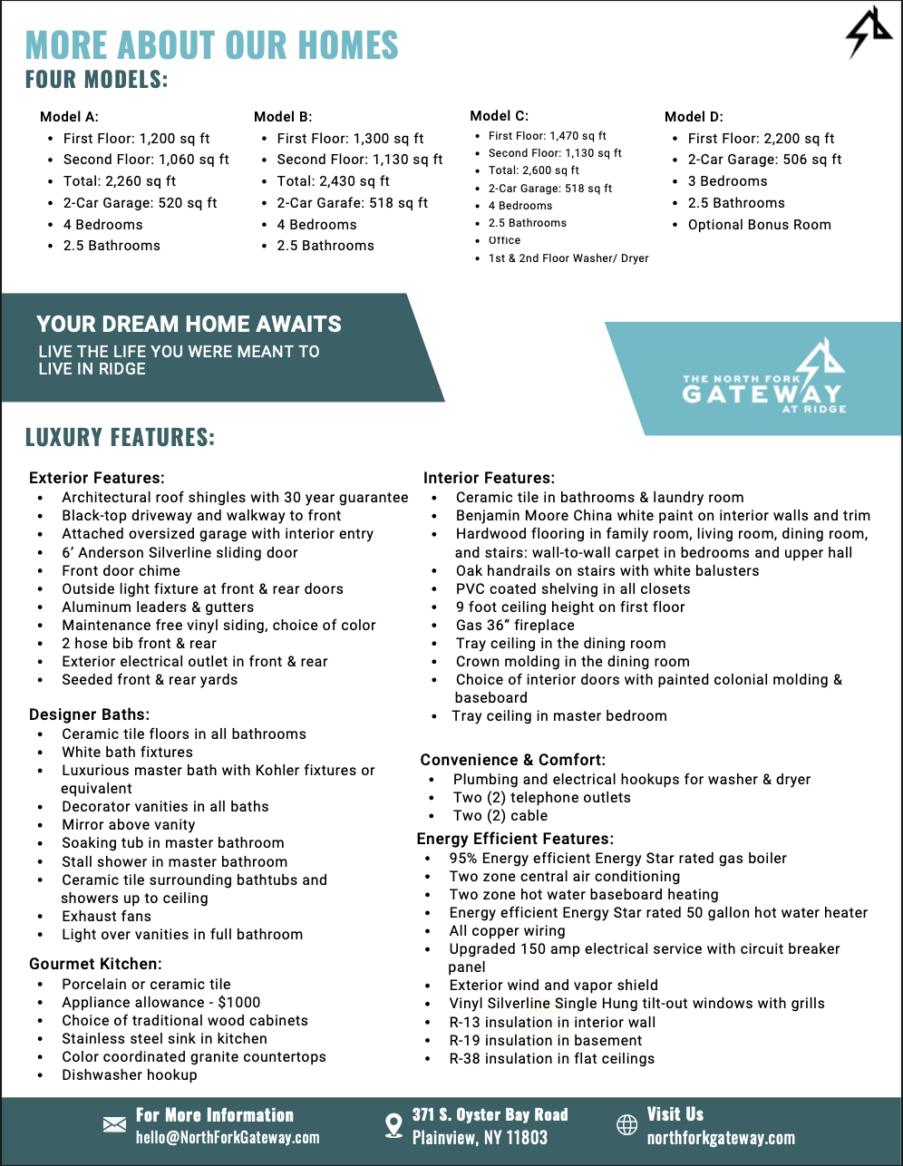

Slide 15

LUXURY FEATURES
Exterior Features:
Interior Features:
Convenience & Comfort:
Architectural roof shingles with 30 year guarantee
Black-top driveway and walkway to front
Attached oversized garage with interior entry
6’ Anderson Silverline sliding door
Front door chime
Outside light fixture at front & rear doors
Aluminum leaders & gutters
Maintenance free vinyl siding, choice of color
2 hose bib front & rear
Exterior electrical outlet in front & rear
Seeded front & rear yards
Ceramic tile in bathrooms & laundry room
Hardwood flooring in main areas. wall-to-wall carpet in bedrooms and upper hall
Oak handrails on stairs with white balusters
PVC coated shelving in all closets
9 foot ceiling height on first floor
Gas 36” fireplace
Tray ceiling in the dining room and master bedroom
Crown molding in the dining room
Choice of interior doors with painted colonial molding & baseboard
Plumbing and electrical hookups for washer & dryer
Two (2) telephone outlets
Two (2) cable
Gourmet Kitchen:
Designer Baths:
Energy Efficient Features:
Porcelain or ceramic tile
Appliance allowance - $1000
Choice of traditional wood cabinets
Stainless steel sink in kitchen
Color coordinated granite countertops
Dishwasher hookup
Ceramic tile floors in all bathrooms
White bath fixtures
Luxurious master bath with Kohler fixtures or equivalent
Decorator vanities in all baths
Mirror above vanity
Soaking tub in master bathroom
Stall shower in master bathroom
Ceramic tile surrounding bathtubs and showers up to ceiling
Exhaust fans
Light over vanities in full bathroom
95% Energy efficient Energy Star rated gas boiler
Two zone central air conditioning
Two zone hot water baseboard heating
Energy efficient Energy Star-rated 50 gal. hot water heater
All copper wiring
Upgraded 150 amp electrical service with circuit breaker panel
Exterior wind and vapor shield
Vinyl Silverline Single Hung tilt-out windows with grills
R-13 insulation in interior wall
R-19 insulation in basement
R-38 insulation in flat ceilings

Slide 16




PORT JEFFERSON HILLS
More than just a historical village, Port Jefferson is home to some of New York's most desired attractions!
Short walk to the L.I. Sound
Family and dog-friendly attractions
Close to Stony Brook University Hospital

Slide 17
THE PROCESS
Choose Your Lot
Design Your
New Home
Lock Rate &
Close Once
Move Into Your
Dream Home

Slide 18
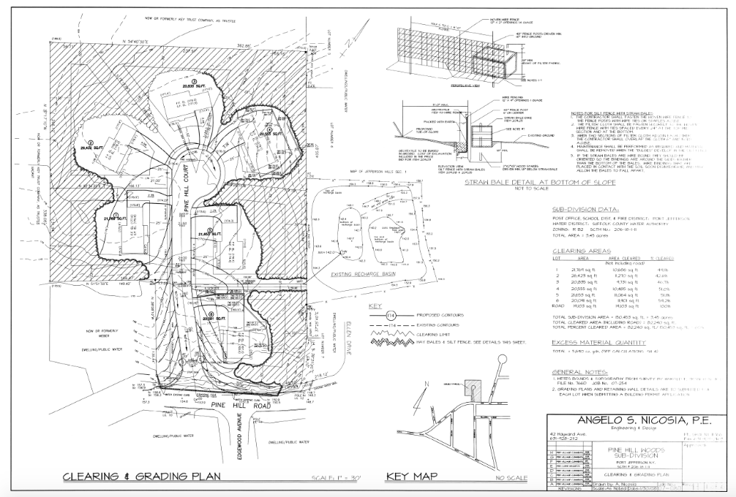

Slide 19


Slide 20





Slide 21
The Mattituck
FIRST FLOOR: 1,200 SQ FT
SECOND FLOOR: 1,060 SQ FT
TOTAL: 2,260 SQ FT
2-CAR GARAGE: 520 SQ FT
4 BEDROOMS
2.5 BATHROOMS

Slide 22
The Jamesport
FIRST FLOOR: 1,300 SQ FT
SECOND FLOOR: 1,130 SQ FT
TOTAL: 2,430 SQ FT
2-CAR GARAGE: 518 SQ FT
4 BEDROOMS
2.5 BATHROOMS

Slide 23
The Jamesport Plus
FIRST FLOOR: 1,470 SQ FT
SECOND FLOOR: 1,130 SQ FT
TOTAL: 2,600 SQ FT
2-CAR GARAGE: 518 SQ FT
4 BEDROOMS
2.5 BATHROOMS
OFFICE
1ST & 2ND FLOOR WASHER / DRYER

Slide 24
The North Fork Ranch
FIRST FLOOR: 2,200 SQ FT
2-CAR GARAGE: 506 SQ FT
3 BEDROOMS
2.5 BATHROOMS
OPTIONAL BONUS ROOM

Slide 25



Slide 26

THANK YOU

