Slide 1
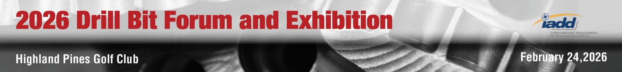
Welcome

Slide 2
Speaker Information
Cutter Grade and Shape Selection for Geothermal Applications
Richard Rivera
PDC Technology Engineering Director
Feb 24, 2026
NOV ReedHycalog

Slide 3
Not All Geothermal Applications Are Equal
Fundamentally Different
Shallow / Direct-Use / GSHP
Environment
  < 1,000 ft typical
  Low temperature
  Soft–medium formations
  High volume drilling
Technical Bit Focus
  Standard PDC cutters
  Cost-effective steel body
  High ROP optimization
  Simple hydraulics
  Low thermal risk
Sedimentary Basin / District Heating
Environment
  3,000–12,000 ft
  Up to 150°C
  Sandstone, carbonates
  Loss zones possible
Technical Bit Focus
  Abrasion-resistant cutters
  Improved thermal stability
  Balanced cutter density
  Optimized hydraulics for hole cleaning
  Enhanced gauge protection
High-Temp Power / EGS / Volcanic
Environment
  8,000–20,000 ft
  >150°C
  Granite, basalt, metamorphic
  Severe vibration & losses
  Technical Bit Focus
  Thermally stable cutter grades
  High-impact resistance
  Reinforced blade geometry
  Anti-whirl stability design
  Heavy gauge / backup cutters
  Hard rock cutting structure

Slide 4
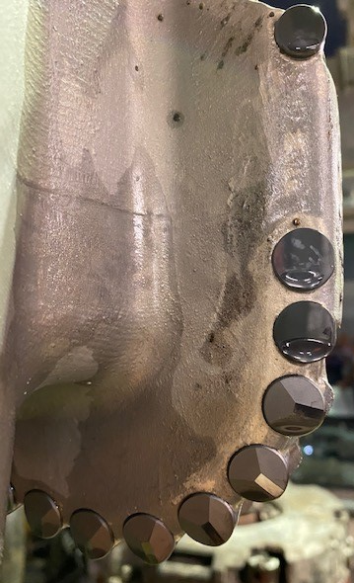
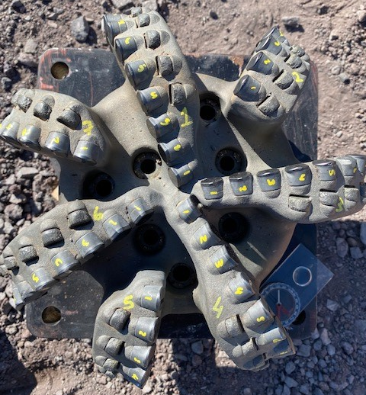
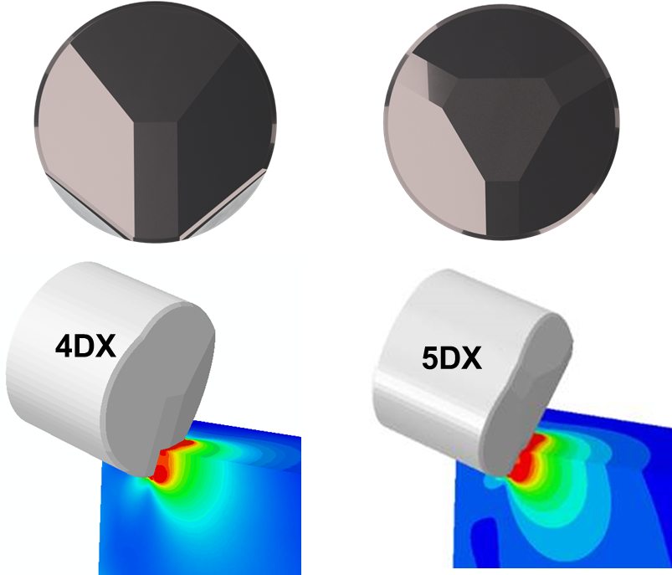
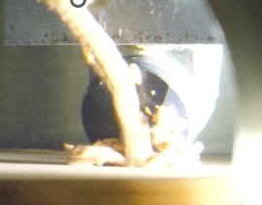
Rotokawa, New Zealand – Volcanic 12.25” Section
Challenge: drill the long deviated 12 ¼” section through a very hard volcanic and sedimentary rock in a single run to TD. To date this section has required several Roller Cone drill bits to complete the section, which, apart from low ROP and high cost presents few other operational risks.
Solution: Upgrade cutting structure use nonplanar cutter geometry
Results:
  Set new performance benchmarks for ROP and interval
  Completed the section in a single run, replacing multiple bit
  15% higher ROP comparing to the best offset
  Met all the directional targets
  Outstanding dull : 1-1-BT-S-X-I-WT-TD (rig)
Notes:
A similar bit had already set an ROP and interval benchmarks in a neighboring geothermal field. The new 12 ¼” FTKC76 Tektonic bit design was upgraded to ION™ 4DX cutter technology and had new stability improvements to further enhance its performance.

Slide 5
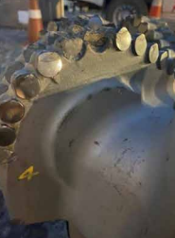
Tauhara Field, New Zealand – Volcanic 16” Section
(SPE-210468-MS)
Drilling Challenge | Drill Bit Challenge
Waiora and Rhyolite Formation | Be durable enough to drill both formations and ideally be rerunnable after two shallow well or one deep well
Directional Objectives | Drill desired profile with good tool face control
Parameter Limitation | Achieve ROP and generate lower torque than a conventional PDC with limited parameter range
Logistic and Economical | Be flexible for all potential drilling challenges and minimize drilling cost.
Typical Dulls Mechanical Failures
Broken Cutters in Nose and Shoulder
Waiora formation includes interbedded siltstones and tuffs. PDC have higher ROP than RC & hybrid drill bits. PDC are more directionally friendly.
Rhyolite formation hard and dense section that causes torque spikes and low for PDC bits. Typical front face overload to shoulder cutters.

Slide 6
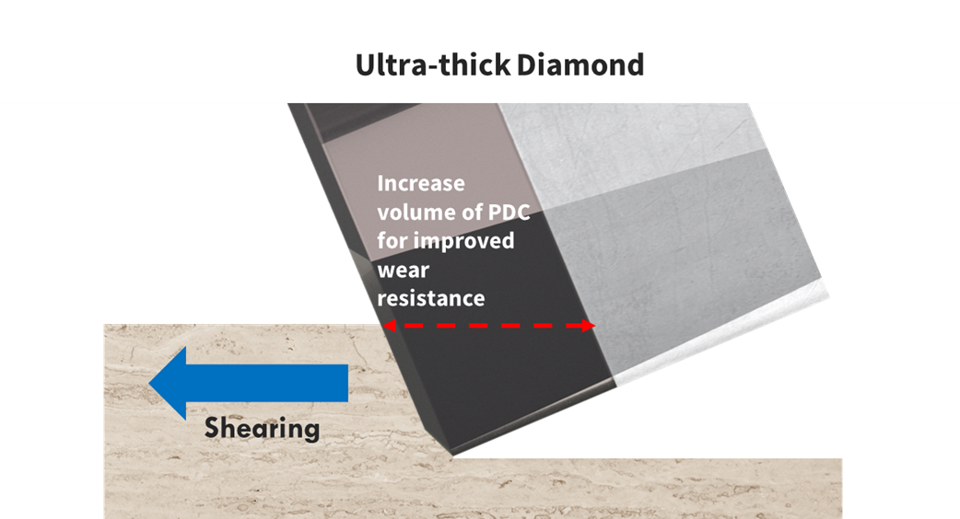
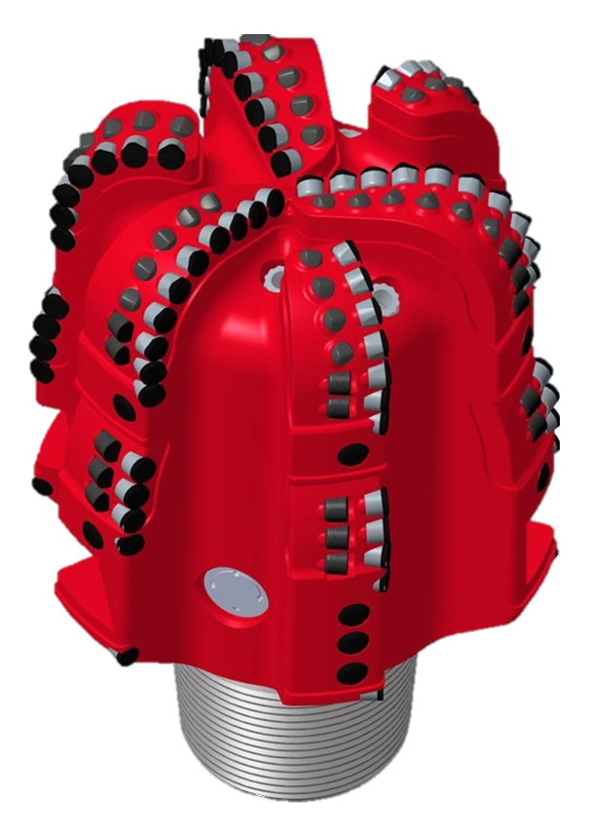
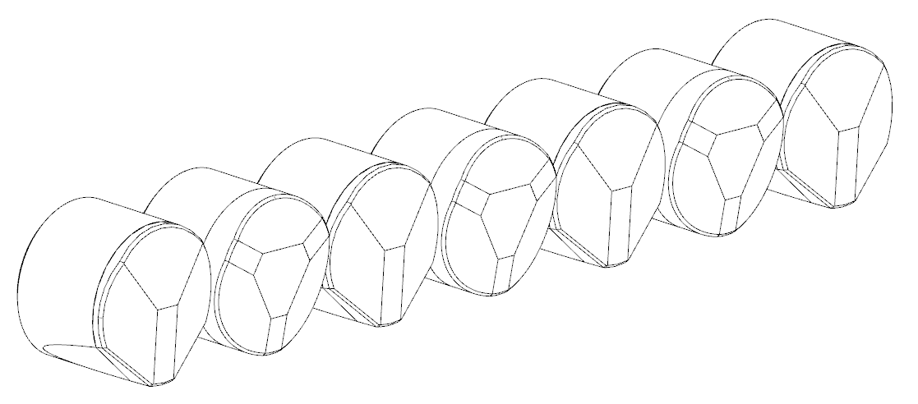
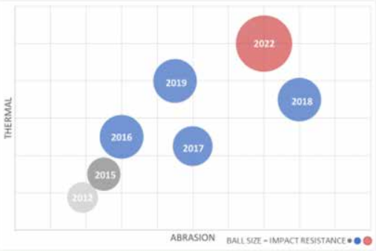
Tauhara Field, New Zealand – Volcanic 16” Section
(SPE-210468-MS)
Shaped Cutters Designs
Purpose Built
Tauhara Field, New Zealand – 16” Volcanic Section
Choosing the Right Cutter Grade
Balance Abrasion, Impact & Thermal
Alternating Shaped Cutters
Balance Efficiency & Durability

Slide 7
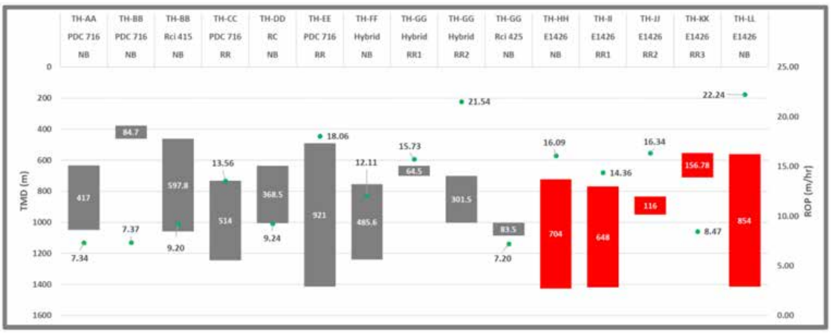
Tauhara Field, New Zealand – Volcanic 16” Section
(SPE-210468-MS)
Tauhara Field, New Zealand – Volcanic 16” Section
1st Run – Successfully drilled the section in one run
ROP of 16.09 m/hr & Excellent Dull
2nd Run – Successfully drilled the section in one run
ROP of 14.36 m/hr & Excellent Dull
3rd Run – Successful short run
4th Run – Pulled for erratic torque
1,000m longer than ay RC run, 700m longer than any Hybrid run

Slide 8
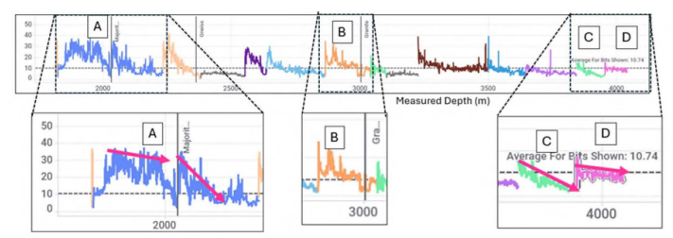
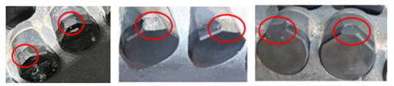
Deep Geothermal Drilling, Switzerland – 12.25” Granite & Gneiss
(SPE/IADC-223784-MS)
The geothermal reservoir lies at a depth of 4 to 5 km below the surface, in lithologies formed of crystalline basement, composed mainly of granite and gneiss.
Ultra-hard formation and abrasive to PDC Cutters leading to “early ROP decline” by 30-50%

Slide 9
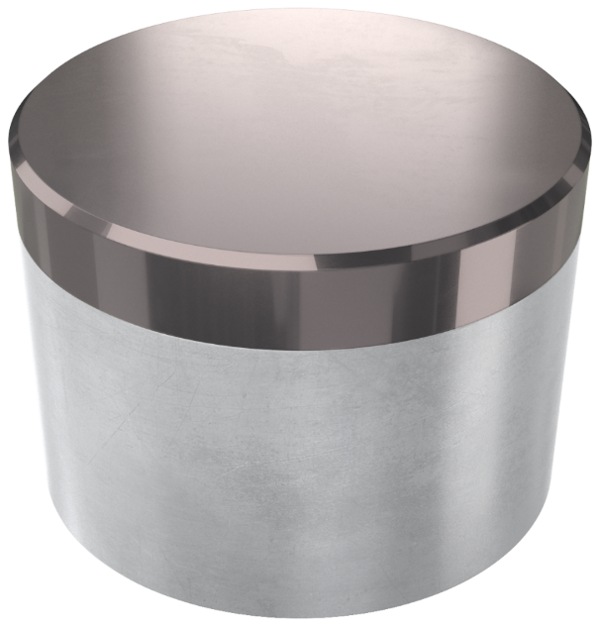
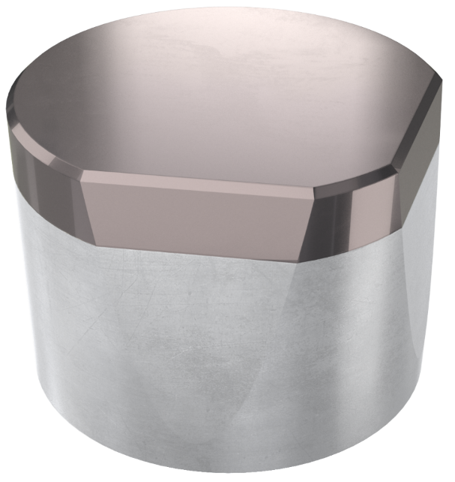
Deep Geothermal Drilling, Switzerland – 12.25” Granite & Gneiss
(SPE/IADC-223784-MS)
Use V-shaped cutter technology achieves higher ROP – reducing sliding distance
Reduced sliding distance reduces thermal and abrasive wear (SPE-208798)
  Cylinder
  V-Shape

Slide 10
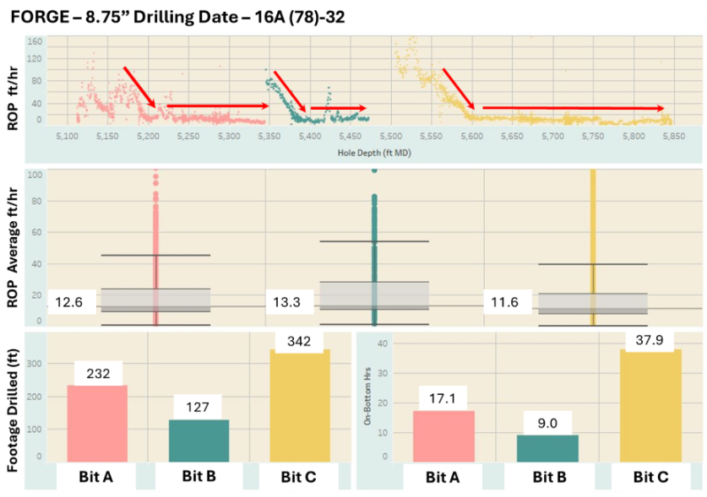
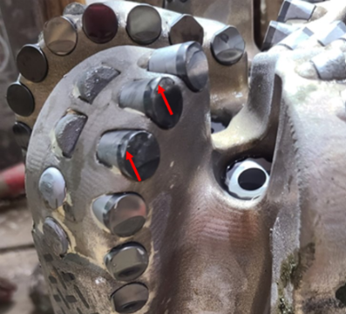
Deep Geothermal Drilling, Switzerland – 12.25” Granite & Gneiss
(SPE/IADC-223784-MS)
Utah Forge - use V-shaped cutter technology achieves higher ROP

Slide 11
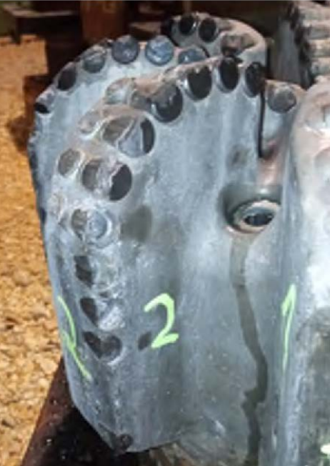
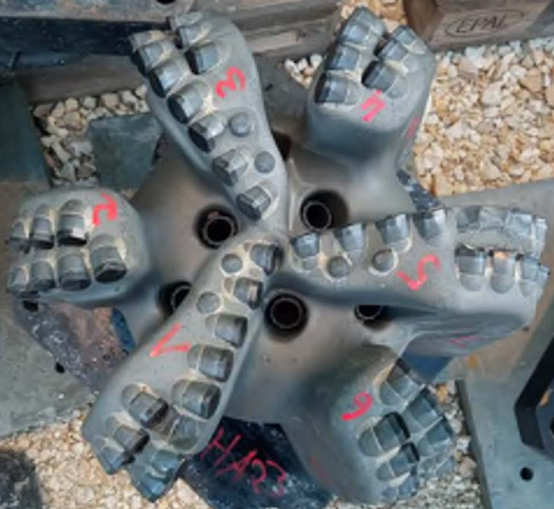
Deep Geothermal Drilling, Switzerland – 12.25” Granite & Gneiss
(SPE/IADC-223784-MS)
Reached TD 26 days ahead of AFE days and reached rig release, after coring, logging, and running casing and cementing, 16 days ahead of schedule
Dulls indicate more work to be done with cutter grade development.
Two different designs: One bit displays thermal abrasive wear while the other shows predominately mechanical damage

Slide 12
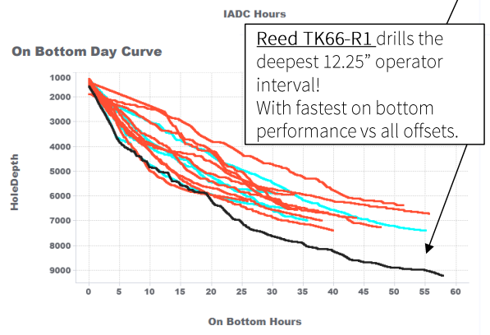
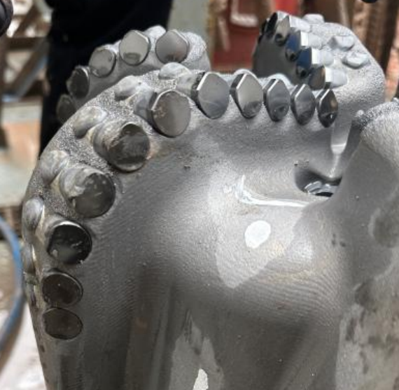
Utah – Deep Set 12.25” Drill-Out
Drilled medium formation but eventually tagged granite top

Slide 13
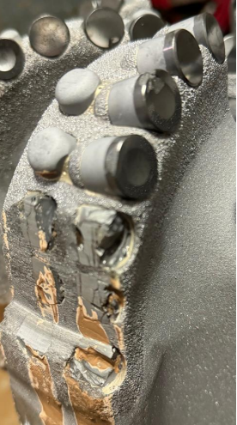
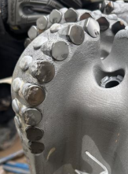
Utah – Deep Set 12.25” Drill-Out
Same bit with different shaped cutters.

Slide 14
Conclusions
Shaped cutters
  Will make or break performance in geothermal applications
  Cutter rock interaction is lithology dependent
  Placement on the drill bit is critical
    Alternating patterns
    Shoulder, cone, & nose
Cutter Grades
  Is the foundation of performance
  Regardless of shape cutter grade can limit performance

Slide 15
Acknowledgements
Utah Forge Work and the Team
NOV-RH New Zealand Team
Alexis Garcia & Tom Roberts – NOV Geothermal & RH Technology VP
Walker Olsen, Stephen Dalton, & James May – Geothermal Team

Slide 16
Thank You

