Slide 1


The following presentation was given at the
2026 IADD Downhole Tool Series Extended Luncheon
focused on
Vibration Suppression Technology
June 18th, 2026
The Woodlands, Texas
All Rights Reserved

Slide 2


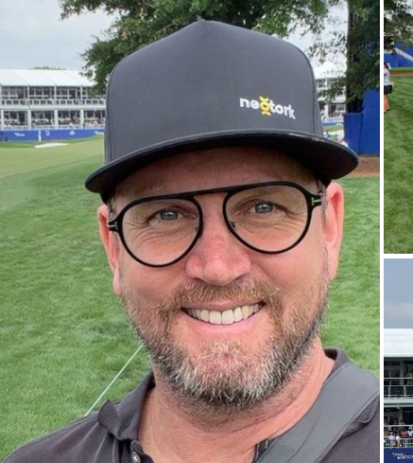
neotork presentation | June 2026
Understanding neotork Within the VSS Classification Framework
Reducing Drilling Dysfunction Through Dynamic Depth-of-Cut Management
Guy Feasey
Global Operations and Business Advisor

Slide 3
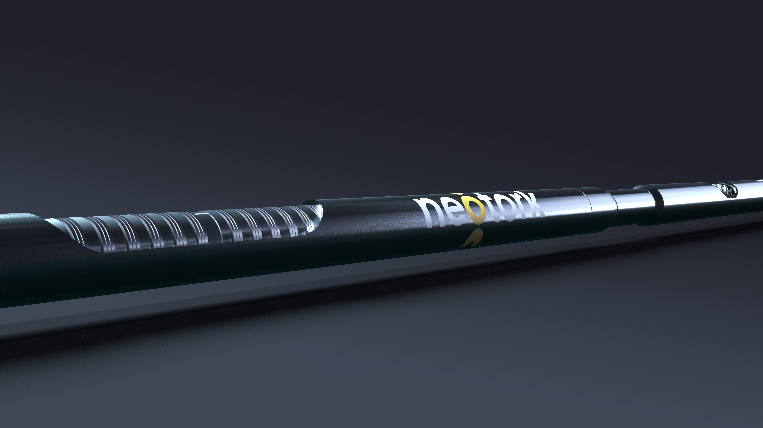
neotork presentation | June 2026
VSS Classification Matrix – Where is neotork?
DOC: Prevention or Cure
Neotork: Cable-based helix mechanism
Examples: 4-in-1 tool
Value: Leading & Lagging
3

Slide 4
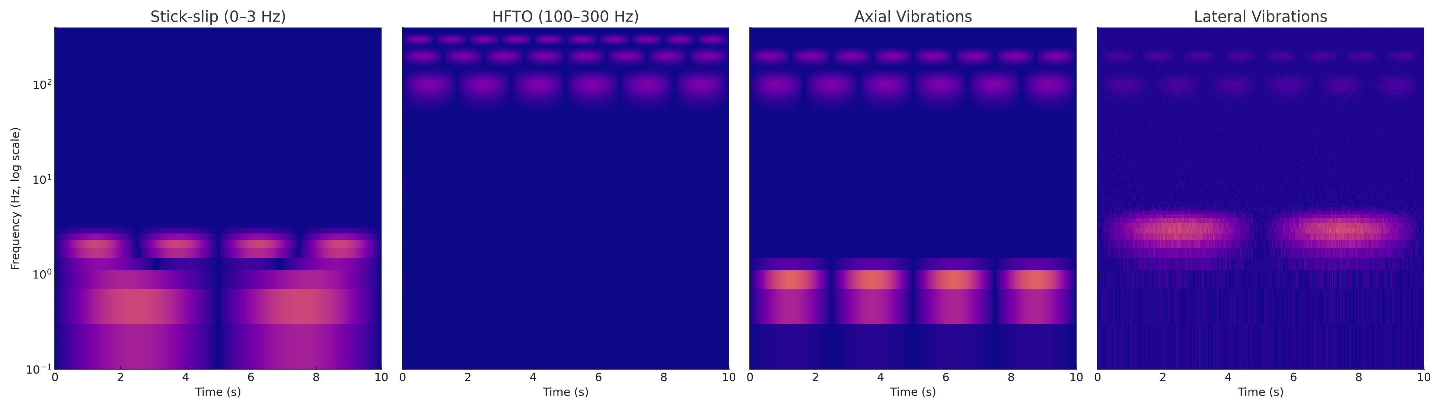

Not All Vibration Suppression Technologies Do The Same Job
VSS encompass a broad range of technologies developed to address different drilling dysfunctions.
Torsional
Stick-Slip
HFTO
Axial
Bit Bounce
Axial Chatter
Lateral
Forward Whirl
Backward Whirl
WHAT IS YOUR DYSFUNCTION?
Notes:
While neotork does not directly damp lateral vibration, improved DOC control and bit stability can reduce the generation of lateral excitation.
Reduced DOC Variation
↓
Improved Cutter Loading
↓
Reduced Side Forces
↓
Reduced Lateral Excitation
↓
Reduced Whirl

Slide 5
The Key Divider in the Matrix: DOC Management
Prevention vs Cure: DOC Management represents the distinction between treating the effects of dysfunction and influencing the mechanism that generates it.
Symptom Treatment
Technologies designed to:
Absorb / Isolate / Dampen
Excitation Control
Technologies designed to:
Dynamically adjust DOC
Influence bit-rock interaction
Reduce excitation generation
Depth Of Cut (DOC))
Depth Of Cut (DOC))
NO
YES
Notes:
Absorb vibration – Takes in vibrational energy and converts it into another form (typically heat), reducing the amount of energy available to sustain the vibration.
Isolate vibration – Prevents or reduces the transmission of vibration from one component or system to another, limiting how much vibration reaches sensitive equipment.
Dampen vibration – Reduces the amplitude of vibration over time by dissipating energy, causing oscillations to decay more quickly after they are excited.

Slide 6
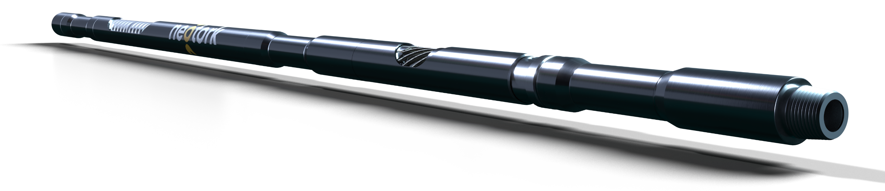
How neotork’s cable-based helix works
Operating Principle: neotork dynamically manages depth of cut (DOC)
Spring & Hydraulic Force
  Belleville springs and hydraulic thrust oppose compression (WOB & TQ at bit).
  The tool continuously seeks equilibrium.
Reactive Torque
  Increased torque at the bit causes the shaft to rotate.
Cable Response
  No opposing loaded helical surfaces; cables wrap and slide along a highly polished mandrel
  minimizing resistance to dynamic movement.
  Tool instantly shortens axially
DOC Management
  Increased torque → reduced DOC.
  Reduced torque → restored DOC.
  Continuous self-adjustment stabilizes bit-rock interaction.
Belleville Thrust
P
P
2
Hydraulic Thrust
1
Weight on bit
Torque on bit

Slide 7
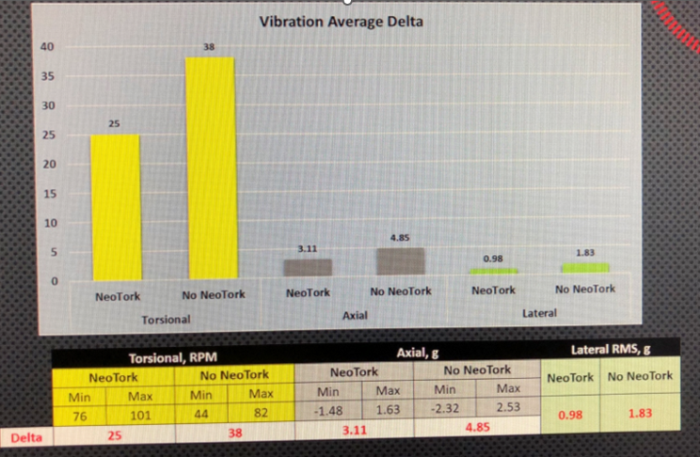
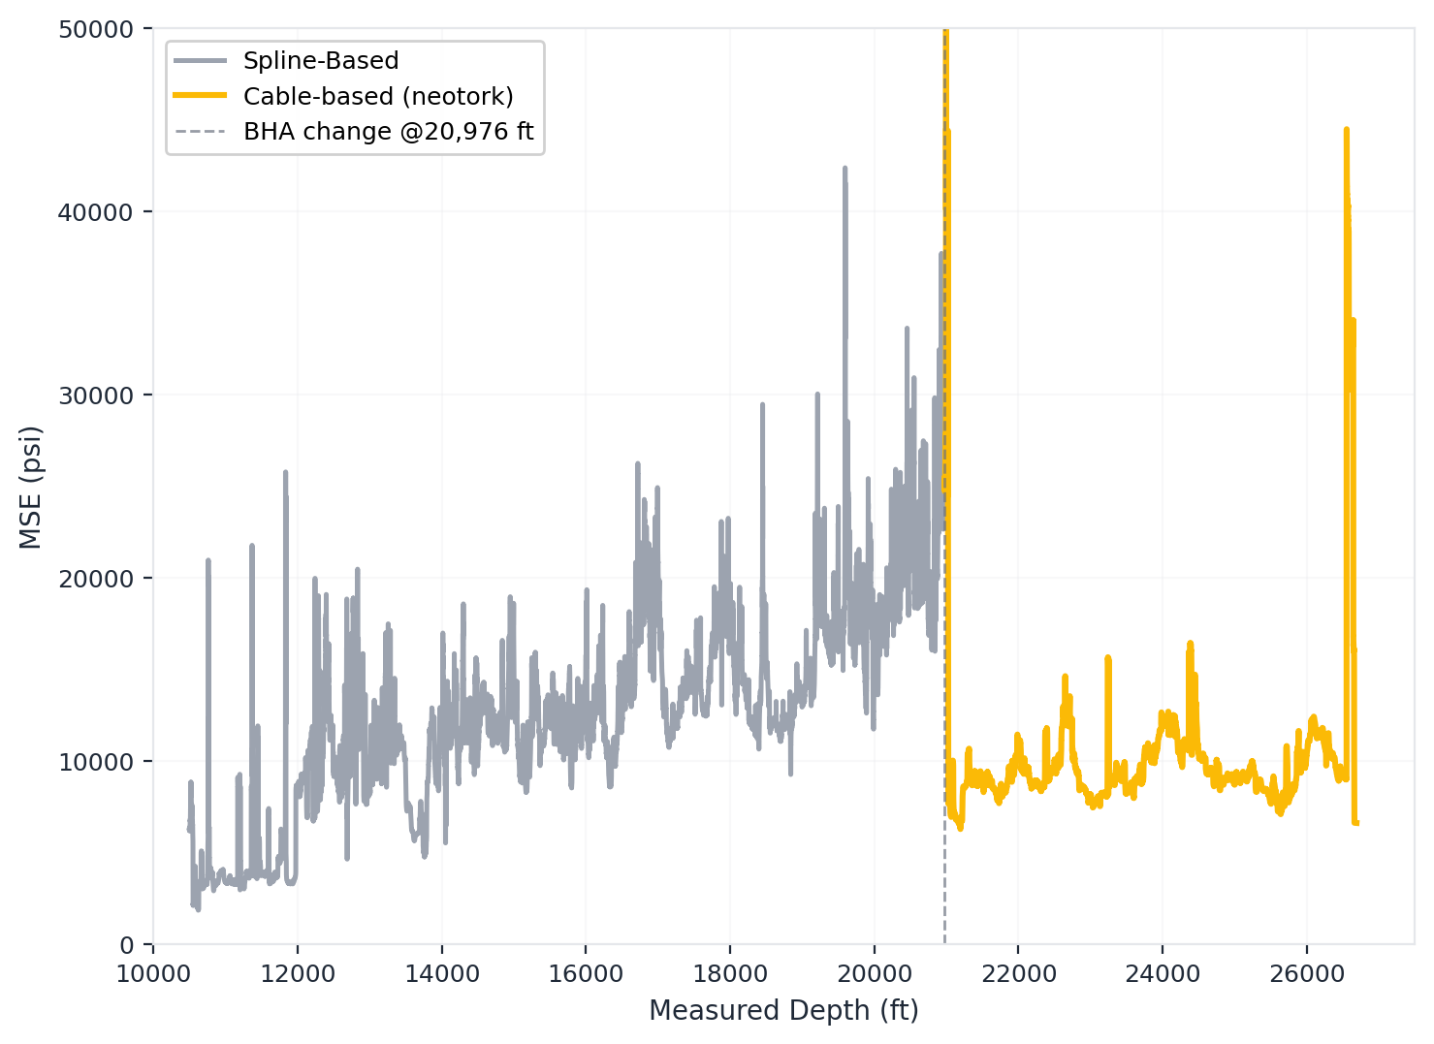
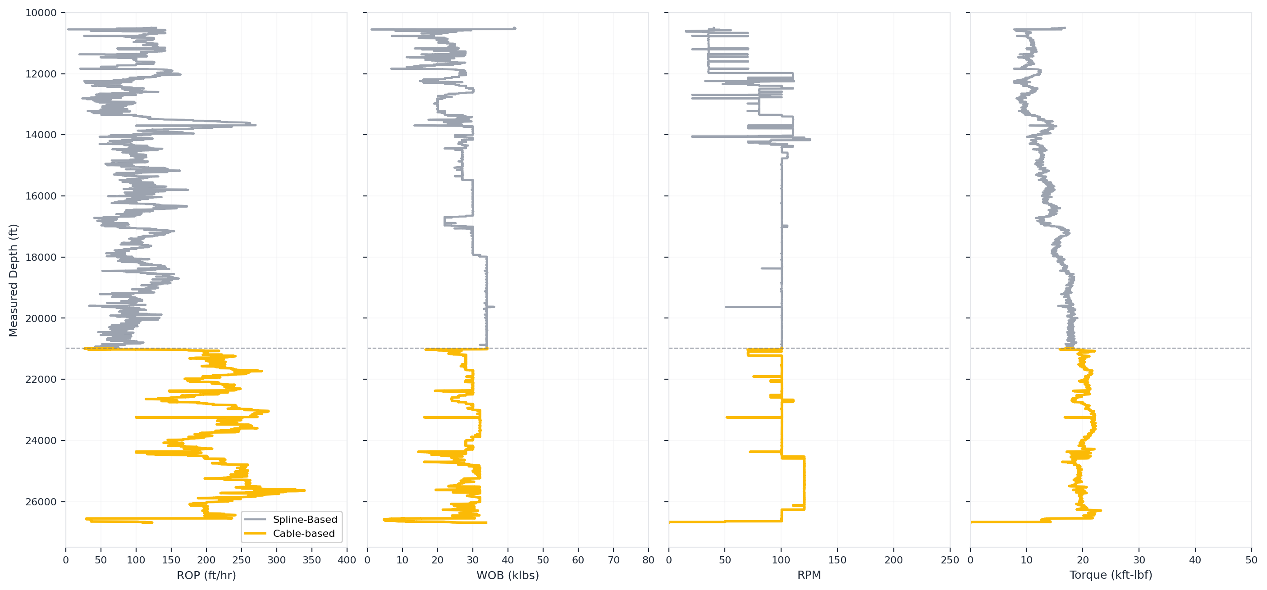
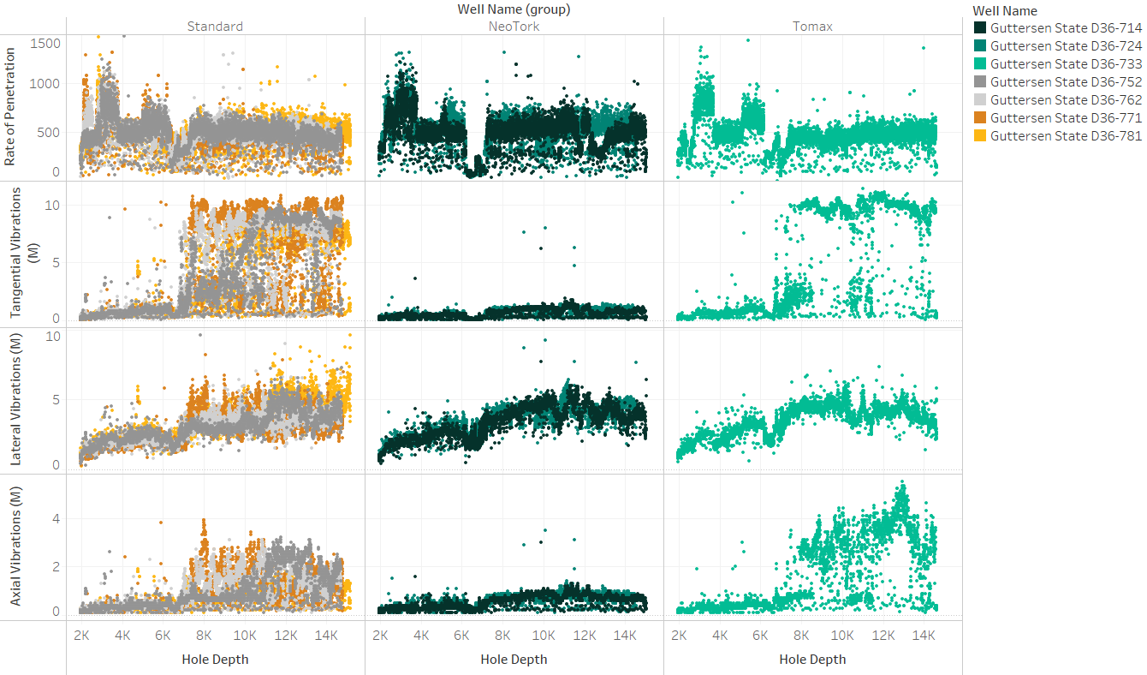
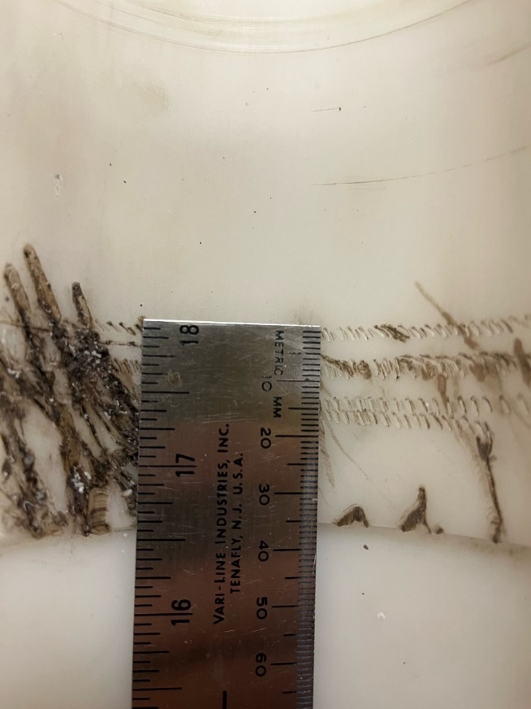
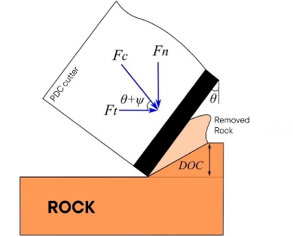
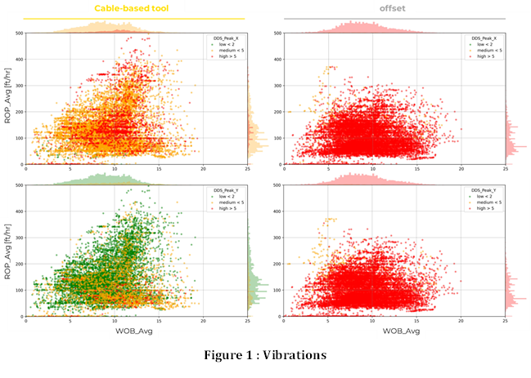
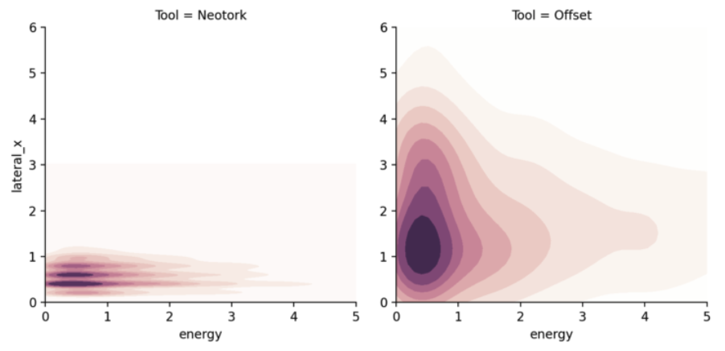
Field Examples
MSE
ROP
Torsional / Axial / Lateral + ROP
Standard
Neotork
Hellical Spline
Torsional & Lateral + ROP
X axis = Lateral
DOC
280 m
5 bits
9 days
Lateral
Y axis = Tangential
Notes:
DOC: The objective of DOC management is to reduce the transfer of mechanical energy into dysfunction, thereby lowering MSE and increasing the proportion of energy available for rock cutting.
Mechanical Specific Energy (MSE), first proposed by Teale (1965), is a measure of the energy required to remove a unit volume of rock. It combines the effects of both axial loading and rotational energy and is commonly used as an indicator of drilling efficiency.
The simplified Teale equation is:
MSE = (W / Ab) + (120πNT / AbR)
Where:
W = Weight on Bit (lbf)
N = Rotary Speed (RPM)
T = Torque (ft·lbf)
R = Rate of Penetration (ft/hr)
Ab = Borehole Cross-Sectional Area (in²)
In general, a lower MSE indicates that more of the applied drilling energy is being converted into rock destruction rather than being lost to drilling dysfunction such as stick-slip, HFTO, axial shock, or lateral vibration.

Slide 8
Value Metrics
Leading, Lagging & Performance Indicators
Leading Indicators
  Primary
    HFTO
    Stick-Slip
    Axial Shock
  Secondary
    Lateral
Lagging Indicators
  MTBF
  Tool Failures
  Trips
  Cycle Time
Performance Indicators
  DOC Stability
  MSE
  ROP

Slide 9
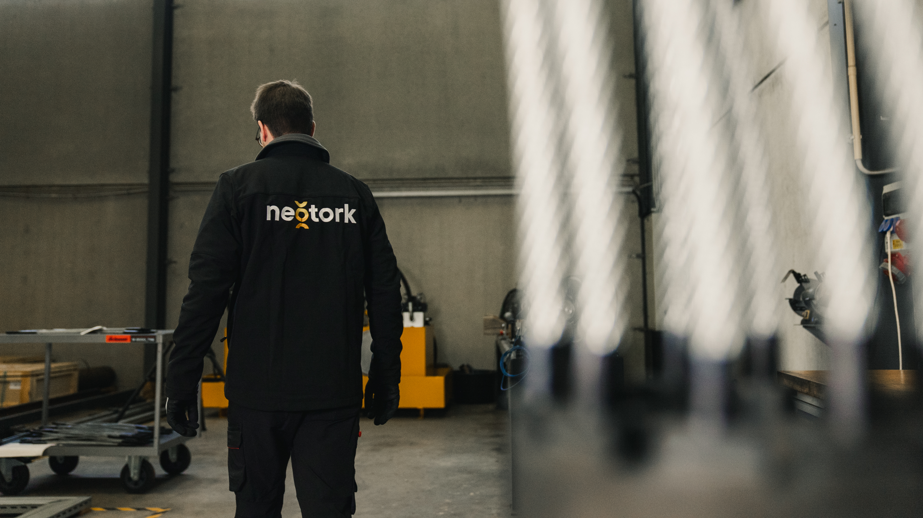
neotork presentation | June 2026
Thank you for listening
9

Slide 10
The preceding presentation was given at the
2026 IADD Downhole Tool Series Extended Luncheon
focused on
Vibration Suppression Technology
June 18th, 2026
The Woodlands, Texas
All Rights Reserved

