Slide 1


Welcome to True2U
Session 7
My Year Reflection
Notes:
Laura

Slide 2
Session 6 Recap
Who remembers something we talked about in our last session?
Have you thought about anything you can add to your Brag Sheet?

Slide 3
Session Activities
Activity 7(a): Impressions
Activity 7(b): True2U/CMSD End of Year Wrap Up Break included in this activity
Activity 7(c): Future-Focused True2U Reflection
Activity 7(d): High School Visions

Slide 4
Turn to PAGE 52 in your Tracker
Impressions
Notes:
Laura

Slide 5
Some studies say that people make major decisions about us within the first seven seconds of meeting us. How we present ourselves, our attitudes, our posture – people are looking at these things and are forming opinions about us.
Notes:
Laura

Slide 6
Do you form opinions of people based on how they present themselves?
Do you have an example of a time when you changed how you presented yourself or acted to fit into different environments?
Notes:
Laura

Slide 7
What impressions do we give different groups of people? How we act with our families might be different from how we act at school or with our friends – and what about people we first meet?
Think about the impression you wanted to make during role playing your mock interview last session.
Complete the first 3 columns
Check off or shade in only the top 5 characteristics in each column of how you think…
Your Parents/Guardians see you
Your Friends see you
People you meet for the very first time see you

Slide 8
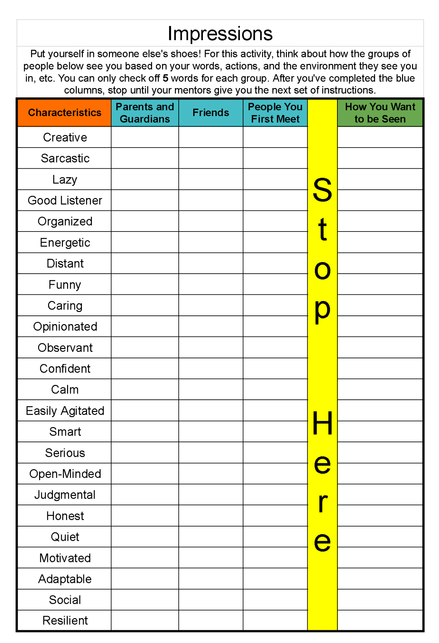
Tracker pg. 52

Slide 9
Did you find it hard to put yourself in someone else’s shoes and think about the impressions you make?
Did you mark different traits for the different groups? Why do you think they’re different?
Did anything surprise you?
Why do you think people form these opinions of you?
Which of the groups do you think has the most accurate understanding of who you really are? Why?
Notes:
Laura

Slide 10
Think back to Session 4 when we learned about personal values.
What’s important to us and how do we want to live our lives?
Final step, complete the fourth column.
Reflect on the impressions you make and how you want to present yourself to others.
Check off or shade in the top 5 attributes you want people to see in you.
Notes:
Laura

Slide 11
What similarities or differences do you see between the first three columns of your worksheet and the fourth column we just completed?
Why do you think they’re similar or different?
Notes:
Laura

Slide 12
Activity 7(b)
True2U/CMSD Wrap Up Video
(35 minutes)

Slide 13
Click Here to View Video

Slide 14
Activity 7(c)
Future-Focused True2U Reflection
(10 minutes)

Slide 15
Turn to PAGE 53 in your Tracker
Session 7 Reflection
We’ve all learned something about ourselves through this program – mentors and scholars. Let’s take some time to think about what we’ve learned through participating in this program.

Slide 16
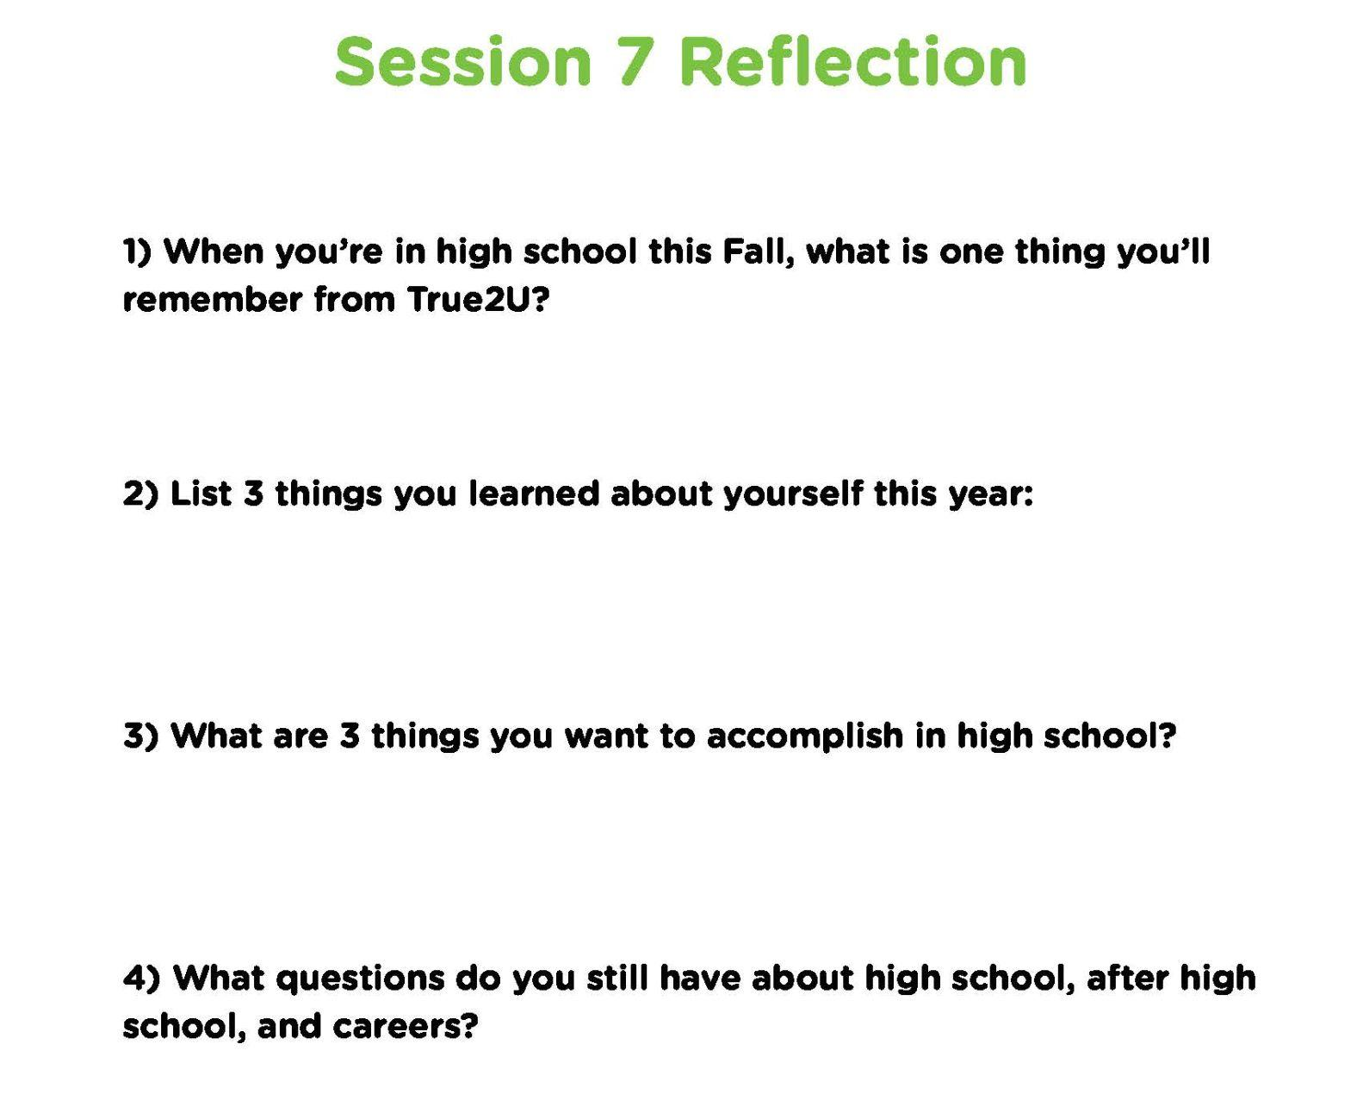
Tracker pg. 53

Slide 17
Activity 7(d)
High School Visions
(50 minutes)

Slide 18
Think about our visions for the next four years – what we want our high school experiences to look like.
be creative with your vision board! You can design it however you want, but it needs to be school-appropriate.
You can:
write words
draw pictures
glue pictures
list people or programs
represent whatever they feel is important for the next four years.
You will have approximately 30 minutes to create your vision board.
Please share the materials, markers, picture cards (need glue stick)

Slide 19
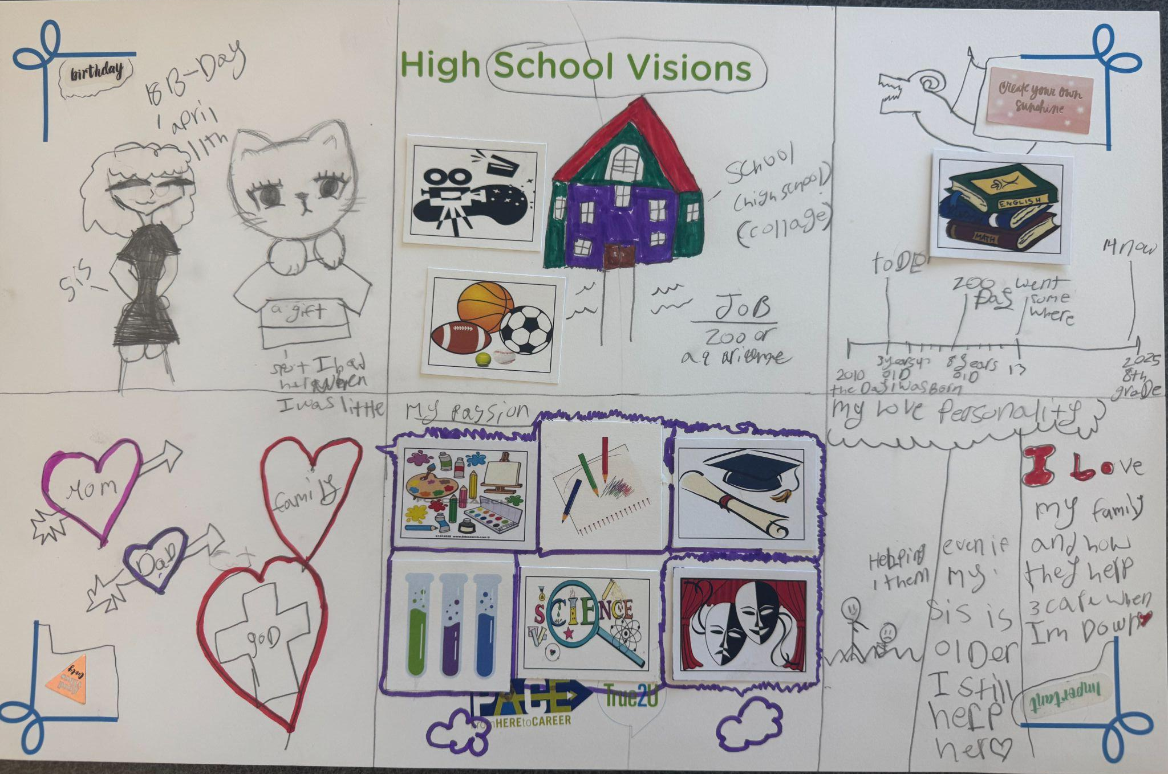
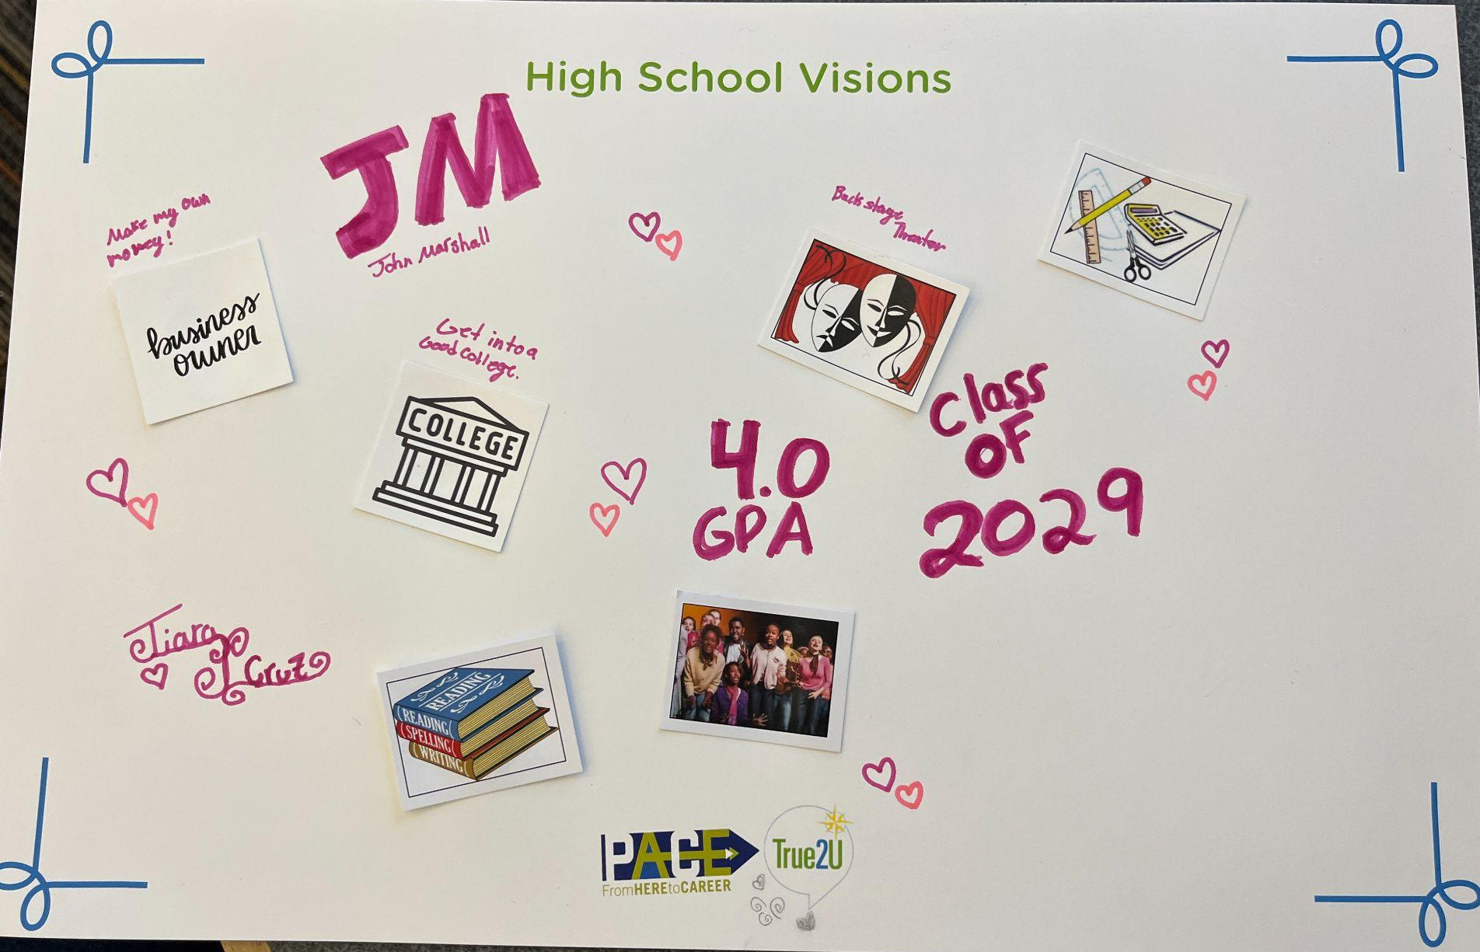
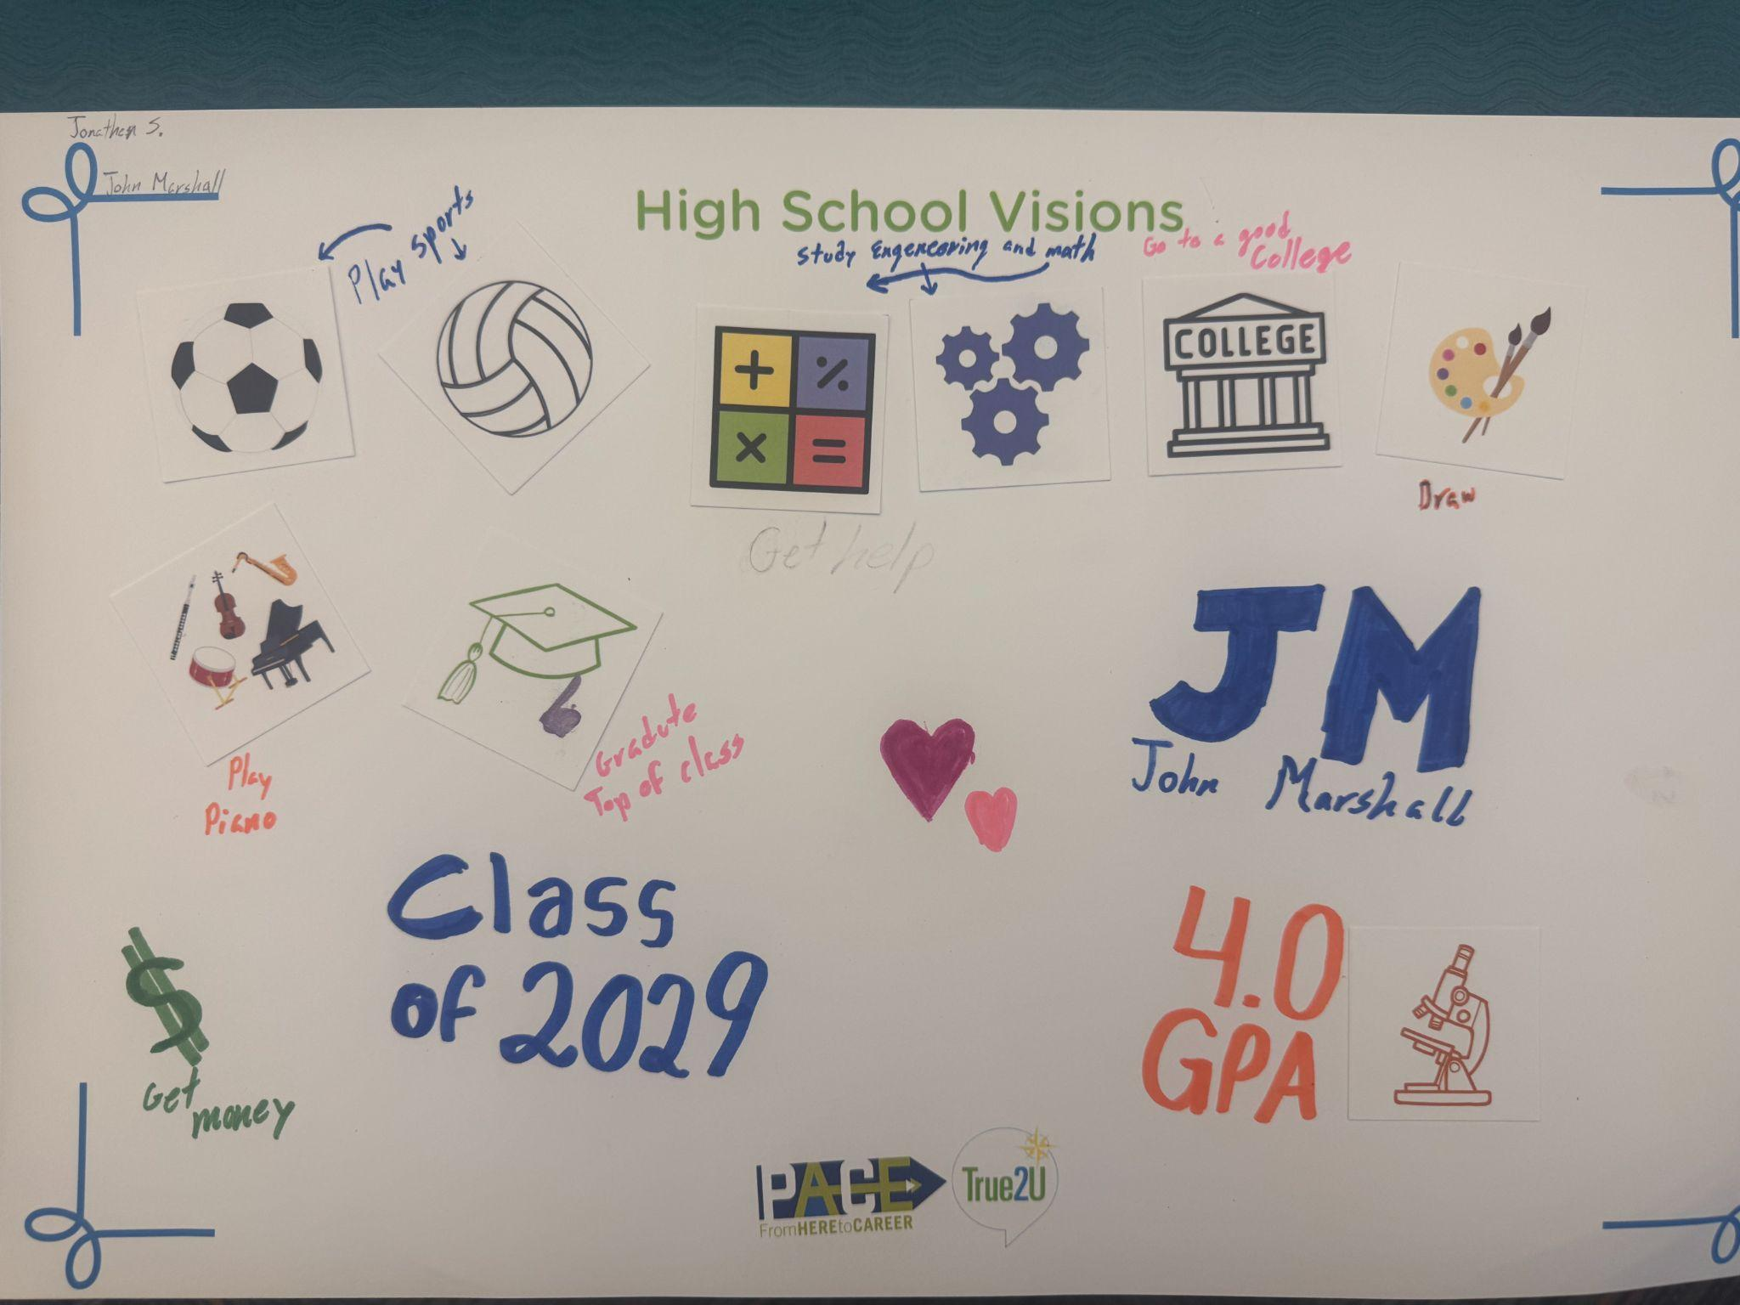
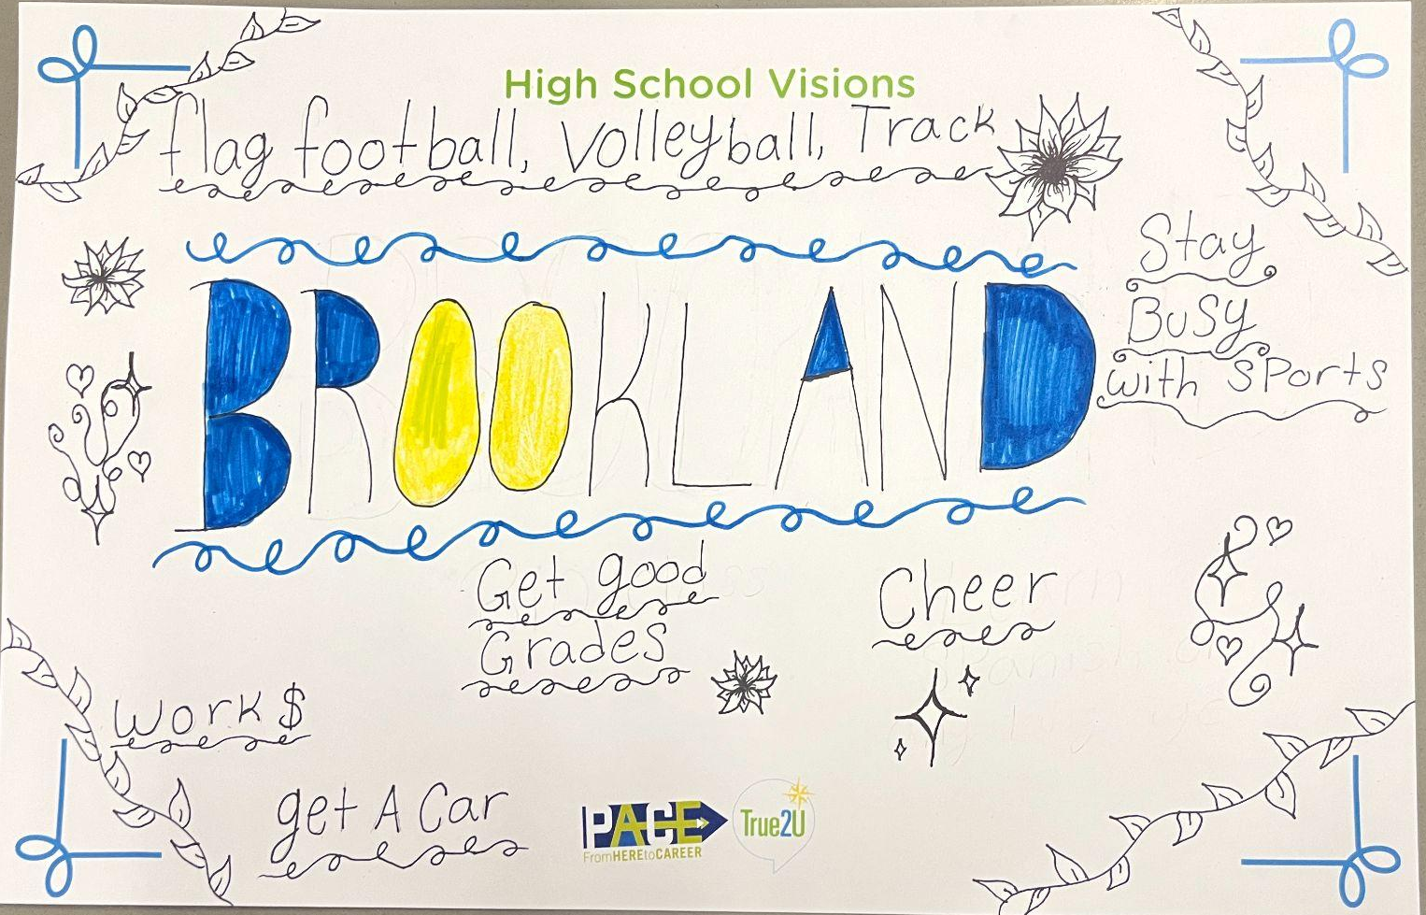
Vision Board Examples

Slide 20
Discussion Prompts
“What steps can you take to make these visions become realities?”
“What can we do to get back to our goals and visions if we happen to experience an obstacle?”

Slide 21
End of the Program Discussion Questions
“What was the best part of this year?”
“What words of wisdom would you pass on to a 6th or 7th grader?”
“After participating in this program, how would you respond if someone asked, what do you want to be when you grow up?”
“What was something that made you laugh this year?”
“What was your favorite activity or field trip this year? And why?”
“What was your biggest area of growth this year?”
“What was one of your favorite memories from this year?”
“What are your summer plans?”
“How are you feeling about going into high school next year?”
“What are you most excited about as you move into high school?”
“What accomplishment are you most proud of from this year?”

Slide 22

Thank you for your participation in True2U!
Add your words of inspiration and encouragement.

