Slide 1


Welcome to True2U
Session 6
Preparing for My Future
Notes:
Laura

Slide 2
Session 5 Recap
Who remembers something we talked about in our last session?
Can anyone share a time since we last met that you noticed yourself using your learning style?

Slide 3
Session Activities
Activity 6(a): Icebreaker: Starburst
Activity 6(b): My Career Exploration
BREAK
Activity 6(c): My Brag Sheet
Activity 6(d): Mock Interviews
Future-Focused Reflection: Preparing For High School

Slide 4
Icebreaker: Starburst
Notes:
Laura

Slide 5
Each of you will take 2 different colored Starbursts.
Do not eat your Starburst until we tell you that you can eat them!
Each color represents a different question that will be answered out loud.
Once everyone has their Starbursts, we’ll show you the questions.
Everyone will take a turn answers the questions that their Starburst match.
Notes:
Laura

Slide 6
Red: If you could be any animal, what would you be and why?
Pink: Who is your favorite music artist and why?
Yellow: Where is your favorite place in Cleveland and why?
Orange: Who do you look up to or admire and why?
Notes:
Laura

Slide 7
Turn to PAGE 46 in your Tracker
My Career Exploration

Slide 8
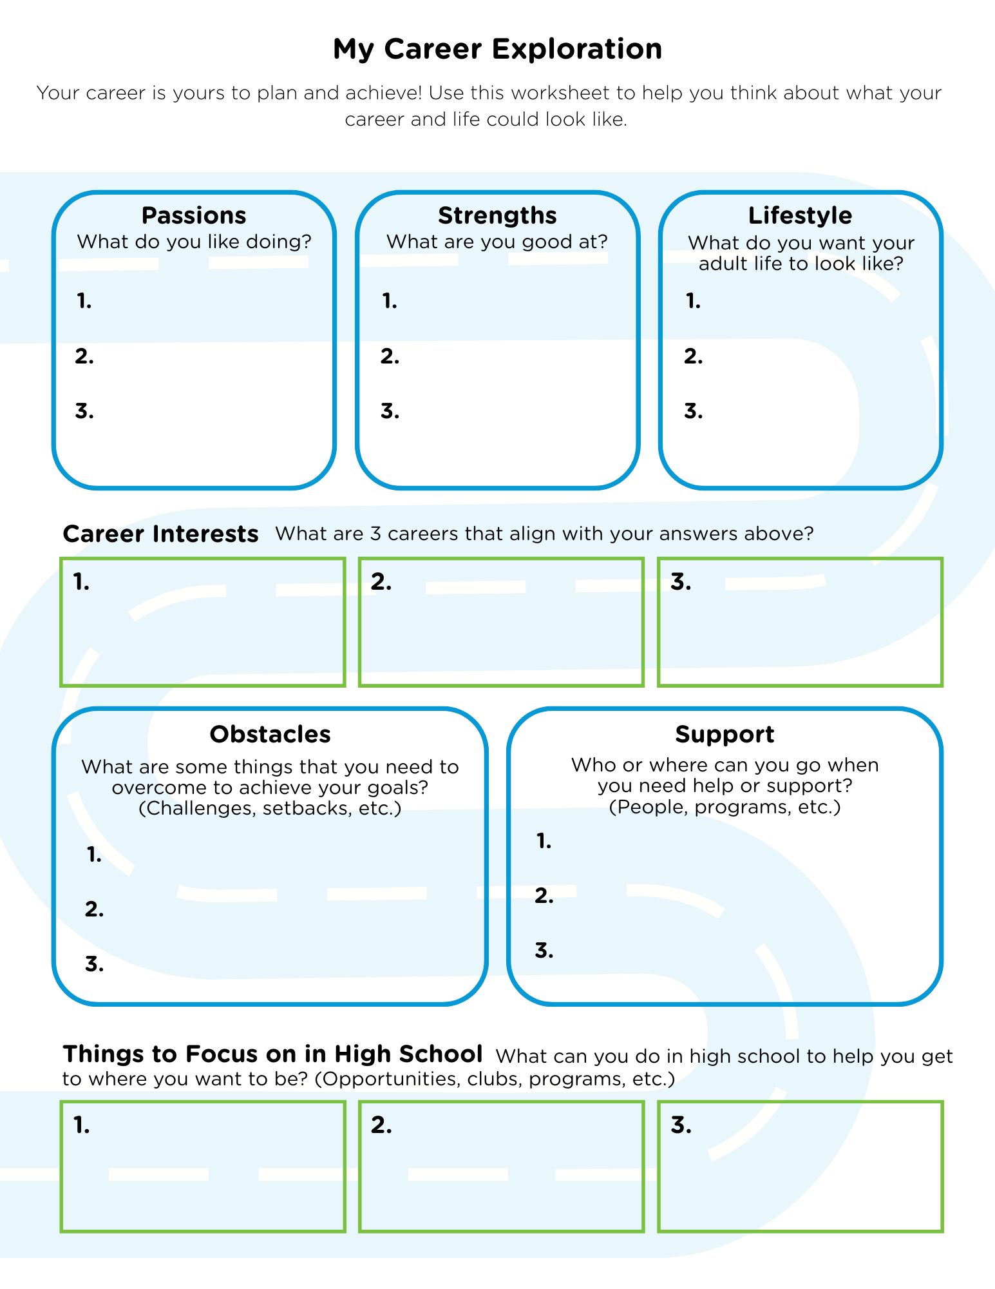
Tracker pg. 46

Slide 9
Enter text
Enter text
Enter text
Enter text
Enter text
Enter text
Mentor A
Enter text
Enter text
Enter text
Enter text
Enter text

Slide 10
Enter text
Enter text
Enter text
Enter text
Enter text
Enter text
Mentor B
Enter text
Enter text
Enter text
Enter text
Enter text

Slide 11
Session Break
5 Minutes

Slide 12
Turn to PAGE 47 in your Tracker
My Brag Sheet

Slide 13
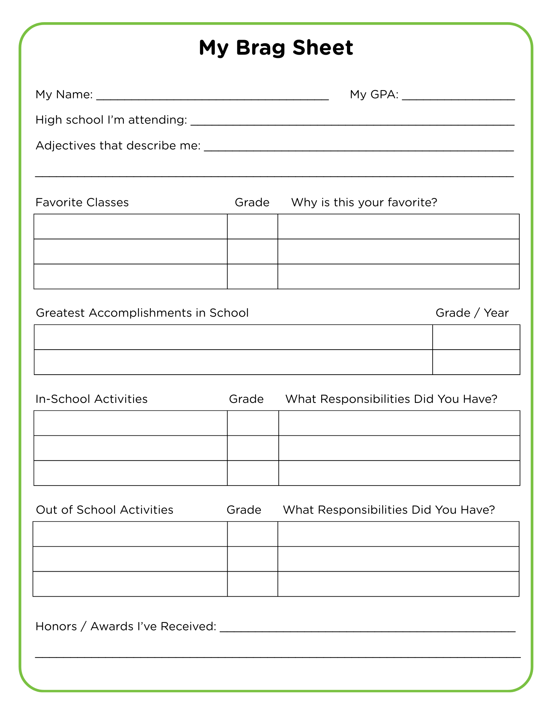
Enter Text
Enter Text
Enter Text
Enter Text
Enter Text
Enter Text
Enter Text
Enter Text
Enter Text
Enter Text
Enter Text
Enter Text
Tracker pg. 47
Enter Text
Enter Text
Enter Text
Enter Text

Slide 14
Enter Text
Enter Text
Enter Text
Enter Text
Enter Text
Enter Text
Enter Text
Enter Text
Enter Text
Enter Text
Enter Text
Enter Text
Tracker pg. 47
Enter Text
Enter Text
Enter Text
Enter Text

Slide 15
Activity 6(d): Mock Interviews

Slide 16
Mock Interviews
We’re going to do an example interview.
Pay attention to what is done well and what could use some improvement.

Slide 17
Discussion Prompts
“How do you think that interview went?”
“What did the applicant do well?”
“What impression did the applicant leave?”
“What might the employer think after that interview?”
“How could the applicant improve?”

Slide 18
Turn to PAGE 48 in your Tracker
Mock Interview worksheet

Slide 19
Work in pairs
Choose roles and practice interviewing
one applicant
one employer
Employer will use the Mock Interview Practice worksheet (pg. 48), take notes and provide feedback.
When times up you will switch roles.

Slide 20
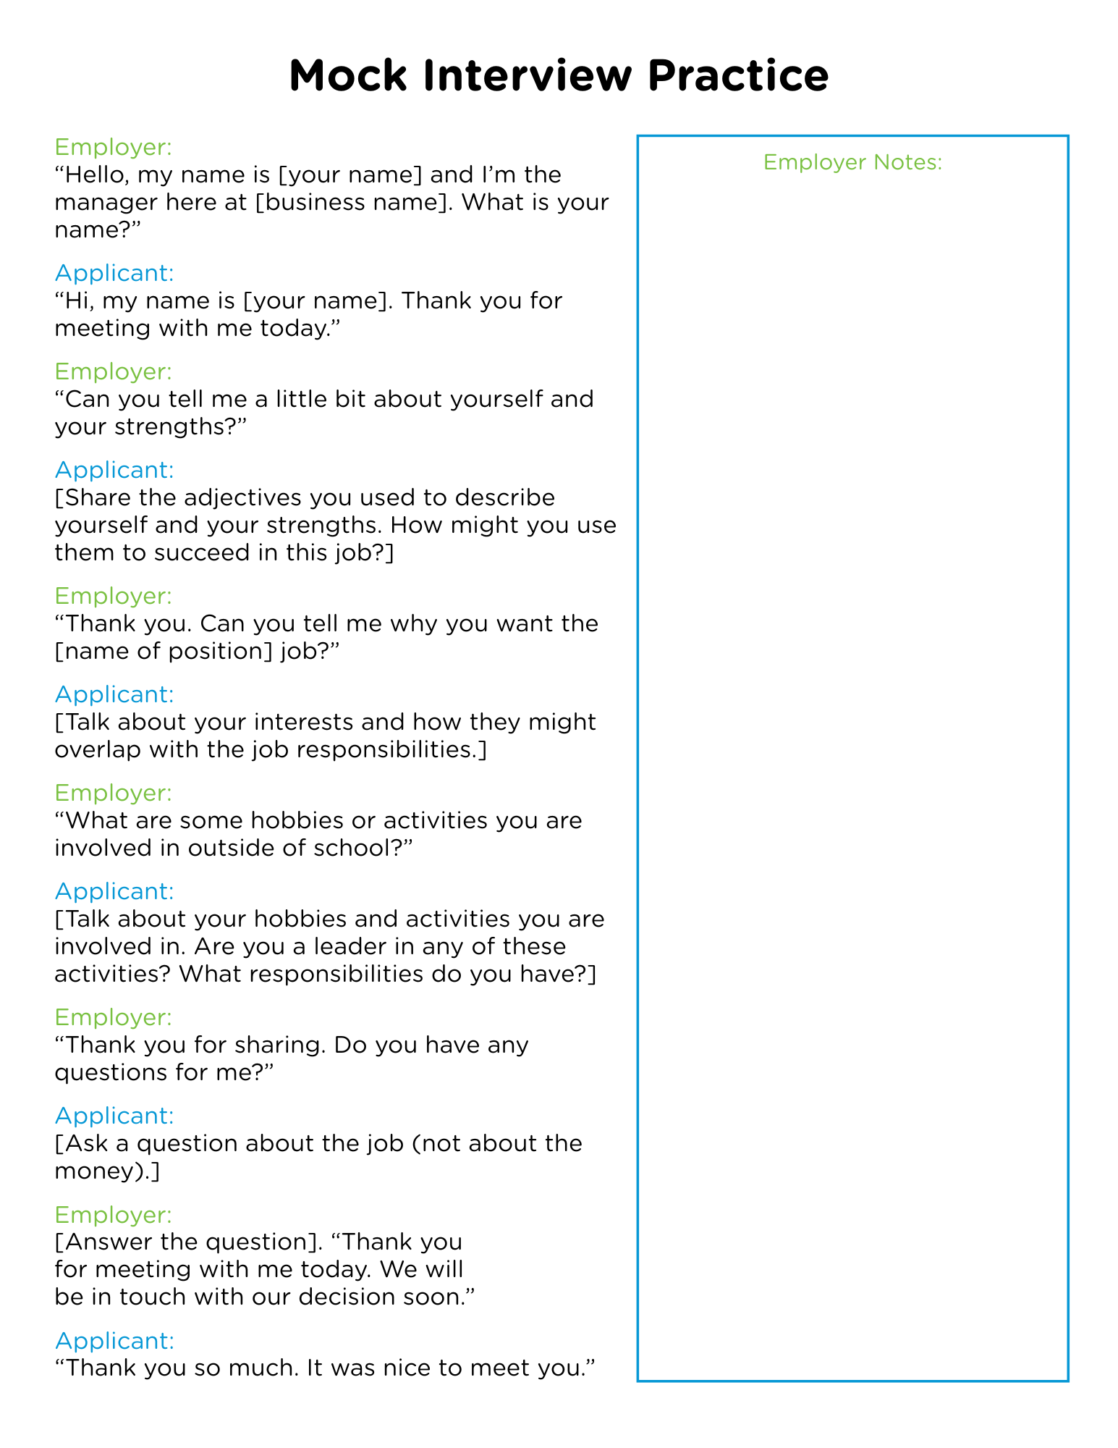
Tracker pg. 48

Slide 21
Discussion Prompts
“How did the interviews go?”
“Do you try to make your ideal impression on people when you first meet them?”
“Do we have control over how we act and how we present ourselves?” “What are some of the challenges you face when trying to make your ideal impression?”
“What can we do to make sure we’re living in line with our values and presenting ourselves the way we want?”
“What’s something you can do daily to leave a positive impression?”

Slide 22
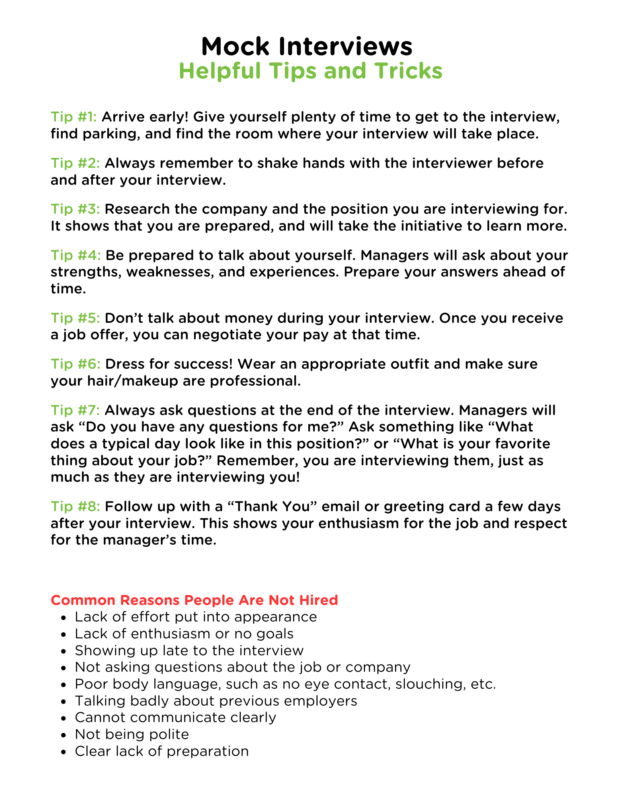
Tracker pg. 49

Slide 23
Turn to PAGE 50 in your Tracker
Reflection Questions:
What is one thing you want to practice so you can feel more confident when being interviewed?
What are some things you can do in high school that would be good additions to your brag sheet? (Clubs, leadership opportunities, volunteering, etc.)
How are you feeling about going to high school?
What do you still want to accomplish in 8th grade to prepare you for next year?
What most excites you about your potential career pathway?
Notes:
Laura

Slide 24

See You Next Month!
Session 7:
My Year Reflection

