Slide 1


Welcome to True2U!
Session 5
My Learning Style

Slide 2
Who remembers something we talked about in our last session?
Can anyone share a time since we last met that you made a good choice?
The High School Choice Portal closes on February 27th.
Have you made your high school choice in CMSD’s Portal?
https://www.clevelandmetroschools.org/building-brighter-futures/bbf-enrollment-page

Slide 3
Agenda
Activity 5(a): Practicing Your Learning Style
Activity 5(b): Learning Style Inventory
Future-Focused Reflection: Understanding Your Learning Style

Slide 4
Practice Your Learning Style

Slide 5
Practice Your Learning Style
There will be four rounds for this activity.
Each round will have you create a shape using your popsicle sticks while receiving the instructions in different ways.
You’ll work on your own.
No talking or commenting during the activity.

Slide 6
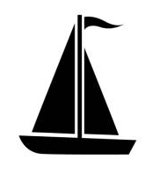
Round 1

Slide 7
Round 2
Listen to the instructions

Slide 8
Turn to PAGE 41 in your Tracker
Learning Styles Written Instructions

Slide 9
Round 3 Instructions
Place two popsicle sticks together at the corners to form a V shape.
Repeat this 5 times so you have 5 Vs.
Put one upside-down V (opening facing down) at the top of your desk.
On the right side, place a V with the opening facing left and connect it to the bottom corner of the top V.
On the left side, place a V with the opening facing right and connect it to the bottom corner of the top V.
For the last two Vs, place one connected to the bottom right and the other connected to the bottom left.
When you’re done, the 5 Vs should all point inward.

Slide 10
Round 4
Make a Flower

Slide 11
Learning Styles Inventory

Slide 12
Turn to PAGE 42 in your Tracker
Learning Styles Inventory

Slide 13
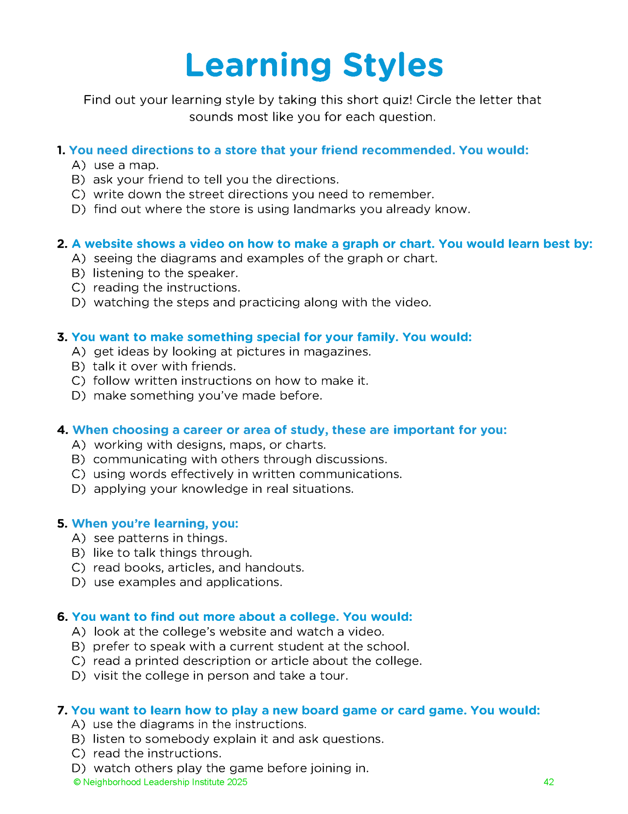

Slide 14
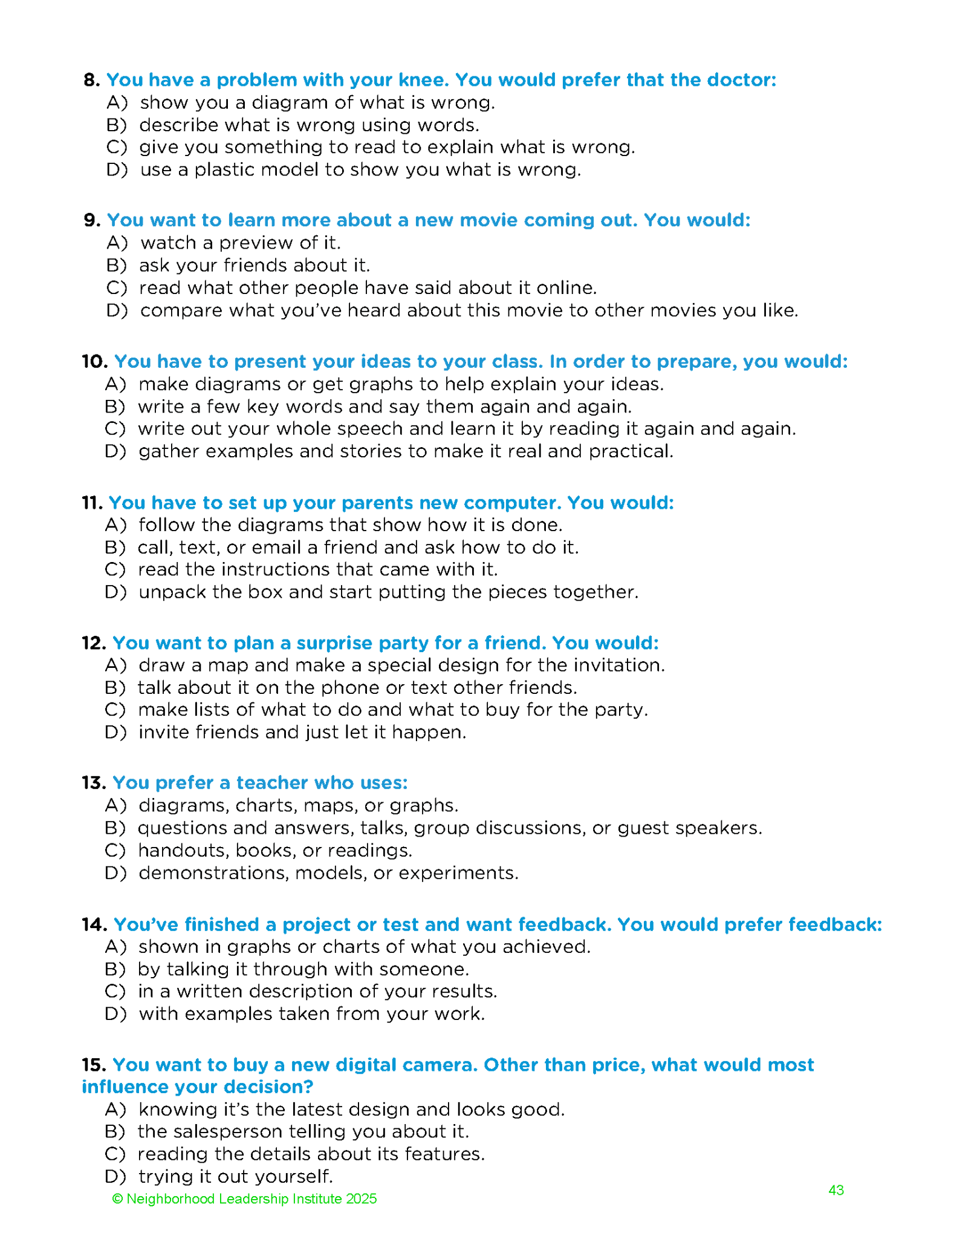

Slide 15
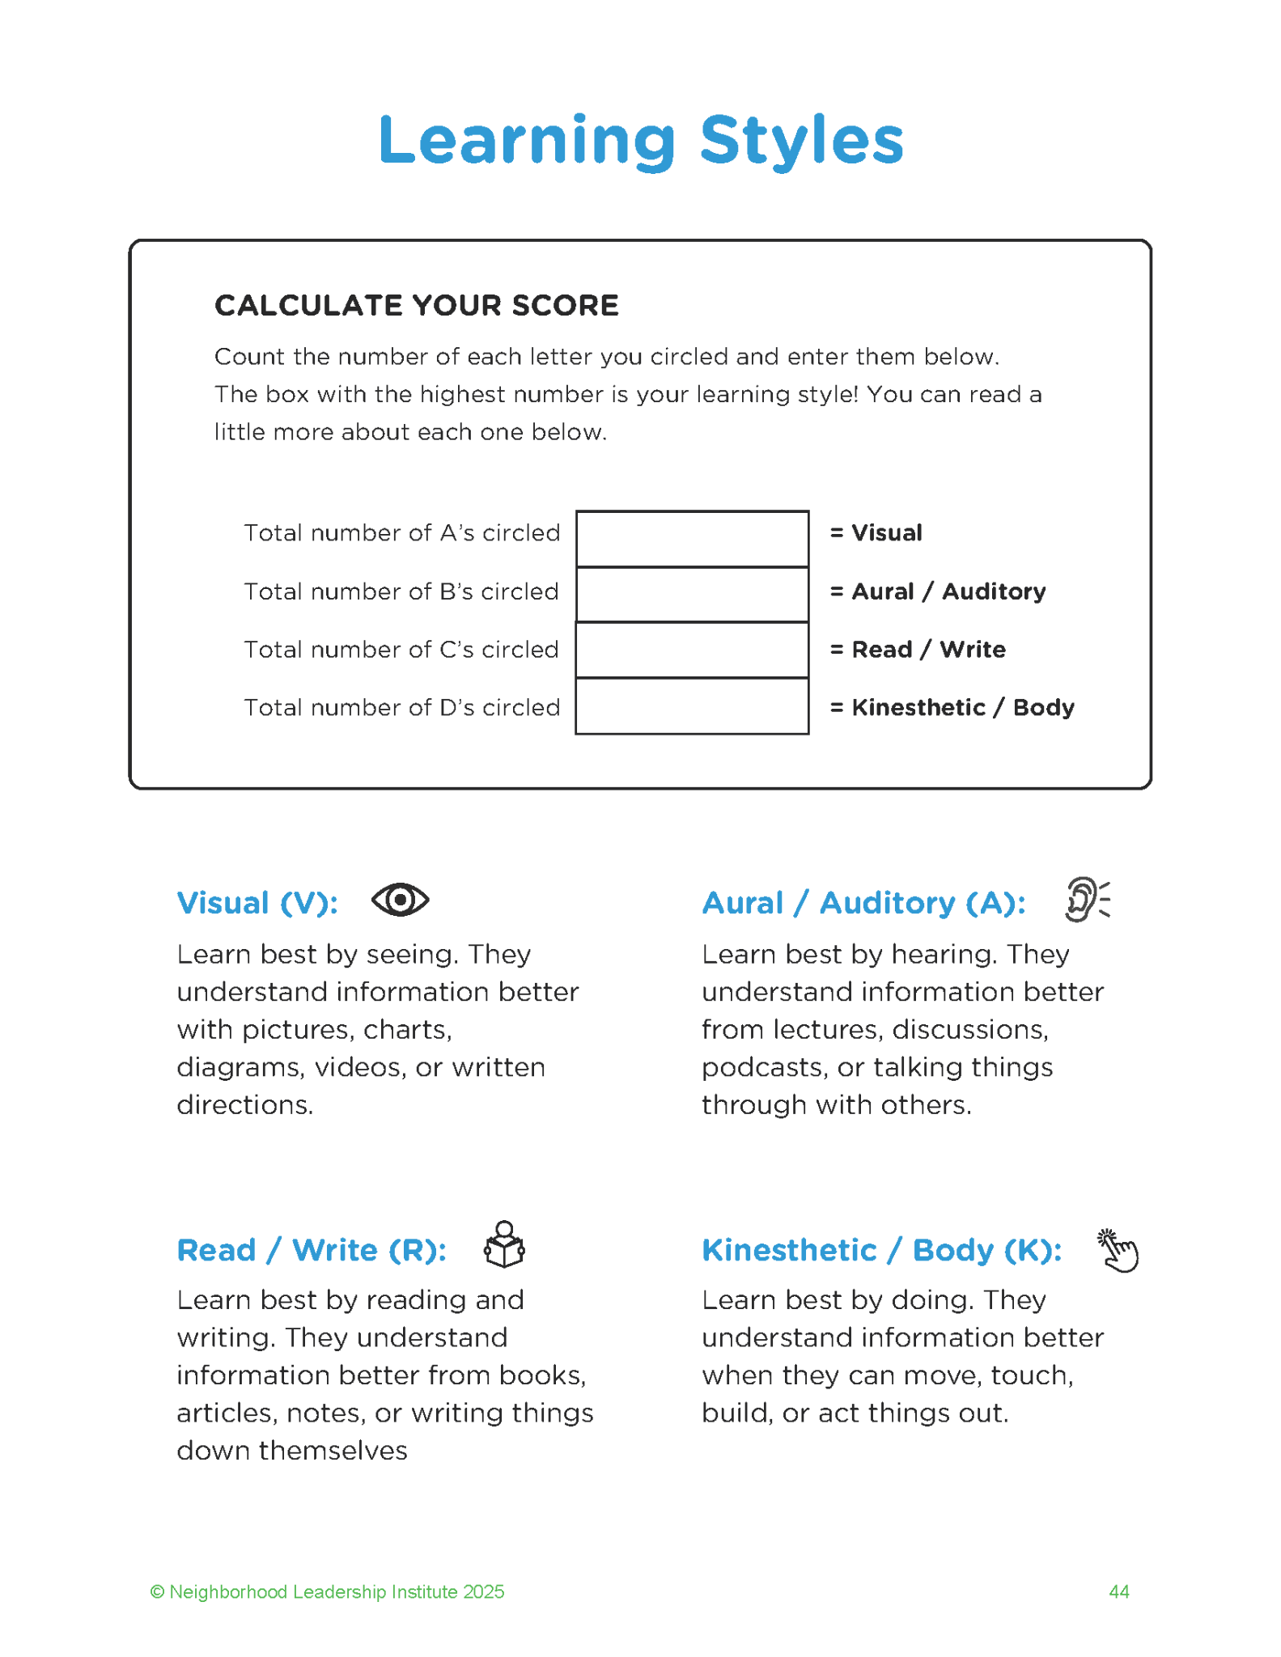

Slide 16
Discussion Prompts
Which was your favorite activity, and why did you like it?
Does the activity you enjoyed most match up with one of your Learning Styles from the inventory?

Slide 17
Future-Focused Reflection:
Understanding Your Learning Style

Slide 18
Turn to PAGE 45 in your Tracker
Reflection Questions
  Write down your learning style and explain it in your own words?
  What are some ways you can use your learning style to help you in high school?
  Describe a time when you wanted to learn about something just because you found it interesting. What was it? How did you learn about it?
  Describe a time you had difficulty learning something in one of your classes. How did you overcome the problem?

Slide 19
Discussion Prompts
Which activity did you like the most and why? What did you learn from the activity?
How can the activities/session be improved and why?

Slide 20
See You Next Month!
Session 6:
Preparing for My Future

Slide 21
True2U 7th Graders
Letter to My Future Self

Slide 22
Welcome
Welcome to True2U!
You’ll participate in True2U during the 8th grade next year.
Today, we’re going to do an activity with you to help you start thinking about your goals and what you want to accomplish.

Slide 23
Discussion Prompts
How often do you think about your future?
What are some goals you have?
  1 year from now?
  5 years from now?
  10 years from now?
Do you ever write goals down? Why or why not?
How do you handle obstacles when working towards goals?

Slide 24
Instructions
You’re going to write a letter to yourself in the future.
Think about what you want in the future.
This letter will be yours to keep so be thoughtful about your answers.
Even if your goals change, the knowledge you learn along the way will still be useful.

Slide 25
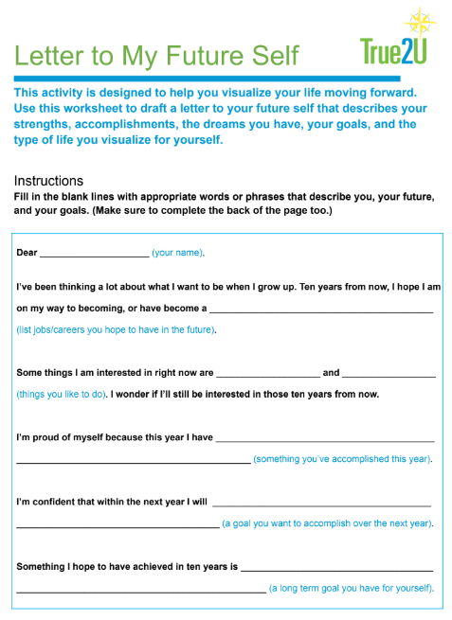

Slide 26
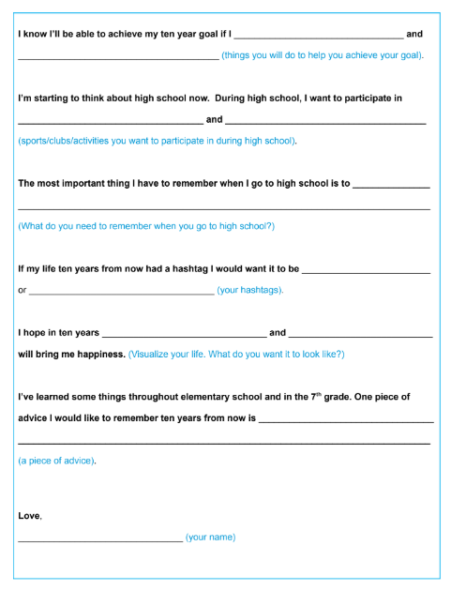

Slide 27
Activity Wrap Up
Would anyone like to share their favorite part of their letter?

