Slide 1


Welcome to True2U!
Session 4
My Values and Choices

Slide 2
Who remembers something we talked about in our last session?
What does your Personality Type have in common with your Career Clusters?
What characteristics of your personality type do you think will help you in high school?
Over your holiday break did you research any of the high schools that interest you?
Have you made your high school choice in CMSD’s Portal?
https://www.clevelandmetroschools.org/building-brighter-futures/bbf-enrollment-page

Slide 3
Agenda
Activity 4(a): Icebreaker: This or That
Activity 4(b): Making Good Choices
Activity 4(c): Personal Values
Future-Focused Reflection: Decisions and Values

Slide 4
Icebreaker: This or That

Slide 5
This or That
We will read a question and give two options for answers.
When we read the answers, we’ll show you which side of the room matches with each answer.
Once we’ve read the questions and answers, you’ll move to the side of the room that matches your answer.

Slide 6
Would you rather…
Work with a lot of people
Work alone

Slide 7
Would you rather…
Be in math class all day
Be in art/music class all day

Slide 8
Would you rather…
Study in a group
Study on your own

Slide 9
Would you rather…
Take a test
Write a paper

Slide 10
Would you rather…
Play sports
Watch sports

Slide 11
Would you rather…
Spend all your time indoors
Spend all your time outdoors

Slide 12
Would you rather…
Learn an instrument
Learn to speak a new language

Slide 13
Would you rather…
Only play sports
Only read books

Slide 14
Would you rather…
Write a song
Perform a song

Slide 15
Would you rather…
Only watch scary movies
Only watch funny movies

Slide 16
Would you rather…
Be invisible for a day
Be able to fly for a day

Slide 17
Would you rather…
Have blue teeth
Have orange eyes

Slide 18
Would you rather…
Always have hiccups
Always have to sneeze

Slide 19
Would you rather…
Live near the beach
Live in the mountains

Slide 20
Would you rather…
Live in the country
Live in the city

Slide 21
Would you rather…
Travel every day
Never leave home

Slide 22
Would you rather…
Wake up at 6am every morning
Go to sleep at 9pm every night

Slide 23
Would you rather…
Give up TikTok
Give up Instagram

Slide 24
Would you rather…
Communicate only in emails
Communicate only in phone calls

Slide 25
Would you rather…
Have breakfast for every meal
Have dinner for every meal

Slide 26
This or That
Debrief
  Did you enjoy that activity? Why or why not?
  Was it easy or hard to choose?
  Were there any choices that really made you think?
  Did you learn anything surprising about your classmates?

Slide 27
Making Good Choices

Slide 28
Turn to PAGE 36 in your Tracker
Making Good Choices

Slide 29
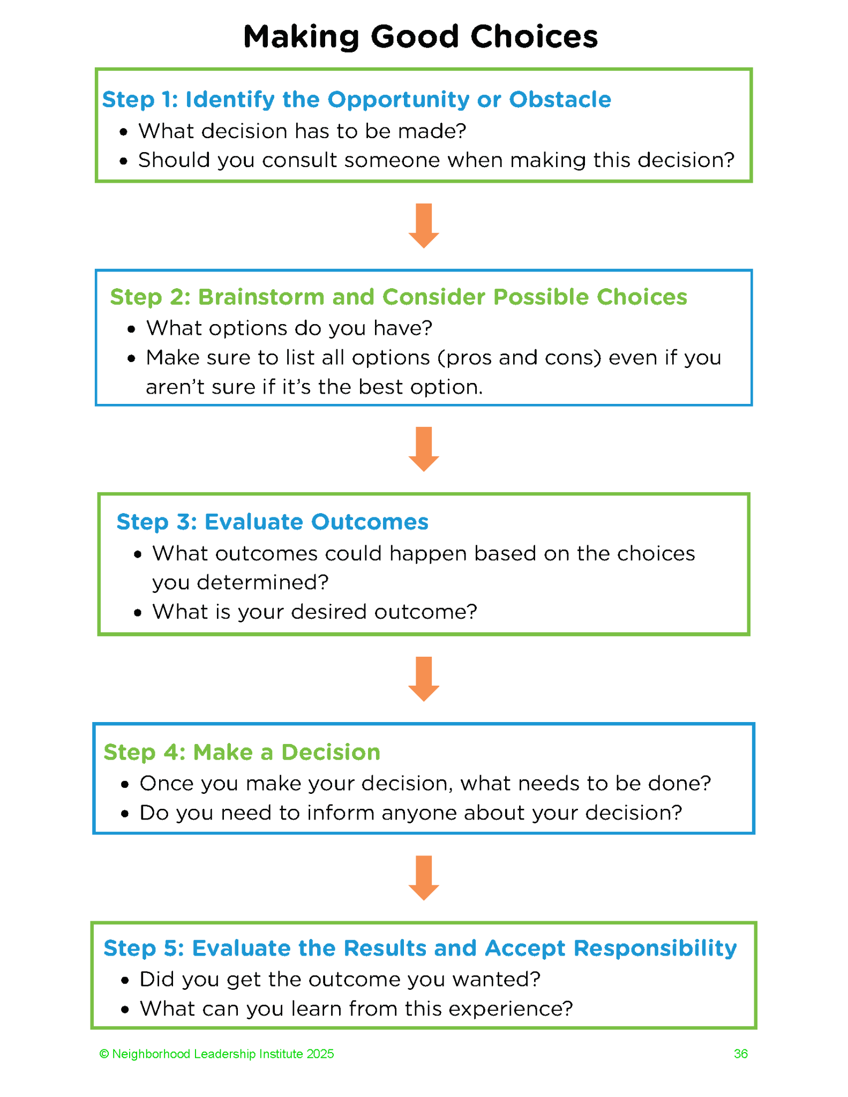
Tracker pg. 36

Slide 30
Making Good Choices
Scenarios
You’ll be divided into groups and given a scenario to work on.
Read through your scenario as a group.
Complete the Small Group Discussion Questions worksheet (Tracker pg. 37) as a group to determine what the best choice is for your scenario.
Groups will present their scenario and decision to the class.

Slide 31
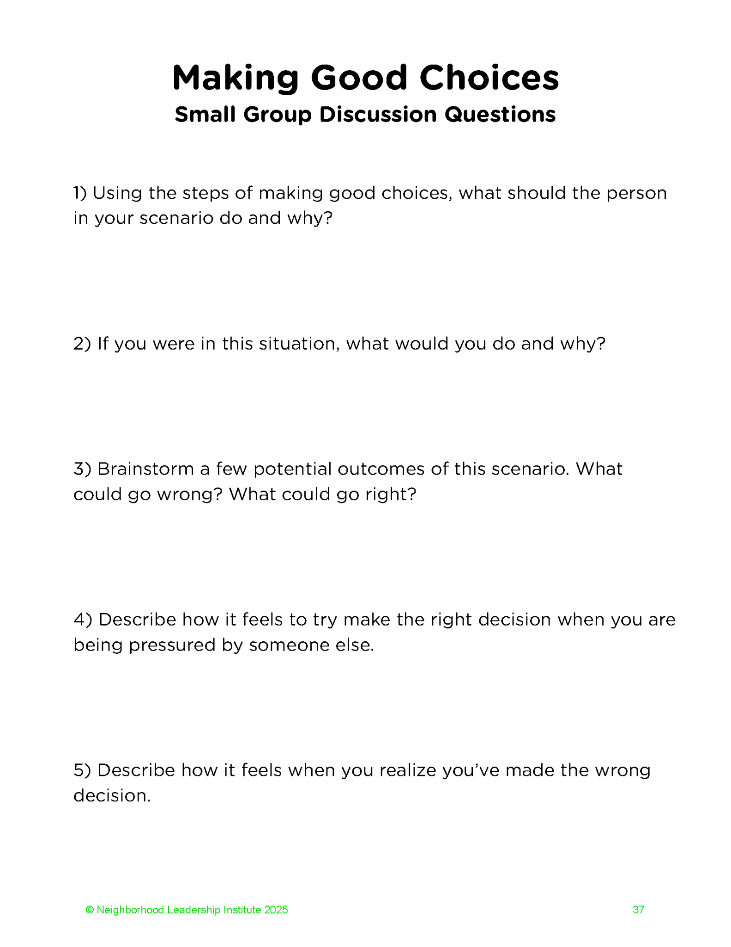
Tracker pg. 37

Slide 32
Making Good Choices Scenario 1
Tasha is in charge of watching her five‐year‐old sister, Marcella, for the day. Marcella keeps nagging Tasha to take her to see a movie that came out last weekend. Tasha saw the movie last weekend with her friends, and she thought it was good, but it was pretty violent, and at one point, it was so scary that Tasha screamed in the theater. Marcella won’t stop asking to go. Tasha’s friend John is encouraging Tasha to take Marcella to the movie. Her other friend, Denise, tells her she shouldn’t because it’s too scary. What are Tasha’s options and what should she do?

Slide 33
Making Good Choices Scenario 2
Cameron is a senior in high school and a star student. He’s trying to decide which college he should attend. He’s gotten into Harvard and Case Western Reserve. Cameron was so excited when he got into Harvard because it’s famous, and everyone congratulated him a lot when they found out. But it’s kind of far away – in Boston – and it doesn’t have a great program for what he wants to study. When Cameron told people he got into Case, they didn’t seem as excited as when he mentioned Harvard; however, Case is closer to home (which Cameron likes because he’s really close to his family and wants to be able to see them often), and it has a great program for what he wants to study. Cameron’s mom thinks he should go to Harvard, but his uncle, who Cameron is really close to, is encouraging him to go to Case because it has a better program for what he wants to do. What do you think Cameron should do?

Slide 34
Making Good Choices Scenario 3
Anthony has noticed that his friend Charles hasn’t been to school in over two weeks. Anthony has texted Charles to see what’s up, but Charles says he just has some things going on and he’s not sure when he’ll be back at school. Anthony knows that Charles has some stuff going on with his family right now, but Anthony also knows how important it is to be in school – he’s becoming concerned that Charles might be considering dropping out completely. Anthony asks his other friend, Naya, what she thinks he should do, and she tells him that it’s not really any of his business. Anthony’s cousin, Jackson, says that Anthony should let Charles do Charles. What are Anthony’s options, and what should he do?

Slide 35
Making Good Choices Scenario 4
Tianna is spending the night at her friend Makenzie’s house. Makenzie’s parents have gone out for the evening and left Tianna, Makenzie, and her older sister Molly home alone for the evening. While Tianna and Makenzie are watching TV, Molly comes into the room asking if they want to use their mother’s car to get ice cream. Tianna asks if Molly has her license, and she says “no” but assures her that it will be fine because the ice cream shop is only 3 minutes away. Mackenzie doesn’t want to go, but Molly says she does this all the time when their parents go out, and nothing has ever happened. What should Tianna do?

Slide 36
Making Good Choices Scenario 5
Khloe, Shawn, Aaron, and Jayden have a group project due in ELA on Friday. The group makes plans to meet on Wednesday after school to work on the project. When the time comes to meet up, Shawn doesn’t show up. He never reached out to say he wasn’t coming, and he also hasn’t done his part of the project. Aaron thinks the rest of the group should just do the parts Shawn was supposed to do, so they can get a good grade. Jayden thinks the group should leave Shawn’s parts blank and tell their teacher what’s going on. What should the group do?

Slide 37
Making Good Choices Scenario 6
Timothy and Justin have been playing video games online together all year. One night, when they’re playing, Justin starts making rude comments to Timothy about his appearance and personality. The comments evolved into threats, and even though Timothy knew Justin was probably just joking around, he felt uncomfortable and was nervous about going to school the next day because Timothy and Justin were in the same class. When they logged off the game, Timothy talked to his two older brothers, Aiden and Darren, about what he should do. Aiden said Timothy shouldn’t worry about it and that nothing bad was going to happen. Darren said Timothy should talk to their dad to see if he could talk to Timothy’s teacher in the morning before school. What should Timothy do?

Slide 38
Personal Values
“What do you think of when you hear value?”
“What does the phrase personal value mean in your own words?”
“Do you think values are important? Why or why not?”
“Have you ever thought about your own values?”

Slide 39
Turn to PAGE 38 and 39 in your Tracker
Valuable Squares

Slide 40
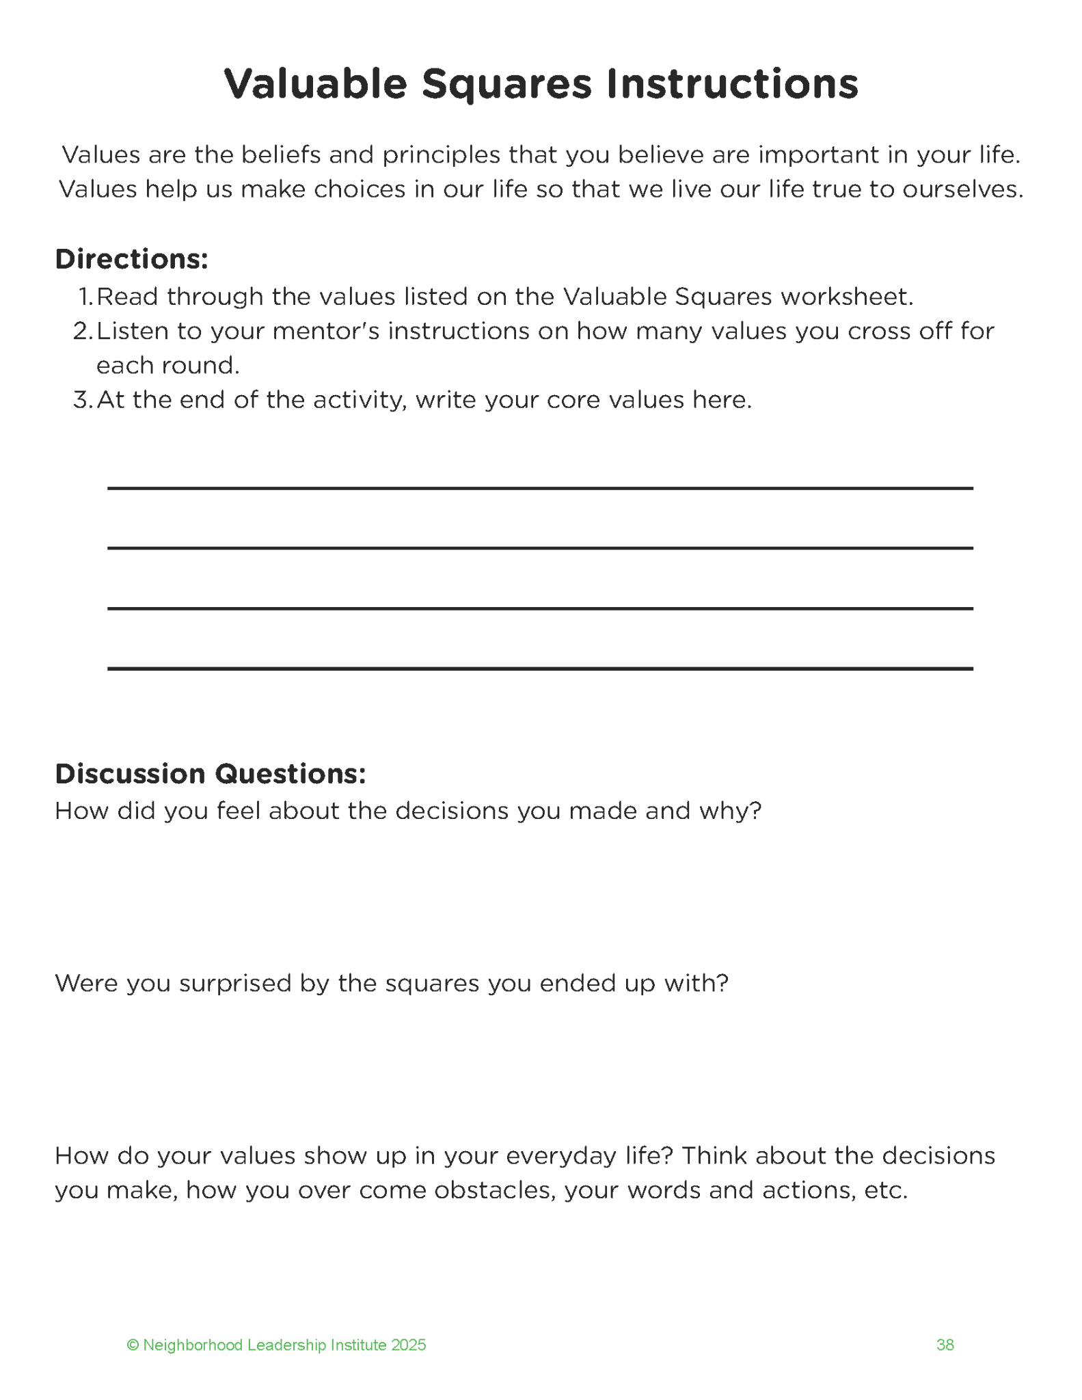

Slide 41
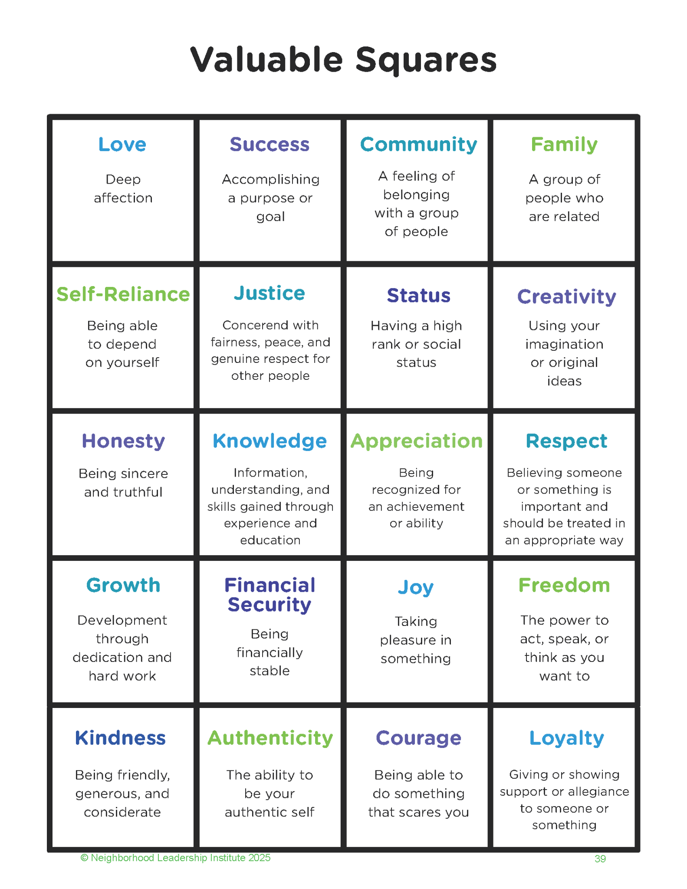

Slide 42
Future-Focused Reflection:
Decisions and Values

Slide 43
Turn to PAGE 40 in your Tracker
Reflection Questions
  What information would be important to know about a career?
  Who are the adults you can turn to for support as you explore your career interests and goals?
  Write about a time when you had a big problem you had to solve by yourself.
  What were your top three values and what do those values represent in your life?

Slide 44
Discussion Prompts
Which activity did you like the most and why? What did you learn from the activity?
How can the activities/session be improved and why?

Slide 45
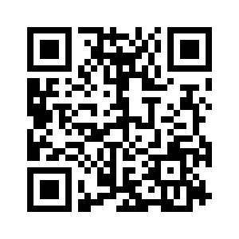
High School Choice Resources
East Side Building Brighter Futures (BBF) School Choice Expo
Saturday, January 31 - John Adams High School (10 am - 2 pm)
West Side Building Brighter Futures (BBF) School Choice Expo
Saturday, February 7 - Max Hayes High School (10 am - 2 pm)
School Finder - self-directed school search tool
https://cmsd.finder.schoolmint.com/

Slide 46
See You Next Month!
Session 5:
Linking Learning Styles to Careers

