Slide 1


Welcome to True2U!
Session 3
My Personality Type
Notes:
Laura

Slide 2
Who remembers something we talked about in our last session?
What do you remember about the career clusters we discussed? What were some career clusters you were interested in?
Have you done any research on the high schools you’re interested and if the programs or classes align with the careers you’re interested in?

Slide 3
Agenda
Activity 3(a): Icebreaker: Notecard Basketball
Activity 3(b): Practicing My Personality Type
Activity 3(c): Personality Type Inventory
Activity 3(d): WOOP, there it is…
Future-Focused Reflection: Personality Strengths

Slide 4
Notecard Basketball
Everyone is going to get a notecard.
On your notecard, write down a fun fact about yourself. Try to make it something not everyone knows about you:
Places you’ve traveled to or would like to travel to
Favorite food, music, movie, etc.
A unique personality fact
Facts about family or pets
Favorite school subjects or career interests
Your fun fact MUST be school appropriate.
It is anonymous - DO NOT write your name on it.
When you’re done, crumple up your notecard.

Slide 5
Notecard Basketball
When we say go, toss your crumpled notecard towards the front of the room.
Grab a crumpled notecard.
We’ll each take a turn reading the notecard and guessing who wrote that card.

Slide 6

Aim Here!

Slide 7
Notecard Basketball
Debrief
Did you enjoy that activity? Why or why not?
Did you learn something new about your classmates?
Did anyone discover they had something in common with someone else?

Slide 8
What are some personality strengths?

Slide 9
Practicing My Personality Type
You’re going to work in teams to complete 3 short activities.
We’ll work through one activity at a time.
Work together with your teammates to complete each task.

Slide 10
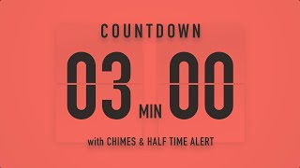
Categorize
Turn to PAGE 27 in your Tracker
Your team will have 3 minutes to sort these 20 words into categories.
You must have at least 2 categories but there is no limit on how many categories you can have.

Slide 11
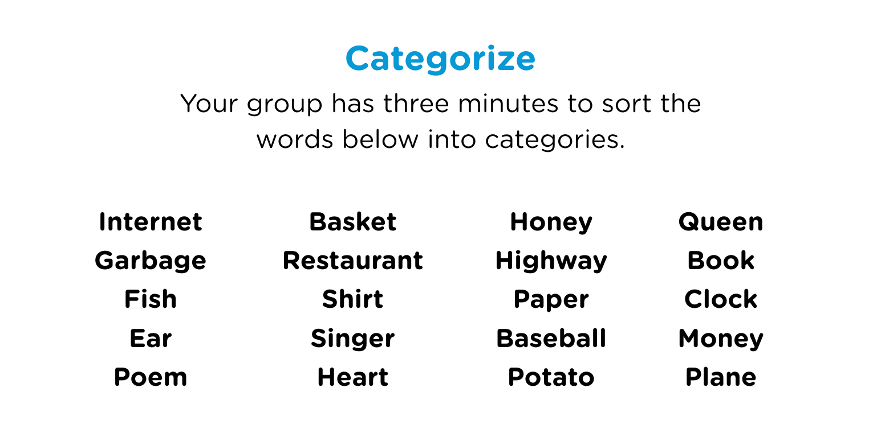
What were your group’s categories?

Slide 12
Did you enjoy this activity, and why or why not?

Slide 13

Create a Story
Turn to PAGE 28 in your Tracker
Your team will have 4 minutes to create a story that must use all 8 words listed on the worksheet.
You are allowed to include additional words.
Your story MUST be school-appropriate.

Slide 14
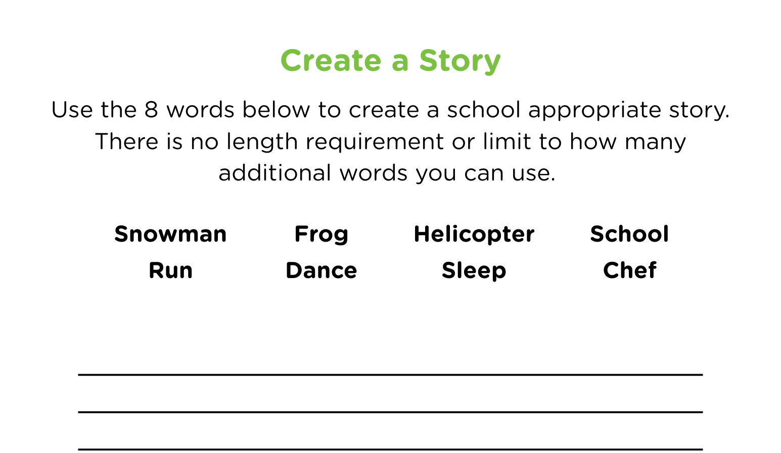
Create a Story
Did you enjoy this activity, and why or why not?

Slide 15
Word Scramble
Turn to PAGE 29 in your Tracker
Your group will have 3 minutes to create as many 2+ letter words as you can using the letters provided.
You cannot use a letter more than once in the same word.
The words must be real words.

Slide 16
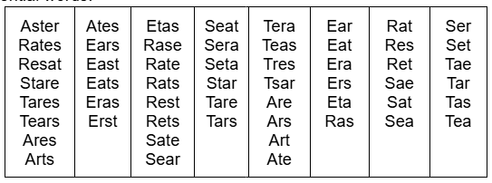
Word Scramble Answer Key
Did you enjoy this activity, and why or why not?

Slide 17
Debrief Questions
Which activity showed a strength you didn’t realize you had?
How do different personality types help a team succeed?
What is one thing you learned about yourself today?

Slide 18
Turn to PAGE 30 in your Tracker
For each question circle A or B based on which one feels most like you.
When you finish a round, tally how many A’s and B’s you circled.
Circle the result that had the most tallies.
Repeat for all FOUR rounds (pages 30 and 31).
Write the corresponding letter for each round in the box at the top of page 30 (“My Personality Code”).

Slide 19
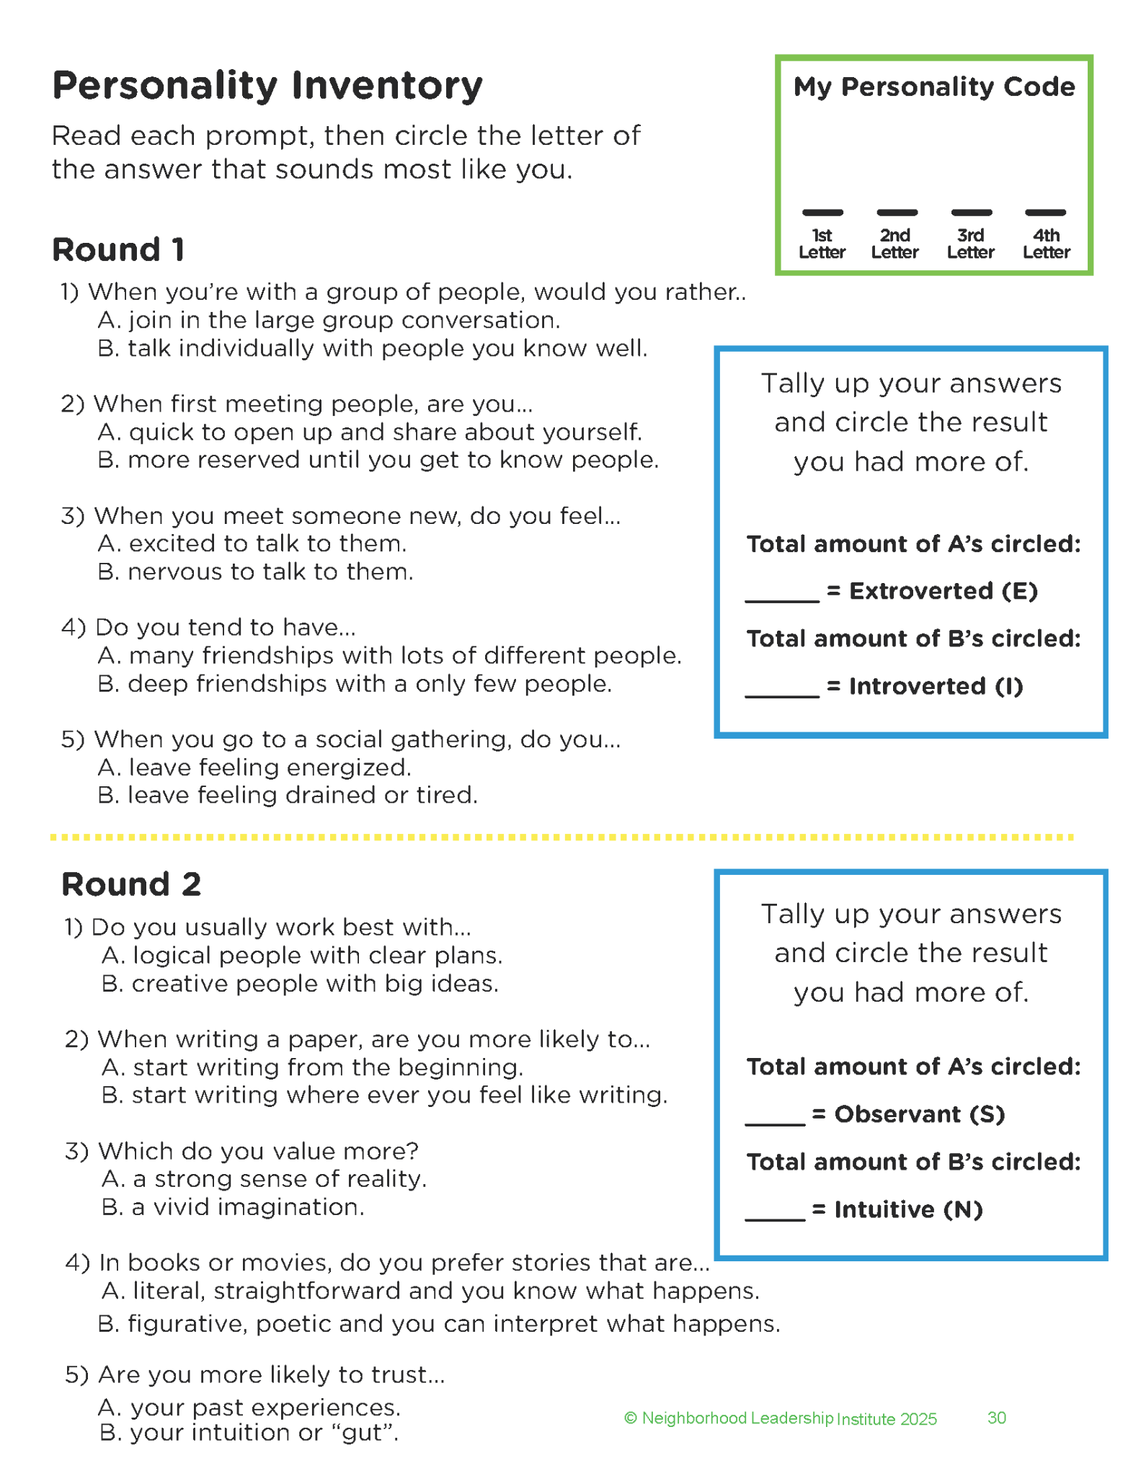
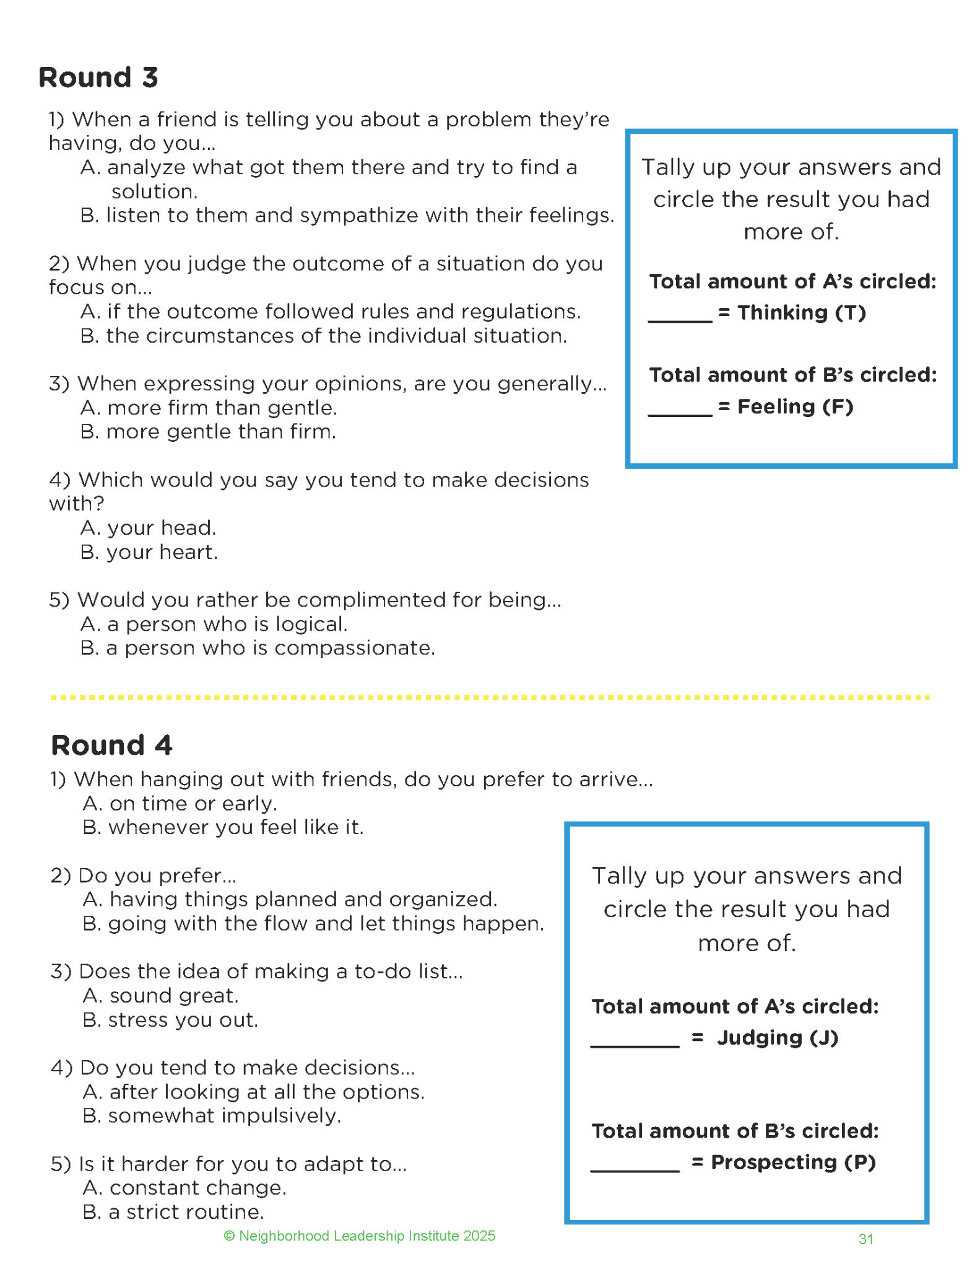
Pg. 30
Pg. 31

Slide 20
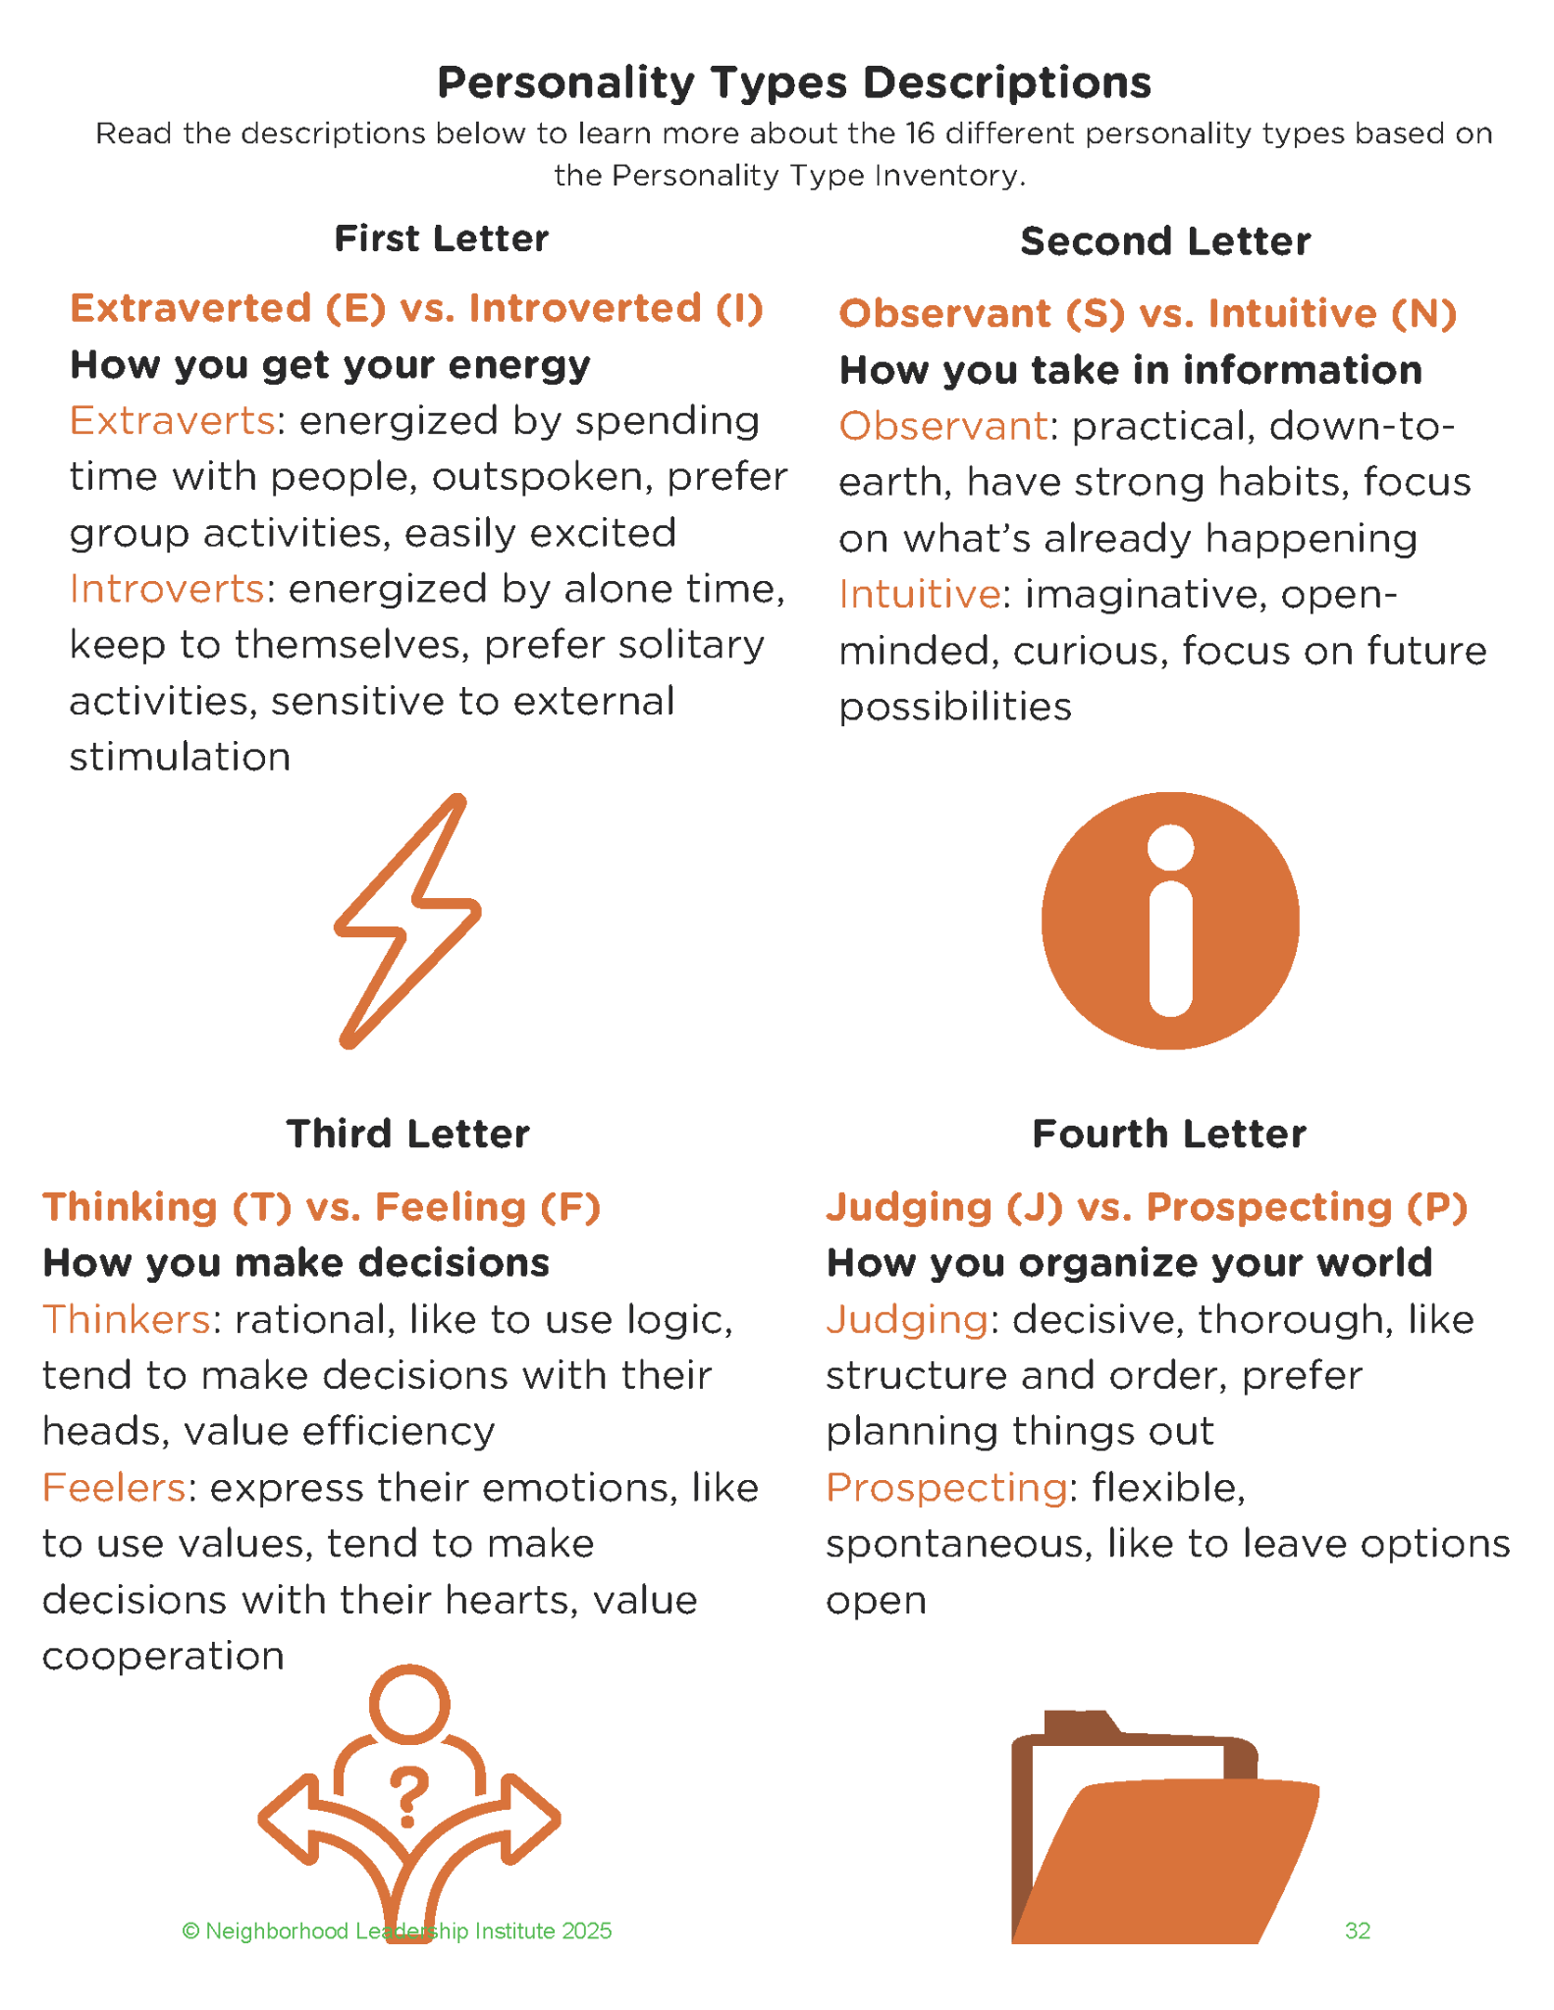
Page 32

Slide 21
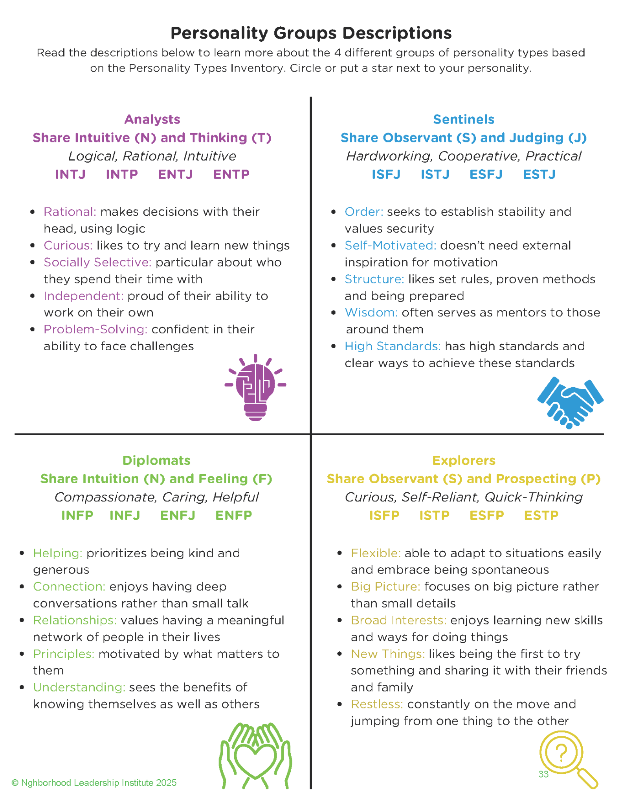
Page 33

Slide 22
Personality Type Inventory
Reflect on your survey results.
Do they match with how you contributed to your team in the last activities?
Do you agree or disagree with your results?

Slide 23

5 Minute BREAK

Slide 24
WOOP, there it is…
How many of you have a goal right now?
Would anyone like to share a goal they’re working towards?
How many of you write your goals down?
Do you usually accomplish your goals?
Do you think you’d be more likely to accomplish your goals if you wrote them down and checked on them each month? Why or why not?

Slide 25
WOOP
We’re going to use WOOP as a tool to help us think through what goals we want to accomplish and how we can get there even when we encounter setbacks.
Turn to PAGE 34 in your Tracker

Slide 26
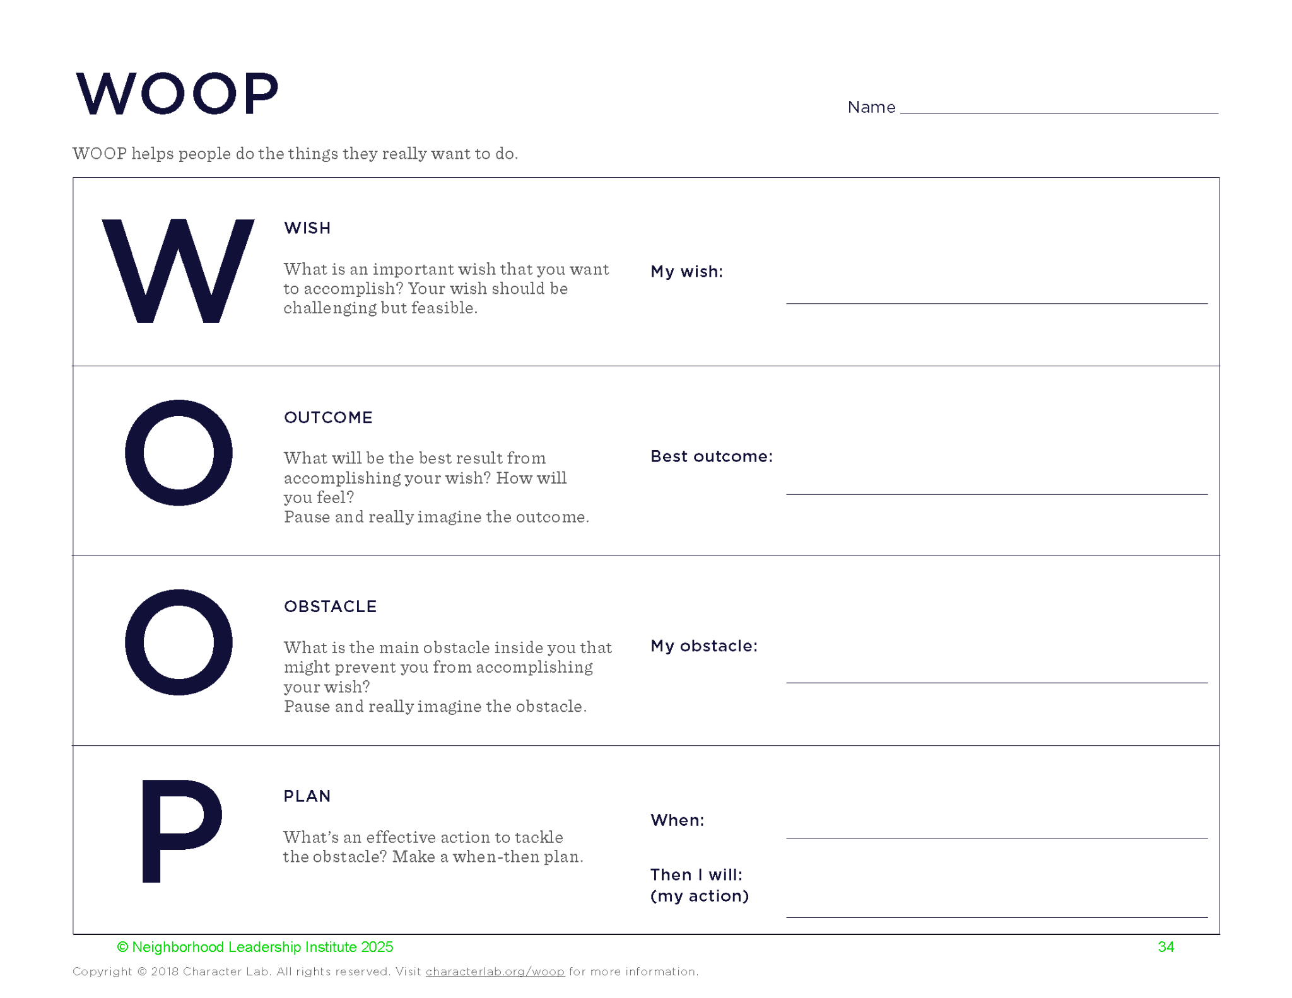

Slide 27
WOOP Debrief
Raise your hand if your goal:
is related to your grades.
will help you in high school.
is something you’ve already started working on.
What are some ways we can stay focused on our goal throughout the year?
We’ll be checking in on your WOOP goals in a few more sessions.

Slide 28
Future-Focused Reflection:
Personality Strengths

Slide 29
Turn to PAGE 35 in your Tracker
Reflection Questions
Write your four-letter personality code and describe what it means in your own words.
List three things your personality type and career cluster have in common.
What characteristics of your personality type do you think will help you in high school?
Why is it important to learn about your personality type?

Slide 30
Discussion Prompts
Which activity did you like the most and why? What did you learn from the activity?
How can the activities/session be improved and why?

Slide 31
See You Next Month!
Session 4: My Values and Choices
Engaging activities built around making good choices, personal values, and how they connect you as an individual, planning for high school and your future.

