Slide 1


Welcome to True2U!
Session 2
My Career Exploration
Notes:
Laura

Slide 2
Who remembers something we talked about in our first session?
What do you remember about the strengths and decision-making activities we discussed?

Slide 3
Agenda
Activity 2(a): Ice Breaker Name Game
Activity 2(b): Career Clusters Inventory
Activity 2(c): Career Cluster Exploration: Posters
Activity 2(c): Career Cluster Exploration:
Gallery Walk
Future-Focused Reflection: High School Matching

Slide 4
Name Game
On the back of your Name Tent write an adjective and a career that starts with the same letter as your first name.
When it’s your turn you will share out loud for the class.
School appropriate
If someone uses your adjective or career try to come up with another one.
EX: Helpful Horticulturist Hannah or
Marvelous Musician Marcus
Notes:
Laura

Slide 5
Mentor
Adjective:
Career:
Name:
Notes:
Laura

Slide 6
Mentor
Adjective:
Career:
Name:
Notes:
Laura

Slide 7
What is a Career Cluster?

Slide 8
Career Clusters
A career is one or many jobs you have for a significant part of your life.
A career should help you grow, achieve your goals, and feel a sense of purpose—not just provide income.
Knowing what careers interest you helps you make choices now—like which high school to attend, classes you take in high school, activities you join, and even volunteer or work experiences.
Today we’ll take an inventory and see which ones interest you most.

Slide 9
Career Clusters Inventory
Be thoughtful in your responses.
It is not a competition to finish first or have the most check marks.
Helpful tool to learn more about who you are and your interests.
There are 4 Pages total
16 Clusters

Slide 10
Turn to PAGE 10 in your Tracker
Directions: Check the items for each Cluster that best describe you.
Add up the number of checks for each Cluster and add to the total box on the right side of the page.
You may select as many or few as you want for each Cluster question.
After you complete the inventory, look to see which three Clusters have the highest numbers.
Find the corresponding Career Clusters at the end of this survey to see which Career Clusters you may want to explore.

Slide 11
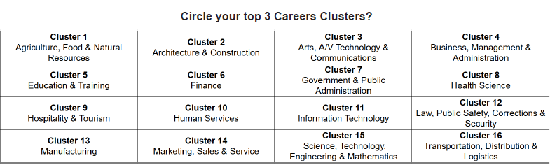

Slide 12

5 Minute BREAK

Slide 13
Activity 2(c) Career Cluster Exploration
Think about the kind of career you might want to have and learn more about the possible occupations/jobs in that field.
Careers require different skills and training, all are valuable and important in our society.
The key is to figure out which might be right for you.

Slide 14
Activity 2(c) Career Cluster Exploration: Posters
You will be put in a group according to your Career Cluster Interest.
As a group you will work together to create a poster that teaches others about the careers in your cluster and shows why those careers matter.
Each group will receive a poster template.
Each group member should have a role(s): Design/layout, scribe, researcher, etc.

Slide 15
Activity 2(c) Career Cluster Exploration: Posters
Use the Career Cluster info sheets and review each section
Your poster should include:
  Cluster name
  Example jobs
  Required skills/training
  Interesting facts
  Why these jobs matter
  Any additional relevant information
Use the True2U 16 Career Clusters for reference (Tracker pgs. 14 - 21)
You will have 20 minutes. Use your time wisely

Slide 16
Activity 2(c) Career Cluster Exploration: Gallery Walk
How it works:
  Quietly walk around and view the other groups’ posters as if we are in a museum.
  It is a silent activity, focus on reading and learning from each poster.
  If too many people are at one poster move to another and go back to it later.
  Using a blank page in your Tracker, take notes to ask questions or provide feedback at the end when we gather back up for a class discussion.

Slide 17
Gallery Walk Debrief
What is one thing you learned from one of the posters?
Is there a career you’re interested in now that you weren’t before?
How do the different Career Clusters connect or support each other?
Does your career interest connect with the high school of your choice?

Slide 18
Future-Focused Reflection:
High School Matching

Slide 19

Page 22

Slide 20
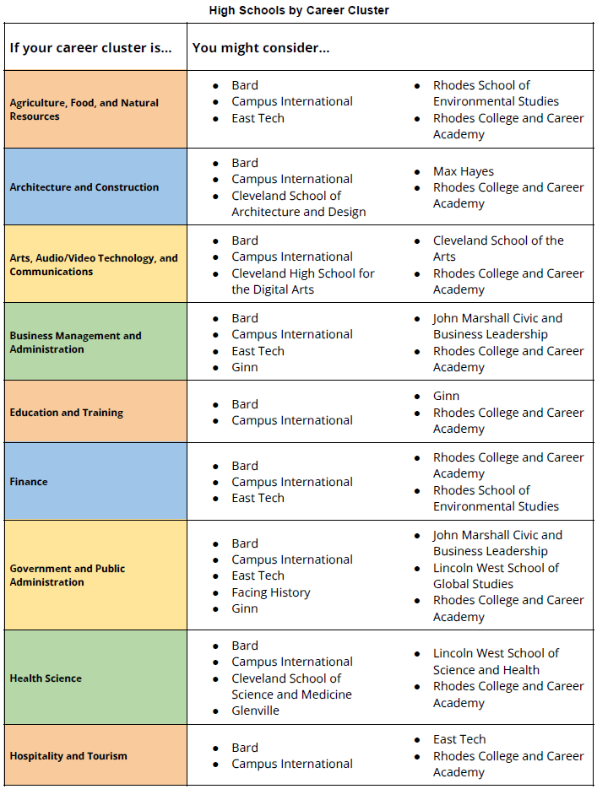
Page 24

Slide 21
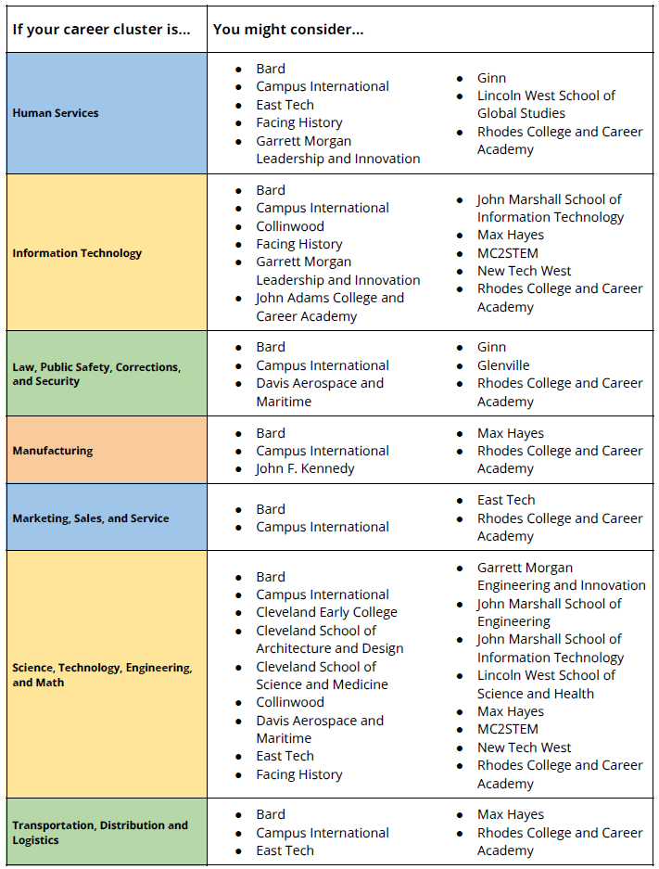
Page 25

Slide 22
Directions
Blue Box: Write a career that interests you.
  You can list a few related careers.
Green Box: Write the cluster that career(s) belongs to.
Yellow Box: Using the HS by Career Cluster info sheet (Tracker pg. 24 & 25) list 1 or 2 high schools that focus on that career cluster.
Repeat for the 2nd row of boxes.
Answer questions 1 - 4

Slide 23
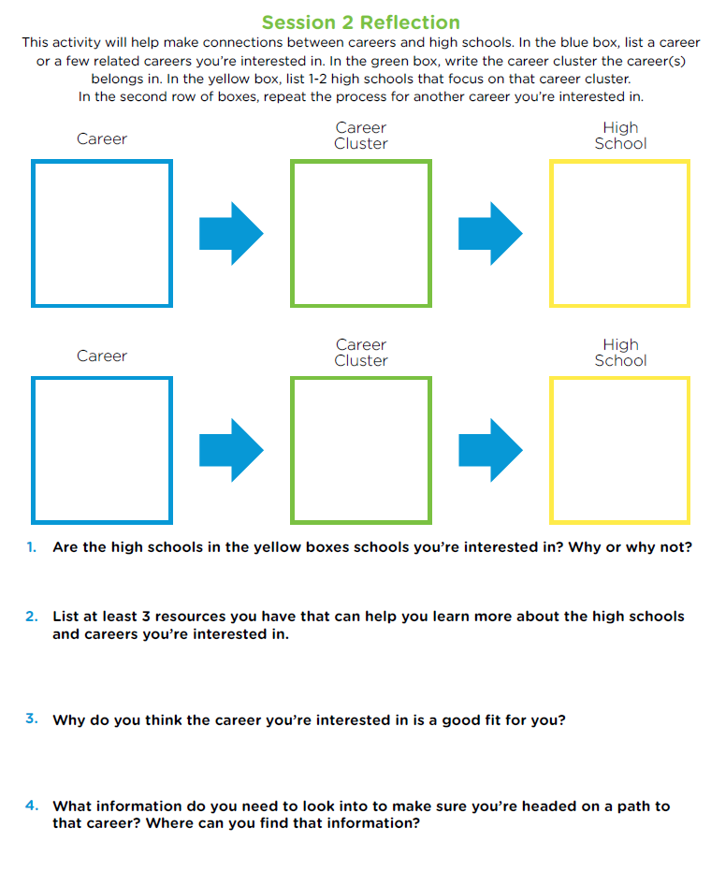
Page 26

Slide 24
High Schools by Career Clusters

Slide 25
Discussion Prompts
Which activity did you like the most and why? What did you learn from the activity?
How can the activities/session be improved and why?

Slide 26
See You Next Month!
Session 3: My Personality Type
  Engaging activities to practice and understand your Personality Type.
  Practice strategies for setting a plan.

