Slide 1


Welcome to True2U!
Session 1
Who Am I Today?
Notes:
Laura

Slide 2
Agenda
Welcome to True2U!
Activity 1(a) My Name
Activity 1(b) Ice Breaker: Step into the Circle
Activity 1(c) My Strengths
Activity 1(d) This or That - Decision Making for High School
Future-Focused Reflection: Opportunities and Obstacles

Slide 3
Welcome to True2U!
Write your name on the front cover of your True2U Tracker!
Give the marker to another classmate when you’re done

Slide 4
Turn to PAGE 1 in your Tracker

Slide 5

Program Overview

Slide 6
Turn to PAGE 2 in your Tracker

Slide 7
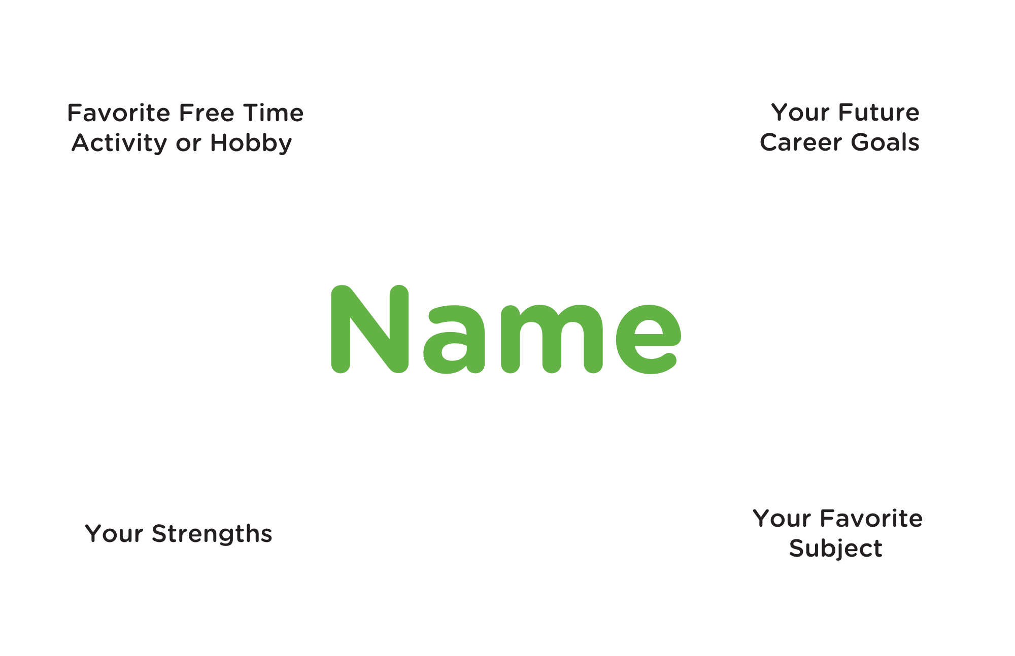

Slide 8
Favorite Free Time Activity or Hobby
Your Future Career Goals
MENTOR NAME
Your Strengths
Your Favorite School Subject

Slide 9
Favorite Free Time Activity or Hobby
Your Future Career Goals
MENTOR NAME
Your Strengths
Your Favorite School Subject

Slide 10
When it is your turn share…
Your Name
One or Two corners of your name tent

Slide 11
Group Guidelines
Why do you think guidelines are important?
What guidelines do you think will help us work well together?
Share guidelines that are important to you and that you have already created for you class.

Slide 12
Step into the Circle
How it works:
We will start by reading a statement.
You will step into the circle if you agree.
If not stay where you are.
"It’s okay to step into the circle or not. This is about reflecting on your values and being honest with yourself."

Slide 13
Practicing Your Strengths
Turn to PAGE 3 in your Tracker
Work alone or with a partner to solve this.
Use your problem-solving skills!
You have 4 minutes

Slide 14
Turn to PAGE 4 in your Tracker
This is an individual activity you will work on your own.
Make this squiggle into something creative.
Use your imagination!
Reminder, it must be school appropriate.
You have 4 minutes

Slide 15
Silent Line-Up
This is a silent activity
Without speaking, line up in order of your birthdays—month, day, and year.
Use non-verbal communication.
You have 4 minutes

Slide 16
Who Are You?
Strengths Inventory
Turn to PAGE 6 in your Tracker
Answer all questions in each section on pages 6 and 7
When you are finished tally your results
Record/Circle your top strengths on page 7

Slide 17
This or That: Decision Making for High School
How it works:
We will read a pair of choices.
Stand on one side of the room depending on your choice.

Slide 18
Future-Focused Reflection:
Opportunities and Obstacles
Turn to PAGE 8 in your Tracker
What is your top strength?
How can your top strength help you in the future when thinking about your career?
For strengths that were not in your top 3, which would you like to work on or get better at and why?
What steps can you take to improve on the strength(s) you listed in question 3?
Circle the areas of life that you want to know more about. (You can choose more than one)
Trade School Interviews High School
Finances / Money Health & Wellbeing
College Work / Life Balance Jobs

Slide 19
See You Next Month!
Session 2: My Career Exploration

