Slide 1

OUR PROGRAM BEGINS AT 12:30
Notes:
Facilitator will put up this slide from 12-12:30

Slide 2

We champion shared learning across the clinical and executive leaders of Minnesota’s assisted living and skilled care settings. Through supportive dialogue grounded in the ECHO principle of “all teach, all learn,” our virtual community of interdisciplinary leaders shares promising practices to improve operational outcomes and quality of life as we age.
PURPOSE
Notes:
The session will start at 12:30

Slide 3
THE CHECK-IN
Insert a check-in question here
Notes:
Facilitator reviews this question with the group from 12:30-12:35 p.m.

Slide 4
WELCOME: MONTH ##, 2026
The CHECK-IN
INSERT SESSION TITLE
ALL TEACH.
ALL LEARN.
Notes:
Facilitator welcomes the room (we will customize this slide; you don’t need to do anything to this template).

Slide 5

WELCOME
Notes:
Facilitator banters with the MN Geriatrics ECHO team around “WHY THIS SESSION MATTERS” and introduces our guest presenter(s). Your photo will be placed on this slide.

Slide 6
Your Slides Go Here
Notes:
Guest presenter

Slide 7
CASE SCENARIO: NAME
Insert your case study on one slide here
End with discussion question(s)
Notes:
Guest Presenter

Slide 8
ALL TEACH. ALL LEARN.
What themes emerged in your small group?
What questions do you have for the group?
What lessons do you have to share on this topic?
Notes:
Facilitator to help lead debrief – guest will get the final word.

Slide 9
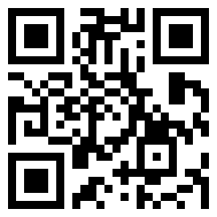
Verify Your Attendance!
Notes:
Facilitator
Don’t forget to verify your attendance!
https://z.umn.edu/echoattend

Slide 10

Notes:
Facilitator

Slide 11
NEXT SESSION: Insert Date
Visit us online:
https://www.mngeriatricsecho.org
Email:
GeriatricsECHO@umn.edu
Insert Topic
Notes:
Facilitator
Email us anytime at GeriatricsECHO@umn.edu

