Slide 1









Search Engine Optimization
01
Process of improving a website’s visibility on search engines like Google so it appears higher in search results.
Generative Engine Optimization
02
Local Business Search Visibility Explained
Focuses on optimizing your digital presence for location-based searches and AI-driven search results.
Answer Engine Optimization
03
Practice of optimizing content to directly answer user questions on search engines and AI-powered platforms
Practical actions to connect and build trust with local audiences
Artificial Intelligence Optimization
04
Process of optimizing content, data, and digital assets so they are accurately understood, trusted, and recommended by AI-powered platforms.

Slide 2





SEO – Search Engine Optimization
Helps attract qualified traffic, increase credibility, and drive consistent, organic growth without relying on paid ads.
01
Focus
Ranking in traditional search engines
02
Methods
Keywords, backlinks, site structure
03
Benefits
Better organic search visibility
04
Example
Ranking for “best pizza in town”

Slide 3






GEO – Generative Engine Optimization
Ensures your business appears accurately and prominently in local searches and is correctly understood and recommended by generative AI platforms, helping you reach the right audience at the right place and time.
Focus
01
Location-specific targeting & AI results
Benefit
Example
03
Greater local relevance and proximity visibility
04
“Pizza delivery near me” searches
Methods
02
Location keywords, Google Business Profile, geofencing

Slide 4








AEO – Answer Engine Optimization
Focuses on clear, structured, and authoritative information so your brand becomes the preferred source for featured snippets, voice search, and instant answers.
Focus
03
Benefits
Voice search & direct answers
01
Captures voice and zero-click searches
Methods
Example
FAQs, structured data, conversational content
02
04
“Where is the nearest pizza place?”

Slide 5





AIO – Artificial Intelligence Optimization
Focus
Benefit
AI-driven optimization & insights
01
03
Efficiency and data-driven improvements
Methods
Example
02
04
AI analyzing local competitor keywords
AI tools, algorithms, analytics

Slide 6
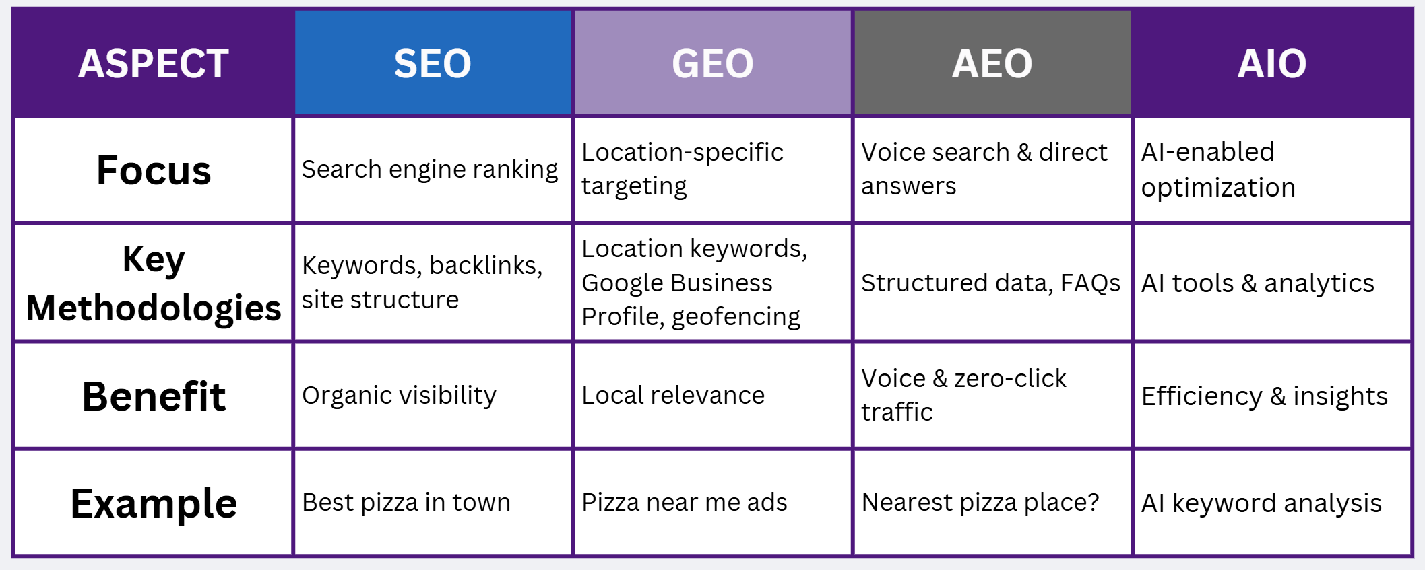
How They Work Together for Local Businesses
Helps ensure your brand is visible, credible, and correctly represented across AI search, assistants, and generative models.

Slide 7

What businesses should do to show up everywhere?
01
02
03
04
GEO
AEO
AIO
SEO
Fully optimize Google Business Profile and local keywords, case studies, reviews
Add FAQ pages, schema markup, and conversational content, cast studies, reviews
Optimize website content, mobile speed, and backlinks
Use AI tools to track competitors, trends, and performance
05
Consistency across website, listings, reviews, and AI platforms

Slide 8



Key Takeaway
Search is no longer one channel
01
03
Businesses that adapt early win more local customers
Local visibility requires SEO + GEO + AEO + AIO
02

