Slide 1
Scouting as a Parish Ministry
Ed Milbrada
Scouting Vice President
Brotherhood of St Andrew

Slide 2
First a Brief Commercial
What is the Brotherhood: We are a national men’s ministry of the Episcopal Church focusing on our mission and our discipline as we lead like the apostle Andrew.
- Founded at St. James’ Episcopal Church in downtown Chicago
in 1883
- Chartered by Congress May 30, 1908
VISION: To inspire, empower and equip men and boys to fulfill the Great Commission.
MISSION: To bring men and youth to Christ.
The Brotherhood endeavors to accomplish this mission through the threefold disciplines of Prayer, Study, & Service.

Slide 3
Importantly, the Brotherhood has been recognized by General Convention as the men’s ministry of the Episcopal Church
Resolved that the 78th General Convention acknowledge, with thanks to God, the Brotherhood of St. Andrew and 132 years of ministry to men and boys;
and be it further Resolved that the 78th General Convention encourage and support dioceses and congregations in their efforts to develop and expand ministry to men, to mentor and raise up the next generation of young men throughout the Episcopal Church.
Journal of the General Convention 2015, page 436
Salt Lake City, Utah

Slide 4
The Brotherhood uses seven focus ministries to accomplish the Discipline of Service
Discipleship/Mentoring
Recovery
Restorative Justice/Prison Ministry
Veterans Ministry
Racial Reconciliation
Social Justice
Scouting

Slide 5
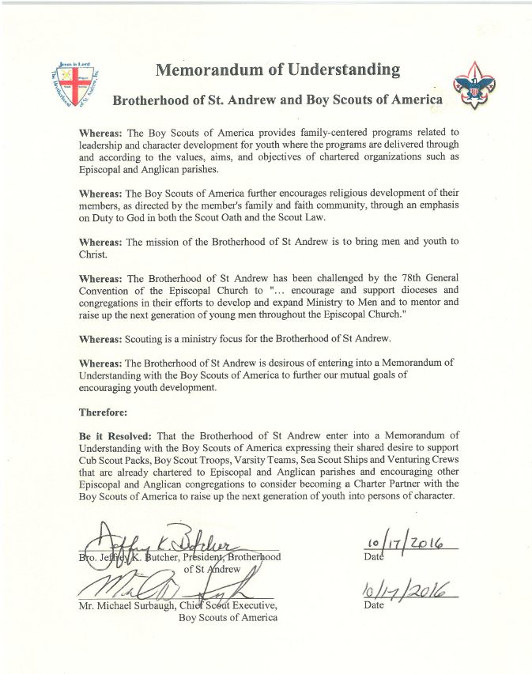
Scouting
Scouting is the Brotherhood’s youth ministry
The Brotherhood has entered into a Memorandum of Understanding with the BSA where:
The Brotherhood agrees to support Scout units chartered to Episcopal congregations and encourage all Episcopal congregations to charter BSA units
The BSA, as part of the charter agreement, agrees to:
- Provide program training
- Provide camping opportunities
- Review leadership, including background checks of leaders
- Provide liability insurance

Slide 6
Scouting
The Brotherhood Scouting Committee supports Scouting in Episcopal congregations and Episcopal youth in Scouting organizations.
Episcopal presence at Boy Scout Jamborees
Encouraging youth in their Duty to God
Scout Sunday
Recognizing adult support of Episcopal youth
Chaplains at camps:
- BSA National High Adventure Bases (Philmont)
- BSA Summer Camps

Slide 7
Episcopal Presence at Jamborees
A Jamboree is a gathering of youth and adults from all over the world. Attendance is roughly 20,000
Boy Scouts hold Jamborees roughly once every four years in West Virginia
The Episcopal presence consists of two parts:
- Jamboree Eucharist
- Display in the Faith and Beliefs area

Slide 8
Jamboree Eucharist
Many faith groups hold a service for the participants and staff during the Jamboree. We are one of them.
The Bishop of West Virginia has been the celebrant for the last three Jamborees.
The congregation (~300) last year was the largest congregation in West Virginia that Sunday.

Slide 9
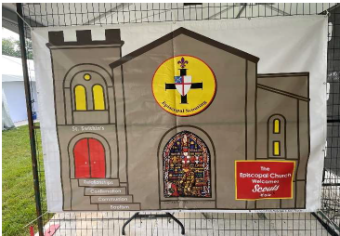
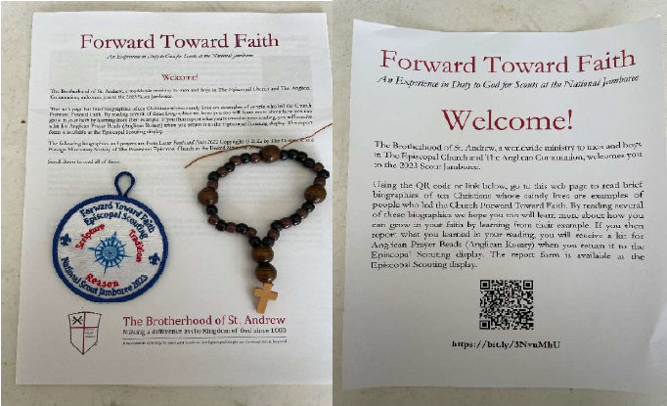
Episcopal Display
Jamborees provide an opportunity for Faith Groups to present information on their faith
The Episcopal display (St Swithin’s at the Jamboree) was one of these
At the display we had the opportunity to discuss the Episcopal Church with about 400 youth and adults
We also had an activity where participants were encouraged to research at least one of a dozen Anglican saints. Those who completed the activity were given an Anglican prayer bead kit

Slide 10
Encouraging Youth in Their Duty to God
Duty to God has always been part of Scouting:
“It does not come in at all. It is already there. It is a fundamental factor underlying Scouting and Guiding.”
Lord Baden Powell
Duty to God is an integral part of many youth serving programs including the Boy Scouts of America and the Girl Scouts of the USA
- On my honor I will do my best to do my duty to God and my country and to
obey the Scout Law; to help other people at all times; to keep myself
physically strong, mentally awake, and morally straight.
- On my honor, I will try: To serve God and my country, To help people at all times, And to live by the Girl Scout Law.
The Brotherhood Scouting Committee encourages Duty to God via:
- Encouraging youth to earn their Youth Religious Award
- Encouraging celebration of Scout Sunday at congregations which sponsor Scout units
- Supporting adult leaders in youth serving organizations

Slide 11
Youth Religious Awards
Most denominations have a religious award so youth can learn about their faith
There is a set of generic Protestant religious awards
(God and Me, God and Family, God and Church, God and Life)
The Brotherhood Scouting Committee recognized that Episcopal-specific awards could help Episcopal youth learn more about “our branch of the Jesus movement.”

Slide 12
Youth Religious Awards
Generic Religious Award |  | Episcopal Religious Award
God and Me |  | Baptism
God and Family |  | Holy Communion
God and Church |  | Confirmation
God and Life |  | Relationships

Slide 13
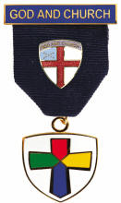
Episcopal Religious Awards
Written by Fr. Ed Erb, Rector St Paul’s, Wellsboro, PA
Focus on the Sacraments
Manuals can be downloaded from the Brotherhood web site
https://brothersandrew.net/service/scouting/

Slide 14

Baptism
Targeted for youth in Grades 1-3
Explains Episcopal understanding of Baptism
Many youth in these grades have seen baptisms. Helps them understand what baptism is all about

Slide 15
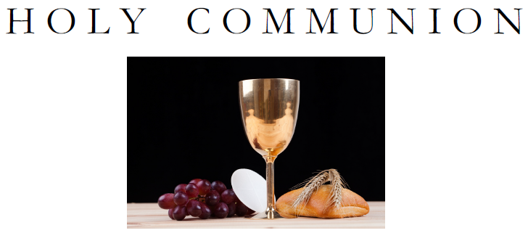
Holy Communion
Targeted for youth in grades 4-6
Can prepare youth for “First Communion”
Youth prepare communion bread
Talks about the relationship between a Jewish Seder and the Last Supper

Slide 16
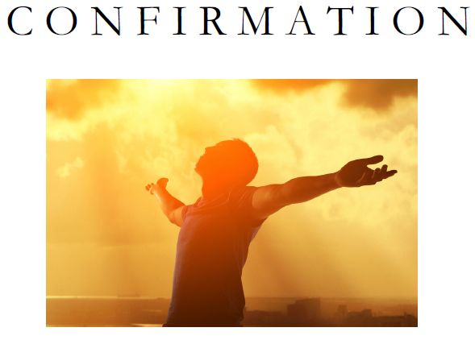
Confirmation
Targeted for youth grades 7-9
Can be used to prepare youth for confirmation
Explores:
- What human nature is
- The need for personal conviction
- Stewardship
- Personal prayer life

Slide 17

Relationships
Targeted for youth grades 10-12
Not everyone called to married life but all have relationships
Also reaches difficult topics such as abuse and bullying

Slide 18
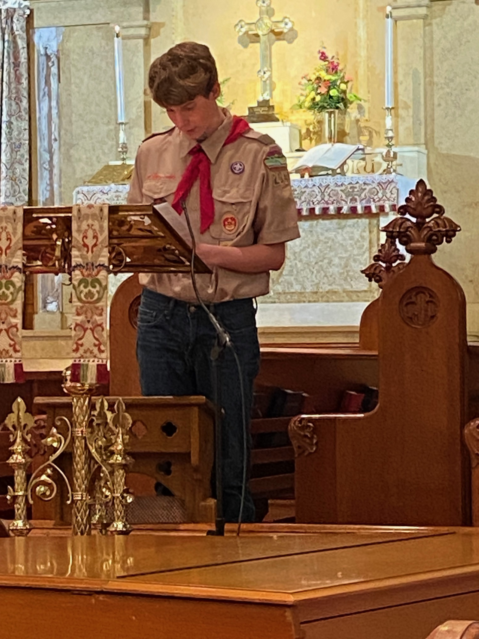
Scout Sunday
Celebrates founding of Scouting
Typically occurs in early February for BSA units
If parish has both BSA and GSUSA units, can occur February to March
Scouts participate in service
- Ushers
- Procession
- Read Old Testament and Epistle
- Sometimes Religious Awards presented
- Sometimes charter is presented
Show parish what their unit(s) have done

Slide 19
How Does the Foregoing Relate to Parish Ministry
Episcopal youth learn more about their faith through the Religious Awards program
Religious Awards can serve as basis for both First Communion and Confirmation programs within the parish
Scouting prepares young people to make ethical choices by instilling in them the values of the Scout Oath and Law
Trained adults can be mentors to youth helping them form these values
Scout units can give back to the parish

Slide 20
Additional Opportunities Scouting Provides
Can involve young families in the parish
- Welcomes boys and girls starting in kindergarten
- Features whole family activities
- Forty percent of Scout families are unchurched
- If Scouting is seen as an active part of parish life, these families may get more involved with the parish
Quote from a Rector in PA: “Our Troops and Cubs are an extension of the ministry of St. Paul’s. Only one family is
involved in the parish - but we have children and youth coming into our building,
recognizing they are welcomed and supported by St. Paul's. And it may be that some
family will sometime explore coming to St. Paul's. I think that's called "Evangelism.”

Slide 21
Additional Opportunities Scouting Provides
Teaches youth the value of service to others
- Unit service projects both at parish and in the community
- Individual service projects
Can offer parish youth groups additional venues
- High adventure opportunities

Slide 22
Some Things You Might Want to Know
(Boy Scout Specific)
  Scouting is all about Character Development: The mission of the Boy Scouts of America is to
  prepare young people to make ethical and moral choices over their lifetimes
  by instilling in them the values of the Scout Oath and the Scout Law.
  Youth safety is of upmost importance:
  - Youth Protection Training is required for all adults. Must be renewed every two years to insure adults are
  current with latest policies and procedures. Similar to Safe Church training.
  - Two Deep Leadership: Never meet one-on-one with the youth.
  - Buddy System: Never allow youth to go away from the group alone; always as a group of two or more.
  Scouting provides training to both adults and youth:
  - Adults: Both on-line training and in person basic training is available for all adults.
  Untrained adults are regularly reminded to keep their training current.
  Advanced training is available for adults who are trained at the basic level.
  - Youth: Scouting is designed to train youth as leaders. Youth learn how to organize themselves, run
  meetings and work together to perform tasks. Position-specific training is available
  for key youth leaders (Patrol leaders, Sr. Patrol Leaders and the Chaplain’s Aide)

Slide 23
Contact Us:
Email: Scouting @Brothersandrew.net
Web: https://brothersandrew.net/service/scouting/

Slide 24
Questions

