Slide 1
Dense Particle Separation

Slide 2

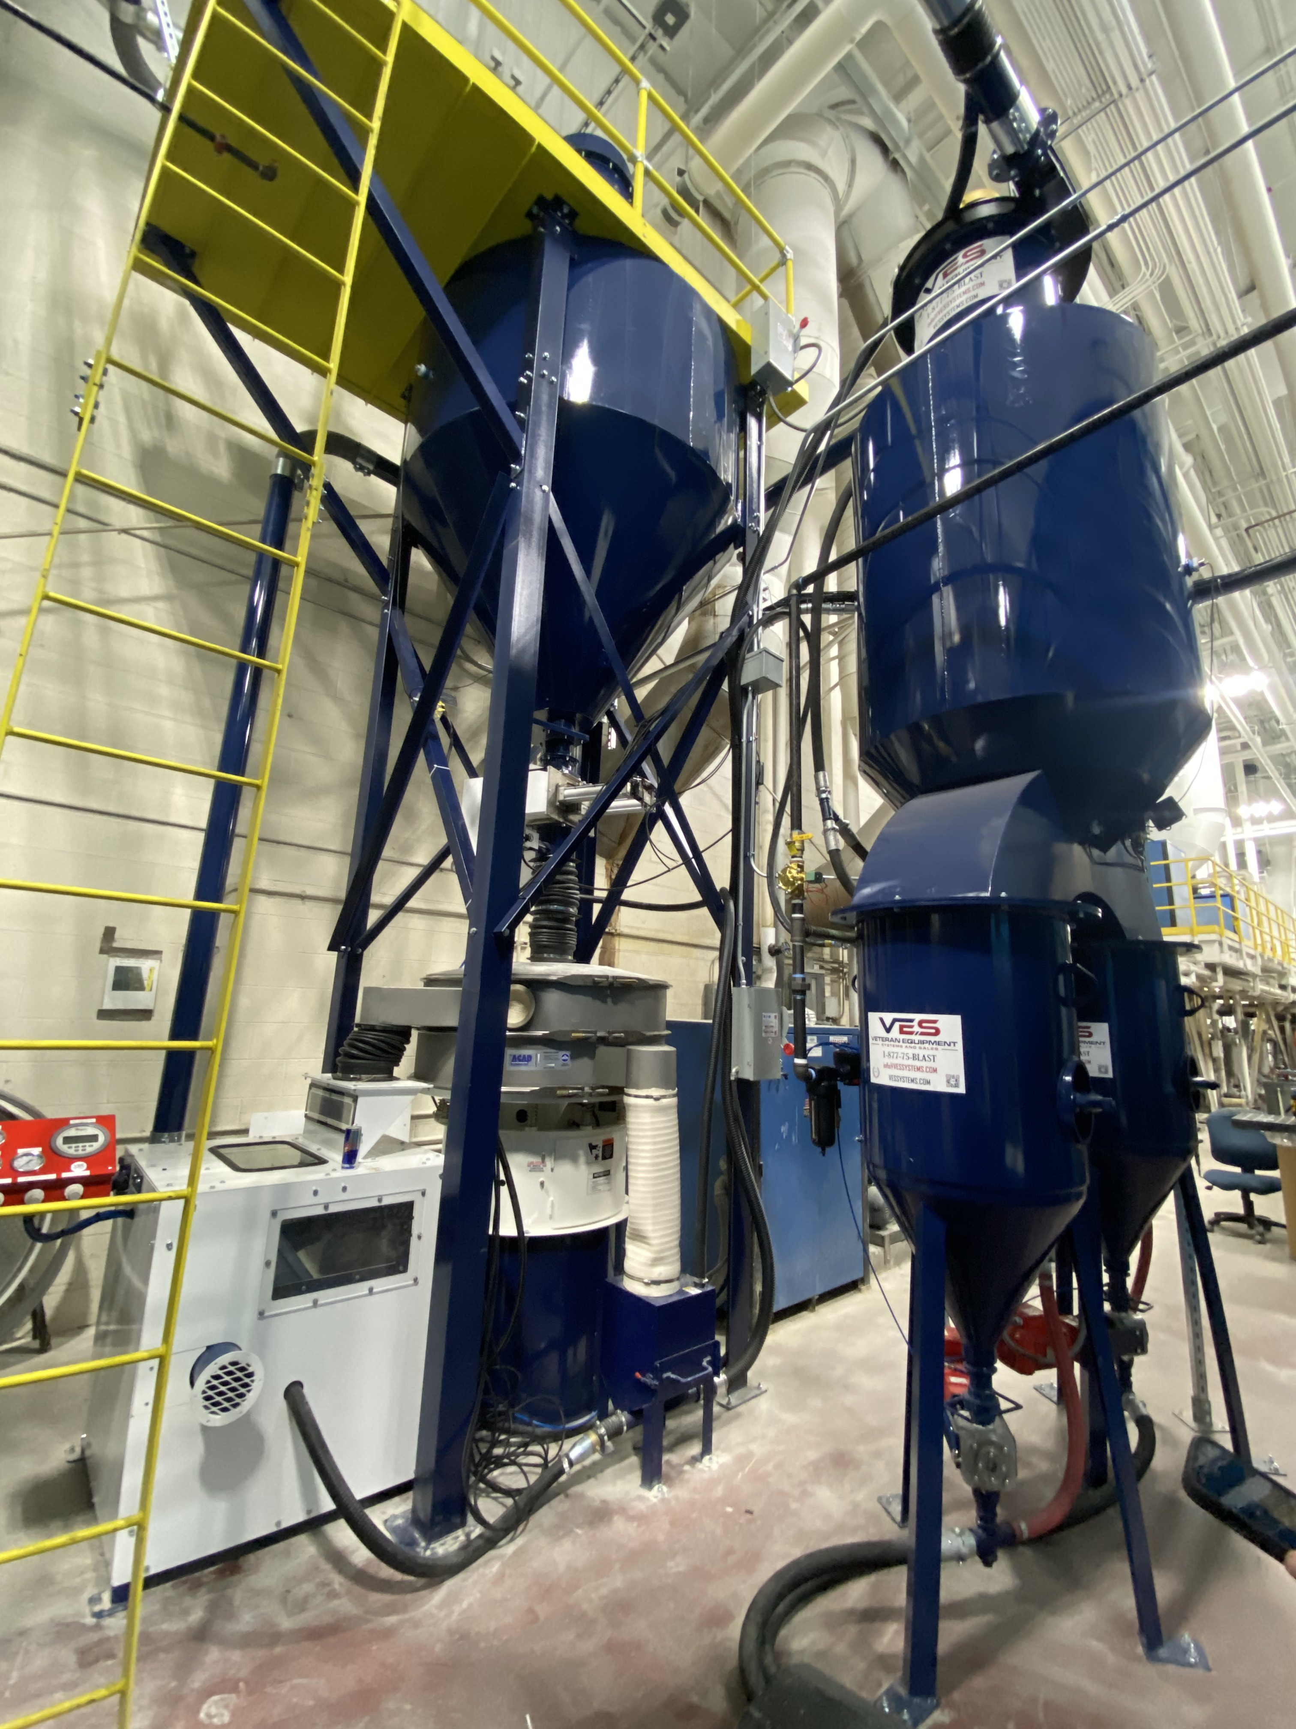
VES High-Density Particle Separation
VES Exclusive Key Design Features:
Fully encapsulated assemblies eliminating leakage of hazardous dust from system components.
Self-Cleaning Magnetic Separator.
Large 24” fluidized bed for high-volume processing
3,000 lbs/hr vs. industry standard 2,400 lbs/hr.
Dense particle separation maintaining Dense Particle Concentration below 0.2% by weight with no more than 10% media carryover of good media.
Meets all testing and performance requirements of T.O. 1-1-8 (Removal of Organic Coatings, Aerospace Equipment) Section 2.12.12 Contamination Testing.
Equipment performance guarantee.

Slide 3
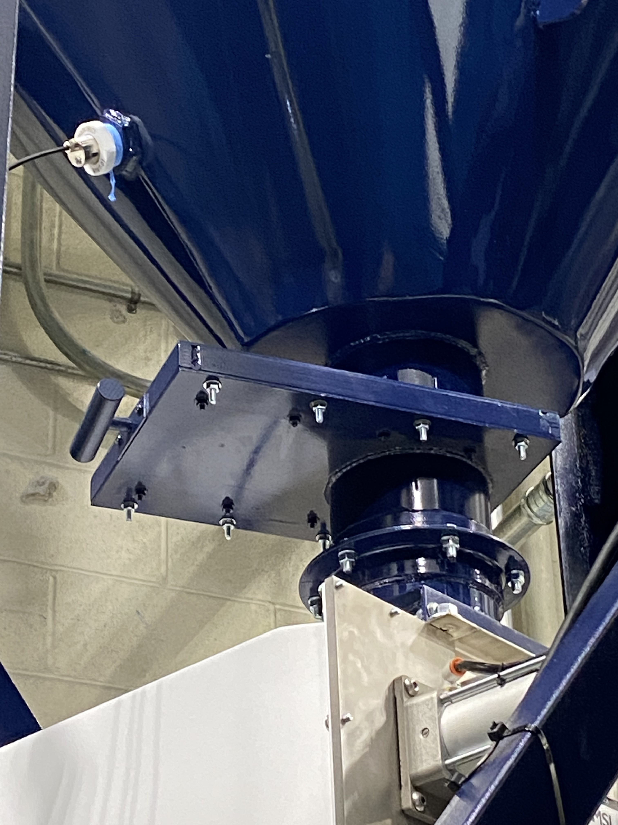
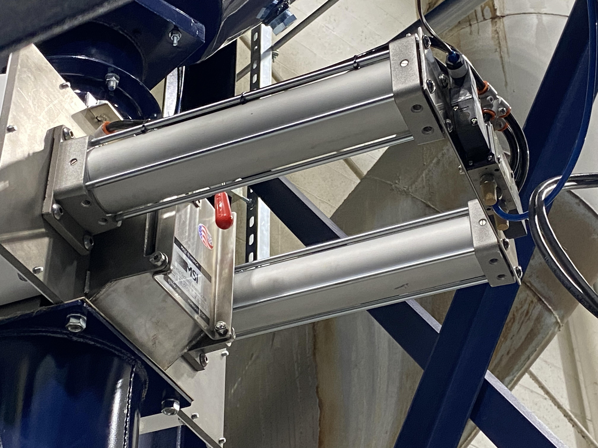
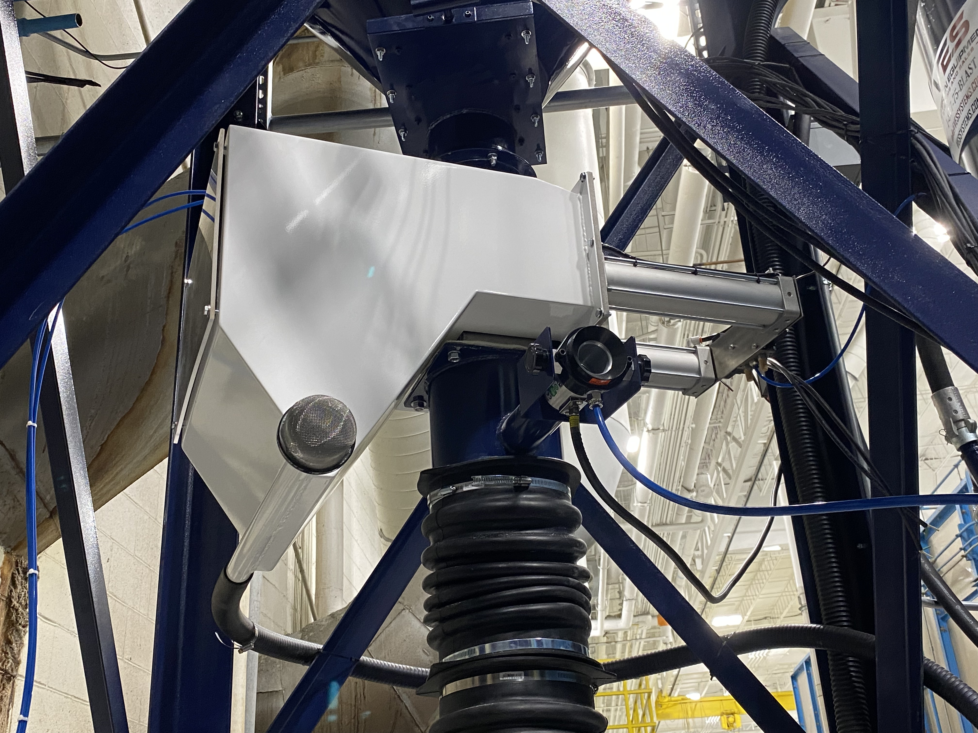
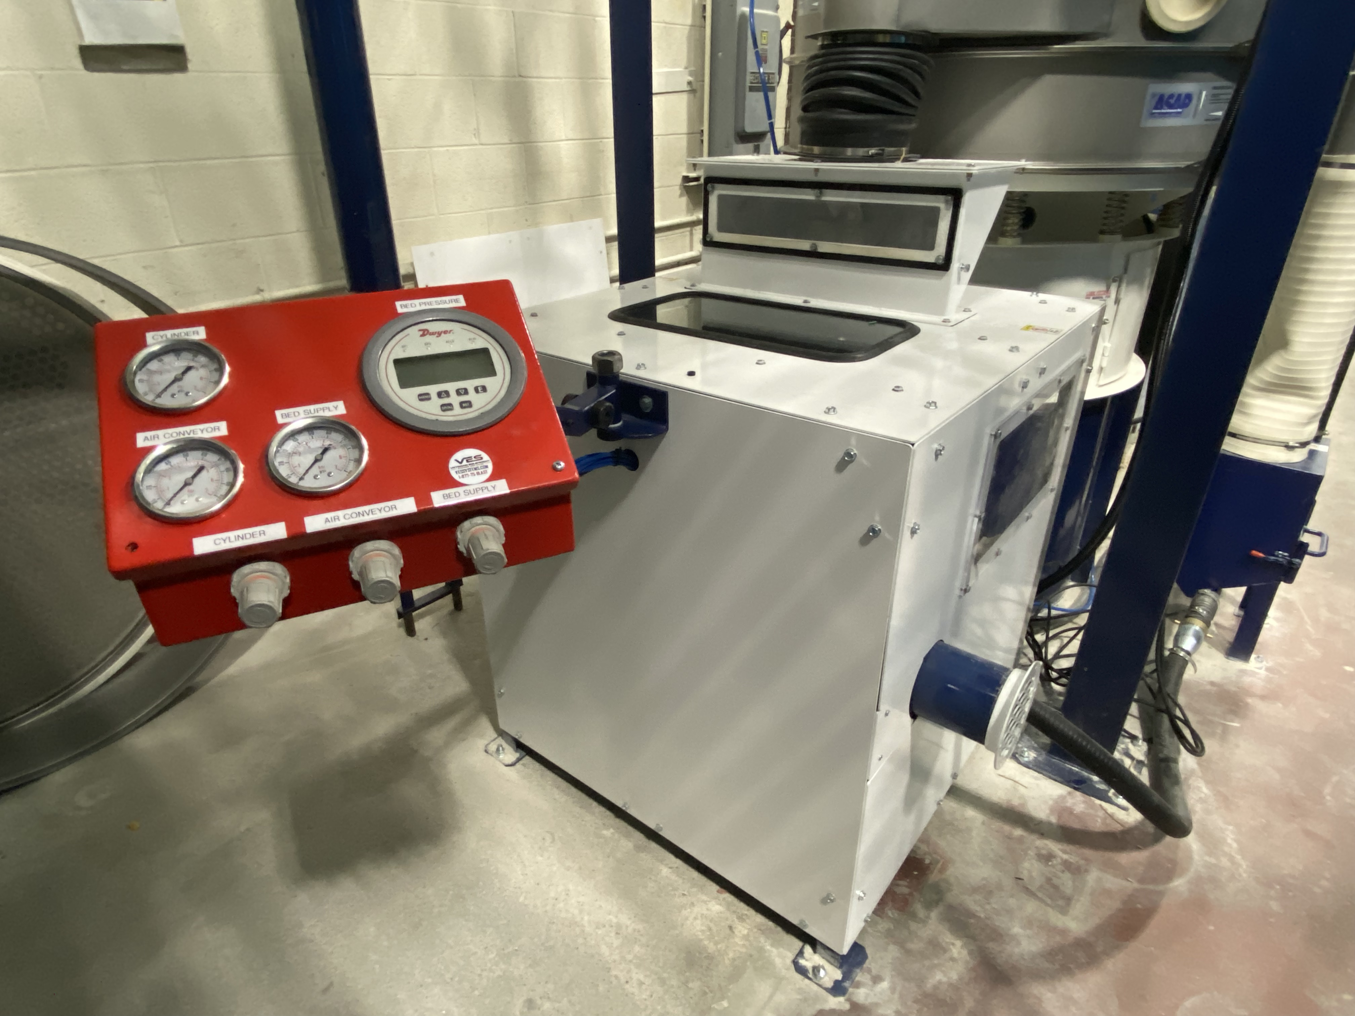
VES High-Density Particle Separation
VES designs are fully sealed eliminating common points of dust leakage.
Slide gates
Magnetic separator
Magnetic separator & Ionizer Assembly
Dense Particle Separator

Slide 4
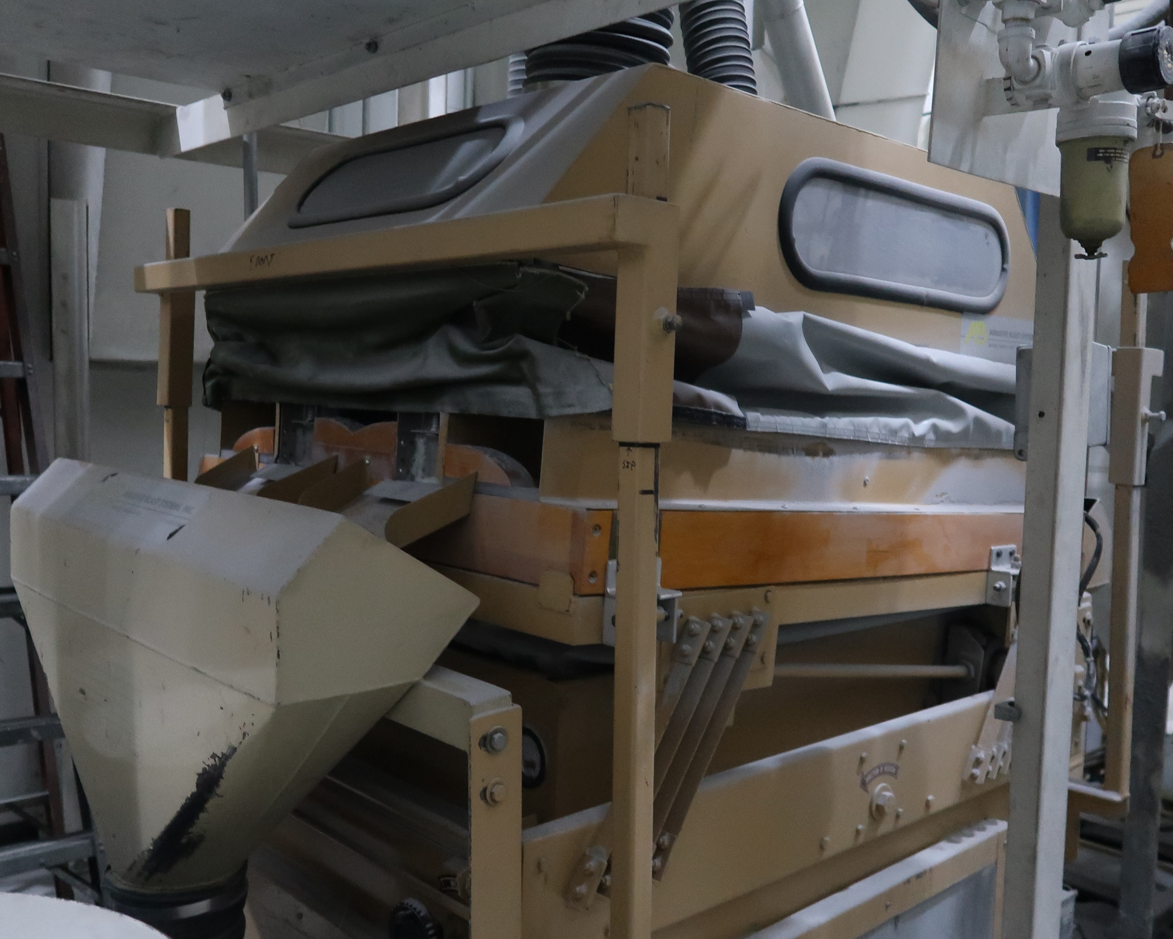


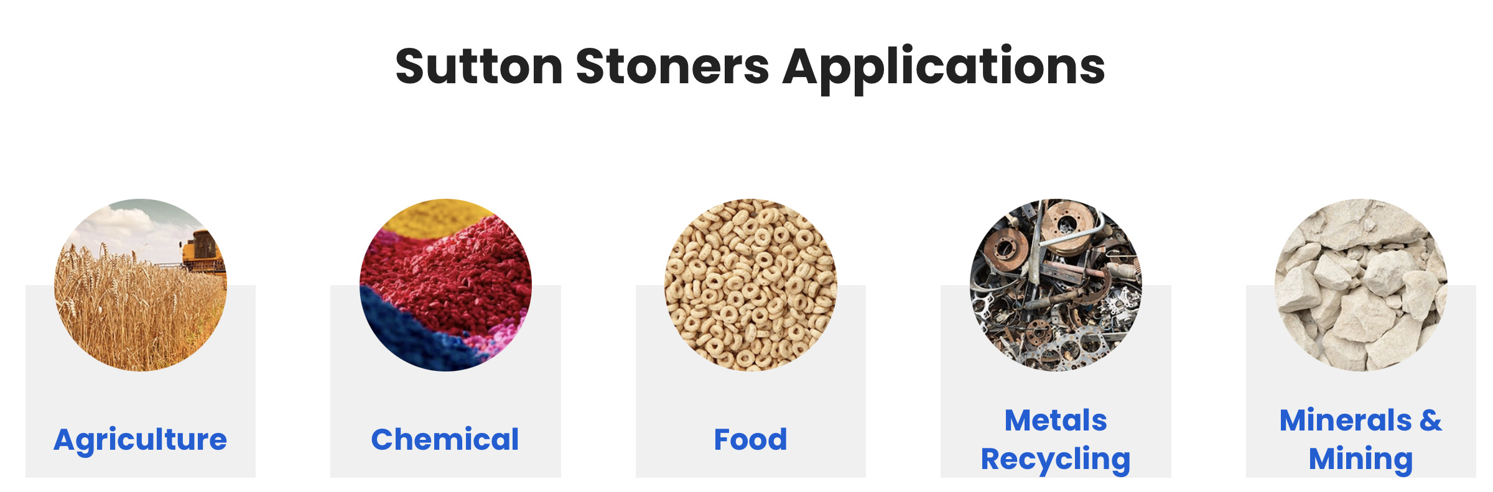
Dense Particle Technology Comparison
Aerospace purpose design
Fully enclosed housing eliminating dust leakage
24” AlOx porous bed for long-life
3,000 lb/hr rate of performance
Guaranteed performance to T.O. 1-1-8
Built for food, minerals, agriculture
Open housing design
Vibratory shaker design
Unspecified rate of performance
NO guaranteed performance to T.O. 1-1-8
This design includes a by-pass feature to allow continued operation in anticipation of an equipment failure.

Slide 5
Performance Differences – VES vs. Competition
VES HDPS Equipment | Competitor Equipment
One moving part | Many moving parts
Annual inspection and adjustment if necessary | Regular system tuning
Operates independent of contaminant concentration | Requires retuning if significant change in contaminant concentration
Single point of adjustment | Multiple adjustment points requires time to achieve proper balance
No vibrational loads | Requires vibration isolation to prevent excessive component wear and/or increased adjustment frequency
Fully encapsulated system containing hazardous dust within | Flexible seals and detachment from receiving chute allows hazardous dust migration
Made of industrial steel with welded seams | System includes use of wood, canvas, hook & loop and/or zipper fasteners prone to deterioration and wear

