Slide 1
Generations at Lough Garadice: History, Heritage, and Family
Young Historian Project
Stephen Kellett

Slide 2
Introduction
The main objective of my project titled Lough Garadice aims to look at the historical timeline based on this lake and the background to my family links of settlements here. My home overlooks the lake, my grandparents and mum have grown up here and I want to establish my family tree and any links to the historical events or references at this Lough. I will obtain information from a number of sources and use many formats such as written text, oral interviews and digital references on this project. I hope to draw up my family tree using the Census, Griffiths valuation and Tithe applotments and I hope to find a reason as to why we’re settled here on the shores of Lough Garadice. There is a number of folklore and stories with references to Lough Garadice and I will investiaget if these have any historical basis.

Slide 3
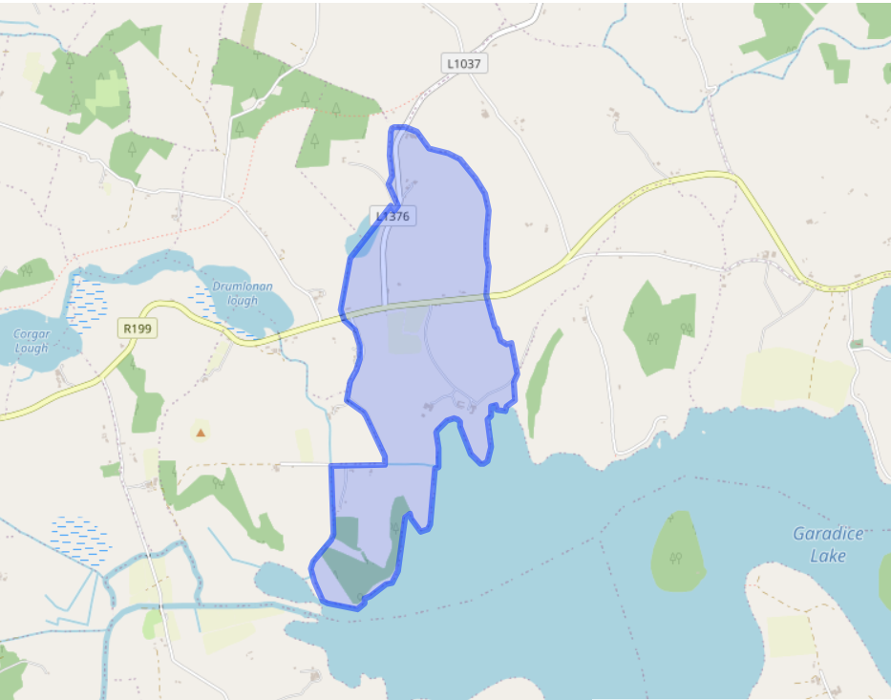
Origin of the name of Lough Garadice
Lough Fionnmhai is the old irish name of the lough. It means the fair plain. The Irish name is completely different to its Anglicised form which was based on the townland of Garadice/Garbhros which lies on the north western shore of the lake. The earliest occurrence of the lake name is in a medieval text called De Fhlathiusaib hErend which is about the Kingships of Ireland. (Leitrim History and society Liam Kelly)

Slide 4
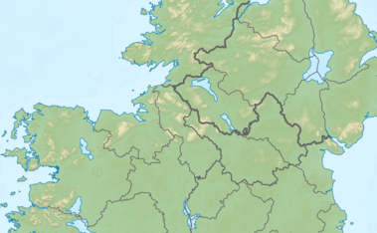
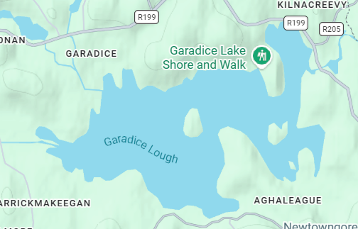
Geography of Garadice
Garadice Lough
Lough Garadice is a freshwater lake located about 8 kilometres east of Ballinamore in south County Leitrim. It is part of the Shannon–Erne Waterway, which connects the River Shannon and the River Erne. The lough is around 3 kilometres wide and has three islands: Church Island, Cherry Island, and Slashers Island.
The Yellow River flows into Lough Garadice and the Woodford River flows out of it. The lake is also known for fishing, with species such as tench, roach, bream, and pike living in its waters. Since 1994 the lake forms part of the Shannon Erne waterway restored in the 90s having first been a famine work releif scheme in the area.

Slide 5
Geography of Garadice
This waterway contributes to tourism through boating activity and walkway on its shores. My home is located on the western shores in the townland of Carrickmakeegan on a farmland belonging to the Maxwells. From here we can see Church Island, the old yellow river entry point and the canal link from the nearby town of Ballinamore. The lake is the last navigable point on the border of Ulster and Connaught where Leitrim meets Cavan. This links with its strategic importance in history
My house

Slide 6
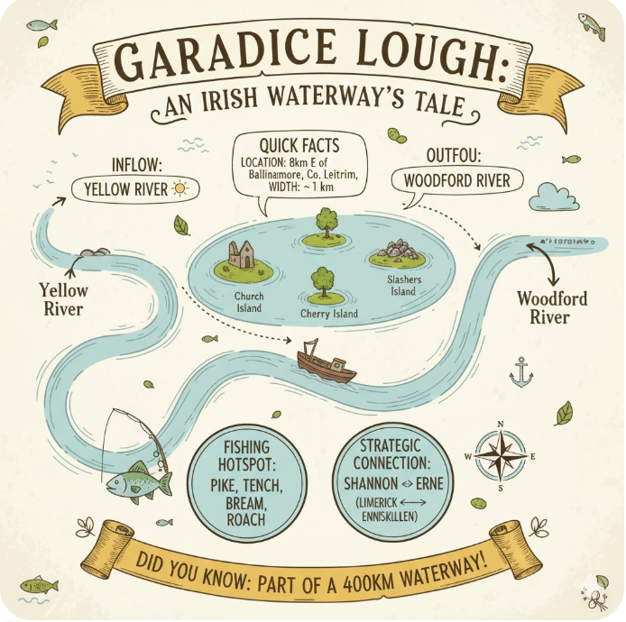

Slide 7
Brief History of Garadice Lake: A Boundary Between O’Rourke and O’Reilly Clans
Historically, Garadice Lake was a strategic boundary between the O’Rourke kings of West Breifne and the O’Reilly lords of East Breifne. Garadice becme a very important strategic point from the 12th century to the arrival of the plantations in the 16th century. The O’Rourkes maintained a fortified island stronghold on the lake, which remained a focal point of conflict as both clans fought for regional control until the collapse of the Gaelic order. Garadice Lough also had relevance to Saint Patrick where he passed the lake on his way to defeat Crom Cruadh.

Slide 8
Brief History of Garadice Lake: A Boundary Between O’Rourke and O’Reilly Clans
From reference to the Annals of Ulster and through an interview with my grandfather it is beleived that the Maxwell Clan arrived into Ireland fighting on the side of Robert the Bruce during the Bruce invasion of the 14th century. As we have maintained a catholic ethnicity, my grandfather has been told by his forefathers that we settled here as a consequence of fighting off the Anglican invasions. This may be heresay as the first hhistorical reference I have in my research dates only from the 18th century.

Slide 9
The history of Garadices islands: Cherry Island
Cherry Island is the second largest island in garadice lake. The Irish name is Cloch inse na dtorc which means stone of the island of the boars. This name Indicates that there was a castle or monument on this Island.
Cherry Island was the location of an O’Rourke stronghold and residence from the twelfth century ending in the fifteenth and sixteenth century when the O’Rourkes power shifted to Dromahair.
On Cherry Island there are remains of a possible medieval castle. There is a rectangular walled structure reduced to rubble along with a single gable wall still standing. The O’Rourkes must have strategically placed their stronghold on Cherry Island as it was very close to the O’Reillys of East Breifne.

Slide 10
The history of Garadices islands: Cherry Island
A fortress on Cherry Island was supposedly burned down and garrisoned by the son of Tighearnan O’Rourke in 13th century.
In 1418 Tighearnan Mor O’Rourke was on his deathbed on cherry island where his whole family including Owen O’Rourke his son was there. On Owens way back from the island on his boat he drowned
Woodford Castle situated beside the Woodford river is supposedly built on top of an old O’Rourke lordly residence. It is recorded that Aine MacDonagh the wife of Tighearnan Mor O’Rourke passed away

Slide 11
The history of Garadices islands: Slashers/Crane Island
Crane Island also known as Slashers Island is the smallest of the 3 islands. The remains of a large rectangular wall structure remains and a circular tower. There is also several gun loops in the walls. In 2013 an outer facing stone from a gun loop in the tower was stolen.
The Islands name is Crane Island but l know it as Slashers Island as Miles the Slasher O’Reilly lived there in the 17th century. Supposedly he commuted between the island and the mainland through hidden tunnels under the lakebed but there is no proven evidence of this.
The only evidence related to Miles the Slasher is that of a knife found in the lake that dates from this period. Again from my interview my grandfather beleives this is one of Miles the Slashers from folklore stories

Slide 12
The history of Garadices islands: Church Island
Church island is the largest of the 3 islands and is the island I can see from my house. It has ruins of an old church that was built by the O’Rourke family with one of them being buried there.
Saint Patrick crossed Lough Garadice on his way to destroy crom cruadh and he is supposed to have stopped on church island. Also in 2012 there was a window from the church stolen and still not returned to this day. (mentioned in The Tripartite life of Patrick)
Church island is also important in our family history as it was a source of timber for generations gone by when the more severe winters caused the lake to freeze over and the horse and cart was used by my great grandfather John James Maxwell and his forefathers also.

Slide 13
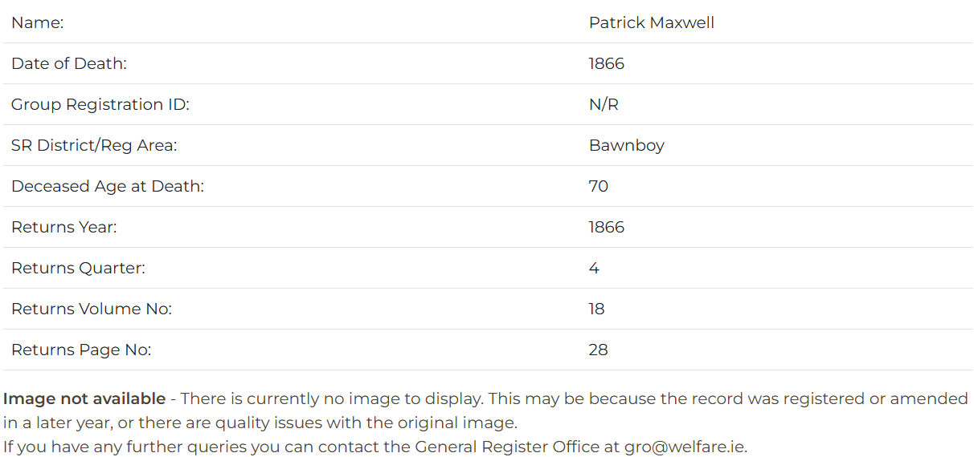
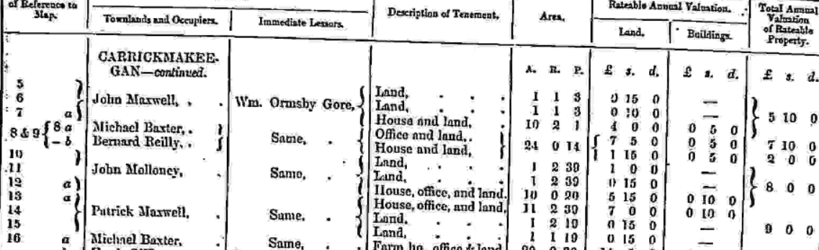
Maxwell Family history beside garadice
My Family has been living beside garadice lake for hundreds of years, since around the 14th or 15th century we presume as the Maxwell clan came to Ireland from Scotland when King Robert the Bruce of Scotland invaded. The furthest back relative I can find proof of is Patt or Patrick Maxwell who was born here in 1796 and died in 1886

Slide 14
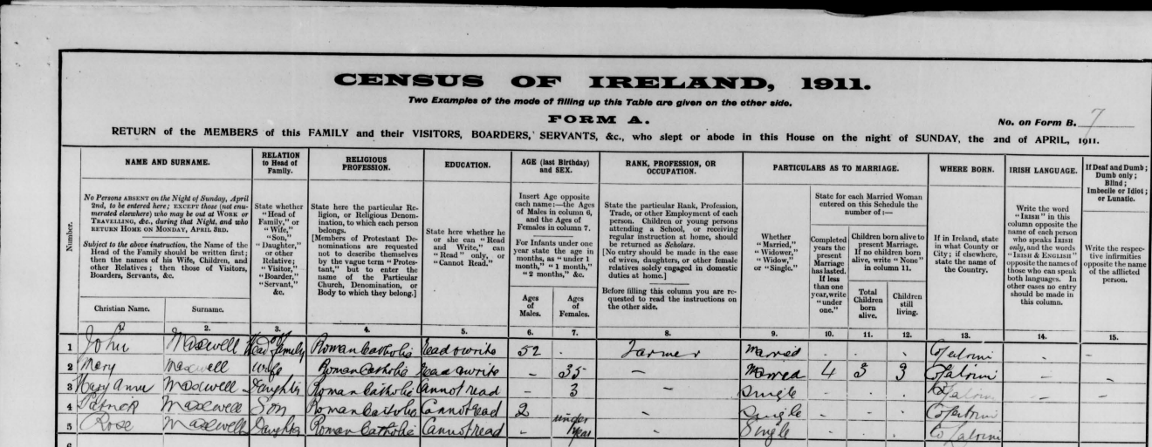
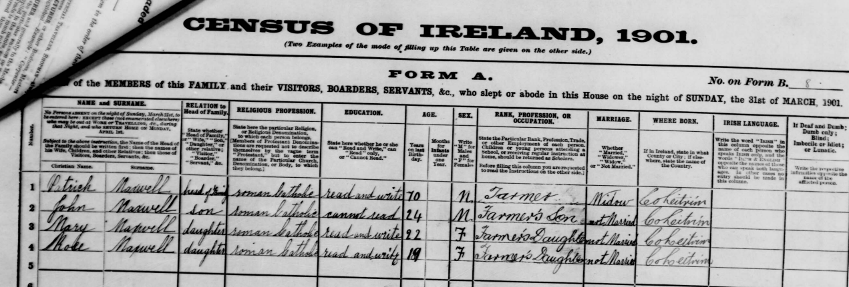
Maxwell Family history beside garadice
Census returns;
1901; Patrick Maxwell (70) Head of house, John Maxwell (24) farmers son and heir, Rose (19) farmers daughter and emigrated to the USA, Mary(22) farmers daughter who also emigrated to the USA
1911;John Maxwell (52) his wife Mary Gill (35) and children Mary Anne (3) Patrick (2) and Rose (0)

Slide 15
Maxwell Family history beside garadice
Griffiths Valuation; The returns for Carrickmakeegan shows Patt/Patrick Maxwell holding a tenancy from William Gore-Ormsby, on lands that today form part of my grandad Noel Maxwells farm.

Slide 16
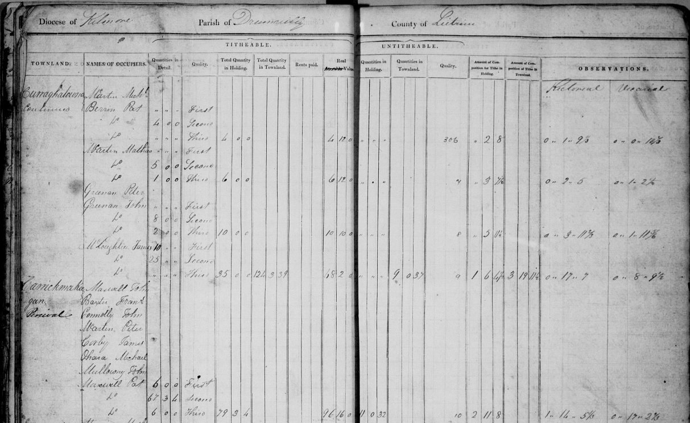
Maxwell Family history beside garadice
Tithe Applotment Books. The date of returns for carrickmakeegan is 1834 and includes two Maxwells, John and Pat. On the balance of probabilities, and as a further pointer, since the death of Patrick Maxwell on 29th October is reported by a Patrick Maxwell of Carrickmakeegan, he seems to be the best candidate.

Slide 17
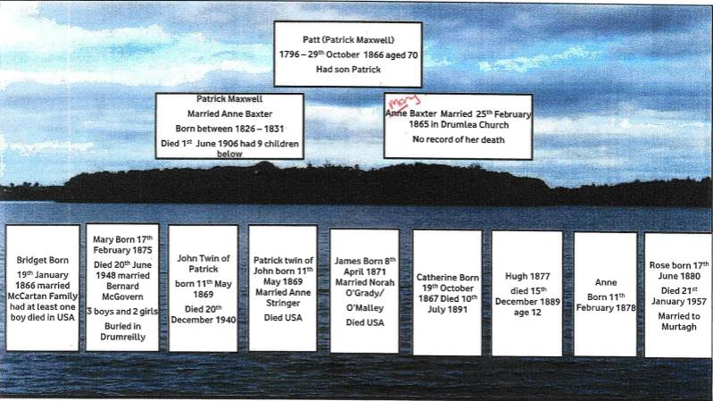
Maxwell Family history beside garadice
I used the Census and my Grandad to tell me all my relatives from Patt, Patrick and John all the way down to me and made a family tree from it.

Slide 18
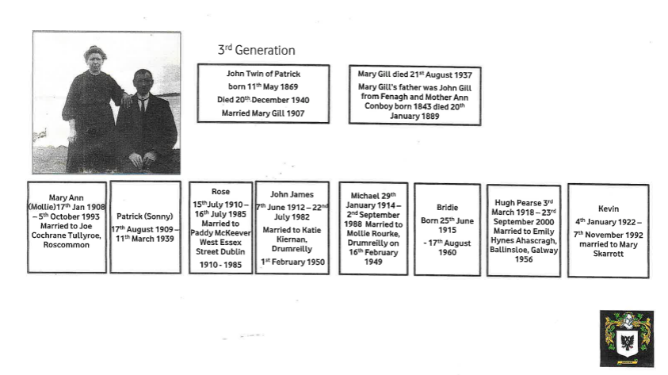
Maxwell Family history beside garadice

Slide 19
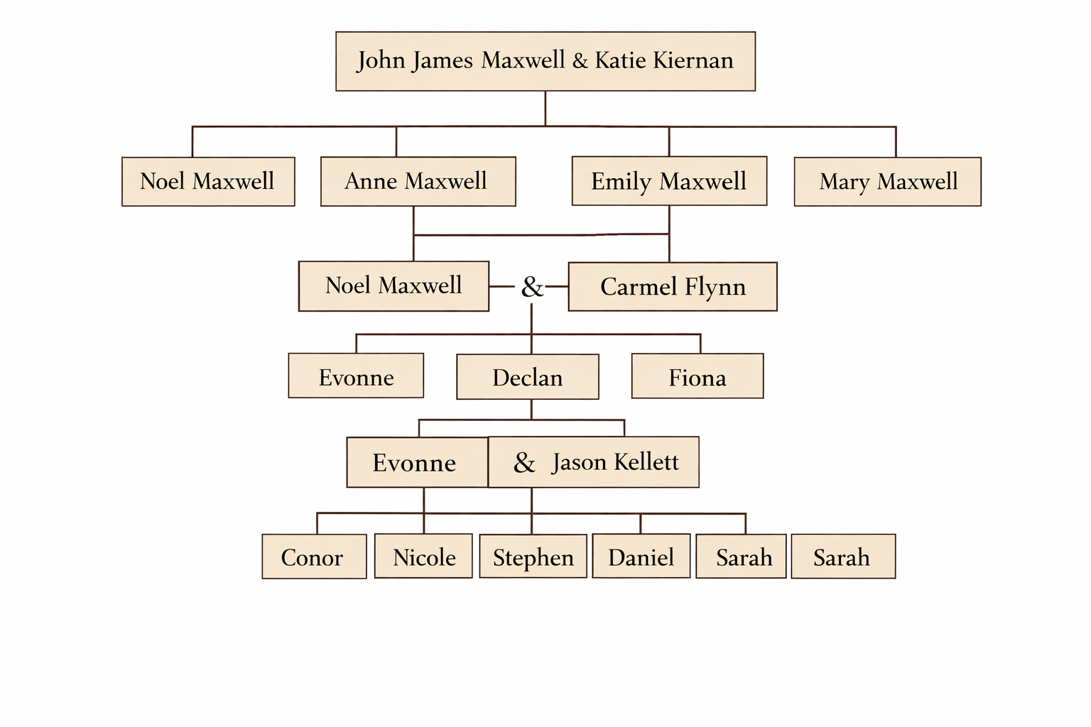
Maxwell Family history beside garadice

Slide 20
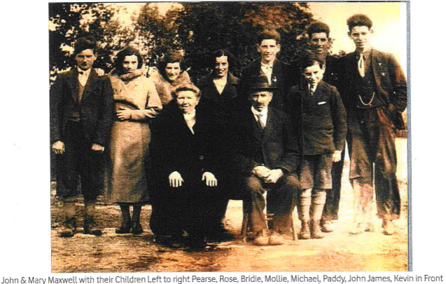
Maxwell Family history beside garadice

Slide 21
Carrickmakeegan boating tragedy
On August 23, 1942, a tragic boating accident occurred at Carrickmakeegan on the Ballinamore–Ballyconnell Canal near Garadice Lake when a group of teenagers overcrowded a small boat that capsized, throwing them into deep water. Six young people aged 15 to 19 drowned, while others survived thanks to the bravery of a few in the group who helped rescue their friends. My Grandad John James Maxwell helped transport the bodies to the catholic hall in Ballinamore.

Slide 22
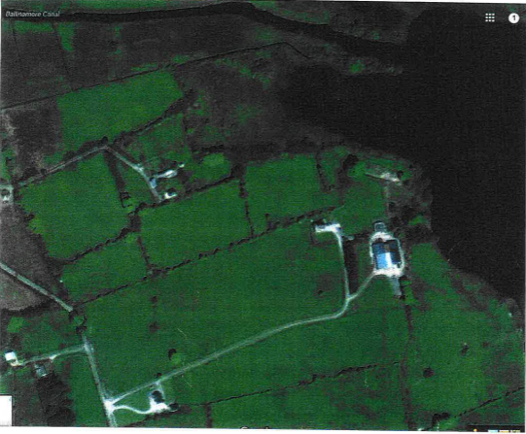
How i link to garadice
I feel a strong connection to Garadice because I live beside it, and my family has lived in this area for hundreds of years. Throughout many generations, the lake has been part of my family’s daily life as they farmed the land and built their lives here. It has witnessed the history of my family and the changes that have taken place over time, making it an important and meaningful place to me.

Slide 23
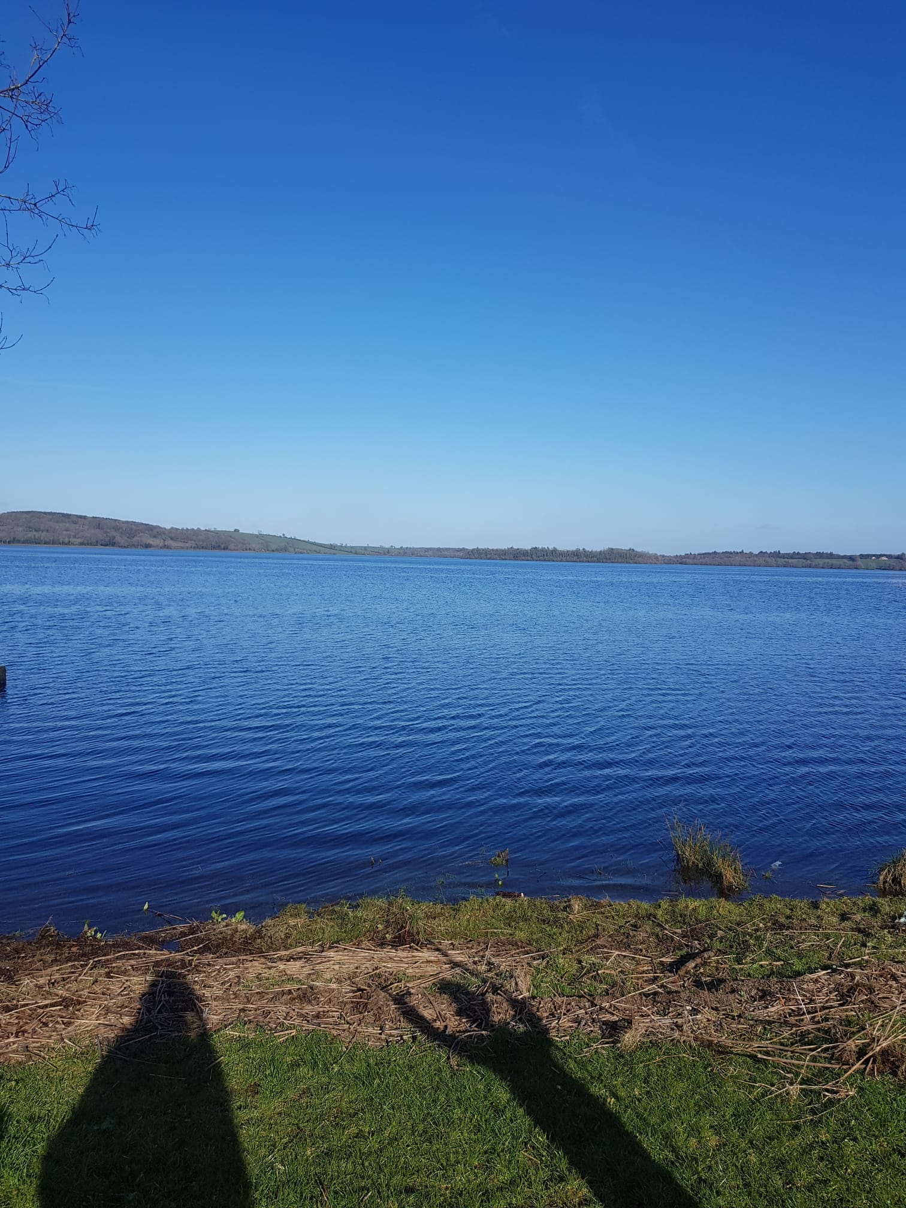
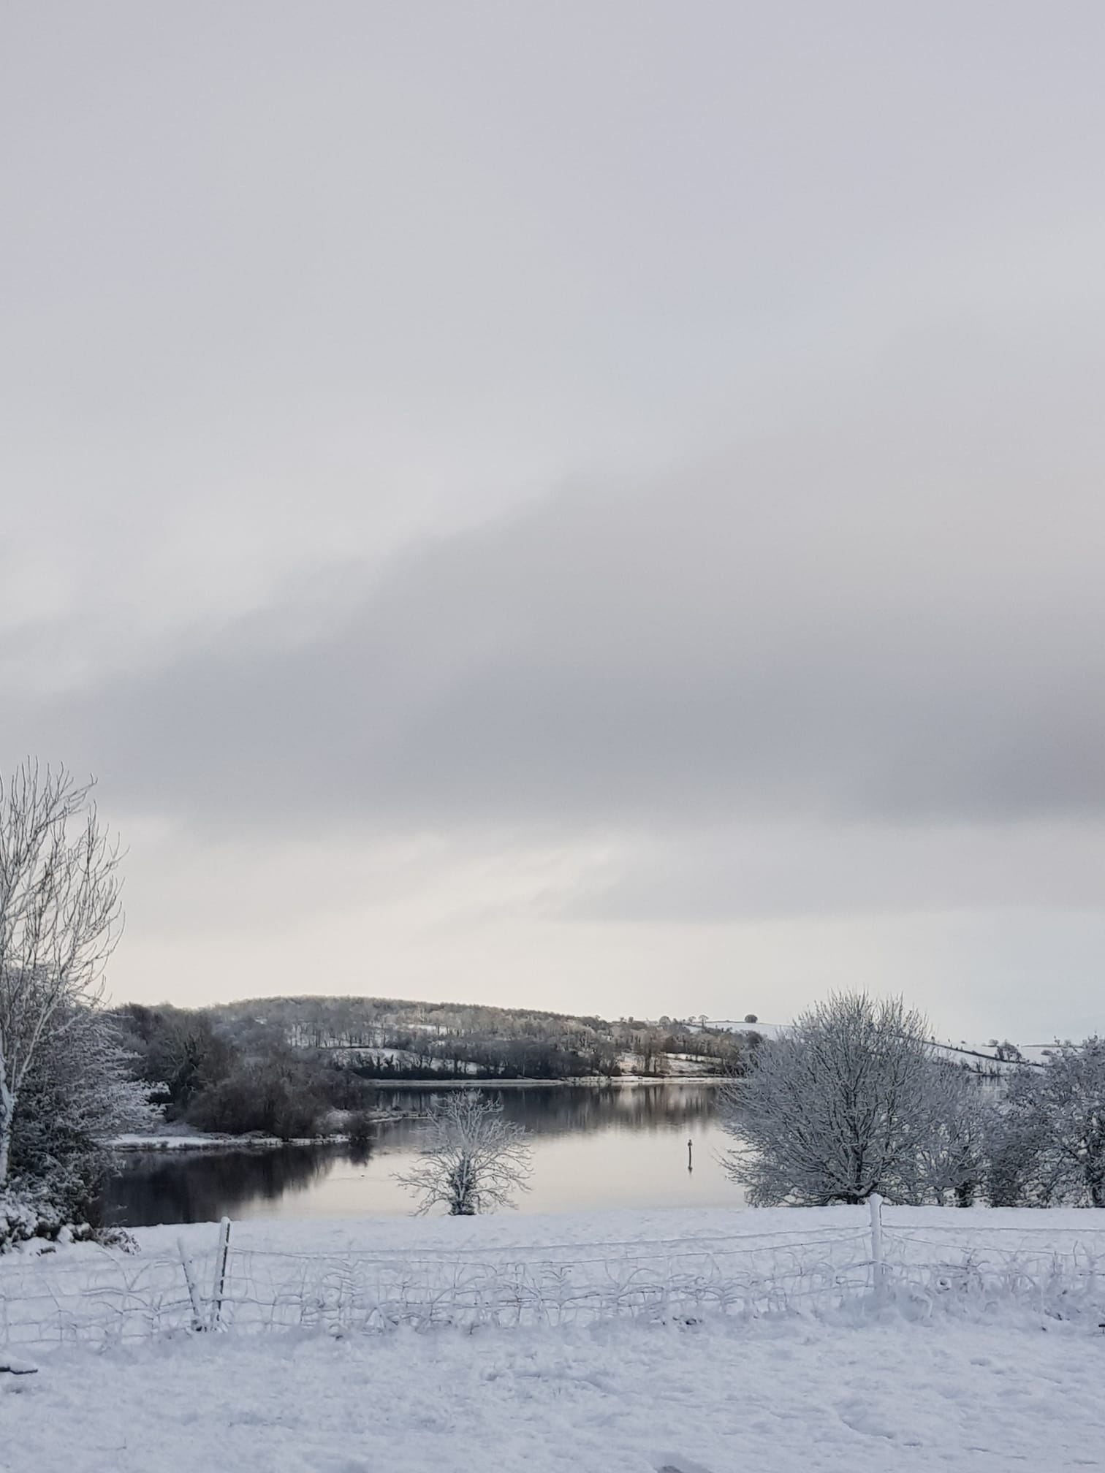
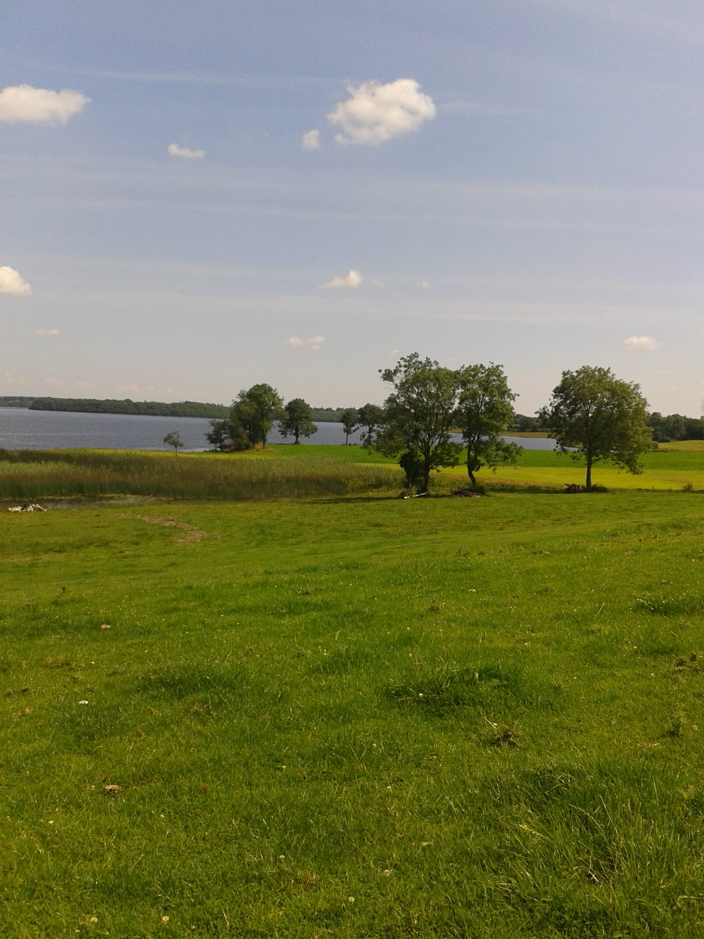
Garadice from my house

Slide 24
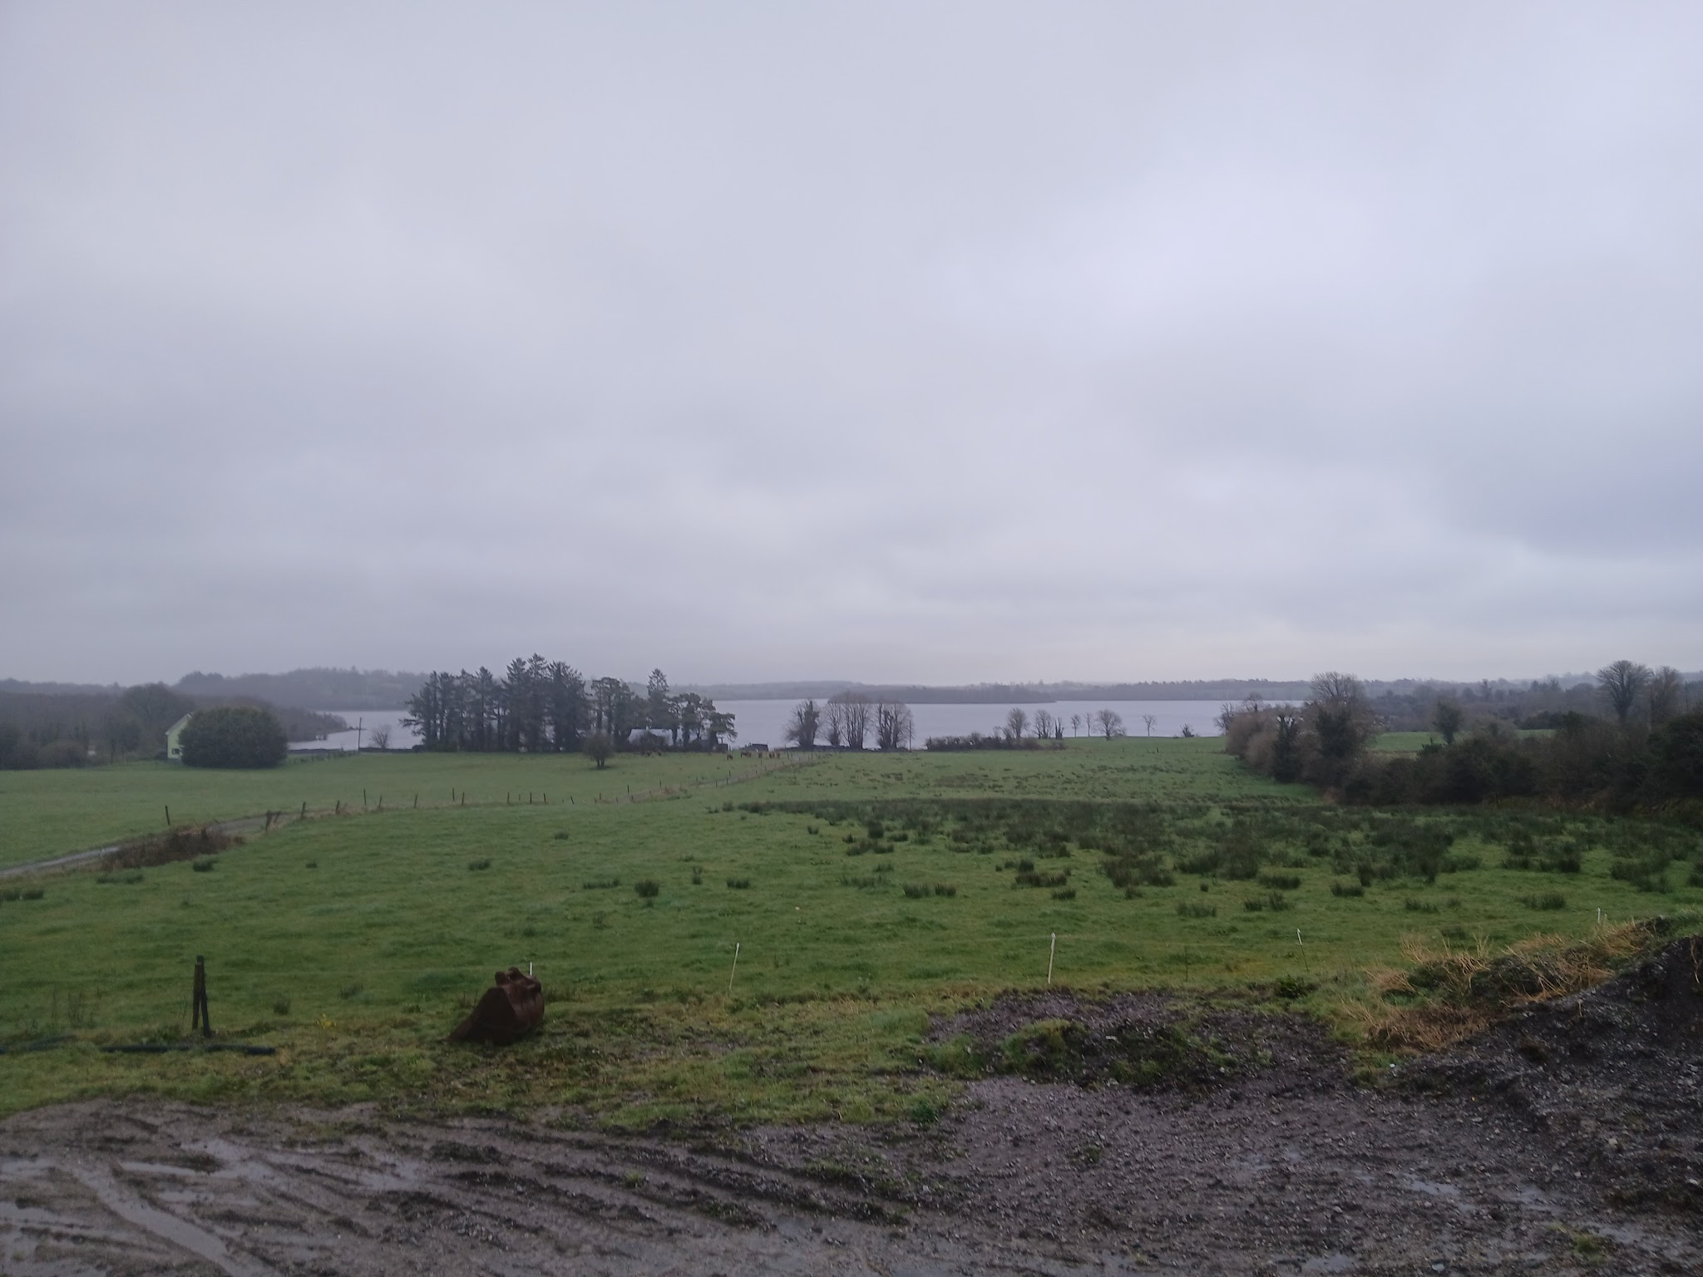
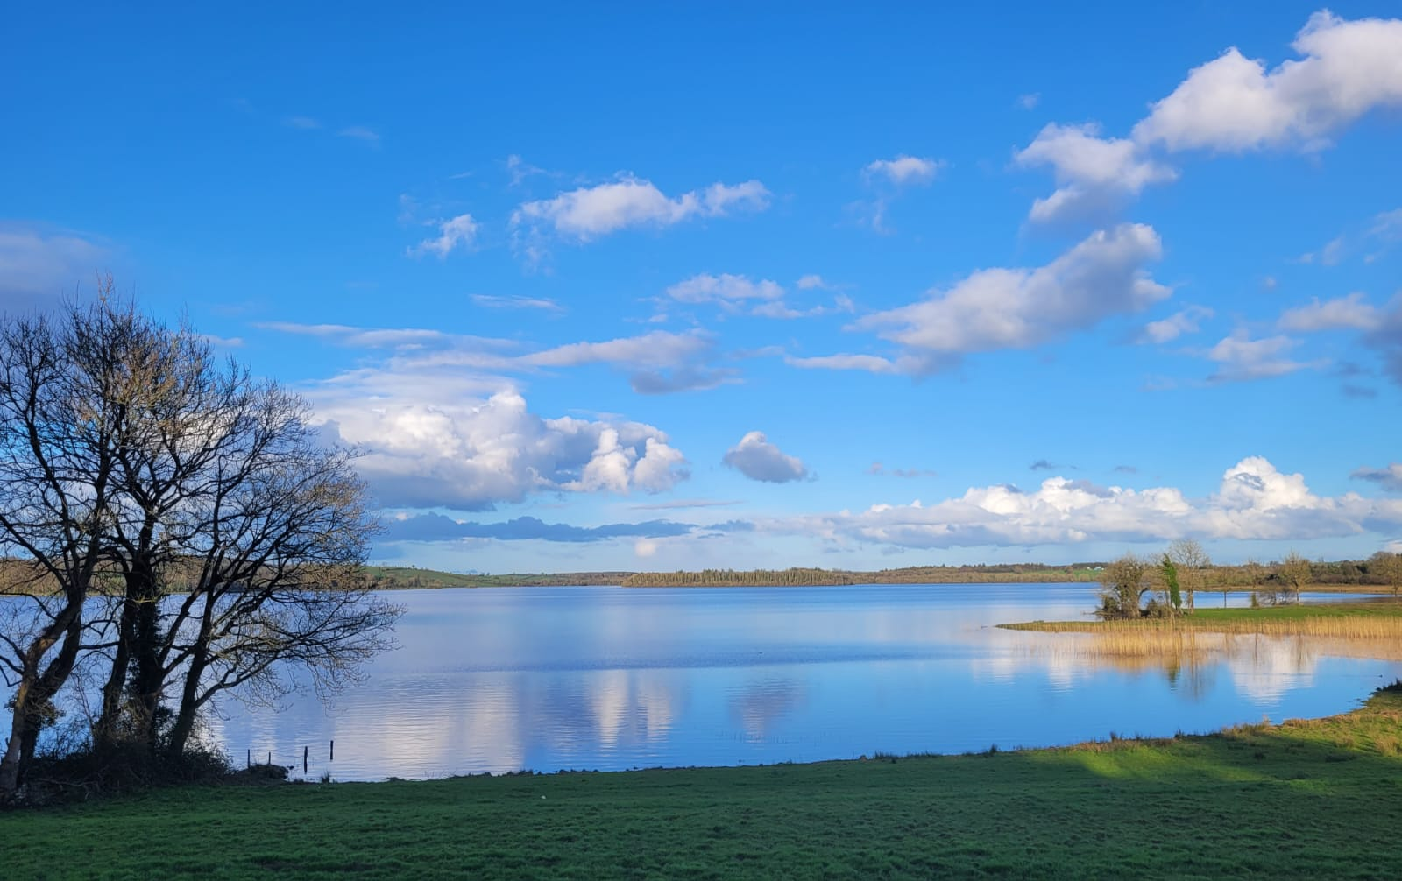
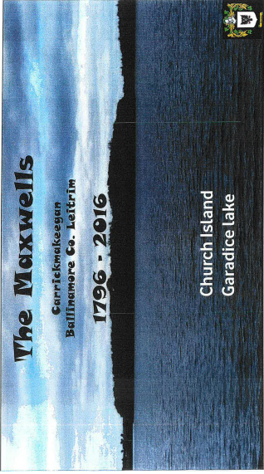
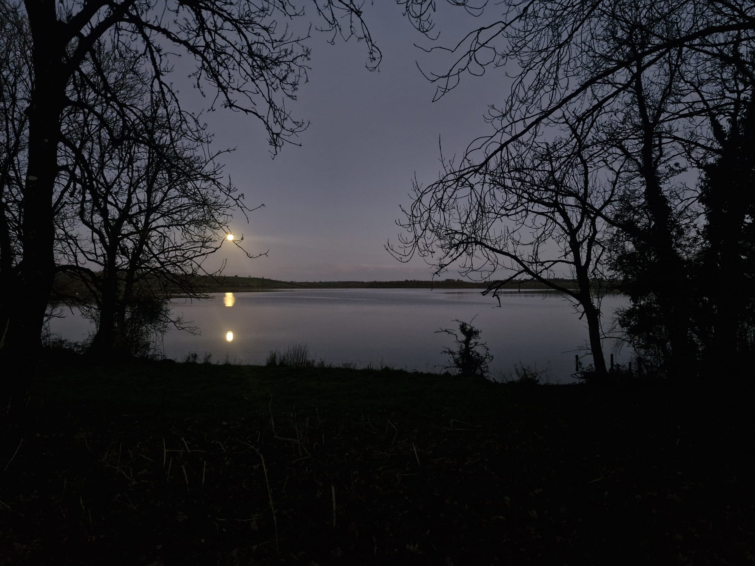
Garadice from my house

Slide 25
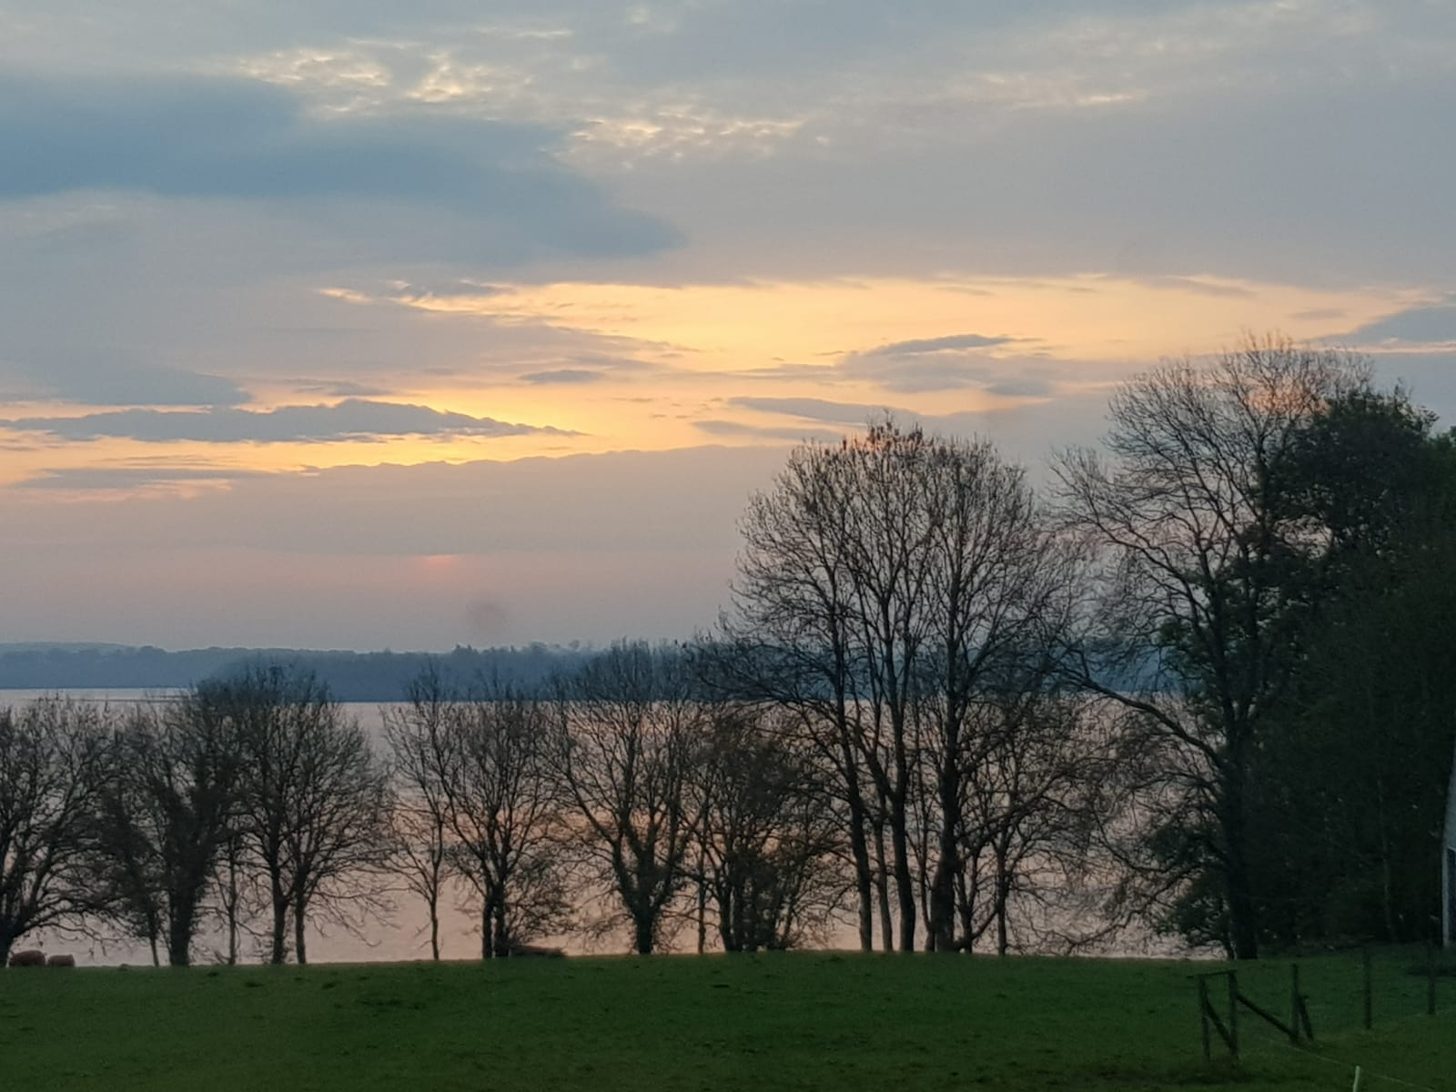
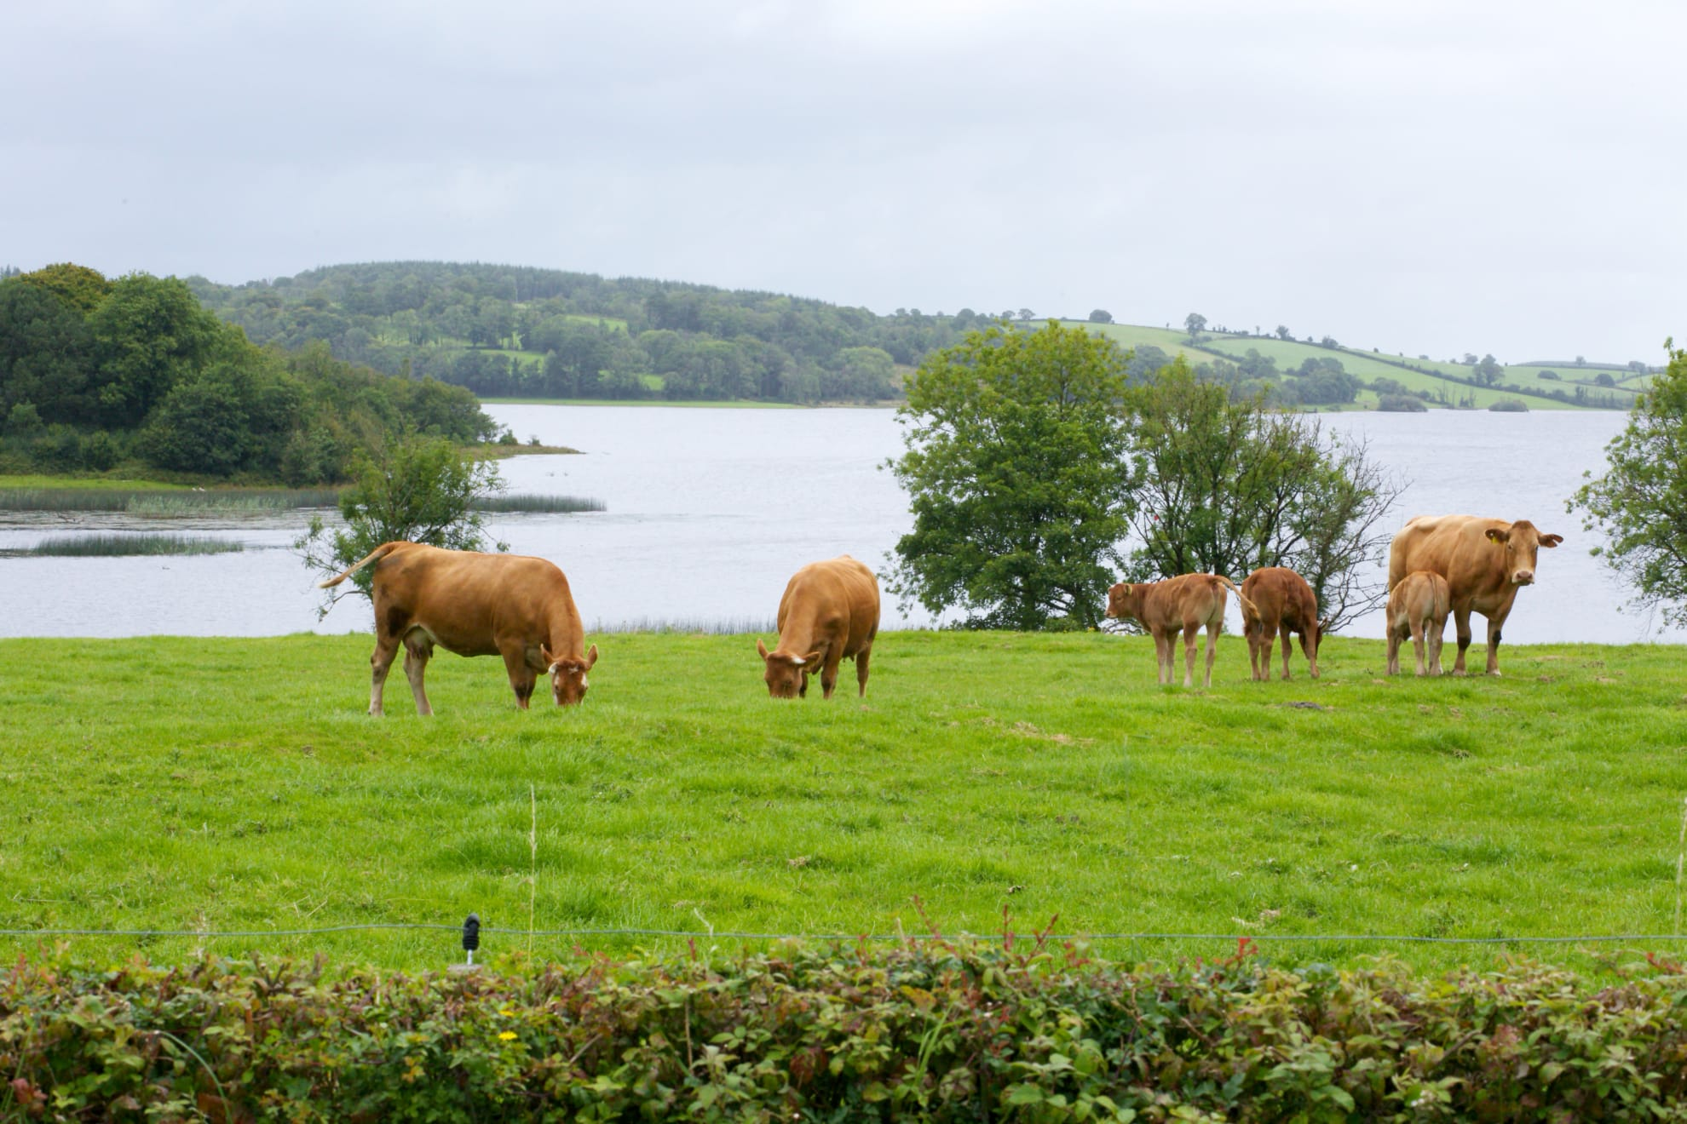
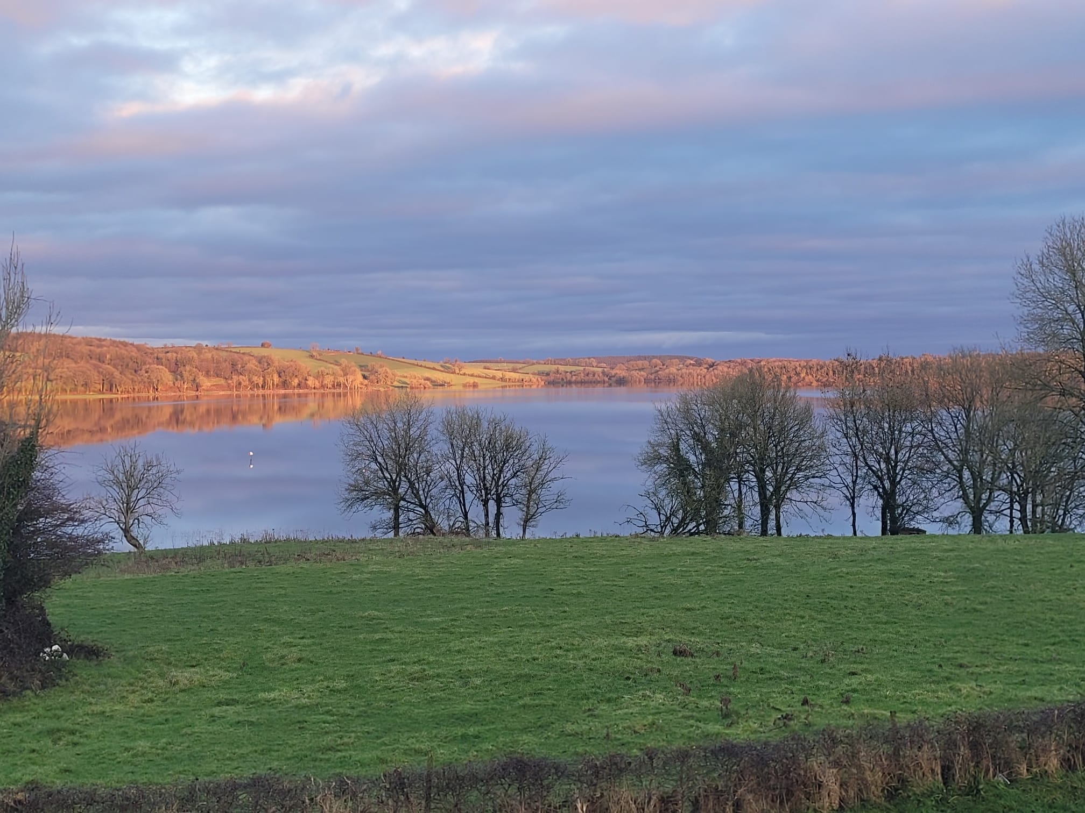
Garadice from my house

Slide 26
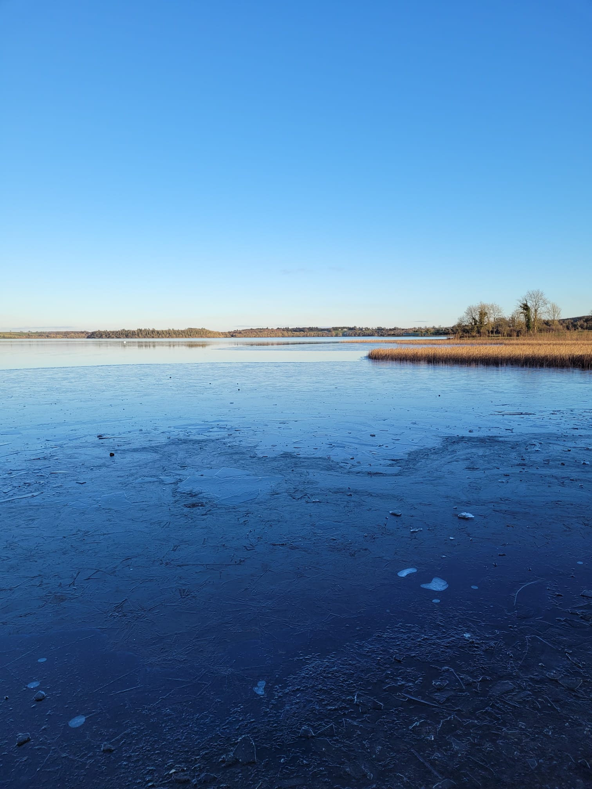
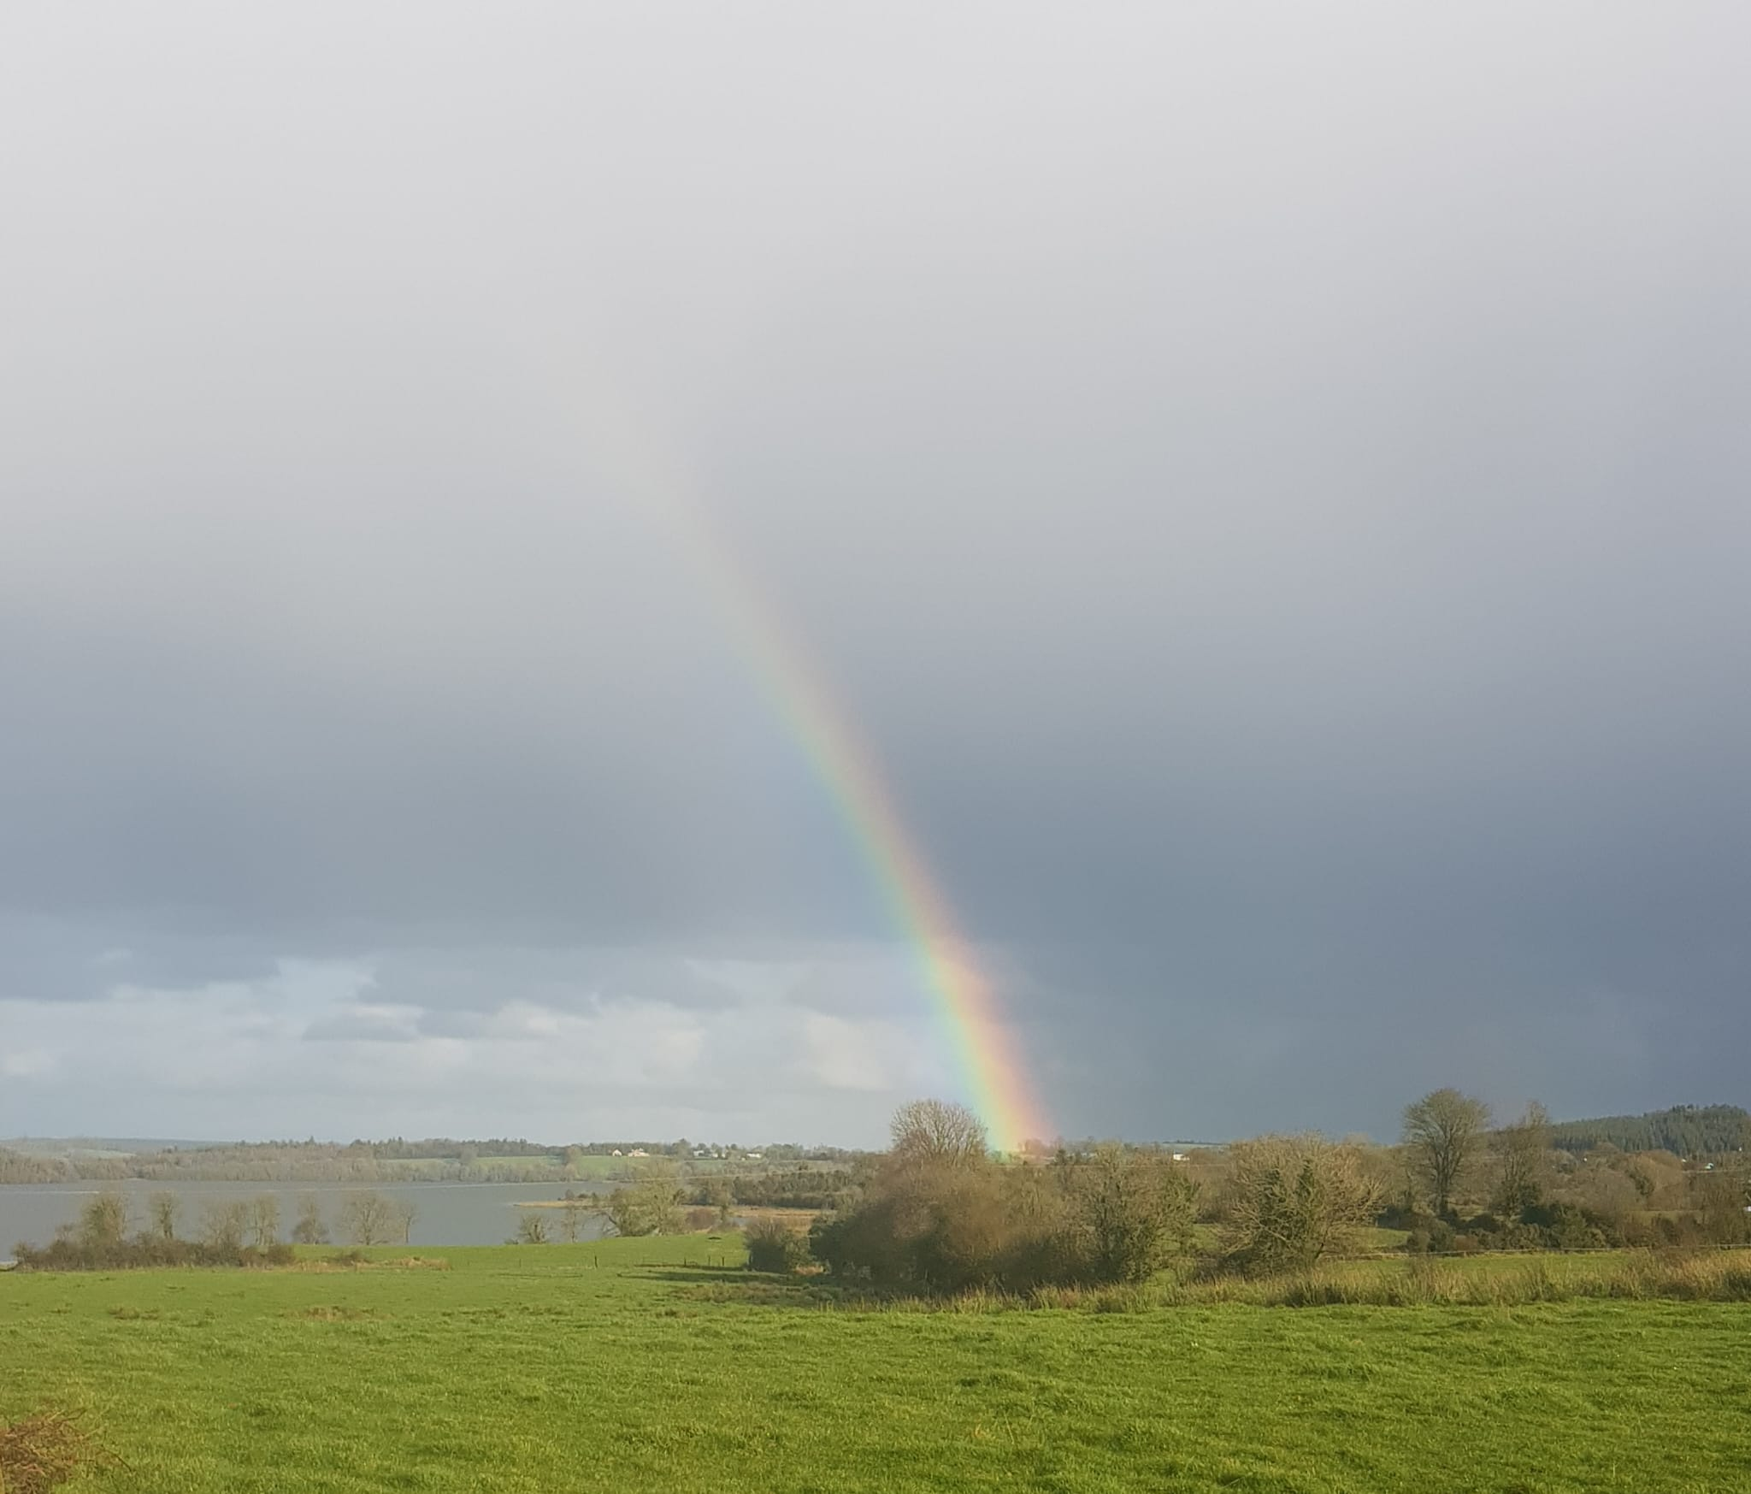
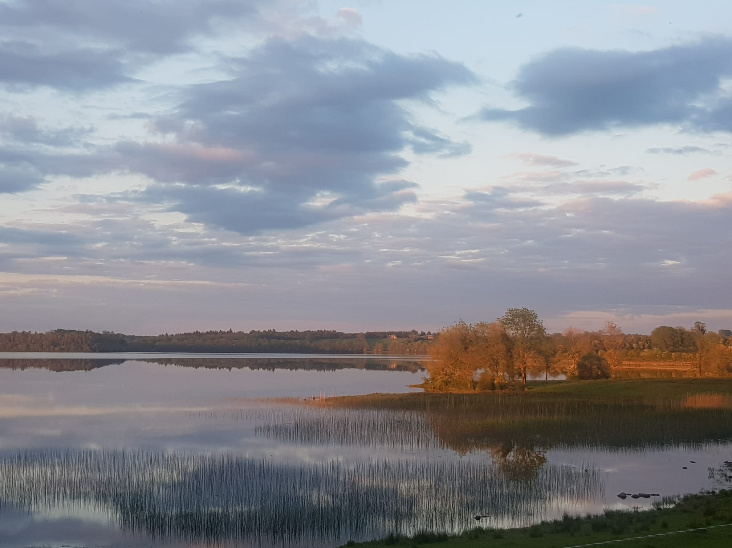
Garadice from my house

Slide 27
Why I picked this for my project
I chose this as my project because Garadice Lake is right outside my door and has always been part of my life. It is a place full of history and stories, and it has been important to the people living around it for generations. My family has lived and farmed beside the lake for hundreds of years, so it means a lot to me. I wanted to do my project on something close to home, and Garadice felt like the perfect choice.

Slide 28
All my sources
I used a wide range of both primary and secondary sources throughout this project to ensure accuracy and depth. My primary sources included oral interviews with my grandad, Noel Maxwell, as well as conversations with neighbours who have long-standing knowledge of the area. These firsthand accounts were especially valuable in providing personal insights, local traditions, and details that are not recorded in written sources.

Slide 29
All my sources
In addition, I consulted several secondary sources to support and verify this information. These included Leitrim: History and Society by Father Liam Kelly, along with official records such as Census returns, Griffith’s Valuation, and documents from the National Archives. These sources provided reliable historical data and helped me confirm dates, land ownership, and changes in the area over time.
I also used reputable online resources, including duchas.ie and articles from the Leitrim Observer, which gave further context, folklore, and more recent local developments.

Slide 30
Use of AI
I used AI, ChatGPT and Gemeni to give me ideas on how to present my information, create infographics and create a family tree. I found AI hard to use as you have to tell it every little detail because it doesn’t know anything. For my family tree the AI could not understand different generations and it was hard creating the family tree that was right. I found that ChatGPT was far better at giving ideas but Gemeni was better at creating images. I also used AI to help me come up with suitable headings and titles.

Slide 31
Reflection
In this project, I learned a lot about Garadice and my family history, including tracing relatives back to the 1700s. A challenge I faced was organising lots of small pieces of information, which I overcame by structuring my work clearly. The most satisfying part was seeing everything come together, especially my infographics and family tree. I found using AI tools like ChatGPT and Gemini frustrating at times. I used books, people, and online sources, which were useful but not always fully reliable. Overall, I felt a strong personal connection as I have lived beside the lake all my life.

Slide 32
Thank You

