Slide 1
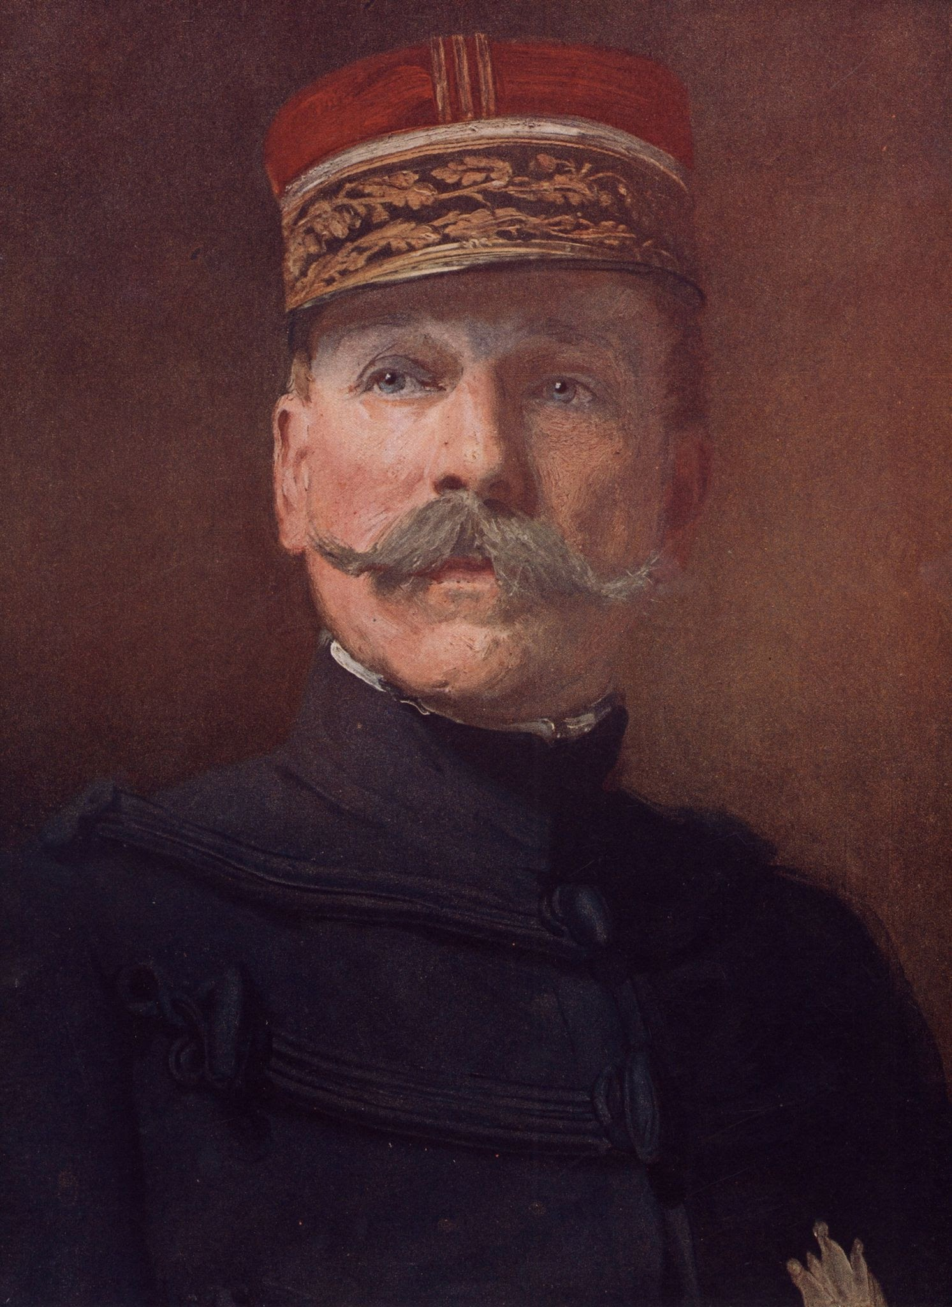
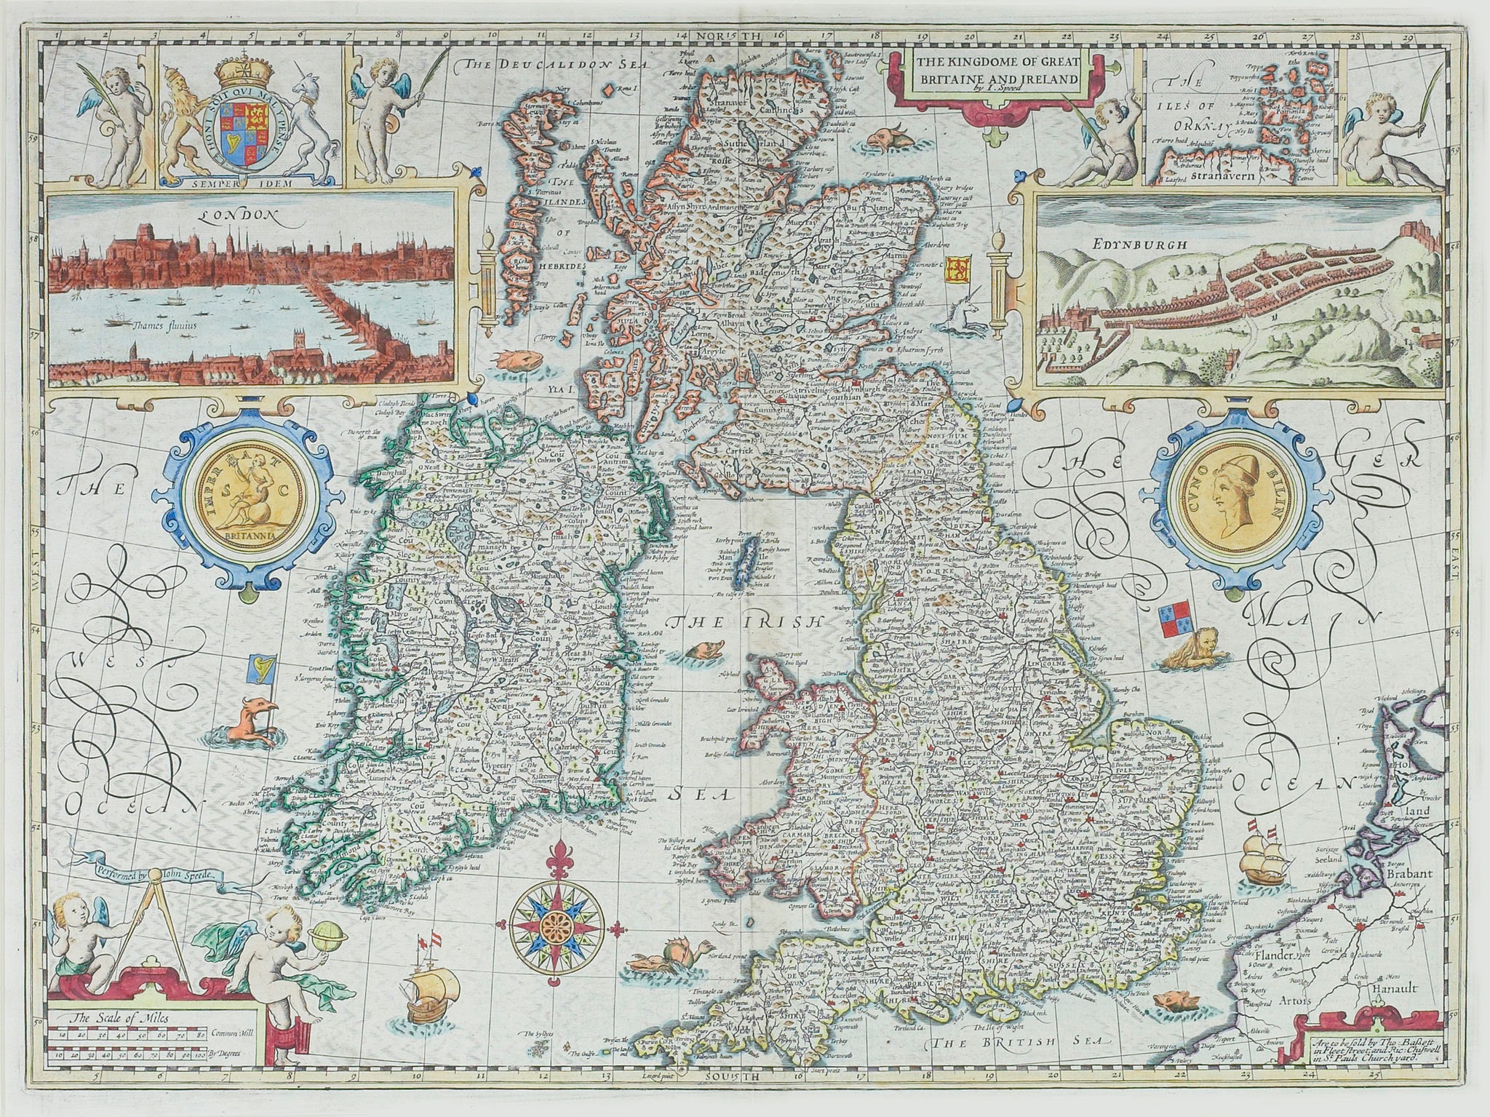
The Tour de Humbert in my local area
By Senan Honeyman

Slide 2
Why I chose this topic
The “Tour de Humbert” or “Humberts trail” runs through my local area - Fenagh - with a few signs up showing its path. It passes right through our farm, where my granny lives, and out the far side, as well as this the trail starts in Killcummin and lacken in Co. Mayo where they landed, which is different to common belief as many believe that they landed in Killala. Lacken is where the other side of my family comes from and I have seen signs for the trail up there too including a monument to it. I also thought this topic would be interesting because I enjoy looking into Irish history and our heritage and I didnt know much about this topic, only that the trail passed through my local area.

Slide 3
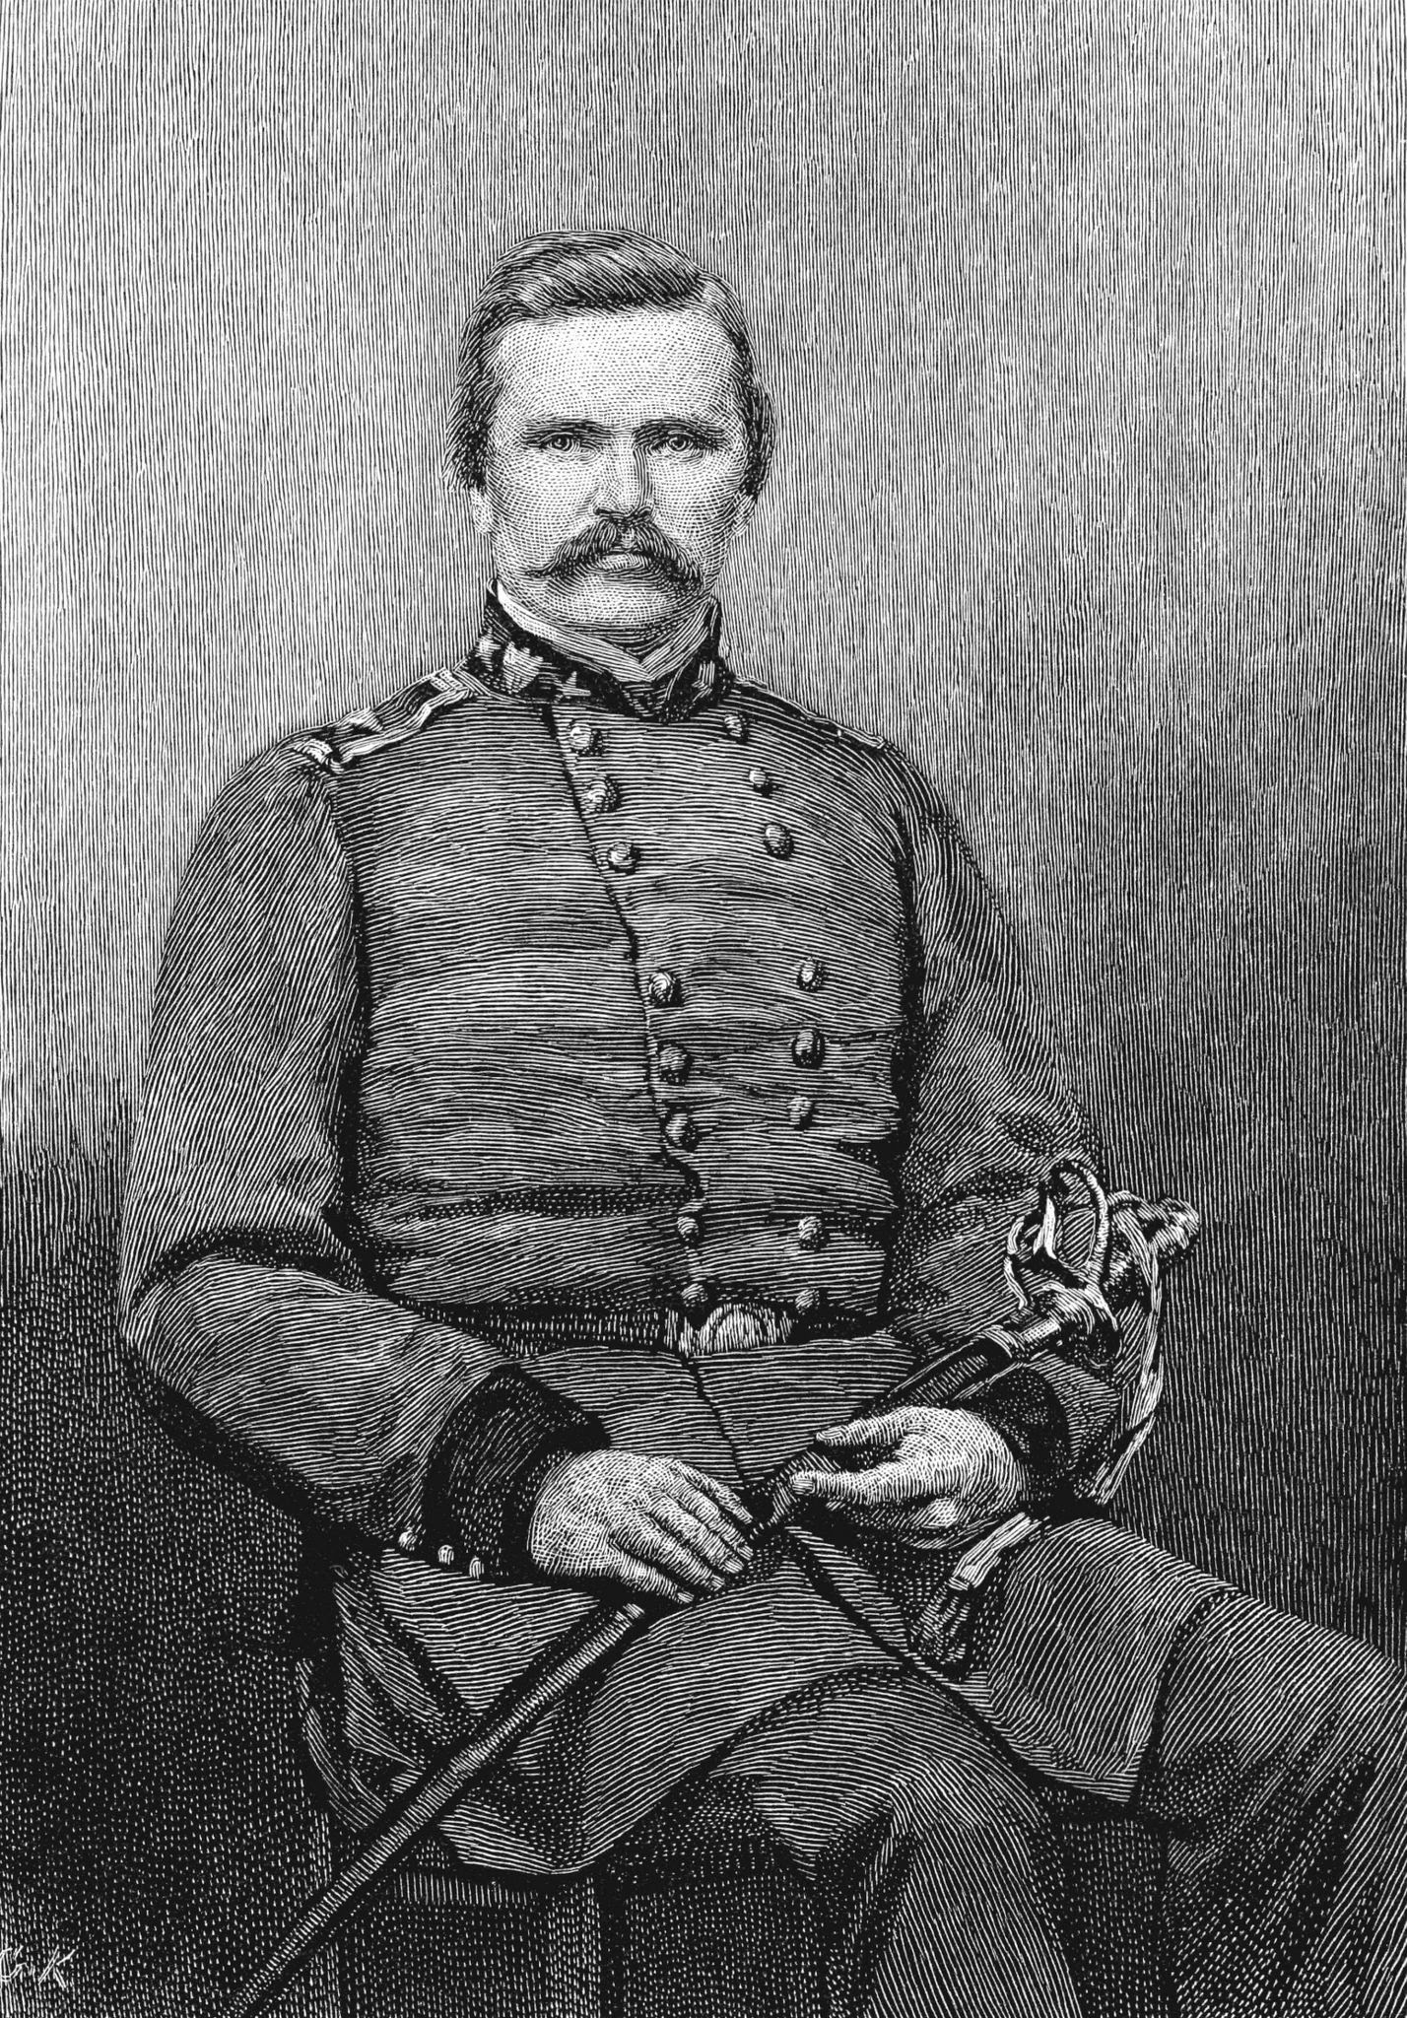
Who was General Humbert?
Jean Joseph Amable Humbert was born on 22 August 1767 near Remiremont in France and was raised by his granny after being orphaned as a child. When he was young, he ran a business selling animal skins to glove factories in Lyon and Grenoble, but he gave it up after the French Revolution began. He joined the army, first serving in the National Guard and then in the 13th Battalion of the Vosges, where he quickly became a captain. By 1794, he had been promoted to brigadier general and gained experience in the War in the Vendée, where he met Lazare Hoche. In 1796, he took part in a failed French attempt to land at Bantry Bay, and in 1798 he returned to lead his own expedition to Ireland.

Slide 4
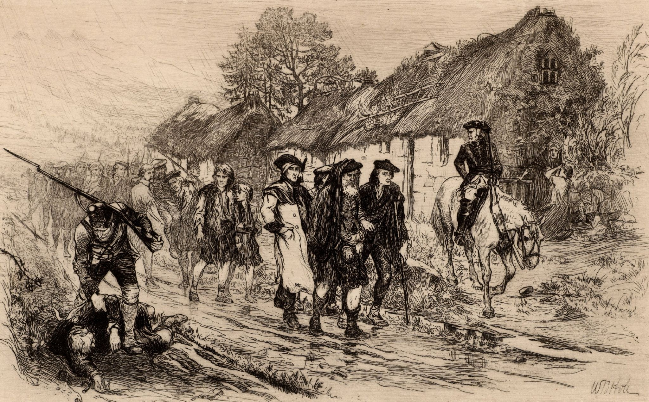
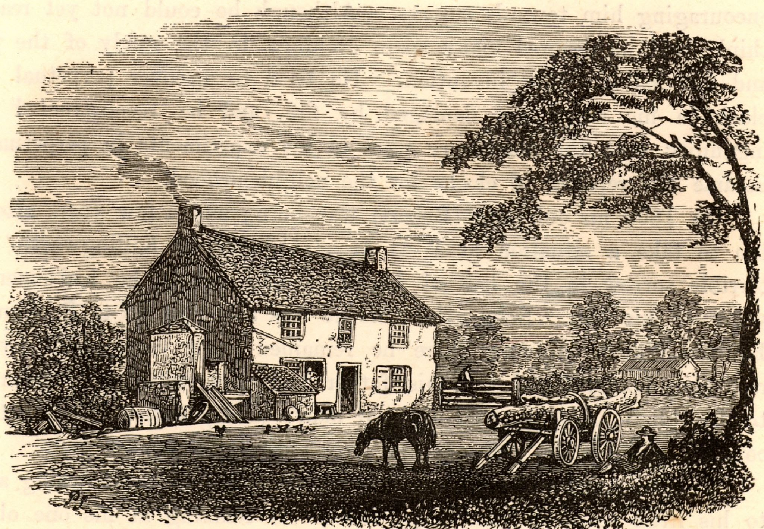
English Plantations and the Loss of Irish Land
During the 1600s, counties such as Leitrim were taken over by English plantations. Irish people were removed from their land and many also lost rights connected to their religion and education. Land that had belonged to Irish families for generations was given to English settlers instead. While some Irish people chose to support or cooperate with the plantation system, most strongly opposed it. They believed their homeland was being stolen and were angered by the loss of their land, traditions, and freedom. This created resentment and tension that lasted for many years.

Slide 5
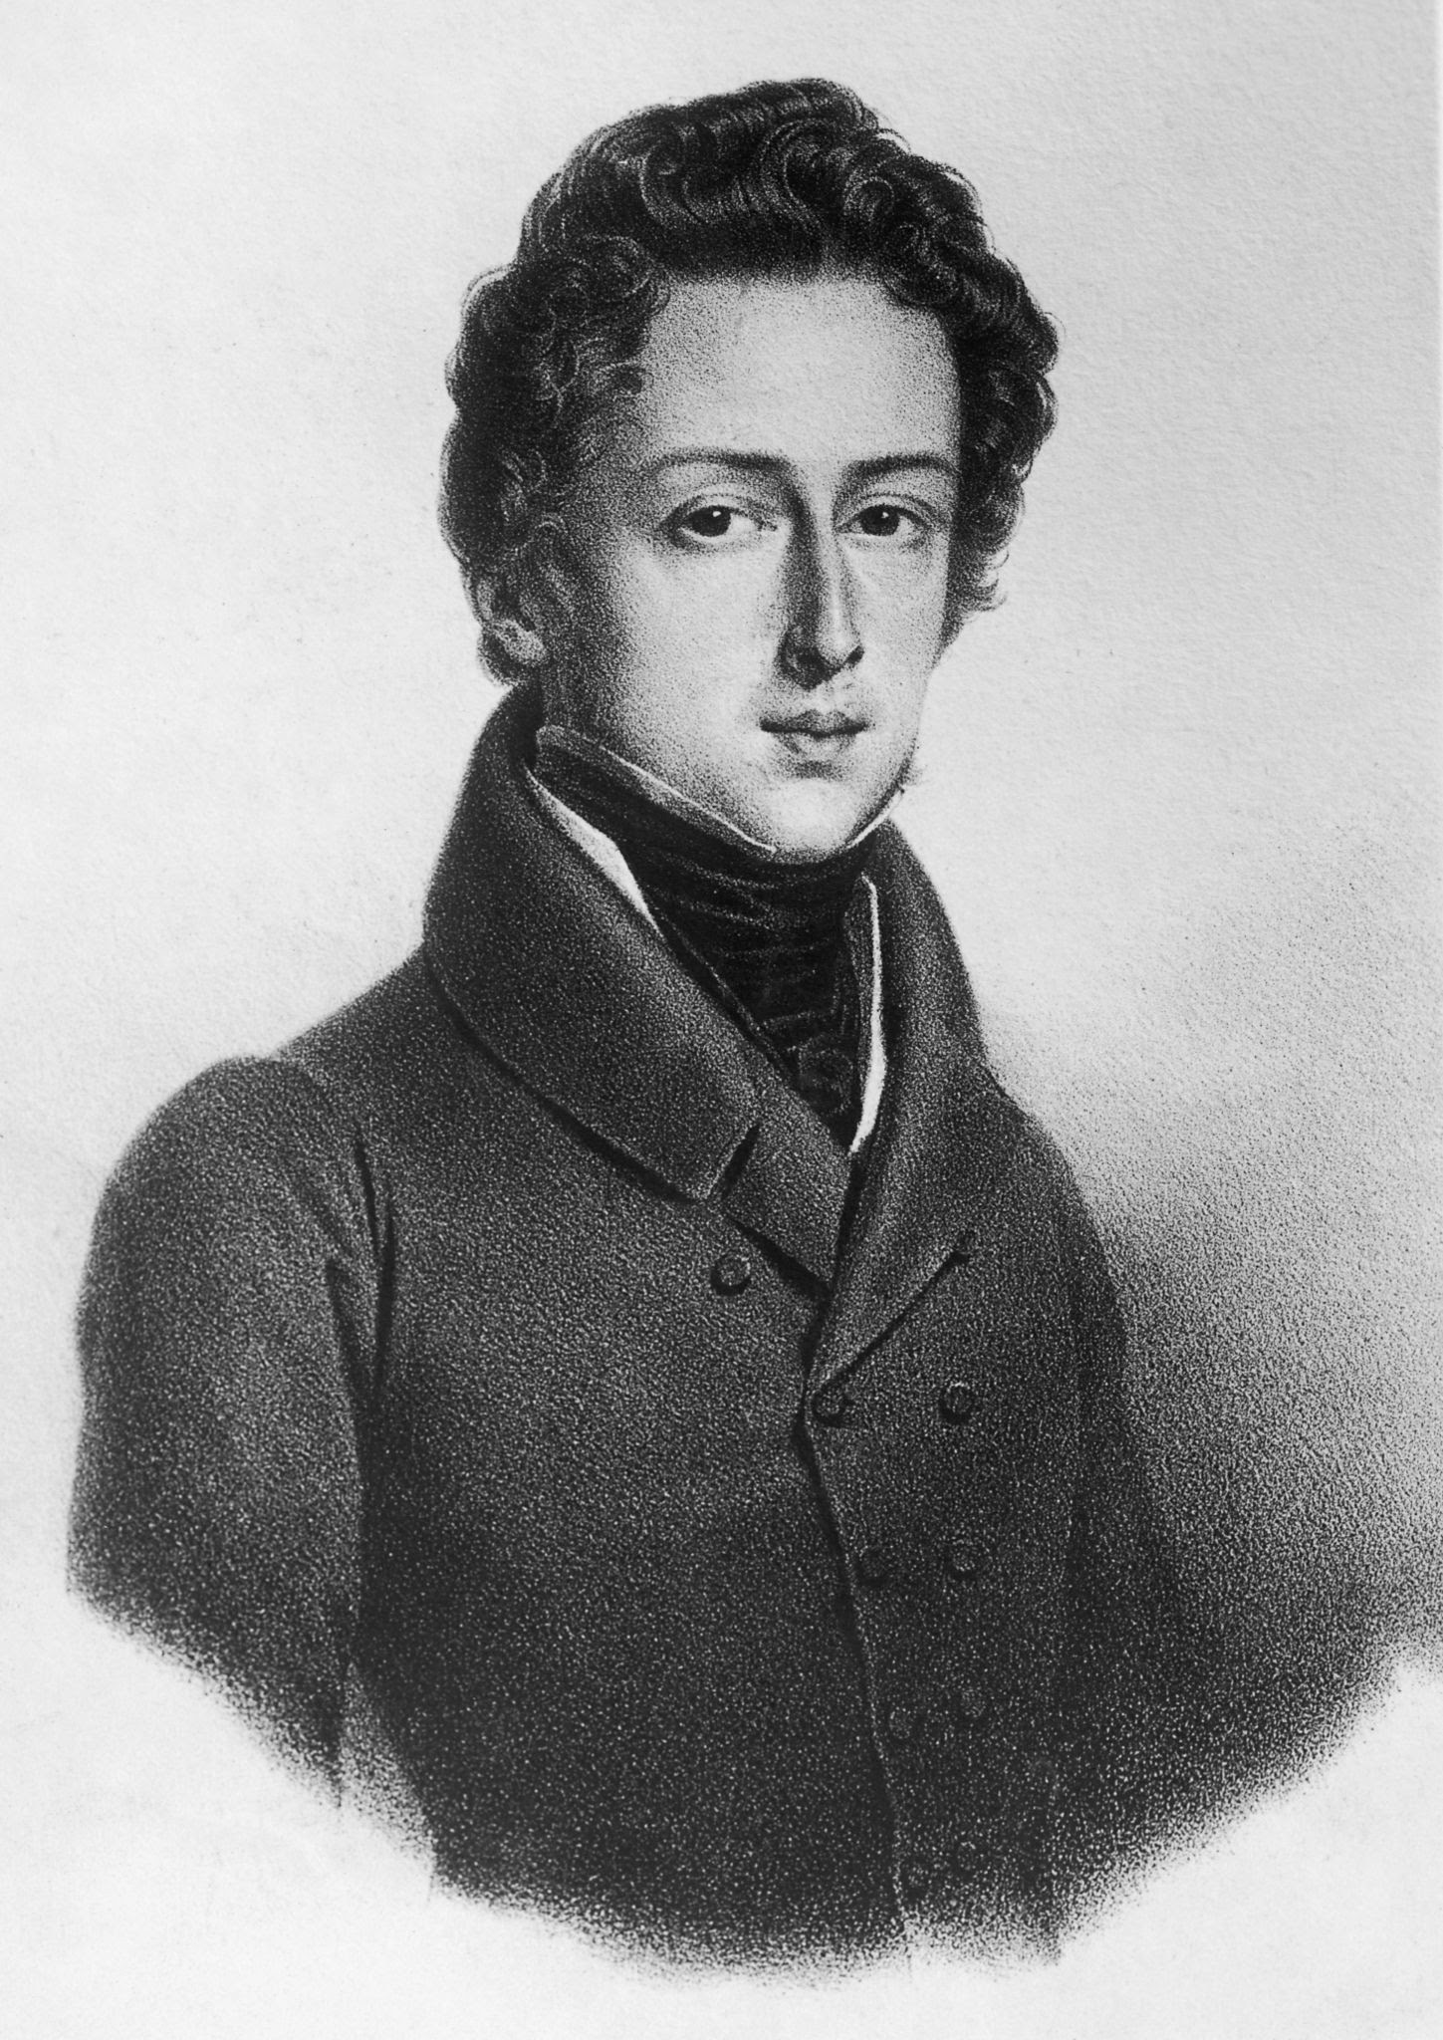
The 1798 Rebellion
The 1798 rebellion was influenced by the American and French Revolutions, which encouraged ideas about equality and political reform. In 1791, Wolfe Tone founded the United Irishmen near Belfast. Their aim was to unite Irish people of all religions in order to bring change and freedom to Ireland. They believed that if peaceful methods failed, they were willing to use force to regain Ireland’s rights. Wolfe Tone travelled to France to ask for help and convinced them that attacking England through Ireland would weaken their enemy. Wolfe Tone played on the fact of France and England's long resentment for one another throughout years and his connection to the French, they responded by sending aid to Ireland in the form of 1,100 soldiers.

Slide 6
What happened next? (Brief overview)
After their first failure to land on Ireland to face the British, the French sent humbert back a few months later with 1,100 men at his side. This time they went around the Island and landed in Kilcummin Co. Mayo where he then set a foothold in the near town Killala where his march officially began towards the pale in dublin where they intended to cut the head of the snake that was the English. But, the English caught word of this and sent men to intercept them at Longford. Here is where Humberts trail ends as the English severely out-manned the French by thousands and their weaponry was superior to the French's. In the end Humbert had to come to terms and surrender to the British only moments into the battle as he knew that defeat was upon him. Later the French were sent safely back to France as prisoners of the English.

Slide 7
The battle of Castlebar / The races of Castlebar
The battle of Castlebar also known as “The races of Castlebar” occurred five days after Humbert and his men landed. This was a battle between the combined forces of the French soldiers and roughly 2,000 Irish Republican soldiers led by Humbert, versus a superior force of 4,000 - 6,000 Englishmen who were led by General Gerard Lake. Humbert used tactics such as leaving 200 men in Castlebar to make sure his rear was safe. The Irish and French came into Castlebar at about 6:00 a.m where they first got heavily gunned down upon by the british who had the advantage at the time. The Republicans quickly found cover. Then began the push forward: a bayonet charge from nearly the entire army. The charge was so fierce that the British fled in fear, but not before roughly 350 of them were killed. The British soldiers didn't stop retreating until they got to athlone Co. Galway where they were headed off by Cornwall, but many thought they were going to keep going.

Slide 8
Humberts Journey in my local area
At Drumshanbo, it is believed that Humbert and his troops travelled along the Aughnasheelin road before turning onto the Annadale road, which brought them close to Lough Scur. From there, they continued along the Rossy road towards the crossroads at Castlefore. According to local tradition, they considered staying there for the night but decided to continue their march. It is also said that at Castlefore the army divided into two groups: one group headed towards Fenagh, passing Graffi Hill and continuing on to Cloone, while the other group went uphill from Castlefore to Leamanish and crossed an area known locally as Claidhe Bui, named after the yellow-flowered whin bushes which are still a big part of the landscape. This route brought them past Laura Lake, after which they likely travelled towards Gorvagh and along the Adoon road to Cloone, where both groups are believed to have reunited.

Slide 9
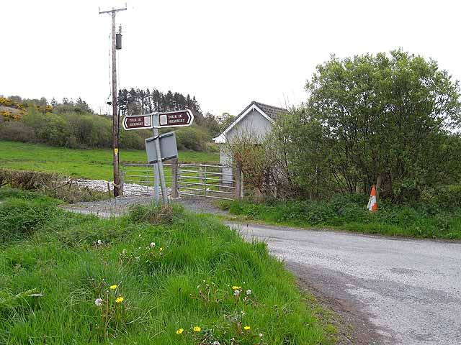
My connections with the Tour de Humbert
This is a picture I took of the Tour de Humbert sign which is roughly a hundred meters away from my farm and my grannys house where my dad grew up, we actually own the field that the pump house is situated in as you can see in the picture. There is also another sign a few kilometers down the road from this in Fenagh village. The road to the left then continues up to Ballinamuck where the trail ends.

Slide 10
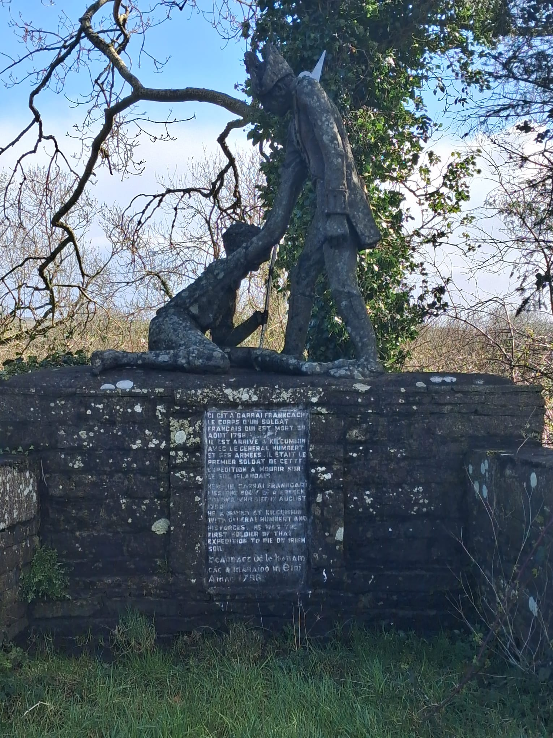
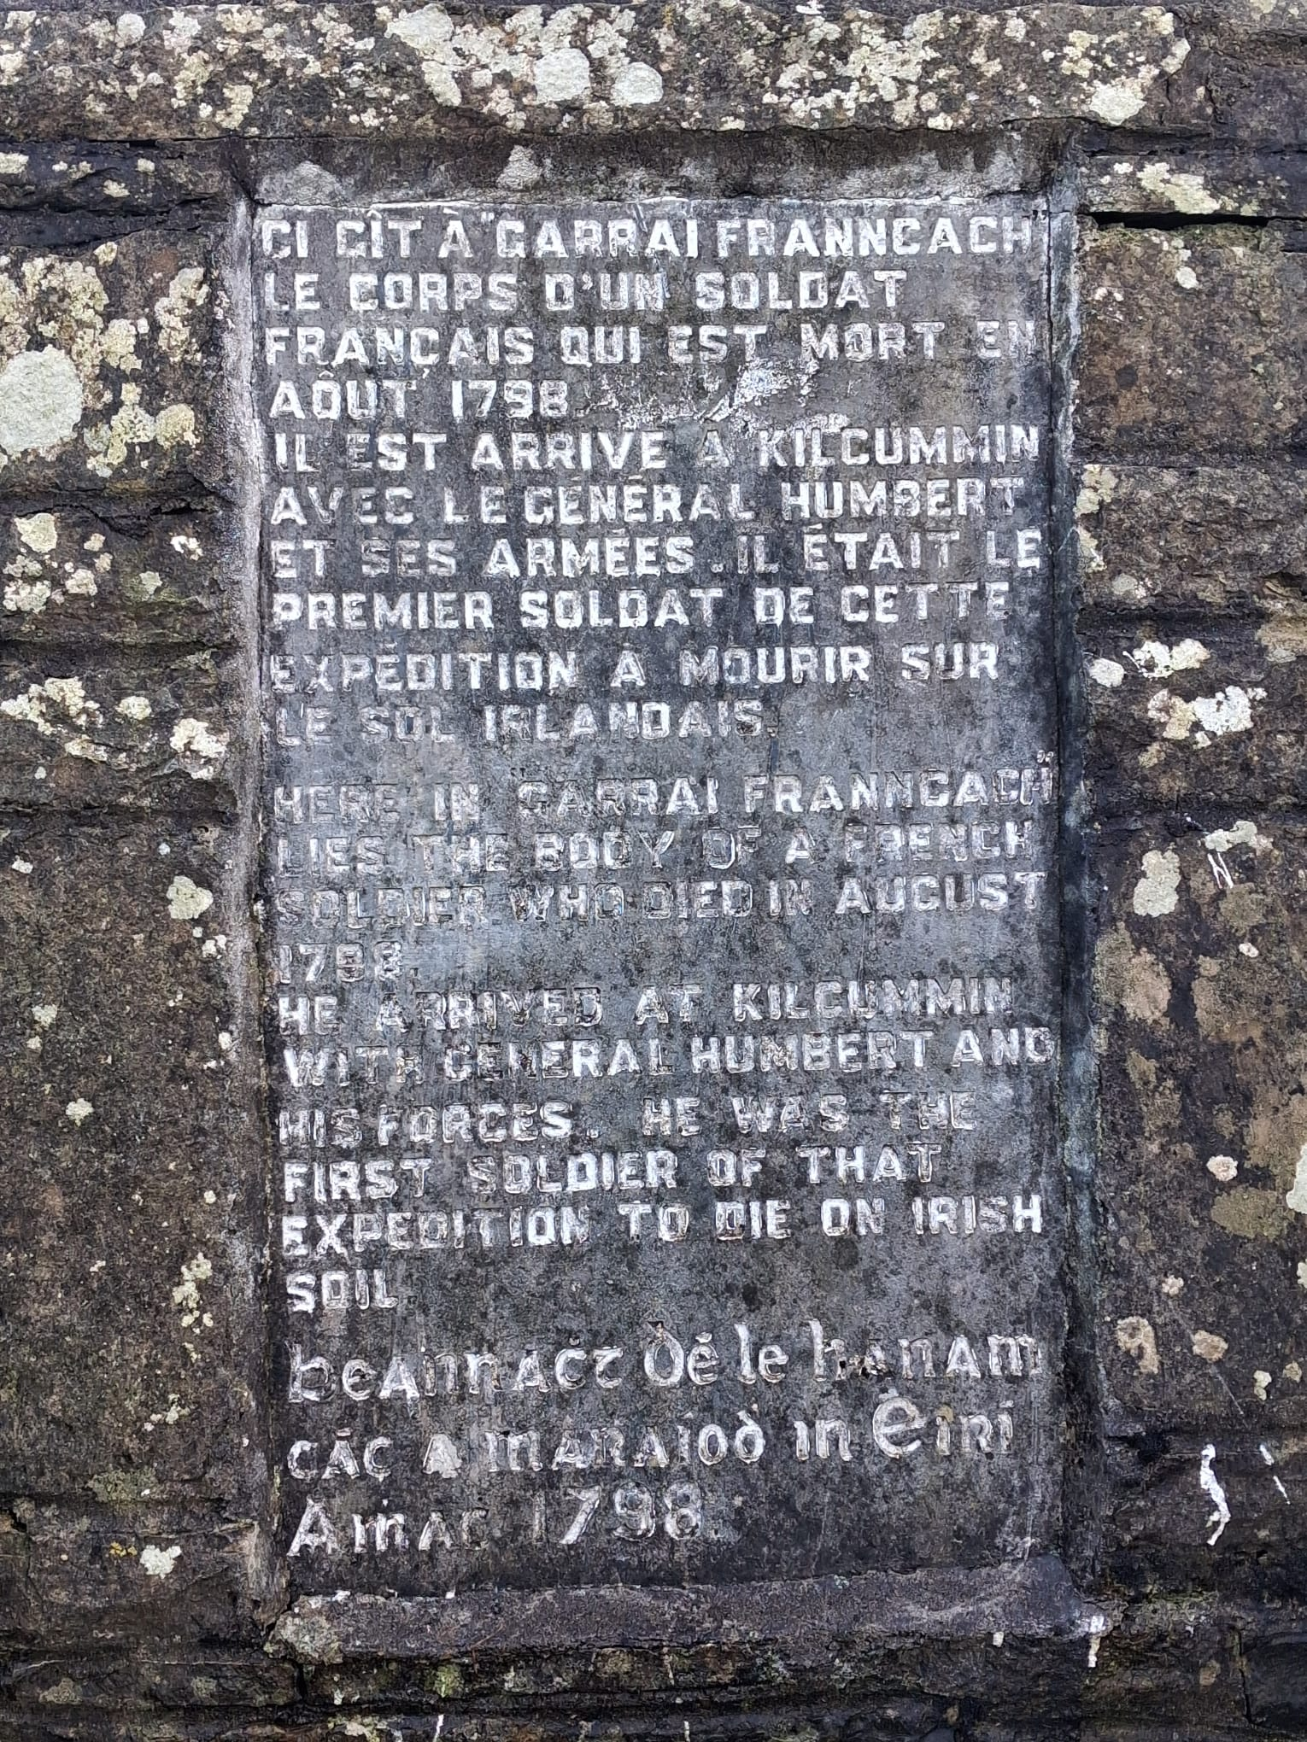
My connections with the Tour de Humbert
These two photos are ones of a monument made for General Humbert and his men. It is located in Lacken and my cousin from there took these photos for me as I haven't been there in awhile, but, I have seen it in person before. And as you can see in the photo on the left part of it is written in French and the year is shown at the bottom.

Slide 11
My connections with the Tour de Humbert
My great grandad from Lacken was actually involved in a short television series called “The year of the French” where he was a side character. He lived in Lacken and the trail went straight by his house. The show focused on the French landing in the 1798 rebellion. It was aired on Channel four in 1982.
Some people like my grand uncle from lacken believe that the French did not only land in Killcummin, but also landed in Lacken Bay.
As well as this the trail went by my granny's house in Lacken Co. Mayo and passed also passed my granny and grandads house in Fenagh where our farm is situated.

Slide 12
The Battle of Ballinamuck
On the 8th of september The battle of Ballinamuck took place. When General Lake and his forces met Cornwall and his 20,000 men in Athlone they joined and headed to cut off Humbert on his way to Dublin. General Humbert was meant to meet 3,000 Irishmen he believed to be near Granard. After four hours of rest they marched on. Humberts men were spread along the road though and he waited in Ballinamuck for them to arrive. By this stage his rear guard of 200 men had already surrendered after a short battle with Lakes men who had advanced from the rear. After this Humberts men got split into many different battalions and were heavily outnumbered. The Irish fought relentlessly but eventually found themselves alone as Humbert was forced to surrender. The French were shown mercy but the Irish were not. The Irish were either killed fighting or fled to the nearby bogs where they escaped. 500 men were said to be buried in a mass grave nearby and the two Irish Generals, General Magee and General Blake were later captured and hung. This battle seen the end of Humberts campaign in Ireland.

Slide 13
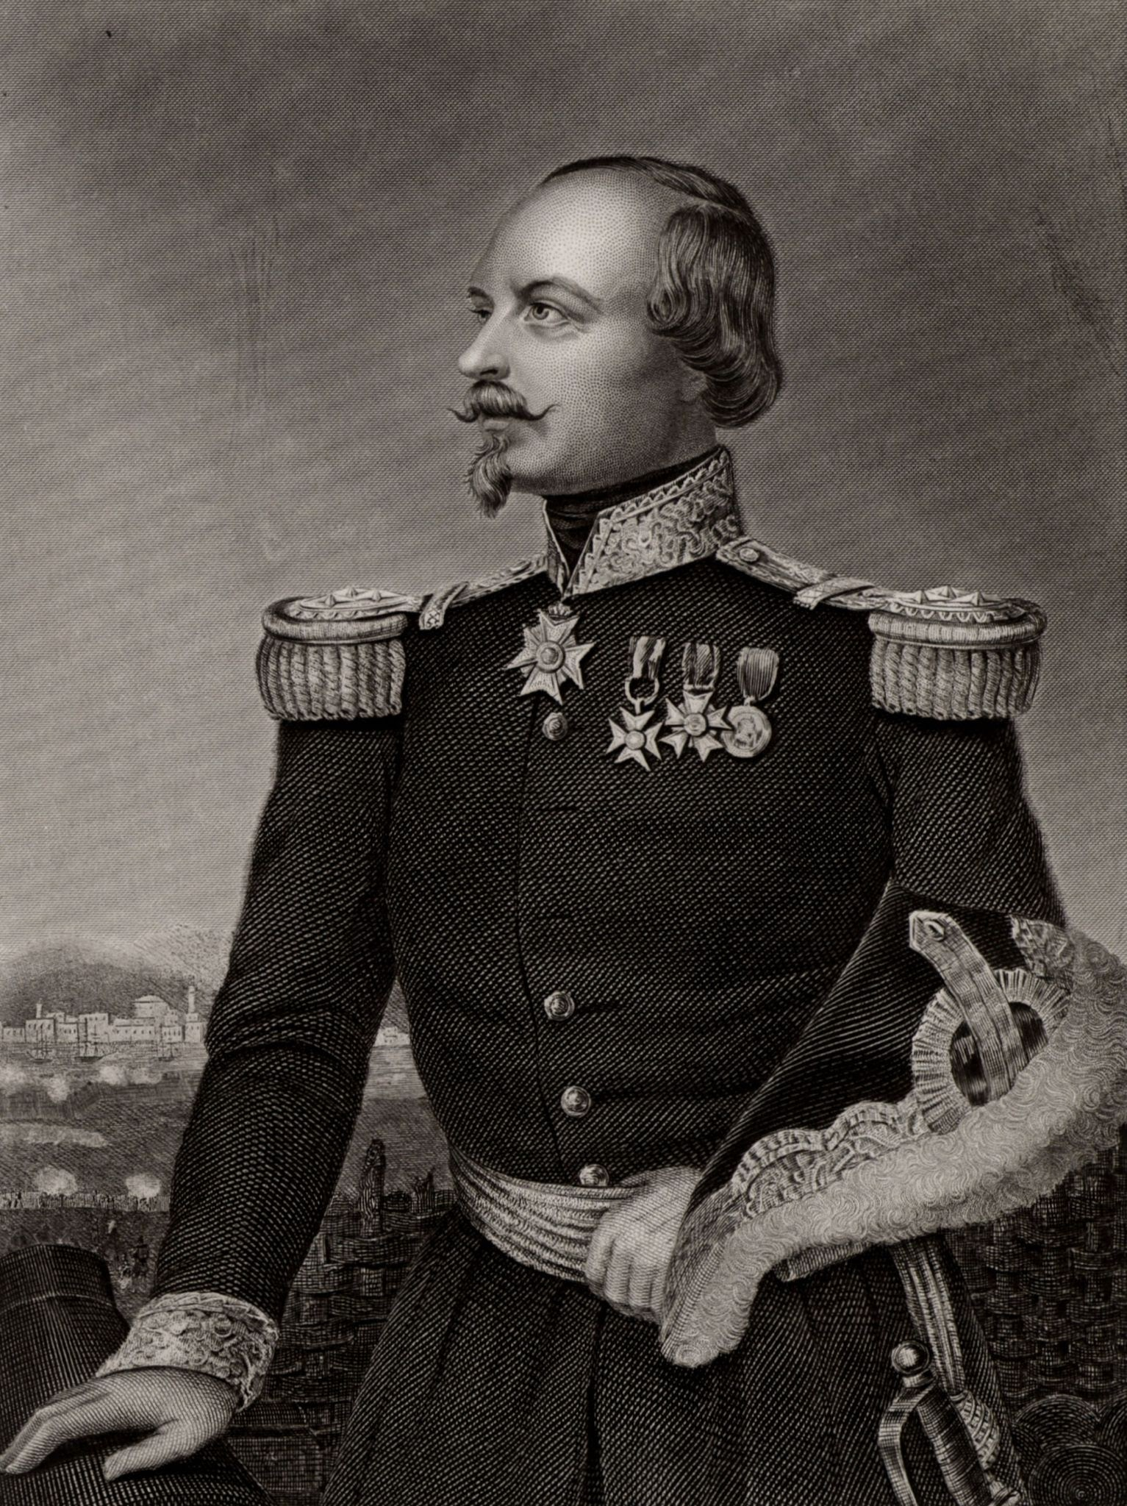
What happened to Humbert?
After his campaign in Ireland, Humbert and his soldiers were sent back to France in a prisoner exchange with the British. He continued his military career in Europe and the Caribbean and became governor of Haiti, also called Saint-Domingue. As a strong republican, he disagreed with Napoleon Bonaparte and was exiled for a time, but later returned to the army and was recommended for the Legion d’Honneur. In 1812, he moved to New Orleans under the name Jean Berthrum and fought in the Battle of New Orleans under Andrew Jackson. He also took part in the Mexican War of Independence and later worked as a teacher of languages and fencing. He died of an aneurysm and was buried in St. Louis Cemetery No. 1 in New Orleans, and is remembered as a hero of republican ideals in both Ireland and America.

Slide 14
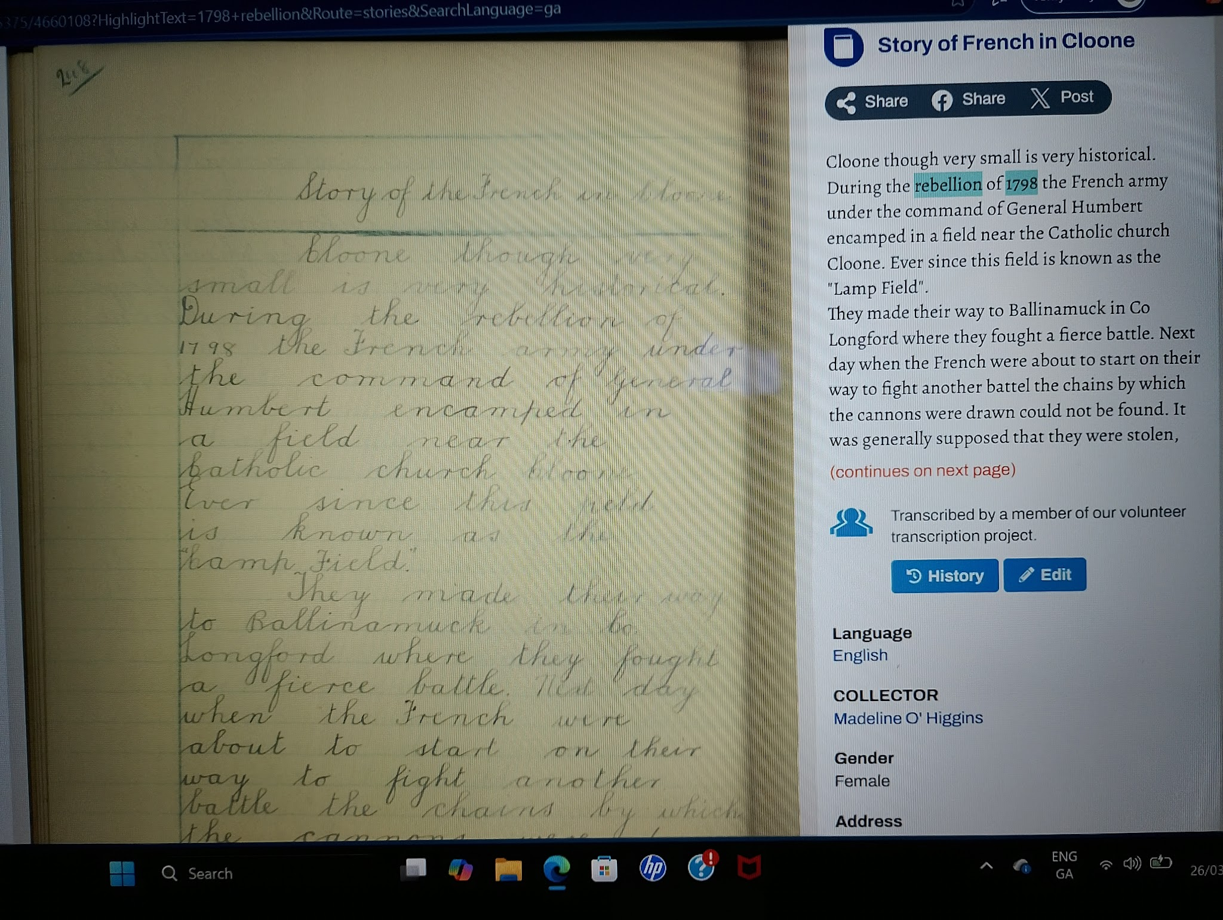
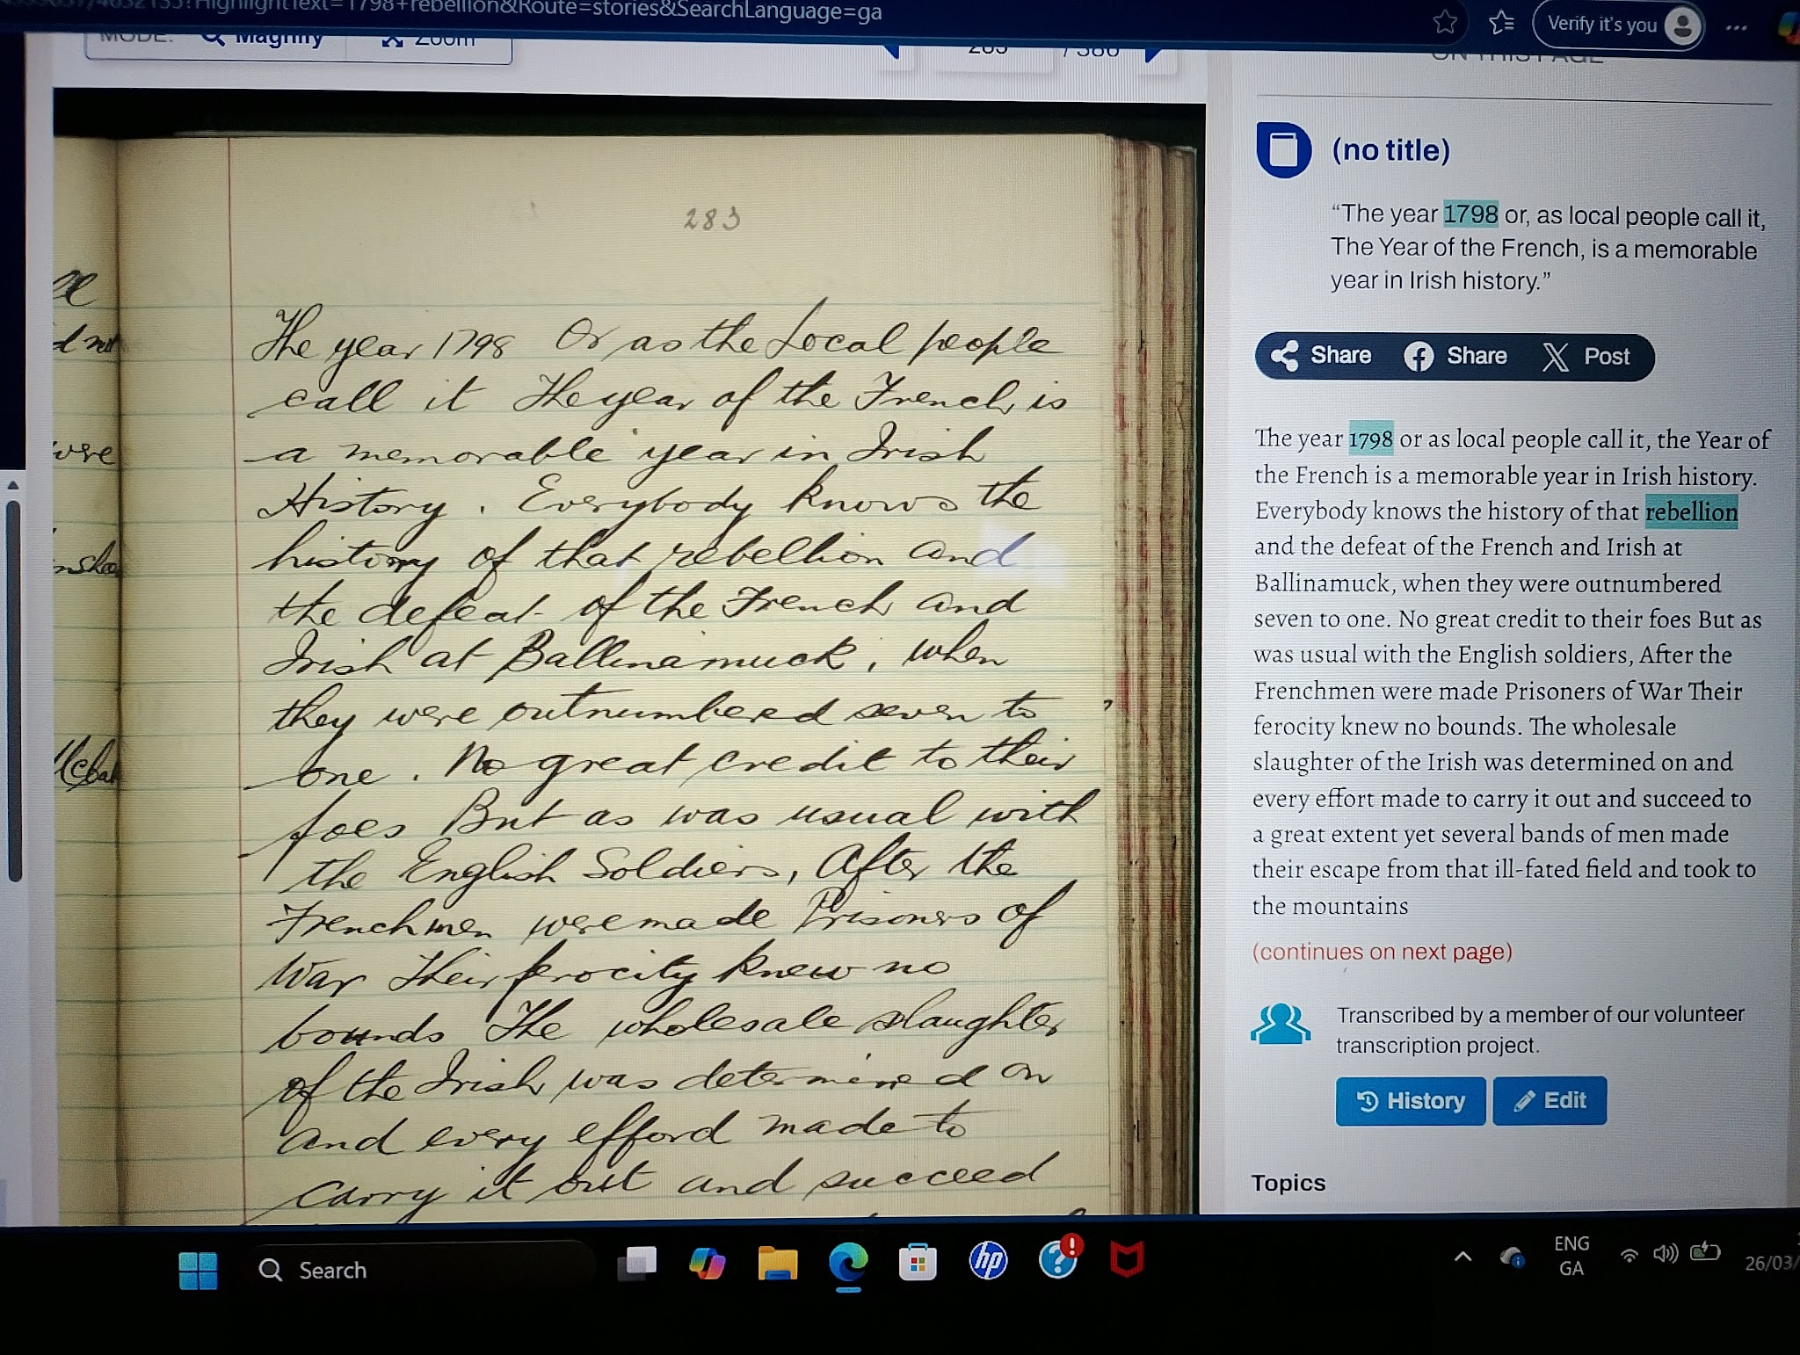
More information I learned
I used Duchas.ie to research some local folklore stories in my area around the time of the 1798 rebellion. I ended up finding two documents that correlated with my topic:

Slide 15

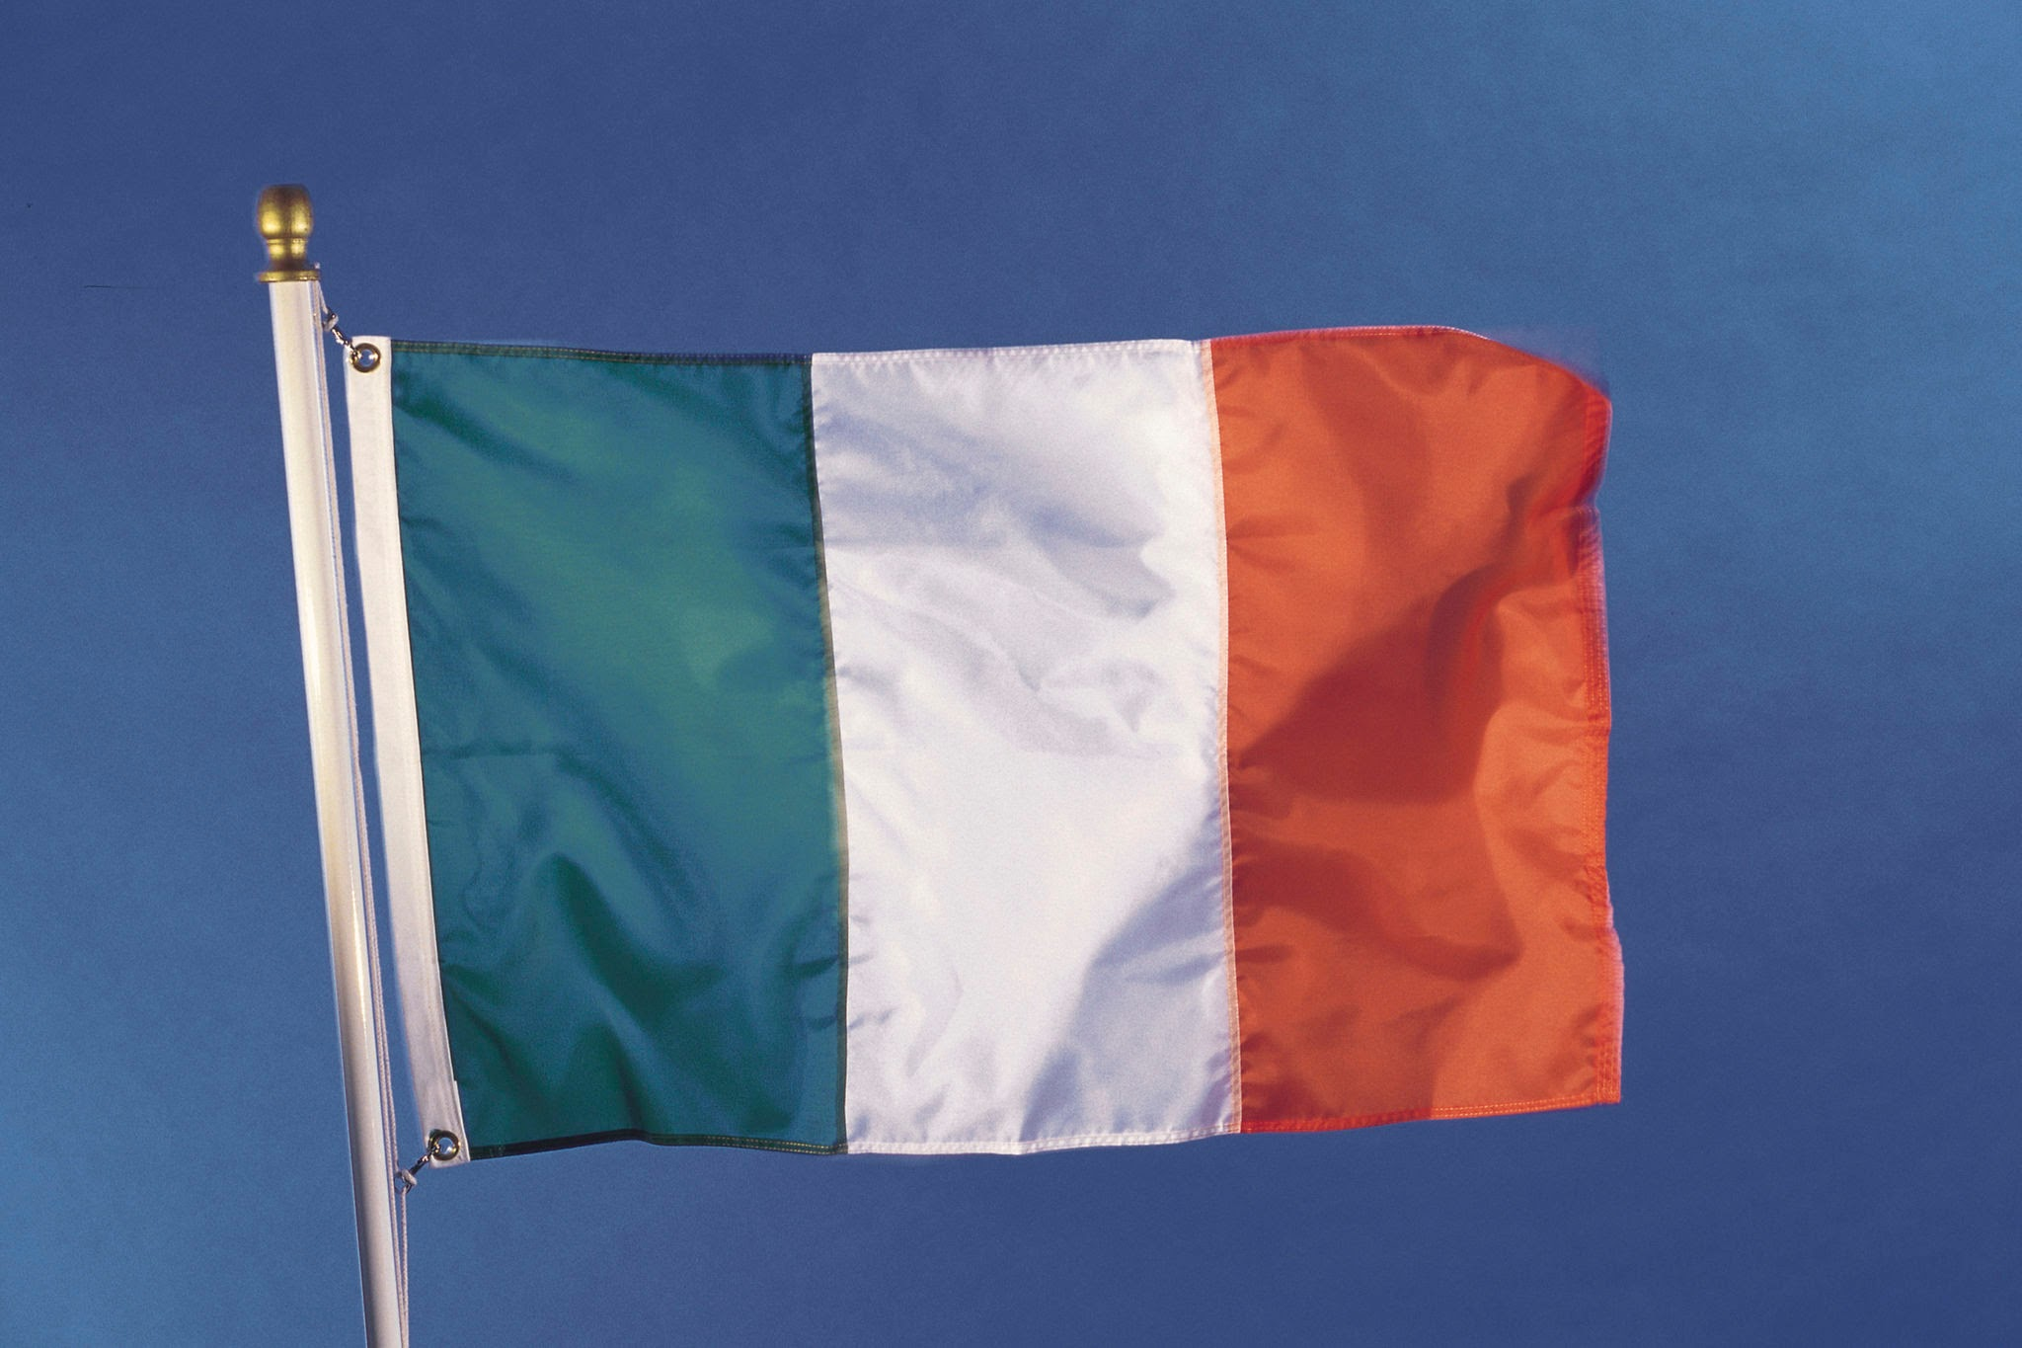
Conclusion
Humbert may not have played a huge part in the 1798 rebellion or in Irish history. But, I think his defeat made it clear to the Irish people that victory over the British and their reign wasn't going to be solved easily and that no help was coming and they had to search for freedom themselves whether it be through politics and talk or through physical means. On the other hand I believe that if Humbert and his men had indeed landed in Cork at that the time that they were meant to, they could have had a huge effect on our history and how the later years after that had played through.

Slide 16
Personal reflection
I enjoyed doing this project and learning more about my local area and in my opinion I believe that Humbert was a great man even though he didn't have ,much of an effect on our history. I think he was loyal to himself and his beliefs and made a great warrior and general.
I had actually planned to do this project on a different topic, nut, now I am happy that I done it on the Tour de Humbert, as even though there isn't a lot of information on it, I found it amazingly interesting and different as most of the history in my local area is based around abbeys and dolmens scattered around. I found this a breath of fresh air.

Slide 17
Bibliography
These are the sources I used for my research for this project:
Ballinamuck.ie
1798castlebar.ie
Britannica.ie
Humbert, Jean-Joseph Amable | Dictionary of Irish Biography
Duchas.ie
As well as this I got information from my grand uncle and cousins from Mayo. My Mam also knew a bit about it due to her spending so much time in Lacken when she was younger.

Slide 18
The End
Thank you for reading through my project on The Tour de Humbert and its significance in my local area
By: Senan Honeyman

