Slide 1
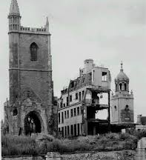

Young Historian 2026
Bristol during ww2 by Sean Kavanagh

Slide 2
Index
Why I chose this project
Aims of the project
Why was Bristol an important city during WW2
The Bristol aero plane company
Bristol shipyards
The conscription
American soldiers in Bristol
African American soldiers in Bristol
Park street riot
Bristol Blitz
Perdown Percy
Spy Networks in Bristol
St Nicholas market and air raid shelter
D-day planning
Other key planning locations in Bristol
Bristol after the war

Slide 3
Why I chose this project
I chose this project as my Great-Grandfather are Grandfather are from Bristol and I have a big interest in WW2 history, Bristol was one of the most important cities to Britain in the war, however it is rarely talked about
Some questions to be addressed include
life for locals during and after the war?
Life for soldiers stationed in Bristol?

Slide 4
Aims of the project
My aims for this project are to find out more about Bristolians during WW2, their lives, how the war affected them during and after
My grandad and his father are both from Bristol and both felt the effects of the war, one during and one after

Slide 5
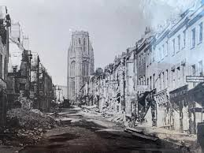
Why was Bristol an important city during WW2?
Bristol was a very important city for the allies as it had a massive harbor and plenty of shipyards
the Bristol Aero Plane Company (BAC) was also located there, making it an obvious target for German bombers
The City was bombed heavily between June 1940 and May 1944
[The road was] covered with glass and stones and steel and hosepipes. … I carried my cycle down through an avenue of flame which seemed to be straining to join its hungry hands across the cringing thoroughfare. The heat was considerable and I veered from one side to the other, according to the intensity of the flanking fires. … When I got to the bottom of Park Street and looked back at this mighty torch flaming to the skies, I estimated that every third shop was ablaze.-Western Daily Press, 28th of June 1946 (wartime Censorship meant that could only be posted after the war)

Slide 6
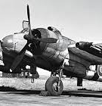
More On The Bristol Aero Plane Company
The Bristol Aero Plane company was Established on the 19th of February 1910
It played a small role in WW1, supplying the British army mainly with scout planes
In WW2 it played a much larger roll, being one of the larger plane manufacturers and selling planes to the RAF during the war, such as The Bristol Blenheim (over 4400 built), the Bristol Beau fighter (5928 built) and the Beaufort (1180 built)

Slide 7
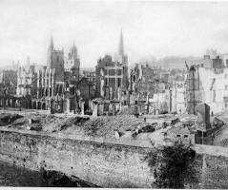
Bristol Shipyards
As a major port, Bristol was essential for receiving supplies from Great Britains allies, mainly the USA with tanks, aero planes, fuel and men being transported there
It was used as a D-Day preparations base due to these reasons, plans were stored in a secret warehouse in Brislington
It was a main target from the Axis during the Blitz due to these reasons, which is why the city was given a powerful Anti-Aircraft gun, known as the "Purdown Percy"

Slide 8
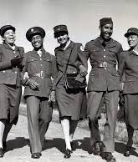
The Conscription
The Conscription took effect on September 3rd 1939
It affected Healthy Men aged 18-41 in Britain under the National Service Act
Over 55,000 men from Bristol joined the war, many joining even before the draft took place
Roughly 6,000 did not return
Men who could not join instead were put into the Home guard or Conscientious Objectors

Slide 9
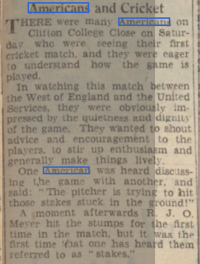
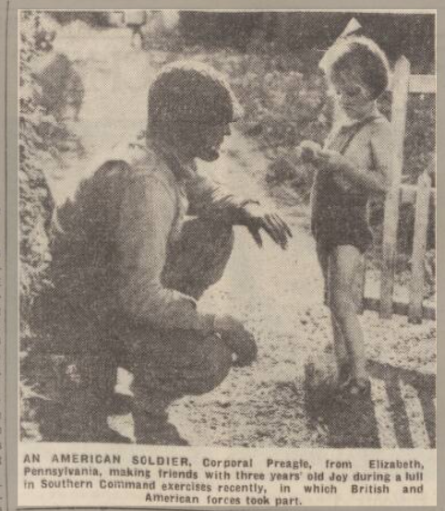
American Soldiers in Bristol
Thousands of American GIs were stationed in Bristol during WW2, Particularly leading up to D-Day
Many US soldiers (Also known as Yanks) were social in the Bristol area, known for sharing rare rations like sweets with children and talking to locals
Some U.S soldiers married local women with "Bride Training" taking place for women moving to the USA

Slide 10
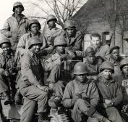
African-American Soldiers in Bristol
During ww2 African Americans made up roughly 10 percent of the Us military, around 150,000 in 1944. Most were in Labor companies, engineers and transport units. A lot of them were placed in Bristol due to the docks there
They were segregated from White US soldiers and had their barracks at: Bedminster, Brislington, Henleaze, Shire Hampton and the Muller Orphanage
Soldiers in Labor companies were almost entirely black, while most officers and MPs were black, leadership in the barracks was poor and soldiers were harshly treated

Slide 11
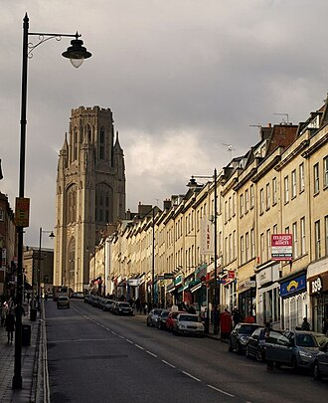
Park Street Riot
The Park street riot occurred n Park street and George street Bristol England on 15th of July 1944 when many Black GIs refused to return to their camps after US military policemen (MPs) arrived to end a minor fracas. More MPs were sent (120 in total) and Park street was closed with buses. During the riot, a MP was stabbed, a black GI shot dead and several others injured

Slide 12
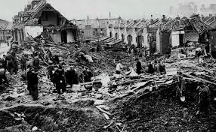
Bristol Blitz
The Bristol Blitz took place between November 1940 and April 1941 mainly due to the harbor and Bristol Airforce company
On the 2nd of November 1940, the Luftwaffe (The Nazi German Airforce) dropped 5,000 incendiary and 10,000 high explosive bomb on the city at night
1299 people were killed,1303 seriously injured and 697 rescued from the debris of bombed buildings
89,080 buildings damaged including 81,830 buildings destroyed and over 3,000 deemed useless and later demolished

Slide 13
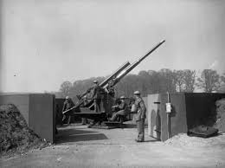
Purdown Percy
Purdown Percy was a renowned World War 2 Heavy anti-Aircraft (HAA) gun battery located on Purdown in the Stoke Park Estate during WW", it defended the cities critical aircraft manufacturing during the war against enemy bombers. It was known locally as a supergun

Slide 14
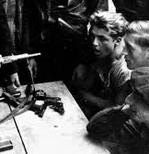
Spy Networks in Bristol
During WW2 Bristol for a hub for ally intelligence, with the grand hotel acting as a base for agents awaiting, decoding, and managing secret, unmarked trains at temple meads
The cities industrial significance made it a target for Germany with intelligence operations focusing on protecting infrastructure and managing escape routes
Various MI departments were active to manage these risks

Slide 15
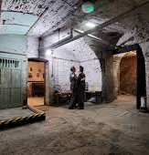
St Nicholas Market And Air Raid Shelter
St Nicholas Market, set up in 1743, at the corn exchange, features a preserved WW2 Air Raid shelter in its basement. Built in the late 1930s, this shelter protected traders and locals during the blitz. It features wartime graffiti, signage and according to local legend a ghost named Maragret
It served as refuge for hours at a time, with evidence of life like a homemade dartboard, original drawings and stars on the wall

Slide 16
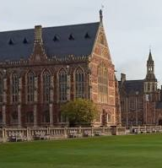
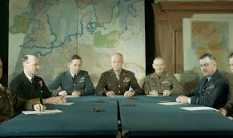
D-Day planning in Bristol
During WW2, Bristol served as a critical nerve center for D-Day, with Clifton College acting as a base of operations for Us General officer Omar Bradley and his first army staff from 1943-1944. Plans such as the Omaha and Utah beach operations were made in the college library and council room
The table Omar Bradley and his men used to plan D-Day is still visible in the college today

Slide 17
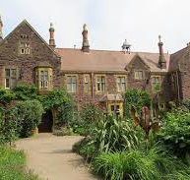
Other Key planning locations in Bristol
The Holmes (Stoke Bishop) accommodation for General Omar Bradley commander of the first army
Clifton and Durdham downs: transformed into an American tank base and vehicle storage
Beggars bush sports ground: used as a temporary airstrip
Brislington: the Bristol Co-operative society building was used for secret logistics

Slide 18
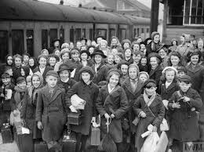
How was Bristol affected after the War?
Bristol infrastructure was destroyed after WW2 taking decades for reconstruction to finish following the severe blitz damage that destroyed homes, government buildings, hospitals, schools, and the city center
Rationing lasted until the 4th of July 1954 in Bristol, after rations started being lifted on other items throughout the end of WW2, the final rations were meat and bacon

Slide 19
Websites used:
https://historicengland.org.uk/whats-new/features/blitz-stories/the-bristol-blitz/
https://heritage.baesystems.com/page/bristol-aeroplane-company
https://museums.bristol.gov.uk/narratives.php?irn=12108
https://yanksinbristol.co.uk/
https://en.wikipedia.org/wiki/Park_Street_riot

Slide 20
Websites used
https://en.wikipedia.org/wiki/Bristol_Blitz
https://www.derelictplaces.co.uk/threads/purdown-percy-haa-battery-bristol-may-11.18812/
https://www.st-nickstours.com/
https://www.bristolpost.co.uk/news/bristol-news/bristols-d-day-role-80-9325564

