Slide 1
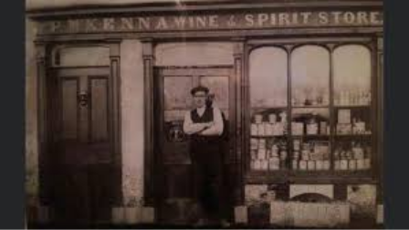
The McKenna's in Mohill
By Anne Tiernan

Slide 2
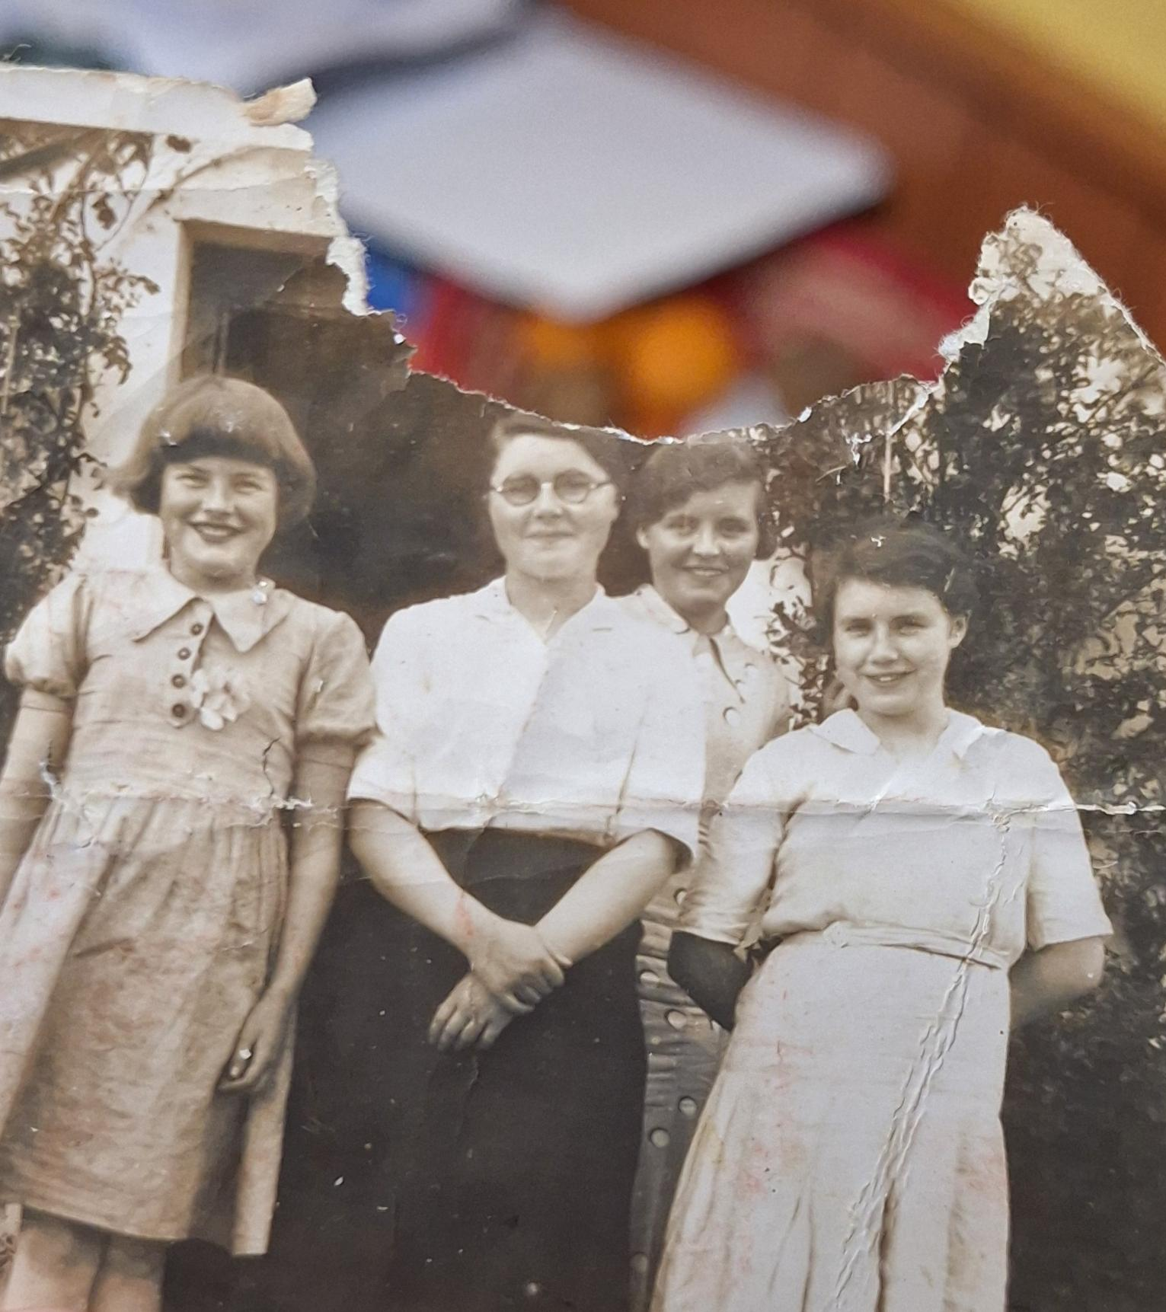
Introduction
For my Leitrim young historian project, I have decided to research my great-great grandfather Patrick Mckenna who was a local merchant and publican in Mohill during the 1910s to his death in the mid 1930s. I have also decided to research his children and my great-grandmother and great-grandaunts.
Here is a picture of Patrick Mckenna's four daughters: Ethna, Moira, Noeleen and Betty.

Slide 3
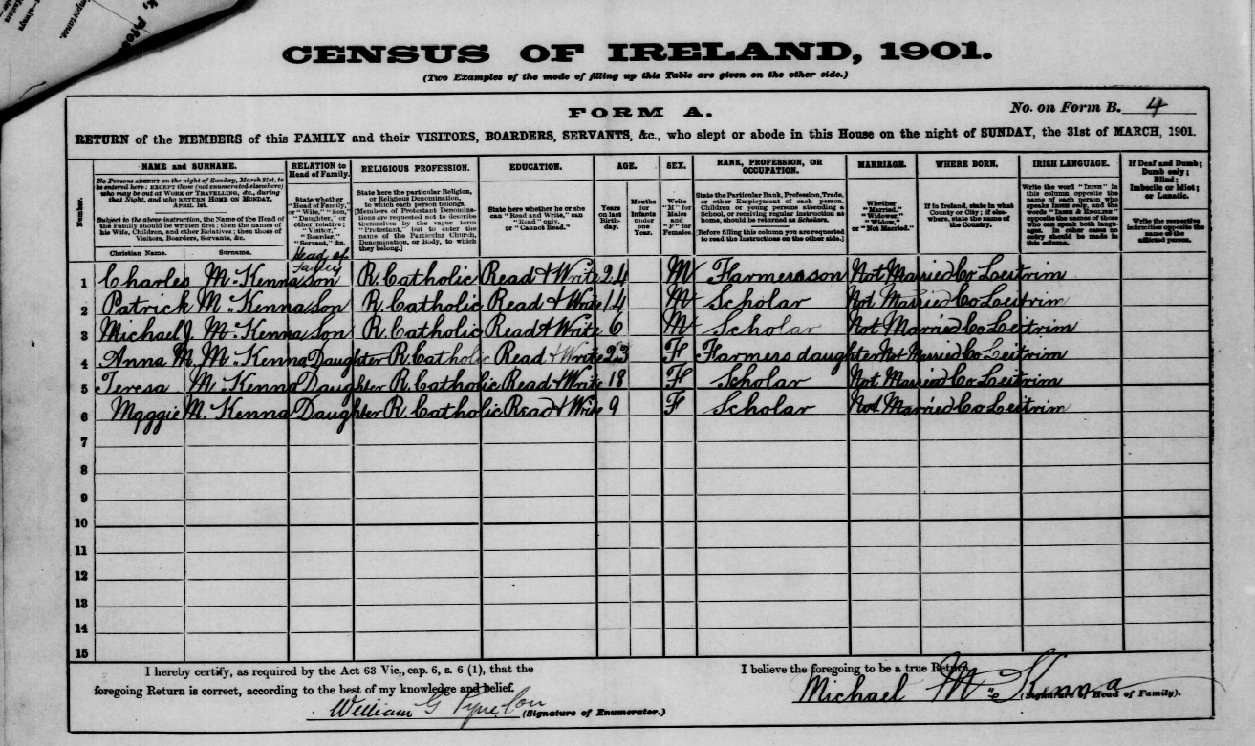
Patrick Mckenna early life
According to the 1901 census[1], Patrick Mckenna who was born in 1886 and recorded as being 14 in that census. His place of residence was Lear in Gortletteragh and his listed house number was 4. He had 5 siblings and neither of his parent are listed as inhabitants. His older brother Charles is listed as the head of the family however in the bottom right-hand corner, his father as named in Patrick's wedding certificate [2] signs as head of the household despite not appearing on the actual list.
This could mean that Patricks father Michael was illiterate and unable to fill out the form which could explain why Patrick was still listed as a scholar on the census form despite being past the average age for a farmer's son to still be in school as he was turning 15 later in year showing that education was important in the household as his 18 year old sister Teresa was listed as a scholar also on the 1901 census

Slide 4
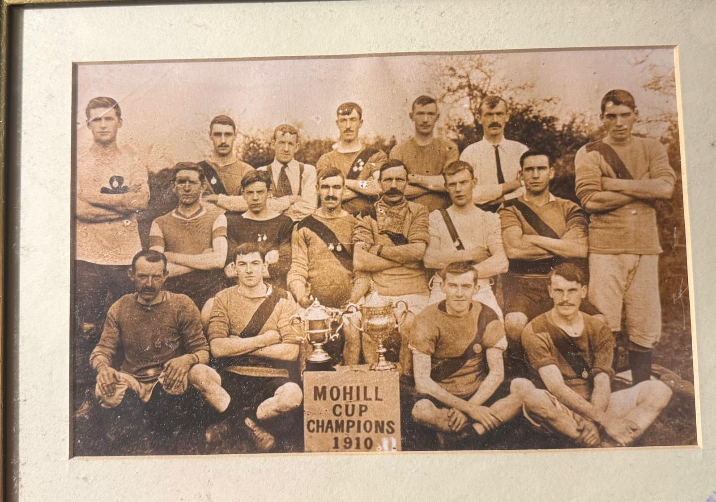
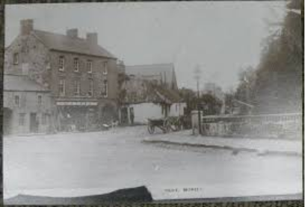
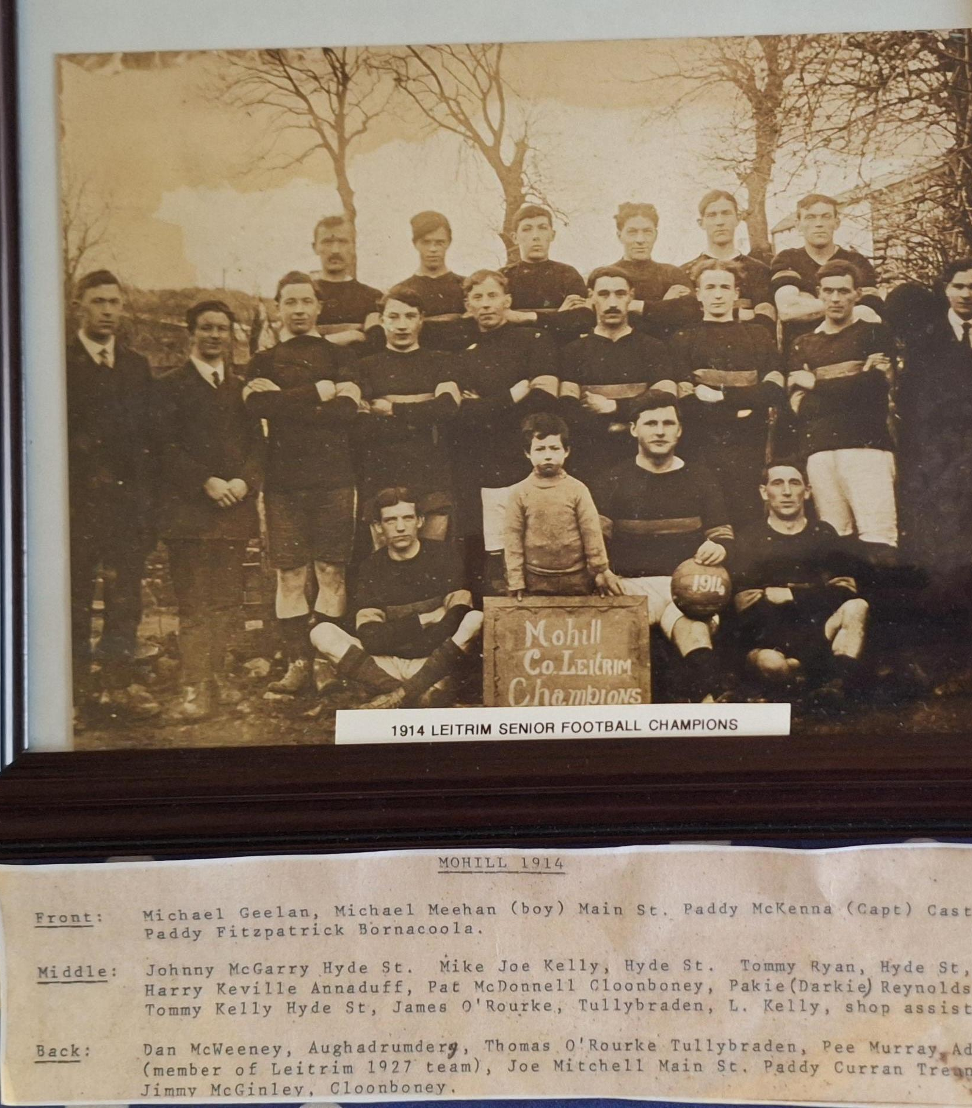
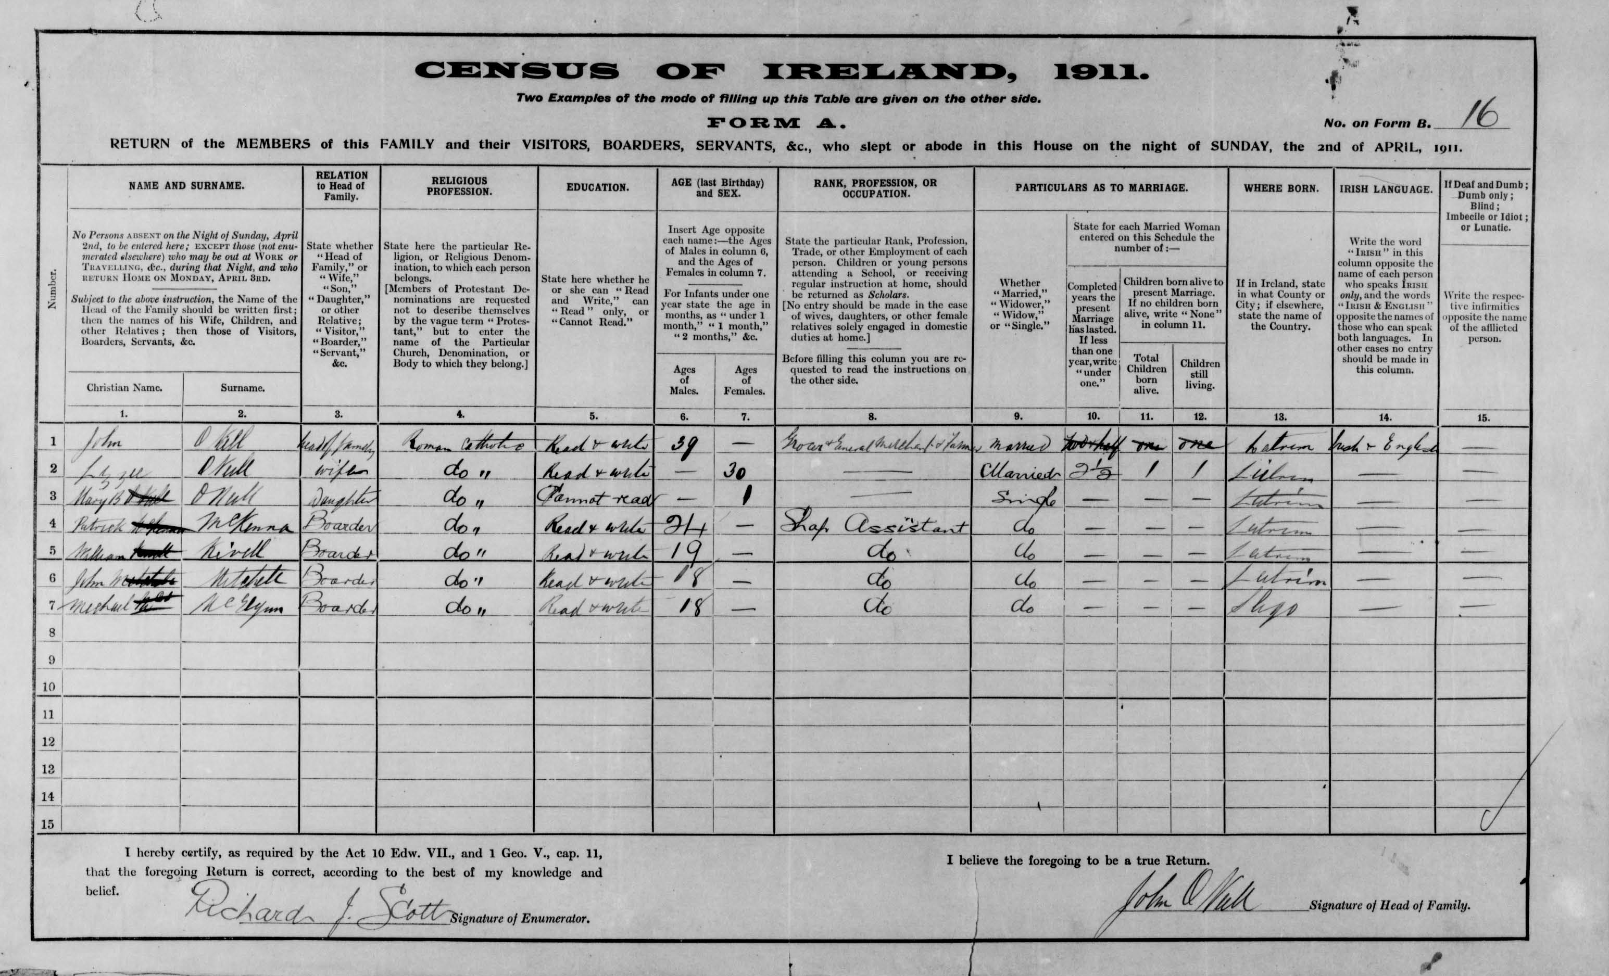
Move to Mohill
The next record of Patrick Mckenna is a picture of him in a Mohill cup champions dated 1910. He is the man standing on the far left of the photograph standing up. (top left corner)
The next record show Patrick as working as a shop assistant to John O'Neill a merchant and grocer on Glebe Street(Bottom right corner)
Patrick is the said to have bought a business premises on castle street from Patrick Maguire after Maguire became bankrupt in 1912[3].
This is place of recidence is later backed up by an image of Patrick, captaining the Mohill County Senior Champions in 1914 where his address is listed as Castle Street, Mohill. (bottom left corner)

Slide 5
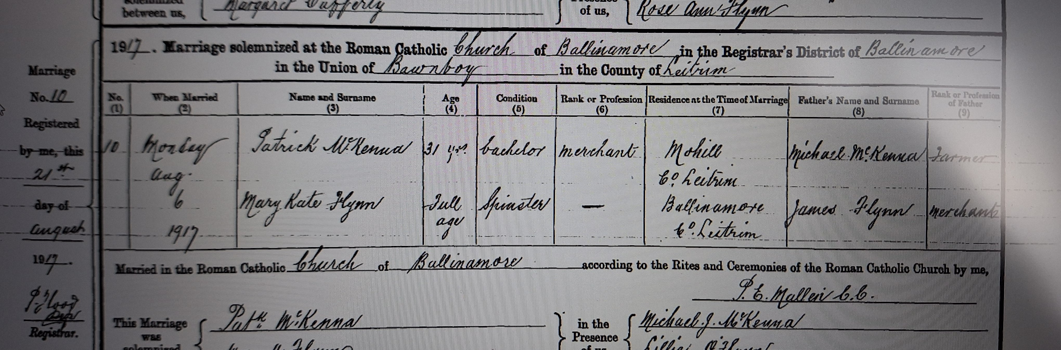
Marriage to Mary Kate Flynn
Patrick Mckenna is set to have started his Mckenna Mercantile business in 1912 and is the listed as a merchant on his wedding certificate[2].
His wedding certificate says that he married Mary Kate Flynn in Ballinamore Catholic Church on Monday, August 6th 1917 with witnesses listed as Patricks brother Micheal. J. Mckenna (Joe) and Mary Kate's sister Lillie O'Flynn. Mary Kate's father James is also documented as being a merchant in Ballinamore. Their marriage was registered by the superintendent's district register on the 21st of August 1917. Patrick was 31 and Mary Kate was "full age" or 21 years and above.[2]

Slide 6
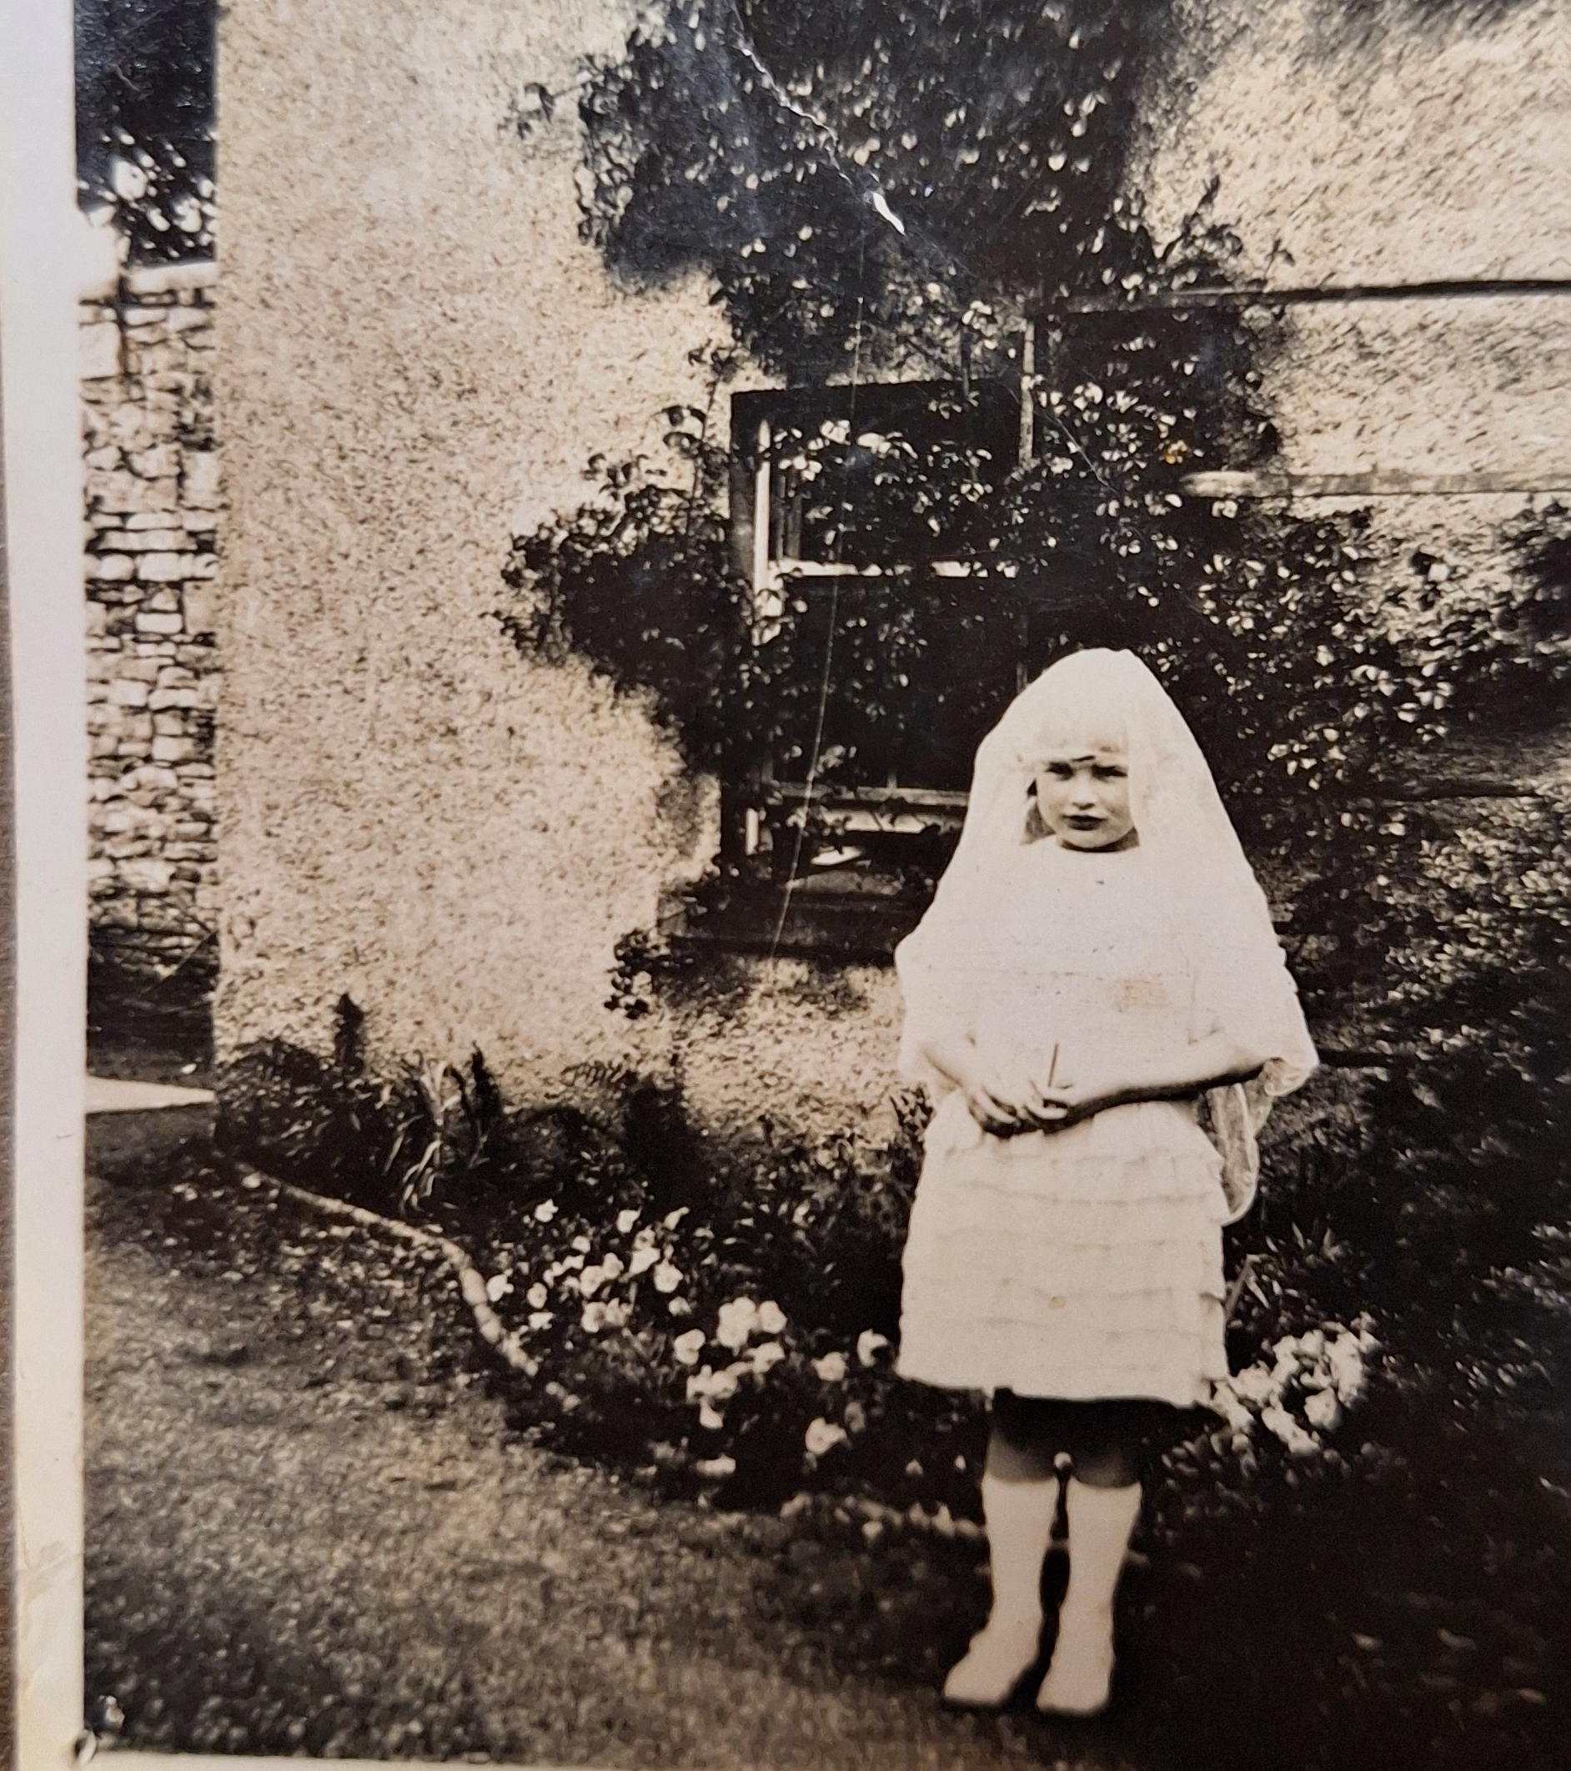
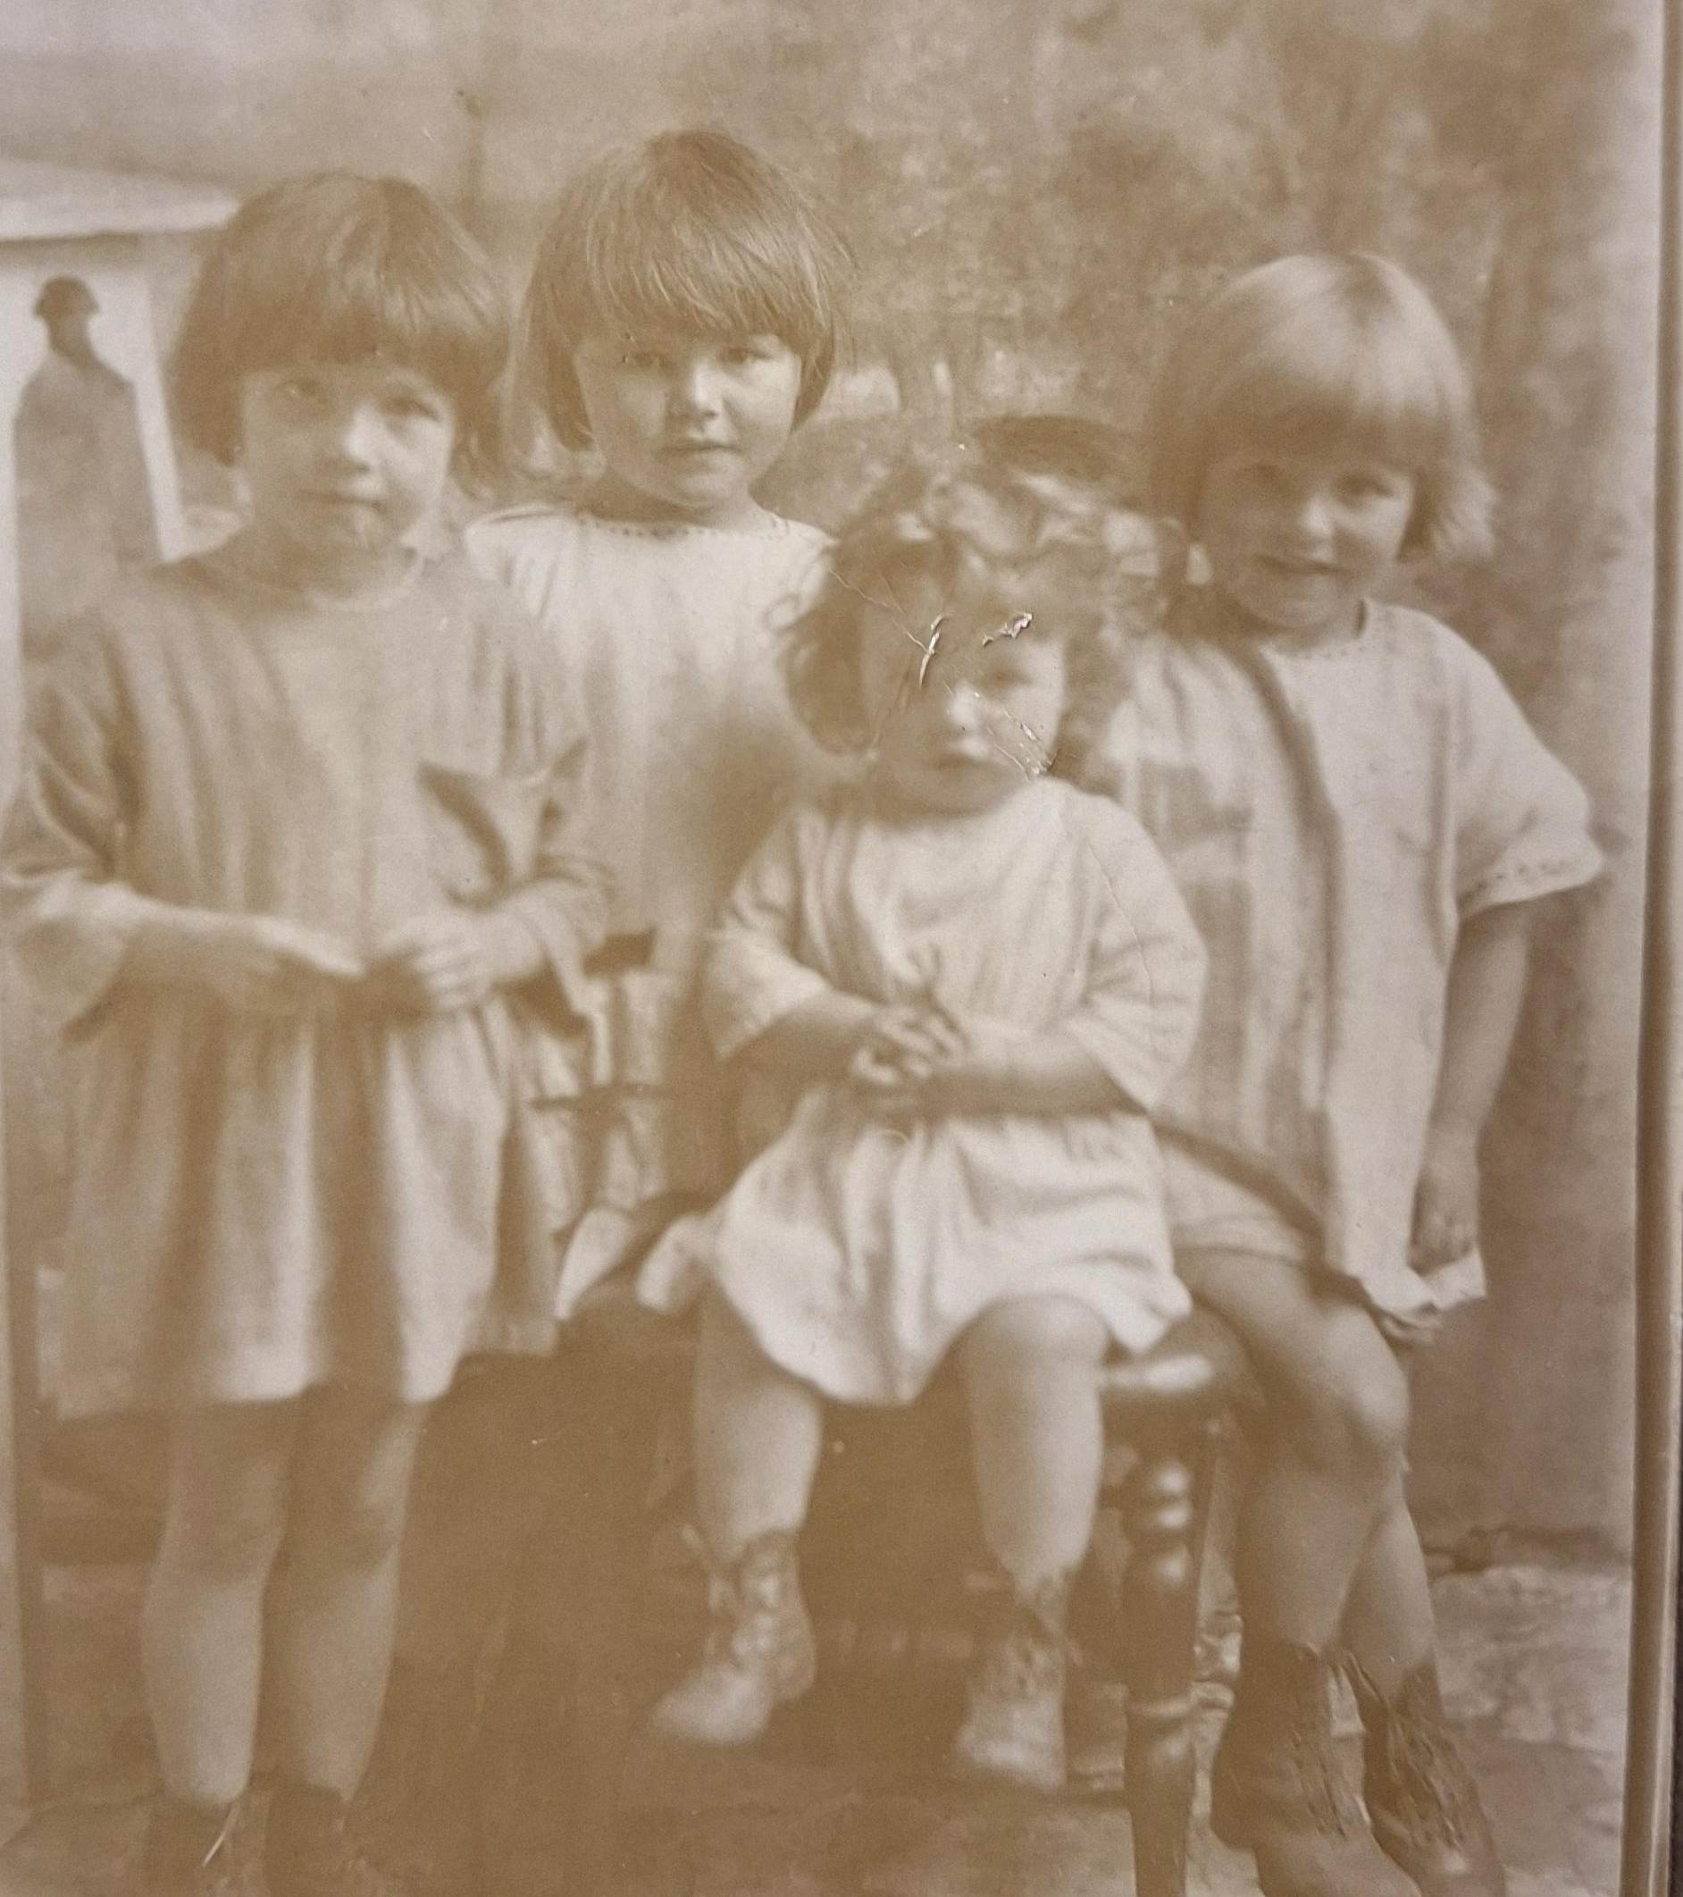
Family Life
Patrick had bought a second piece of property that would after his death become Quinn's hardware store. It is here that Patrick and Mary Kate settled and decided to have a family.
In 1918 Patrick and Mary welcomed their first daughter Moira, their second Noeleen (my great grandmother) in 1919, then Ethna and finally Bettie.
There were some stories shared by Moira to my grand-aunts of her and her sister playing in the yard behind the premises and of her hiding her sister Ethna in a coffin left in the yard for a while!
All 4 sisters had a happy and comfortable childhood before their tragic passing in 1925 following a short illness soon after the birth of her 4th child Bettie[6].

Slide 7
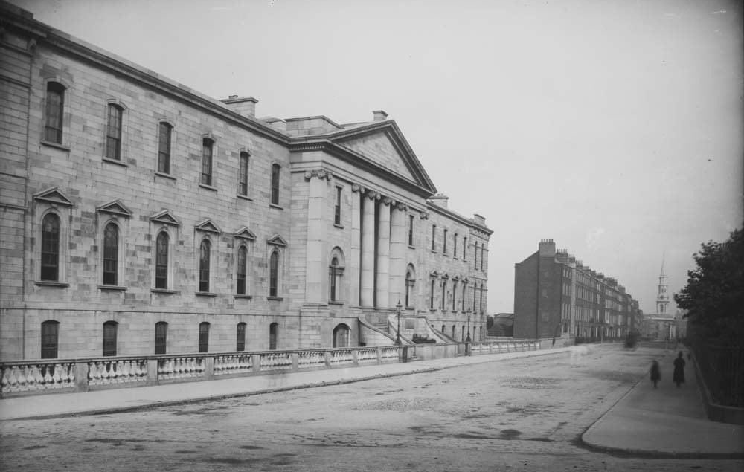
The shooting of Patrick Mckenna
On the night of Saturday April 22nd, 1922 during the pre-civil war tensions in Ireland two men entered Patrick's public on Main street asking for directions to Garradice. Mckenna left his pub to take the two men to the crossroads and show them the road to take, once Mckenna turned around to leave he was fired at twice by one of the men (James Kiernan)[3].
The first shot missed but the second hit him in the shoulder seriously wounding him. Both men fled the scene on bicycles and Patrick was treated at the scene by a local doctor before being moved to the Mater hospital in Dublin where he stayed for 9 weeks.[3]

Slide 8
Why was Patrick Mckenna shot?
A prominent figure in Mohill G.A.A [4][7]Mckenna was liked and respected among the community, however in his first purchase of property on Castle Street Mckenna purchased of a bankrupt man named Patrick Maguire[3]. ( premises pictured on left)
Then in 1920 following the return of Maguires nephew William Bohan from America tensions between the Patrick Mckenna and Charles, William, and Lizzie Reilly, Maguires nephews and niece really began to sour. [3]
There were multiple reports of incidents at the property including a smashed-up window, an attack by William on Mckenna with a horse whip and verbal abuse/ attacks on Mckenna business[3].
All these reasons eventually led to a conspiracy to pay 3 I.R.A soldiers to shoot Mckenna for the sum of £200 between the 3 relatives of Maguire so that Mckenna could be "got out of the way"[3].

Slide 9
What caused James Kiernan, Terence McQuaide, and Francis McNally to become so violent?
All the men were part of a highly active branch of the Longford Irish volunteers
James Kiernan: records show him as being named the Quartermaster of the 5 Battalion in Longford how had a highly active role and probably led to his desensitisation of killing making him a perfect candidate as a gun for hire.[3]
Terence McQuaide: Having emigrated to North America in 1912 McQuaide served in the Canadian Army before deserting on leave to join the Irish Volunteers in 1918 while home on leave, he served in senior roles in his I.R.A company and battalion during the war of Independence and took part in raids, sniping operations, and ambushes. In his pension application McQuaide denied any involvement in the shooting and had many references from past comrades and one letter from Sean Mac Eoin! However, this goes against his own statement following the shooting stating he supplied the revolver something both he and Kiernan agreed in both their statements. Used to giving hard orders in the war McQuaide made the perfect candidate to ask to head up the ambush and attempted murder of Mckenna. [3]

Slide 10
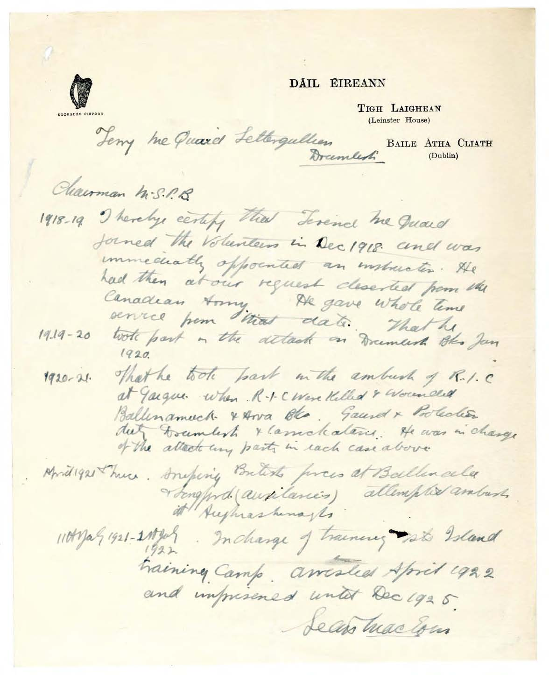
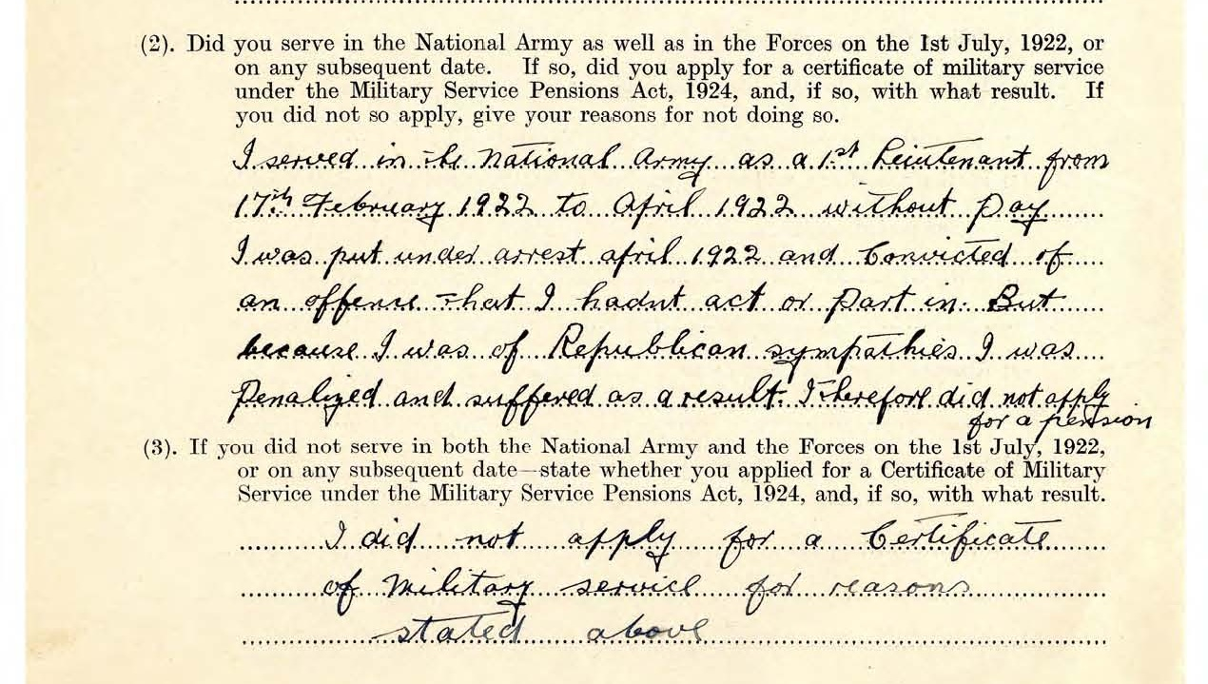
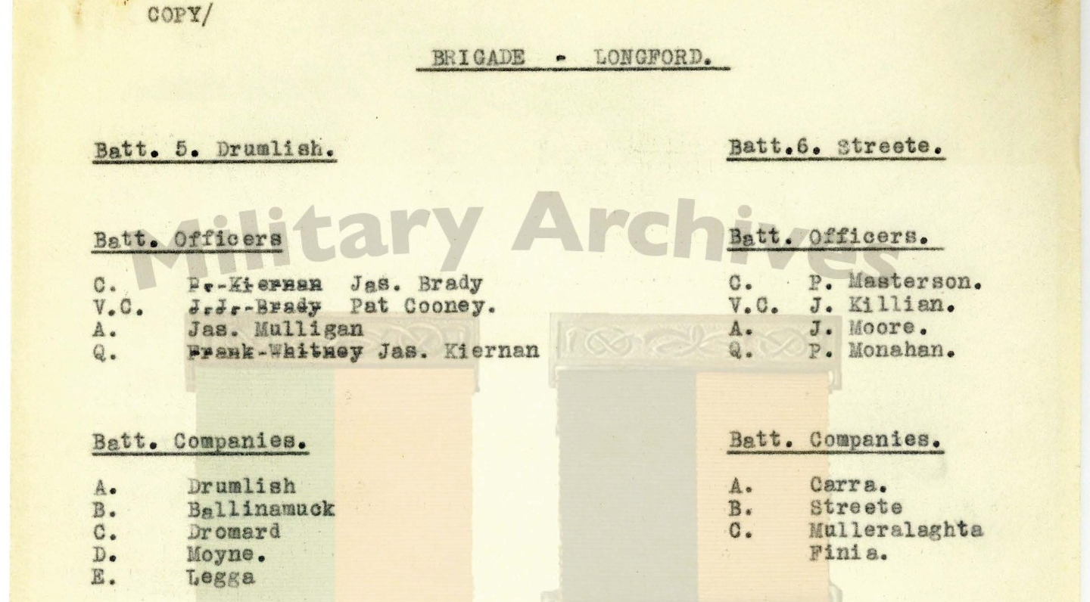
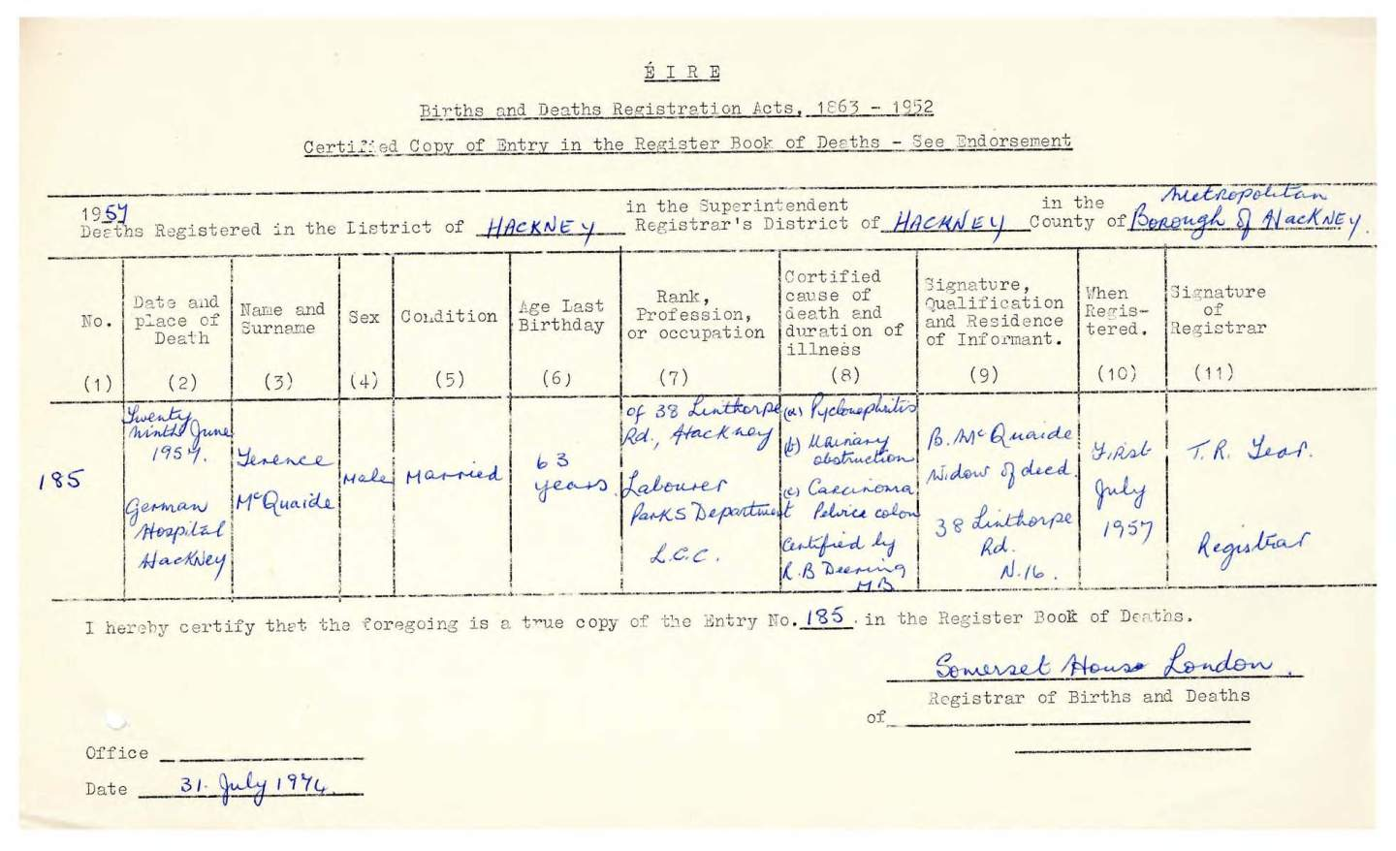
James Kiernan and Terence Mc Quaine pictures including
Recommendation for McQuaine to receive a pension from Sean Mac Eoin on Leinster house paper.(left)
McQuaines death certificate. (bottom right)
Kiernan register on documents as Quartermaster of the 5 battalion(middle right) .McQuaines pension application in which he claims he was wrongly convicted(top right)

Slide 11
What caused James Kiernan, Terence McQuaide, and Francis McNally to become so violent?
Francis McNally: Francis McNally stated that he joined the Volunteers in 1917 and was involved in arms raids, road blocking, despatch work, guarding prisoners, attacks on RIC barracks, as well as fights with the Black and Tans. He too later joined the National Army. [3]
Francis McNally stated on his file that he was released from prison in 1926. His military service pension application was unsuccessful. However, he did receive a Service (1917-1921) Medal without Bar, and later a special allowance under the Army Pensions Acts. He died in Longford County Hospital on 11 March 1965 [3]. He was an acquaintance of McQuaines from the war and so became part of the conspiracy for a cut of te £200 offered [3]

Slide 12
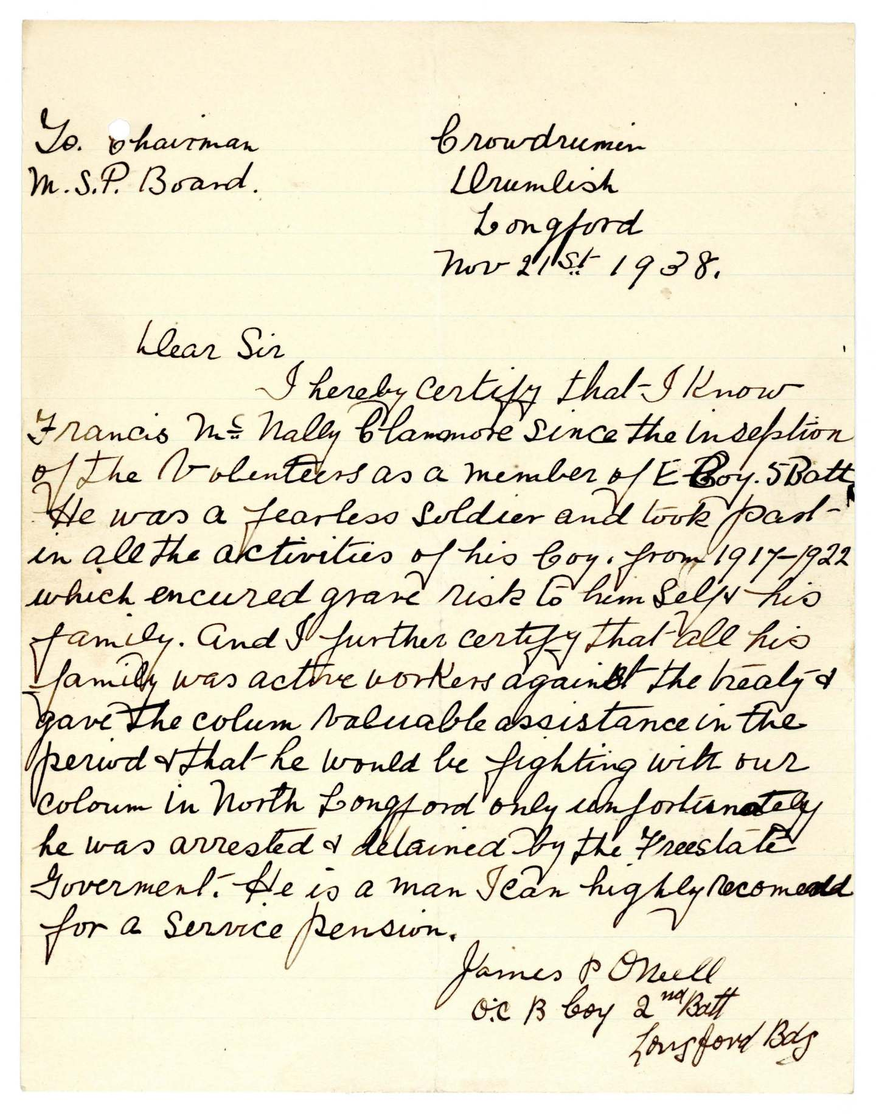
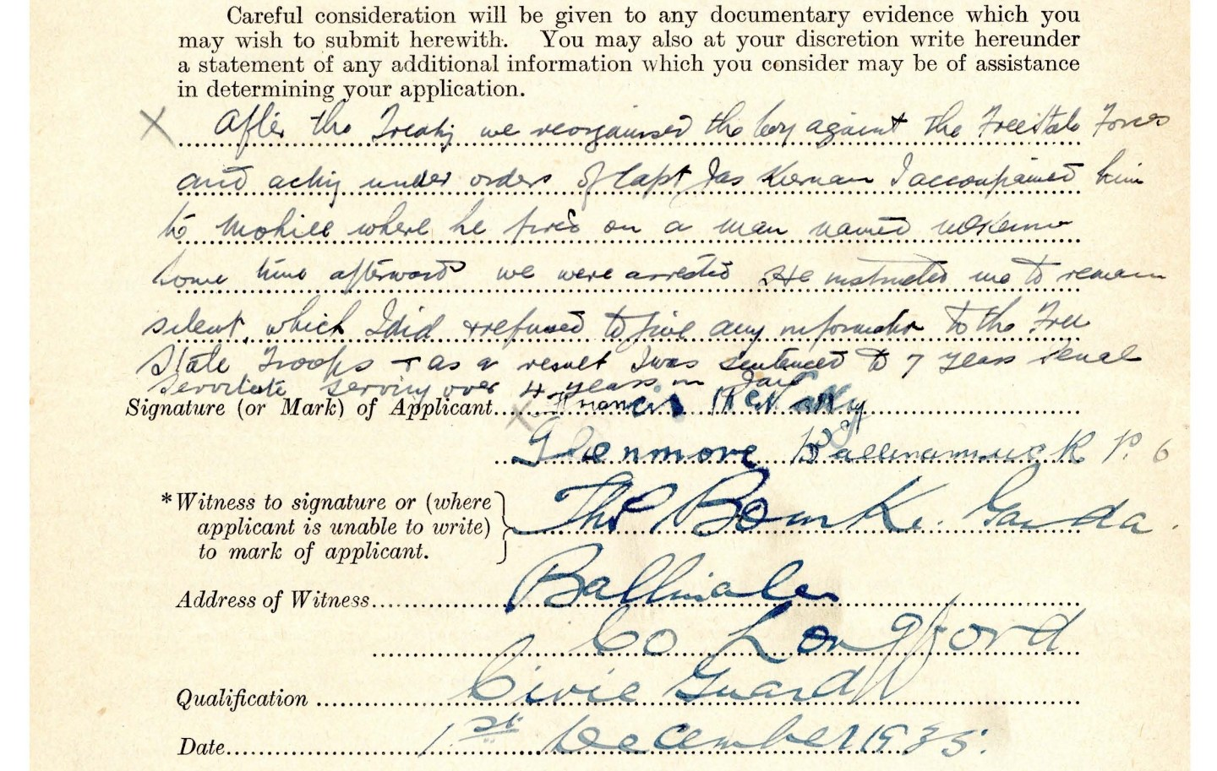
Francis McNally pictures
Including a recommendation from James O'Neill for him to receive and army pension.(right)
An extract from McNally army pension application and a recommendation at the end of the paper(left)

Slide 13
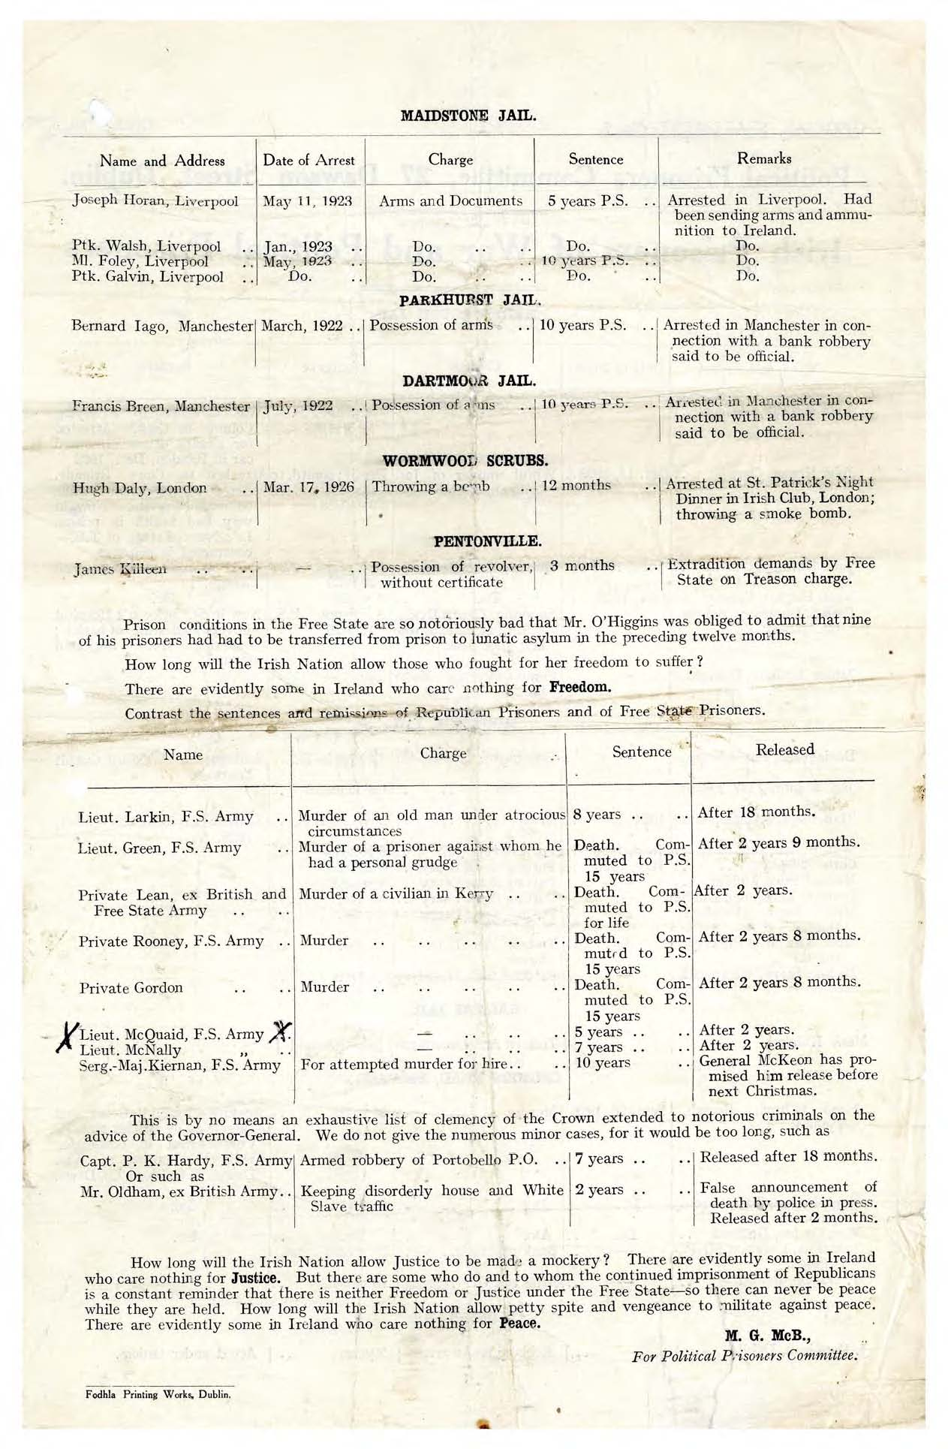
Results of the shooting
McKenna remained in the Mater hospital until late June discharging right at the beginning of the Civil War in Dublin.
In the week following the shooting all three I.R.A men James Kiernan (the gunman), Terrence McQuaide (who provided the gun)and Francis McNally who accompanied James Kiernan on the night. William Bohan was also arrested however there is no mention of Charles Bohan or of Lizzie Reilly in the arrests [3]
Due to the outbreak of the civil war the trial was delayed until November 1923 it was at this trial Kierna was sentenced to 10 years penal servitude, McNally 7 years and McQuaide 5 years. William Bohan was sentenced to 3 months imprisonment with hard labour.[3]

Slide 14
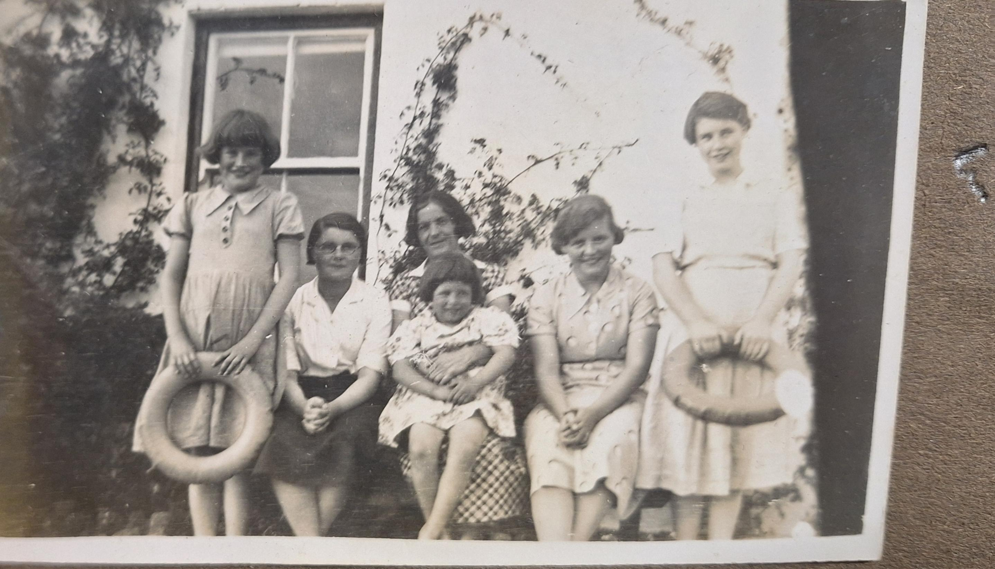
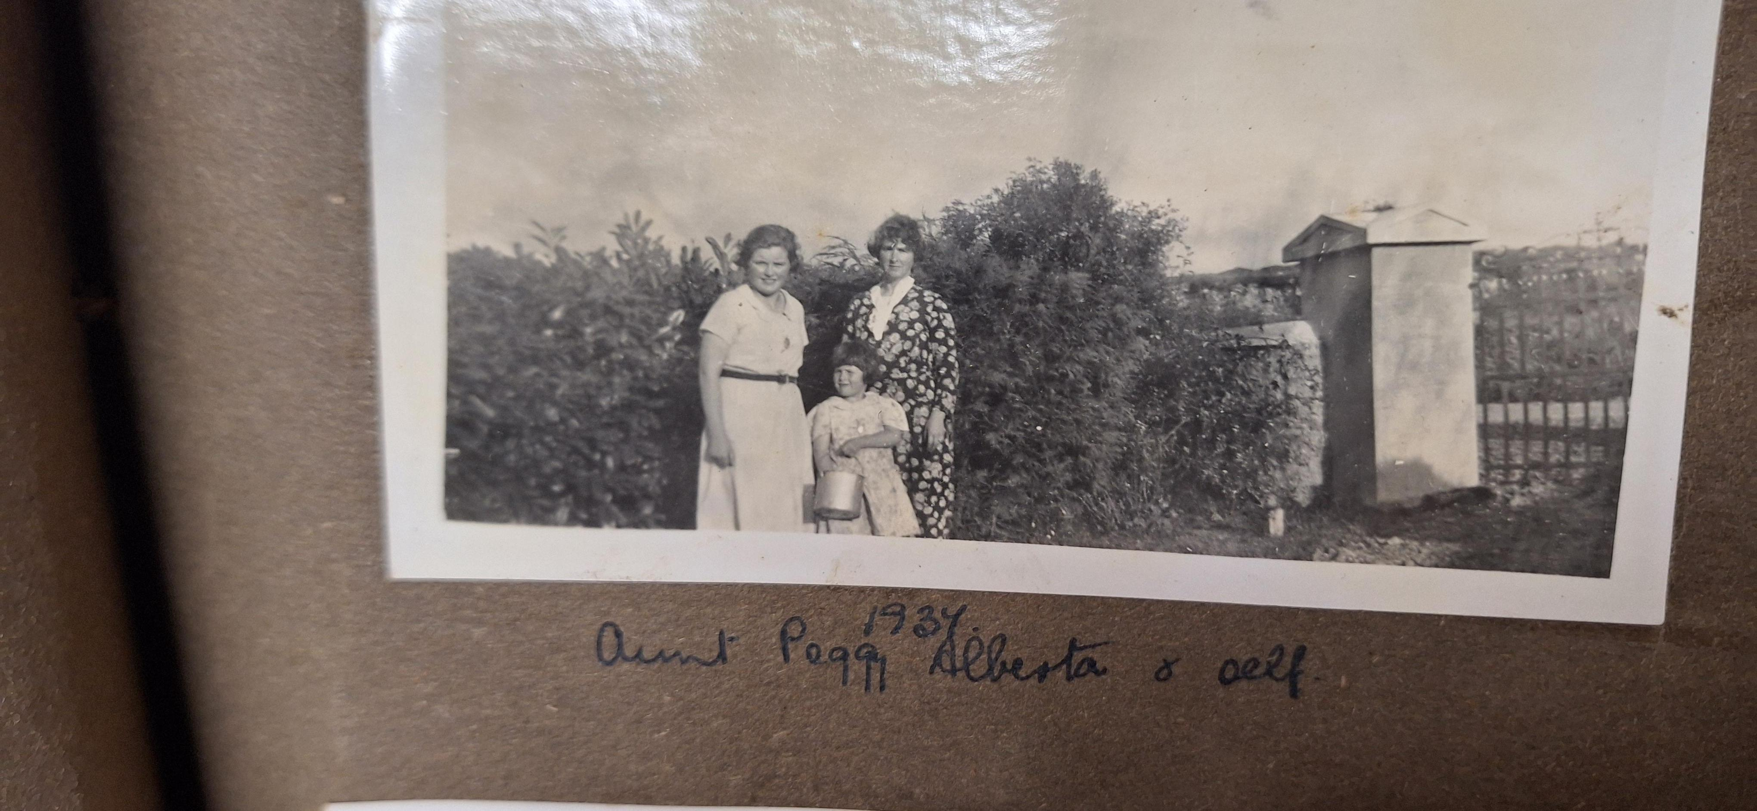
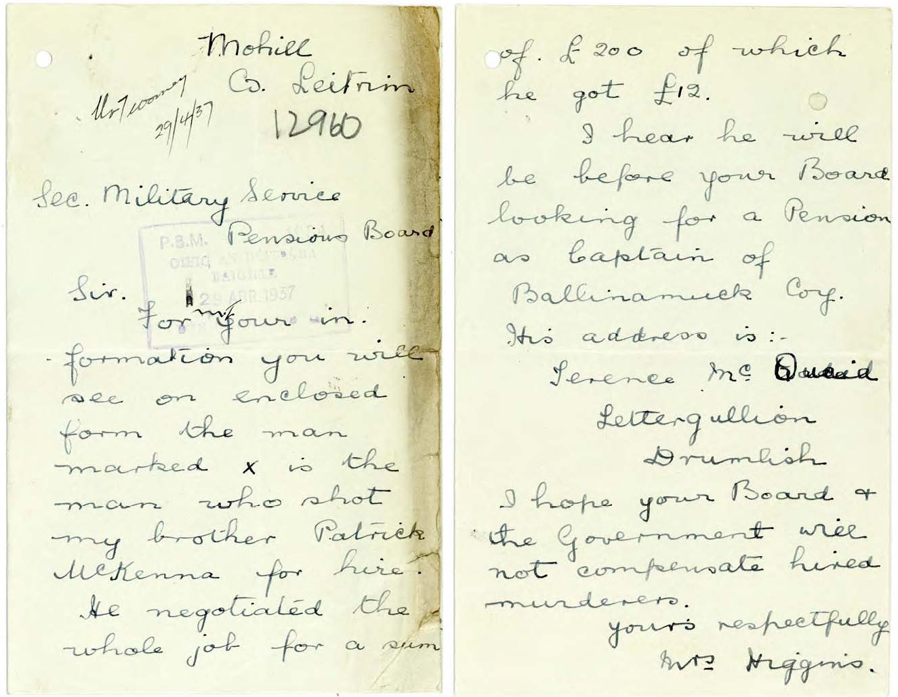
Life following the shooting
Following the shooting Mckenna stayed in business but was changed by the shooting and said to have walked with a limp following the shooting.
In 1925, his wife Mary Kate sadly passed away due to a sickness brought on by the birth of their last daughter Bettie.
Due to the time in which Patrick McKenna lived in following his wife death his children were sent out to grow up with relatives for fear they could go to an orphanage otherwise. Patrick was luckily able to get them living with a female relative or married couple each something his daughters describe as feeling incredibly lucky about. Patrick was also able to pay to send all of his four daughters to boarding school in the Ursuline convent in Sligo where they were all able to receive a full education. (pictured with Aunt Peggy on the two pictures on top row)
There was quite a lot of animosity in the family after the shooting with Tessie Higgins( Teresea) writing to the Longford Army pension board to encourage them to refuse McQuaide's pension application, two years after Patricks passing (Bottom left and right)
Patrick lived for thirteen years following the shooting and eventually died in January 1935 from Endocarditis. Possibly a condition caused by the movement of shrapnel slowly over time from the shoulder towards the heart from his earlier gunshot wound [4].

Slide 15
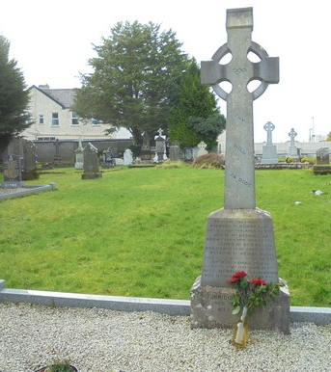
The Death of Patrick Mckenna
Patrick Mckenna died on January 10th, 1935, aged 47 from endocarditis.
My great-grandmother was sixteen by the time she lost both of her parents. Despite not living with their father anymore all four daughters retained a strong relationship with their father, and he would often travel to Gortletteragh and Ballinamore to visit them.
The Longford leader reported a large attendance at his funeral and burial in Mohill which was attended by all four of his daughters[3]

Slide 16
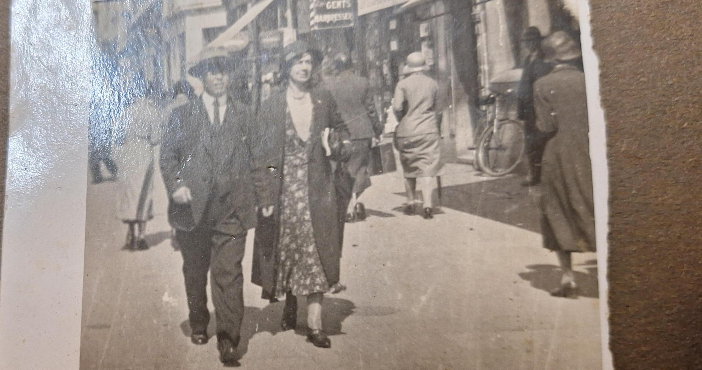
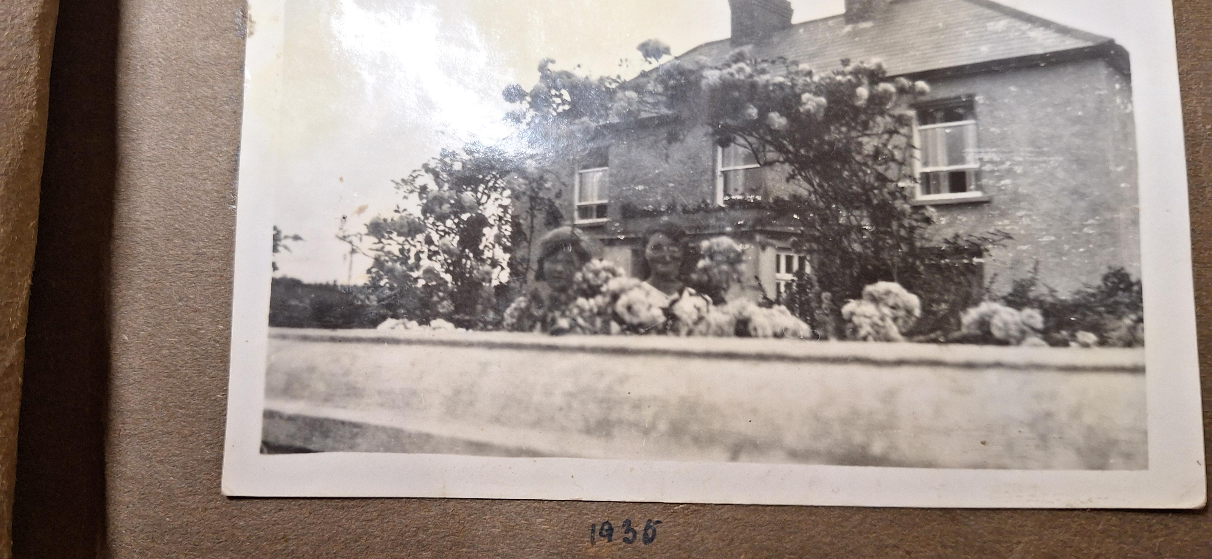
McKenna's daughters
Following their mothers passing Moira, Noeleen, Ethna and Bettie were all sent out to grow up different aunts and uncles for fear of being put into care otherwise by simply staying with their father.
Moira the eldest who would have been around 7 at the time moved out to Peggy and Patrick Kearney in Breanross, Gortletteragh
Noeleen(my great-grandmother) moved to Tessie (Tereasa) and Dominic Higgins in Anskert, Gortletteragh. (house pictured in photo) (coupled pictured on top left)
Ethna moved to Uncle Joe (Michael J Mckenna) and his wife Marie-Anne in Farnaght.
Bettie moved to Ballinmore with one of Mary Kate's sister who had also recently given birth to a baby.

Slide 17
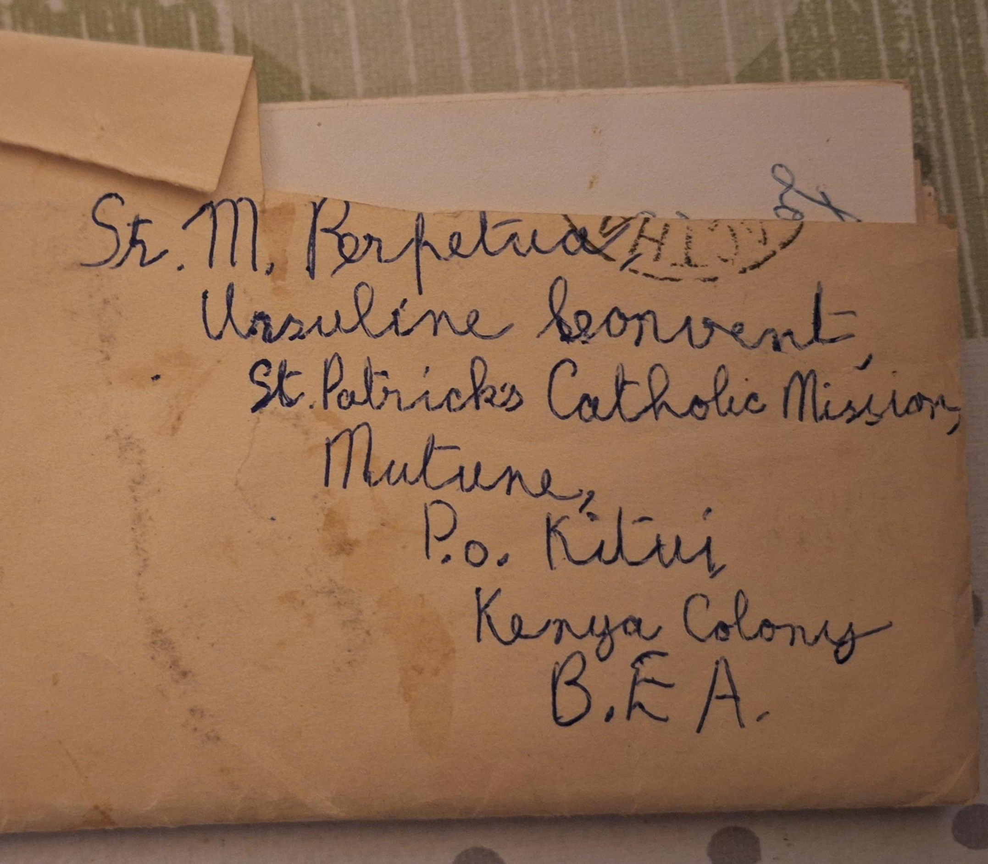
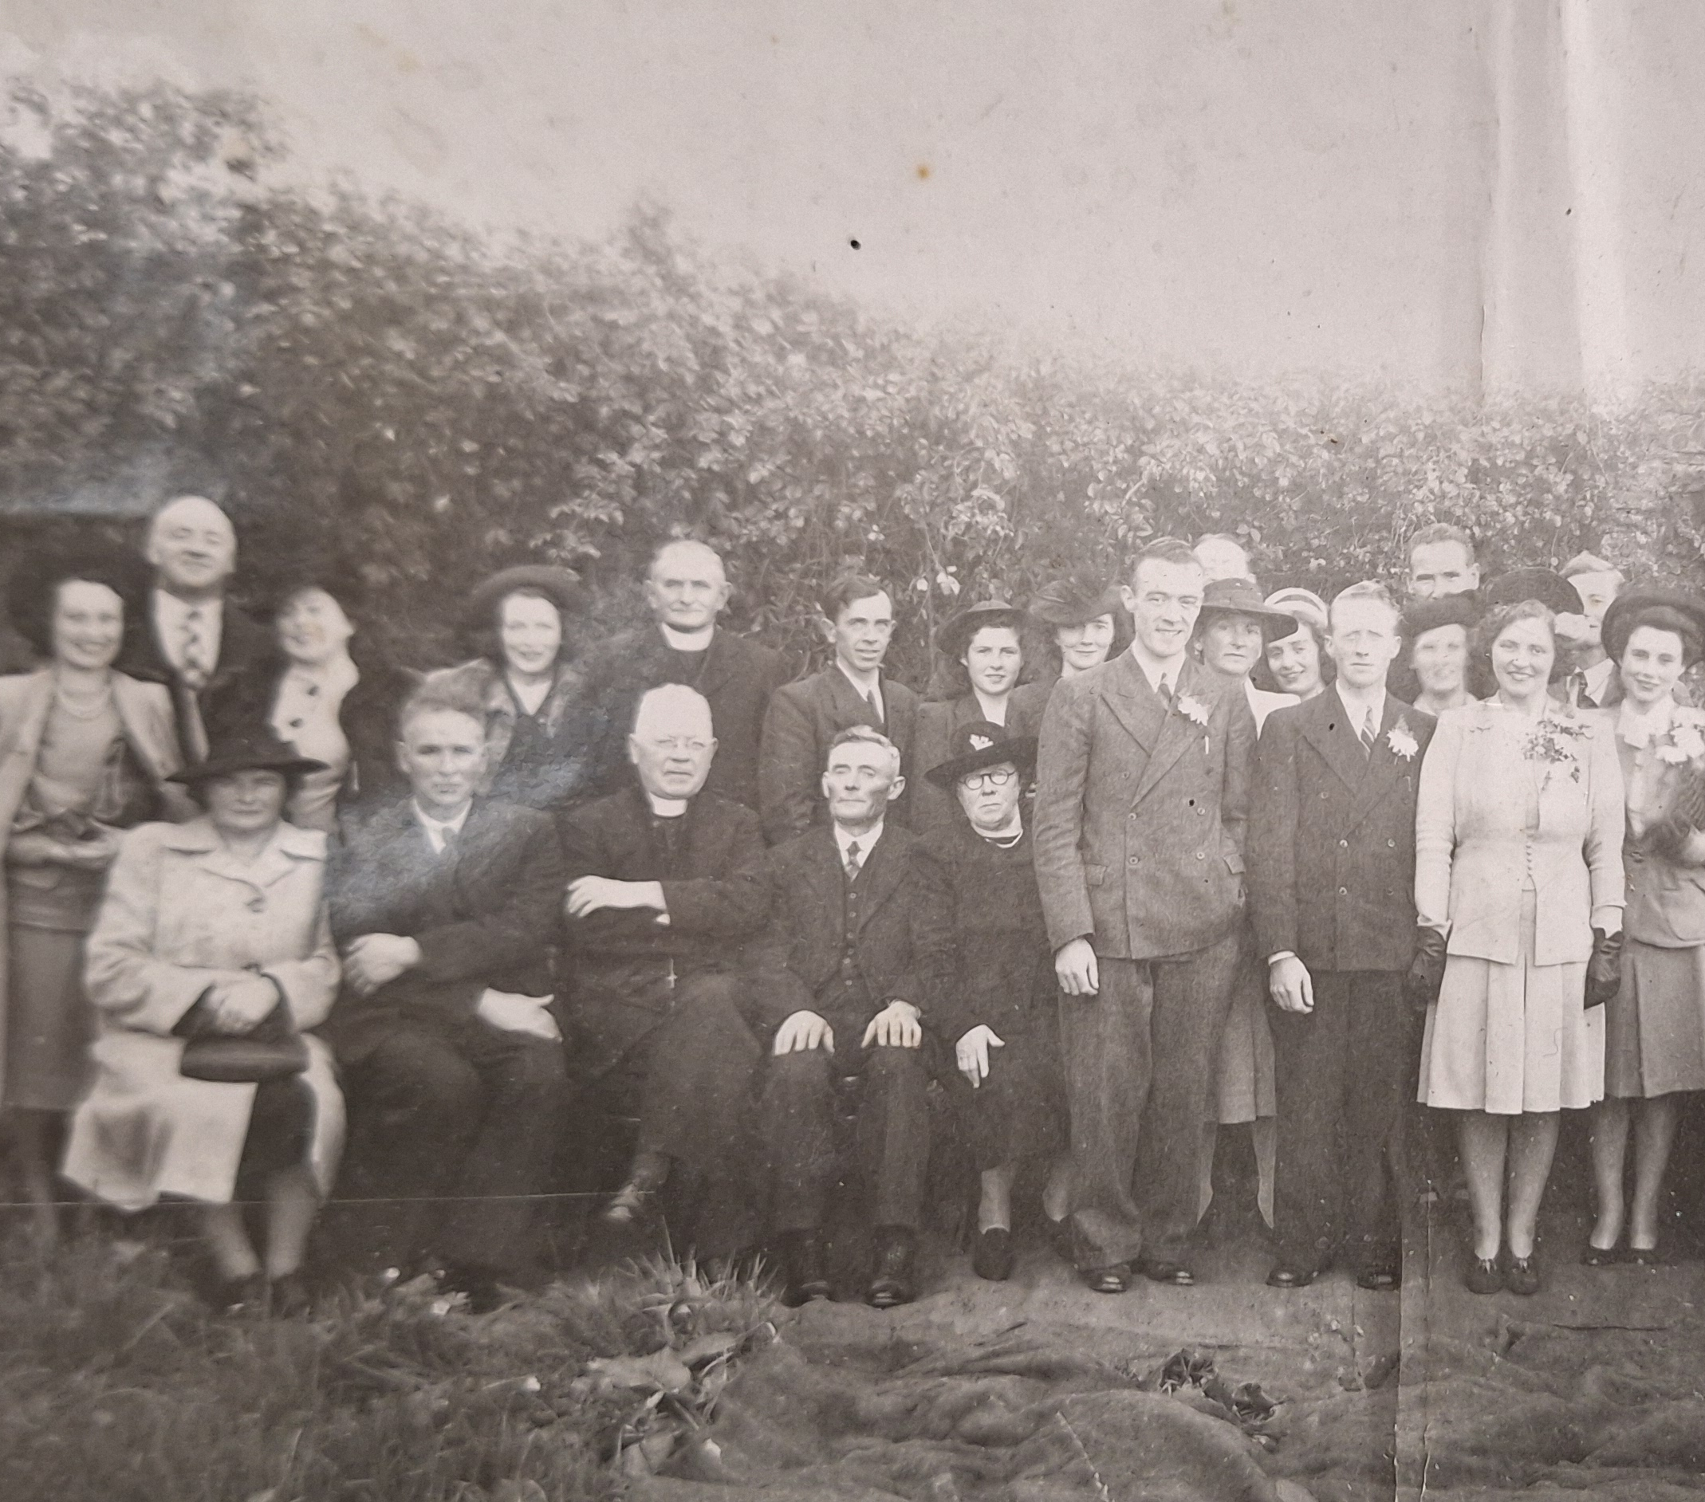
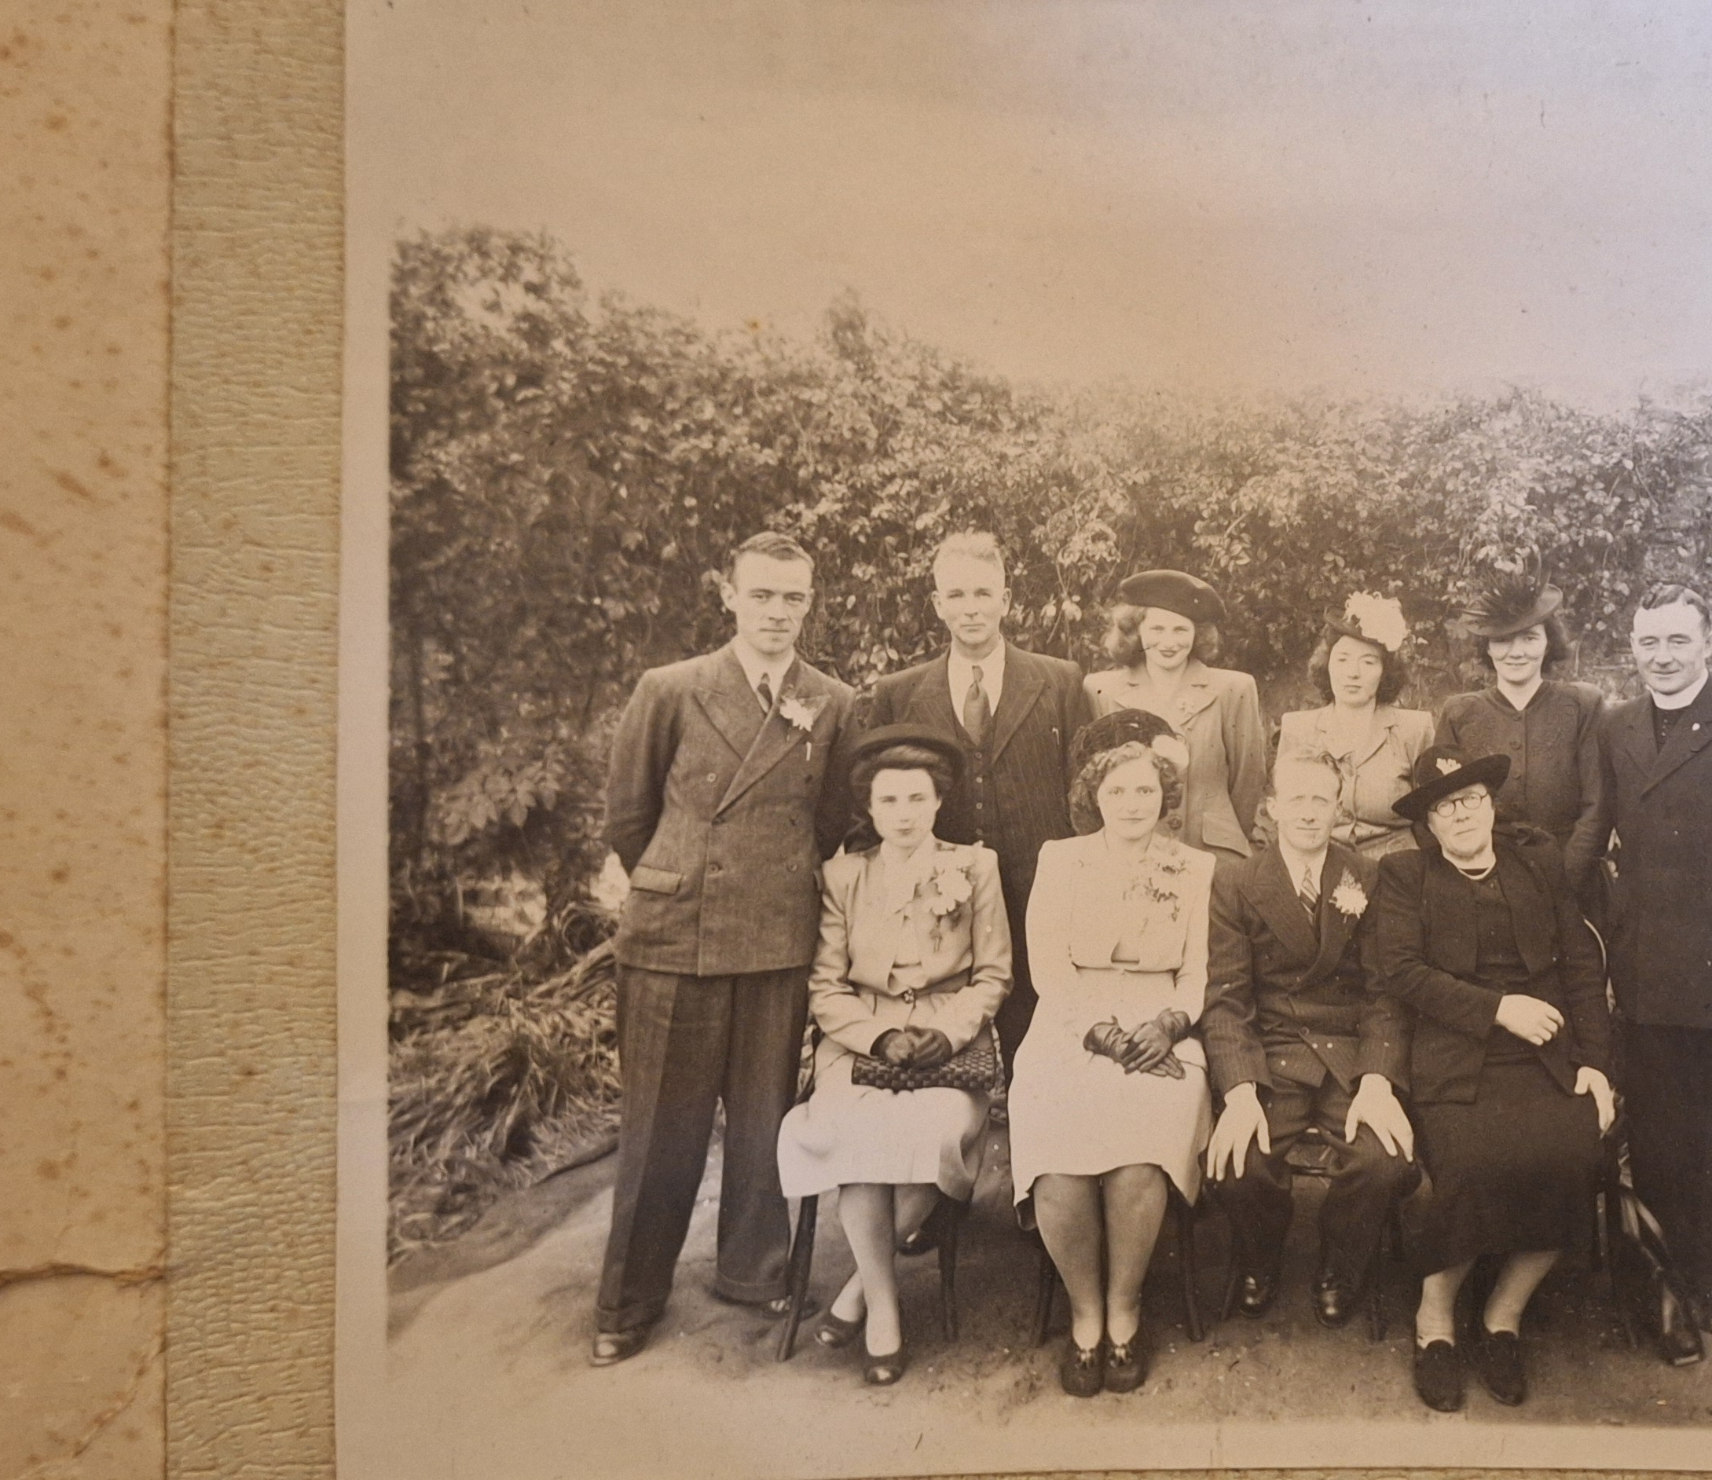
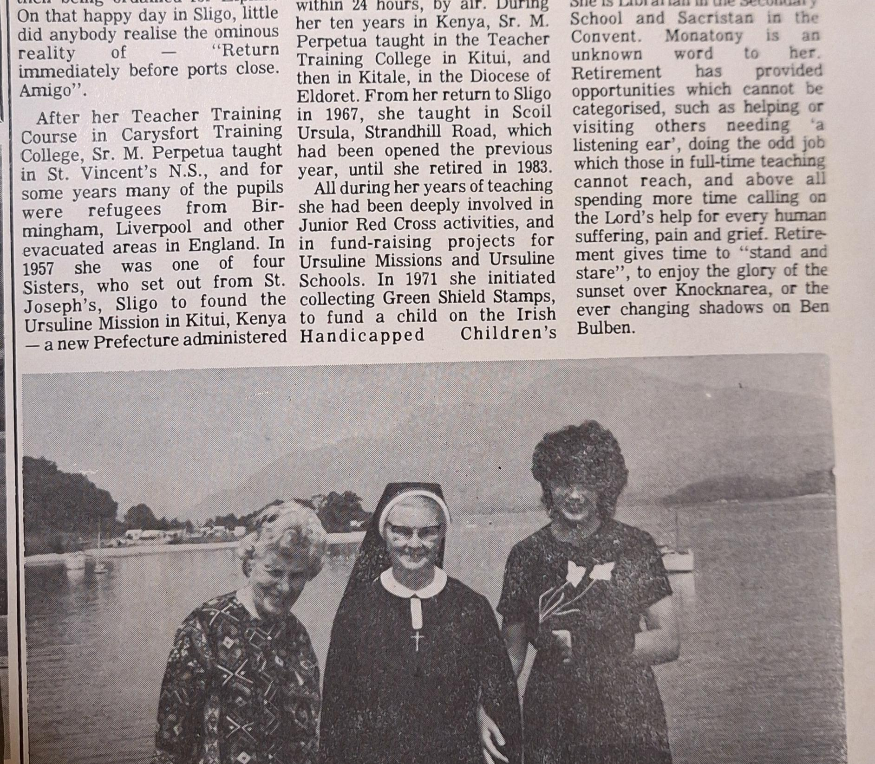
How did McKenna's four daughter grow up?
All four McKenna girls attended the Ursuline convent school in Sligo where they received a full education.
Despite being split up quite young all four sisters kept a strong bond and would meet often. My great-Grandmother Noeleen kept a photo album with pictures showing her on trips to the Isle of Man and England when she was growing up. It also showed pictures of her at Boarding school and with her three sisters and cousins as seen on the side.
His daughter Moira then joined the Ursuline convent where she was one of the first Ursuline nuns to travel to Kenya. [5]
Bettie emigrated to Vancouver, Noeleen became a domestic science teacher in Mohill and Kesh and Ethna became a nurse in Peaumont hospital Dublin before moving to England with her husband.

Slide 18
Sources
[1] https://nationalarchives.ie/collections/search-the-census/census-record/#census_year=1901&surname__icontains=mckenna&firstname__icontains=patrick&county=Leitrim&sex=M&id=6899595
[2] https://www.irishgenealogy.ie/files/civil/marriage_returns/marriages_1917/09754/5539976.pdf
[3] https://militarypensions.wordpress.com/2026/02/09/a-vendetta-in-mohill-the-1922-shooting-of-patrick-mckenna
[4] https://europepmc.org/article/pmc/pmc8957050
[5] https://www.independent.ie/regionals/sligo/news/nuns-diary-recalls-epic-journey-to-set-up-african-mission/27571982.html
[6]https://irishgraveyards.ie/plot?plotno=251&yardid=307&section=Old

