Slide 1
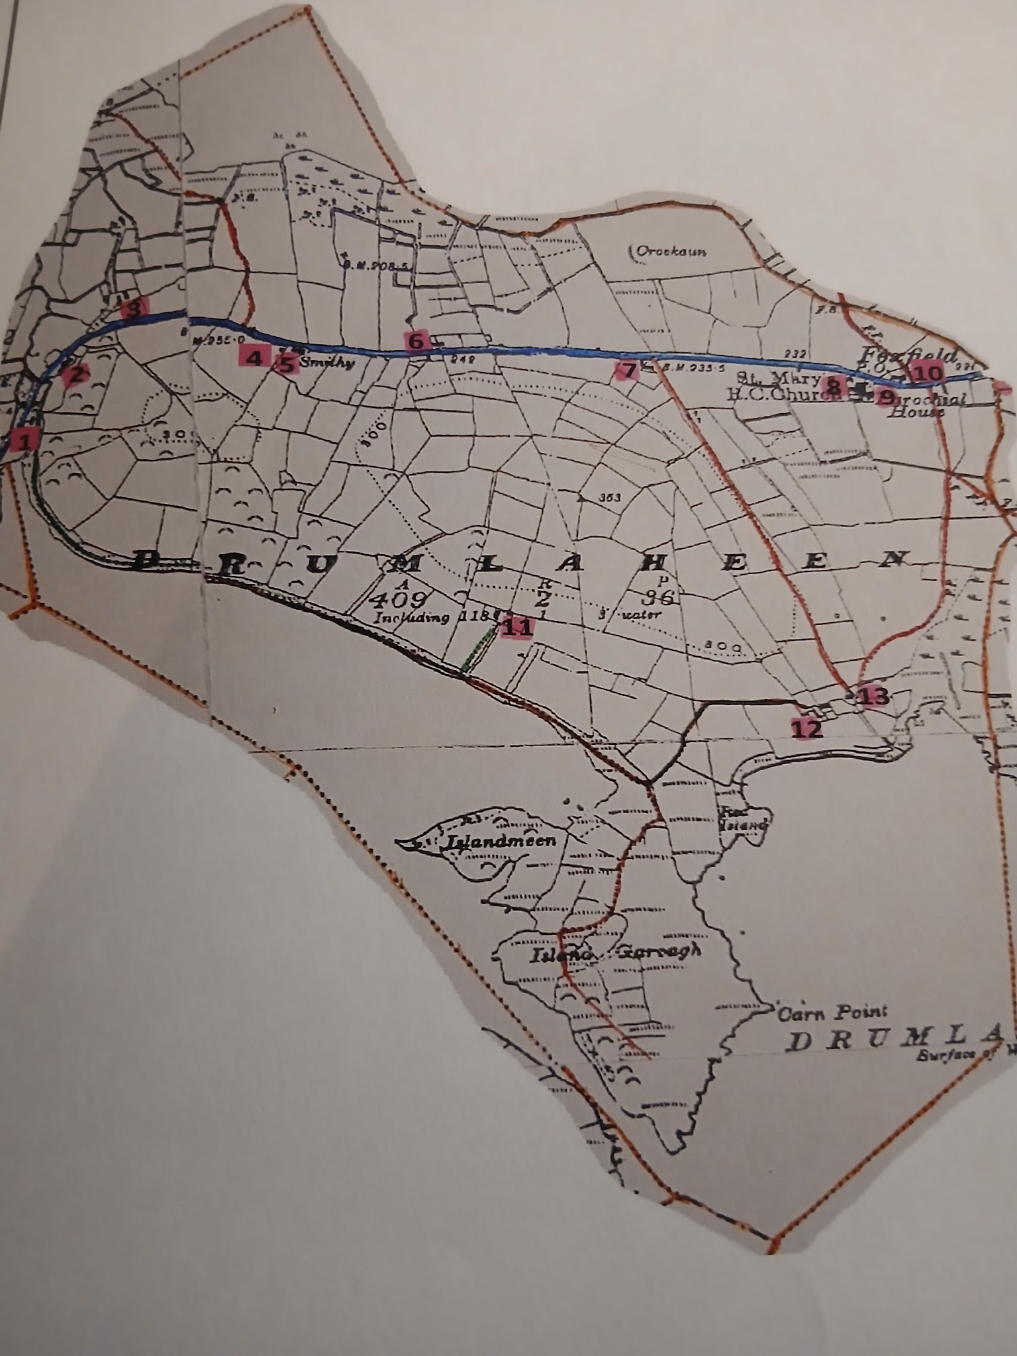
Drumlaheen: Where My Family Calls Home
By Luke Mullins

Slide 2
Index
Introduction
Meaning of Drumlaheen
Drawing of Drumlaheen Today
St Mary’s Catholic Church
Geography of Drumlaheen
My ancestors
Family in the Applotments 1833
Family in Griffith’s evaluation 1857
Family between valuation and census
Family in 1901 Census
Family in 1911 Census
Family since 1911 Census
Photos
Reflection
Sources

Slide 3
Introduction
I decided to do my young historian project on my parish of Drumlaheen as my family has lived here for nearly two hundred years, with my Granny still living in the same house that my great great great great grandfather Owen O’ Beirne built in the early 1800’s. Another reason why I chose to do this project is because my Granny has great knowledge of her relatives going back as far as my great great great grandfather Charles Byrne, who was the son of Owen. My granny will be a key source of most of the information for this project. I also just really wanted to find out about my ancestors before I had heard we were participating in the Young Historian project, so this topic was a very easy and exciting topic for me to choose

Slide 4
The Origins of the Name Drumlaheen
From my research, I have found that the Irish for Drumlaheen is Droim Leathchaoin. However, there is no 1 definitive answer for the true meaning of Drumlaheen. Droim translates from Irish into English as ridge, and leath translates to half or side. Putting these two together, and the English for Drumlaheen generally translates to one of the following: “Ridge of the little wet spot”, “Ridge of the little grey place”, and “Ridge of the smooth sides”. In my opinion, Ridge of the smooth sides would best describe the geography of Drumlaheen as a townland, as nowadays the road R209 splits the land up, with one side being high up and the other being low lying with St. John’s lake. The landscape of Drumlaheen is very similar to a drumlin, hence why Droim was used to describe Drumlaheen many moons ago . My house is on the high side of the townland with my Granny’s house down in a hollow on the low side.

Slide 5
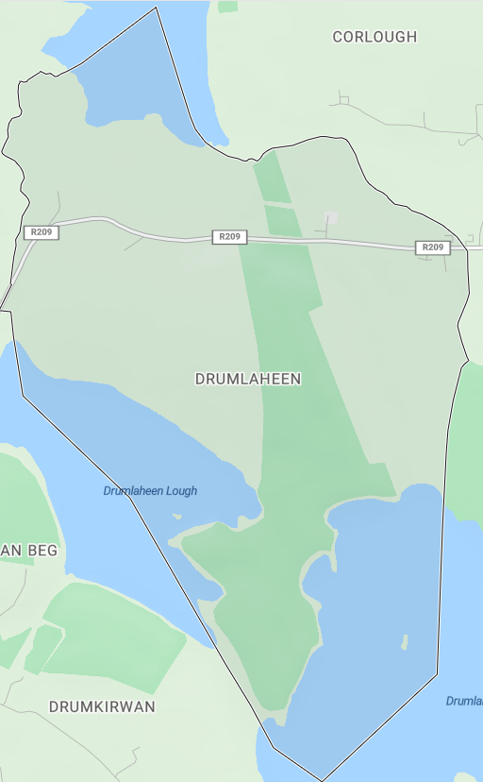
A Modern Map of Drumlaheen

Slide 6
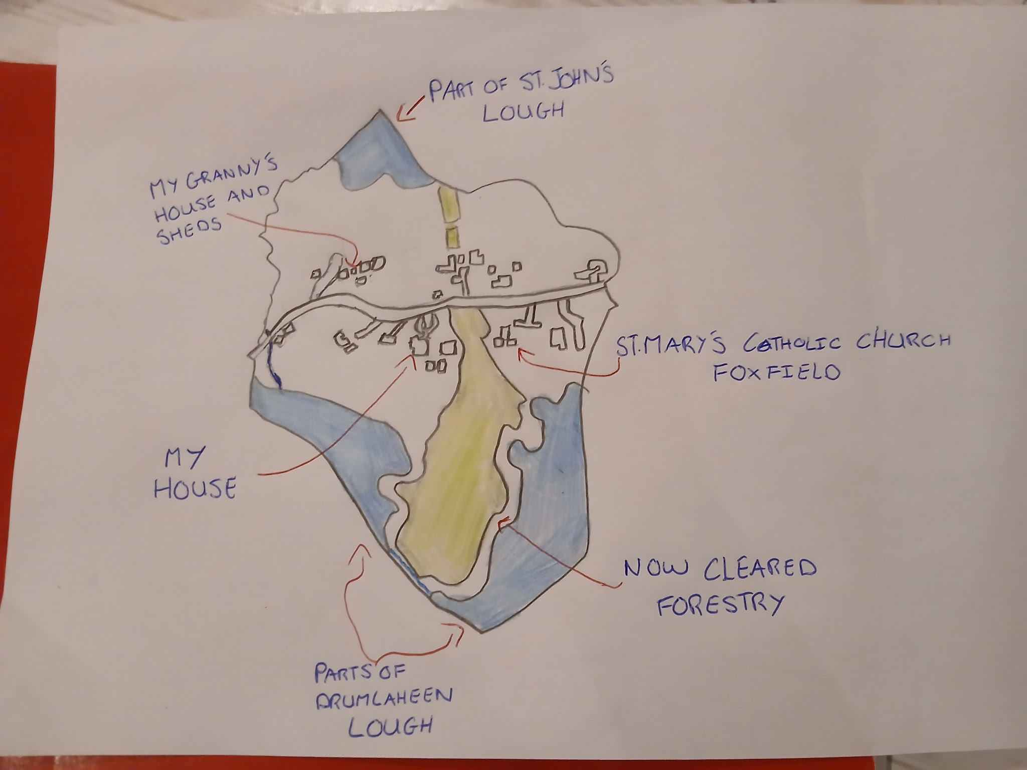
My drawing of Drumlaheen Today
Here is my drawing of Drumlaheen today. In total, there are 12 houses in the parish today. My granny Gretta’s house is one of them and also my dad’s sheds, who we inherited from Gretta’s brother Brendan Beirne who lived at the house until he passed away in 2023. My house is on the land bought by my great grandfather Charles Beirne. My uncle also lives on the land, and he lives in the house to the right of mine in the drawing. St. Mary’s Catholic Church Foxfield, the only catholic church in Fenagh in use at the moment, is also in Drumlaheen. Drumlaheen lough is situated behind my house, while the land at my Granny’s meets St.Johns Lake.

Slide 7
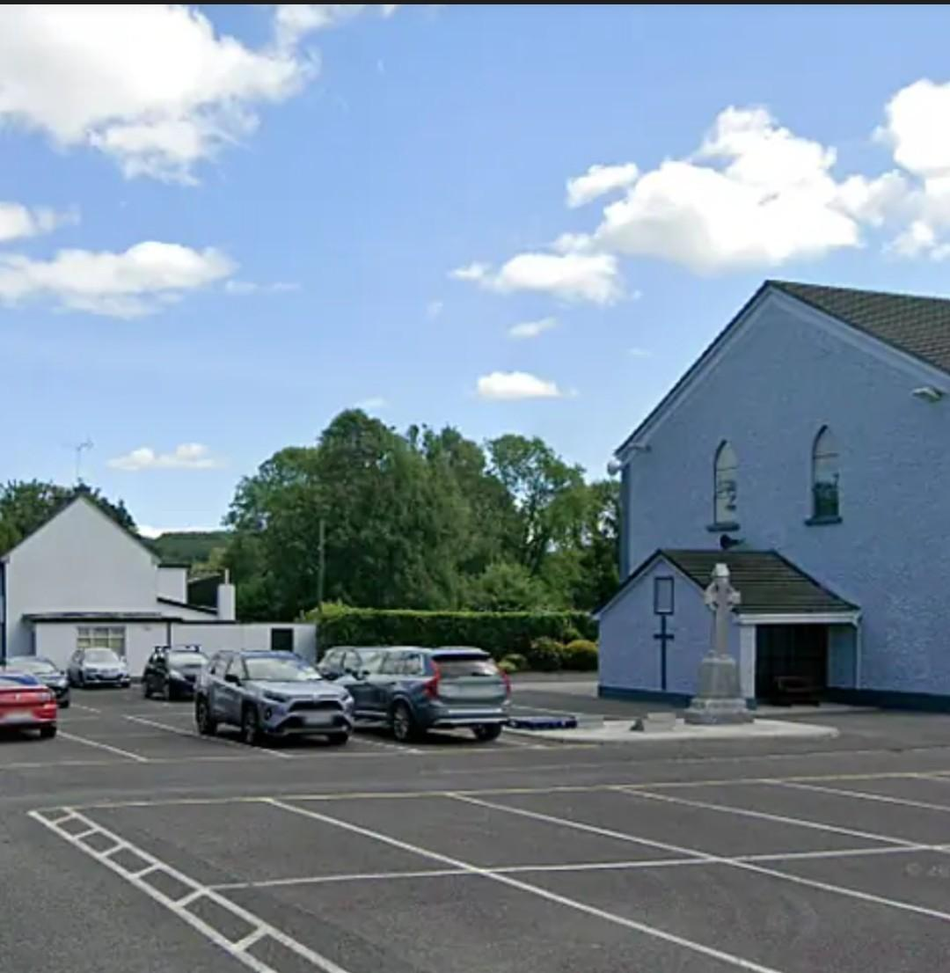
St. Mary’s Catholic Church Foxfield
St. Mary’s Catholic Church Foxfield, which is located in my parish of Drumlaheen, was formally dedicated and opened on the 9th of October 1879, by Rev. Dr. Woodlock, who was the bishop of Ardagh and Clonmacnoise at the time. The church is a staple of the parish of Fenagh, with mass taking place every Sunday morning at half 11.. Fenagh National School has its communions in the Church every year with confirmations being every second year. The church is the only Catholic church operating in Fenagh currently, and Fr. Nigel Charles is the current parish priest. Mass takes places on Christmas Day every year. Many members of my family have been married in the Church, with my Mam and my granny being the last 2 to do so.

Slide 8
The Landscape of Drumlaheen
The highest point in Drumlaheen is around 200 metres above sea level, with the lowest point being around 50 metres.
Drumlaheen is part of the Irish Drumlin belt, which was formed during the last ice age, which means there are plenty of low-lying, rounded glacial hills and hollows.
The landscape of Drumlaheen is mainly limestone and shale, which dense, clay-rich glacial tilt that often leads to poor soil drainage.
The environment around Drumlaheen in made up of grasslands that are difficult to drain in most places.

Slide 9
My direct family ancestors in Drumlaheen
Here is a list of my direct ancestors going as far back as I could.
My great great great great grandfather Owen O’ Beirne, Born: Unknown, Died: Unknown
My great great great grandfather Charles Byrne, Born: 1800, Died: 1863
My great great grandfather Owen O’ Beirne, Born 1846, Died: 1929
My great great grandmother Margaret Maguire Born: 1861, Died: 1934
My great grandfather Charles Beirne, Born 1896, Died: 1971
My great grandmother Rose Ann Greenan, Born 1907, Died: 1968
My grandmother Gretta Beirne( Now Fanning), Born 1946
My grandfather J.P Fanning, Born: 1940, Died:2024

Slide 10
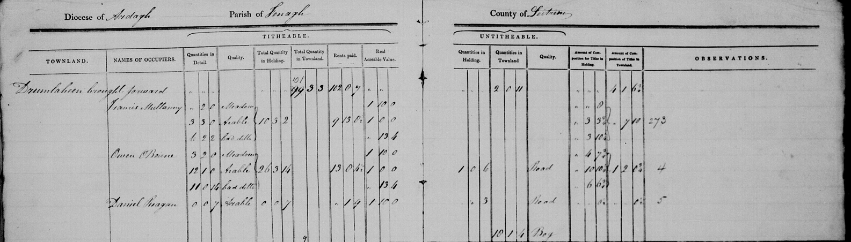
The 1833 Applotments: My Family in the Parish
The Applotments of 1833 is the first record that I could find or that my family knows of there being a presence of the Beirne surname in Drumlaheen. A man named Owen O’ Beirne ( O’Beirne became Beirne at some point in the future) was featured in the applotments of 1833, and my granny thinks that this is my great great great great grandfather, as my family has a history of people being called Owen. Owen O’ Beirne had meadows, arable land and a word that I make out as bad tillage, when describing the quality of his land. This would make sense for the land around my Grannys. He had paid all his rent at the time. There was 9 houses in the Parish in 1833, including Muldoons, Mcgreals, Mcdermotts, Sullivans, Byrnes, Mcneal’s, Mullany's and Reagans. There are still Muldoons in Drumlaheen today, but I have no idea if they are related to these Muldoons.

Slide 11
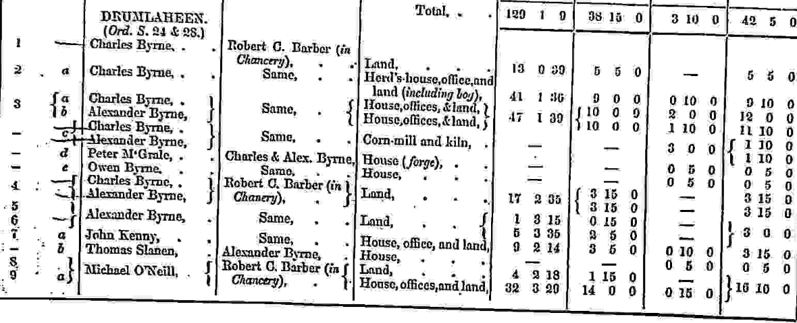
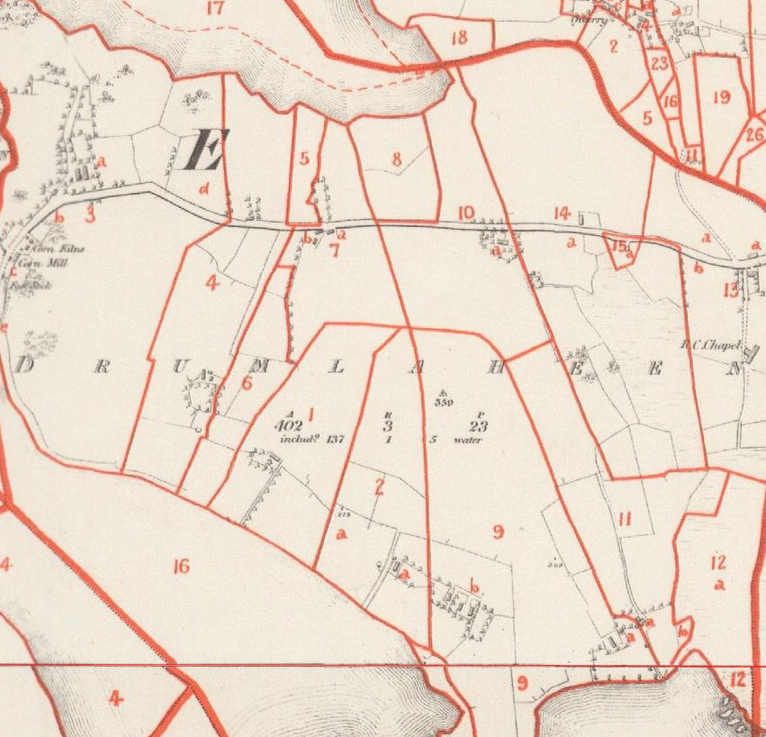
My Family in the Griffith’s Valuation of 1857:
In 1857, the O’Beirne family had expanded significantly, and the family name had changed to Byrne at some point between 1833 and 1857. The main house was occupied by Charles Byrne, who was the son of Owen in the Applotments. Charles is my Great Great Great Grandfather. He paid rent to Robert C. Barbor, and because he was in chancery it is likely that either the house was under legal dispute or in control of the courts at the time. Charles had a house, offices and land at the site of his house, with more land around Drumlaheen as well, which included bog and a herd’s house. Charles’ brother Alexander lived in a house just down from Charles’ and that house is still standing today. Alexander owned a corn-mill,kiln, offices and land, none of which are standing today. He also paid rent to Robert C. Barbor. According to the valuation, Peter Mcgrale paid rent to both Owen and Alexander, and this would make sense to me, as his house in the map on the left is on land that my family still has today, and my granny told me that there used to be a small forge there, which checks out when you look at the valuation above. Owen Byrne in the valuation was not a relation.

Slide 12
My Family Between the Valuation and the Census
Between 1857 and 1901, my great great great grandfather Charles died on the 16th of October 1863, at the age of 63. Charles’ headstone was erected by his son Owen Beirne, who was only 17 when he died. This makes Owen Beirne my great great grandfather. Owen was married twice between 1857 and 1901. He married a woman named Jane Kelly and she was from Keadue, Co. Roscommon. They had 2 daughters that I don’t know the name of. Sadly, Jane died young and then Owen went on to marry Margaret Maguire from Cloone. They had 3 sons, Eugene, Patrick and Charles, who were born in 1892, 1895 and 1896 respectively.
Charles brother Alexander died on the 7th of July 1874, at the age of 64. His headstone was erected by his wife Elizabeth Beirne. They had a son, Michael, who was born in 1861. He was just 13 years old at the time of Alexander’s death. Michael married a woman named Alice, and they had 6 children, Charles, Mary Anne, Kate, Lizzie, Alice and James, who were born in 1891, 1892, 1895, 1897, 1898 and 1900 respectively.

Slide 13
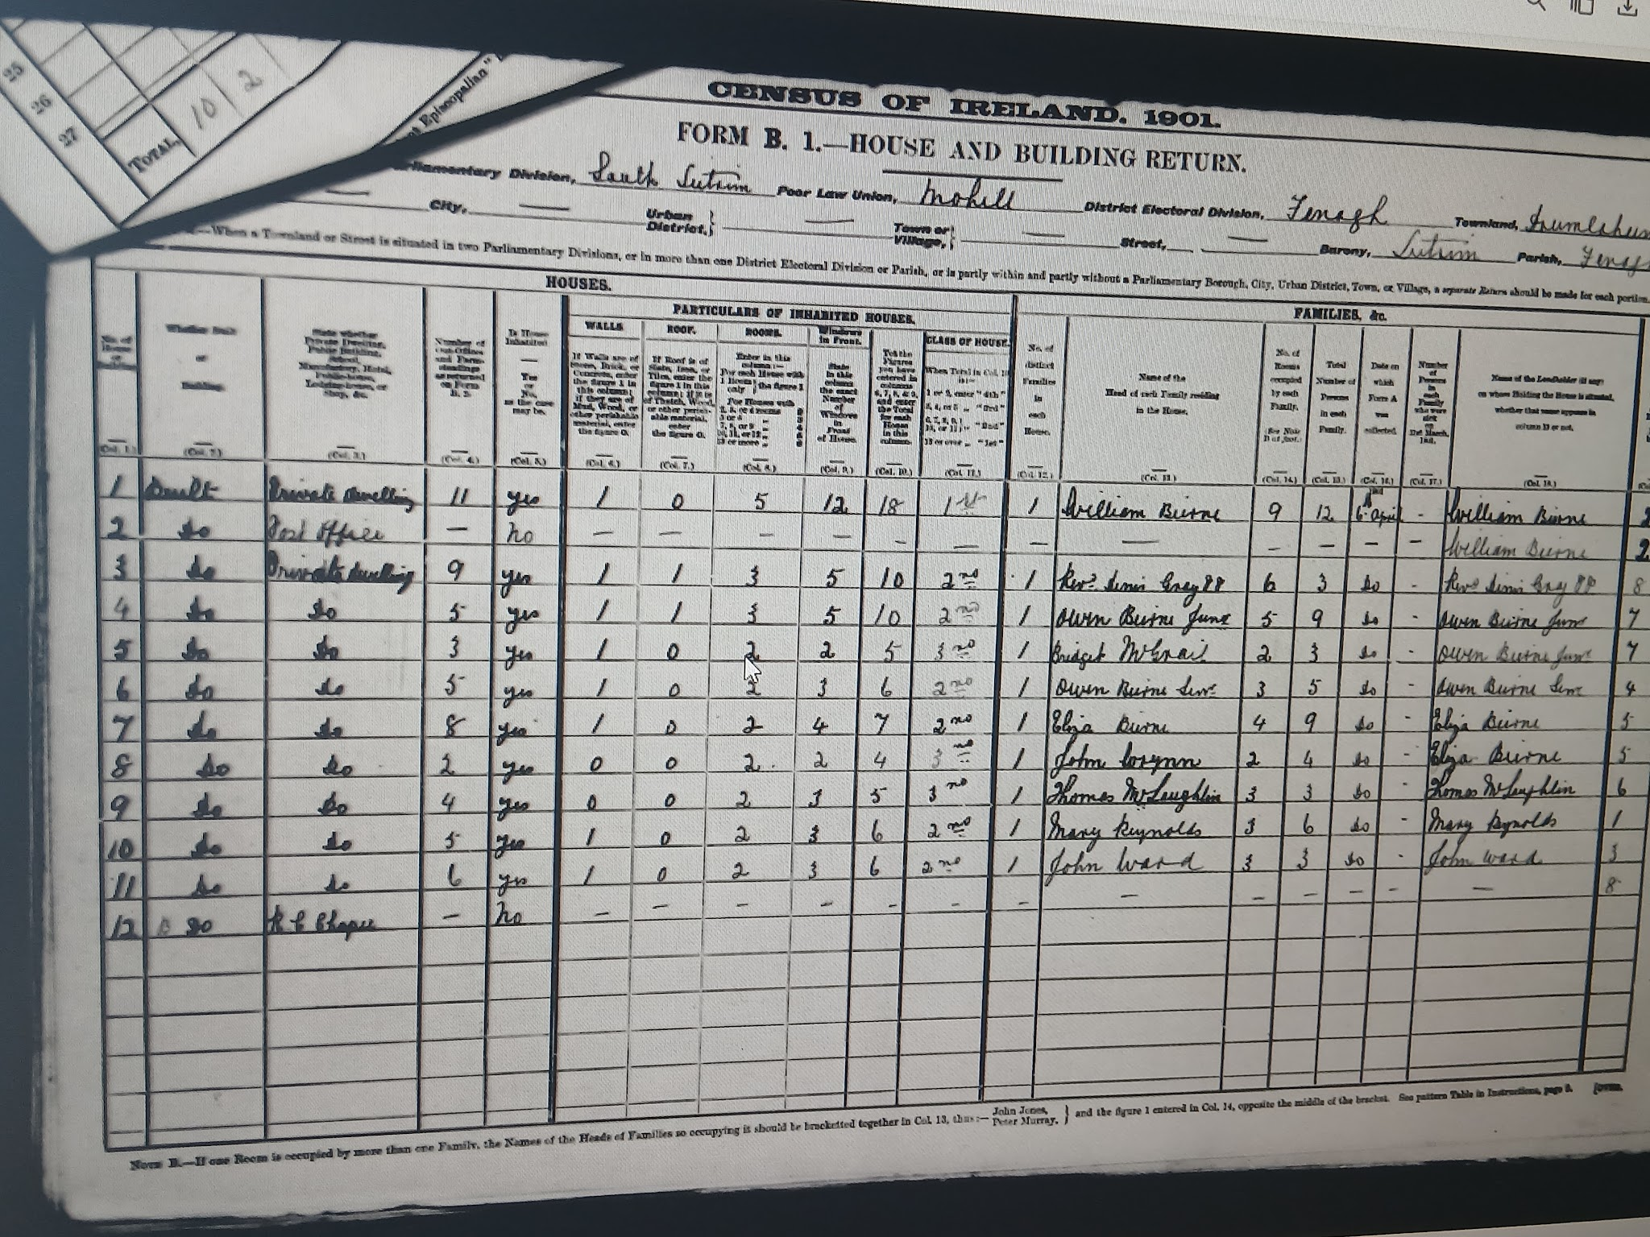
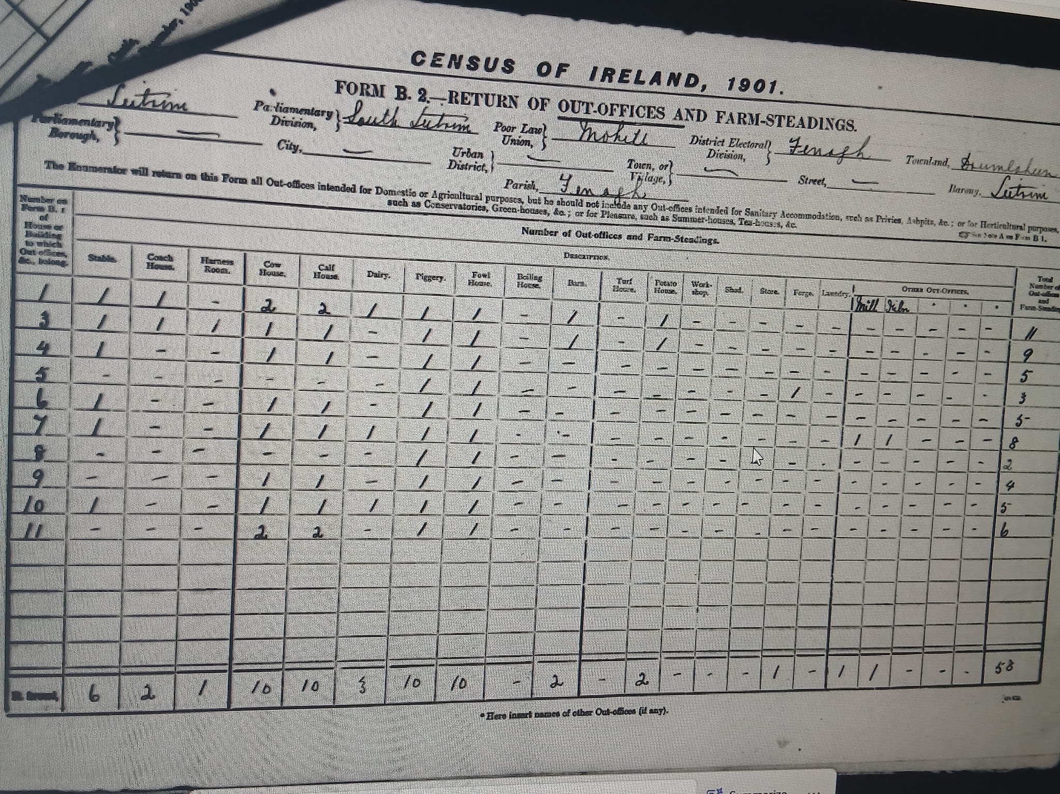
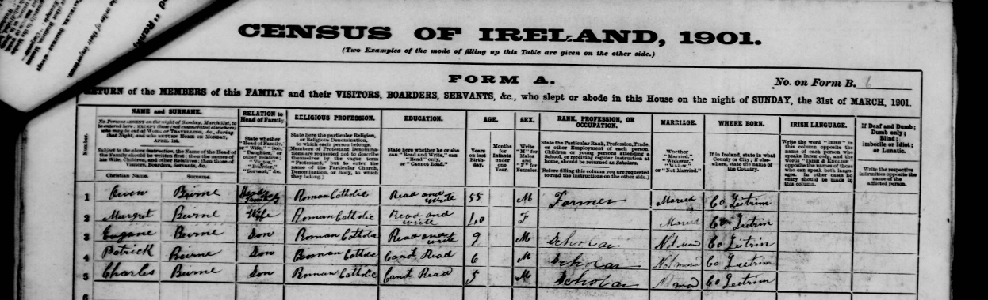
My Family at the Time of the 1901 Census
In 1901, my great great grandfather Owen Beirne was the head of the family in the old house. At the time of the census, Owen was 55, his wife Margaret, my great great grandmother, was 40, their oldest son Eugene was 9, middle son Patrick was 6 and Charles, My great grandfather, was 5. They were all Roman Catholics, Owen, Margaret and Eugene could read and write, while Patrick and Charles couldn’t read. Owen was a farmer at the time, and the 3 lads were scholars. In the house and buildings return, it shows that the walls of the house were made of either stone brick or concrete, that there were 5 out-offices and farm steadings. It also shows that the roof of the house was made of thatch, that there were either 2, 3 or 4 rooms in the house, that there were 3 windows at the front of the house and the house was 2nd class. It also says that the Mcgrale family was still living on the land of Owen, and they were paying him rent. In the out-offices and farm steading returns, it showed that the family owned a stable, a cow house, a calf house, a piggery and a fowl house. The cow house and the stable is still standing today and my granny uses it to store turf and old tools, as the stable and cow house were joined together. Alexander wife Elizabeth, son Michael and his children were all living in the same house as in the 1857 Griffiths valuation

Slide 14
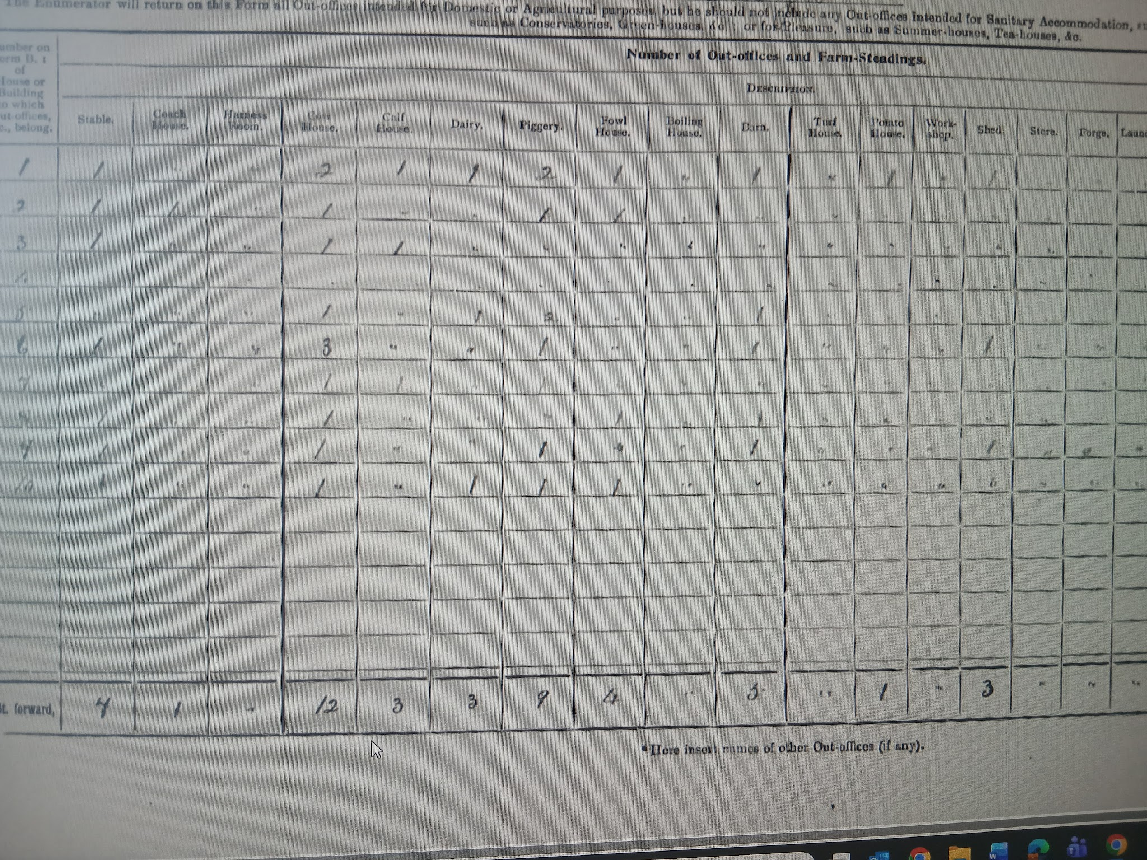
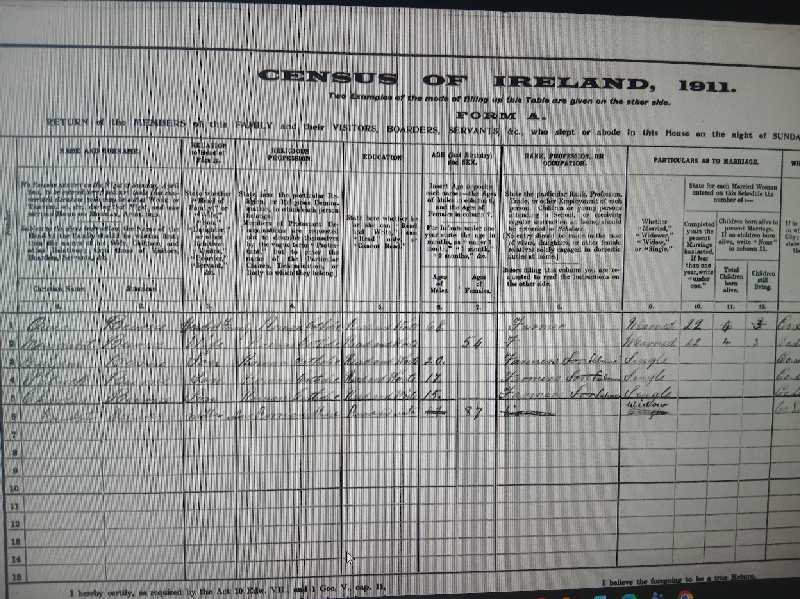
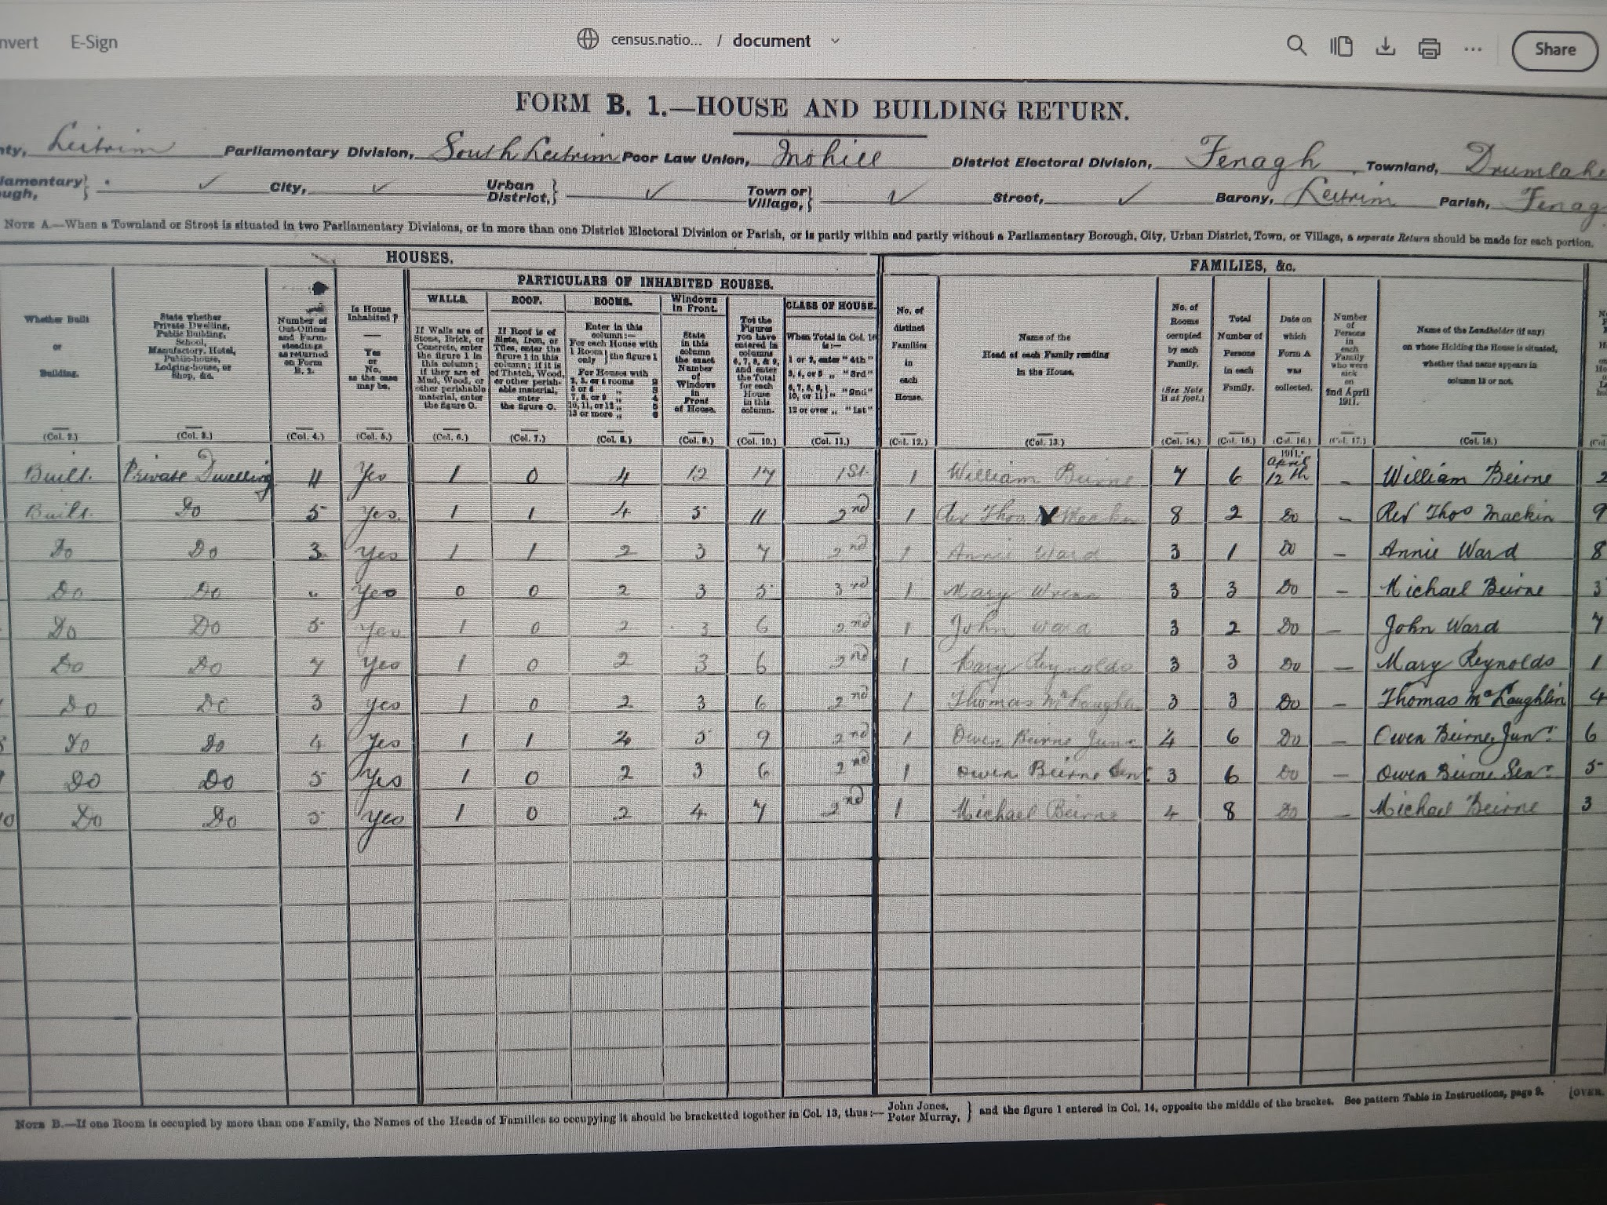
My Family at the Time of the 1911 Census
In 1911, not much changed at the house. Owen O’ Beirne was still the head of family at the age of 65, even though his age on the census says 68, his wife Margaret was 54, Eugene was 20, Patrick was 17 and Charles was 15, along with Bridget Maguire, who was Margaret’s mother and Owen’s mother in law, and she was 87 years old. They were still Roman Catholics and they could all read and write. Owen was still a farmer but Eugene, Patrick and Charles were now farmers labourers. Owen and Margaret were 22 years married at this time. In the house and buildings return, the house was the same as it was 10 years ago, with Bridget being an extra person in the house. In the out-offices and farm-steadings report, there was still the stable, cow house and the piggery, but there was no calf house or fowl house anymore, but they now had a barn. Alexander’s family remained the same in 1911, only that his wife Elizabeth died sometime between 1901 and 1911.

Slide 15
My Family’s Story After 1911
Since the 1911 Census, my great great grandfather Owen O’ Beirne died in March 1929, and my great great grandmother Margaret died in March 1933. My great grandfather Charles married a woman named Rose Anne Greenan, who lived in the townland of Corlough just beside Drumlaheen, on the 26th of February 1935. Charles and Rose Ann had 2 children. My great uncle Brendan Beirne was born on the 12th of May 1944 and my granny Gretta Beirne was born on the 21st of November 1946. The house that Owen O’Beirne had first built was knocked soon after my Granny was born, and a new two story house took its place. My granny faintly remembers the old house, telling me that they lived in two rooms of the old house while the new one was being built. My great granny Rose Anne died on the 11th of August 1968, and Charles died on the 19th of July 1971. My granny married J.P Fanning from Kiltubrid in 1970. They had 6 children, with my Mam Carol being one of them.I was born in 2009. My great uncle, my granny and my grandad all lived in the house until Brendan passed away on the 16th of November 2023 and my grandad J.P died on the 27th January 2024. Today, it is only my granny who lives in the house on the site of where Owen O’ Beirne built the original house back in the early 1800’s.
Alexander’s house was last lived in by his granddaughter Alice, who died in 1988.

Slide 16
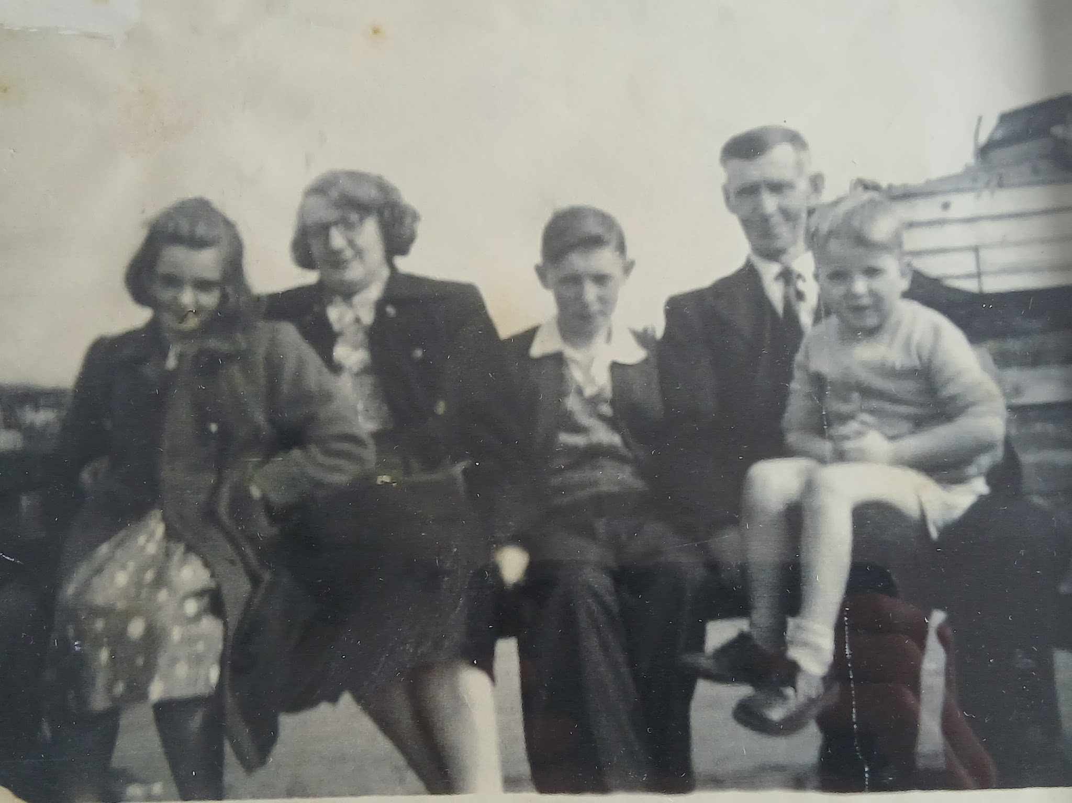
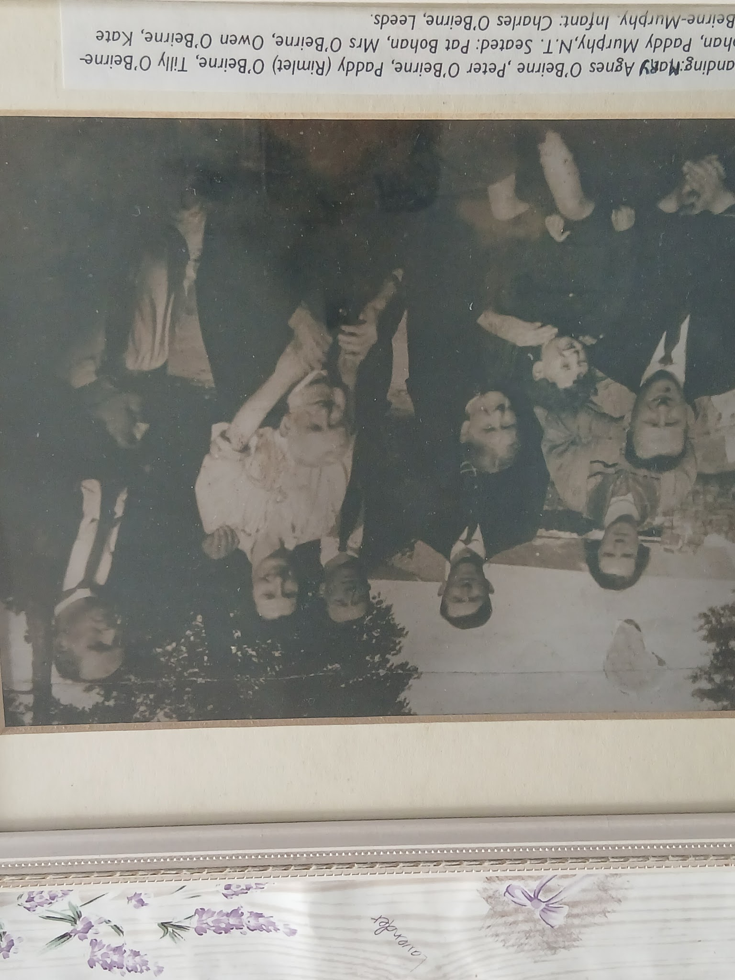
Faces from My Family Past
In this picture, you are able to see my great great grandad Owen O’ Beirne who is seated second from the right.
Here is a picture of my granny Gretta on the far left, my great granny Rose Anne second from left, my great uncle Brendan in the middle and my great grandad Charles on the right.

Slide 17
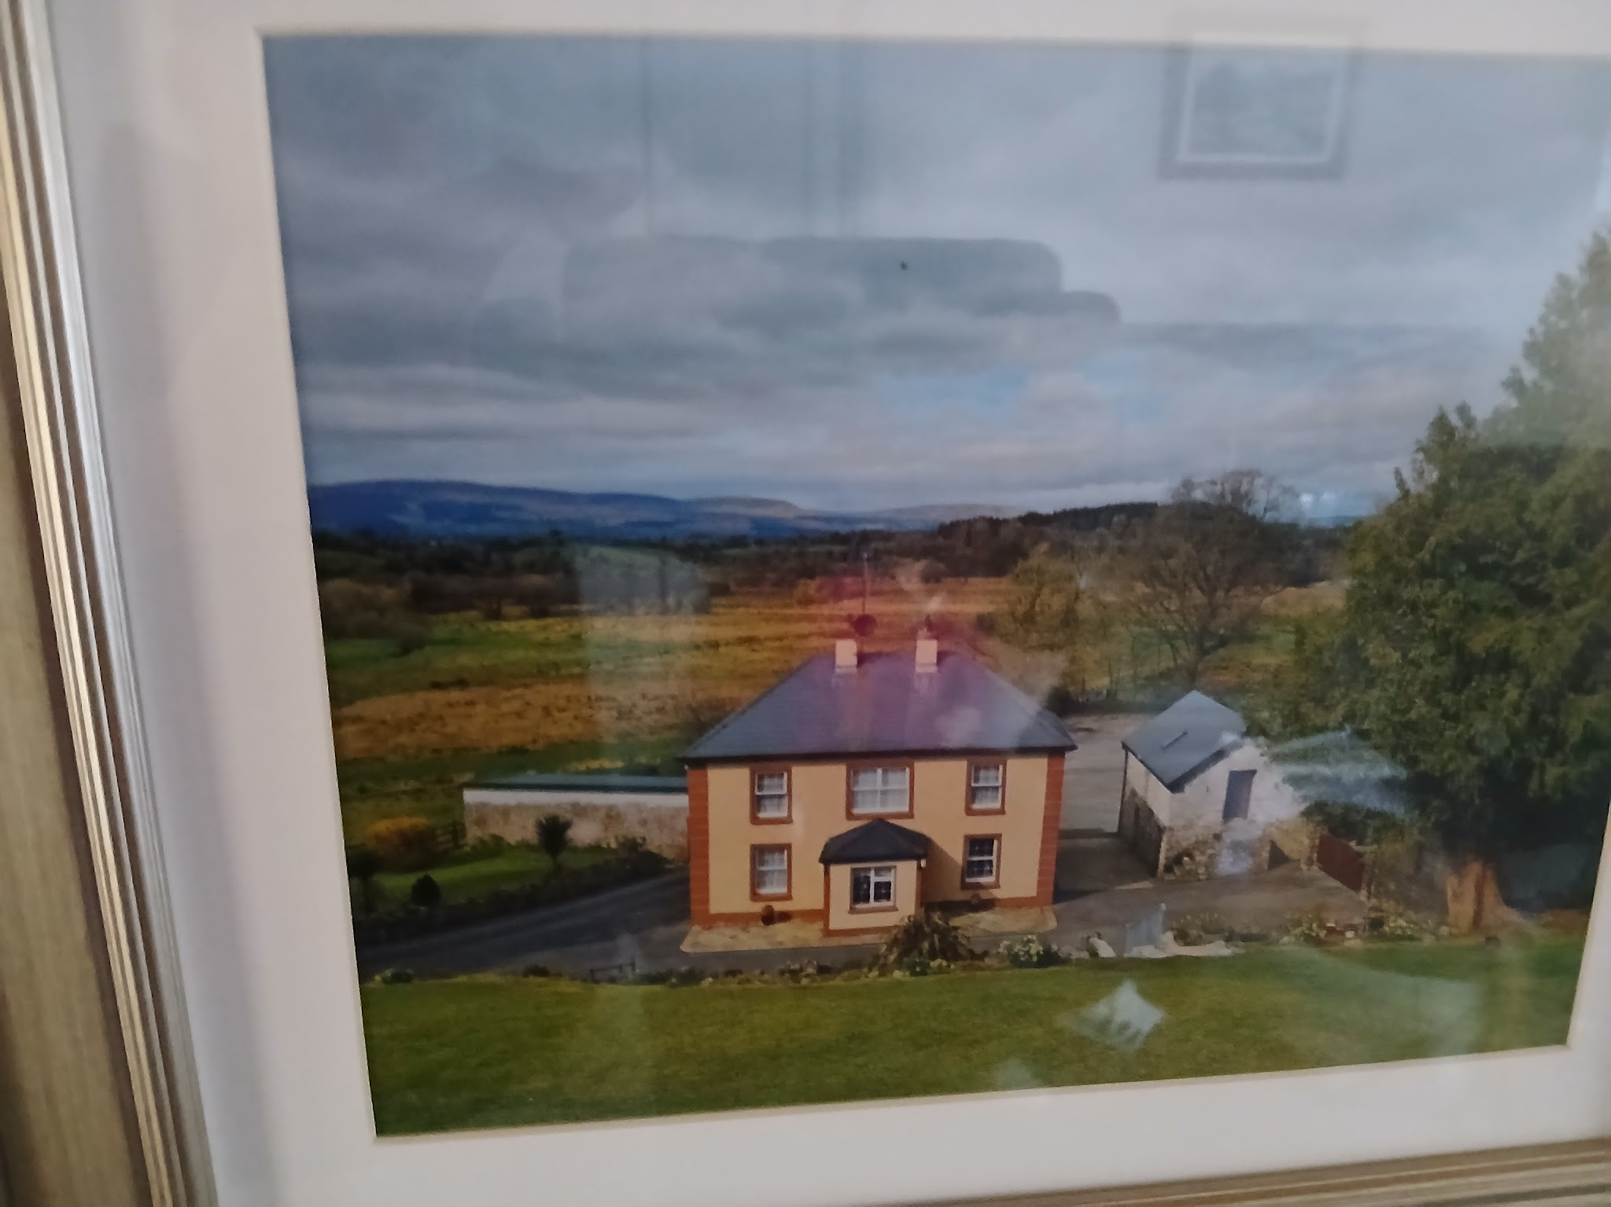
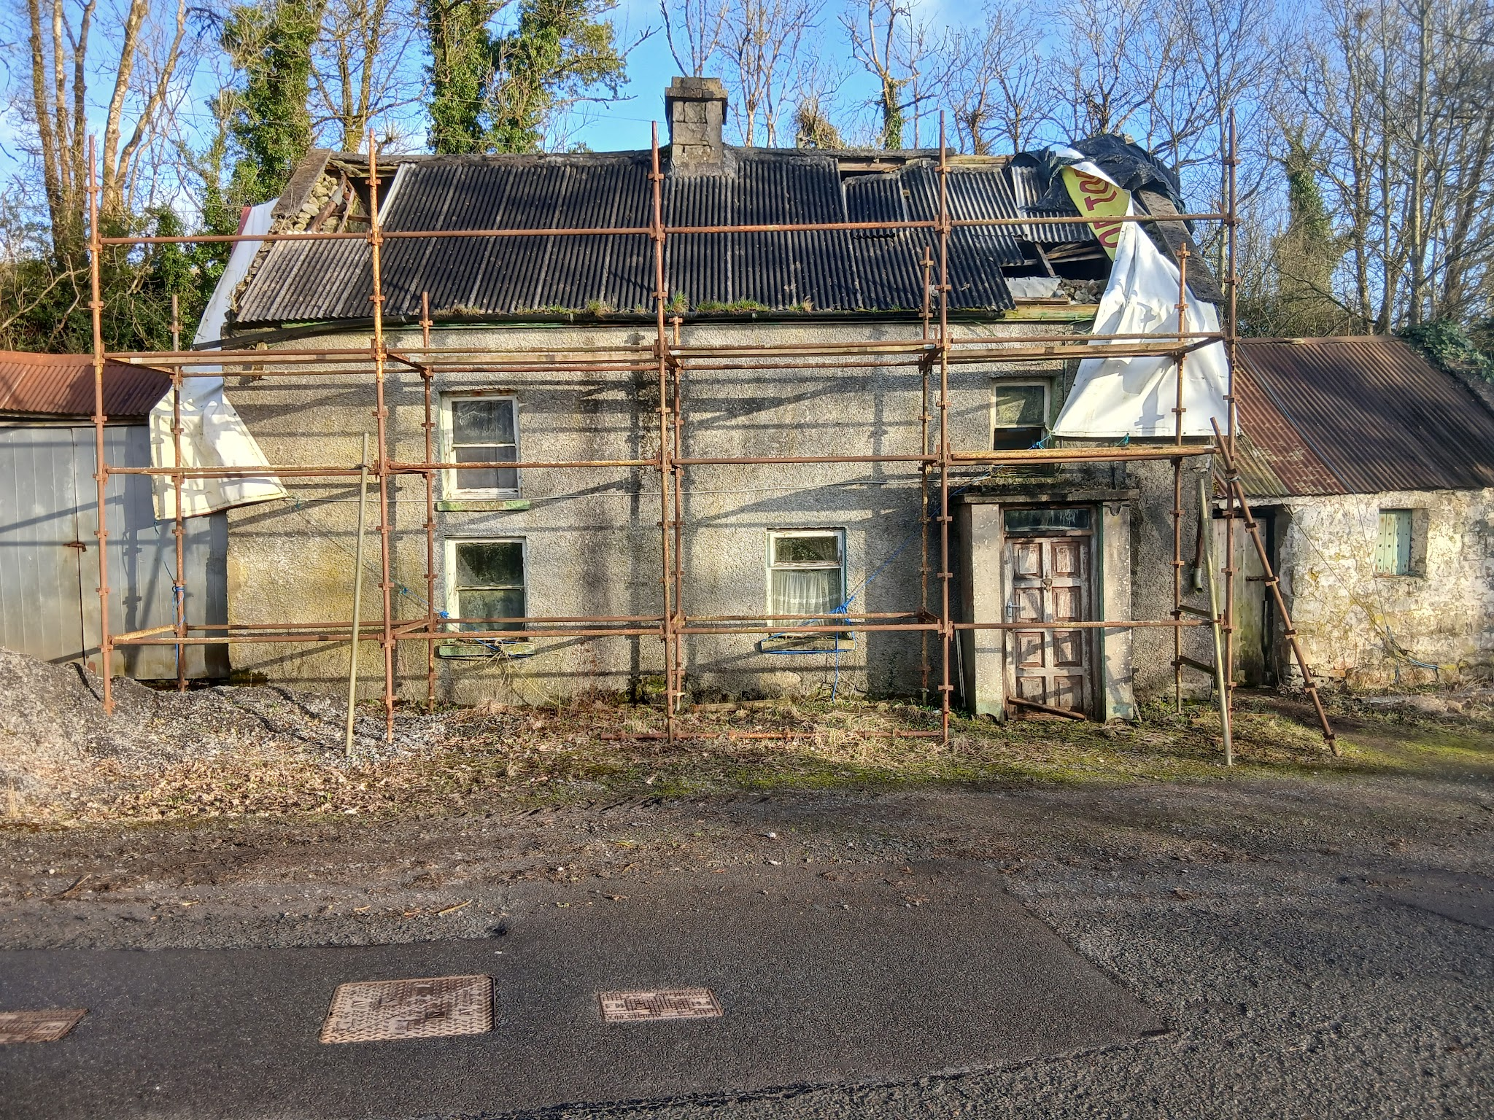
Photos of the houses in my family:
Here is a picture of Alexander Beirne’s house built sometime in the mid 1850’s. His granddaughter Alice Beirne was the last to live in this house.
Here is my granny's house and the land behind it today.

Slide 18
Reflection:
I enjoyed doing this project as it was something I was really interested in. I enjoyed researching about my family throughout the different sources I could find, such as the Applotments and Griffith’s valuation. I was really pleased that I was able to ask my Granny about most of the information I got in the project to make sure the people I was including in my project were people who were actually related to me, so she was a big help and I’m very grateful to be able to talk to her about her own family and her stories about her father and grandfather. I found this project very satisfying and worthwhile as it finally gave me a good motivation to learn more about my ancestors and where they lived, what they owned etc.
If I was to do this project again, I would have tried to have look at more primary sources from my local area such as the Book of Fenagh to try find out more about the townland, as I struggled to find much information online.
Overall, I really enjoyed doing this project and I’m happy I got to do it on my own family in Drumlaheen.

Slide 19
Sources used in my project:
My granny, Gretta Fanning
Tithe Applotments 1833
https://titheapplotmentbooks.nationalarchives.ie/search/tab/results.jsp?county=Leitrim&parish=Fenagh&townland=Drumlaheen&search=Search
Griffiths valuation 1857
https://www.askaboutireland.ie/griffith-valuation/index.xml?action=doNameSearch&PlaceID=776496&county=Leitrim&barony=Leitrim&parish=Fenagh&townland=%3Cb%3EDrumlaheen%3C/b%3E
Census Records
https://www.census.nationalarchives.ie/pages/1901/Leitrim/Fenagh/Drumlaheen/
https://www.census.nationalarchives.ie/pages/1911/Leitrim/Fenagh/Drumlaheen/

