Slide 1
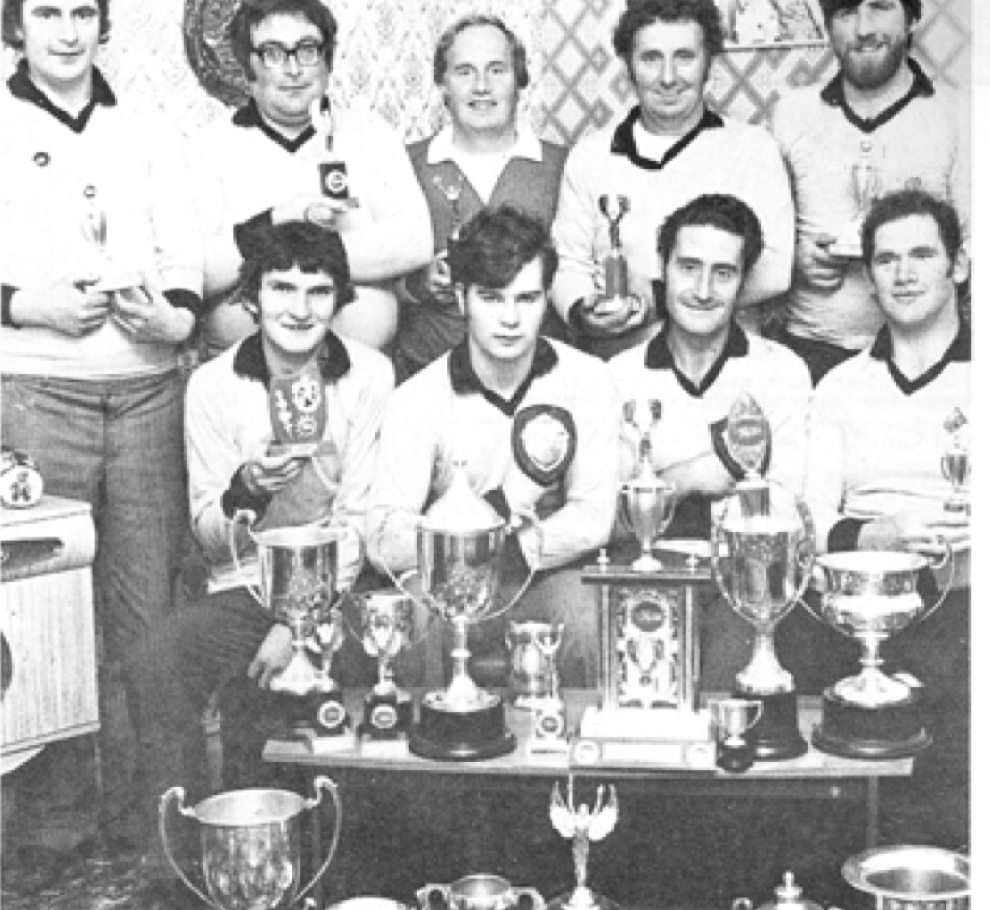
Carrigallen Tug o’ war team
Young historian project
Katie Lynch

Slide 2
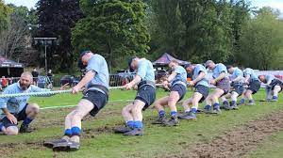
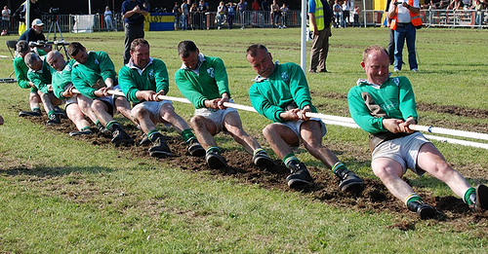
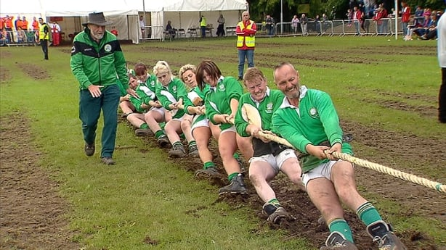
What is tug of war?
Tug of war is a sport that pits two teams against each other, teams pull on opposite ends of a rope with the goal being to drag the other team over a central line.

Slide 3
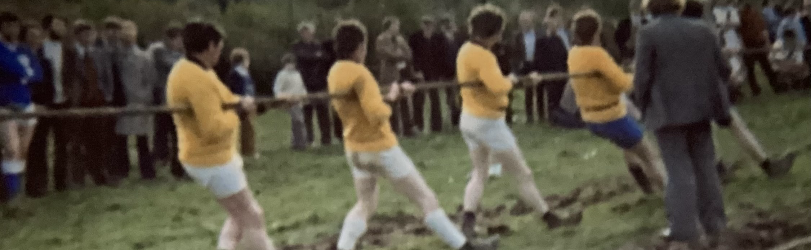
One of their first pulls
History of Carrigallens team
The Carrigallen tug o war club began in the late summer of 1976.After participating in two tournaments the boys were convinced they had potential to go further and earnest training began thereafter This training involved some interesting techniques, including pulling a tractor around a field and lifting a tar barrell pull of stones up in the air with a pulley.

Slide 4
How the team was formed
The tug of war team was formed in February 1976. A
meeting was called for 3 o’ clock,Sunday at McManus’s garage. A good number attended, and it was decided to form a team and start training.
Trainings were to take place on Wednesday evenings and on Sunday afternoon, on the first few training sessions there was quite a good crowd but numbers decreased and that left ten to fifteen men.

Slide 5
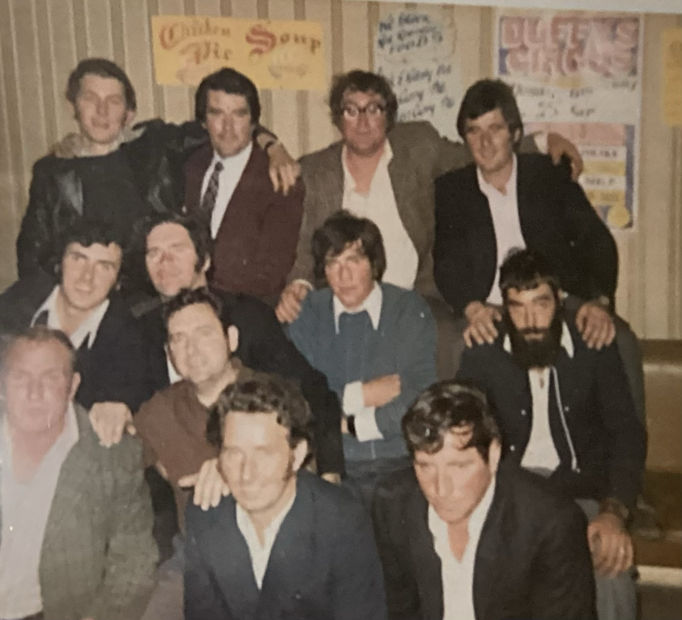
The members:
Joe Reilly, Sonny Keirnan , Kevin McManus (my grandad), Tommy Grimes, James Grimes, Joe Grimes, Peter Duignan and Mickie Flynn And First Coach : John Burke
After 1977: Laughlin McManus (my great uncle ) and Gerry Lyons took over the coach position.
The team celebrating after a win

Slide 6
Some of the members had pulled before in a pub tournament in Mohill the previous year, Others had pulled at field days or sports. Most had never pulled before except when an animal got stuck in a hole
The coach John Burke, had pulled extensively as an anchor man in England and had won many cups and trophies. In training John taught the team the importance of pulling with their body rather than their arms which beginners instinctively did

Slide 7
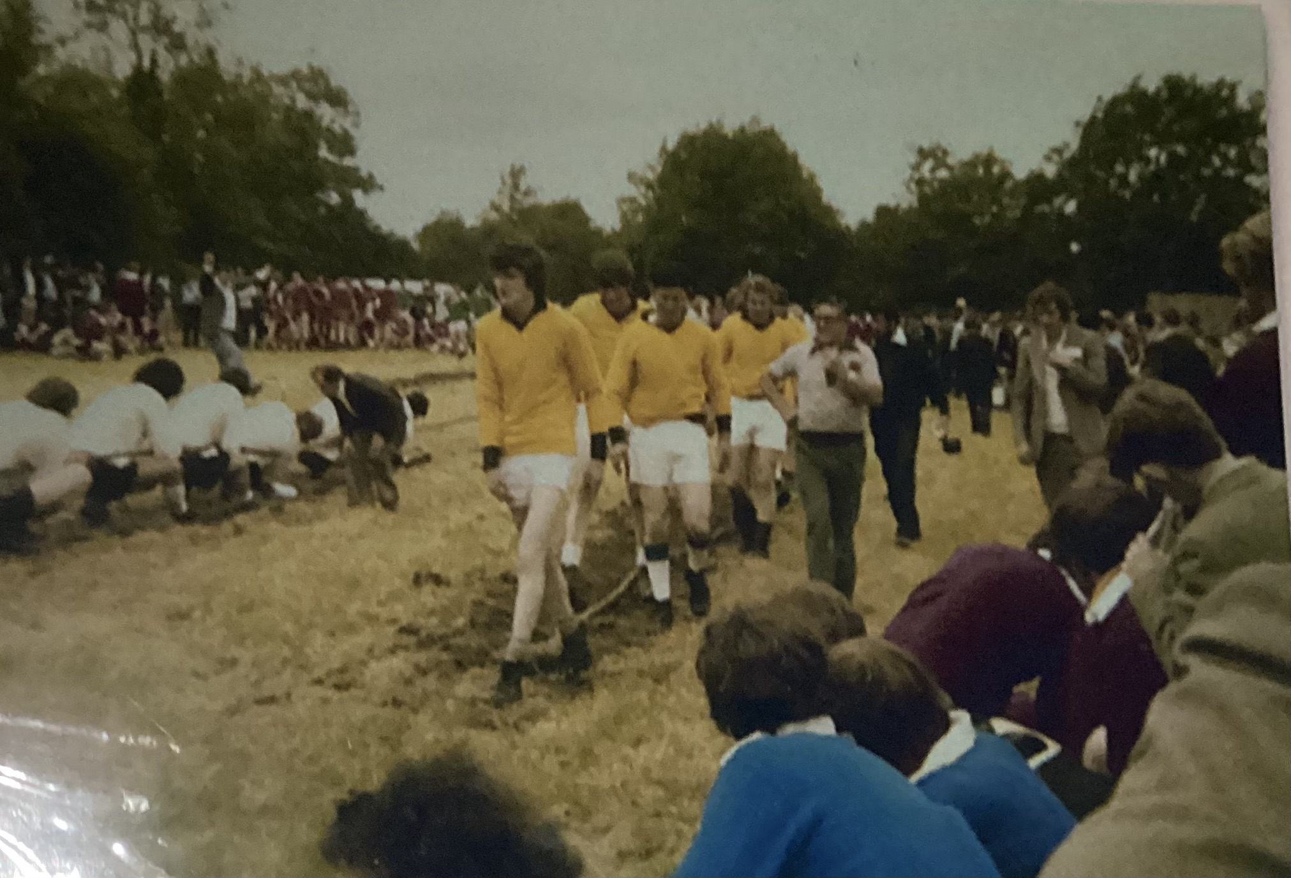
The story of the team
In march there was a challenge pull against Ballinagh, .Charley Fleming, Ballinagh pulled on the opposite side of the rope to the rest of the team as he was left handed. He advised them to affiliate to the All-Ireland Tug of War Association as they would be eligible to pull at all their fixtures.
The first pull of the 1976 season was at Tierworker, Kells, on Easter Sunday. They decided to go there as they had a section for novice teams.This was the first time many of the Carrigallen team had witnessed a properly organised tournament.
The team at Tierworker Kells.

Slide 8
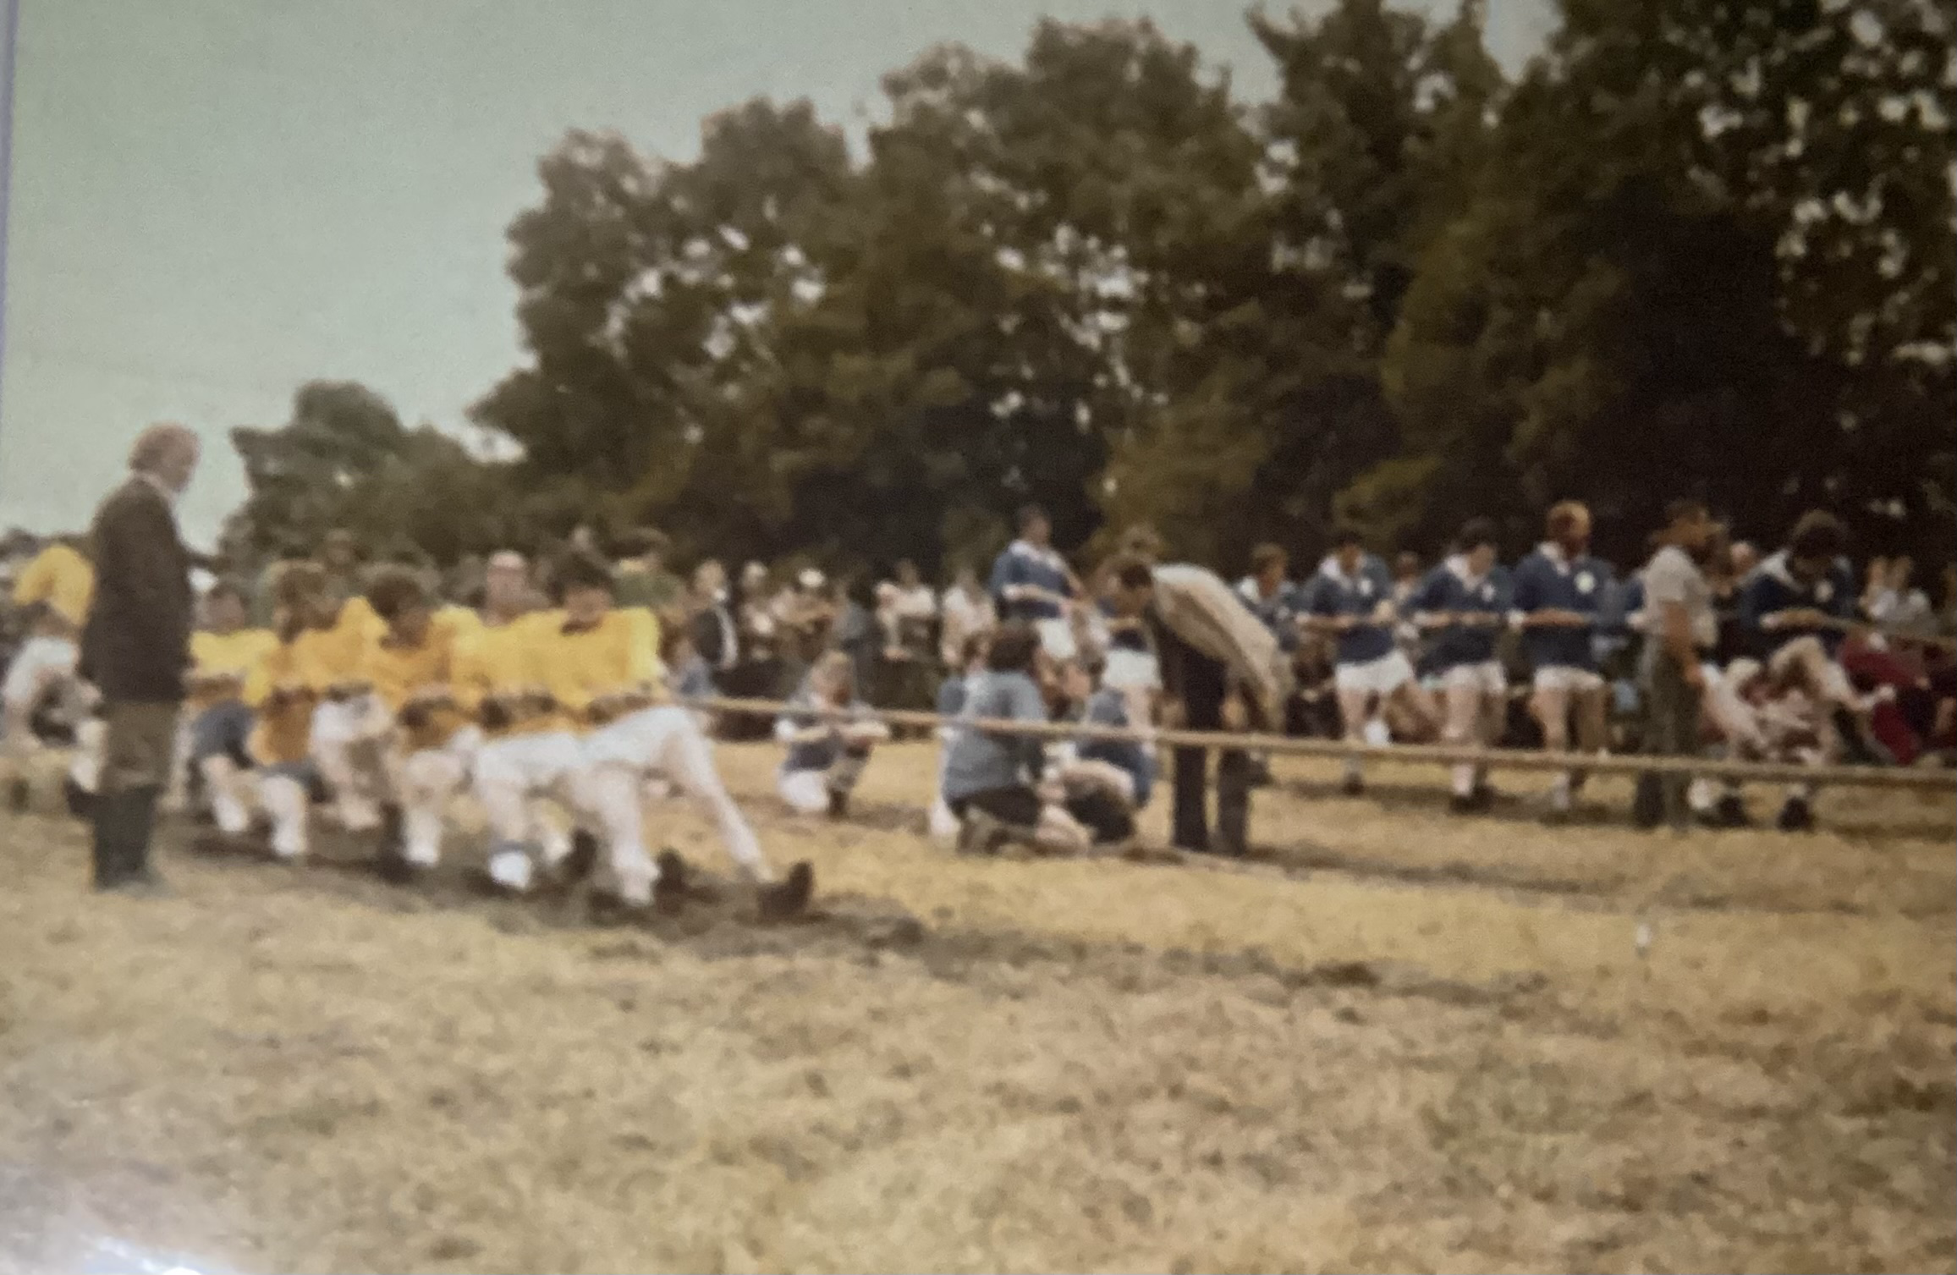
When the novice section was due to start, Carrigallen stepped up to take their postions to shouts of encouragement from the few followers that travelled to see them that day. They won through to the final, which was against the local Tierworker team. and after three hard pulls came out winners. Carrigallen had mixed success in 1976 and winning some tournament, losing others, but always losing gracefully, something they were respected for during the 4 years
1978 All Ireland 106 stone novice in Tom Eddie Kiernan's field

Slide 9
Highlights from the next three years
The winning of the Connaught 113 stone and catchweight for the third year in succession. Participating in the World Club Championships in Oriel Park Dundalk in 1978. Staging of All Ireland 106 stone novice in Tom Eddie Kiernan's field at back of what is now Jetwash in 1978.
One of the club's biggest days and greatest disappointments was the aforementioned All-Ireland in 1978.On that day in front of a crowd in excess of 800, Carrigallen did not perform to their usual standard. There were 19 teams, divided into three groups-two groups of six teams and one group of seven. Carrigallen was in the group of seven, so they had to pull six other teams with a minimum of two pulls each to win the group, which they did. They then had to pull against runners-up in group two which proved a very tough pull. There was one pull each with two blow-outs, eventually winning the last pull. That put Carrigallen into the final against their old friends and rivals from Mayo, Barrashrule. However the previous pulls had taken their toll and Carrigallen were only to be runners-up.

Slide 10
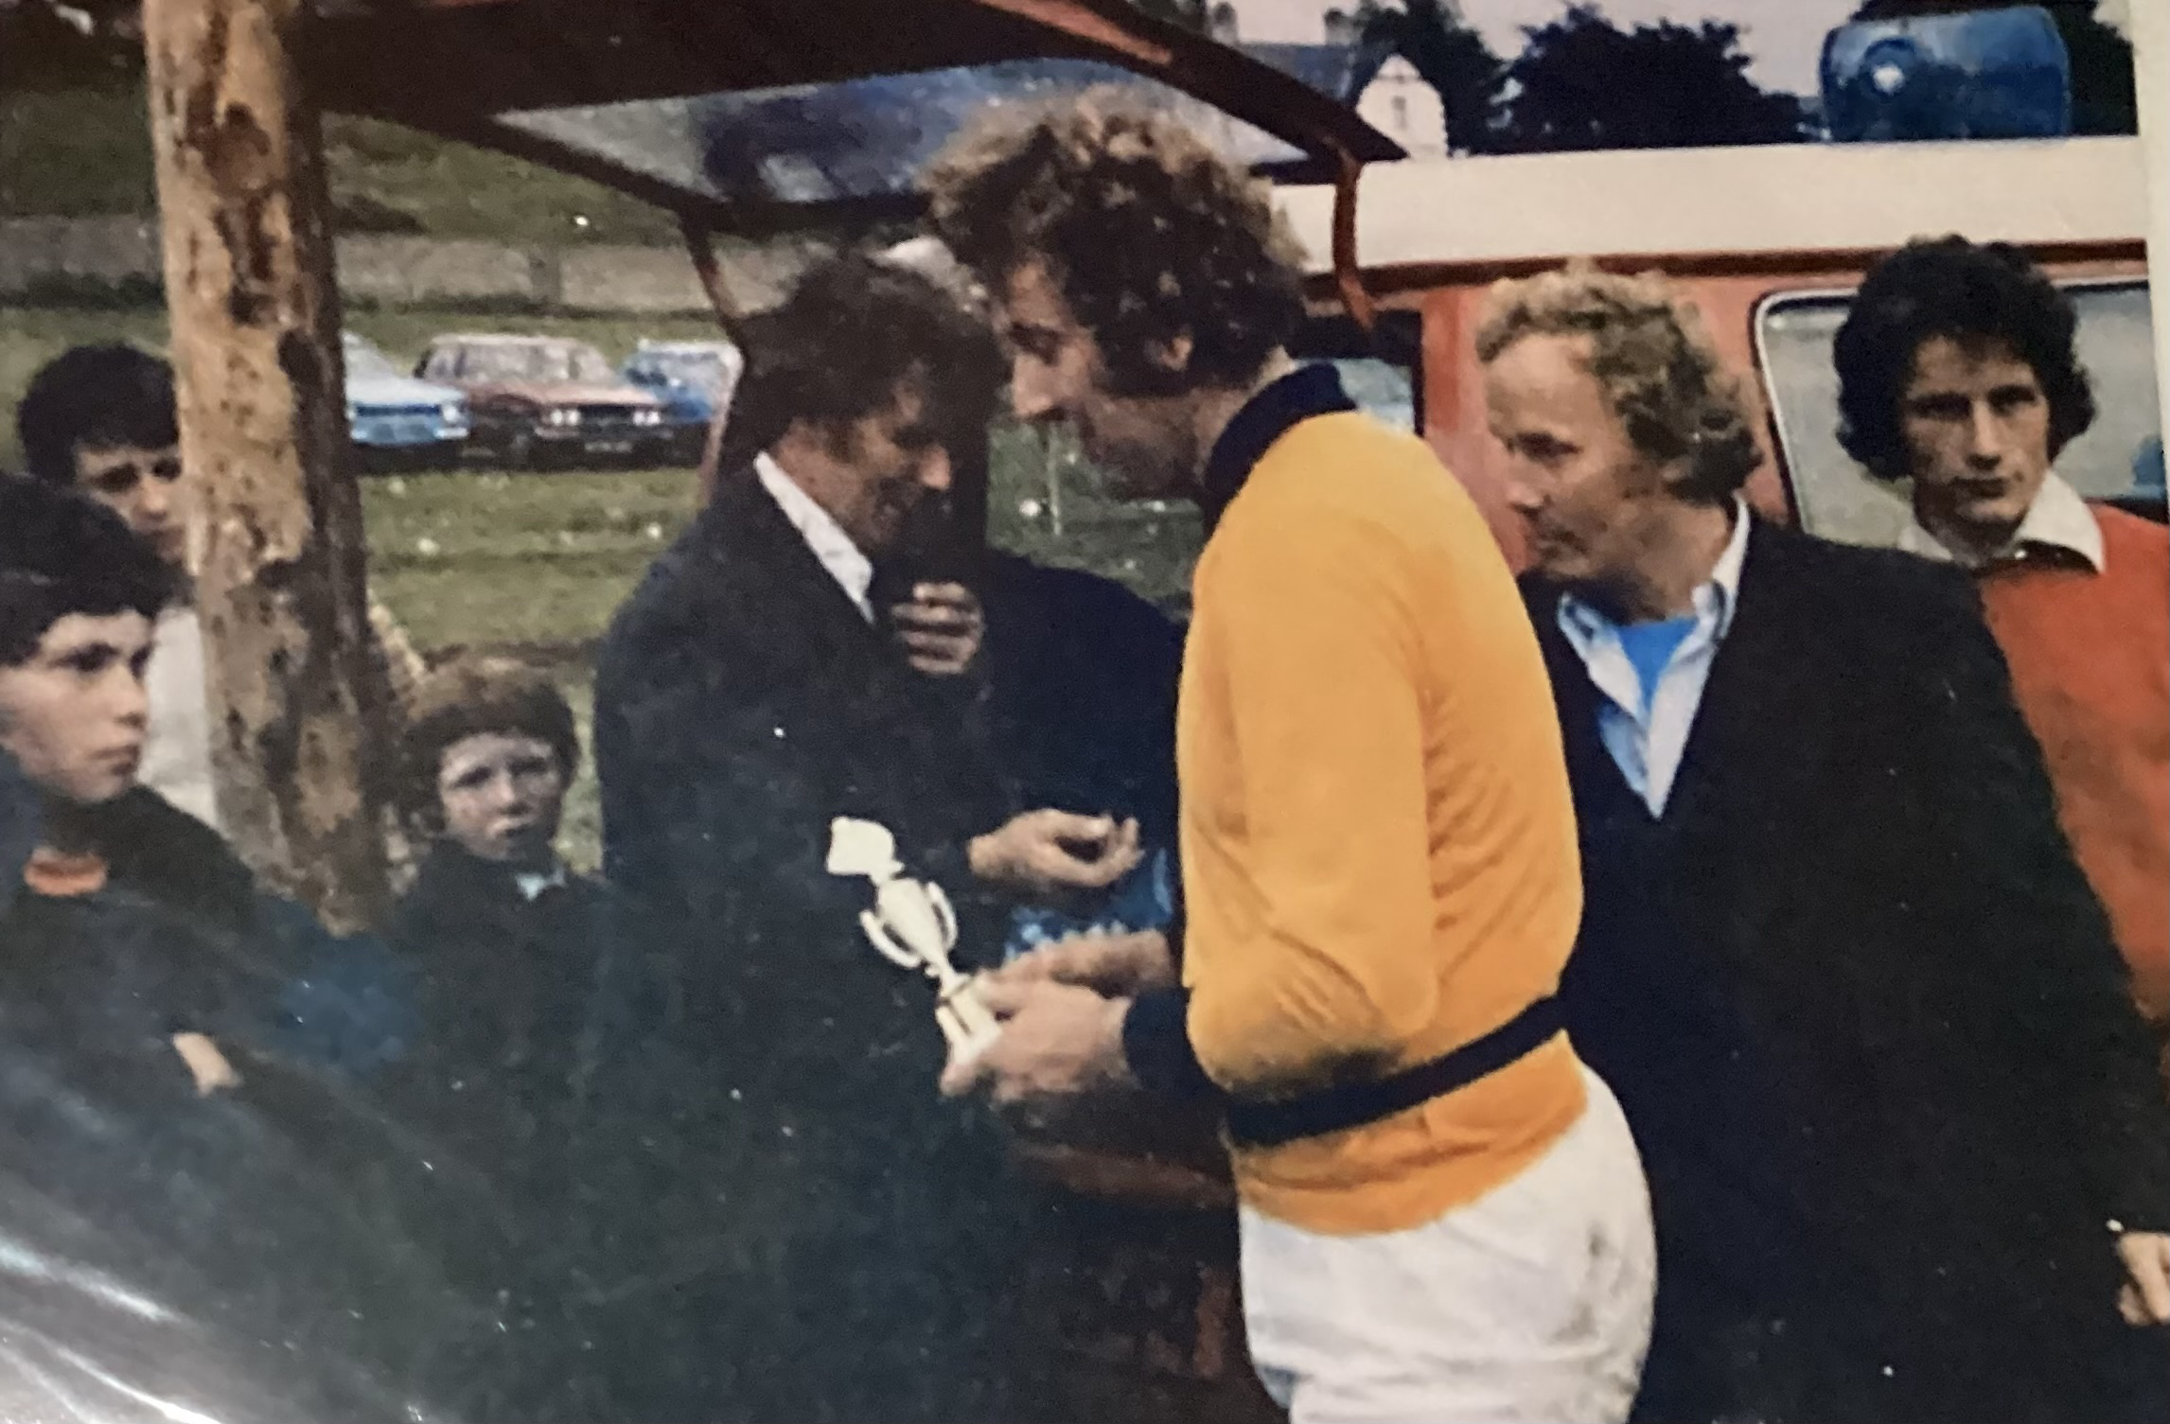
The team travelled extensively over the next two years, competing in tournaments in Meath, Cavan, Fermanagh, Roscommon, Sligo, Mayo, Offaly, Monaghan and Leitrim. At Most of these events Carrigallen won the catch weight competition and on occasions competed in weight category sometimes having to put seven men instead of eight when they could not make the weight. On one such occasion at Mohill Festival, six Carrigallen men pulled an opposing team of eight men.
Peter duignan collecting his trophy

Slide 11
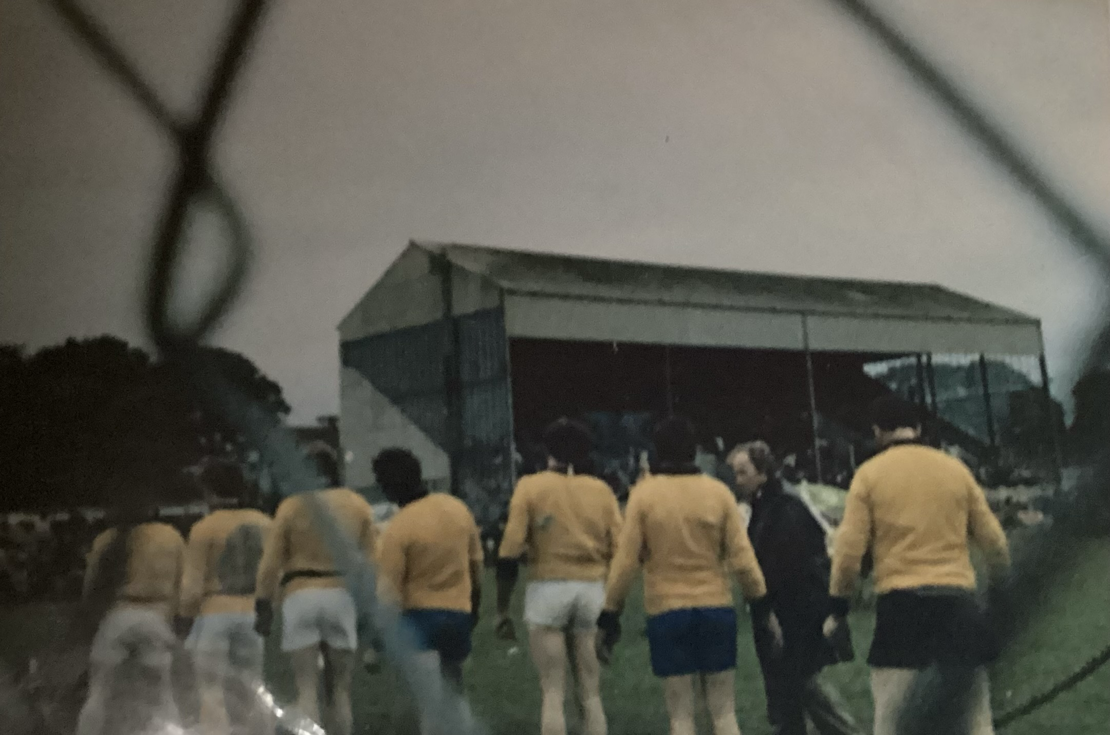
The beginning of the end
In 1980 the team applied to the Tug of war Association for permission to stage the catch weight all Ireland in Carrigallen. Later that year the club was informed they could host the 109 stone event, they accepted even thought it wouldn’t be the most suitable weight. When Carrigallen arrived at the event they were told they could not compete because they hadn’t pulled that weight in Connacht.
That evening members of the team confronted the Tug of war association, saying they don’t see much point supporting an organisation that would not allow them to participate in a national tournament
Pre competition chat from the coach

Slide 12
Carrigallen did not affiliate in 1981 but continued to pull at festivals and tournaments nearer home. Over the five or six years of its existence Carrigallen team won in excess of 60
trophies along with many cups and medals. A further blow to the team was the sudden death in February 1982 of its big 19 stone anchor-man, Joe Reilly.
Later that year the Club disbanded. The money-in-hand about £200, was given to charity, the ploughing association took custody of the rope and the club donated one of their winning cups as a Joe Reilly memorial and the gantry and pulleys at the football field disappeared. For a small community with no tradition of tug of war the team from 1976-1982 achieved much.

Slide 13
The story from my Grandads perspective
How did it all start?
Me and John Burke were having a conversation in a pub one night and tug o’ war came up in the conversation, since it was something to do because we didn’t play football. John used to train and pull in teams in England. So I got chatting with a few of my friends and we called a meeting about it.
What happened at the trainings?
We had a barrel of stones and we would have a rope through a pulley over a branch of the tree and two or three of us used to pull the barrel up off the ground. Then one day we came in and the tree was cut so we couldn’t do that anymore. We used to pull a tractor too.

Slide 14
What would you do before a pull?
We used to have a resin that noreen (my granny) would make for our hands so they wouldn’t slip. And we’d have to weigh in before a pull if it was a 106 pounds pull. I remember I weighed in last and we went over the weight limit and John said “Kevin you’ll have to sub for this one” and the other men said “if Kevin mc is not pulling then we aren’t.”
And I remember one time in Westport we went to weigh in and we were too heavy so we dropped one man and we only had seven and we still won it.
What was your worst memory?
The worst memory was when Joe Reilly died, He was our anchor man, he was the main man at the back and he died over in Castlebar. The team didn’t feel the same without him. When he died they decided to donate one of their cups as a memorial cup to the Carrigallen ploughing association.
Do you have any funny stories?
After the pull we were going to a pub for a drink and they wouldn’t serve us In the pub because we were all covered in muck and dirt and our hands were all black. There was no showers after like their would be now.
And in some pubs they’d fill the cup with drink and we’d pass it around.

Slide 15
What did the other teams think of you?
You would over hear the other teams saying “oh here’s Carrigallen we haven’t a hope in hell today”
Why did it end?
The team ended because Joe Reilly had died and it wasn’t the same without him
How did you raise money?
We would have collected money at the gate before going in when we held the competitions. We also held a tug o war dance to raise money one year.
How often would you have ran a competition?
I’d say we ran a competition once or twice a year.

Slide 16
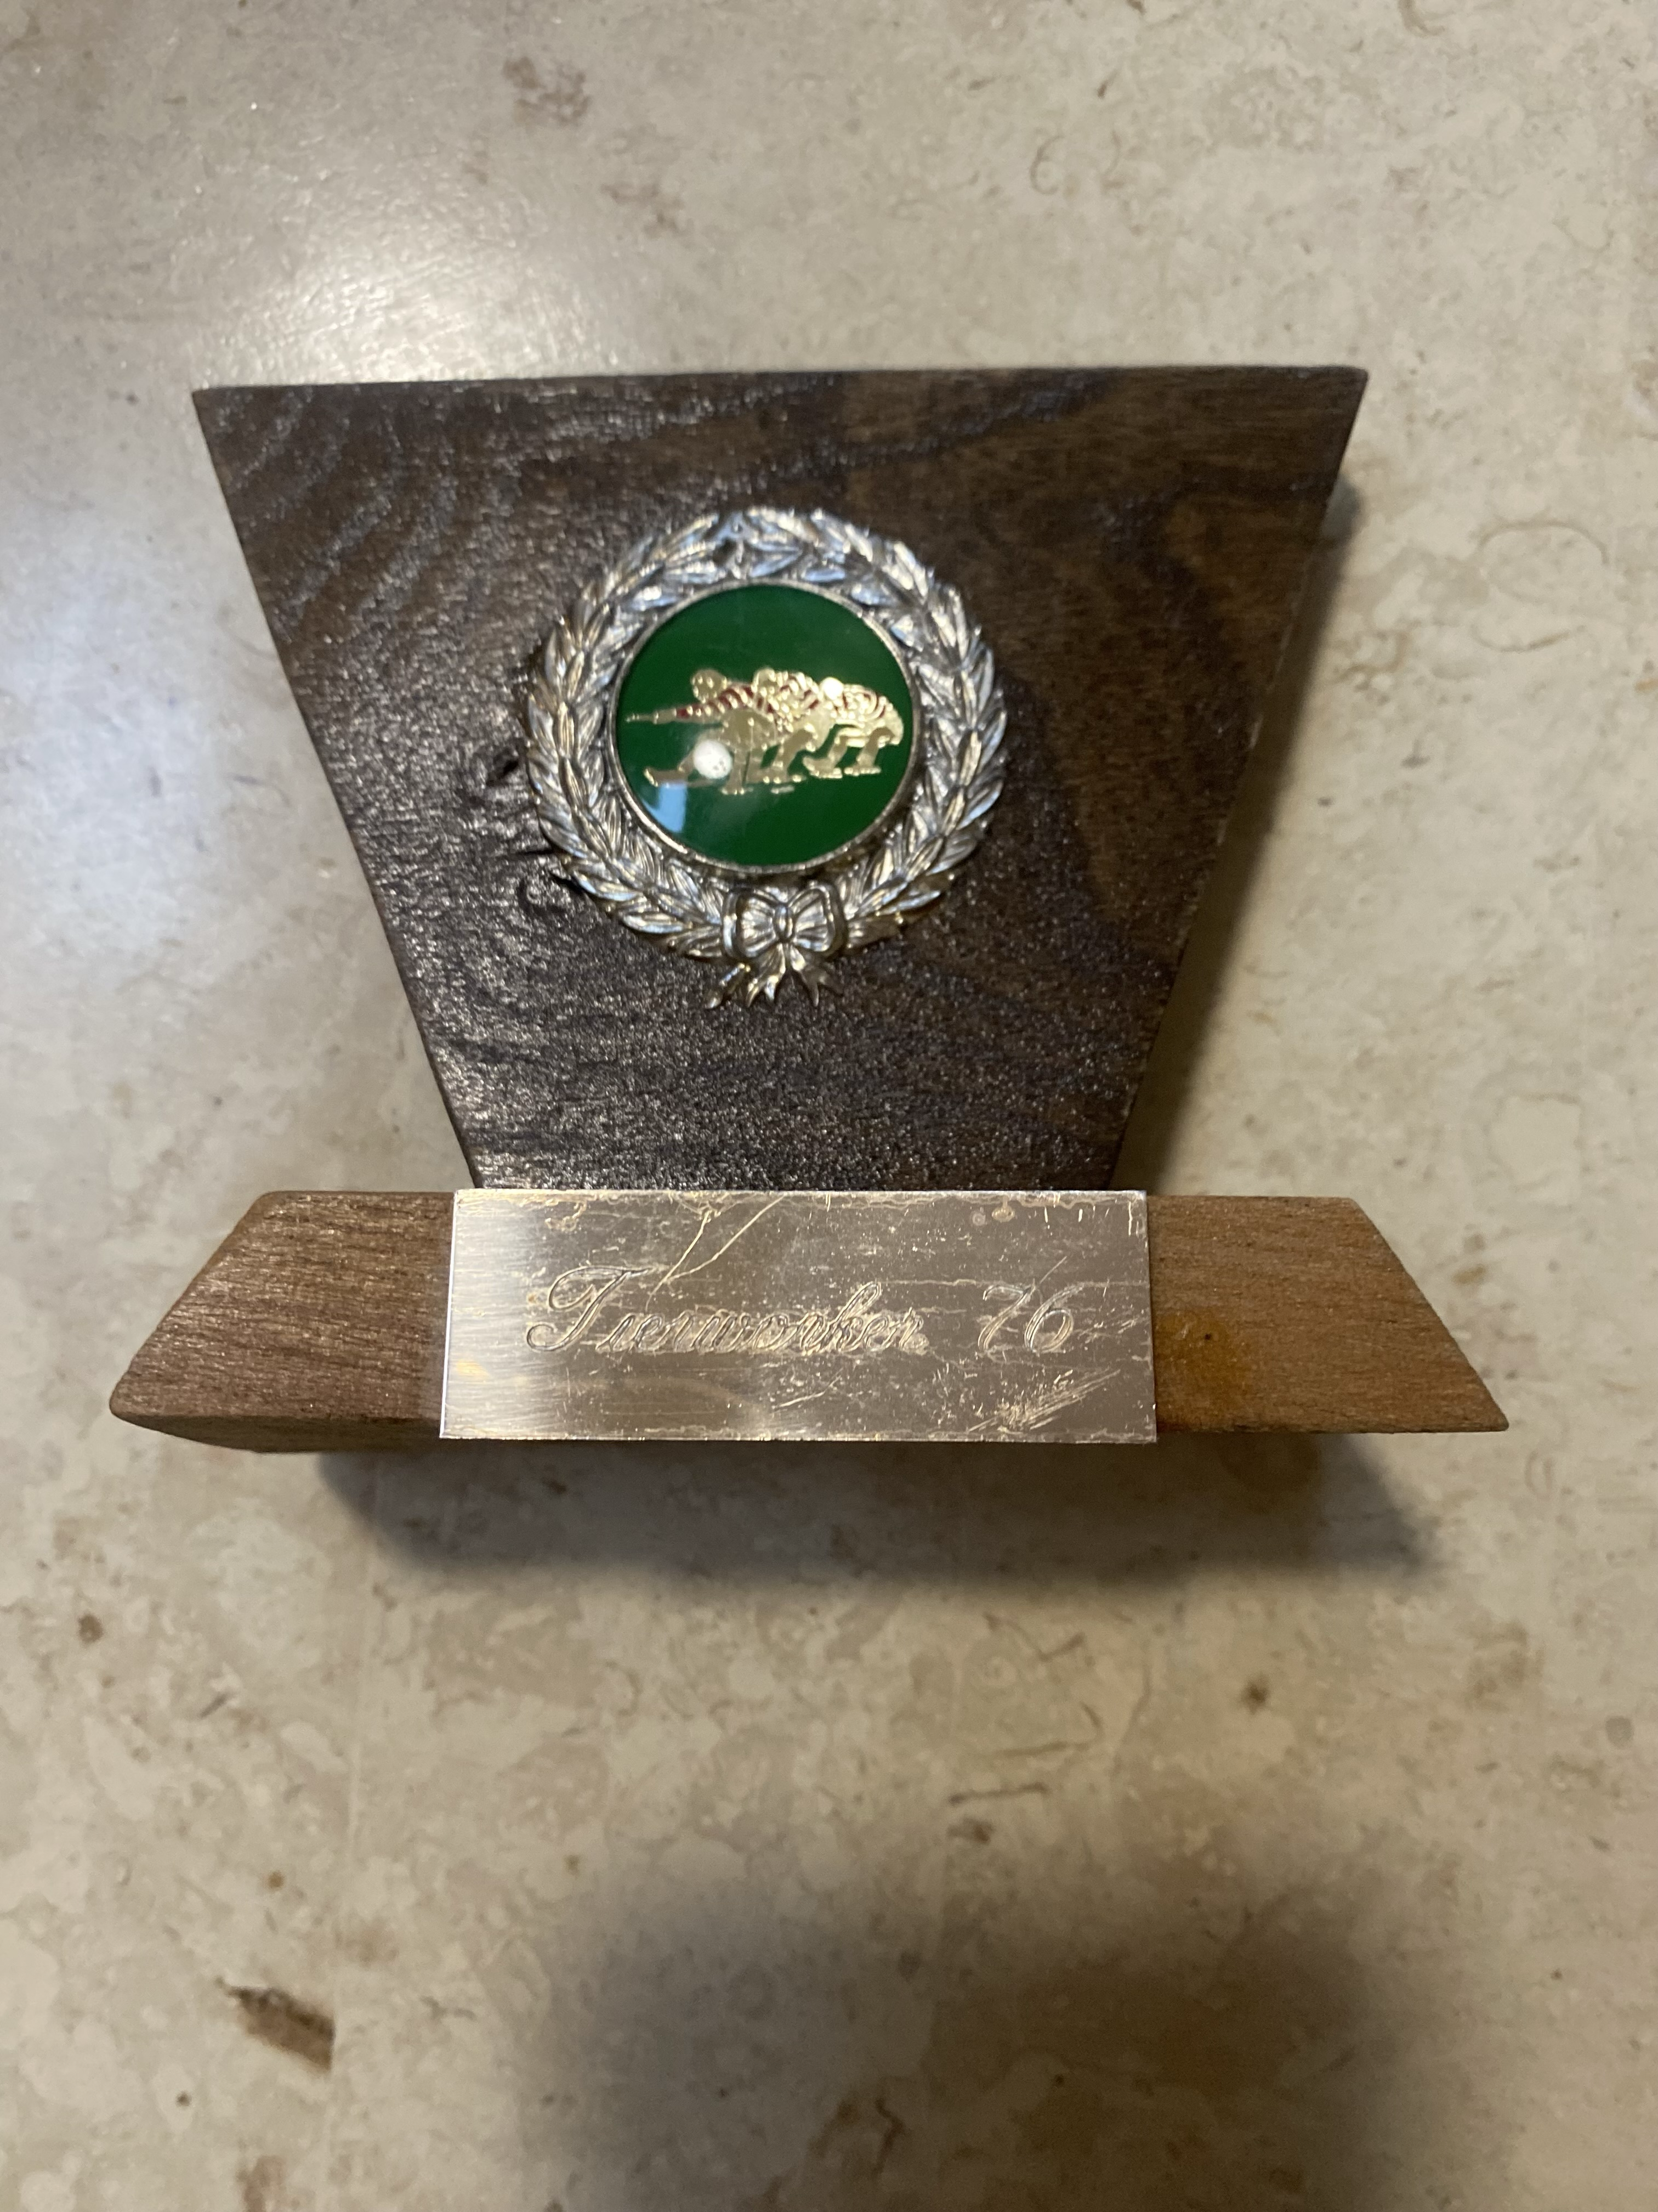
How long did it go on for?
It went on from 1976 to 1982 so for about 6 years
How often were there pulls?
I’d say every second Sunday or more, it was a seasonal thing it only went on during the summer months. But we would have started training in the spring.
What was the first thing you ever would have won?
The first competition we ever won was at Tierworker Kells.
Would you have won most of the games?
Yes I think we won most of them types of pulls
Tierworker 1976
What weight categories were you in?
We were In 2, catch weight and 106 stone. Catch weight was any weight, we mostly played catch weight and you wouldn’t have to weigh in for that but in 106 stone you’d have to and if you were too heavy you’d have to drop a man or bring in a smaller one.

Slide 17
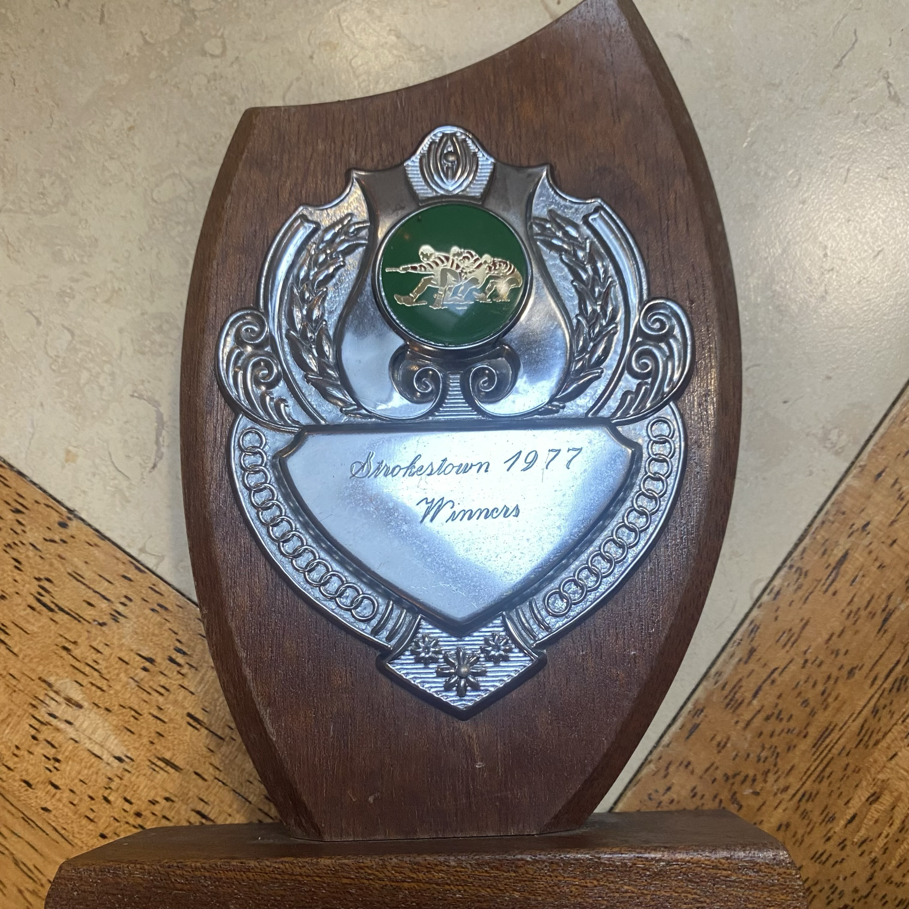
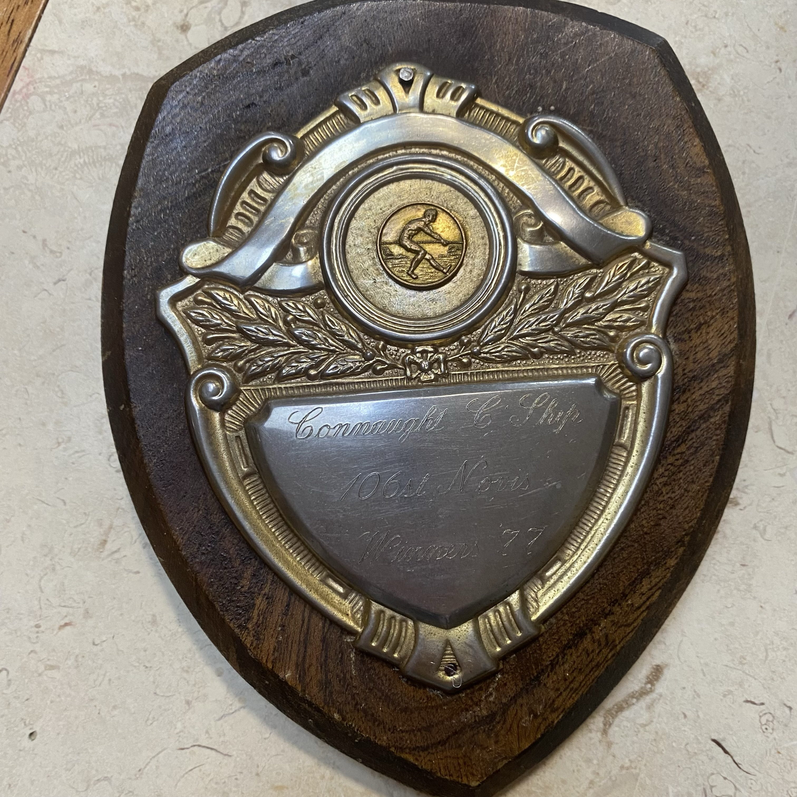
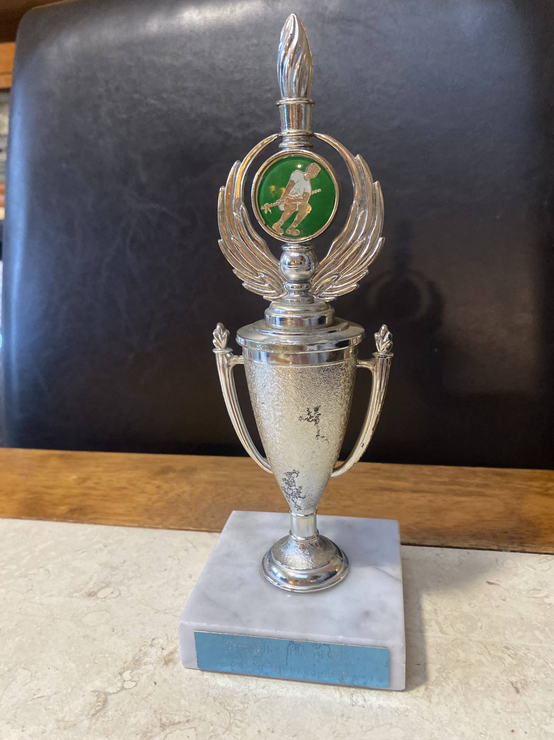
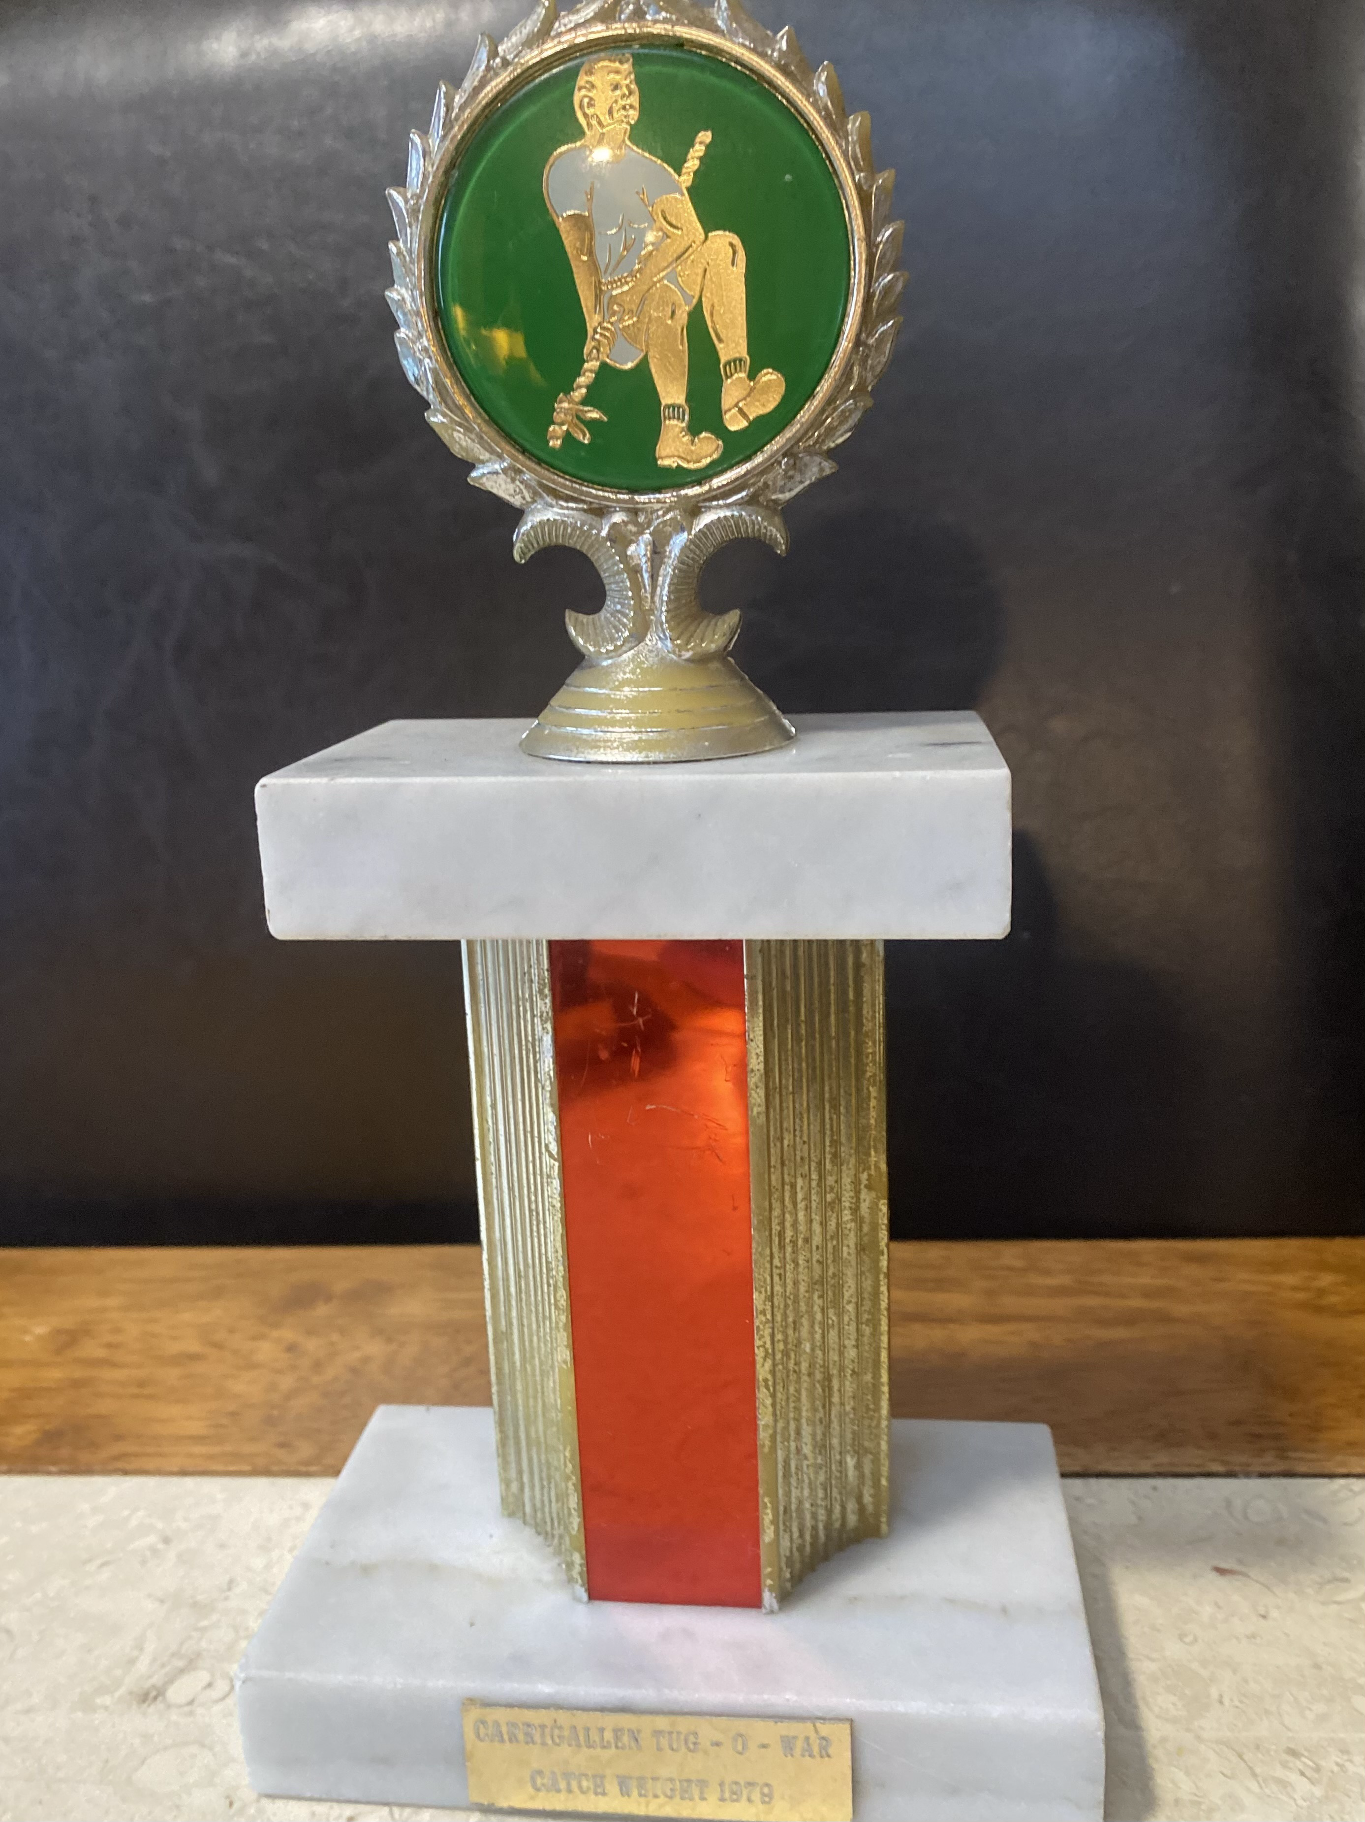
Would you be able to name some of the competitions you were in?
1976: So the first would have been Tierworker Kells then Ballyhaunis, Marlbank
1977: the Connaught championship and Marlbank again, Strokestown
Then in 1978 and 79 we got 2nd and 3rd in the all Ireland and in 79 we hosted a tournament and won
We got 3rd place in the worlds in Dundalk in 1980,.
We won in Manorhamilton and Newport in Mayo

Slide 18
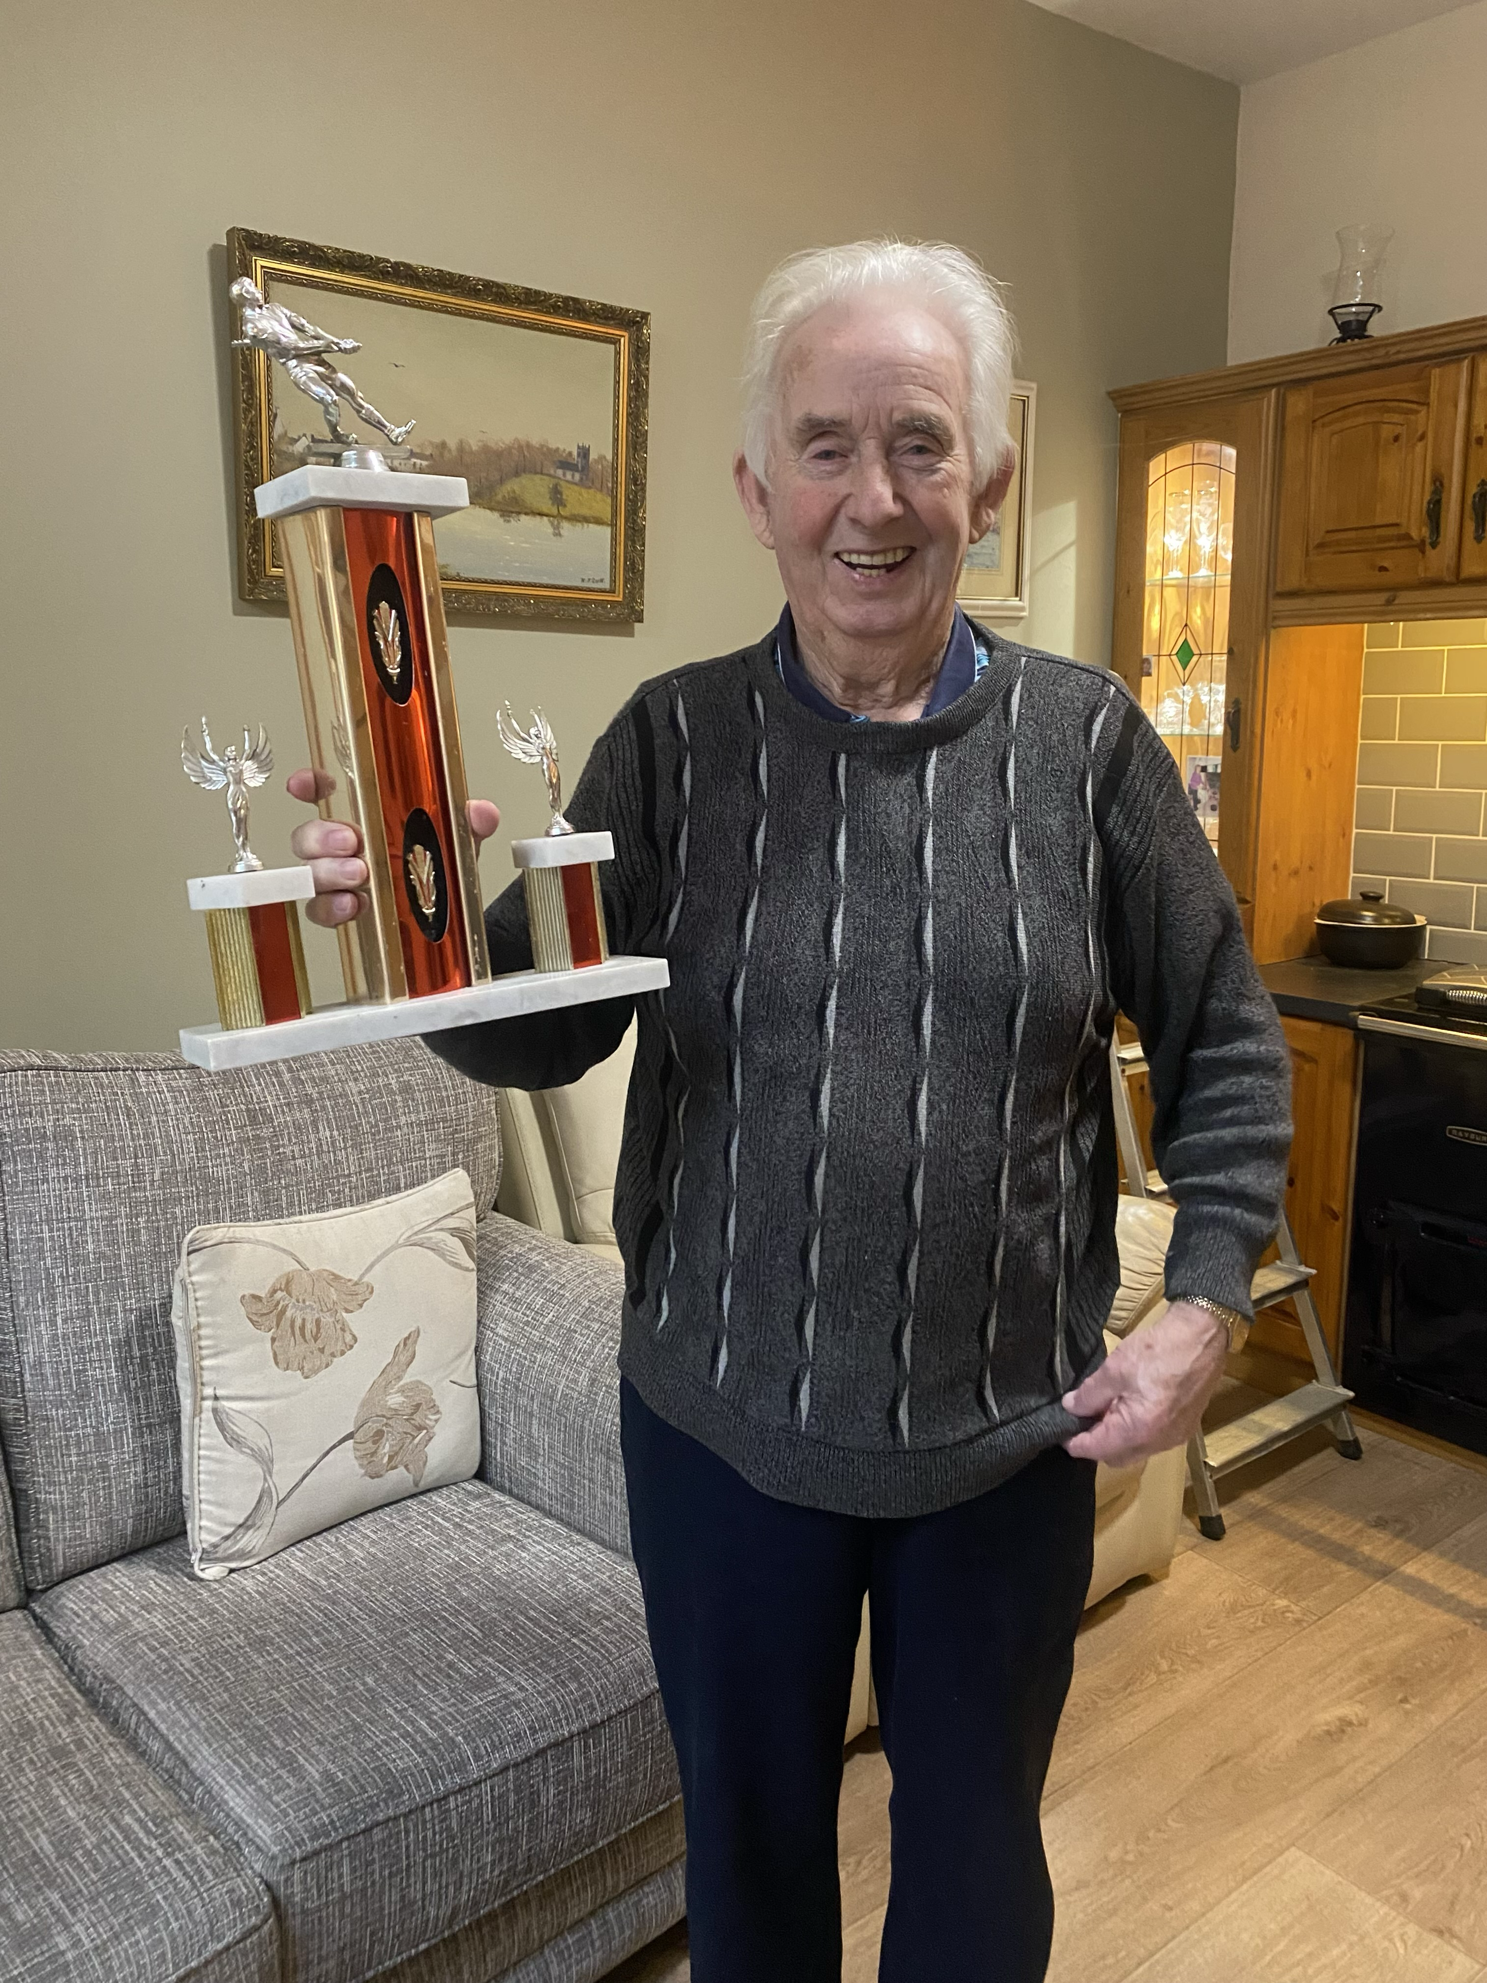
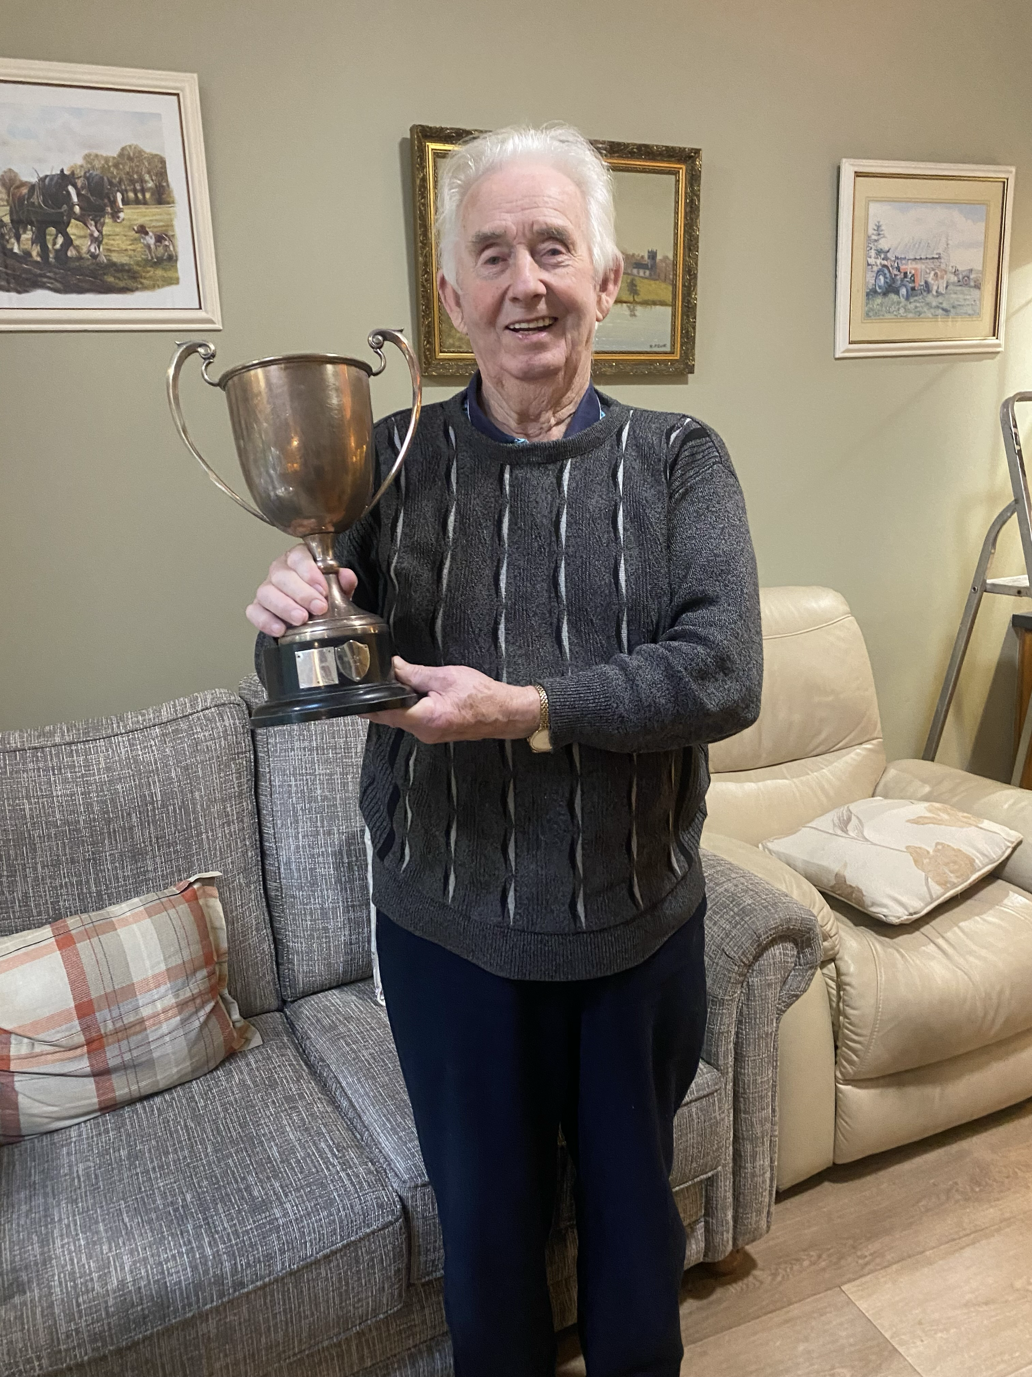
What was the hardest part about the sport?
The trainings were definitely the hardest part, we had to drag tyres and barrels around fields, I remember we also tied a rope to a tractor and all pulled it along the field, it was rough especially the first few trainings after a while you’d get used to it.
What was your favourite part about the sport?
My favourite part was definitely winning, just the feeling of trying you very hardest and winning was the best feeling ever and of course the celebratory pints and getting the cup filled in McGuckians pub in Carrigallen.
My grandad with one of the teams winning trophies
Him with the Marlbank trophy .

