Slide 1
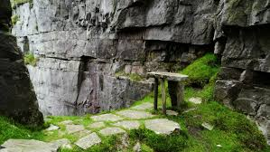
Mass on the mountain: The History of Mullaghgarve Mass Rock
Tara Mahon

Slide 2
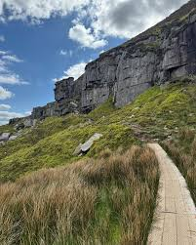
Contents
Introduction (1 slide)
My connection to the mass rock (1 slide)
The meaning of Mullaghgarve (1 slide)
History of the mass rock (2 slides)
Duchas.ie (3 slides)
The mass rock today (1 slide)
Car park (1 slide)
Conclusion and Reflection (1 slide)
Sources (1 slide)
Walkway to the mass rock

Slide 3
Introduction
Mullaghgarve mass rock is a mass rock on Sliabh an Iarainn mountain. A mass rock is a rock where Catholic mass was held during penal times when Catholic people were forbidden to go to mass.
I chose the mass rock for my project because it is near where I live and I have been to see it many times. I have always heard about it from my family but I wanted to know more information about it. I am interested in the history of the mass rock and where it originated from.
The aim of my project is to learn more about the mass rock and present it in a creative and interesting way.

Slide 4
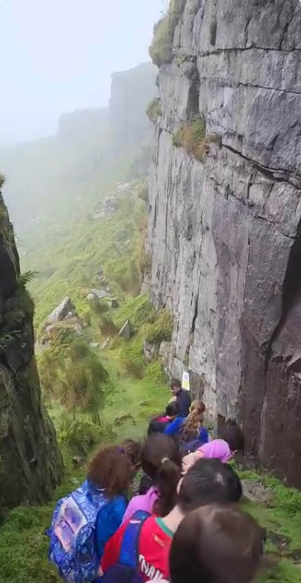
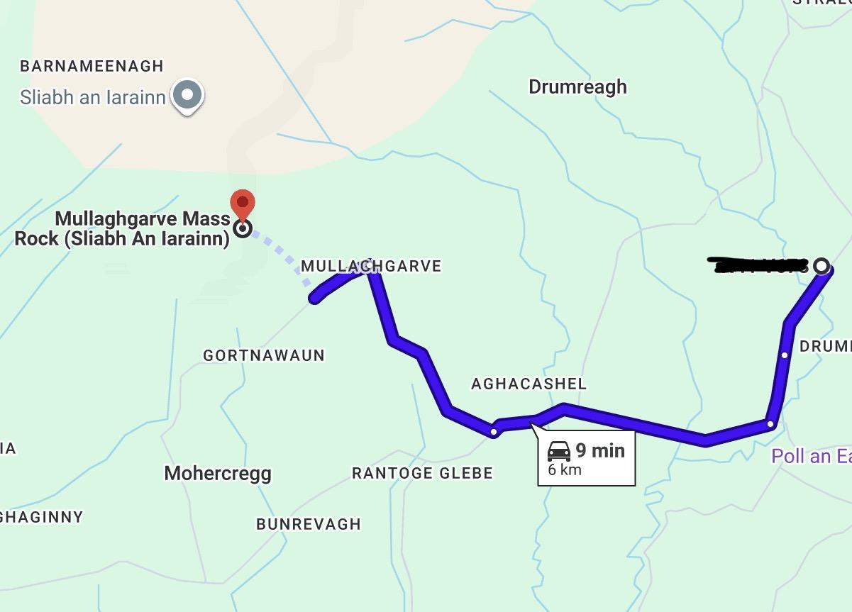
My connection
My connection to the mass rock is that I live at the bottom of sliabh an Iarainn. I have been to the mass rock many times. This is a map that shows the route from my house to Sliabh an Iarainn.
My house
Me at the Mass Rock in July 2024

Slide 5
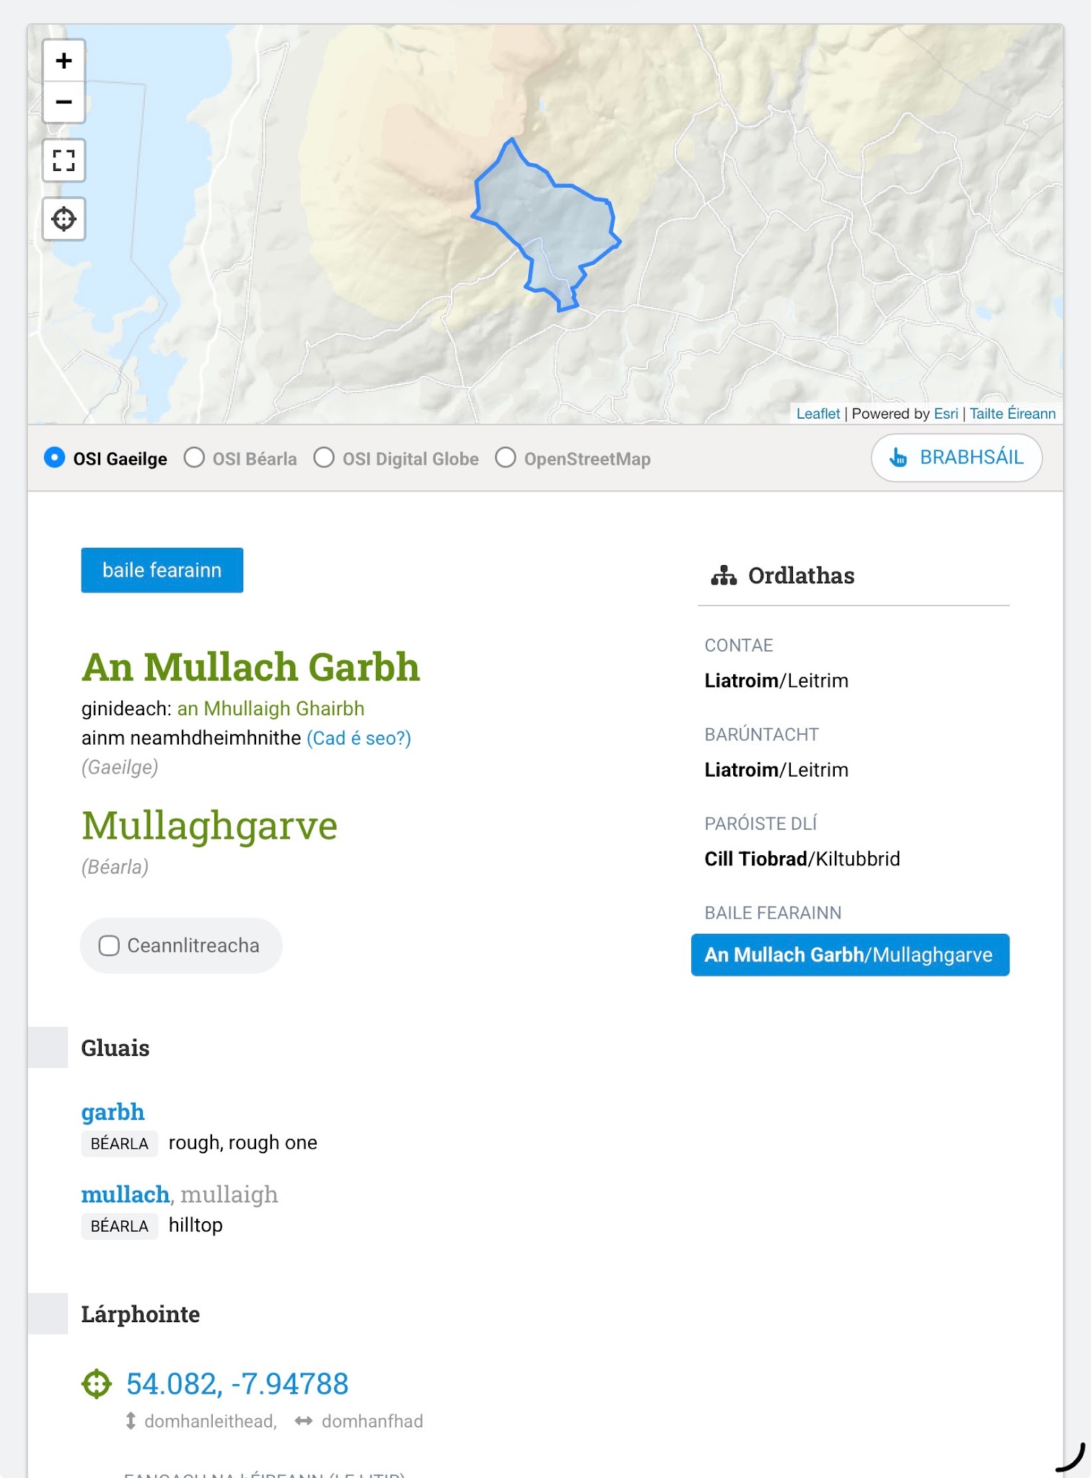
Mullaghgarve Meaning
Mullaghgarve is the English translation of An Mullach Garbh.
Mullach- meaning “hilltop” or “summit”
Garbh- meaning “rough” or “coarse”
This means that Mullaghgarve means “The rough hilltop”. It may be named this way because of the hilltop of Sliabh an Iarainn mountain, which is steep and rocky.

Slide 6
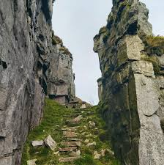
History of the mass rock
Mullaghgarve Mass Rock, located on Sliabh an Iarainn in County Leitrim, is a historic, hidden outdoor altar from Ireland’s Penal Law era (c. 1590–1750). It was used to host Catholic mass during the Penal times because the Penal laws forbade Catholics from going to mass. It was situated in a remote part of Sliabh an Iarainn so that it could not be seen from far away. It is said that priests who said mass here lived in the nearby caves.

Slide 7
History of the mass rock
The first documented reference to religious ceremonies up there was in 1611, when a Jesuit Priest came on a mission to Longford and came on into Leitrim. He spent a week there; preaching, saying Mass and hearing confessions, along with other priests.
7 people were jailed for attending mass. They lived in horrible conditions, which are well documented. Priests who said mass there disguised themselves using bagpipes and juggling.
It is believed that mass was celebrated at Mullaghgarve mass rock for almost 150 years, up until 1750.

Slide 8
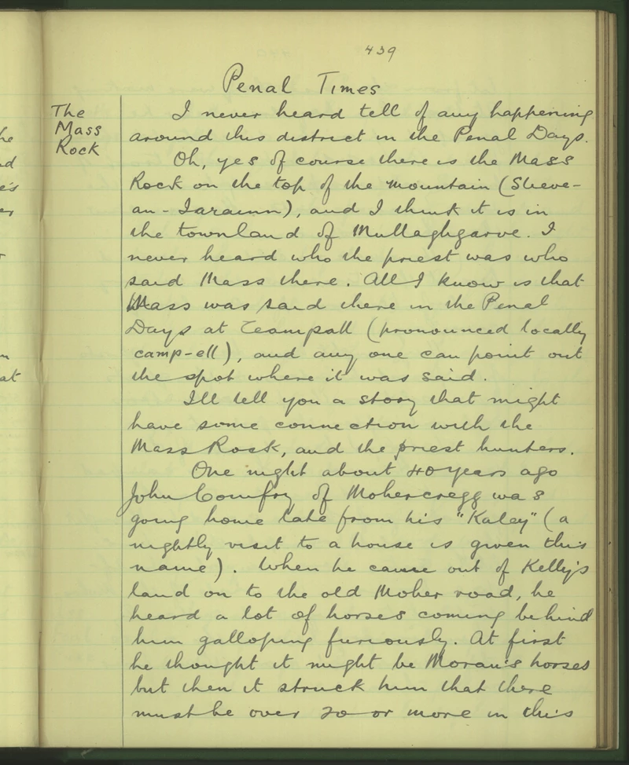
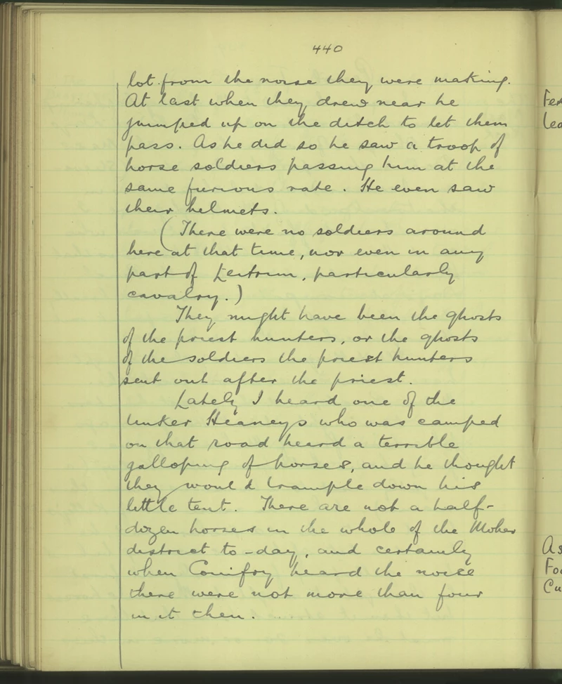
Duchas.ie

Slide 9
Transcription
The Mass Rock
I never heard tell of any happening around this district in the Penal Days.
Oh, yes of course there is the Mass Rock on the top of the mountain (Slieve-an-Iarainn). and I think it is in the townland of Mullaghgarve. I never heard who the priest was who said Mass there. All I know is that Mass was said there in the Penal Days at Teampall (pronounced locally camp-ell), and any one can point out the spot where it was said.
I'll tell you a story that might have some connection with the Mass Rock and the priest hunters.
One night about 40 years ago John Conifry of Mohercregg was going home late from his "Kaley" (a nightly visit to a house is given this name). When he came out of Kelly's land on to the old Moher road, he heard a lot of horses coming behind him galloping furiously. At first he thought it might be Moran's horses but then it struck him that there must be over 20 or more in this
lot from the noise they were making. At last when they drew near he jumped up on the ditch to let them pass. As he did so he saw a troop of horse soldiers passing him at the same furious rate. He even saw their helmets.
There were no soldiers around here at that time, nor even in any part of Leitrim, particularly cavalry).
They might have been the ghosts of the priest hunters, or the ghosts of the soldiers the priest hunters sent out after the priest.
Lately, I heard one of the tinker Heaneys who was camped on that road heard a terrible galloping of horses, and he thought they would trample down his little tent. There are not a half-dozen horses in the whole of the Moher district to-day, and certainly when Conifry heard the noise there were not more that four in it then.

Slide 10
Duchas.ie
This shows a story written by someone named Thomas Gallagher from the primary school in Aghacashel. It is about a priest who was walking home one night and heard many horses running down the road. The writer thought that they might have been the ghosts of soldiers from the penal times who were hunting him for being a priest. He jumped into a ditch to escape them and he found that there were many more horses in the lot then there were in the area at the time. This shows that priests were worried about getting in trouble for being Catholic, which is why they had to have secret mass.
“An Teampall” refers to the stone altar where the priests said mass.

Slide 11
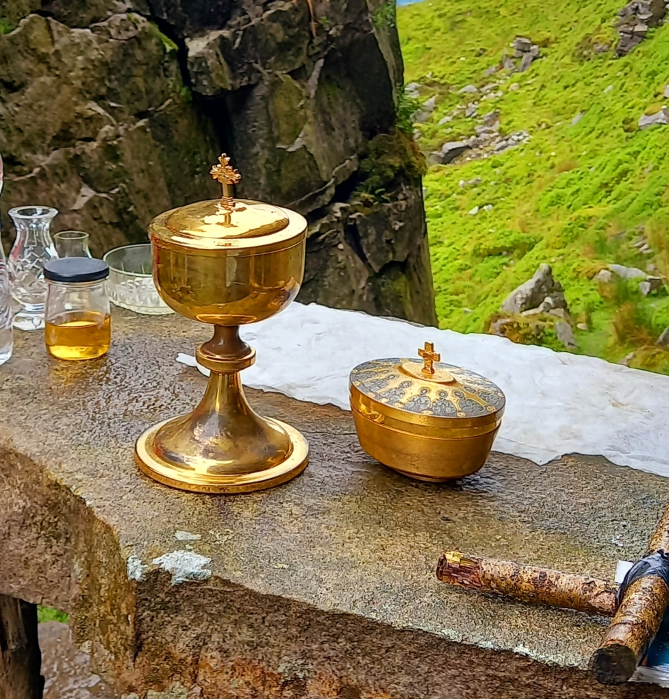
The mass rock today
The mass rock is now a tourist attraction, with many people going to visit it each day. In July 2023, mass was celebrated at the mass rock, organised by Kiltubrid youth pastoral council.
The walk has been waymarked and developed with an access road, car parking facilities and short sections boardwalked. It is considered ‘mildly challenging, with an elevation of 178 metres’. The walk is 3.1km long and takes about an hour to complete.

Slide 12
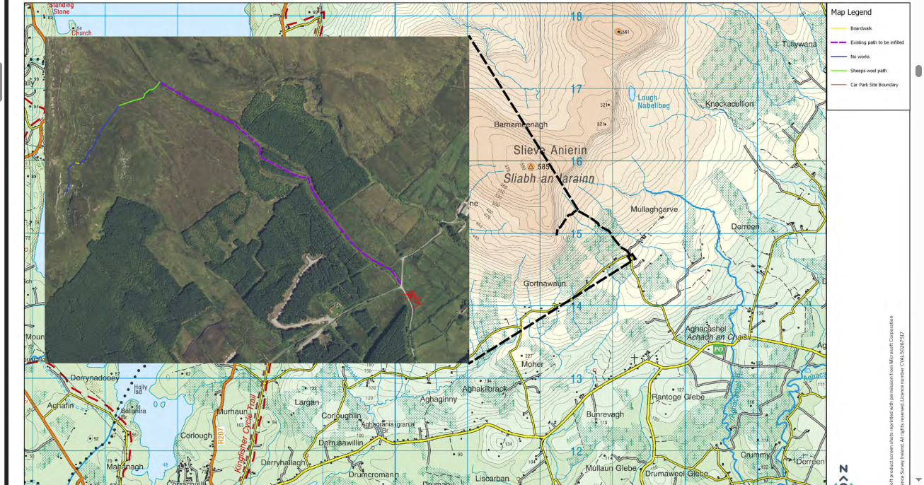
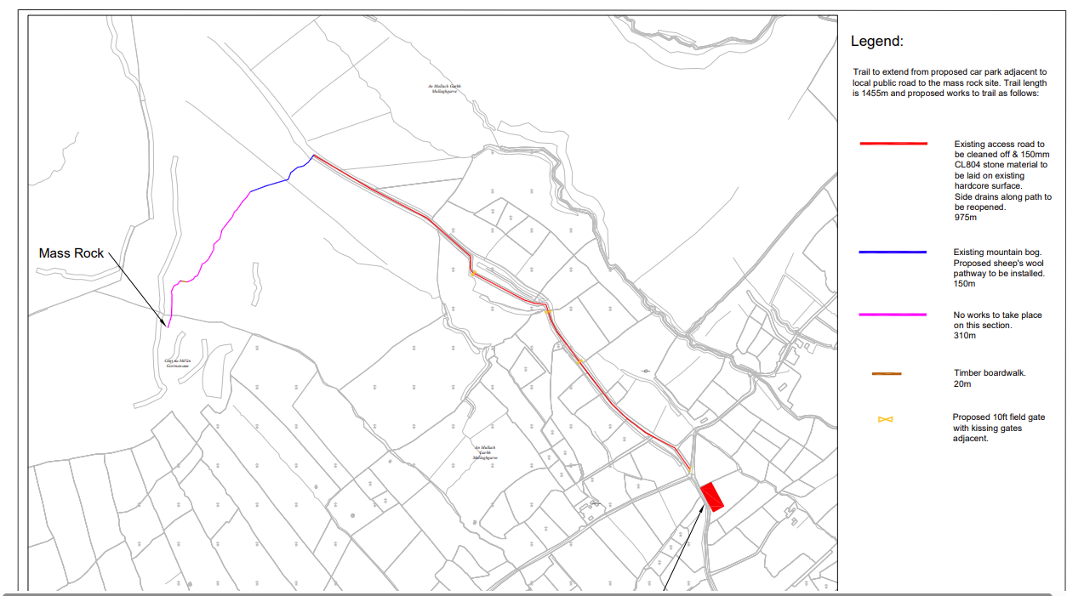
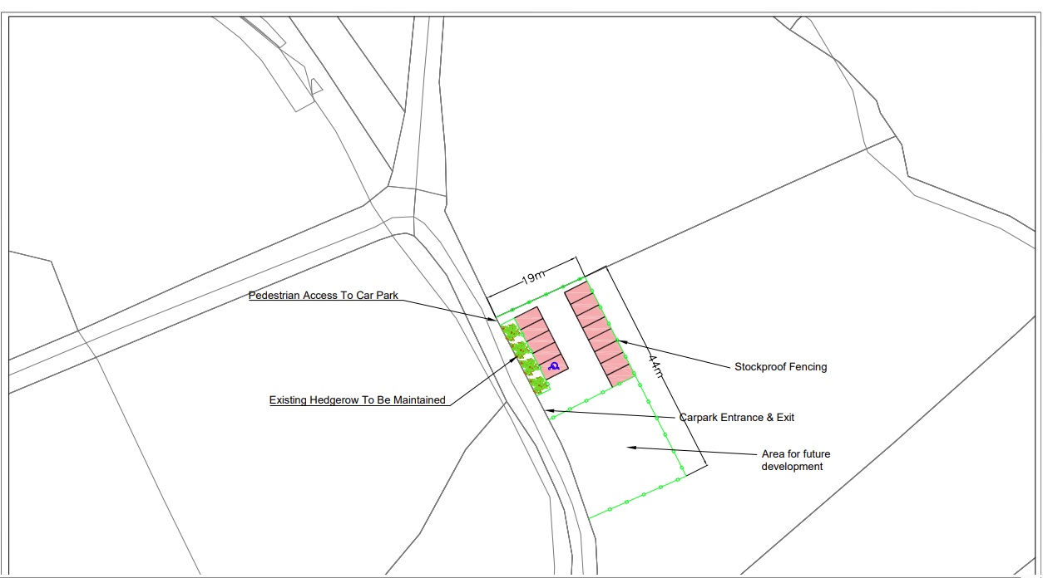
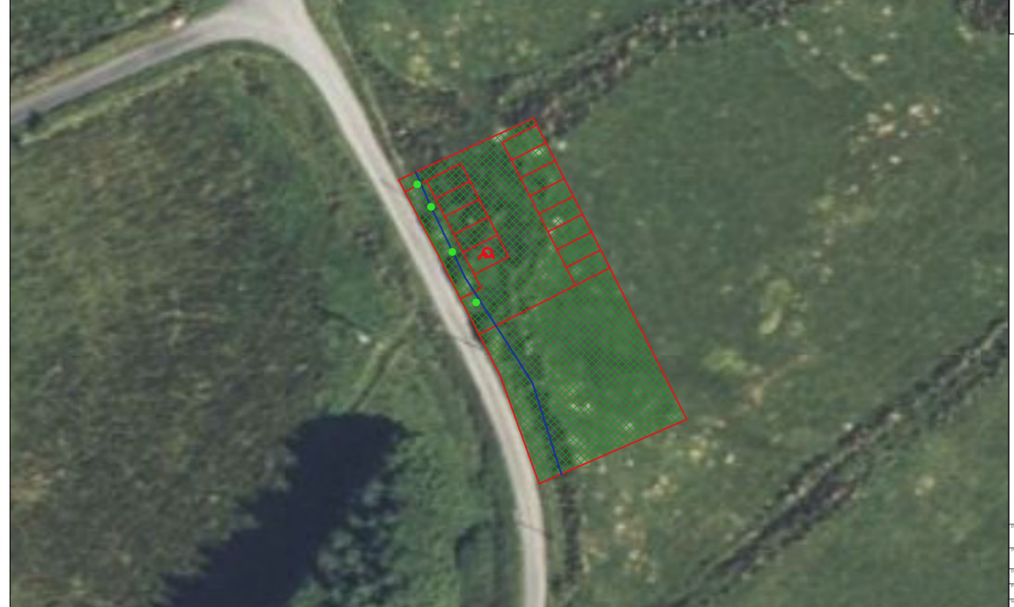
Plans for the car park at the trail (2022)

Slide 13
Conclusion and Reflection
I enjoyed this project because I liked learning about the history of an important landmark in my area. I have always heard about it and I have been to visit it many times but I never fully knew why so many people go on the hike each day. It will be useful to know about this in the future because it means I will be informed the next time I go there. I would have liked to learn more about the history of the mass rock but with the time and sources I had I wasn't able to.
In conclusion, it is clear to me from my research that the Mass rock is a very important part of history in my area and my culture because of all of the history behind it and the connections to different people in the community.

Slide 14
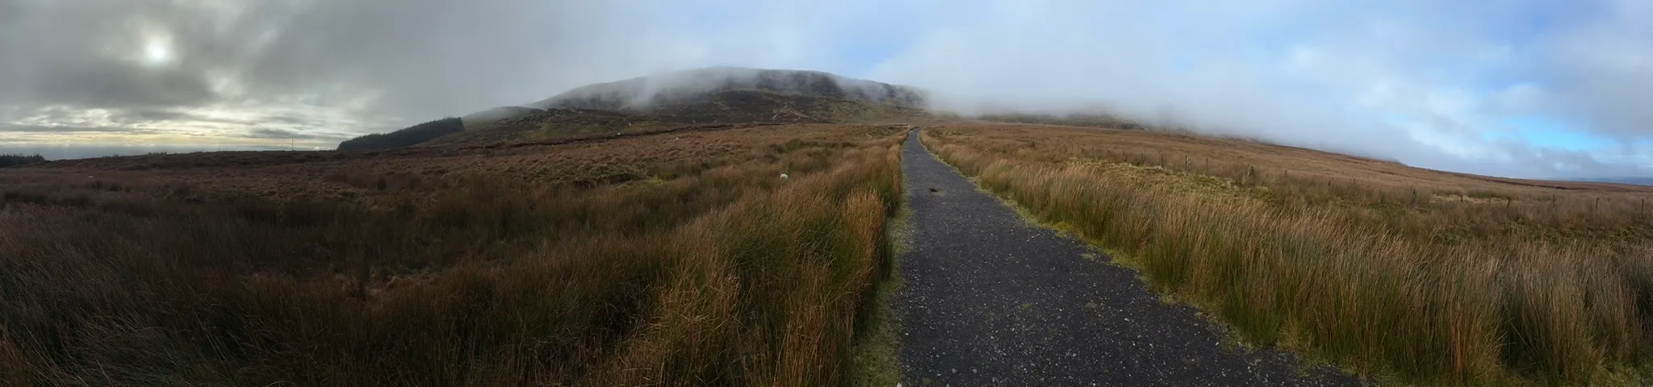
Sources used
School story: Penal Times - The Mass Rock · Aughacashel · The Schools' Collection | dúchas.ie
Meaning of Mullaghgarve: Mullaghgarve Place Name Meaning
The mass rock today/history: Mass celebrated at Mullaghgarve Mass Rock - Leitrim Live
Map: Mullaghgarve Mass Rock Walk Map

