Slide 1
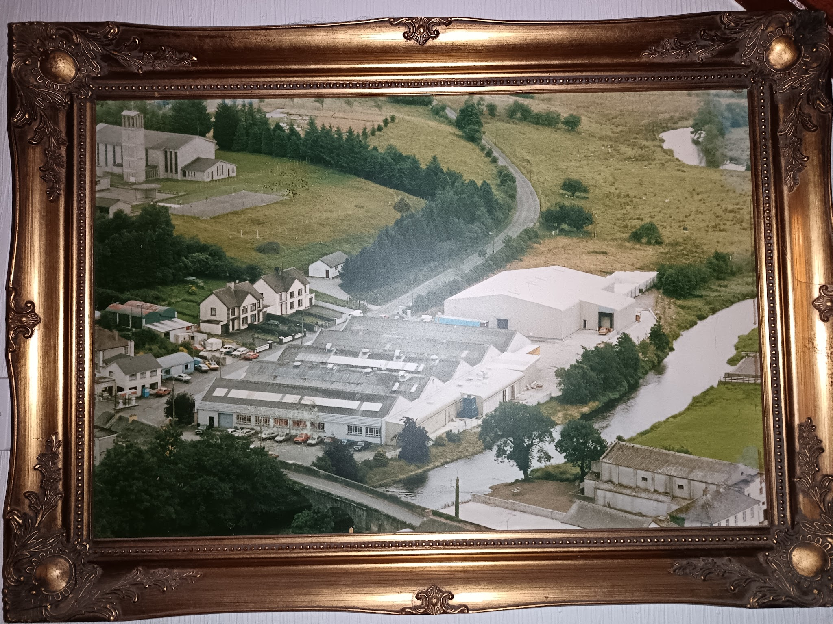
My grandfather - the entrepreneur
by Donnachadh Maguire

Slide 2
Introduction
For this project, I decided to interview my grandfather to gain some historical information on his life and the fact that he was born in Northern Ireland in the 50s, but chose to settle in the Republic of Ireland.
I chose this project because I find modern history from around that time to be very interesting, and I felt that he could give me a comparison of life both sides of the border and answer why he settled in the South.
I conducted an interview with my him, which I recorded on my phone and transcribed some of it into my copybook (so I could make a timeline in my copybook of events), and some will be going directly onto my computer.
The main body of this presentation will be based on the information from my interview that was recorded.

Slide 3
The interview - early days
My grandfather, Johnny Maguire, was born at home (which was normal at the time) on 27th July 1952 in Derrylin, County Fermanagh. He was the oldest boy and the second eldest in a family of 8 children. His family owned a small farm in Teemore where they kept pigs, hens, a few cattle and had a vegetable garden. They were not a wealthy family, earning little money from their farm, and primarily surviving on what they grew/killed. He was saying that wasn’t an uncommon thing at the time, and was keen to stress the ‘simple way of life’ in Ireland in the 60s and 70s.
Growing up in the North, my grandfather said that he never felt endangered and that fear never really came into it. He supposes that growing up in that environment, you became used to the conflict. In his parish, it was primarily Catholic based and apart from the checkpoint stops by the British Army, life was quite normal. Living in a border county in his opinion somewhat diluted the impact of the Troubles in this day to day life.
Johnny only stayed in education from age 5 until 15, which was common at the time. Afterwards he would go on to go to a technical college in Enniskillen for 1 year, and then moved between several forms of employment throughout Fermanagh until eventually settling on spraying and fixing cars, teaching himself how to do so.

Slide 4
Settling in the South
In his early 20s, the initial plan was to work and live in Australia, but this didn’t come to fruition in the end.
Johnny’s brother in law reached out to mention that there was an old filling station and a derelict house for sale in Ballyconnell just across the border in Cavan. He did mention that he did meet a little resistance in his family, with settling in the South.
It had been abandoned for 40-50 years and there wasn’t much interest in it but Grandad saw the potential in the site. It cost IR£17,100 to buy the house and filling station. I was surprised with the low price for the time, given how expensive property is now.
The filling station was established in 1978 and in that first year, its profits almost paid for the purchase! And that was where the developments to this land began. In 1980, the second story to the house began construction which was much needed as the family expanded (there are 5 children).
During the early days of the business, especially into the early 1980s, my grandfather was also involved in some of the many (sometimes successful) smuggling operations, but says he has a ‘clean slate’! I learned that smuggling in the border regions was very common from everything like car parts to alcohol.

Slide 5
Expanding outwards
In 1985, the opportunity arose to buy a piece of land beside the shop & filling station. It was purchased and a car garage was developed on the site. In its peak there were 6-8 employees who completed repairs, spraying cars etc.
10 years later, Boxmore Plastics were planning to relocate, and the old factory site was up for sale and was in close proximity to the filling station and garage. Johnny bought the old factory and set about developing it in to a supermarket and filling station, eventually closing the original shop.
Grandad did stress, planning laws were not as tight back in the 80’s than they are now. He probably wouldn’t get away with some of the developments now though!

Slide 6
Other questions surrounding the Troubles in Northern Ireland
One major thing that I asked was if he felt that there would ever be a United Ireland, a very politically controversial question, but Johnny does feel it will eventually happen, feeling that England is neglecting Northern Ireland. However he also said that it would take time and would be at a cost, being a big burden on the Exchequer of the Republic of Ireland.
When I asked about what he sees is the biggest difference between both sides of Ireland today (fighting and bombings aside), he said there is little or no difference and that the younger generation wouldn’t understand what went on (checkpoints, customs stops and so on). He also made the important point that guerilla warfare cannot be beaten by a full scale army - it’s a totally different game, that Britain had one of the best armies in the world and couldn’t beat the IRA, so they had to sit down and talk, leading to the 1994 ceasefire and 1998 Good Friday Agreement.

Slide 7
Mapping out the area
The garage - that area is now where I live.
Filling station
This was where Boxmore Plastics left - became the supermarket mentioned previously.

Slide 8
Conclusion
When I was doing this interview, I found that my grandfather did go off on a tangent a good bit and as such I didn’t get to do the interview I hoped (I was hoping for it to be about the North-South divide, which meant I could see how different things were at the time on each side of the border).
Despite this however, I did enjoy it and got to learn multiple things about his work career that I didn’t know before, including the initial plan to work and live in Australia, the initial price for the filling station and house being low compared to the majority of prices today (IR£17,100 in 1977, today that wouldn’t even get you a tent) and also the fact that he himself sprayed cars previously.
In conclusion, whilst I didn’t get to answer the points I was hoping to answer, I did learn some new stuff about his life and careers that were unknown to me before.

