Slide 1
Young Historian Award”25-26”
Her Soil, Her Story: A Life Carved into History
By Arsen Panchenko

Slide 2
Introduction
1
2
3
4
5
My great granny - Matrona Shpygotska
Early Life
Mid Life
End of Life
Family tree

Slide 3
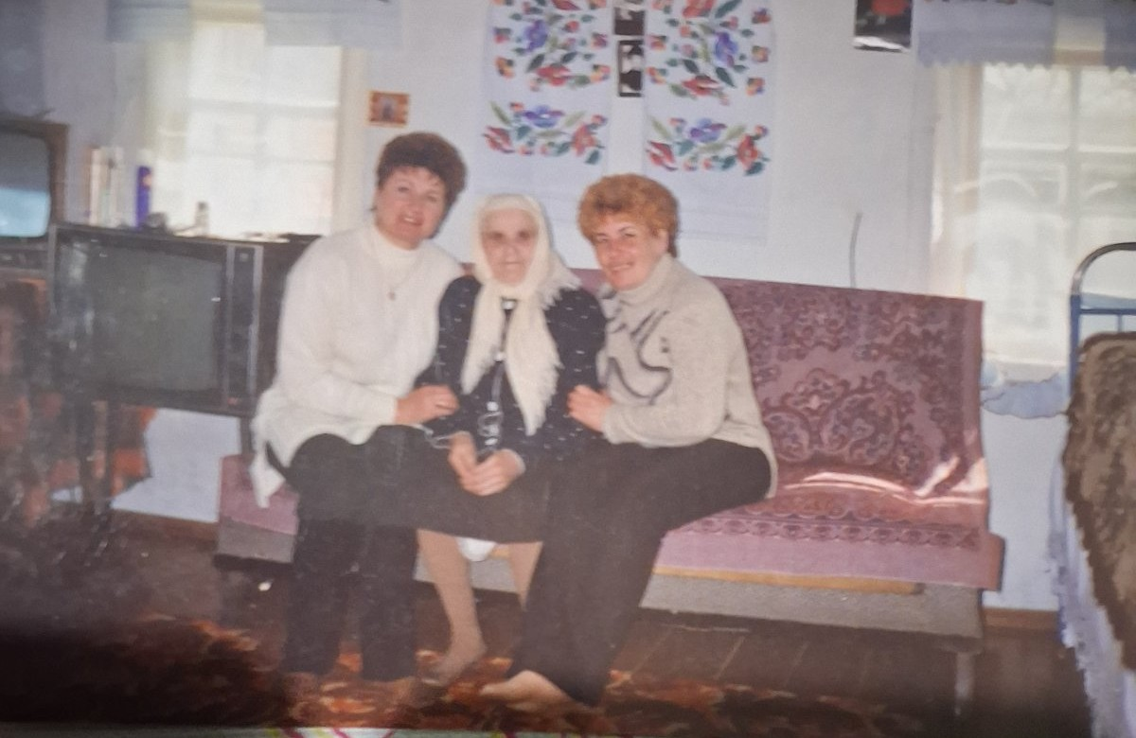
My Great Granny
Matrona Shpygotska is my great granny. She was born in the 1924 in a
big family that wasn’t poor and she had 11 siblings. Through her life she
saw a lot of struggle such as Holodomor and WWII. She was a healthy
woman because for whole her life she was in the hospital only 3 times
when she gave birth to her children. She lived 98 years and died in 2022.

Slide 4
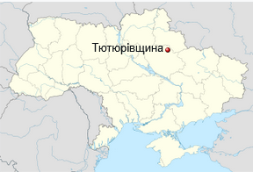
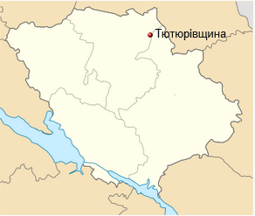
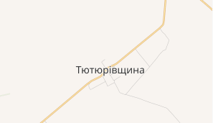
Early Life
Matrona was born in 1924 in the village Tuturivshina. At the age of 3 the USSR’s government took everything from them (house/land/livestock) and her dad Joseph was shot by the government, all of them had to live in a rent house that had one room for 7 children and their mother Melania. They only had one pair of shoes for whole family. At 1932 came Holodomor, they had to eat different plants and they had a cow, some of the managed to survive but 5 of children died

Slide 5
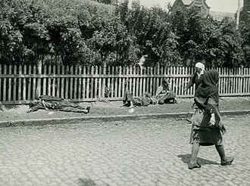
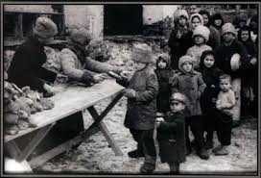
Early Life
The Holodomor was caused because of the government that wanted to take people under control. They were scared that inside of Ukraine people helped each other and made their own communities. Scientists said that roughly 3.5-5 million people died but everyone knows that this number is much higher but the USSR hid it.

Slide 6
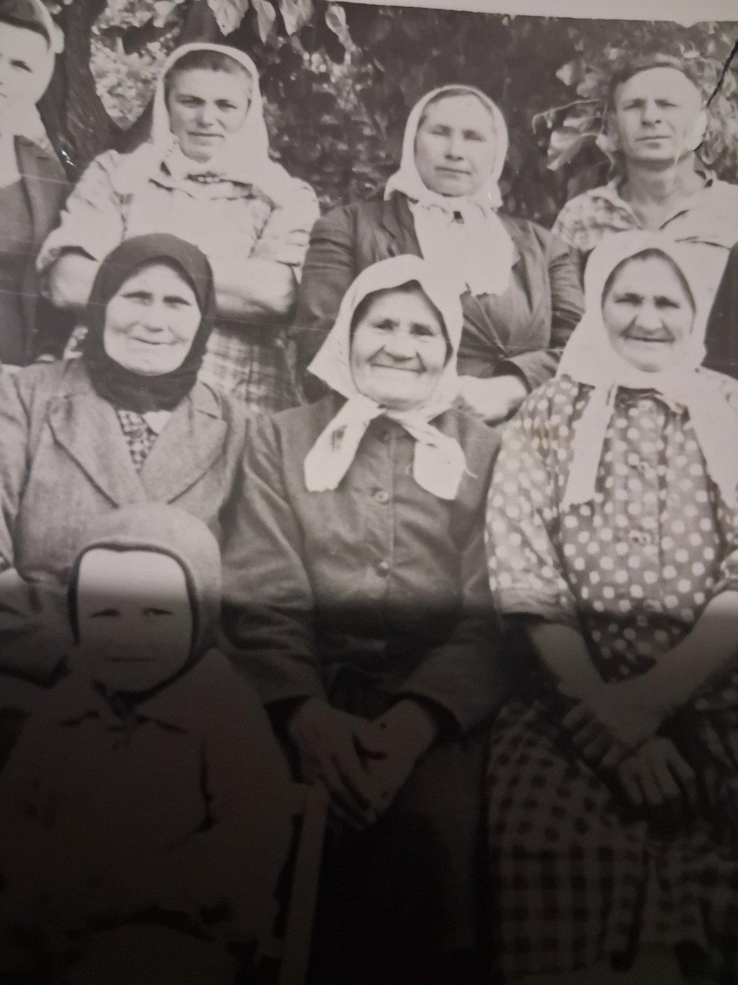
Mid Life
Not long after Holodomor came WWII. Matrona was just a teenager when the war came and she worked in the mine shaft(until the war finished) and dug trenches for the soldiers and brought food and water to them. The war came to their land at around 1942 and her older sister Hanna was taken to Germany to work in the factory. Her older brother was taken to the German captivity and was counted as dead but in reality he was lucky to be taken on a German man’s farm to work and he survived.

Slide 7
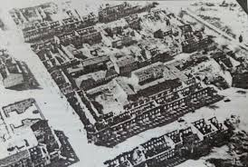
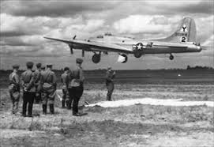
Mid Life
At that time siblings tried to build a new house for themselves but came again the Soviet government and took it away. At the age of 25 she got married and a year later she gave birth to her first child. When she got married she moved to another house that was new and during the war the German soldiers lived in it. At that time the house was the biggest house in the village.
This house still standing even after 100 years. They had a few good bits of livestock left.

Slide 8
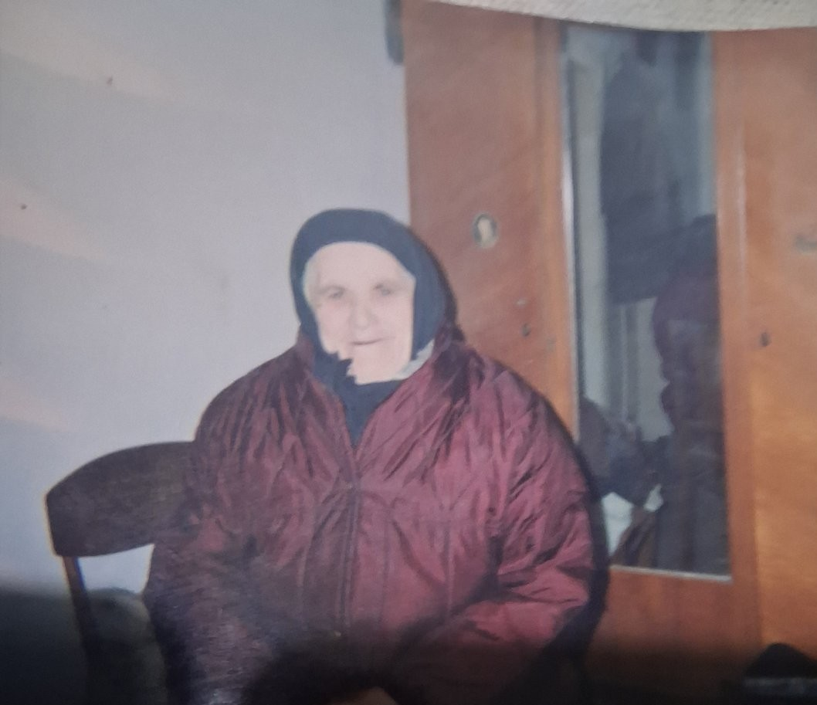
End of Life
Her documents were changed, she was made two years younger in her passport and in the birth certificate. It was done because of the problems in the law. She worked on the collective farm until 60 years old when everyone could retire at the age of 55. As well at that time people had to work the labor days if they worked on collective farms. For the year they had to work 360-365 labor days but Matrona did 370 every year because she worked double shifts. For her hard work she got the Veteran of Labor medal. In 1988 her husband died. She lost her vision at the age of 75. She had 3 children and 5 grandchildren. She died in 2022 at the age of 98 years old.
Notes:
Labor day
is a unit of labor accounting in collective farms of the USSR (1930–1966), which was not equal to a calendar day, but determined the collective farmer's share in the profits of the artel. For labor days, peasants received payment in kind (grain, products) or meager money at the end of the year, which was actually a form of forced labor
The Veteran of Labor medal is a USSR award (established in 1974) awarded for many years of conscientious work after reaching retirement age.

Slide 9
Sources
My family
Wikipedia
I asked my family to tell me about my great granny by the phone. strengths - source that I can trust and find information that I can't in google
weakness- don't have very correct dates of moments that happened
strengths - huge base of data and correct dates
weakness - doesn't have information about my granny

Slide 10
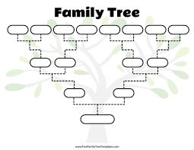
Family Tree
Joseph
Zuban
Melania
Zuban
Ivan
Holdenok
Maria
Veremeeva
Volodimir
Prokopev
Ludmila
Prokopeva
Myhailo
Panchenko
Hanna
Panchenko
Mykhailo
Shpygotsky
Matrona
Zuban
Anatolii
Holdenok
Natalia
Prokopeva
Valera
Panchenko
Lida
Shpygotska
Tetiana Holdenok
Bohdan
Panchenko
ME

Slide 11
THANK
YOU!

