Slide 1
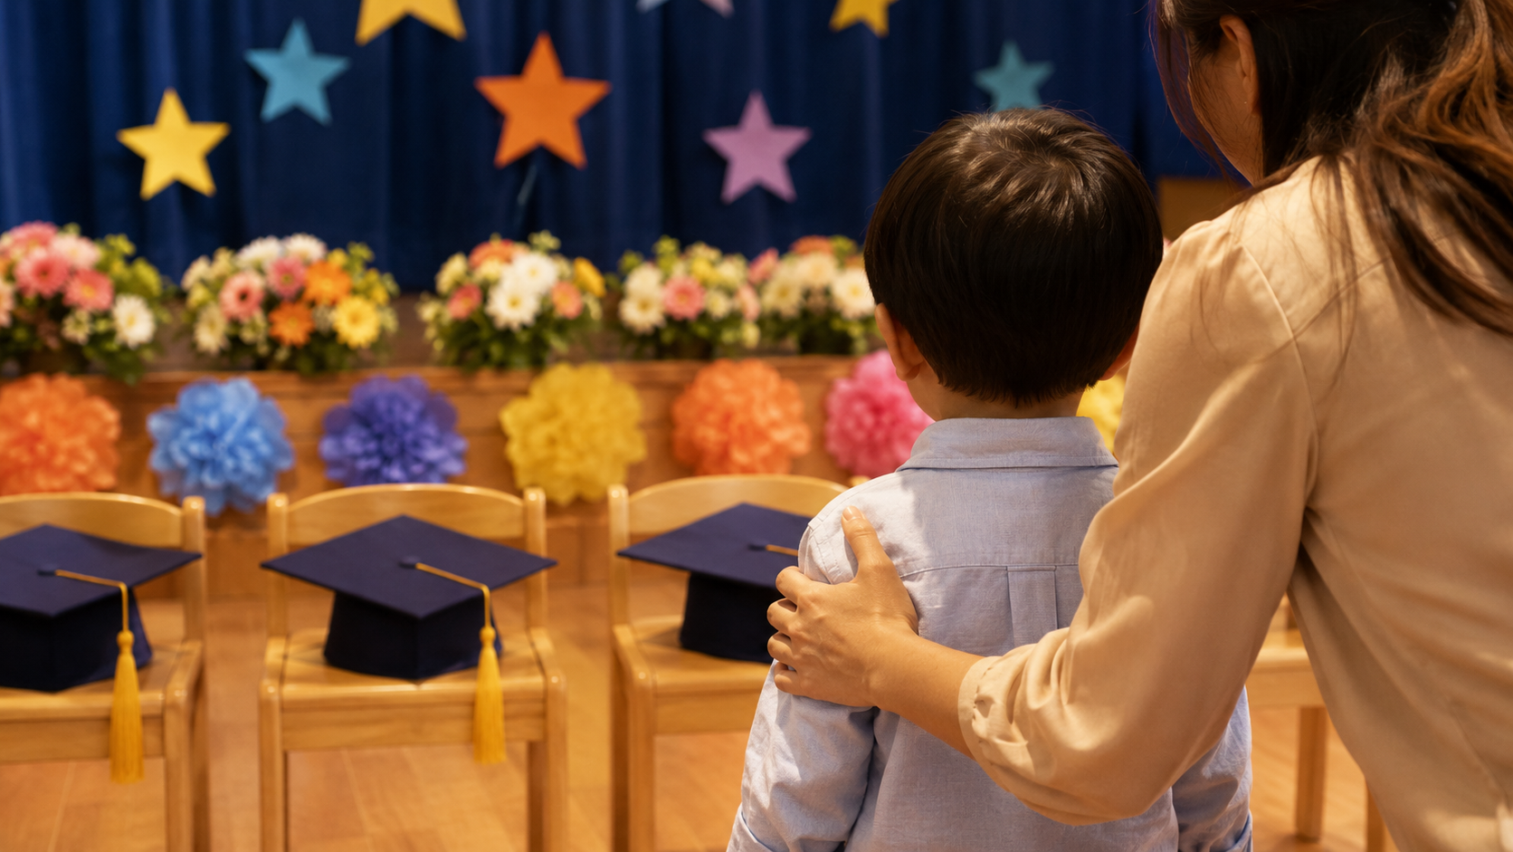
Graduation Celebration
Congratulations, Graduates!
Westminster Preschool Friends
Kindergarten is calling — and you are ready.
Notes:
Source basis: Westminster Preschool Friends location and general preschool description from Westminster Preschool website.

Slide 2
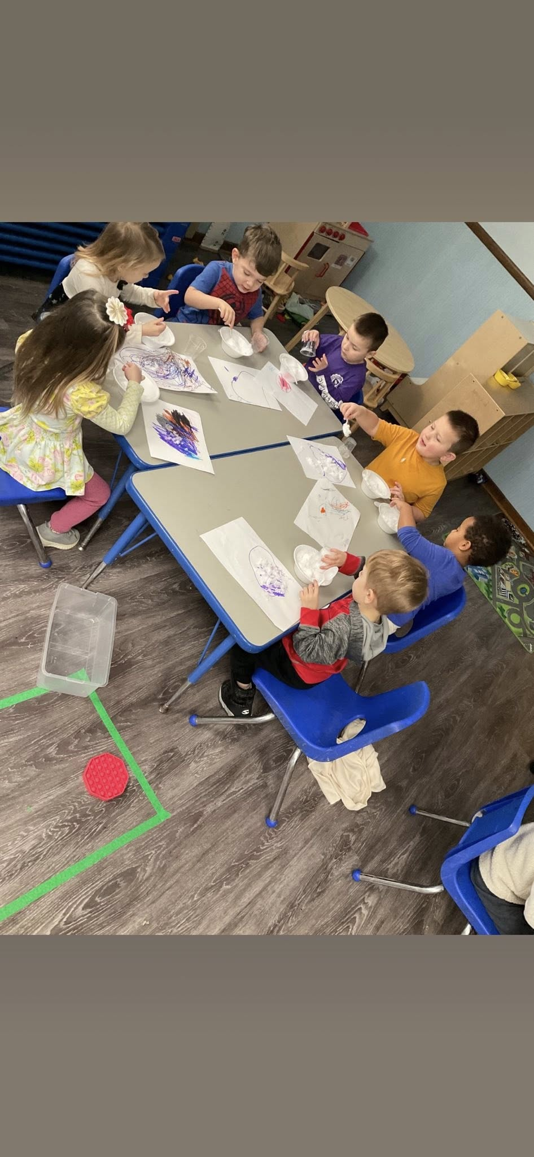
A Place of Welcome
A Christian atmosphere where children are safe, cared for, and invited to grow.
Notes:
Source basis: Westminster describes its preschool as a Christian atmosphere supporting children’s growth and development in a safe and caring environment.

Slide 3
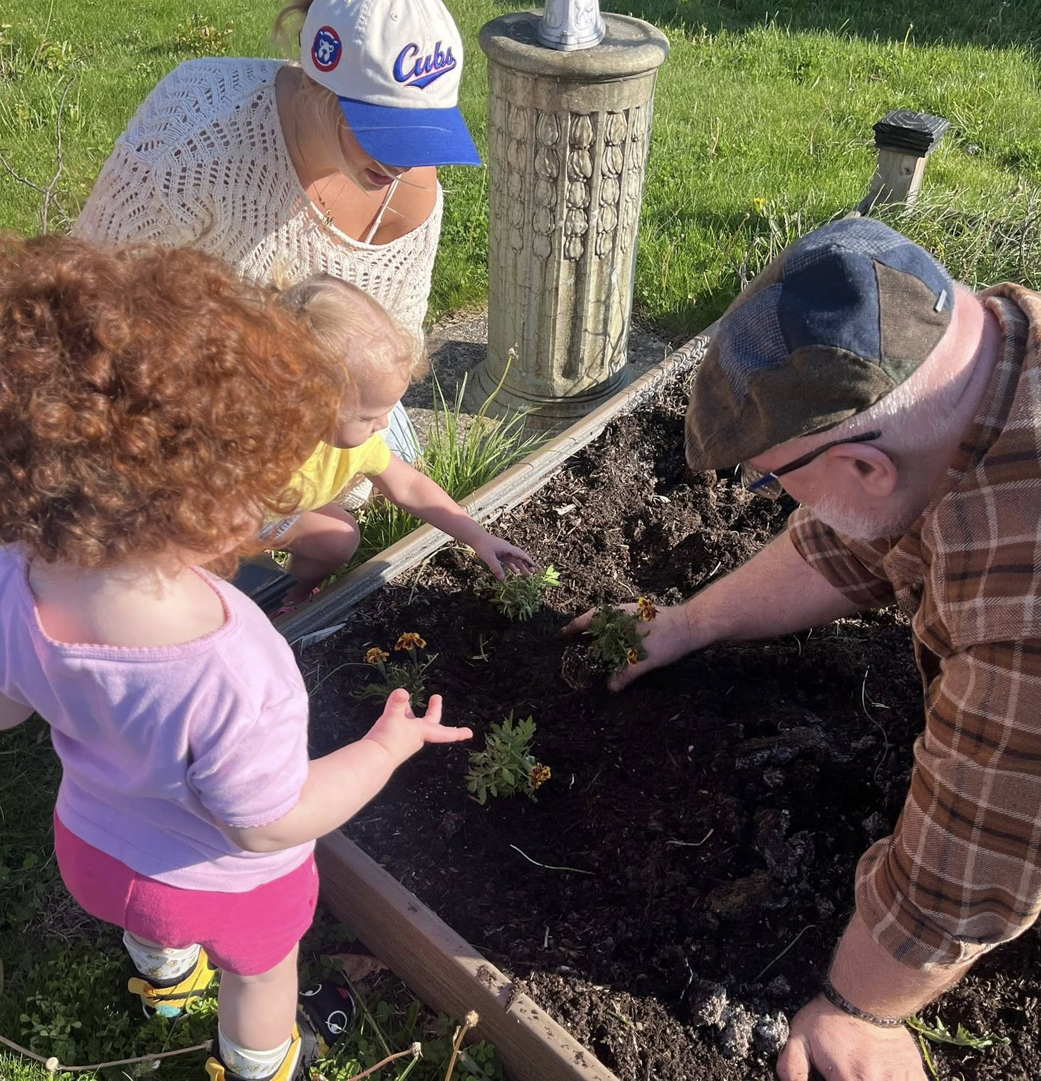
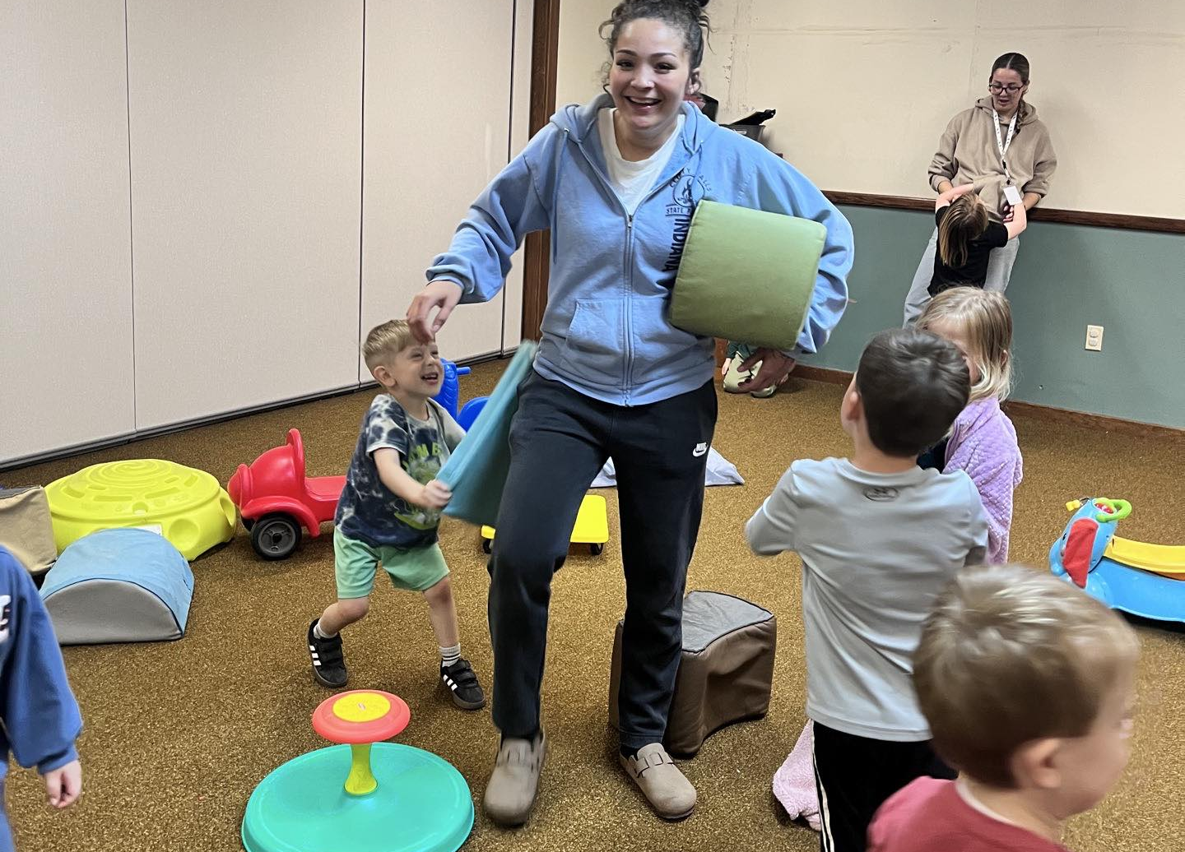
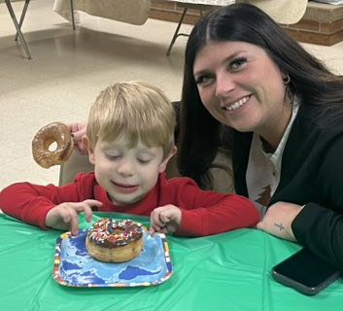
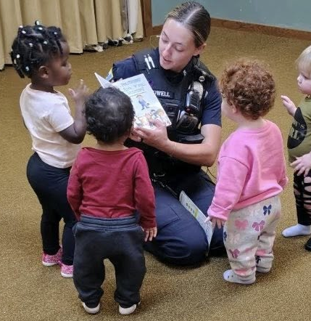
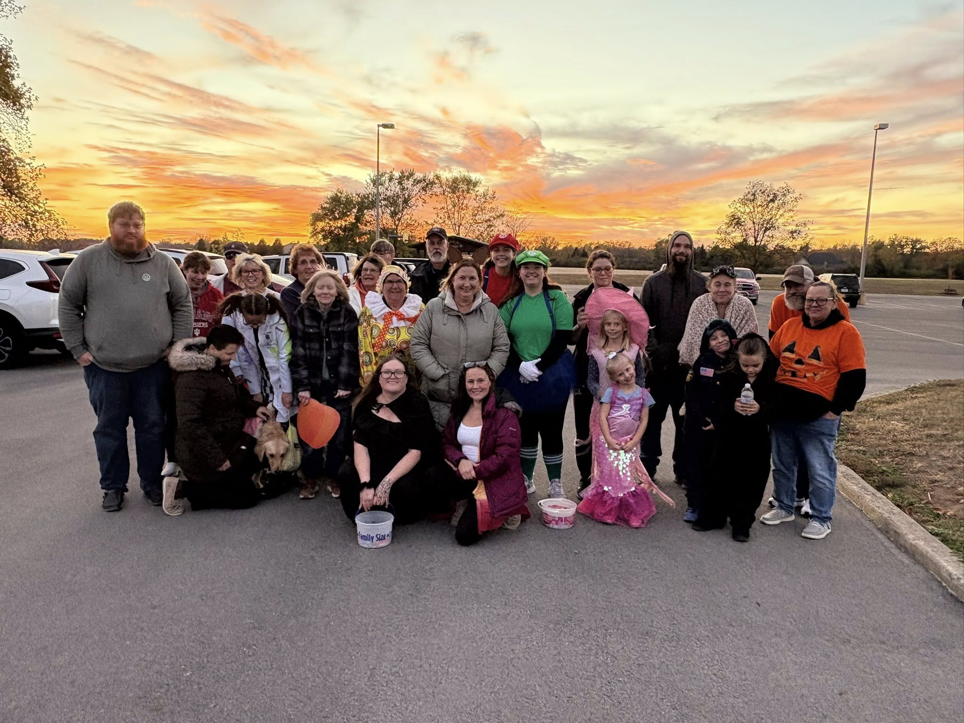
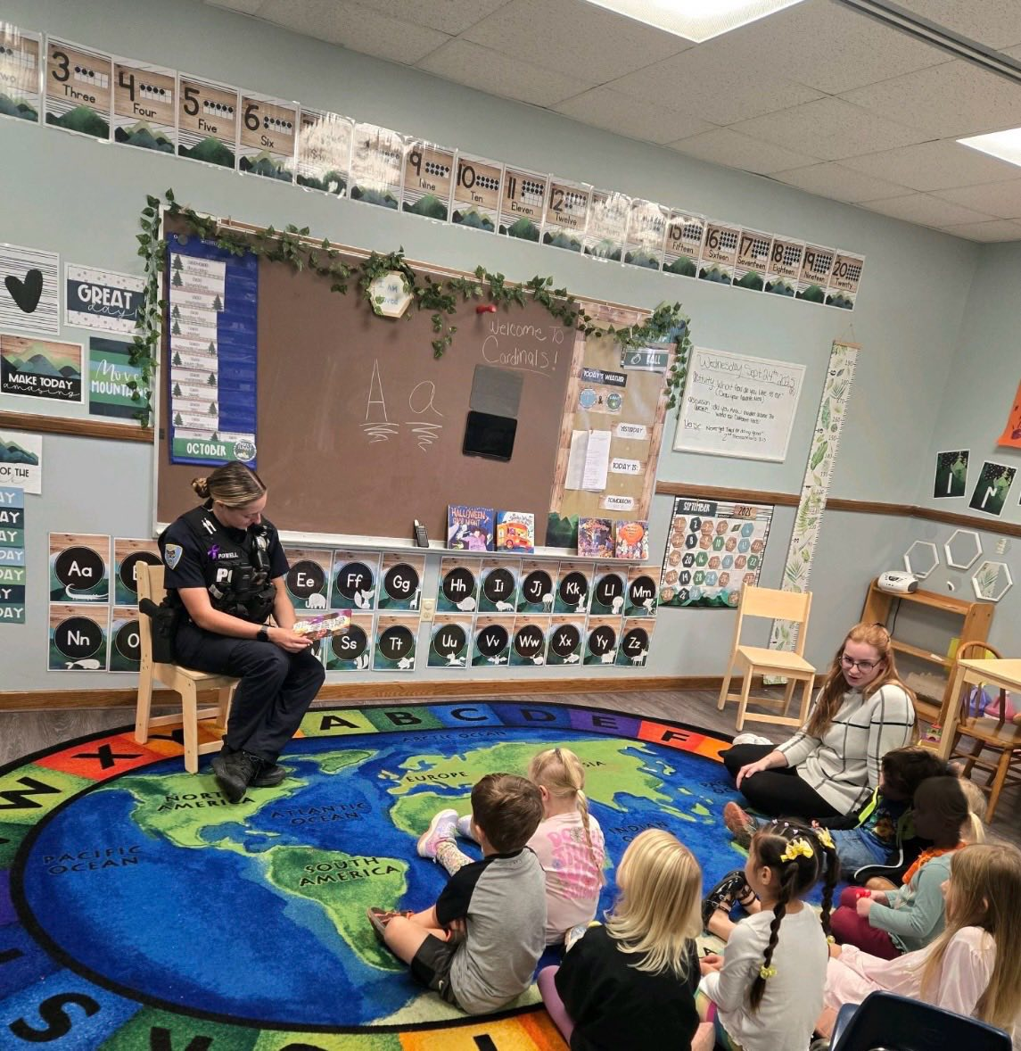
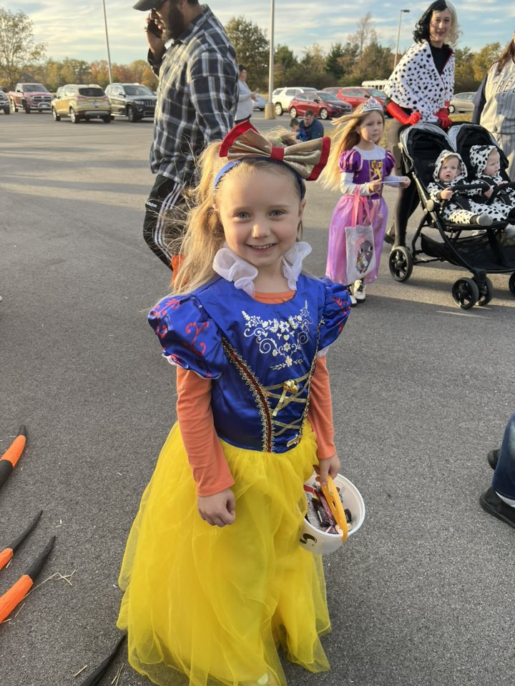
Wonder Leads the Way
Curiosity, natural wonder, and discovery are part of the learning path.
Notes:
Source basis: Westminster names natural wonder, curiosity, and child-centered learning as part of its philosophy.

Slide 4
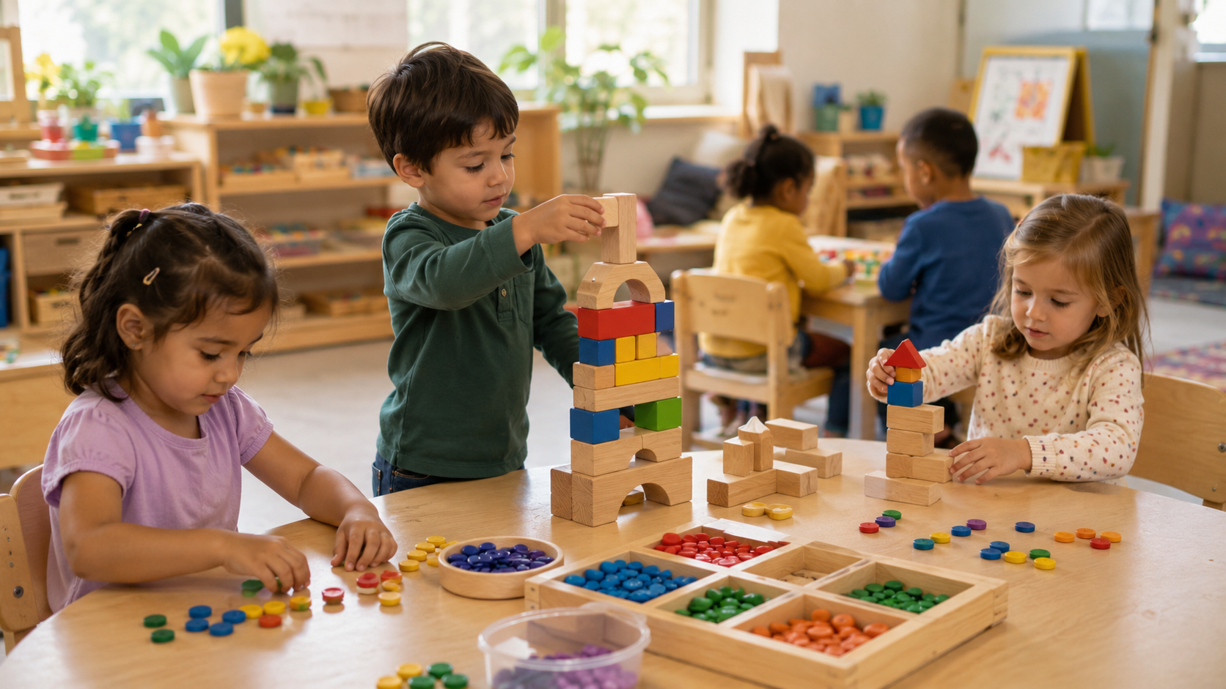
“Play is my work.”
Learning happens with hands, hearts, imagination, and friends.
Notes:
Source basis: Westminster lists “Play is my work” among statements for children and describes itself as play-based.

Slide 5

Whole-Child Learning
Creativity, language, math, science, movement, relationships, and spiritual growth.
Notes:
Source basis: The website describes whole-child learning and areas of development including language, math, science, creative arts, physical growth, and spiritual growth.

Slide 6
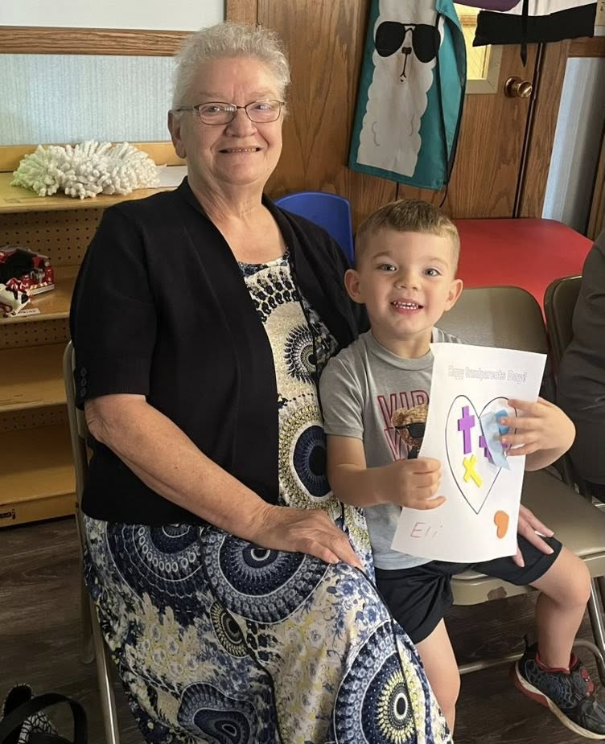
Stories Shape Hearts
Books, words, listening, and love help children become lifelong learners.
Notes:
Source basis: The preschool describes helping children become lifelong learners.

Slide 7
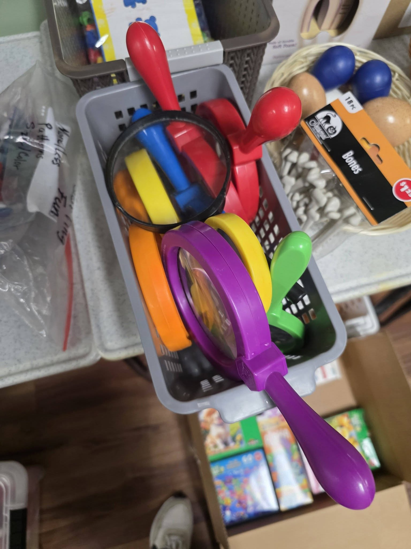
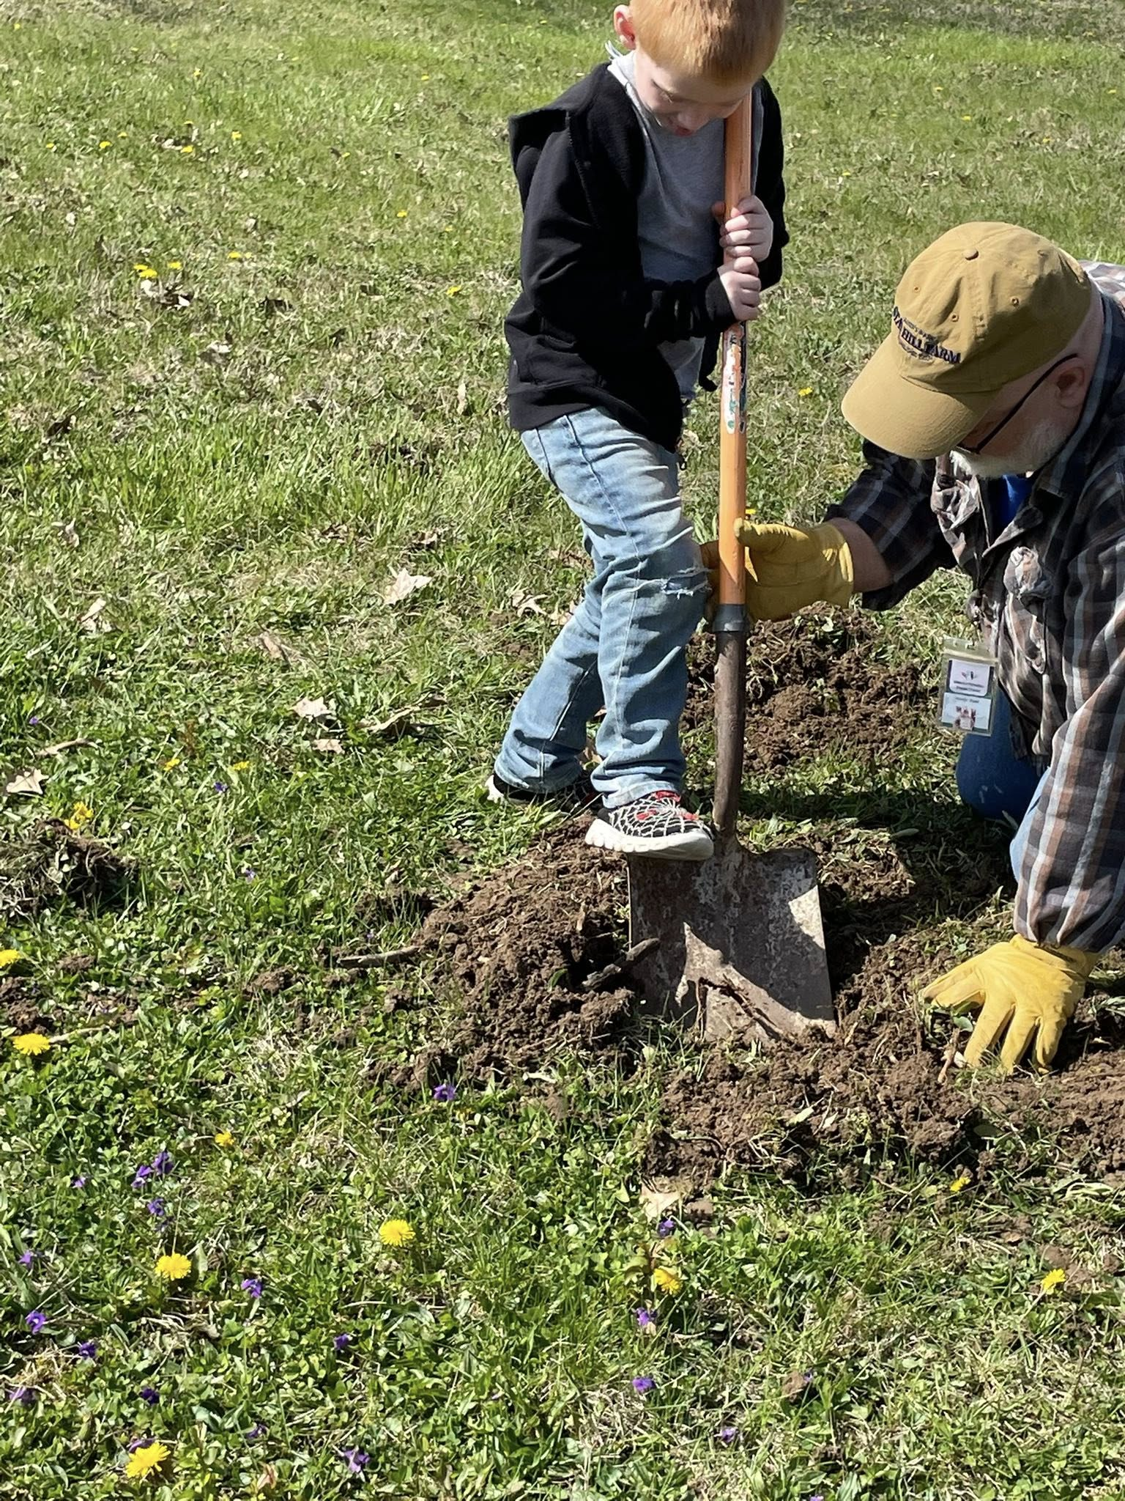
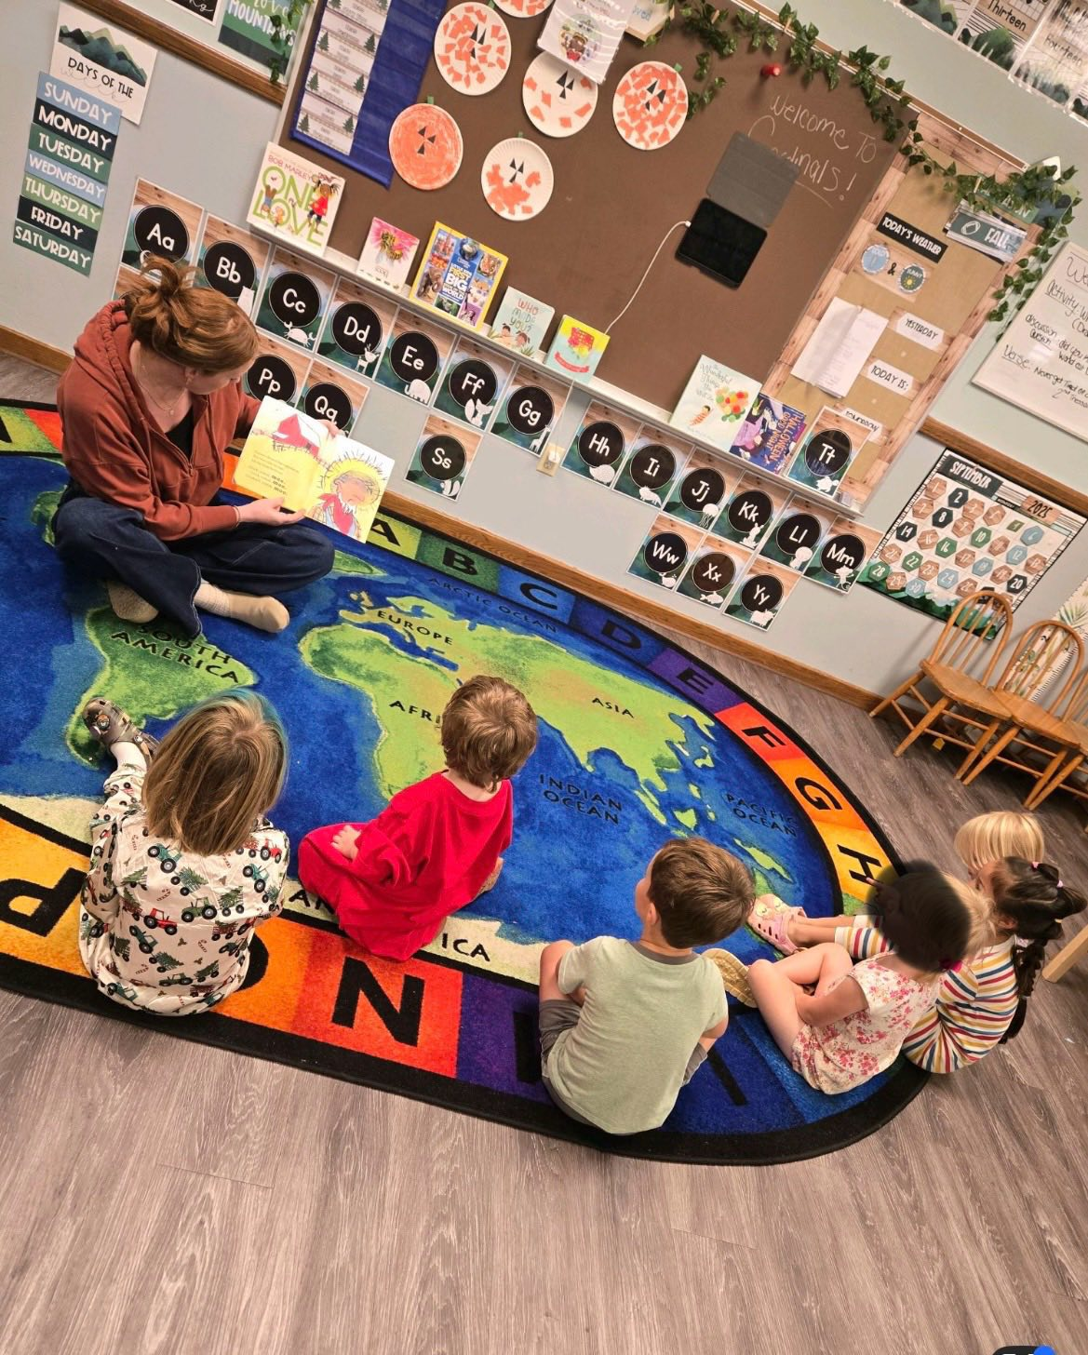
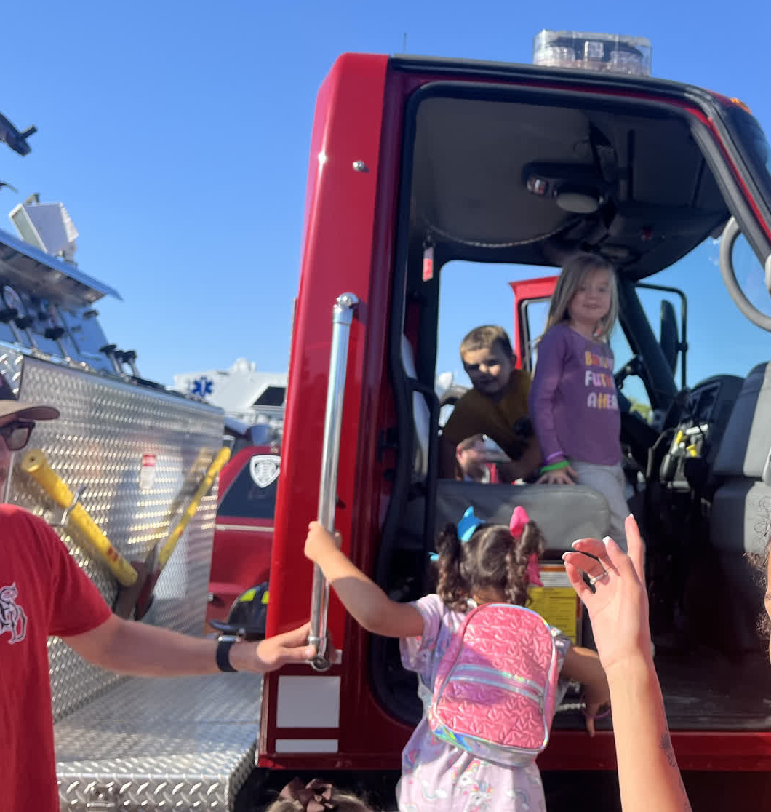
“I can do hard things.”
Kindergarten readiness grows one small brave step at a time.
Notes:
Source basis: Westminster lists “I can do hard things” among statements for children.

Slide 8
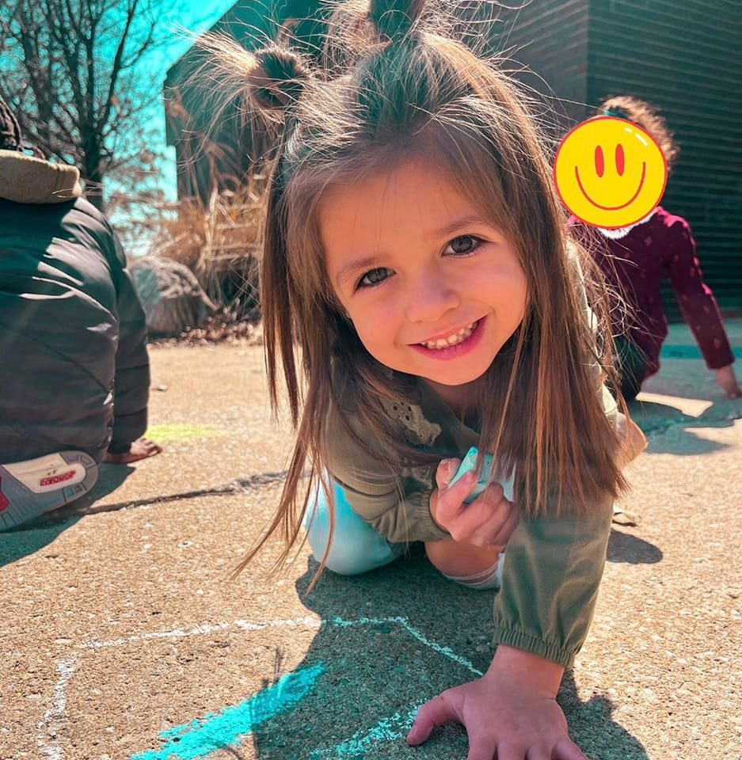
Every Feeling Belongs
Children learn trust, belonging, competence, and care for one another.
Notes:
Source basis: Westminster lists “All my emotions are welcome” among statements for children and describes trust, belonging, and competence.

Slide 9
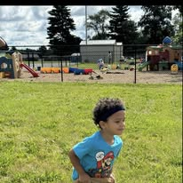
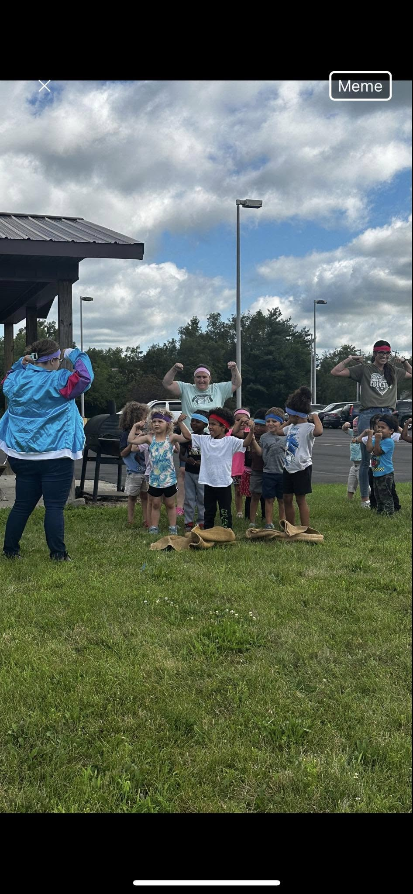
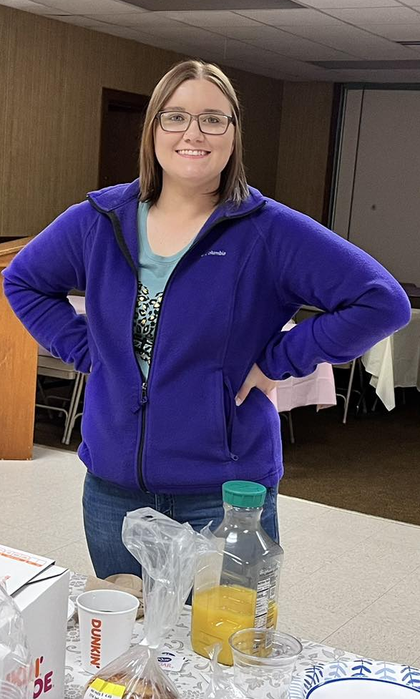
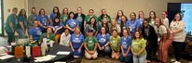
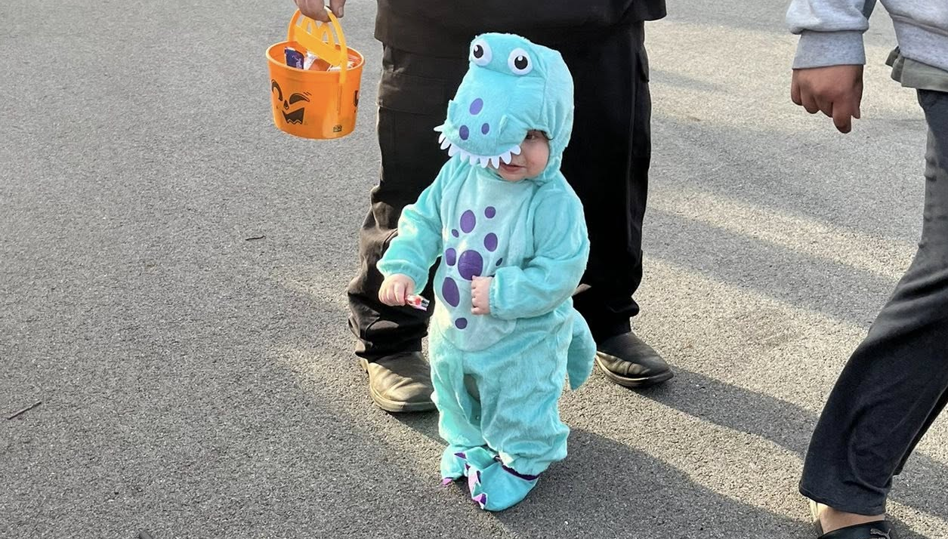
Growing at Their Own Pace
Child-initiated. Teacher-supported. Safe enough to try. Loved enough to grow.
Notes:
Source basis: Westminster says it is child-initiated and teacher-supported, and children develop at their own pace.

Slide 10
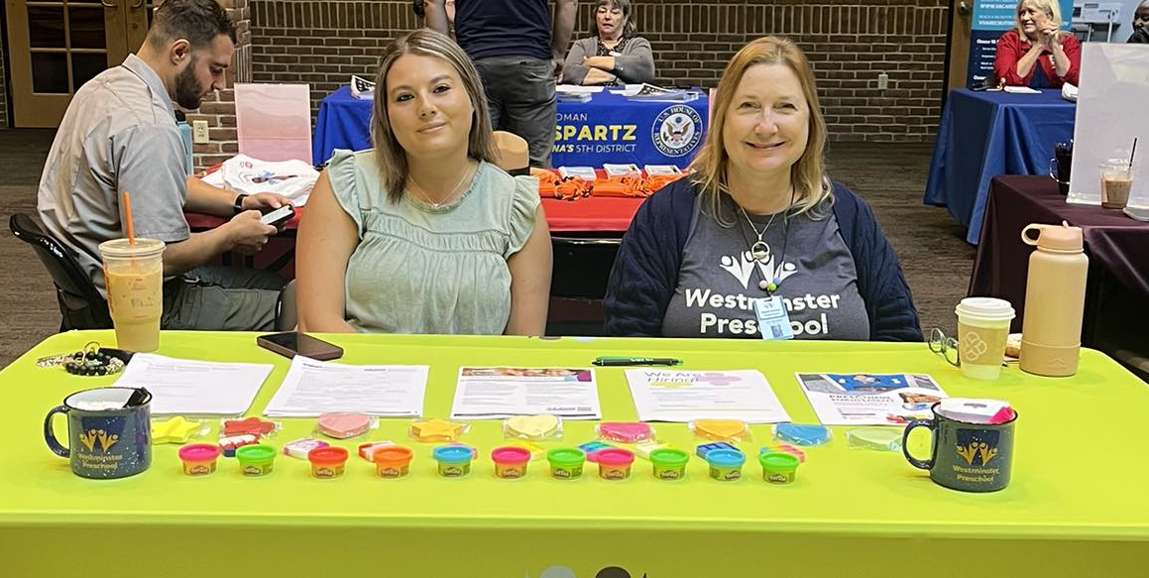
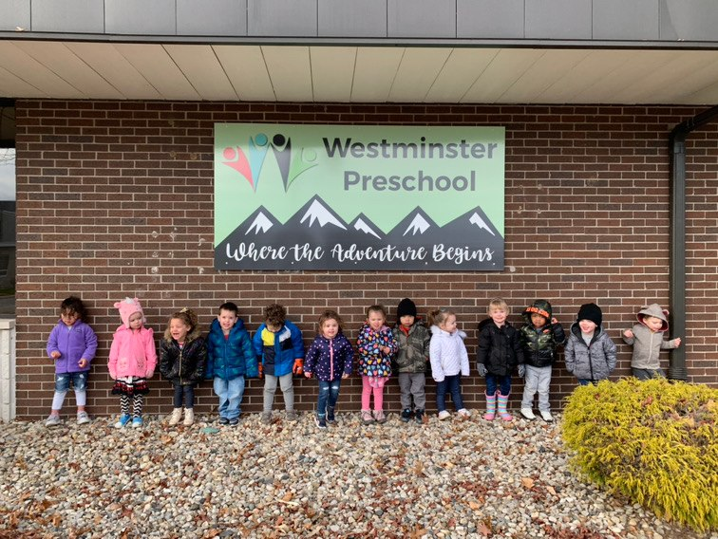
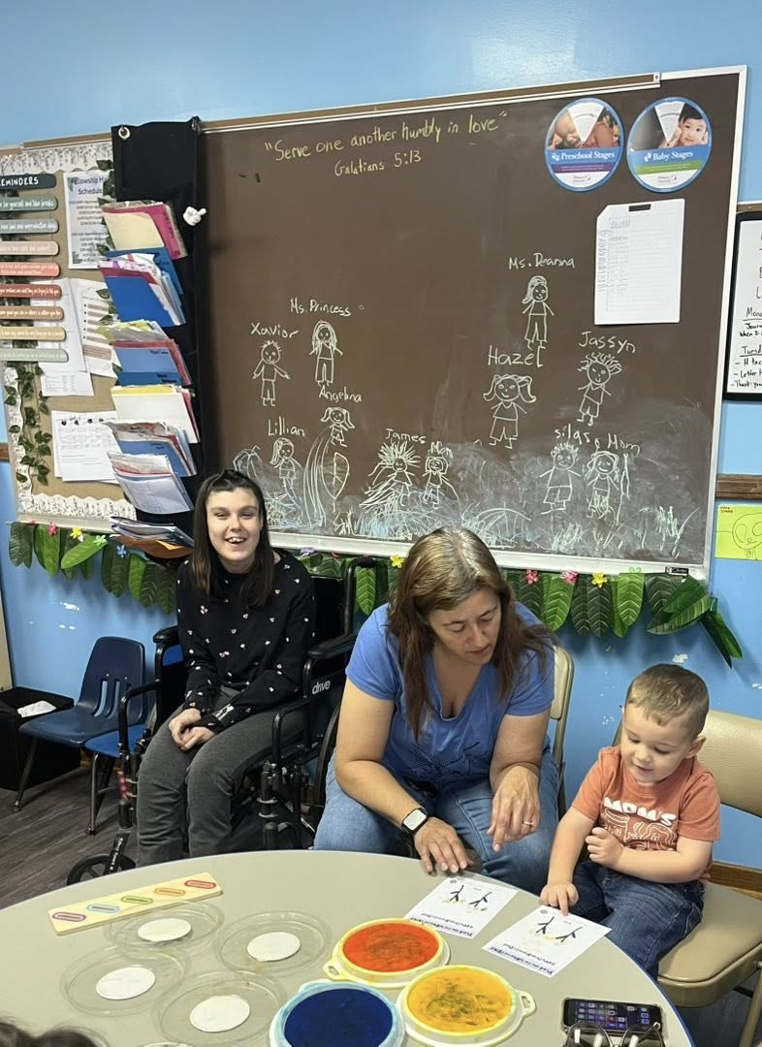
Who We Are
High Standards. Caring Hands.
Level 4 Paths to Quality • Cognia accredited • Trained staff • Christian curriculum
Notes:
Source basis: The website lists Level 4 Paths to Quality, Cognia accreditation, highly educated and trained staff, and Christian curriculum.

Slide 11
Ready for Kindergarten
You have learned.
You have grown.
You have blessed us.
Notes:
Source basis: Graduation celebration message written for the Westminster Preschool Friends class.

Slide 12
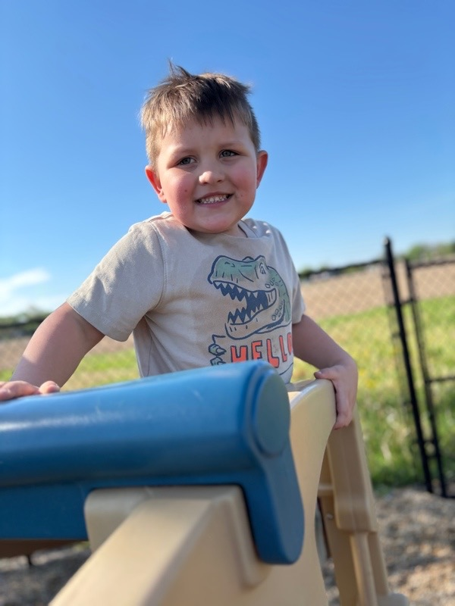
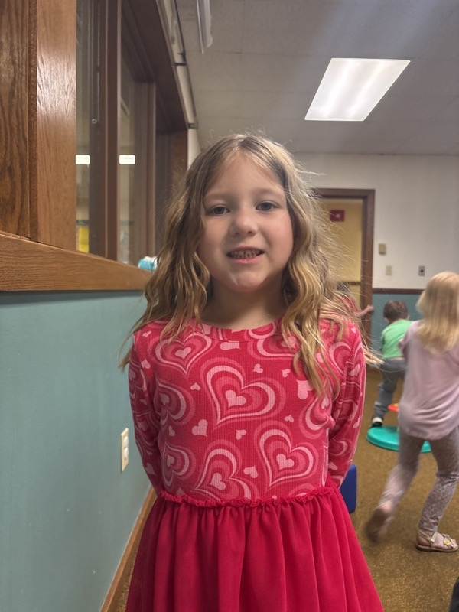
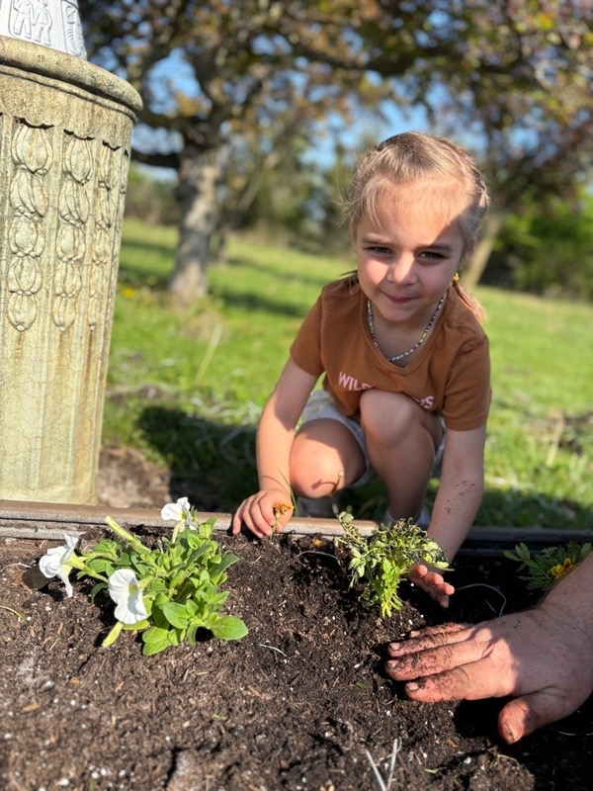
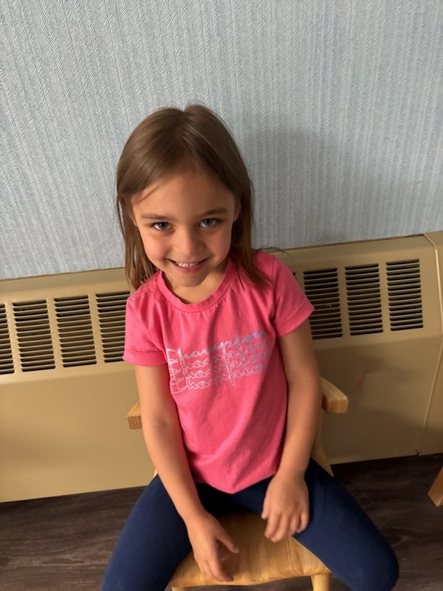
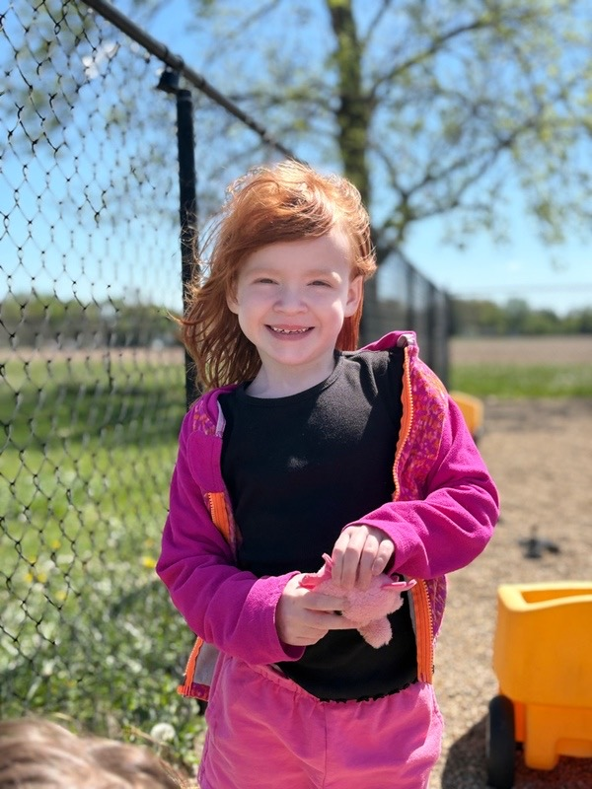

Slide 13
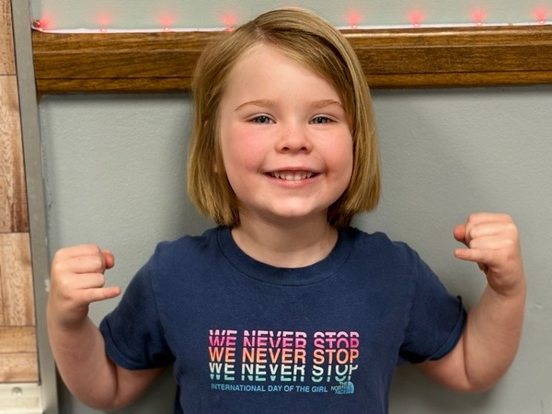
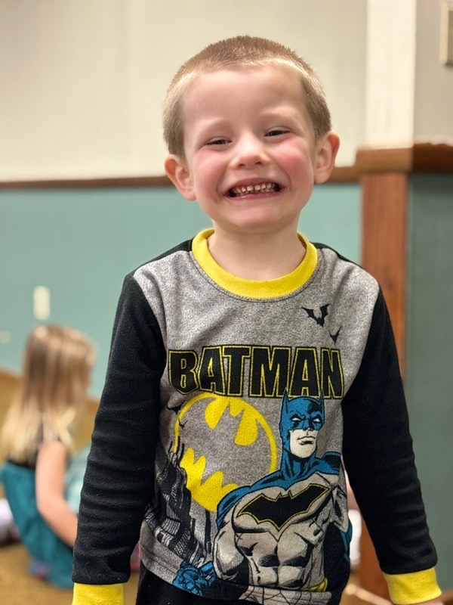
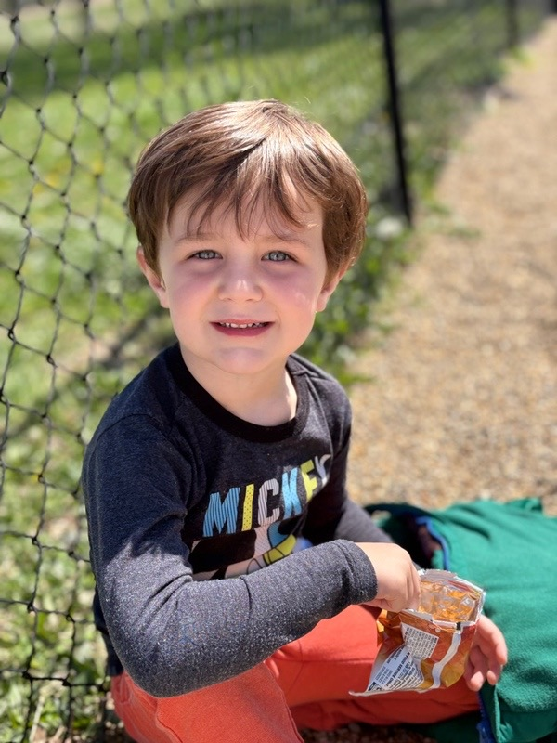
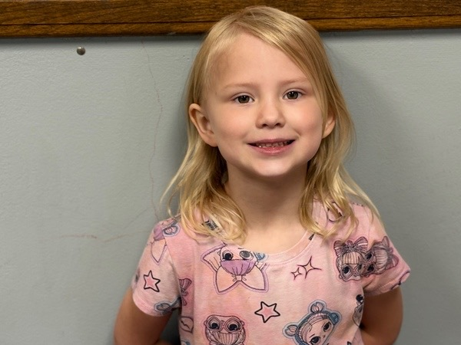
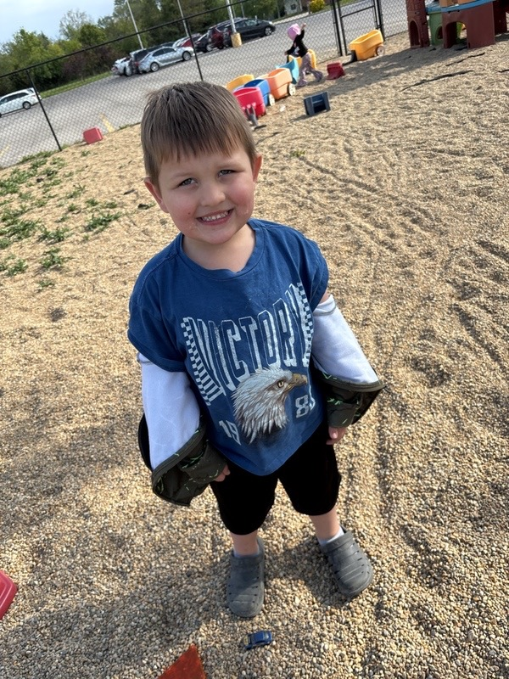

Slide 14
Thank You, Teachers
For every story read, tear wiped, prayer whispered, lesson taught, and child loved.
Notes:
Source basis: Appreciation slide for Westminster Preschool Friends teachers and staff.

Slide 15
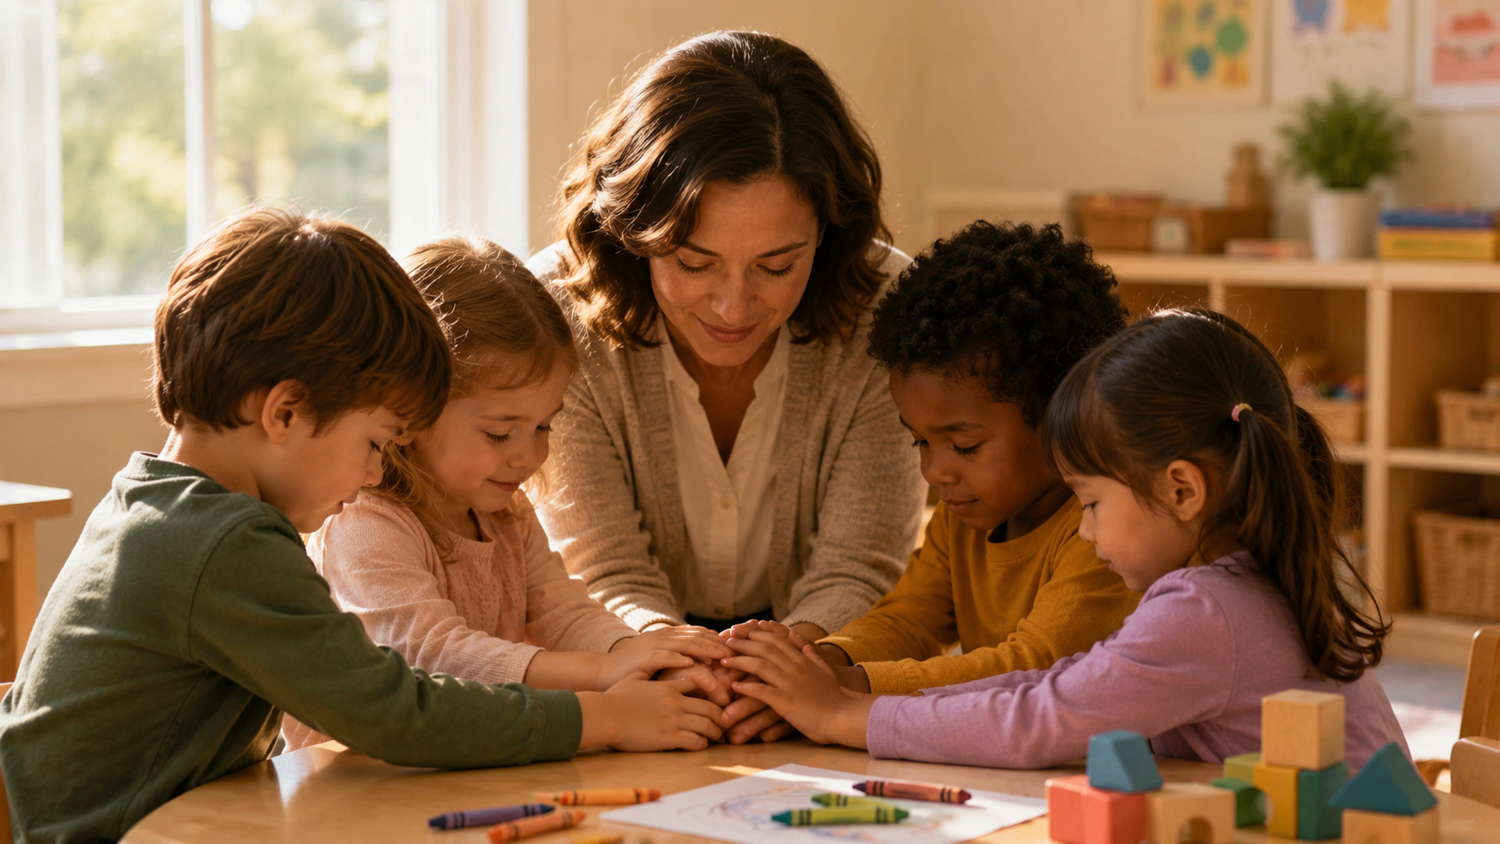
A Blessing for the Children
May Jesus bless your steps, strengthen your courage, and keep your hearts full of wonder.
Notes:
Source basis: Pastoral blessing for the graduating children.

Slide 20
We Are So Proud of You!
Congratulations, Westminster Preschool Friends graduates.
Go with joy. Grow in love. Shine bright.
Notes:
Source basis: Final congratulations slide for loop.

