Slide 1
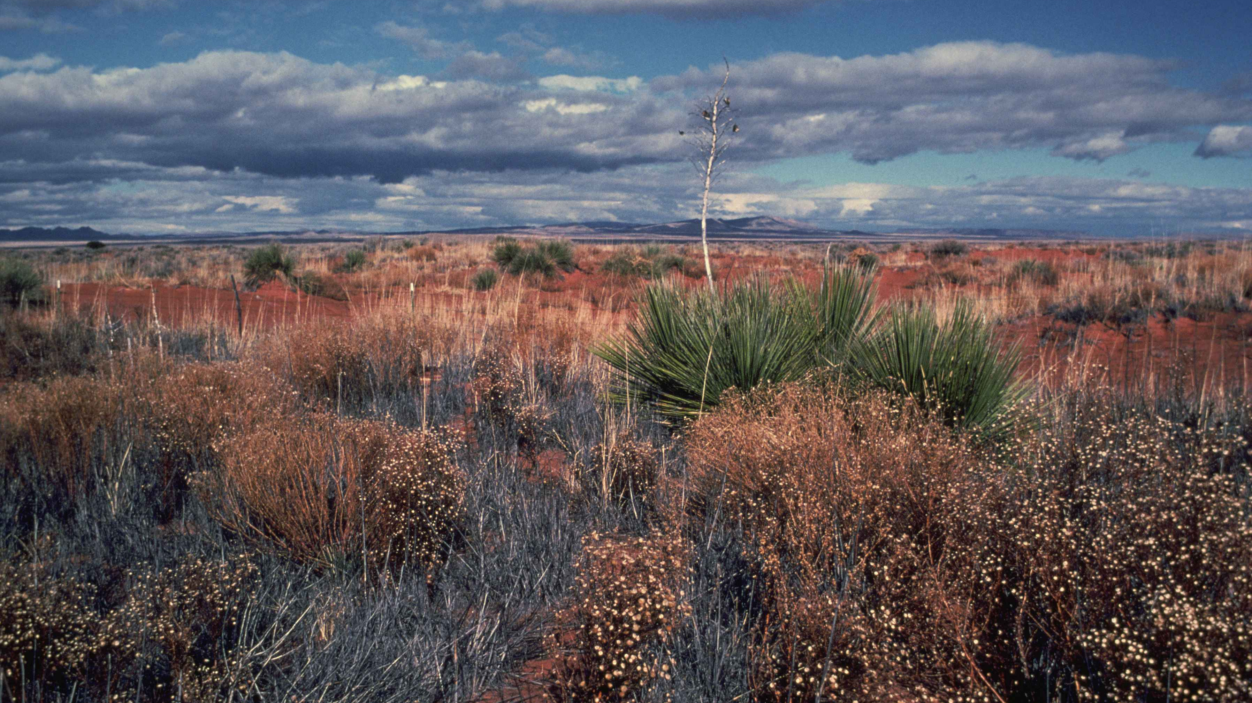
Re-Aimed by Grace
First Sunday in Lent • Matthew 4:1–11 (NIV)
Feb. 22, 2026 • Paul David Bravard, DMin
Notes:
[Sources]
- Desert image (public domain): https://www.public-domain-image.com/public-domain-images-pictures-free-stock-photos/nature-landscapes-public-domain-images-pictures/deserts-public-domain-images-pictures/desert-beauty-landscape.jpg
[/Sources]

Slide 2
Big Idea
Lent 1
In the wilderness, Jesus reveals the true “mark”—
faithful communion with the Father—
and grace restores our aim when we miss.
Holiness is formed over time as we are re-aimed by grace.
Genesis 2–3 • Psalm 32 • Romans 5:12–19
Notes:
[Sources]
- Desert image (public domain): https://www.public-domain-image.com/public-domain-images-pictures-free-stock-photos/nature-landscapes-public-domain-images-pictures/deserts-public-domain-images-pictures/desert-beauty-landscape.jpg
[/Sources]

Slide 3
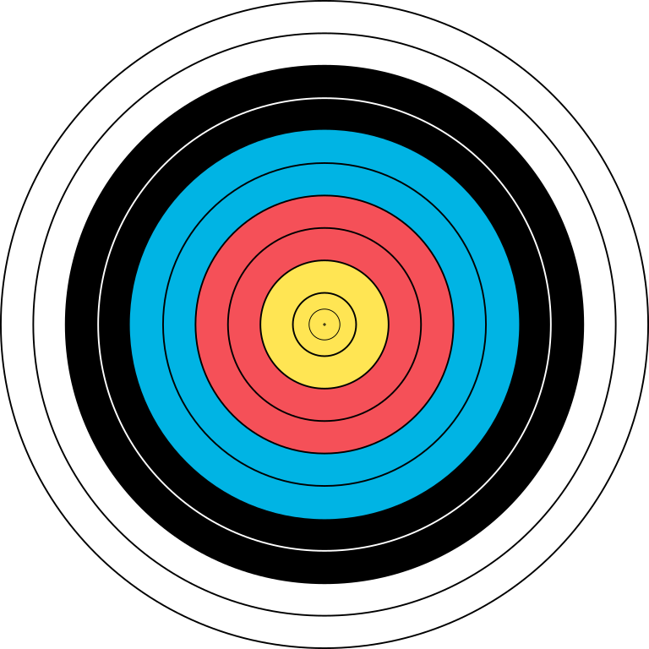
Opener: “Aim is revealed under pressure”
hamartia
“Hamartia” = “missing the mark”
Sin is real—sometimes rebellion, sometimes mis-aimed life under pressure.
Temptation often offers shortcuts:
• provision without trust
• proving instead of abiding
• power without worship
Key question for Lent:
“What shortcut is being offered to me right now?”
“Aim is revealed under pressure.”
Notes:
[Sources]
- Archery target image (CC BY-SA via Wikimedia Commons): https://commons.wikimedia.org/wiki/File:WA_80_cm_archery_target.svg
[/Sources]

Slide 4
Temptation 1: Provision without trust
Matt 4
Shortcut:
“If you are the Son of God, tell these stones to become bread.”
Relief without reliance
Re-aim:
Matthew 4:3 (NIV)
Trust the Father’s word
“Man shall not live on bread alone, but on every word that comes from the mouth of God.”
Matthew 4:4 (NIV)
Notes:
[Sources]
- Desert image (public domain): https://www.public-domain-image.com/public-domain-images-pictures-free-stock-photos/nature-landscapes-public-domain-images-pictures/deserts-public-domain-images-pictures/desert-beauty-landscape.jpg
[/Sources]

Slide 5
Temptation 2: Proving instead of abiding
Matt 4
“If you are the Son of God… throw yourself down.”
Matthew 4:6 (NIV)
“Do not put the Lord your God to the test.”
Matthew 4:7 (NIV)
Shortcut:
Perform identity
Re-aim:
Receive + trust
Notes:
[Sources]
- Archery target image (CC BY-SA via Wikimedia Commons): https://commons.wikimedia.org/wiki/File:WA_80_cm_archery_target.svg
[/Sources]

Slide 6
Temptation 3: Power without worship
Matt 4
Shortcut:
“All this I will give you… if you will bow down and worship me.”
Control + influence
Re-aim:
Worship-first life
Matthew 4:9 (NIV)
“Worship the Lord your God, and serve him only.”
Matthew 4:10 (NIV)
Notes:
[Sources]
- Desert image (public domain): https://www.public-domain-image.com/public-domain-images-pictures-free-stock-photos/nature-landscapes-public-domain-images-pictures/deserts-public-domain-images-pictures/desert-beauty-landscape.jpg
[/Sources]

Slide 7
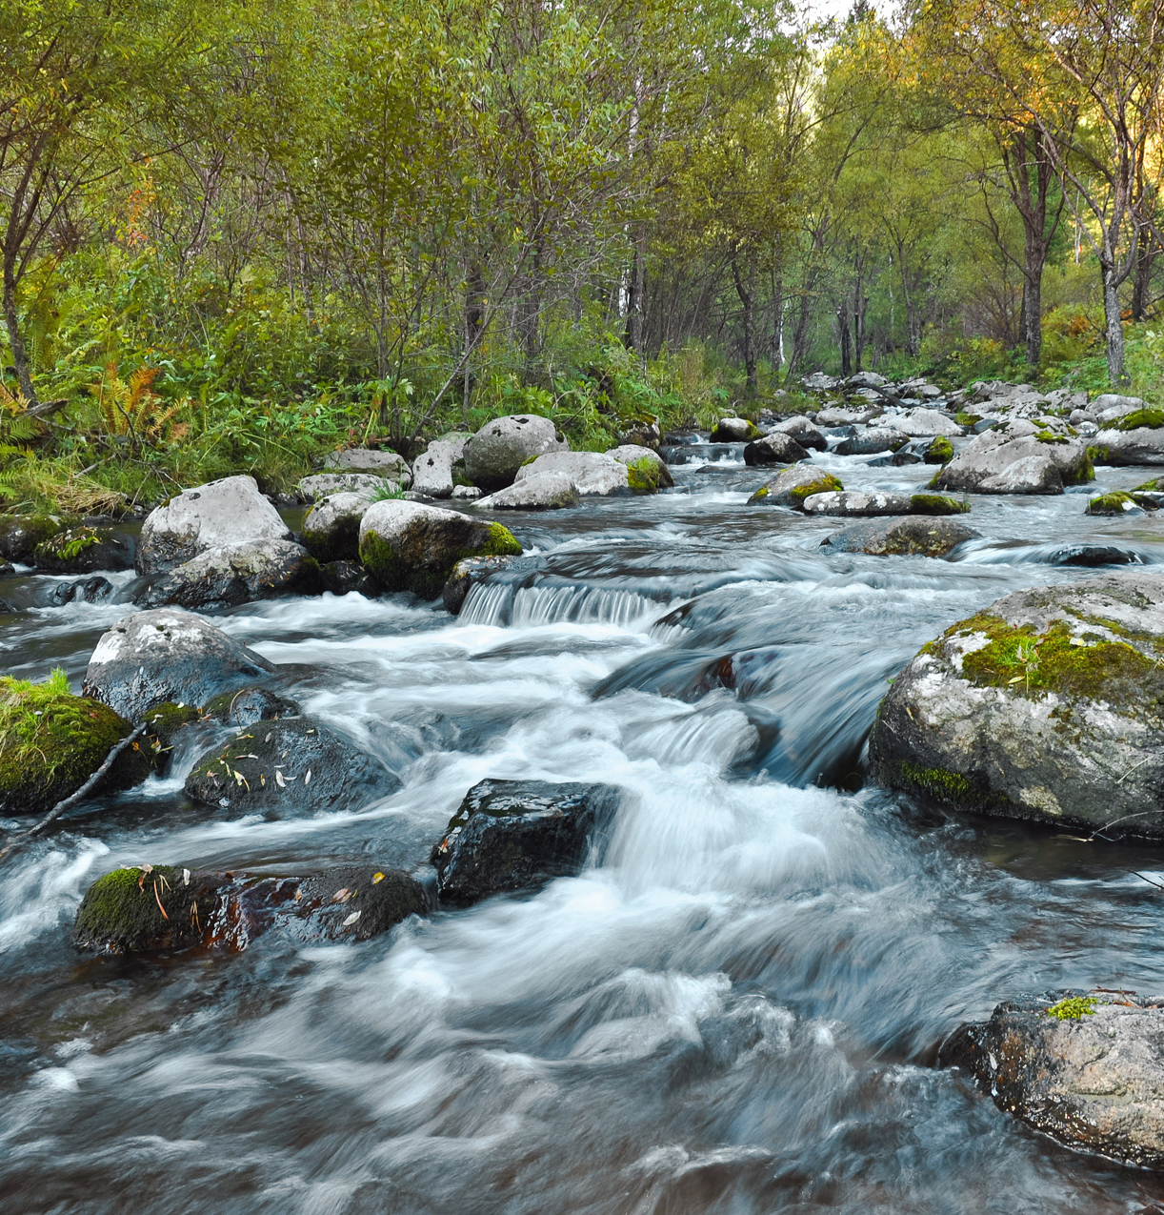
Hamartia + Grace
Psalm 32 • Rom 5
Hamartia = “missing the mark”
Grace does not leave us in shame—
it restores our aim through confession and mercy.
“Blessed is the one whose transgressions are forgiven.”
Psalm 32:1 (NIV)
“You forgave the guilt of my sin.”
Psalm 32:5 (NIV)
“Through the obedience of the one man…
…many will be made righteous.”
Romans 5:19 (NIV)
Notes:
[Sources]
- River image (CC0 public domain): https://www.publicdomainpictures.net/view-image.php?image=25508&picture=fast-flowing-river
[/Sources]

Slide 8
Flow of Holiness
Grace is the current
“Holiness is not a ladder we climb; it’s a river we enter.”
“The headwaters are Jesus revealed; the downstream is Jesus reproduced.”
Prevenient
Grace
Justifying
Grace
Sanctifying
Grace
Missional
Grace
Awakens us
to truth
Forgives
+ restores
Retrains
our aim
Sends love
outward
Notes:
[Sources]
- River image (CC0 public domain): https://www.publicdomainpictures.net/view-image.php?image=25508&picture=fast-flowing-river
[/Sources]

Slide 9
Take-away
Small stone question
What shortcut is being offered to you right now?
Shortcuts to watch for:
• Provision without trust: “Just take control and fix it.”
• Proving instead of abiding: “Just perform.”
• Power without worship: “Just win—make it go your way.”
Remember:
Shortcuts are expensive.
They feel like relief now, but they cost us the center.

Slide 10
Practice for the Week
Pause before you answer
One minute of quiet before you answer…
Before the email • before the hard conversation • before the snap decision
Pray (honest):
“Lord, show me what I’m reaching for.”
Pray (obedient):
“Lord, re-aim me toward worship and trust.”
“You forgave the guilt of my sin.”
Confess quickly • Repair quickly • Aim again
Psalm 32:5 (NIV)

Slide 11
The mark is not spiritual impressiveness.
The mark is faithful communion with the Father:
worship-first • trust-first • obedience-from-love
Amen.
Notes:
[Sources]
- River image (CC0 public domain): https://www.publicdomainpictures.net/view-image.php?image=25508&picture=fast-flowing-river
[/Sources]

