Slide 1

God With Us
Seeing God and Worshiping Him
Notes:
Last week we asked whether the New Earth is replacement or renewal. Tonight we move from the renewed world to the One who makes that world Heaven. We may look forward to reunion. We may long for pain to end. We may imagine beauty, peace, work, music, or rest. Those are not small desires. But Revelation keeps taking us deeper. The throne is occupied. The Lamb is present. God comes to dwell with his people. The deepest hope is not merely a perfect place. It is life with the living God.
Source: Paul David Bravard, “God With Us: Seeing God and Worshiping Him,” Heaven Week Seven leader’s guide, manuscript. Randy Alcorn, Heaven, chapters 17–19, as summarized in the guide. Scripture quotations: New International Version (2011).
Image: Elizabeth Gottwald. “A Path in the Middle of a Lush Green Forest.” Unsplash. https://unsplash.com/photos/29bsekvyObc. Accessed September 24, 2026. Used as a contemplative image; it does not depict the world to come.

Slide 2

The deepest hope is life with the living God.
Notes:
Last week we asked whether the New Earth is replacement or renewal. Tonight we move from the renewed world to the One who makes that world Heaven. We may look forward to reunion. We may long for pain to end. We may imagine beauty, peace, work, music, or rest. Those are not small desires. But Revelation keeps taking us deeper. The throne is occupied. The Lamb is present. God comes to dwell with his people. The deepest hope is not merely a perfect place. It is life with the living God.
Source: Paul David Bravard, “God With Us: Seeing God and Worshiping Him,” Heaven Week Seven leader’s guide, manuscript. Randy Alcorn, Heaven, chapters 17–19, as summarized in the guide. Scripture quotations: New International Version (2011).
Image: Chr Appelsved. “The Sunlight Is Shining through the Windows in the Building.” Unsplash, April 19, 2022. https://unsplash.com/photos/Ngy0FJqPjOM. Accessed September 24, 2026. Used as a contemplative image; it does not depict the world to come.

Slide 3
What comes first?
God
Loved ones
Relief
Beauty
Notes:
Place the four cards - God, Loved Ones, Relief, and Beauty - where everyone can see them. Ask participants to choose silently which one they most often hear first when Christians talk about Heaven. Then invite a few observations without ranking anyone as more or less spiritual.
Source: Paul David Bravard, “God With Us: Seeing God and Worshiping Him,” Heaven Week Seven leader’s guide, manuscript. Randy Alcorn, Heaven, chapters 17–19, as summarized in the guide. Scripture quotations: New International Version (2011).

Slide 4
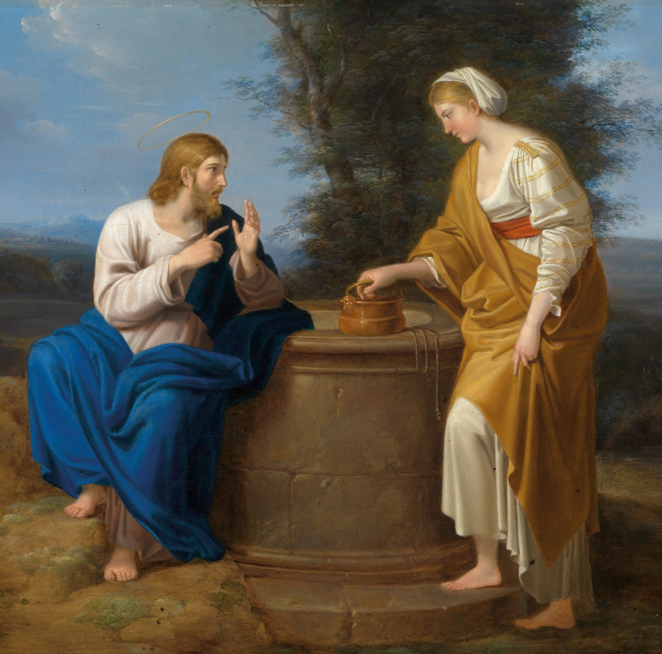
Become still before the living Christ.
Notes:
Invitation: Friends, become still before the living Christ. Do not try to manufacture an emotion. Simply become available to the One who is already present. Let every picture of Heaven grow quiet for a moment, and attend to God himself.
Source: Paul David Bravard, “God With Us: Seeing God and Worshiping Him,” Heaven Week Seven leader’s guide, manuscript. Randy Alcorn, Heaven, chapters 17–19, as summarized in the guide. Scripture quotations: New International Version (2011).
Image: Chr Appelsved. “The Sunlight Is Shining through the Windows in the Building.” Unsplash, April 19, 2022. https://unsplash.com/photos/Ngy0FJqPjOM. Accessed September 24, 2026. Used as a contemplative image; it does not depict the world to come.

Slide 5
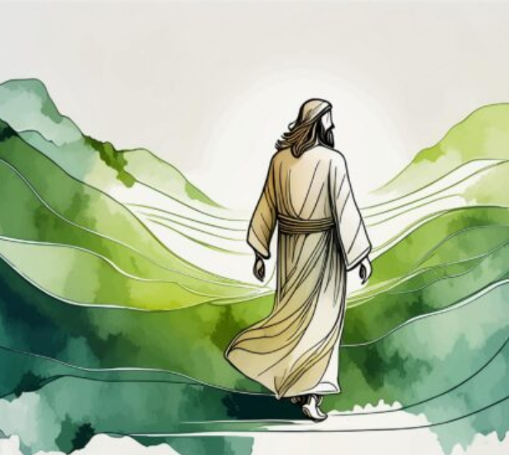
“Holy, holy, holy is the Lord God Almighty”
Revelation 4:8, NIV
Notes:
Read slowly: 'Holy, holy, holy is the Lord God Almighty' (Revelation 4:8, NIV).
Source: Paul David Bravard, “God With Us: Seeing God and Worshiping Him,” Heaven Week Seven leader’s guide, manuscript. Randy Alcorn, Heaven, chapters 17–19, as summarized in the guide. Scripture quotations: New International Version (2011).
Image: Benjamin Voros. “Snow Mountain under Stars.” Unsplash, February 26, 2018. https://unsplash.com/photos/phIFdC6lA4E. Accessed September 24, 2026. Used as a contemplative image; it does not depict the world to come.

Slide 6
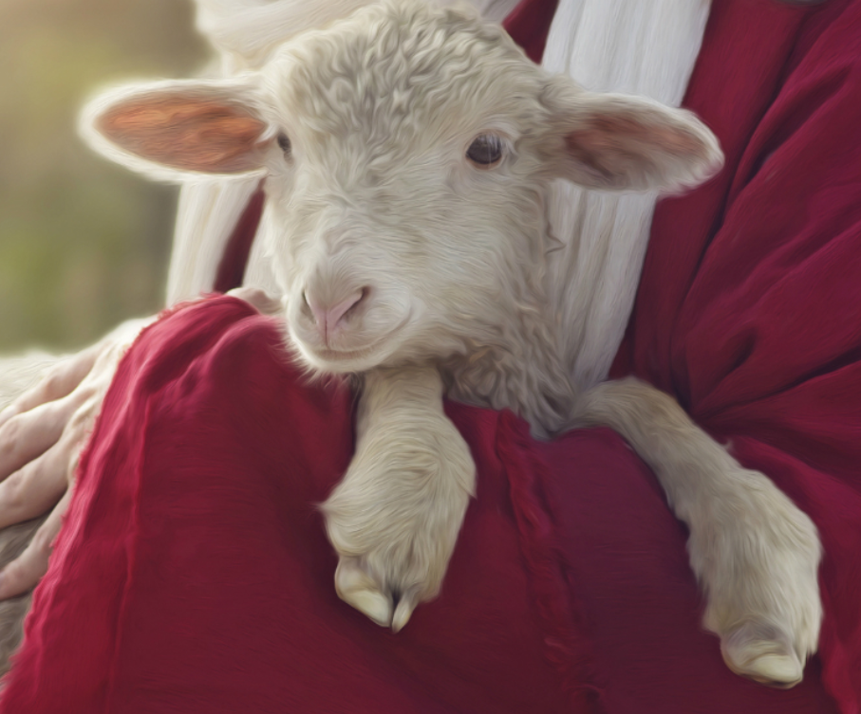
“Worthy is the Lamb, who was slain”
Revelation 5:12, NIV
Notes:
Then: 'Worthy is the Lamb, who was slain' (Revelation 5:12, NIV).
Source: Paul David Bravard, “God With Us: Seeing God and Worshiping Him,” Heaven Week Seven leader’s guide, manuscript. Randy Alcorn, Heaven, chapters 17–19, as summarized in the guide. Scripture quotations: New International Version (2011).
Image: Adriel Sand. “A Cross Is Silhouetted against a Sunset Sky.” Unsplash, January 22, 2024. https://unsplash.com/photos/BPGhU1gzWWU. Accessed September 24, 2026. Used as a contemplative image; it does not depict the world to come.

Slide 7
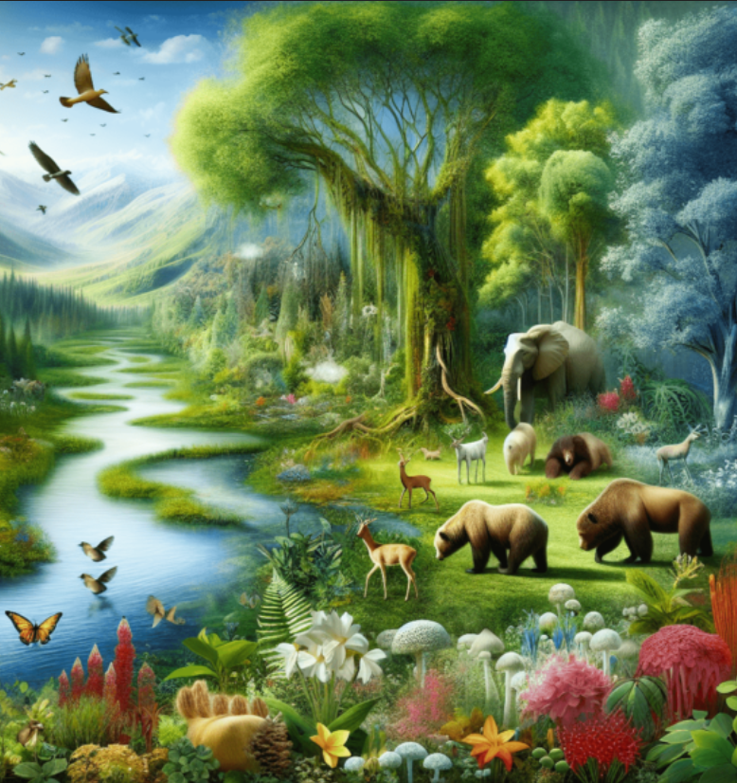
The Creator is worthy
Revelation 4:1–11
Notes:
God is holy, eternal, sovereign, and worthy as Creator; worship begins with who God is and what God has made.
Source: Paul David Bravard, “God With Us: Seeing God and Worshiping Him,” Heaven Week Seven leader’s guide, manuscript. Randy Alcorn, Heaven, chapters 17–19, as summarized in the guide. Scripture quotations: New International Version (2011).
Image: Benjamin Voros. “Snow Mountain under Stars.” Unsplash, February 26, 2018. https://unsplash.com/photos/phIFdC6lA4E. Accessed September 24, 2026. Used as a contemplative image; it does not depict the world to come.

Slide 8
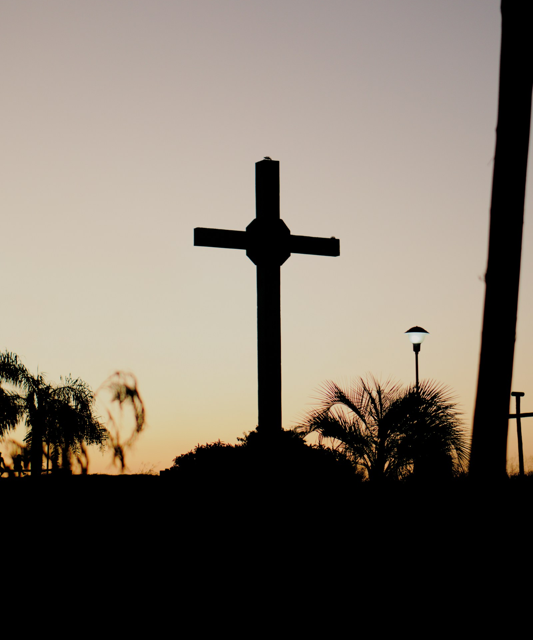
The Lamb is worthy
Revelation 5:1–14
Notes:
The Lamb is worthy because he was slain and purchased a people for God; worship widens until all creation answers.
Source: Paul David Bravard, “God With Us: Seeing God and Worshiping Him,” Heaven Week Seven leader’s guide, manuscript. Randy Alcorn, Heaven, chapters 17–19, as summarized in the guide. Scripture quotations: New International Version (2011).
Image: Adriel Sand. “A Cross Is Silhouetted against a Sunset Sky.” Unsplash, January 22, 2024. https://unsplash.com/photos/BPGhU1gzWWU. Accessed September 24, 2026. Used as a contemplative image; it does not depict the world to come.

Slide 9
God with us
Revelation 21:3
Revelation 22:3–5
Notes:
Distance, curse, and darkness are gone; God dwells with the redeemed, they see his face, bear his name, serve him, and reign.
Source: Paul David Bravard, “God With Us: Seeing God and Worshiping Him,” Heaven Week Seven leader’s guide, manuscript. Randy Alcorn, Heaven, chapters 17–19, as summarized in the guide. Scripture quotations: New International Version (2011).
Image: Elizabeth Gottwald. “A Path in the Middle of a Lush Green Forest.” Unsplash. https://unsplash.com/photos/29bsekvyObc. Accessed September 24, 2026. Used as a contemplative image; it does not depict the world to come.

Slide 10
Heaven is Heaven because God is there.
Notes:
Alcorn's chapters 17-19 make a necessary correction to the way many of us imagine Heaven. We naturally begin with the things we miss: people, health, beauty, safety, freedom from pain. Scripture does not mock those desires. Yet Revelation places something deeper beneath them. Heaven is Heaven because God is there. The final promise is not merely that we will receive God's gifts forever, but that God himself will dwell with us.
Source: Paul David Bravard, “God With Us: Seeing God and Worshiping Him,” Heaven Week Seven leader’s guide, manuscript. Randy Alcorn, Heaven, chapters 17–19, as summarized in the guide. Scripture quotations: New International Version (2011).
Image: Elizabeth Gottwald. “A Path in the Middle of a Lush Green Forest.” Unsplash. https://unsplash.com/photos/29bsekvyObc. Accessed September 24, 2026. Used as a contemplative image; it does not depict the world to come.

Slide 11
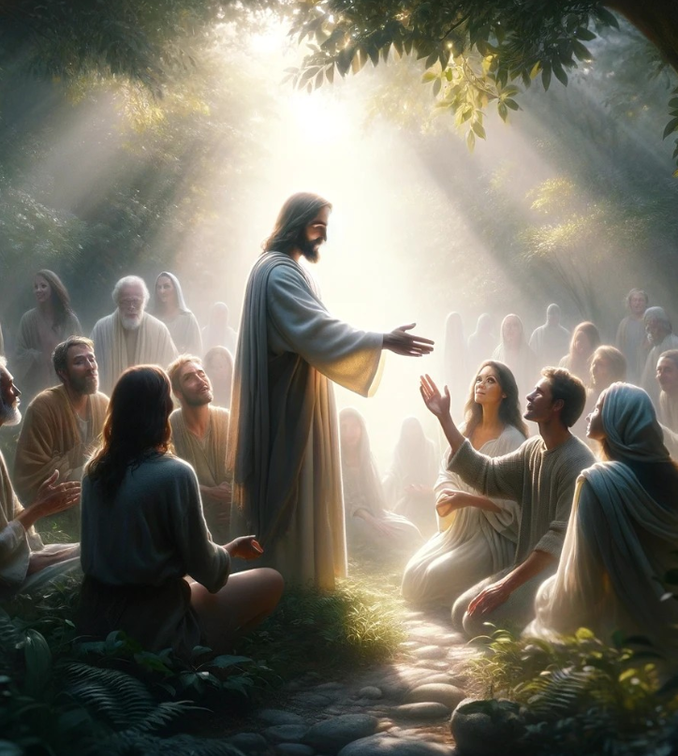
Christ has brought us home by grace.
Notes:
This keeps the gospel at the center. We do not arrive in God's presence because we have cultivated spiritual taste or performed worship well enough. The Lamb who was slain has redeemed a people for God. The One we worship is the One who has acted in grace to bring sinners near. Eternal worship is therefore not flattery offered to a distant deity. It is the grateful life of a people who know they have been created, sought, purchased, cleansed, and brought home by Christ.
Source: Paul David Bravard, “God With Us: Seeing God and Worshiping Him,” Heaven Week Seven leader’s guide, manuscript. Randy Alcorn, Heaven, chapters 17–19, as summarized in the guide. Scripture quotations: New International Version (2011).
Image: Adriel Sand. “A Cross Is Silhouetted against a Sunset Sky.” Unsplash, January 22, 2024. https://unsplash.com/photos/BPGhU1gzWWU. Accessed September 24, 2026. Used as a contemplative image; it does not depict the world to come.

Slide 12
God made us.
The Lamb redeemed us.
Revelation 4–5
Notes:
Revelation 4 praises God as Creator. Revelation 5 praises the Lamb as Redeemer. Creation and redemption belong together. The God who made all things does not abandon what he made, and the Lamb does not merely rescue souls from a failed creation. He purchases a people who will serve and reign in God's renewed world.
Source: Paul David Bravard, “God With Us: Seeing God and Worshiping Him,” Heaven Week Seven leader’s guide, manuscript. Randy Alcorn, Heaven, chapters 17–19, as summarized in the guide. Scripture quotations: New International Version (2011).

Slide 13

All life is gift.
All redemption is grace.
Notes:
That means worship is rooted in truth. We do not worship because God needs affirmation. We worship because the mind and heart finally see reality clearly: all life is gift, all redemption is grace, and all glory belongs to the One from whom and through whom our life comes. Worship is the creature gladly becoming truthful before the Creator.
Source: Paul David Bravard, “God With Us: Seeing God and Worshiping Him,” Heaven Week Seven leader’s guide, manuscript. Randy Alcorn, Heaven, chapters 17–19, as summarized in the guide. Scripture quotations: New International Version (2011).
Image: Benjamin Voros. “Snow Mountain under Stars.” Unsplash, February 26, 2018. https://unsplash.com/photos/phIFdC6lA4E. Accessed September 24, 2026. Used as a contemplative image; it does not depict the world to come.

Slide 14
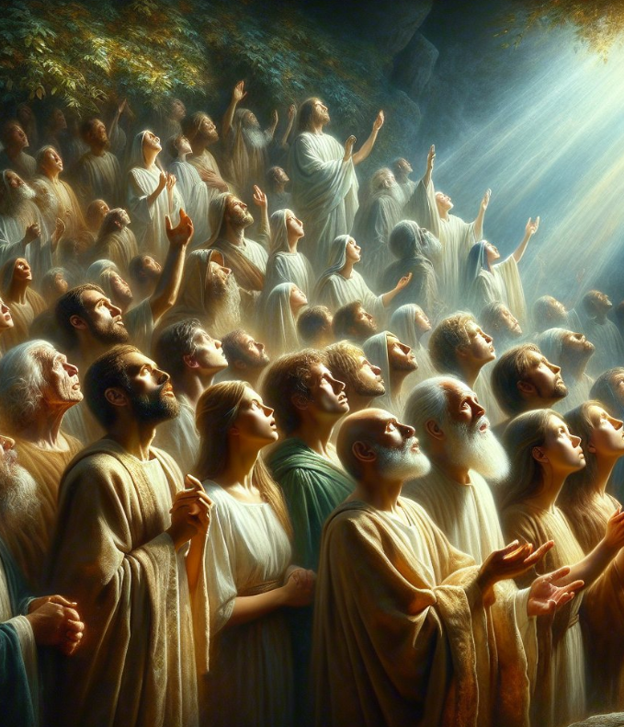
“They will see his face”
Revelation 22:4, NIV
Notes:
For centuries Christians have used the phrase beatific vision for the promise of seeing God - a sight that makes blessed because the redeemed delight in God without the distortions of sin, fear, shame, and distance. Alcorn rightly makes this the greatest joy of Heaven. The biblical language is concrete and personal, but we should not force it into a technical description of God's invisible essence. Scripture gives us enough to say that the communion we now know by faith will become open, direct, and unbroken in the world to come.
Source: Paul David Bravard, “God With Us: Seeing God and Worshiping Him,” Heaven Week Seven leader’s guide, manuscript. Randy Alcorn, Heaven, chapters 17–19, as summarized in the guide. Scripture quotations: New International Version (2011).
Image: Chr Appelsved. “The Sunlight Is Shining through the Windows in the Building.” Unsplash, April 19, 2022. https://unsplash.com/photos/Ngy0FJqPjOM. Accessed September 24, 2026. Used as a contemplative image; it does not depict the world to come.

Slide 15
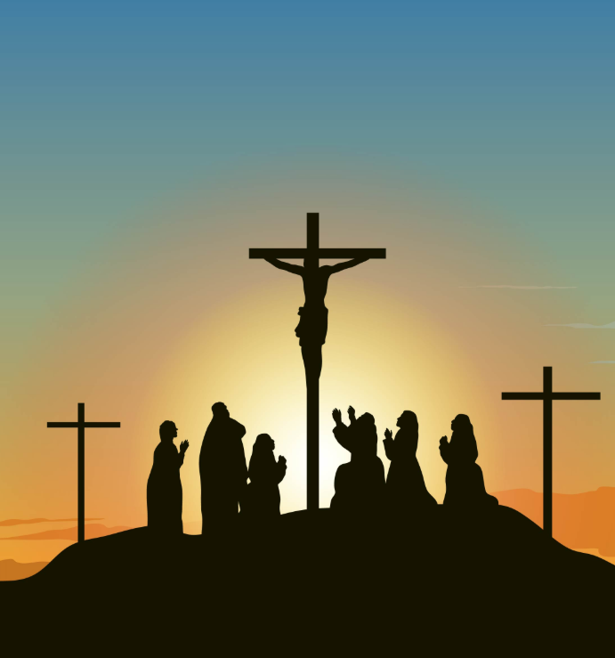
The risen Christ is our Lord forever.
Notes:
Jesus Christ remains essential here. The invisible God has made himself known in the Son. The Lamb at the center of the throne is not a temporary bridge we leave behind when we reach eternity. The risen Christ is our Lord forever. To long to see God is therefore not to seek an abstract brightness. It is to long for the unveiled fellowship of the Father, through the Son, in the fullness of the Spirit.
Source: Paul David Bravard, “God With Us: Seeing God and Worshiping Him,” Heaven Week Seven leader’s guide, manuscript. Randy Alcorn, Heaven, chapters 17–19, as summarized in the guide. Scripture quotations: New International Version (2011).
Image: Adriel Sand. “A Cross Is Silhouetted against a Sunset Sky.” Unsplash, January 22, 2024. https://unsplash.com/photos/BPGhU1gzWWU. Accessed September 24, 2026. Used as a contemplative image; it does not depict the world to come.

Slide 16

Every good gift can lead us back to the Giver.
Notes:
Some Christians hear 'God should be enough' as though affection for family, friendship, beauty, food, music, work, or place were spiritually suspicious. That is not the biblical movement. God is the Giver of every good gift. Sin turns gifts into rivals and tries to make them carry what only God can carry. Redemption does not require us to love God's good creation less; it heals love so that every gift leads gratitude back to the Giver.
Source: Paul David Bravard, “God With Us: Seeing God and Worshiping Him,” Heaven Week Seven leader’s guide, manuscript. Randy Alcorn, Heaven, chapters 17–19, as summarized in the guide. Scripture quotations: New International Version (2011).
Image: Natalie Behn. “A Person Holding a Loaf of Bread in Their Hands.” Unsplash, August 22, 2023. https://unsplash.com/photos/K1n97Uih77A. Accessed September 24, 2026. Used as a contemplative image; it does not depict the world to come.

Slide 17

Love healed.
Love freed from fear.
Notes:
This is particularly important in grief. A widow who longs to see her husband is not failing to love Jesus. A parent who hopes for reunion with a child need not be corrected into a more 'spiritual' answer. Christian hope widens the longing: the love we cherish is gathered into a redeemed household where Christ is Lord, no good thing needs to be clutched in fear, and no relationship must bear the weight of being our god.
Source: Paul David Bravard, “God With Us: Seeing God and Worshiping Him,” Heaven Week Seven leader’s guide, manuscript. Randy Alcorn, Heaven, chapters 17–19, as summarized in the guide. Scripture quotations: New International Version (2011).
Image: Elizabeth Gottwald. “A Path in the Middle of a Lush Green Forest.” Unsplash. https://unsplash.com/photos/29bsekvyObc. Accessed September 24, 2026. Used as a contemplative image; it does not depict the world to come.

Slide 18

Worship is a whole life joyfully offered to God.
Revelation 22:3–5
Notes:
Alcorn resists the caricature of Heaven as an endless church service. Revelation certainly contains singing, proclamation, falling before God, and corporate praise. But Revelation 22 also says that God's servants will serve him and reign. Worship is not less than gathered praise; it is larger than gathered praise. It is life rightly ordered toward God.
Source: Paul David Bravard, “God With Us: Seeing God and Worshiping Him,” Heaven Week Seven leader’s guide, manuscript. Randy Alcorn, Heaven, chapters 17–19, as summarized in the guide. Scripture quotations: New International Version (2011).
Image: Natalie Behn. “A Person Holding a Loaf of Bread in Their Hands.” Unsplash, August 22, 2023. https://unsplash.com/photos/K1n97Uih77A. Accessed September 24, 2026. Used as a contemplative image; it does not depict the world to come.

Slide 19
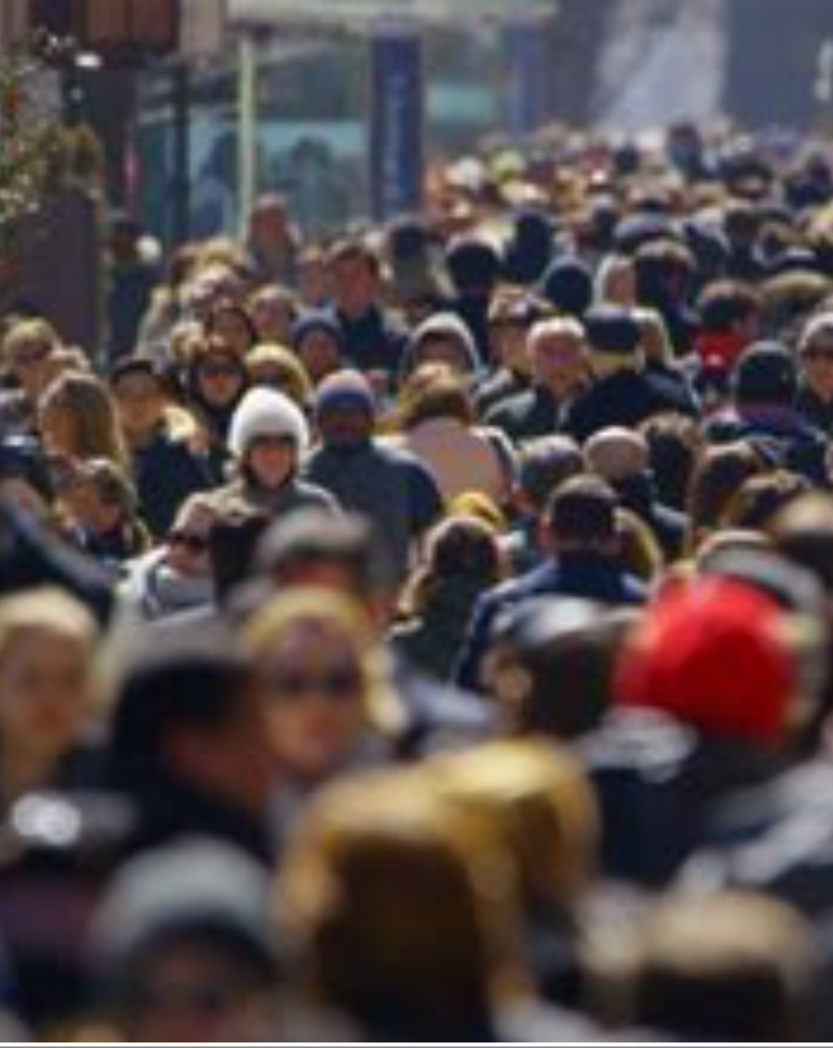
Let worship become holy life.
Notes:
Friends have long understood worship as attentiveness to the living Christ rather than performance alone. Waiting worship trains desire: we become quiet enough to notice who is at the center. Holiness grows from the same center. When God becomes our supreme good, gratitude loosens our grip, obedience becomes response rather than bargaining, and ordinary acts of service can become offerings of love. Eternal worship begins to tutor present holiness.
Source: Paul David Bravard, “God With Us: Seeing God and Worshiping Him,” Heaven Week Seven leader’s guide, manuscript. Randy Alcorn, Heaven, chapters 17–19, as summarized in the guide. Scripture quotations: New International Version (2011).
Image: Chr Appelsved. “The Sunlight Is Shining through the Windows in the Building.” Unsplash, April 19, 2022. https://unsplash.com/photos/Ngy0FJqPjOM. Accessed September 24, 2026. Used as a contemplative image; it does not depict the world to come.

Slide 20

Who is worthy?
Why?
Revelation 4–5
Notes:
What do Revelation 4-5 teach about who God is and why God is worthy?
Source: Paul David Bravard, “God With Us: Seeing God and Worshiping Him,” Heaven Week Seven leader’s guide, manuscript. Randy Alcorn, Heaven, chapters 17–19, as summarized in the guide. Scripture quotations: New International Version (2011).

Slide 21
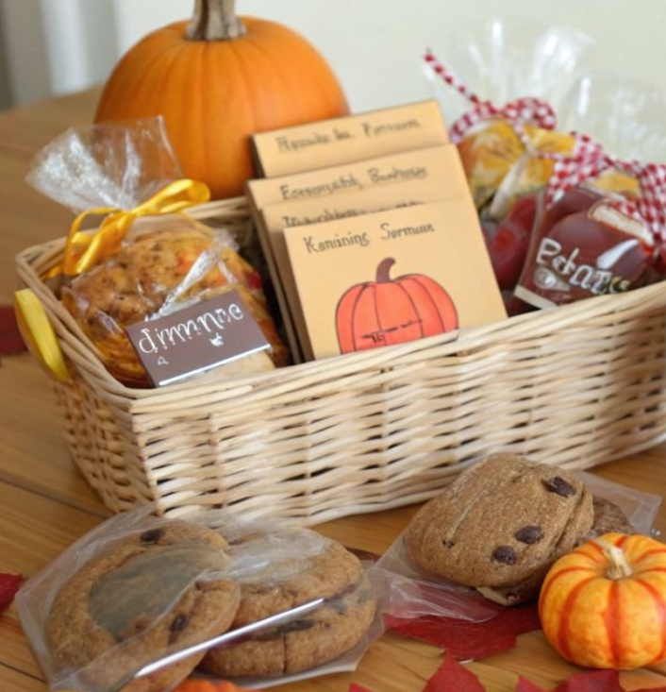
Which good gift awakens gratitude in you?
Notes:
How can every good gift deepen delight in the Giver rather than compete with God?
Source: Paul David Bravard, “God With Us: Seeing God and Worshiping Him,” Heaven Week Seven leader’s guide, manuscript. Randy Alcorn, Heaven, chapters 17–19, as summarized in the guide. Scripture quotations: New International Version (2011).
Image: Natalie Behn. “A Person Holding a Loaf of Bread in Their Hands.” Unsplash, August 22, 2023. https://unsplash.com/photos/K1n97Uih77A. Accessed September 24, 2026. Used as a contemplative image; it does not depict the world to come.

Slide 22
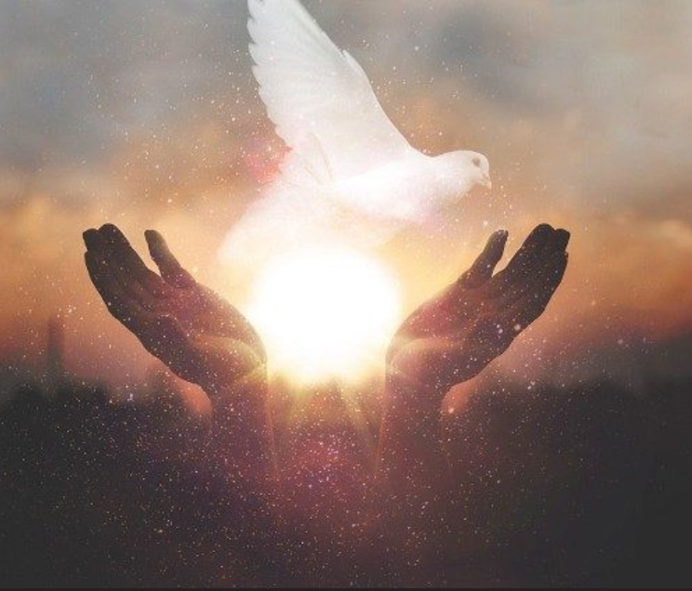
How might seeing God shape holiness now?
Notes:
How might the hope of seeing God shape holiness, gratitude, and obedience now?
Source: Paul David Bravard, “God With Us: Seeing God and Worshiping Him,” Heaven Week Seven leader’s guide, manuscript. Randy Alcorn, Heaven, chapters 17–19, as summarized in the guide. Scripture quotations: New International Version (2011).
Image: Elizabeth Gottwald. “A Path in the Middle of a Lush Green Forest.” Unsplash. https://unsplash.com/photos/29bsekvyObc. Accessed September 24, 2026. Used as a contemplative image; it does not depict the world to come.

Slide 23
My response
One truth about God
One gift received with gratitude
One ordinary act of worship
Notes:
Distribute an index card. Invite each person to respond privately. The response is not a test of spiritual intensity; it is an invitation to let tonight's Scripture shape desire.
Source: Paul David Bravard, “God With Us: Seeing God and Worshiping Him,” Heaven Week Seven leader’s guide, manuscript. Randy Alcorn, Heaven, chapters 17–19, as summarized in the guide. Scripture quotations: New International Version (2011).

Slide 24
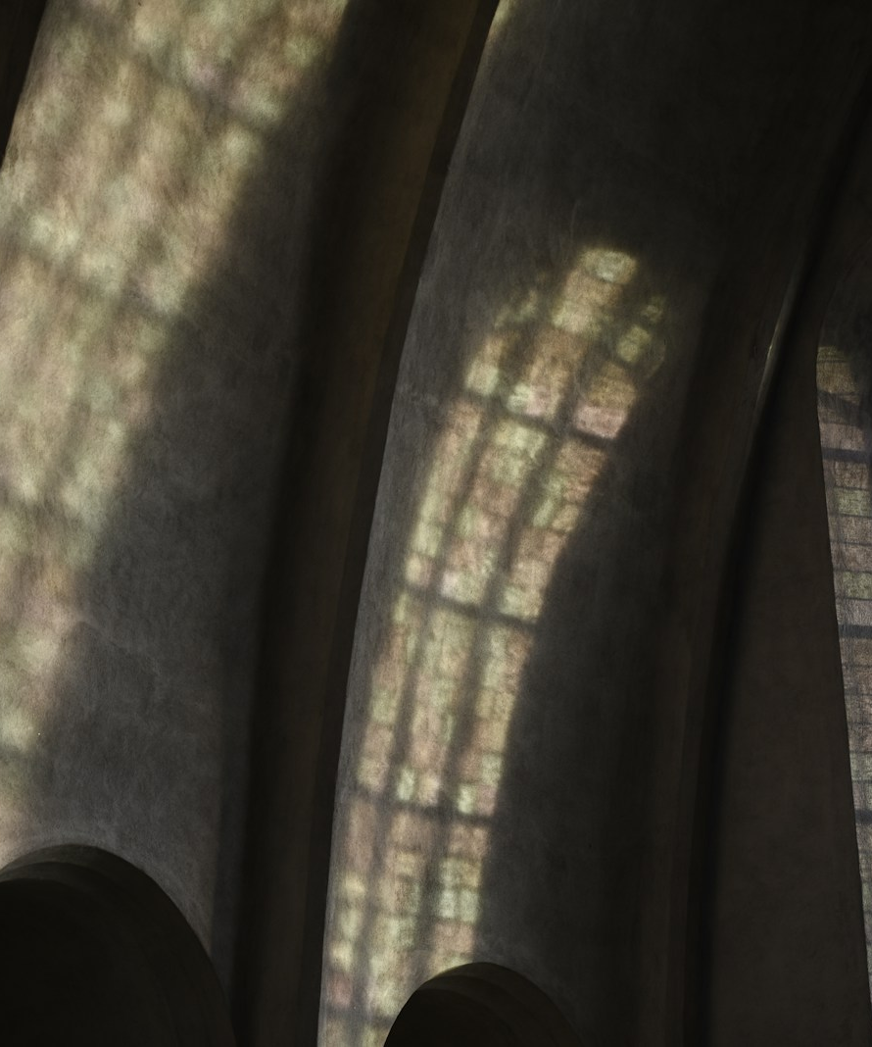
“They will see his face”
Revelation 22:4, NIV
Notes:
84-86 - Settle: Rest before the throne and the Lamb. 'They will see his face' (Revelation 22:4, NIV).
Source: Paul David Bravard, “God With Us: Seeing God and Worshiping Him,” Heaven Week Seven leader’s guide, manuscript. Randy Alcorn, Heaven, chapters 17–19, as summarized in the guide. Scripture quotations: New International Version (2011).
Image: Chr Appelsved. “The Sunlight Is Shining through the Windows in the Building.” Unsplash, April 19, 2022. https://unsplash.com/photos/Ngy0FJqPjOM. Accessed September 24, 2026. Used as a contemplative image; it does not depict the world to come.

Slide 25
Receive every good gift with gratitude.
Let your whole life become worship.
Notes:
89-90 - Close: Holy God, you made us for yourself and Christ has brought us near by his blood. Teach us to desire you without despising your gifts, to love your gifts without turning them into gods, and to let worship become holy life. Bring us to the day when your dwelling is with humanity and we see your face in joy. Amen.
Source: Paul David Bravard, “God With Us: Seeing God and Worshiping Him,” Heaven Week Seven leader’s guide, manuscript. Randy Alcorn, Heaven, chapters 17–19, as summarized in the guide. Scripture quotations: New International Version (2011).
Image: Elizabeth Gottwald. “A Path in the Middle of a Lush Green Forest.” Unsplash. https://unsplash.com/photos/29bsekvyObc. Accessed September 24, 2026. Used as a contemplative image; it does not depict the world to come.

