Slide 1

HEAVEN | WEEK SIX
A New Earth:
Destroyed or Renewed?
Genesis 1–3 • Isaiah 65 • 2 Peter 3 • Revelation 21
Wednesday, Sept. 23
Notes:
Display as people arrive. The three-part landscape previews the session: original creation, fallen creation, and renewed creation.

Slide 2

CENTRAL TRUTH
God will judge and radically purify what sin has corrupted, yet Scripture’s story moves toward creation restored and God dwelling with resurrected humanity on a renewed Earth.
Notes:
Name the central truth before introducing the activity. Let the language of judgment and restoration remain together.

Slide 3
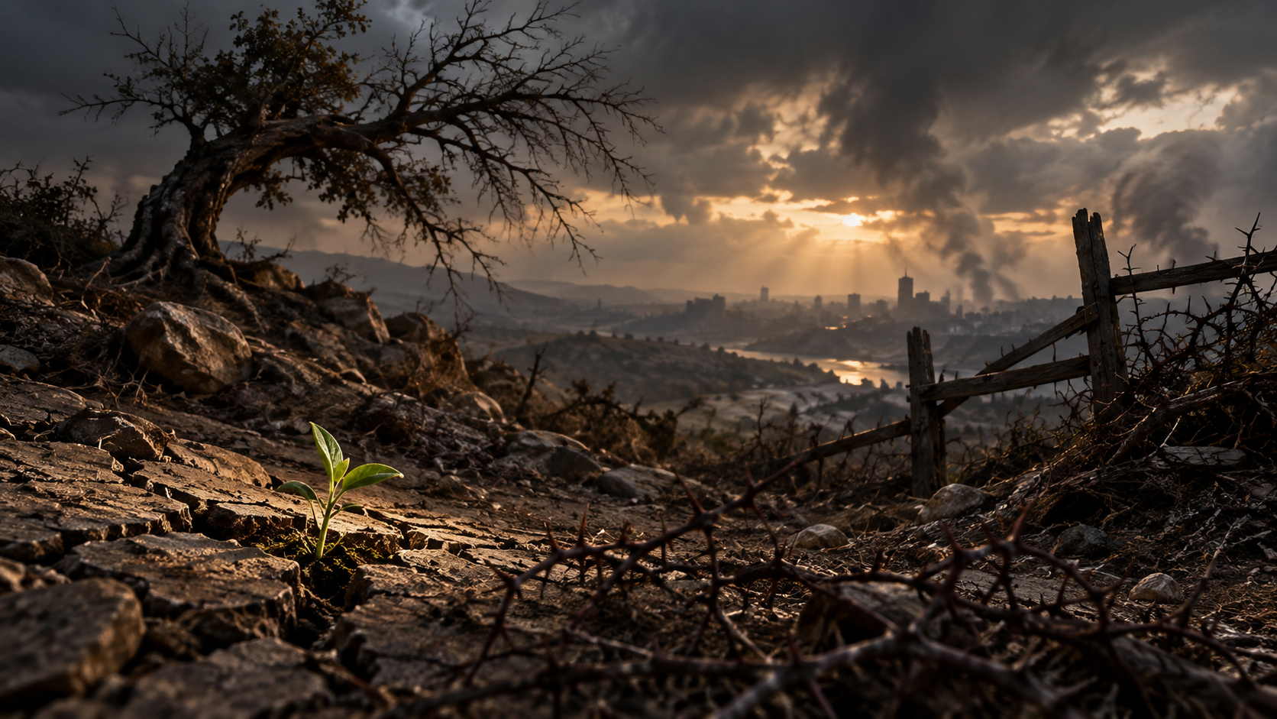
PULSE SENTENCE
God does not give up on his creation.
He removes the curse
and makes everything new.
Notes:
Pause on the sprout in the wounded landscape. This is the sentence to return to throughout the evening.

Slide 4
FROM RESURRECTION TO NEW CREATION
Last week:
Christian hope has a body.
This week asks the next question:
Where will resurrected people live?
Notes:
Use the transition exactly as written in the guide. Let the question open the session rather than immediately answering every detail.

Slide 5
THE THREE ERAS
ORIGINAL CREATION
FALLEN CREATION
RESURRECTED CREATION
Good • embodied • fruitful
Wounded • futile • dying
Judged • renewed • dwelling
Notes:
Use for the Three Eras Wall activity. Ask participants where they instinctively place words and images of continuity or change.

Slide 6
WAITING WORSHIP
Hold before Christ…
one good part of creation you love
and
one wound in creation you long to see removed.
Let gratitude and grief remain together.
Notes:
Hold two minutes of silence after reading the invitation. The image intentionally carries both woundedness and a living sprout.

Slide 7
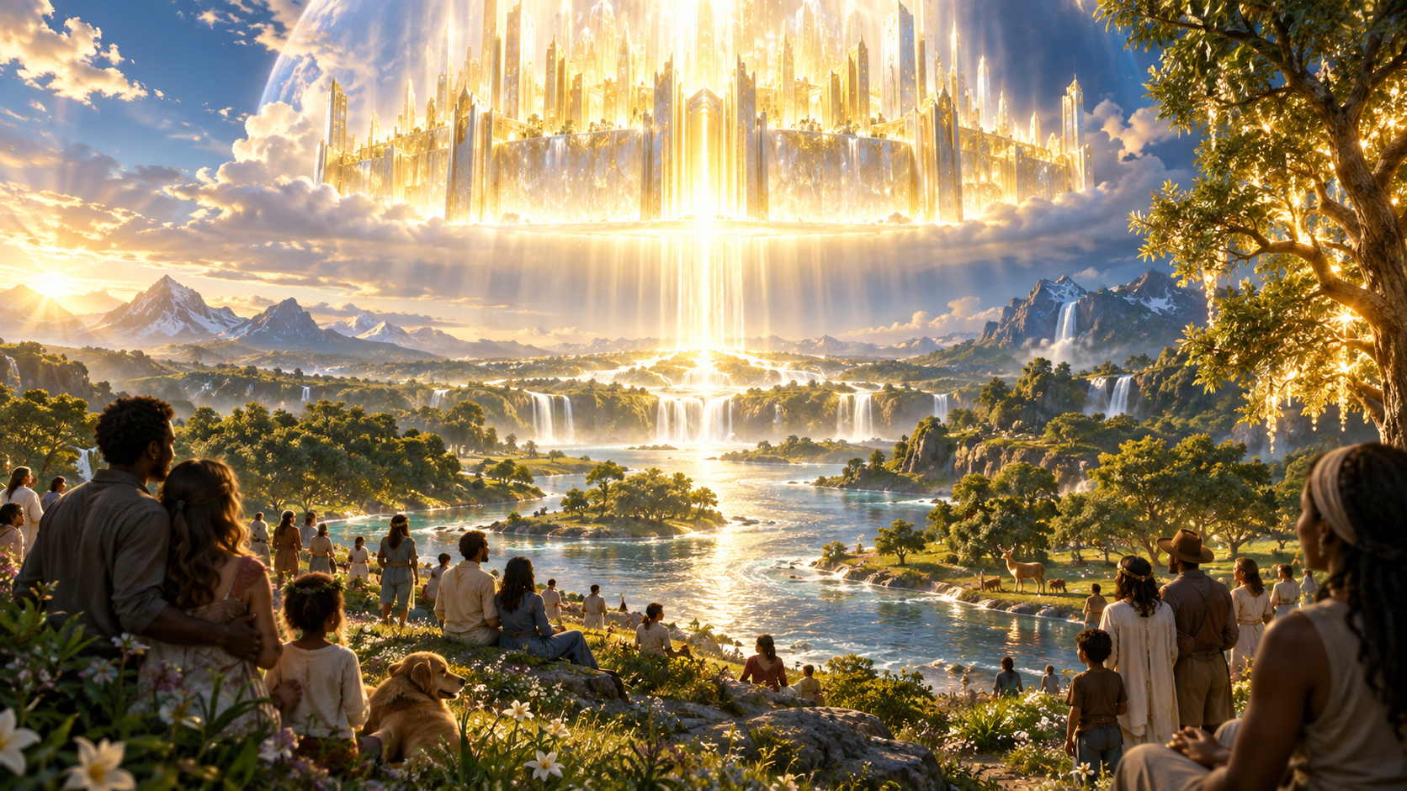
THE ONE ON THE THRONE SAYS
“I am making everything new!”
(Revelation 21:5, NIV).
Notes:
Read slowly, then move into silence. This is the session’s central biblical refrain.

Slide 8
SCRIPTURE ENCOUNTER
Read the texts as one movement.
GENESIS 1–3
ISAIAH 65
2 PETER 3
REVELATION 21
Good creation → curse
Homes → work → peace
Judgment → holy living
God dwells → death removed
Circle what continues. Underline what God confronts or removes.
Notes:
This slide can remain up while giving the reading method. Then advance through the four Scripture slides.

Slide 9

GENESIS 1–3
God called creation good.
Embodied life
Work
Fruitfulness
Communion with God
Sin brings alienation, cursed ground, toil, conflict, and death.
Notes:
Ask: What does God call good? What changes after rebellion? Keep the goodness of creation and the seriousness of the fall together.

Slide 10
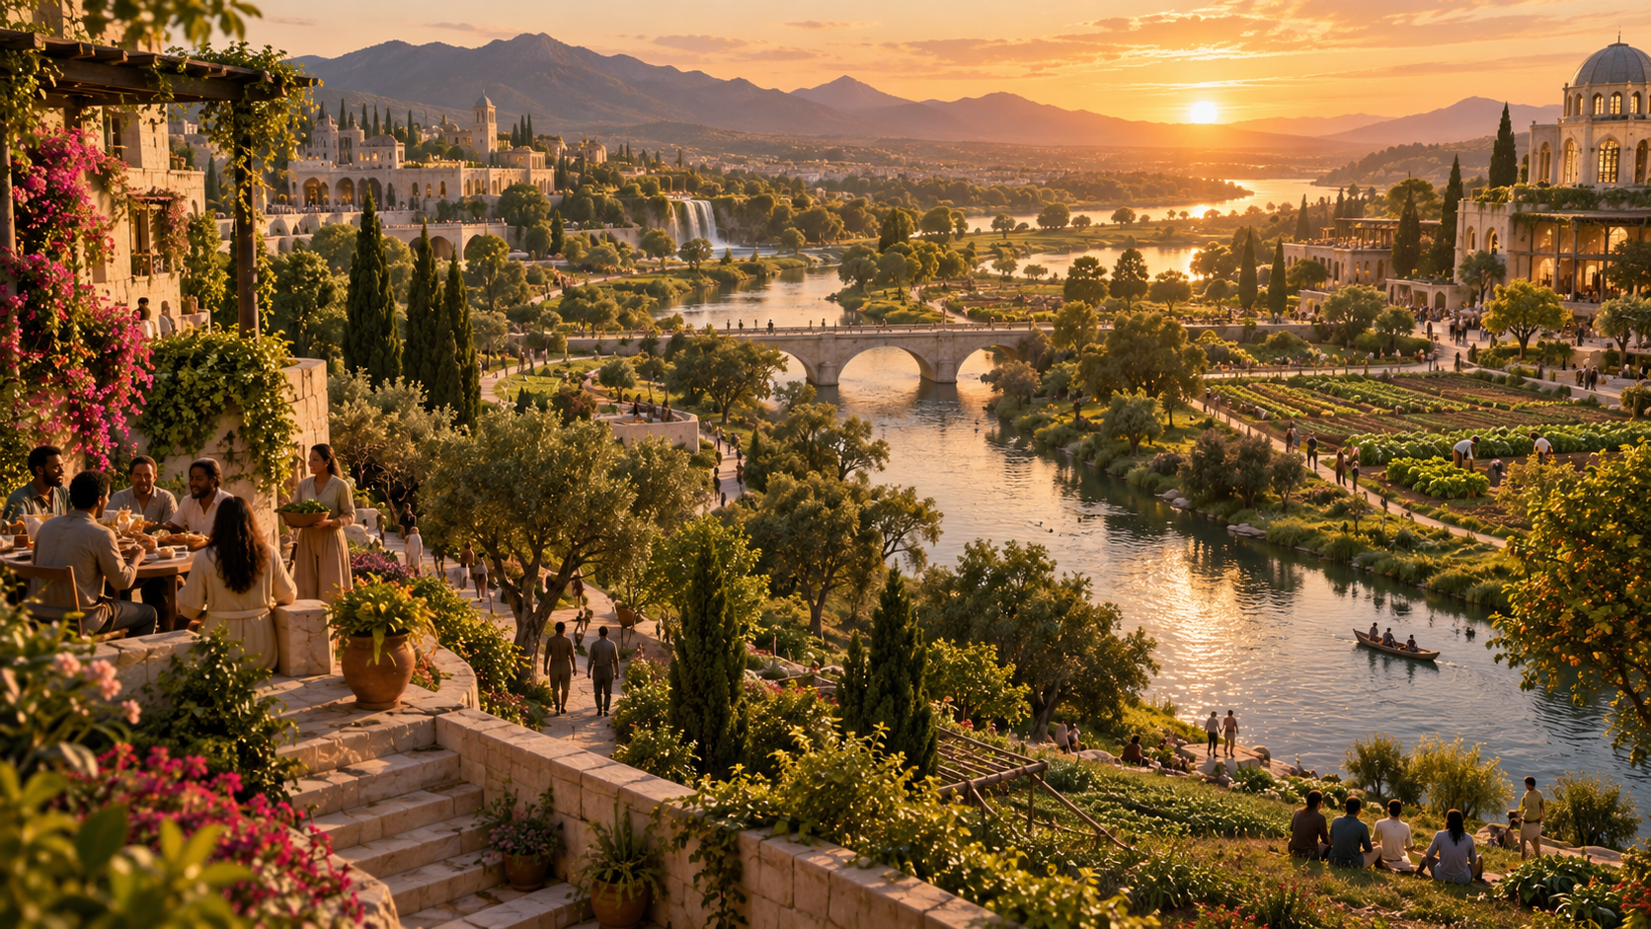
ISAIAH 65:17–25
A restored human world.
Homes.
Work.
Fruitfulness.
Joy.
Creaturely peace.
Continuity — without pretending Isaiah gives a technical map.
Notes:
Ask: Which ordinary human goods continue? Which forms of futility and violence recede?

Slide 11
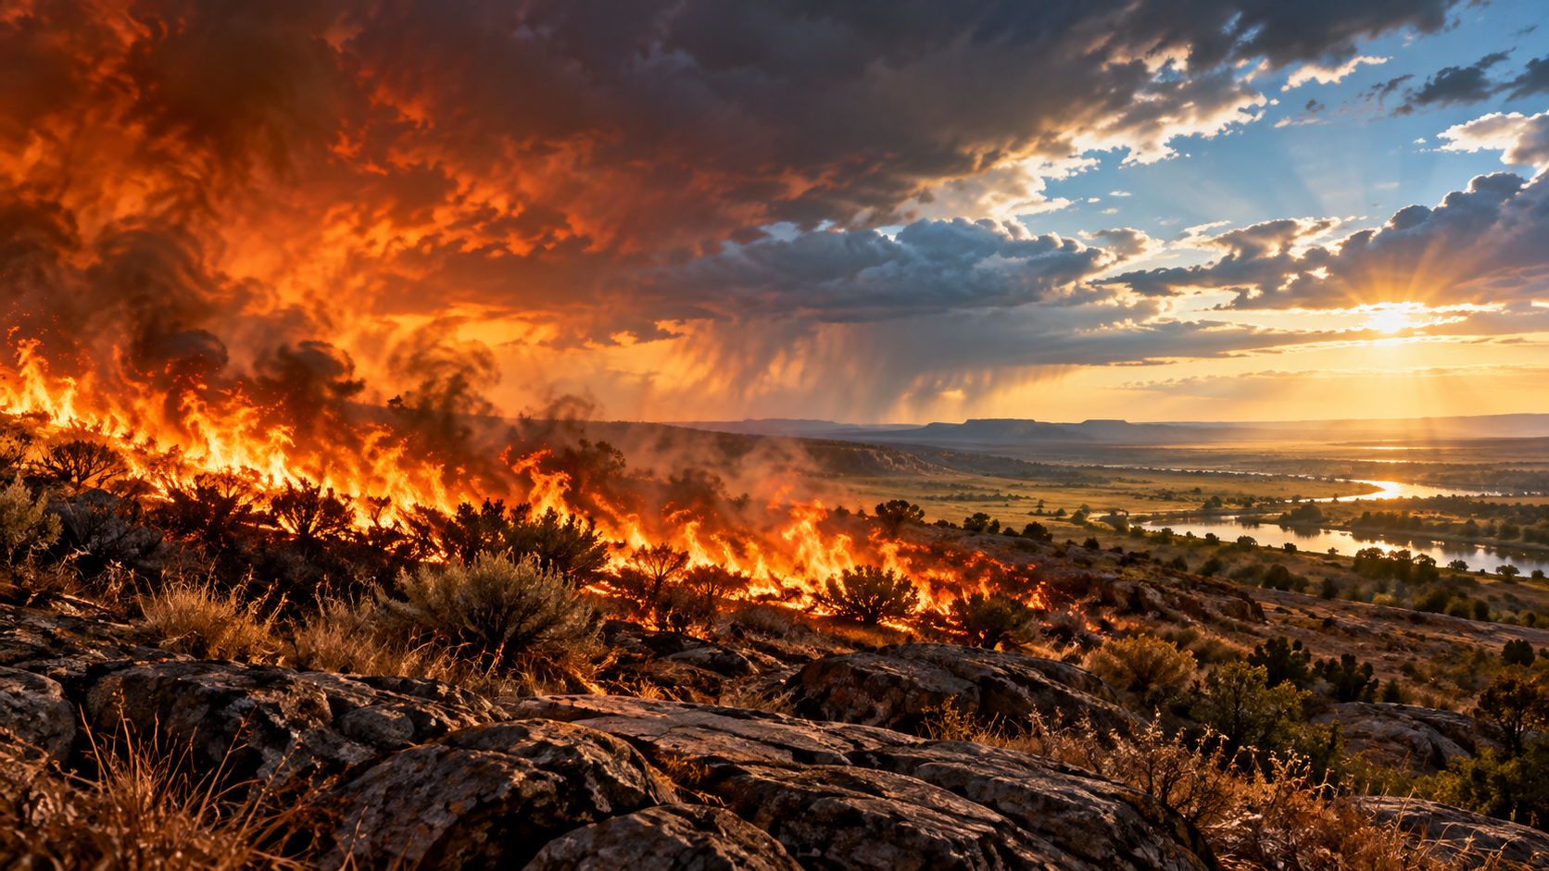
2 PETER 3:7–14
Judgment is real.
The old order cannot pass untouched into God’s future.
Peter’s pastoral question:
What kind of people ought we to be?
Holy • godly • peaceable
Notes:
Ask: What does the fire expose and destroy? What kind of people should hope produce? Avoid forcing a single mechanical interpretation of the imagery.

Slide 12
REVELATION 21:1–5
God’s dwelling is with humanity.
Death — gone
Mourning — gone
Crying — gone
Pain — gone
The Creator comes to dwell with the redeemed in new creation.
Notes:
Ask: Who comes to dwell with whom? What is finally removed? Let the direction of Revelation 21 be noticed: God comes to dwell with humanity.

Slide 13
TEACHING | THE THREE ERAS
One creation story.
CREATION
→
FALL
→
JUDGMENT
→
RESURRECTION
→
RESTORATION
Not three unrelated divine projects — one biblical movement toward consummation in Christ.
Notes:
Teaching movement 1. Emphasize continuity across the one story without denying judgment and transformation.

Slide 14
CONTINUITY + RADICAL REMOVAL
What carries forward? What is removed?
CARRIED FORWARD
REMOVED
People
Nations
Homes
Work
Worship
Communion
Curse
Futility
Violence
Death
Mourning
Pain
Notes:
Teaching movement 2. The future is recognizably created and human, yet not the present order carried forward unchanged.

Slide 15
HOLY JUDGMENT
God does not cosmetically improve evil.
Cruelty. Exploitation. Idolatry. Death.
They face the judgment of God.
The old order cannot continue unchanged.
Notes:
Teaching movement 3. Do not soften the fire into a harmless metaphor. Judgment is part of good news because evil and death will not be immortalized.

Slide 16
THE PROMISE AND THE PROCESS
Faithful teaching should be
as confident as the promise
and
as modest as the imagery.
The promise is clearer than the precise mechanics.
See Richard J. Bauckham, Jude, 2 Peter, Word Biblical Commentary 50.
Notes:
Use this to reduce anxiety around end-times systems. Distinguish clear teaching from reasonable inference and faithful imagination.

Slide 17

HOLY WITNESS NOW
Future hope forms present faithfulness.
Receive gratefully.
Resist evil.
Practice repair.
Live peaceably.
Holiness is hopeful participation.
Notes:
Teaching movement 4. We do not build the New Earth, but the promised future gives direction to present stewardship, peace, truth, generosity, and neighbor love.

Slide 18
CONVERSATION
Three queries for the room
What is carried forward — and what is removed — in Isaiah 65 and Revelation 21?
1
How should we understand the fire language of 2 Peter 3 without forcing precision?
2
Why does Peter connect the promise of a new Earth to holy and godly living now?
3
Notes:
Two minutes silence; eight minutes in groups of three; then whole-group sharing. Participants may answer one query, pass, or name an unresolved question.

Slide 19
PERSONAL RESPONSE
Complete one sentence slowly and personally:
The promise of a renewed Earth changes my hope by …
The part of God’s character I see more clearly is …
One present act shaped by this future will be …
Hold three minutes of silence.
Notes:
Distribute index cards. Do not turn the responses into debate about end-times systems.

Slide 20
SENDING WORD
The Creator has not abandoned his world.
God will judge what destroys,
remove death and pain,
and make everything new.
Live holy, peaceable, and faithful lives while you wait.
Notes:
Use after the closing prayer. This is the takeaway line to send home with participants.

Slide 21
NEXT WEDNESDAY | WEEK SEVEN
God With Us:
Seeing God and Worshiping Him
Revelation 4–5 • Revelation 21:3 • Revelation 22:3–5
Read Heaven, chapters 17–19.
Bring one aspect of God’s character that makes eternal life with God desirable.
Notes:
Display as people leave. Preview Week Seven without beginning its teaching.

