Slide 1
HEAVEN BIBLE STUDY | WEEK FOUR
Creation Groans—
and God Will Redeem It
Romans 8 | Colossians 1 | Acts 3
Wednesday, September 9
HEAVEN | WEEK FOUR
1
Notes:
Timing: Opening
Welcome the group. Tonight widens the hope of Week Three: bodies await redemption, creation awaits liberation, and Christ is Lord of both.
[Sources]
- Heaven Week 4 Working Guide ; Scripture quotations identified as NIV (2011).
- Romans 8:18-25; Colossians 1:15-20; Acts 3:19-21.

Slide 2

CENTRAL TRUTH
What groans
is not abandoned.
Christ holds creation together.
God will redeem it.
HEAVEN | WEEK FOUR
2
Notes:
Timing: 1-3 minutes
Read the central truth in the guide. God will liberate creation from decay, raise his children, and restore all things under Christ’s reconciling lordship.
[Sources]
- Heaven Week 4 Working Guide ; Scripture quotations identified as NIV (2011).

Slide 3
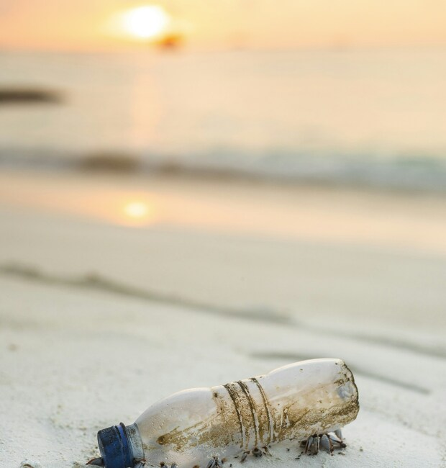
Beauty and groaning
share the same
world.
Where do you see
both at once?
HEAVEN | WEEK FOUR
3
Notes:
Timing: 3-7 minutes
Invite observation before explanation. The image holds beauty and damage in one scene. Use the guide’s local word pictures: river, field, neighborhood, animal, and body. Do not imply the image depicts a local place.
[Sources]
- Heaven Week 4 Working Guide; Scripture quotations identified as NIV (2011).
- Ishan @seefromthesky, Clear plastic bottle beside beach, Unsplash. https://unsplash.com/photos/clear-plastic-bottle-beside-beach-4xmgrNUbyNA

Slide 4
LOOK HONESTLY
Beauty
Groaning
Where do you receive
creation as gift?
Where do you see
damage or loss?
Keep both on the same map.
HEAVEN | WEEK FOUR
4
Notes:
Timing: 7-12 minutes
Give each person one sticky note of each color. Place responses under Beauty and Groaning. Ask whether the same place, creature, body, or community appears on both sides.
[Sources]
- Heaven Week 4 Working Guide ; Scripture quotations identified as NIV (2011).

Slide 5
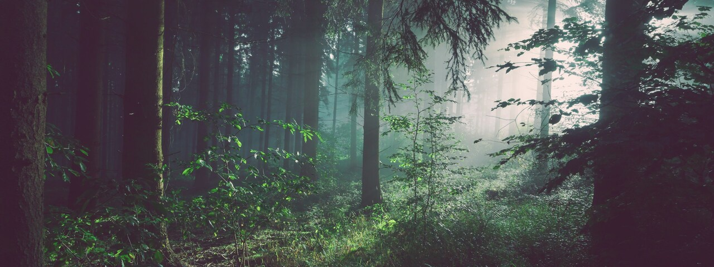
Hold the gift and the groaning
in the Light of Christ.
HEAVEN | WEEK FOUR
5
Notes:
Timing: 12-17 minutes
Bring to mind one beloved place, creature, body, or community. Receive its beauty and do not turn away from its wounds. Read Romans 8:22, hold two minutes, and pray the guide’s prayer.
[Sources]
- Heaven Week 4 Working Guide ; Scripture quotations identified as NIV (2011).
- Romans 8:22.
- Sebastian Unrau, Trees on forest with sun rays, Unsplash. https://unsplash.com/photos/trees-on-forest-with-sun-rays-sp-p7uuT0tw

Slide 6
SCRIPTURE READINGS
Romans 8:18–25
Creation waits, groans, and hopes.
Colossians 1:15–20
Christ creates, sustains, and reconciles.
Acts 3:19–21
Turn to God; await his restoration.
HEAVEN | WEEK FOUR
6
Notes:
Timing: 17-19 minutes
Read each passage aloud twice. First circle creation, all things, and everything. Then underline waits, groans, created, holds together, reconcile, repent, and restore.
[Sources]
- Heaven Week 4 Working Guide ; Scripture quotations identified as NIV (2011).

Slide 7
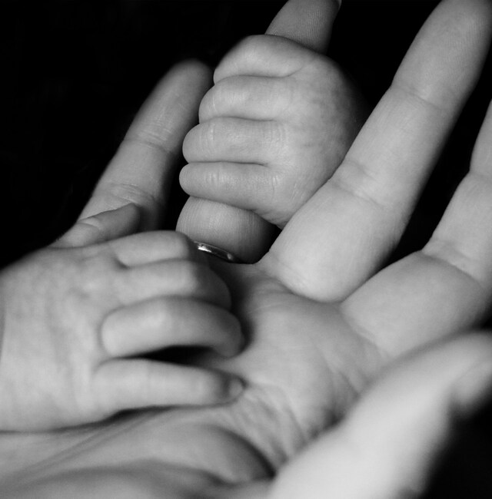
“has been groaning
as in the pains
of childbirth”
Romans 8:22 · NIV
HEAVEN | WEEK FOUR
7
Notes:
Timing: 19-23 minutes
Romans uses childbirth, not extinction, as its image. Real anguish is joined to a promised future. The photograph supports the metaphor; it does not explain away present pain.
[Sources]
- Heaven Week 4 Working Guide ; Scripture quotations identified as NIV (2011).
- Romans 8:18-22.
- Liv Bruce, Photo of baby holding person’s fingers, Unsplash. https://unsplash.com/photos/photo-of-baby-holding-persons-fingers-M0oVPGsWk1E

Slide 8
ROMANS 8:21–23
Creation waits for freedom.
We wait for the redemption
of our bodies.
One redemptive horizon.
HEAVEN | WEEK FOUR
8
Notes:
Timing: 23-27 minutes
Creation waits for God’s children to be revealed. Verse 23 connects its liberation to the redemption of our bodies. Do not separate humanity’s resurrection from creation’s promised freedom.
[Sources]
- Heaven Week 4 Working Guide ; Scripture quotations identified as NIV (2011).
- Romans 8:21-23.

Slide 9
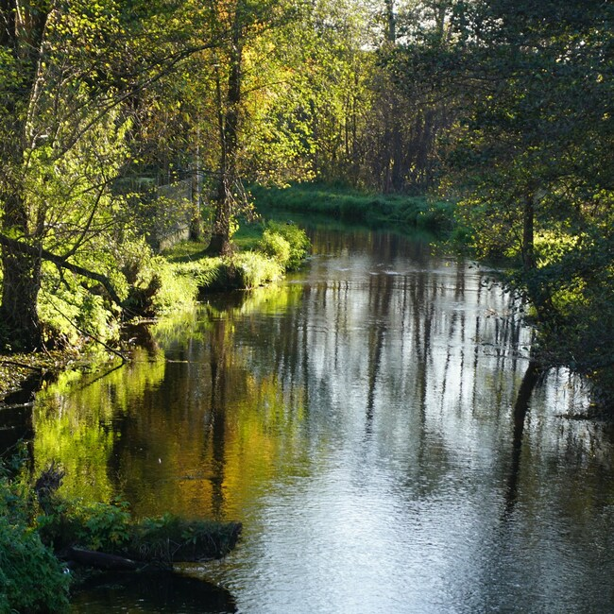
Through Christ.
For Christ.
Held together
in Christ.
Colossians 1:15–17
HEAVEN | WEEK FOUR
9
Notes:
Timing: 27-31 minutes
Begin with Christ, not anxiety about the world. The Son is the source, goal, and sustaining center of all creation. Invite the group to see the image as received gift rather than spiritual escape.
[Sources]
- Heaven Week 4 Working Guide ; Scripture quotations identified as NIV (2011).
- Colossians 1:15-17.
- Czesława Grabowska, Sunlit forest river with reflections on water, Unsplash. https://unsplash.com/photos/sunlit-forest-river-with-reflections-on-water-WoVRhgpk7XU

Slide 10
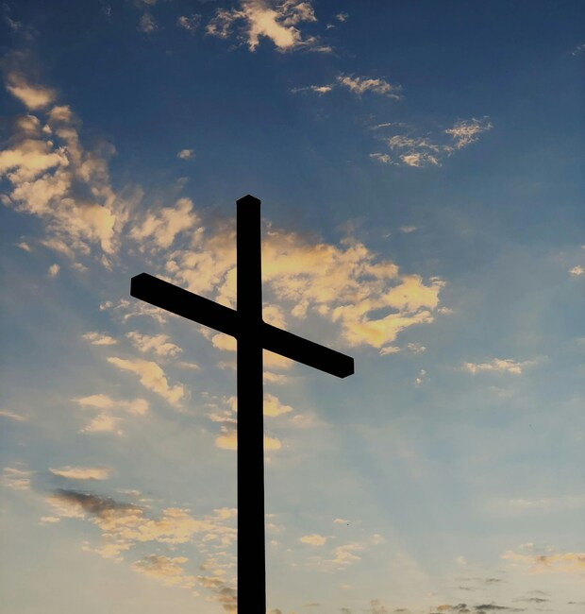
Peace through
the cross.
“to reconcile to
himself all things”
Colossians 1:20 · NIV
HEAVEN | WEEK FOUR
10
Notes:
Timing: 31-35 minutes
The cross is not a private spiritual rescue detached from creation. It is the Creator’s decisive peace-making act. Preserve the guide’s guardrail: cosmic reconciliation does not erase the call to repentance and faith.
[Sources]
- Heaven Week 4 Working Guide ; Scripture quotations identified as NIV (2011).
- Colossians 1:18-20.
- Aaron Burden, Silhouette of cross under blue sky, Unsplash. https://unsplash.com/photos/silhouette-of-cross-under-blue-sky-I57ErM93uZQ

Slide 11
ACTS 3:19–21
Turn to God.
God will restore everything.
Forgiveness. Refreshment.
The returning Christ.
HEAVEN | WEEK FOUR
11
Notes:
Timing: 35-42 minutes
Peter speaks after the healing of a man who could not walk. Personal turning, forgiven sins, refreshed lives, healed bodies, Christ’s return, and promised restoration belong within one gospel. The slide condenses the passage rather than presenting a verbatim quotation.
[Sources]
- Heaven Week 4 Working Guide ; Scripture quotations identified as NIV (2011).
- Acts 3:1-21.

Slide 12
THE FAR REACH OF REDEMPTION
The Creation Christ
Will Not Abandon
Creation. Resurrection. Restoration.
HEAVEN | WEEK FOUR
12
Notes:
Timing: 42-43 minutes
Introduce the guide’s teaching manuscript. The four movements keep Christ at the center and move hope toward concrete, faithful care.
[Sources]
- Heaven Week 4 Working Guide ; Scripture quotations identified as NIV (2011).
- Teaching synthesis in the user-supplied guide, engaging Randy Alcorn, Heaven, chapters 8-10.

Slide 13

The gospel does
not make creation
disposable.
The scarred world
is still God’s world.
HEAVEN | WEEK FOUR
13
Notes:
Timing: 43-46 minutes
Explain “This world is not our home” as the guide’s half-truth. The world disfigured by rebellion is not our lasting home, yet humanity was made for embodied life with God. Do not speculate here about the destiny of individual animals.
[Sources]
- Heaven Week 4 Working Guide ; Scripture quotations identified as NIV (2011).
- Teaching movement 1 in the user-supplied guide.
- Boris Dobretsov, A hand pets an old dog’s head, Unsplash. https://unsplash.com/photos/a-hand-pets-an-old-dogs-head-RwPTtBjLLtQ

Slide 14
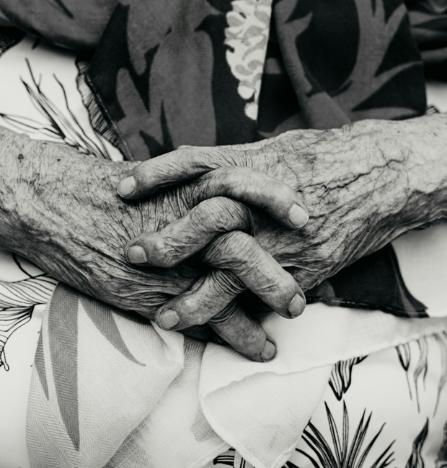
Sin has wounded
creation;
it has not transferred
ownership away
from God.
HEAVEN | WEEK FOUR
14
Notes:
Timing: 46-48 minutes
Contempt is a poor form of hope. Rivers, soil, creatures, neighborhoods, bodies, work, music, gardens, and shared life still carry signs of their intended goodness. Honor bodies as part of creation, not as an exception to it.
[Sources]
- Heaven Week 4 Working Guide ; Scripture quotations identified as NIV (2011).
- Luigi Ritchie, Elderly hands, Unsplash. https://unsplash.com/photos/close-up-of-elderly-hands-clasped-together-EljMmcGmeGA

Slide 15
CREATION AND THE CHILDREN OF GOD
Creation’s bondage is shared.
Its liberation is joined to ours.
The fall’s reach is not permission
to blame the sufferer.
HEAVEN | WEEK FOUR
15
Notes:
Timing: 48-51 minutes
Speak of the fall’s reach humbly. Do not claim the exact spiritual cause of each storm, disease, drought, accident, or loss. Romans teaches shared bondage and promised freedom.
[Sources]
- Heaven Week 4 Working Guide ; Scripture quotations identified as NIV (2011).
- Romans 8:18-25; teaching movement 2 in the guide.

Slide 16
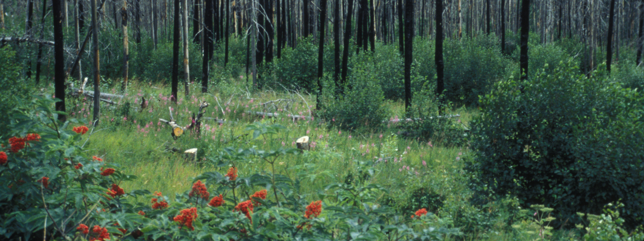
Groaning is pain moving toward birth.
HEAVEN | WEEK FOUR
16
Notes:
Timing: 51-53 minutes
Pause and look. What is wounded? What is alive? The ecological photograph is a contemplative analogy, not proof of resurrection or a reason to minimize loss. Read the guide’s line: groaning is not evidence that God has forgotten his world.
[Sources]
- Heaven Week 4 Working Guide ; Scripture quotations identified as NIV (2011).
- Romans 8:22.
- Phyllis Cooper / U.S. Fish and Wildlife Service, Forest recovery, Kenai National Wildlife Refuge (2001), public domain. https://commons.wikimedia.org/wiki/File:Forest_recovery.jpg

Slide 17
THE CREATOR IS THE REDEEMER
Christ’s reconciling work
reaches as far as the curse.
Restoration rests on the
crucified and risen Christ.
HEAVEN | WEEK FOUR
17
Notes:
Timing: 53-55 minutes
All things come through Christ, exist for him, and hold together in him. Through his cross God makes peace. Use the guide’s distinction: redemption is victory over what twists, corrupts, enslaves, and destroys.
[Sources]
- Heaven Week 4 Working Guide ; Scripture quotations identified as NIV (2011).
- Colossians 1:15-20; Acts 3:21.

Slide 18
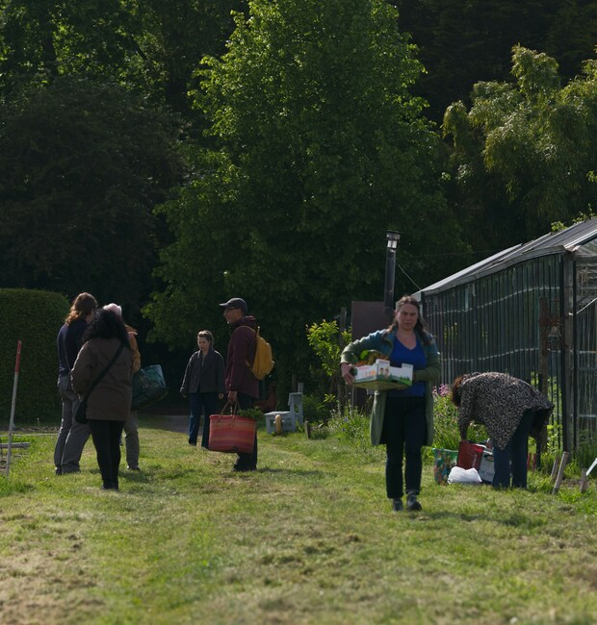
The coming kingdom
gives present
faithfulness
direction and dignity.
HEAVEN | WEEK FOUR
18
Notes:
Timing: 55-57 minutes
Our labor cannot build the kingdom by human power. Yet the coming kingdom makes faithful work meaningful now. Keep the distinction between participating in God’s purpose and imagining ourselves to be creation’s savior.
[Sources]
- Heaven Week 4 Working Guide ; Scripture quotations identified as NIV (2011).
- The user-supplied guide’s synthesis of N. T. Wright’s resurrection theology.
- Haberdoedas, People gathering in a community garden, Unsplash. https://unsplash.com/photos/people-gathering-in-a-community-garden-with-trees-in-background-c9xGzxR8ego

Slide 19
HOPE BECOMES CARE
Future restoration
forms present holiness.
Hope frees us from
indifference and panic.
HEAVEN | WEEK FOUR
19
Notes:
Timing: 57-58 minutes
We care because creation belongs to Christ, not because we can save it apart from Christ. Hope makes faithfulness possible; anxiety cannot make total control possible.
[Sources]
- Heaven Week 4 Working Guide ; Scripture quotations identified as NIV (2011).

Slide 20
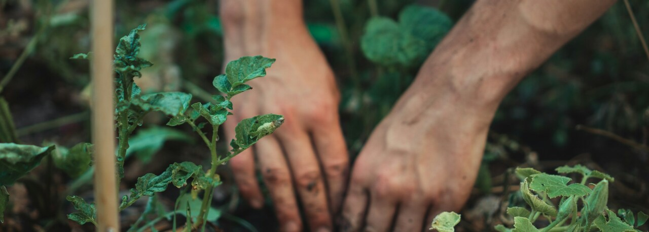
Concrete. Fitting. Faithful.
The act need not be dramatic.
HEAVEN | WEEK FOUR
20
Notes:
Timing: 58-60 minutes
Name the guide’s possibilities: neighbor care, local cleanup, church-property stewardship, reducing waste, protecting water or habitat, animal care, a community garden, or shared repair. Mercy received becomes mercy made visible.
[Sources]
- Heaven Week 4 Working Guide ; Scripture quotations identified as NIV (2011).
- Jonathan Kemper, Hands planting a seedling, Unsplash. https://unsplash.com/photos/hands-planting-seedling-in-garden-4z3lnwEvZQw

Slide 21
QUERIES FOR REFLECTION
What is creation waiting for?
How far does reconciliation reach?
How should hope change our care?
HEAVEN | WEEK FOUR
21
Notes:
Timing: 60-77 minutes
Two minutes of silence, eight in groups of three, five in whole-group sharing, and two in synthesis. Participants may pass. The aim is faithful listening, not forced consensus. Keep speculative questions and policy disagreements from displacing the Word.
[Sources]
- Heaven Week 4 Working Guide ; Scripture quotations identified as NIV (2011).

Slide 22
A PRIVATE RESPONSE
Choose one faithful act of care.
Person · Place · Creature · Community
This week, faithful care will look like …
Local. Proportionate. Repeatable.
HEAVEN | WEEK FOUR
22
Notes:
Timing: 77-84 minutes
Give each person an index card. Invite one local, proportionate, repeatable act and a person who can help them remain steady. Hold three minutes; do not turn responses into public pledges. Christ is the Savior; our calling is faithful participation.
[Sources]
- Heaven Week 4 Working Guide ; Scripture quotations identified as NIV (2011).

Slide 23

What groans is not abandoned.
Go in hope and care faithfully
for what is within your reach.
HEAVEN | WEEK FOUR
23
Notes:
Timing: 84-90 minutes
Pray the guide’s sequence: settle, lament, rejoice, ask, and close. Leave this image and sending word on screen through the final silence. Christ is Lord of creation, and God will restore all things.
[Sources]
- Heaven Week 4 Working Guide ; Scripture quotations identified as NIV (2011).
- Acts 3:21; the guide’s sending word.
- Study-series landscape artwork supplied in the user’s earlier Heaven working guide; reused as the series closing background.

