Slide 1
HEAVEN BIBLE STUDY | WEEK THREE
What Happens
When We Die?
Luke 23 | Philippians 1 | 2 Corinthians 5 | Revelation 6
Wednesday, September 2
HEAVEN | WEEK THREE
1
Notes:
Timing: Opening
Welcome the group. Let the title remain as people settle. Name tonight as a pastoral act of truth-telling under Scripture and in the presence of the living Christ.
[Sources]
- Heaven Week 3 Working Guide (NIV 2011 Scripture quotations).
- Luke 23:39-43; Philippians 1:20-23; 2 Corinthians 5:1-10; Revelation 6:9-11.

Slide 2
CENTRAL TRUTH
With Christ now.
Raised with Christ then.
Believers who die are consciously with Christ in the present Heaven—"better by far."
Resurrection and life on the New Earth remain the final Christian hope.
HEAVEN | WEEK THREE
2
Notes:
Timing: 1-3 minutes
State the central truth slowly. Do not over-explain the sequence yet; the four passages will give the group its shape.
[Sources]
- Heaven Week 3 Working Guide (NIV 2011 Scripture quotations).
- Philippians 1:23.

Slide 3

What do we usually say
after someone dies?
Which words are promise—
and which are assumption?
HEAVEN | WEEK THREE
3
Notes:
Timing: 3-6 minutes
Surface familiar language without correcting it yet. Some phrases carry the gospel; some are shorthand; some are possible but unrevealed; some are comforting inventions.
[Sources]
- Heaven Week 3 Working Guide (NIV 2011 Scripture quotations).
- Vruyr Martirosyan, Empty chair near window, Unsplash: https://unsplash.com/photos/empty-chair-near-window-AxZNLcEHNIs

Slide 4
CONNECTION ACTIVITY
Place each phrase where it belongs.
Biblically grounded
Faithful shorthand
Uncertain
Not biblical
Our goal is not to grade grief. Our goal is to strengthen Christian hope.
HEAVEN | WEEK THREE
4
Notes:
Timing: 6-12 minutes
Place the prepared phrases beneath the four headings. Let disagreement remain visible. Promise that the group will return to the phrases after listening to Scripture.
[Sources]
- Heaven Week 3 Working Guide (NIV 2011 Scripture quotations).

Slide 5
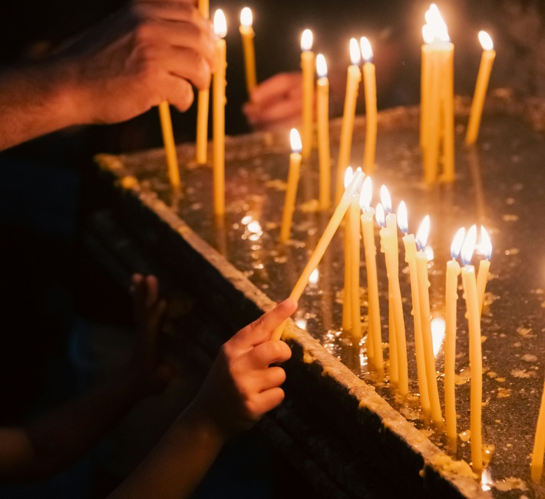
WAITING WORSHIP
Hold one name
in the Light
of Christ.
Gratitude. Regret. Anger.
Relief. Love. Silence.
HEAVEN | WEEK THREE
5
Notes:
Timing: 12-17 minutes
Invite stillness. If a face or name comes, do not push it away. Read Philippians 1:23 slowly, hold two minutes, and close with the guide's prayer.
[Sources]
- Heaven Week 3 Working Guide (NIV 2011 Scripture quotations).
- Philippians 1:23.
- Bao Menglong, Hands lighting candles, Unsplash: https://unsplash.com/photos/hands-lighting-many-candles-in-a-dark-room-FVxegrU44KA

Slide 6
SCRIPTURE ENCOUNTER
Four windows into Christian hope
Luke 23:39-43 — Today. With me. Paradise.
Philippians 1:20-23 — To depart and be with Christ.
2 Corinthians 5:1-10 — At home with the Lord; longing to be clothed.
Revelation 6:9-11 — Conscious, secure, and still waiting.
HEAVEN | WEEK THREE
6
Notes:
Timing: 17-19 minutes
Read each passage aloud twice. First listen for Christ, the person who dies, and what remains unfinished. Then mark words of presence and words of waiting, longing, or completion.
[Sources]
- Heaven Week 3 Working Guide (NIV 2011 Scripture quotations).

Slide 7
LUKE 23:43
“Today you will be
with me in paradise.”
Today. With me. Paradise.
HEAVEN | WEEK THREE
7
Notes:
Timing: 19-23 minutes
Give the three words room. The passage's simplest center is immediate personal presence with Christ. Avoid making it answer questions about paradise's physical properties or location.
[Sources]
- Heaven Week 3 Working Guide (NIV 2011 Scripture quotations).
- Luke 23:39-43.

Slide 8
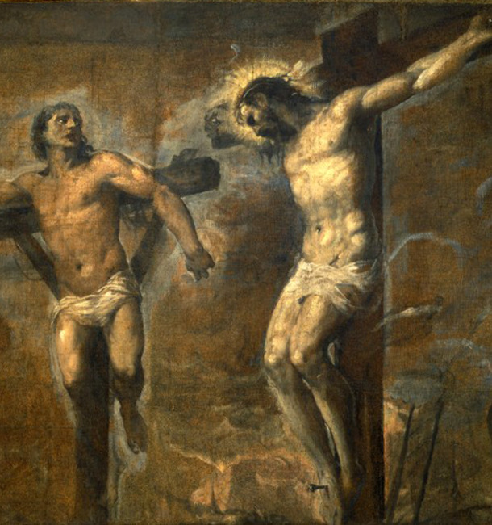
Where does
the promise rest?
Not in a lifetime
of achievement.
In the mercy of Jesus.
HEAVEN | WEEK THREE
8
Notes:
Timing: 23-25 minutes
Pause for Visio Divina. Attend to Christ's face, the dying man's posture, and the space between them. The promise rests on Jesus' mercy, not accumulated moral achievement.
[Sources]
- Heaven Week 3 Working Guide (NIV 2011 Scripture quotations).
- Luke 23:39-43.
- Titian, Christ and the Good Thief, public-domain reproduction via Wikimedia Commons: https://commons.wikimedia.org/wiki/File:Titian_-_Christ_and_the_Good_Thief_-_WGA22832.jpg

Slide 9
PHILIPPIANS 1:23
“I desire to depart
and be with Christ,
which is better by far.”
Genuinely blessed—yet not the final resurrection.
HEAVEN | WEEK THREE
9
Notes:
Timing: 25-30 minutes
Paul describes departure into the nearer presence of Christ as genuinely good. He does not call death the final Christian victory; elsewhere he locates that victory in resurrection.
[Sources]
- Heaven Week 3 Working Guide (NIV 2011 Scripture quotations).
- Philippians 1:20-23.

Slide 10
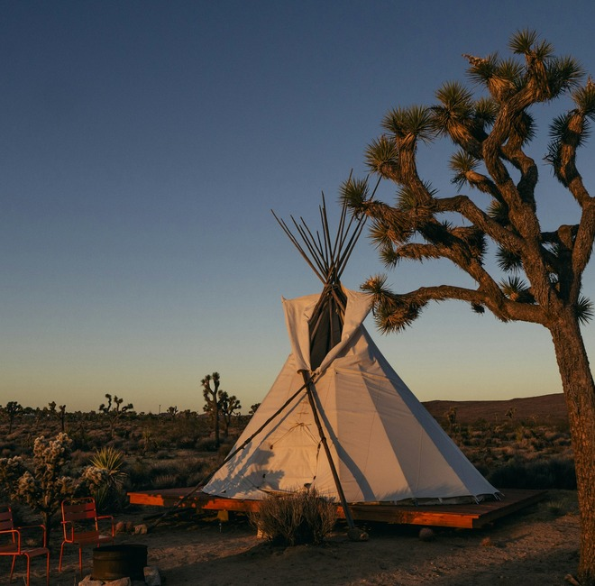
2 CORINTHIANS 5
“At home with
the Lord.”
Confidence and longing
belong together.
Paul does not celebrate
permanent disembodiment.
HEAVEN | WEEK THREE
10
Notes:
Timing: 30-37 minutes
Hold Paul's two movements together: away from the body and at home with the Lord, yet longing to be clothed with what God provides. Life remains accountable to Christ.
[Sources]
- Heaven Week 3 Working Guide (NIV 2011 Scripture quotations).
- 2 Corinthians 5:1-10.
- Susan Q Yin, White tent at sunset, Unsplash: https://unsplash.com/photos/white-tent-on-brown-field-during-sunset-rQ6bPQp8t6o

Slide 11
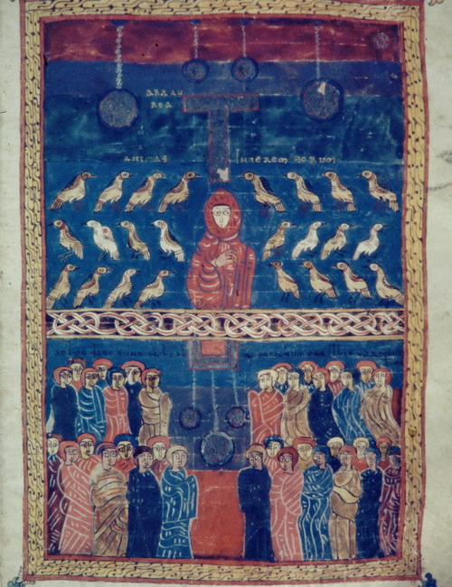
REVELATION 6:9-11
“How long?”
Conscious.
Recognizable.
Prayerful.
Waiting.
HEAVEN | WEEK THREE
11
Notes:
Timing: 37-42 minutes
Attend to what the vision clearly communicates without forcing every image into a literal map. The dead in Christ are conscious and secure, yet redemption is not complete.
[Sources]
- Heaven Week 3 Working Guide (NIV 2011 Scripture quotations).
- Revelation 6:9-11.
- Valcavado Beatus, Souls under the altar, public domain via Wikimedia Commons: https://commons.wikimedia.org/wiki/File:Valcavado_Beatus_f._096r_-_Souls_under_altar.jpg

Slide 12
TEACHING AND ALCORN SYNTHESIS
With Christ Now,
Raised with Christ Then
Presence • Waiting • Resurrection
HEAVEN | WEEK THREE
12
Notes:
Timing: 42-43 minutes
Introduce the teaching synthesis. The present Heaven is real and blessed because Christ is there. Its incompleteness reveals the largeness of God's final purpose.
[Sources]
- Heaven Week 3 Working Guide (NIV 2011 Scripture quotations).
- Randy Alcorn, Heaven, chapters 5-7.

Slide 13
MOVEMENT ONE
Christian comfort
begins with Christ—
not with a theory of death.
The center is the risen Jesus.
HEAVEN | WEEK THREE
13
Notes:
Timing: 43-47 minutes
Scripture answers the question of death by naming a relationship: with me, with Christ, at home with the Lord. We bear witness to Christ's mercy, not humanity's automatic destination.
[Sources]
- Heaven Week 3 Working Guide (NIV 2011 Scripture quotations).
- Luke 23:43; Philippians 1:23; 2 Corinthians 5:8.

Slide 14
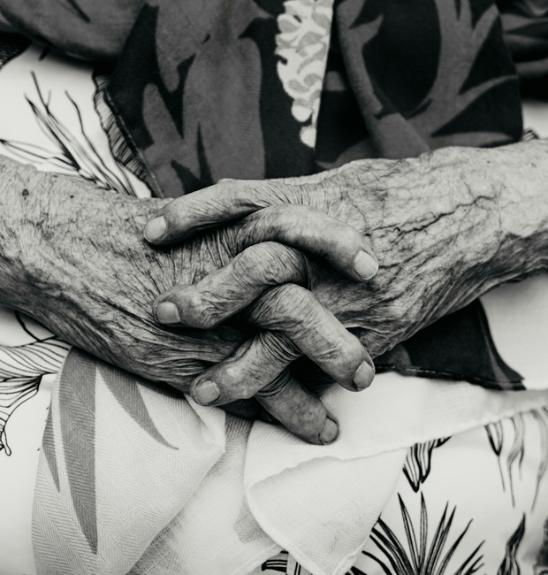
Death removes us
from the body.
It does not remove us
from Christ.
HEAVEN | WEEK THREE
14
Notes:
Timing: 47-48 minutes
Let this sentence stand. For the believer, death changes the mode of life but not the bond of grace.
[Sources]
- Heaven Week 3 Working Guide (NIV 2011 Scripture quotations).
- Luigi Ritchie, Elderly hands, Unsplash: https://unsplash.com/photos/close-up-of-elderly-hands-clasped-together-EljMmcGmeGA

Slide 15
MOVEMENT TWO
The present Heaven is conscious,
personal, and genuinely good.
Intermediate does not mean imaginary,
half-safe, or disappointing.
HEAVEN | WEEK THREE
15
Notes:
Timing: 48-51 minutes
Explain 'present' or 'intermediate' Heaven as the blessed life with Christ between death and resurrection. Scripture gives more than vague survival: continued personal life in Christ's presence.
[Sources]
- Heaven Week 3 Working Guide (NIV 2011 Scripture quotations).
- Randy Alcorn, Heaven, chapters 5-7.

Slide 16

Temporary does not mean unreal.
A safe room during a storm is temporary—but its shelter is real.
HEAVEN | WEEK THREE
16
Notes:
Timing: 51-53 minutes
Use the safe-room and airport-embrace word pictures. Present Heaven is blessed because Christ is there. Its temporary character does not make its shelter or joy less real.
[Sources]
- Heaven Week 3 Working Guide (NIV 2011 Scripture quotations).
- Liana S, Rain-streaked window at night, Unsplash: https://unsplash.com/photos/rain-streaks-down-a-window-at-night-MO7fBjXjCOM

Slide 17

MOVEMENT THREE
The present Heaven
is not the final
destination.
The dead in Christ are
with the Lord now.
They still await resurrection.
HEAVEN | WEEK THREE
17
Notes:
Timing: 53-55 minutes
Recover Scripture's movement. God's final answer to death is not permanent life as souls away from the body, but resurrection life with Christ in renewed creation.
[Sources]
- Heaven Week 3 Working Guide (NIV 2011 Scripture quotations).
- ekrem osmanoglu, Sunrise over a dark horizon, Unsplash: https://unsplash.com/photos/sunrise-over-a-dark-horizon-with-gradient-sky-NNE7hJJOb0E

Slide 18
TWO HORIZONS OF CHRISTIAN HOPE
Present Heaven
Final Resurrected Life
with Christ now
secure and conscious
awaiting completion
bodily life with Christ
creation renewed
death undone
Two horizons. One Christ.
HEAVEN | WEEK THREE
18
Notes:
Timing: 55-57 minutes
Compare without pitting the two horizons against each other. The present Heaven is secure communion with Christ; the final hope is bodily life with Christ in renewed creation.
[Sources]
- Heaven Week 3 Working Guide (NIV 2011 Scripture quotations).

Slide 19

MOVEMENT FOUR
Resurrection hope
makes room for
honest grief.
Love feels the rupture death causes.
The family table has an empty chair.
HEAVEN | WEEK THREE
19
Notes:
Timing: 57-59 minutes
Christian hope does not require us to call death good. We grieve because love feels the rupture, the body matters, and even the saints in Revelation ask, 'How long?'
[Sources]
- Heaven Week 3 Working Guide (NIV 2011 Scripture quotations).
- Revelation 6:10.
- Beth Stevenson, Sunlit dining table, Unsplash: https://unsplash.com/photos/sunlight-streams-through-a-large-window-onto-a-dining-table-m2x91x7LqC8

Slide 20
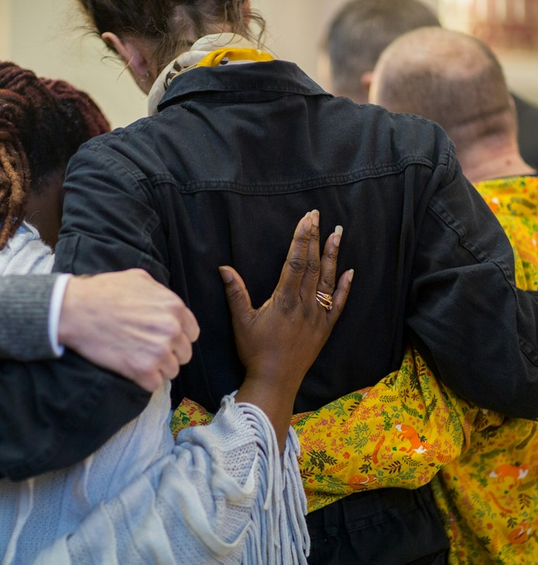
AT THE GRAVESIDE,
WE CAN SAY:
They are with Christ now.
We miss them because death is an enemy.
We await resurrection and renewed creation.
HEAVEN | WEEK THREE
20
Notes:
Timing: 59-60 minutes
Use language that is confident about Christ and honest about grief. Holiness in bereavement is not emotional denial; it is truthfulness held in Christ's presence.
[Sources]
- Heaven Week 3 Working Guide (NIV 2011 Scripture quotations).
- The Good Funeral Guide, Funeral embrace, Unsplash: https://unsplash.com/photos/a-group-of-people-hugging-each-other-5og4RMhk7PM

Slide 21
CONGREGATIONAL CONVERSATION
We can speak with confidence—
and humility.
What can we say with confidence about the dead in Christ?
Why can something temporary still be wonderful?
How might this change the way we comfort someone who grieves?
You may answer one query, remain silent, or speak privately afterward.
HEAVEN | WEEK THREE
21
Notes:
Timing: 60-77 minutes
Hold two minutes of silence, then groups of three, whole-group sharing, and summary. Do not require anyone to name the person they are remembering. Park speculative questions rather than rushing them.
[Sources]
- Heaven Week 3 Working Guide (NIV 2011 Scripture quotations).

Slide 22
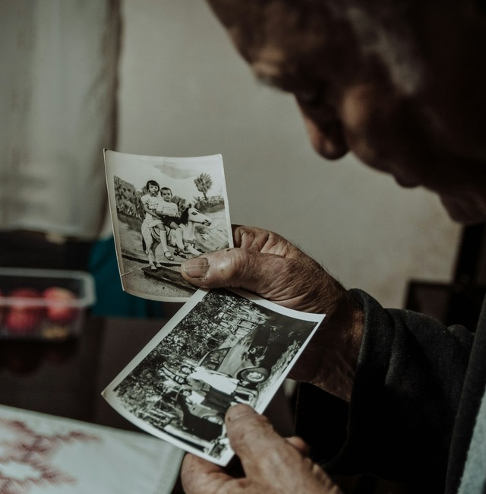
PLACE ONE NAME
WITHIN THE PROMISE
Name — Whom am I entrusting?
Promise — What word will I hold?
Grief — What do I need permission to carry?
The living Christ is near;
we do not have to hurry.
HEAVEN | WEEK THREE
22
Notes:
Timing: 77-84 minutes
Distribute index cards. Invite people to name silently or write someone whose death makes this hope personal. Hold three minutes. No public disclosure is required.
[Sources]
- Heaven Week 3 Working Guide (NIV 2011 Scripture quotations).
- Andreea Popa, Elder examining family photographs, Unsplash: https://unsplash.com/photos/an-elderly-man-examines-old-black-and-white-photographs-jtKMyOjH9tc

Slide 23

Entrust the one you love to Christ.
He holds his people now,
and he will raise them when his kingdom comes in fullness.
With Christ now. Raised with Christ then.
HEAVEN | WEEK THREE
23
Notes:
Timing: 84-90 minutes
Use the guide's prayer: settle, entrust, uphold, hope, and close. Leave the sending word on screen through the final silence.
[Sources]
- Heaven Week 3 Working Guide (NIV 2011 Scripture quotations).
- Landscape photograph supplied in the Heaven Week 3 Working Guide.

